Slide 1

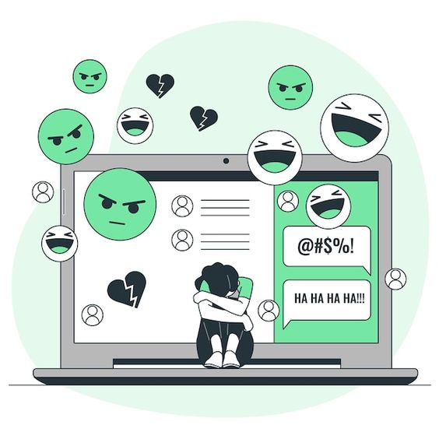
Hate Speech Detection
MANSI MEHARA 2021305 sec. B 3rd semester class rno. 33
Made under the mentorship of
Mr. KIREET JOSHI
(Assistant professor)

Slide 2
Introduction
In this modern world where everything is already in or going to be in the online domain, the social lives have also shifted according to the same. With this shift there came the need of social media sites and with these social media sites came the evil of spreading hate online.
There is a particular ease for people in spreading hate online as one can easily target anyone from anywhere without any kind of a boundary or obstacle as such.
In addition to that, if left unchecked or unattended to, there can be millions and millions of such hateful/offensive comments on such social platforms which surely will result into people leaving the platforms due the hate.

Slide 3
With this problem comes the need to eradicate this speech and to do that we first need to detect the hate/offensive speech from the rest and that is where the need for this project comes into existence.
We are going to build a ML model to detect if there is a hateful/offensive sentiment in any input text or not.

Slide 4
Methodology
The project is implemented using python due to the wide variety of libraries provided by python for Machine Learning needs which are essential to the project.
The necessities or the requirements that I had for this project are as follows :-
1) Visual Studio Code
2) Python 3.10.9
3) Dataset (from Kaggle)
4) Python libraries (pandas, numpy, sklearn, nltk and streamlit)

Slide 5
Visual Studio Code is a free to all code editor by Microsoft. I chose it due to the interactive and easy interface it has.
Python is a high-level programming language. I chose the 3.10.9 version due to its support for almost all of the libraries (unlike 3.11.x).
The dataset that I took was downloaded from a site called Kaggle. It contains a large number of twitter comments which are classified into ‘Hate speech’, ‘Offensive speech’ and ‘No hate or offensive speech’.
Amongst the libraries ‘pandas’ is used to work on data, ‘numpy’ provides us with various mathematical tools to work on arrays, ‘sklearn’ (scikit-learn) provides us with machine learning tools, ‘nltk’ (natural language toolkit) helps us to apply statistical Natural Language Processing (NLP) and ‘streamlit’ is an open-source app framework used to create interactive web apps for machine learning python codes.

Slide 6
After setting up of the code editor, the interpreter and installation of the libraries, the main processes involved in the project are as follows :-
1) The dataset is read. It is currently in the raw form.
2) A column called ‘labels’ is added to the dataset and it is
labelled accordingly.
3) The dataset is then cleaned and all the punctuation marks, ‘@’,
‘https’, ‘www’, etc. are removed.
4) The model is now trained using this dataset. The function used is
‘train_test_split’. It splits the dataset into two models, one to train
the other to test the efficiency.
Finally, an interface is made using the ‘streamlit’ library which is used to make interactive web-apps for machine learning python projects.

Slide 7
Result and Discussion
This resulting model that we have now is capable of predicting any input text or tweet that we provide it with into the following categories :-
1) Hate speech
2) Offensive speech
3) No hate or offensive speech
The model trains on the dataset and looks for the set of letters that are repeated uniquely in the comments labelled as hate/offensive. It is now able to predict the future inputs according to this information it has after being trained.

Slide 8
This model, for detecting hate speech, is found out to do its work with a 86%+ efficiency even after being one of the most basic models for the task out there.
On the off chance it predicts the output incorrectly is when the hate or non-hate is logical and not direct. For example, the text, “The gay community must kill the thought that they will not be accepted. We stand with you.” will result into the output ‘Hate Speech Detected’ due to word ‘kill’ which is logically non-hate here but technically a hateful word.
The resulting interface is shown in the next slide :-

Slide 9
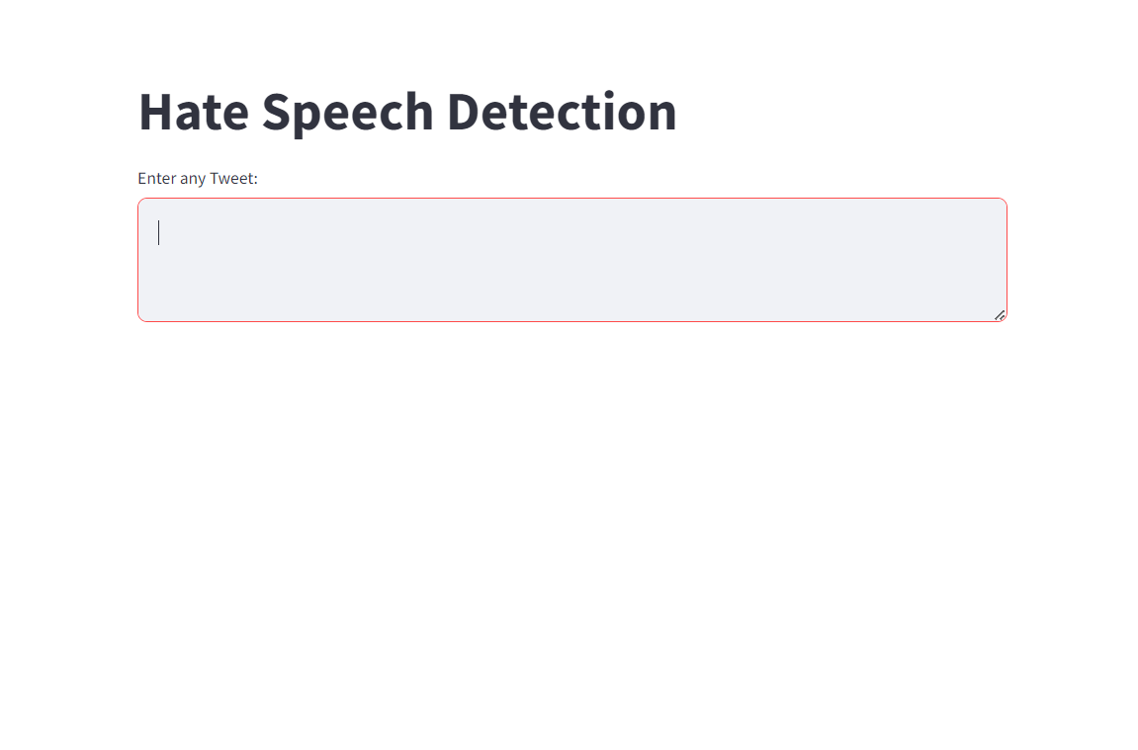

Slide 10
Conclusion and Future Work
The model so made is a basic model for doing the task. Even after being basic, it shows an accuracy over 86%+.
Many models better than this one can be made which will be able to work on logical hate as well (as portrayed in the example earlier).
Models that work on pictures rather than text can also be made which can be used to eradicate hate online more effectively.
There can be many better codes which will be able to work on comments with emojis and check them for vulgar or non-vulgar.
The future works may also include projects which can detect the sentences or comments as the user is typing them and restrict the user to post it so the problem is eradicated even before it becomes a problem.

