Slide 1
ACE: Upgrade Hardware/Software Requirements

Slide 2
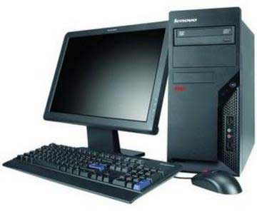
Upgrade execution plan
Rehost Windchill installation 10.2 from Prod with Vault
Target Windchill installation (11.1 M010)
Upgrade activity, validation
R1/Pre Upgrade: New Server
Existing 10.2 installation refresh with prod db/Ldap with vaults
Target Windchill installation (11.1 M010)
Update Cad workers to compatible version (Creo Parametric & adapter)
Upgrade activity Full testing including PUBLISHING
UAT/Pre prod Upgrade: Test Server
Target Windchill installation (11 M010)
Update Cad workers to compatible version (Creo Parametric & adapter)
Upgrade activity and customization porting, Full testing including publishing
Note : Source Windchill and DB will be same as current Prod
Prod Upgrade: Current Prod server

Slide 3
Development server Requirements
New Server: R1
Component | Current Configuration | Required | Comments
OS | N/A | Windows Server 2012 R2 Standard | This server is needed to run R1(Rehearsal 1) for upgrade. Requirement duration is for 10 Weeks.
Memory | N/A | 16GB RAM
HDD | N/A | C() D() F() M() N()
SQL Server | N/A | Microsoft SQL Server 2014 SP2

Slide 4
Test server requirements
Test server: R2
Component | Current Configuration | Required | Comments
OS | Windows Server 2012 R2 Standard | No Change
Memory | 6GB | 16GB RAM
HDD | C(0/59.6GB) D(32.1GB/49.9GB) F(187GB/530GB) M(106GB/899GB) N(9.70GB/100GB)
SQL Server | Microsoft SQL Server 2014 SP2 | No Change

Slide 5
Production server requirements
Production server
Component | Current Configuration | Required | Comments
OS | Windows Server 2012 R2 Standard | No Change
Memory | 64GB | No Change
HDD | C(9.6GB/69.3GB) D(213GB/599GB) G(6.69GB/35GB) H(237GB/599GB) M(109GB/1.22TB) N(63.4GB/100GB)
SQL Server | Microsoft SQL Server 2014 SP2 | No Change

Slide 6
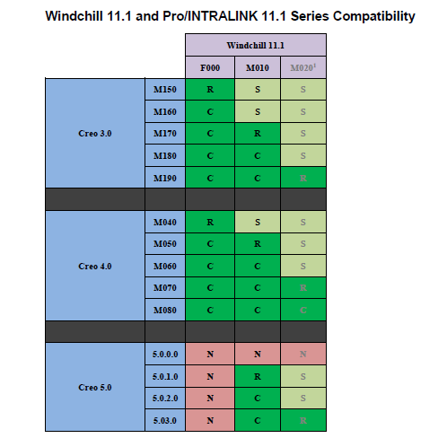
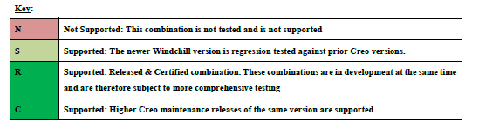
Creo Compatibility

