Slide 1

P673 E-Commerce
Olist Store Analysis

Slide 2
Team Members:
Ganesh Niwas Pawar
Prathipati Revathi
Supriya Swapnil Narkhedkar
Mansi Rajput
Mahesh Rajaram Ushir
Arth Singh

Slide 3
Presentation Steps:
What E-commerce Means?
Objectives of E-commerce
Data analysis projects for e-commerce
Steps of Data Transformation
Overview of Project (Dashboard & kpi’s details)
Advantages of e-commerce
Disadvantages of e-commerce
Challenges in Data
Suggestions and comments
Conclusions

Slide 4
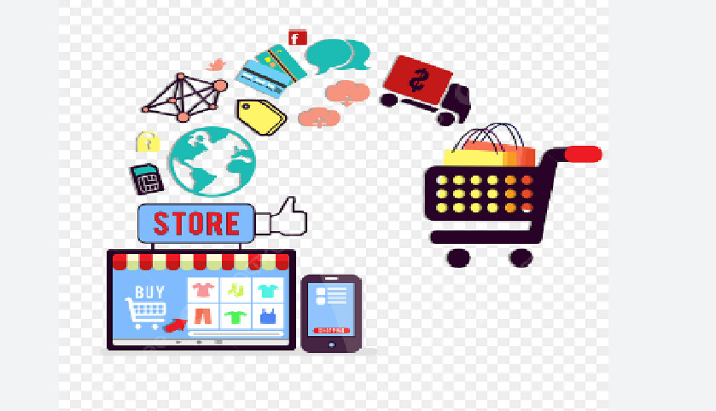
E-commerce

Slide 5

Ecommerce or "electronic commerce" is the trading of goods and services online. The internet allows individuals and businesses to buy and sell an increasing amount of physical goods, digital goods, and services electronically.

Slide 6
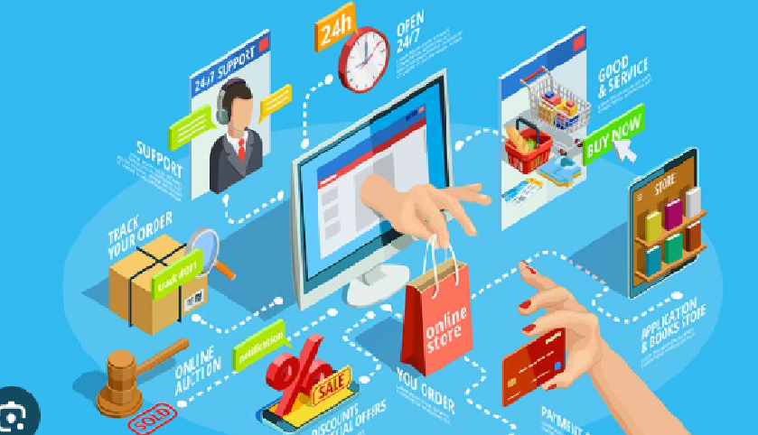
Operation Of Ecommerce

Slide 7
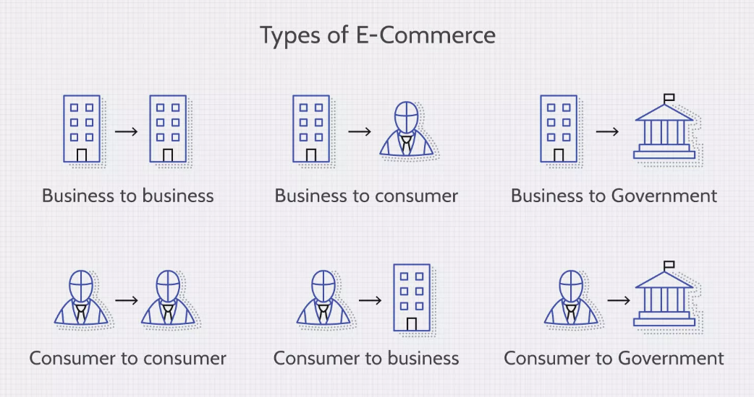
Types of E-commerce

Slide 8
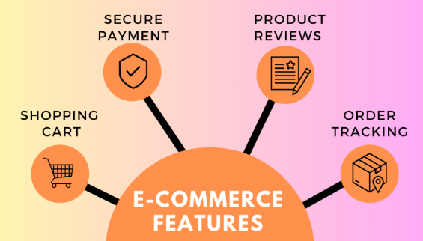
Features of E-commerce

Slide 9
Objectives of Ecommerce
Customer experience: Improve customer engagement, satisfaction, and retention
Sales growth: Increase conversion rates, drive sales, and improve margins
Website traffic: Increase traffic from social media and improve website design
Cost reduction: Reduce management costs and marketing overhead
Data analytics: Use data analytics to track progress and inform decision-making
Digital marketing: Leverage digital marketing strategies and email marketing
Customer relationships: Build direct customer relationships and develop business relations
Geographic reach: Expand geographic reach and reach niche markets
Price flexibility: Offer price flexibility
Adapting to demand: Adapt to demand and test and scale rapidly

Slide 10
Data analysis projects for e-commerce businesses can include:
Collecting data: Gather information about consumer transactions, purchase frequency, and behavioral trends
Developing models: Use historical data to create a predictive model to project a customer's future value
Segmenting customers: Divide the customer base based on anticipated lifetime value (CLV)
Creating marketing strategies: Use focused marketing techniques to attract and retain valuable customers
Identifying product bundles: Use data science techniques to identify products that are often purchased together
Analyzing buying patterns: Analyze the buying patterns of each segment to create product bundles that meet their needs and preferences

Slide 11
Steps of Data Transformation
Define Objectives and Goals
Data Collection and Preparation
Data Exploration
Data Preprocessing
Data Modeling
Interpretation of Results
Documentation and Communication

Slide 12
Overview of Project:
The Olist Store Analysis project aims to analyze customer purchasing patterns and payment statistics on an E-commerce platform, Olist. Data Exploration and cleaning: The analysis is based on 9 CSV files ,which are cleaned and manipulated to extract valuable insights. Identify missing and duplicate values in each dataset and treat them accordingly.Also treat all data quality issues associated with the dataset. Data Modelling: Build relationships of all datasets by creating bridge table in power query Data Merging: For Extracting Different kpi's we need to merge the 2 or 3 datasets with the help of power query Data Visualization: Create appropriate visualizations to identify the most ordered products by payment statistics and purchasing patterns. Market analysis: Identify combinations of average delivery days for product category and calculate shipping days and visualise them as required.This can be done by creating a custom column in power query of powerbi Dashboarding and final PPT: created a neat dashboard containing the important visualizations and supplement it with an executive summary containing valuable insights and recommended steps of action.

Slide 13
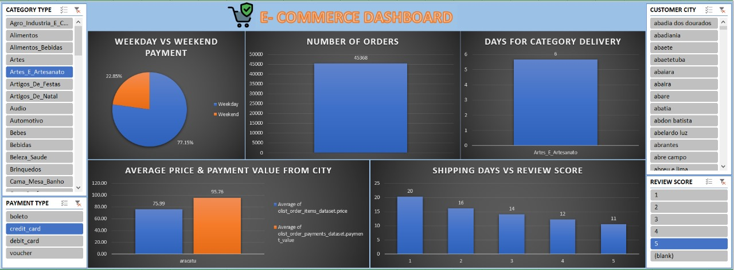
E-commerce Dashboard Excel

Slide 14
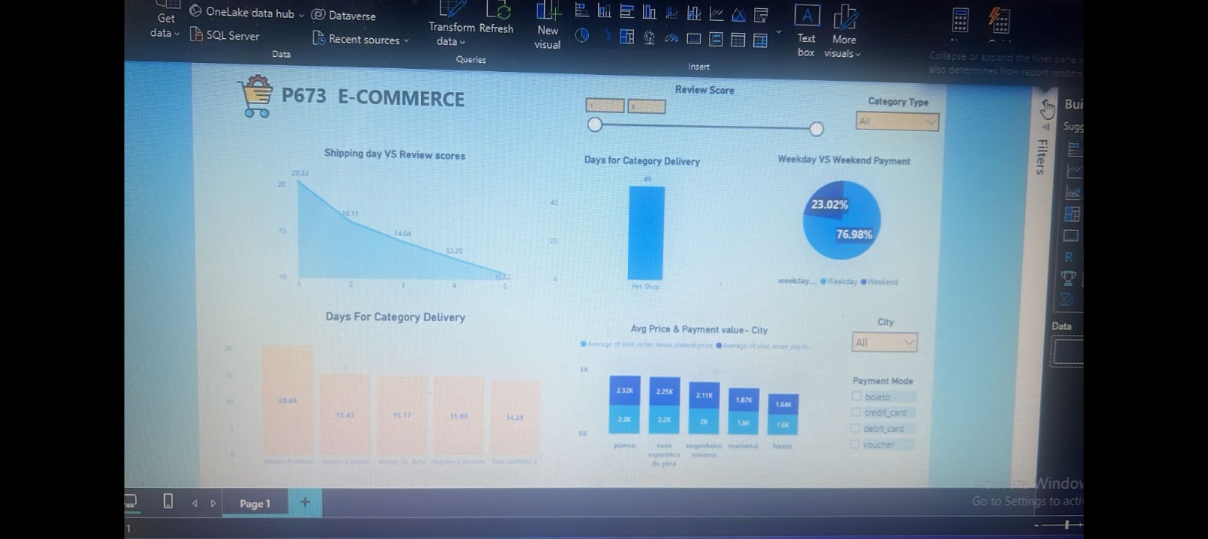
E-commerce Dashboard PowerBI

Slide 15
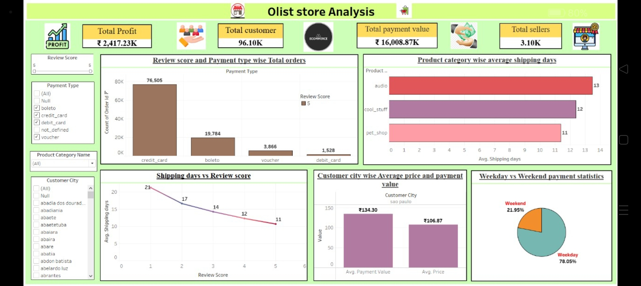
E-commerce Dashboard Tableau

Slide 16
Dashboard overview:
Key Insights:
💹According to the data, Olist E-commerce has about 99,440 orders. With about 89,940 orders being delivered, the company has a 90% delivery success rate.
✔Their average product rating is 4.09 stars, with product categories going as high as 4.67 stars and as low as 2.5 stars. 1 Star reviews are on third place in the review score distribution ranking which likely indicates that there could be problems with product quality in some product categories
✔It helps in understanding the spending patterns of customers in sao paulo city .it also helps Olist in identifying high value customers and creating targeted marketing campaigns.
✔The analysis of payment statistics based on weekday vs. weekend provides an understanding of the buying behavior of customers. and can also help Olist to improve their weekend sales and plan promotions accordingly.

Slide 17
Kpi’s:
✔Weekdays and weekend payment statistics
✔Payment Type with review score 5 and payment types as credit card
✔Average numbers of delivery days taken for pet shop
✔Average price and payment value of sao paulo city
✔Average shipping days vs review scores

Slide 18
Kpi’s in description
Weekday vs Weekend payment statistics On weekends payment is 21.95% and on weekdays it is 78.05%
Review score wise and payment types wise total orders count id is Credit card 76,505 ,boleto 19784, voucher 3866,debit card 1528.
Product category wise shipping days Audio 13 days , cool stuff 12 days , pet shop 11 days
Customer city wise average payment value Rs 134.30 is and price is Rs106.87
More the shipping days less the review score and vise versa for 21 days review score 1 and for 11 days review score 5.

Slide 19
Advantages of E-commerce
Convenience
Increased selection
Potentially lower start-up costs
International sales
Opportunity to collect valuable data

Slide 20
Disadvantages of E-commerce
Limited customer service
Lack of instant gratification
Inability to touch products
Dependence on technology
Greater competition

Slide 21
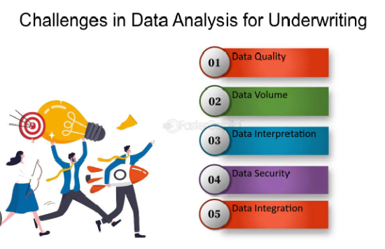

Slide 22
Suggestion and comments:
Clustering
Use algorithms to group customers with similar attributes.
Collaborative filtering
Identify customers with similar purchase history or product preferences to make personalized recommendations.
Social media listening
Monitor social media to understand customer preferences and sentiment.
Seasonal trend analysis
Analyze data to identify seasonal trends and adjust marketing and sales strategies.
User behavior analysis
Analyze user behavior data to identify patterns and optimize the user experience.
Product demand forecasting
Build a model to forecast product demand to improve customer satisfaction and optimize the supply chain.

Slide 23
Conclusion:
A conclusion for a data analysis project for an e-commerce business might highlight the benefits of data analytics and how it can help businesses improve their performance and competitiveness:
Data analytics can help businesses make informed decisions based on insights from customer behavior and preferences.
Data analytics can help businesses understand their customers and provide personalized experiences, which can lead to improved customer satisfaction.
Data analytics can help businesses stay ahead of the competition by optimizing their operations and marketing strategies.

Slide 24

