Slide 1
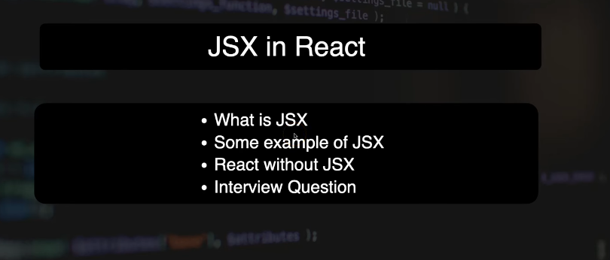

Slide 2
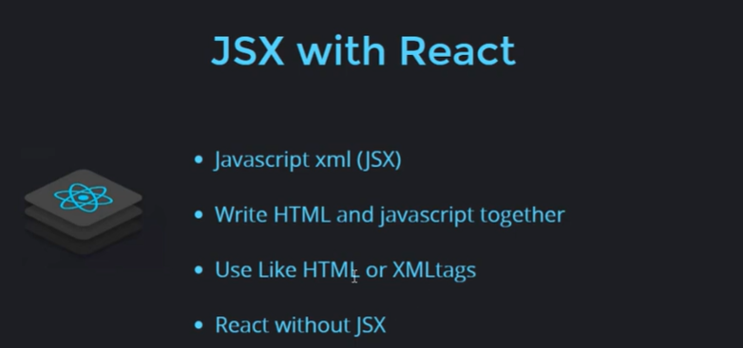

Slide 3
jsx
It is a syntax extension of JavaScript that lets you write HTML-like code inside JavaScript.
JSX makes it easier to describe what the UI should look like in React.
Combine HTML+JS

Slide 4
Example
const element = <h1>Hello, JSX!</h1>;

Slide 5
function App() {
const uniname="LPU";
return (
<div>
<p> Uni name is {uniname} </p>
</div>
)
}

Slide 6
Earlier Usage
We used to make separate files for HTML and Java Script
In HTML file, we make script tag
In JSX, We can write HTML inside Java Script

Slide 7
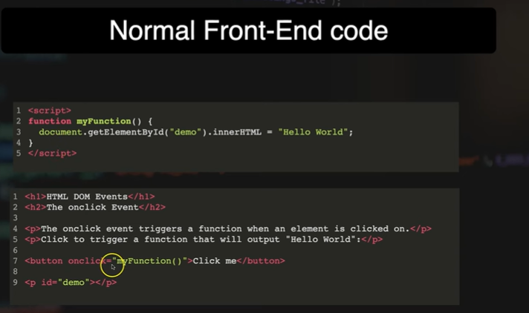
Normal Front-End Code

Slide 8
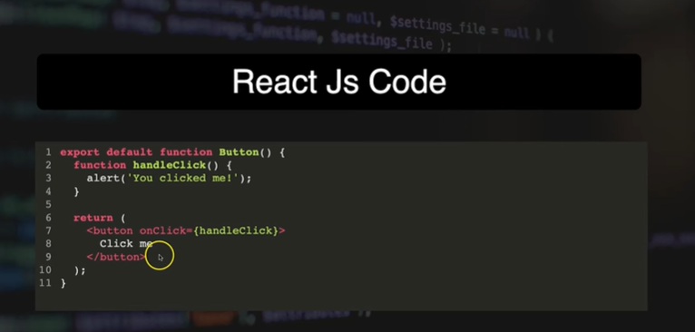
React JS Code

Slide 9
Using Constant in JSX
import './App.css'
function App() {
const username="John Doe";
return (
<>
<h1> HTML inside Java SCript {username} </h1>
</>
)
}
export default App

Slide 10
Earlier Approach
<!DOCTYPE html>
<html>
<head>
<title>No JSX Example</title>
</head>
<body>
<h1 id="heading"></h1>
<script>
const username = "John Doe";
document.getElementById("heading").innerText = "HTML inside JavaScript " + username;
</script>
</body>
</html>

Slide 11
Adding Button in JSX
//add button in jsx
import React from 'react';
export default function Button() {
return (
<button onClick={()=>alert("hello")}>Click Me</button>
);
}

Slide 12
Call Button Component in App.jsx
import Button from './Button.jsx’

