Slide 1
Bank of Baroda Hackathon 2024
Your Team Name : Mansi Ruhil
Your team bio : Artificial Intelligence and Machine Learning Enthusiast
Date : 30 June 2024

Slide 2
Health and Fitness?
Why did you decide to solve this Problem statement?
When addressing the topic of "health and fitness" for a hackathon, there are several compelling reasons to focus on solving problems in this domain:
1. Impact on Public Health: Health and fitness solutions directly impact individuals' well-being and quality of life. By addressing issues like physical inactivity, poor nutrition, or stress management, innovative solutions can contribute to reducing chronic diseases and improving overall public health.
2. Market Demand and Growth: The health and fitness industry is rapidly expanding, driven by increasing consumer awareness of health issues and the adoption of digital health technologies. Developing solutions in this space presents opportunities for market penetration and growth.
3. Technological Advancements: Advances in wearable technology, data analytics, and artificial intelligence enable sophisticated health monitoring and personalized interventions. Leveraging these technologies can lead to groundbreaking innovations in health and fitness management.
4. Personal Empowerment: Effective health and fitness solutions empower individuals to take control of their health through data-driven insights, personalized recommendations, and motivational support. This fosters long-term behavior change and adherence to healthier lifestyles.
5. Integration with Healthcare Systems: Integrating health and fitness technologies with existing healthcare systems can enhance preventive care, reduce healthcare costs, and improve patient outcomes. This integration aligns with trends towards proactive health management and telemedicine.
In summary, tackling challenges related to health and fitness not only addresses critical societal needs but also aligns with technological advancements and market opportunities. It offers a chance to make a meaningful impact on individuals' lives while contributing to broader healthcare objectives and advancements. Therefore, I decided to solve this problem statement

Slide 3
Pre-Requisite
What are the alternatives/competitive products for the problem you are solving?
examples of competitive products and their features that you might want to explore and potentially differentiate from in your solution:
Well_Fit: Imagine a device that not only counts your steps but also tracks your heart rate, monitors your sleep patterns, and connects you with a community of like-minded individuals striving for better health. Well_fit does just that, offering a range of models from simple trackers to advanced smartwatches, all with an easy-to-use app that keeps you motivated.
Apple Watch: Picture a watch that not only tells time but also monitors your heart rate, alerts you to irregular heart rhythms, tracks your workouts, and even reminds you to stand up if you've been sitting too long. The Apple Watch does all this and more, seamlessly integrating with your mobile Phone and Health app for a comprehensive health experience.
Garmin Fitness Trackers: For those who love the great outdoors, Garmin offers fitness trackers with built-in GPS, tailored metrics for running, cycling, and swimming, and long battery life that can withstand rugged conditions. Whether you're hiking, biking, or swimming, Garmin's trackers are designed to keep up with your active lifestyle.
Samsung Galaxy Fit: Imagine a sleek wearable that not only tracks your heart rate and sleep but also manages your stress levels and monitors your workouts. The Samsung Galaxy Fit does all this while seamlessly syncing with the Samsung Health app, offering a vibrant AMOLED display and a design that can handle water splashes without worry.
WHOOP: Designed for athletes and anyone serious about performance optimization, WHOOP goes beyond basic tracking. It continuously monitors your heart rate, provides insights into your recovery based on heart rate variability, and offers personalized coaching to help you reach your peak performance. It's like having a personal coach on your wrist, guiding you to optimize your training and recovery.

Slide 4
Tools or resources
Azure tools or resources which are likely to be used by you for the prototype, if your idea gets selected:
**Azure IoT Hub**
Usage: Connect and manage IoT devices (such as the fitness tracker) securely.
Benefit: Facilitates real-time data ingestion from devices, ensuring scalable and secure communication.
** Azure Active Directory (Azure AD)**
Usage: Identity and access management service.
Benefit: Securely manage user identities and access to the fitness tracker application, ensuring data privacy and compliance with regulatory requirements.

Slide 5
Any Supporting Functional Documents
Present your solution, talk about methodology, architecture & scalability
** Methodology**
Our approach focuses on integrating advanced wearable technology with cloud-based analytics to empower users in managing their health proactively. The methodology encompasses iterative development cycles, user-centered design principles, and continuous feedback loops to ensure the solution meets evolving user needs.
**Architecture**
Device Layer:
We utilize state-of-the-art wearable devices equipped with sensors for monitoring vital health metrics such as heart rate, activity levels, sleep patterns, and stress levels.
These devices securely transmit data to the cloud infrastructure via Azure IoT Hub, ensuring real-time data ingestion and device management.
Cloud Infrastructure:
Azure serves as our robust cloud platform for scalable data storage and processing. Azure Cosmos DB provides a globally distributed database to store and manage user health data with low latency and high availability.
Azure Machine Learning is employed for building and deploying predictive models that analyze user data to generate personalized health insights and recommendations.
Application Layer:
The frontend application, hosted on Azure App Service, provides users with intuitive interfaces across web and mobile platforms. It offers real-time health monitoring dashboards, personalized recommendations, and goal tracking features.

Slide 6
**Scalability**
Vertical Scalability:
Azure's PaaS offerings like Azure App Service and Azure Functions allow us to vertically scale our application components based on demand, ensuring optimal performance during peak usage periods
Horizontal Scalability:
Azure Cosmos DB's globally distributed nature enables horizontal scaling to support growing user bases across different regions without compromising on data consistency or availability.
Elasticity:
Leveraging Azure's autoscaling capabilities, we dynamically adjust compute resources based on workload fluctuations, optimizing cost-efficiency while maintaining responsiveness.

Slide 7
**Benefits**
User-Centric Design:
Our solution prioritizes user experience with personalized health insights, intuitive interfaces, and actionable recommendations to foster long-term engagement and behavior change.
Security and Compliance:
Azure's comprehensive security features, including Azure AD integration and data encryption, ensure data privacy and compliance with healthcare regulations like HIPAA.
Innovation and Future Readiness:
By harnessing Azure's cutting-edge technologies and scalable infrastructure, we position our solution to evolve with emerging trends in wearable health technology and digital healthcare.

Slide 8
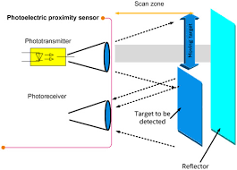
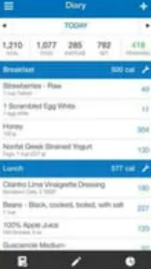
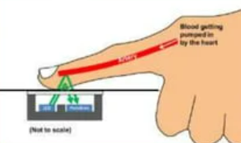
GitHub Repository Link & supporting diagrams, screenshots, if any
How far it can go?
Health and fitness website name: WellFit
https://github.com/mansiruhil13/Bank-of-Baroda-Hackathon
Proximity Sensors
Optical heart-rate sensors

Slide 9
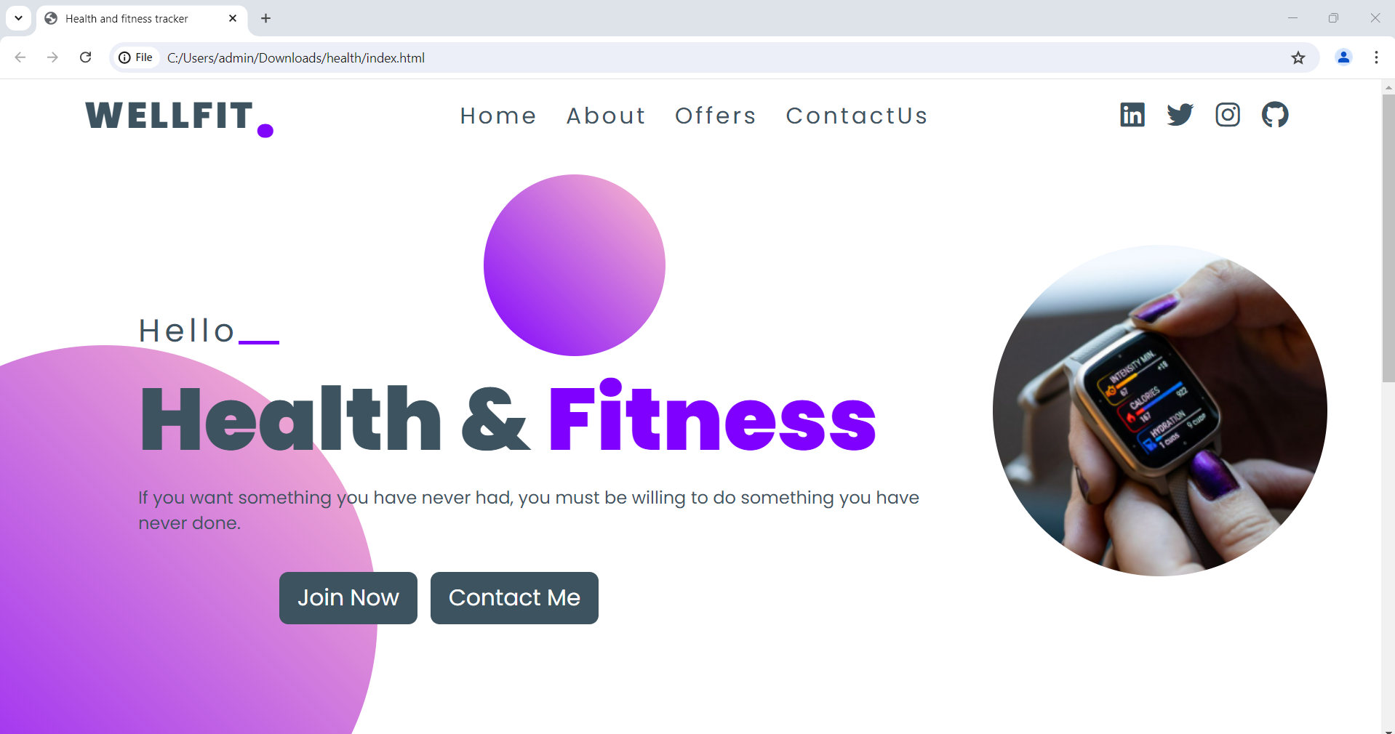

Slide 10
Business Potential and Relevance
What are the business applications of the problem you are solving?
Our health and fitness tracker offers diverse business applications:
Direct-to-Consumer Sales: Through subscription models and device sales.
Corporate Wellness Programs: Enhancing employee health and productivity.
Healthcare Partnerships: Facilitating remote patient monitoring and data analytics.
Fitness Industry Integration: Supporting gyms with personalized training and member engagement.
Research and Development: Providing real-world data for clinical trials and health research. This broadens market reach and enriches user experience across sectors, propelling digital health innovations.

Slide 11
Uniqueness of Approach and Solution
What is the unique aspects of the proposed idea?
Developing a health and fitness tracker offers business opportunities in direct-to-consumer sales, corporate wellness programs, healthcare partnerships, fitness industry integrations, and data analytics for research. It enhances health management, supports employee wellness, enables remote patient monitoring, and drives insights for personalized health solutions, shaping the future of digital health markets.

Slide 12
User Experience
How will your idea enhance the user experience?
how the idea of a health and fitness tracker can enhance user experience:
Easy to Use: Designed for effortless navigation and accessibility across devices, ensuring anyone can use it intuitively.
Personalized Guidance: Tailored advice and goals based on individual fitness levels and preferences, keeping users motivated and on track.
Motivation and Engagement: Uses challenges, rewards, and social features to inspire users and make fitness fun and collaborative.
Real-Time Feedback: Provides instant insights on progress and health metrics, helping users adjust and stay informed throughout their day.
Educational Support: Offers tips, workouts, and articles on fitness and wellness, empowering users with knowledge to make informed health choices.
Integration with Wearables: Syncs seamlessly with wearable devices for comprehensive health monitoring, ensuring users have all their health data in one place.
Continuous Improvement: Listens to user feedback to continuously enhance features and usability, ensuring it evolves with users’ needs and preferences.

Slide 13
Security Considerations
What measures are incorporated to ensure the security and integrity of your solution?
Here are key security considerations:
Data Encryption: Use strong encryption methods (e.g., HTTPS, AES) to protect data during transmission and storage, preventing unauthorized access.
User Authentication: Implement robust authentication mechanisms (e.g., multi-factor authentication) to verify user identities and restrict access to sensitive information.
Data Minimization: Collect only necessary data and anonymize or pseudonymize personal information to reduce risks associated with data breaches.
Compliance: Adhere to data protection regulations (e.g., GDPR, HIPAA) to ensure lawful handling of user data, including consent management and data access rights.
Secure Development Practices: Follow secure coding standards and conduct regular security assessments (e.g., penetration testing) to identify and mitigate vulnerabilities.
User Awareness: Educate users about security best practices (e.g., strong passwords, recognizing phishing attempts) to enhance overall security posture.
Incident Response Plan: Maintain a response plan to promptly address and mitigate security incidents, minimizing potential impact on users and operations.

Slide 14
Thank You
Mansi Ruhil

