Slide 1
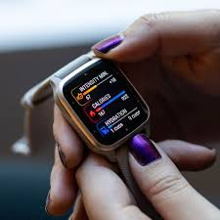
HEALTH
&
FITNESS TRACKER

Slide 2
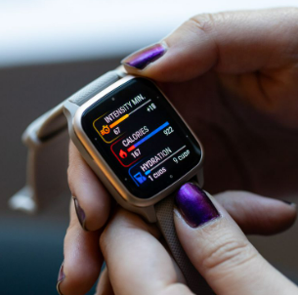

Slide 3


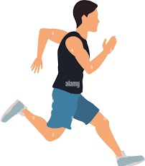
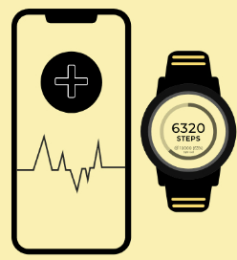



Calories
290cal
Distance
4km
Weather
25
Duration
22:41

Slide 4
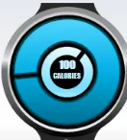
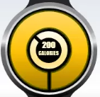
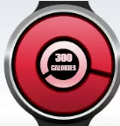
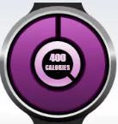
A Measure of Food Energy
75%
90%
25%
65%
portion of food will provide your body with 100 units of energy derived from the food's nutrients
portion of food will provide your body with 200 units of energy derived from the food's nutrients
portion of food will provide your body with 300 units of energy derived from the food's nutrients
portion of food will provide your body with 400 units of energy derived from the food's nutrients

Slide 5
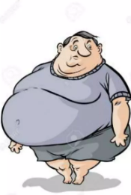

Fitness Tracker don’t magically transform you into a fit and healthy person. Though it helps in becoming you fit, all the hard work has to be done by you.

Slide 6
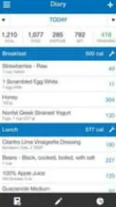

The History of Wearables
2005: Release of the self-tracking app and website MyFitnessPal.
2008: Fibit debuted with first of its fitness.

Slide 7
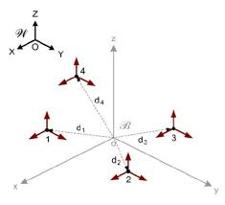
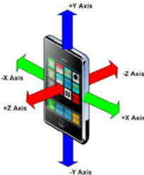
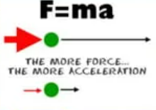
Accelerometer
Health and Fitness tracker sense the movement of body with 3 axis accelerometer to track movement in every direction.
Newton 2nd law of motion.

Slide 8
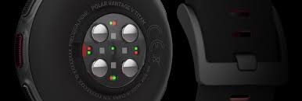
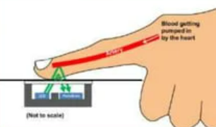
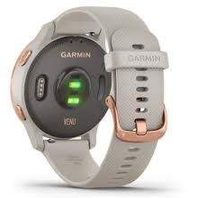
Optical Heart-Rate Sensor
An optical heart rate sensor monitor measures your heart rate using green light or red light.
LED shines through your skin & an optical sensor scans the light that bounces back.

Slide 9
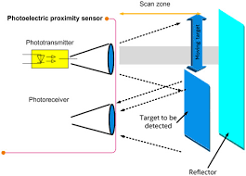
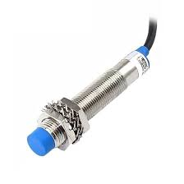
Proximity sensor
Detect presence or absence of objects using electromagnetic fields, lights and sound.
In capacitive sensors, 2 conduction plates are housed together in a sensing head.
As a target enters the sensing zone the capacitance of the two plates increases creating an output signal.

Slide 10
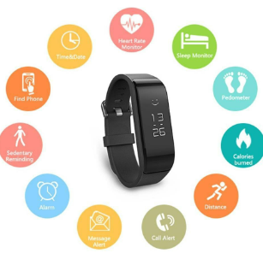
Features
Step Counter
Heart Rate Monitor
Calorie Tracker
Sleep Tracker
GPS
Smartphone Notifications
Water Resistance
Long Battery life

Slide 11
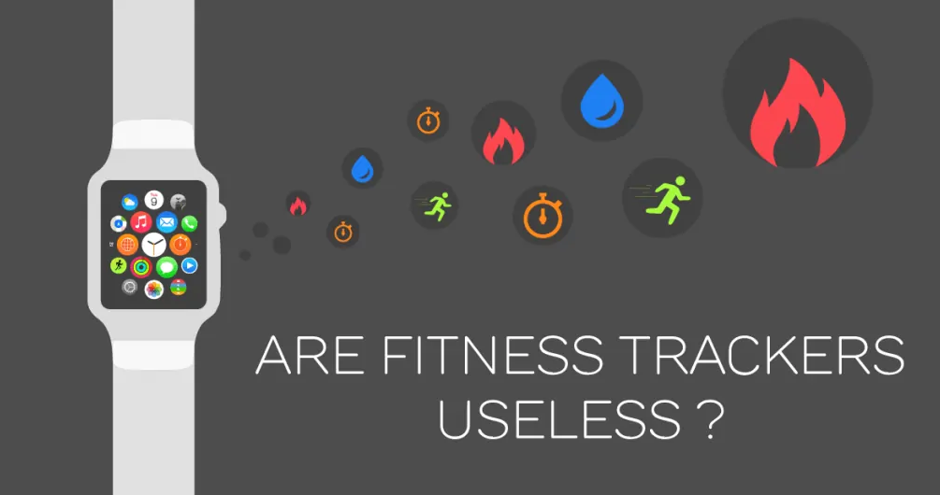
Advantages
No need to define leisure time
Motivates physical activity
Motivates to achieve optimum caloric intake and healthy eating
Monitors quality of sleep
Long Battery life
Helpful in Scientific Research
Disadvantages
Some of them are Expensive
Some of them have inaccurate measurement
Less Functionality
It can be very time consuming to set up and organize

Slide 12



Thank-You
For More Details, Contact info:
mansiruhil99@gmail.com
https://github.com/mansiruhil13
https://www.linkedin.com/in/mansi-ruhil-7a00a0228/

