Slide 1


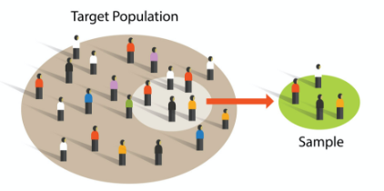
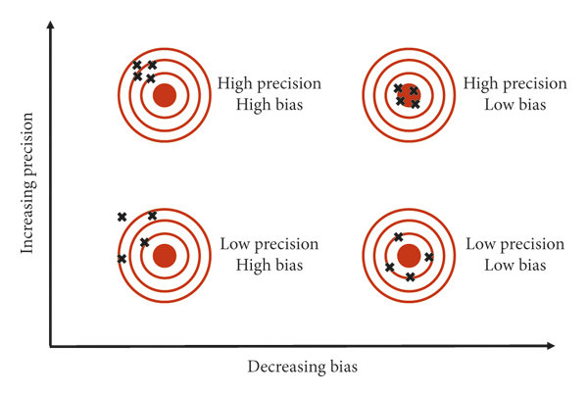





FairClean: Toolkit for Fairness-aware Data Cleaning and Debiasing
Description: FairClean is a pioneering toolkit designed to enhance fairness in machine learning. It focuses on identifying, cleaning, and debiasing datasets to ensure ethical AI applications in critical sectors like healthcare and finance.
Data Bias & Unfairness (The Problem)
FairClean (The Solution)
Fair AI
Data Cleaning
ML Fairness
Skewed Data Collection
Historical Inequalities
Gaps in fairness integration
Bias Identification and Debiasing algorithm
Applications
Existing Tools for Data Cleaning: JENGA, Auto-SkLearn and AlphaClean
User-Friendly interface
Inspired by: Mehrabi, N., Morstatter, F., Saxena, N., Lerman, K., & Galstyan, A. (2021). A survey on bias and fairness in machine learning. ACM computing surveys (CSUR), 54(6), 1-35.
Notes:
Notes/ feedback
1. research more on how to integrate bunch of different constraints on existing methods
2. tool development instead of interface creation ( automated data cleaning )

Slide 2
FairTrain: FAIRness-aware Data Processing
and TRAINing
Team Fair Data Pioneers: Aaditya, Divya, Swetha, Mansi

Slide 3
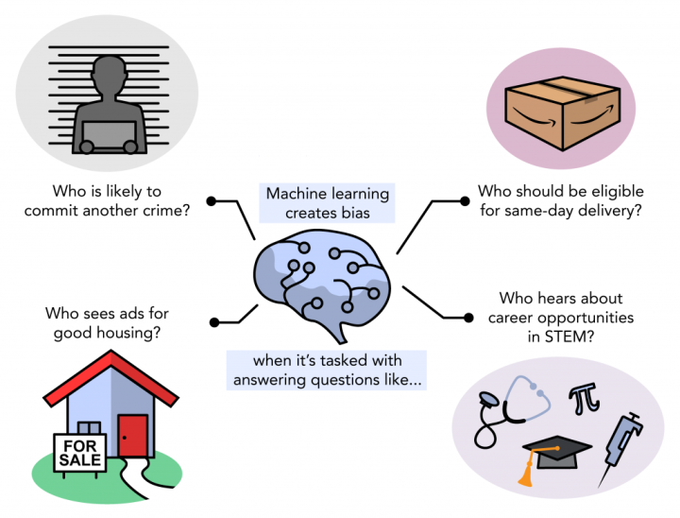
Motivation and Challenge
Why consider “FAIRNESS”?
Current Issues:
Skewed Data Collection
Historical Inequalities
Gaps in fairness integration
Existing automated pipelines: AlphaClean, AutoSklearn, BoostClean

Slide 4

The Vision of FairTrain
Introducing FairTrain:
Weave fairness into the fabric of data processing and model training.
Our goal:
To not only train a model for better precision but to ensure it upholds the principles of equity and justice.

Slide 5
Unpacking FairTrain
FairTrain
Pre-Processing:
Alpha Clean
Imputation
BoostClean
In-Processing:
XGBoost
AutoSkLearn
Fair model and predictions
Raw Data

Slide 6
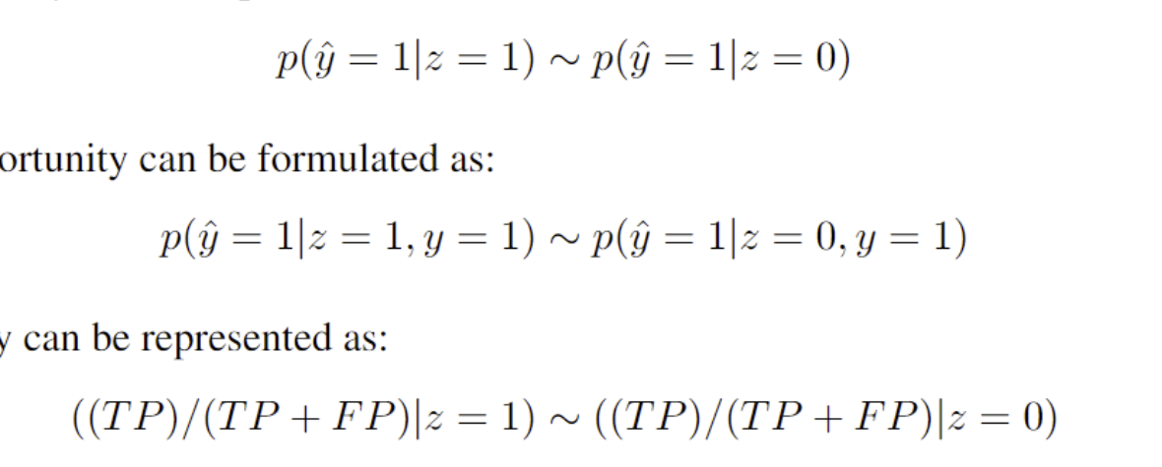
Theoretical Foundations (Metrics)
Demographic Parity
Average decision across groups should be similar
Equality of Opportunity
True Positive Rate for positive outcomes should be similar across groups

Slide 7

Theoretical Foundations (Metrics)
Predictive Parity
Ensure groups have similar precision (also false discovery rate) instead of accuracy
Treatment Equality
Ratio of FN to FP should be similar across groups. Used as a policy lever while optimizing multiple metrics.

Slide 8
Setting the stage - Dataset
German Credit (Statlog) Dataset
Source: UCI Machine Learning Repository
Target: Predict risk of good/ bad credit
10,000 samples with 20 features
Sensitive features: Age, Sex
Adult (Census Income) Dataset
Source: UCI Machine Learning Repository
Target: Predict an individual earns >50K per annum or not
50,000 samples with 14 features
Sensitive features: Sex, Race

Slide 9
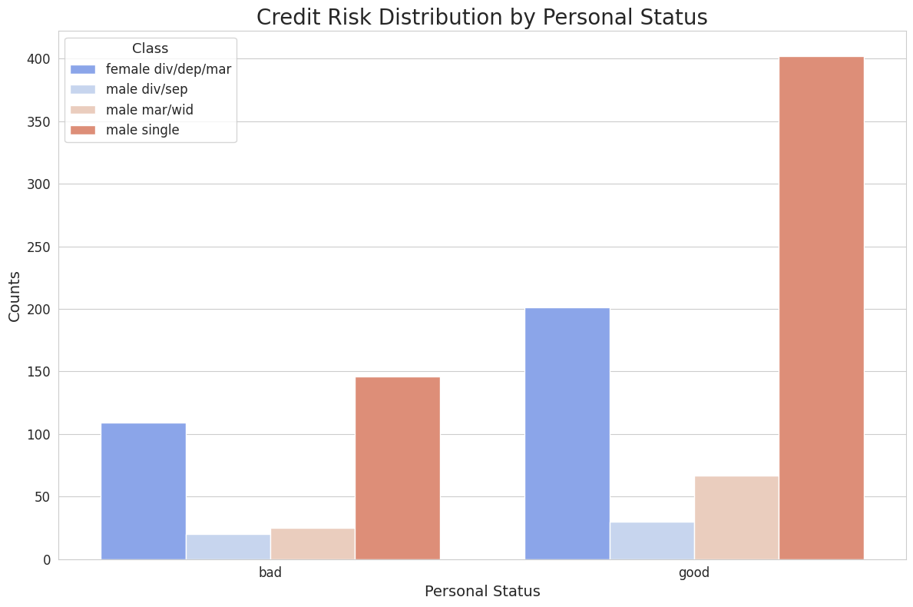
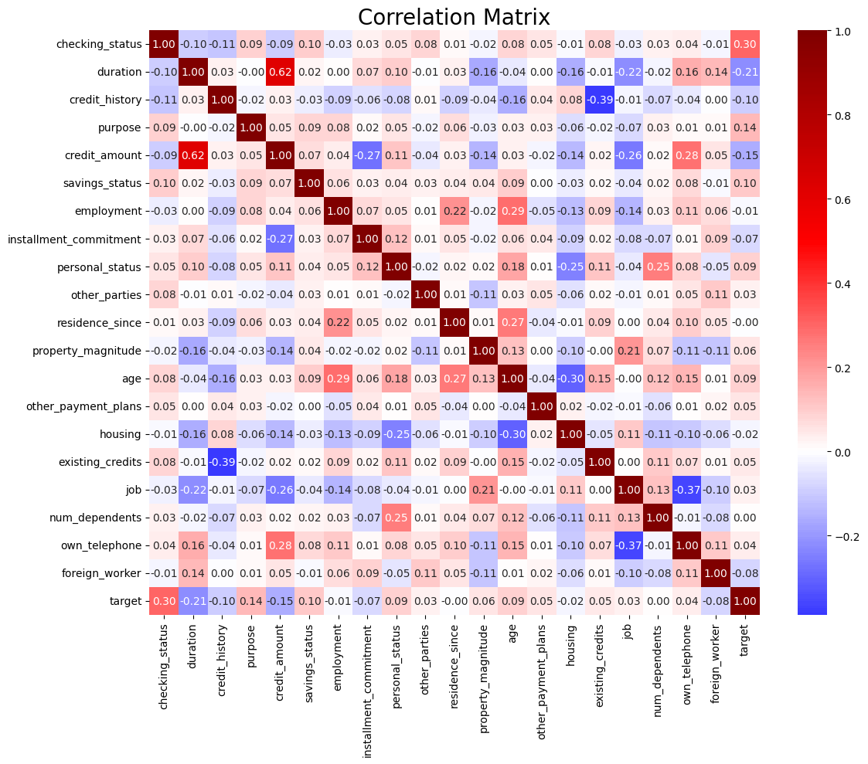
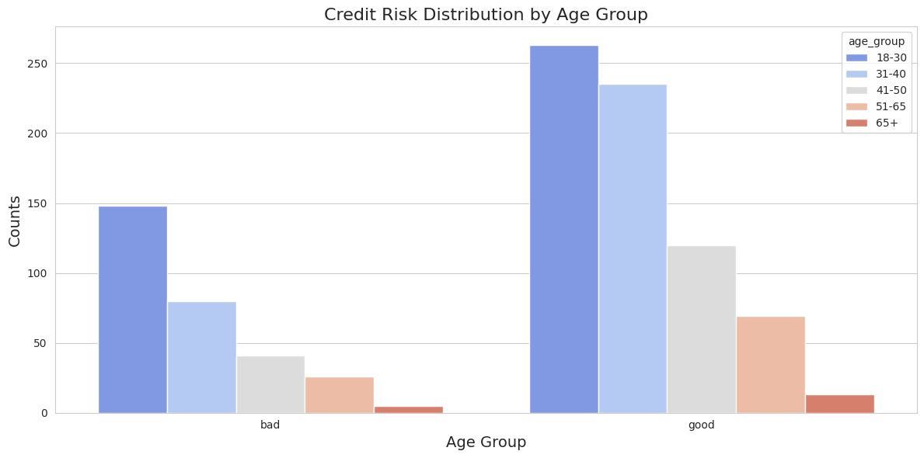
EDA - German Credit

Slide 10
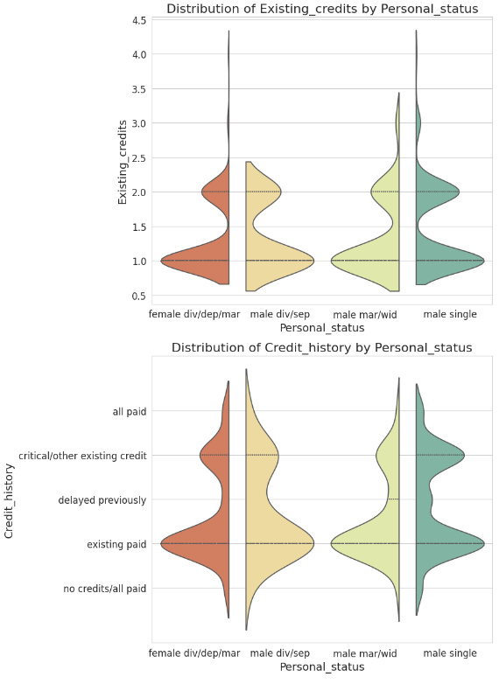
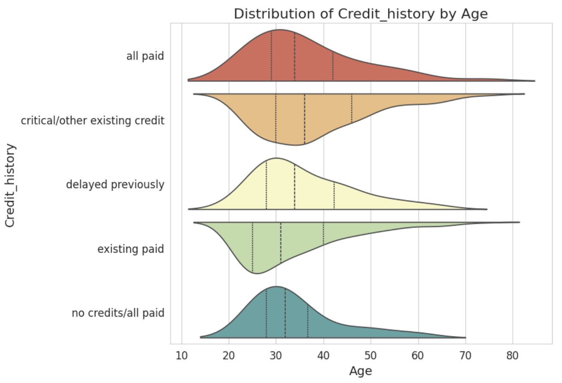

Slide 11
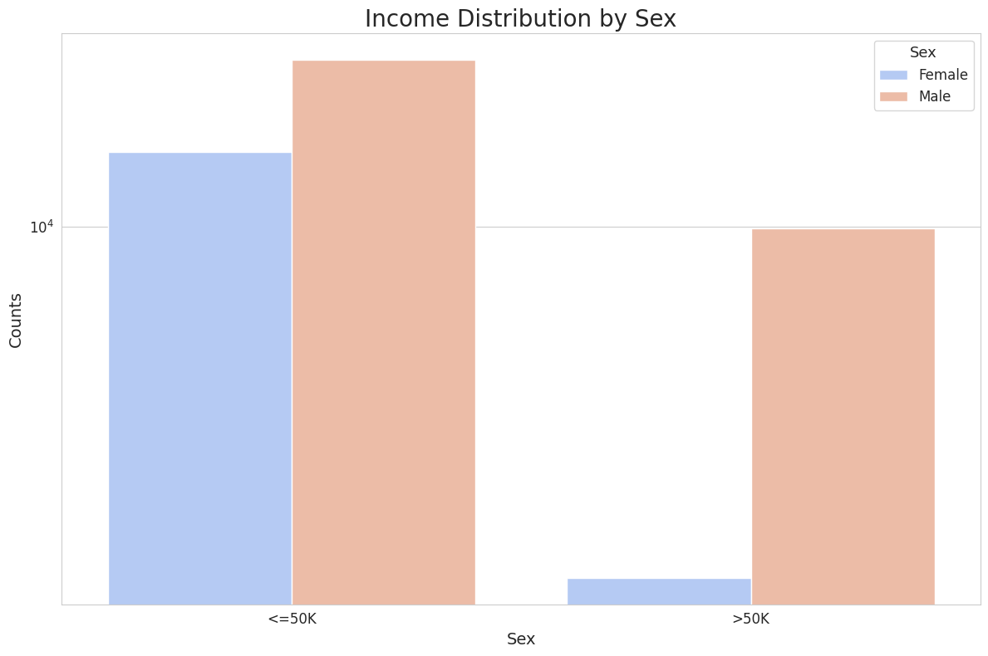
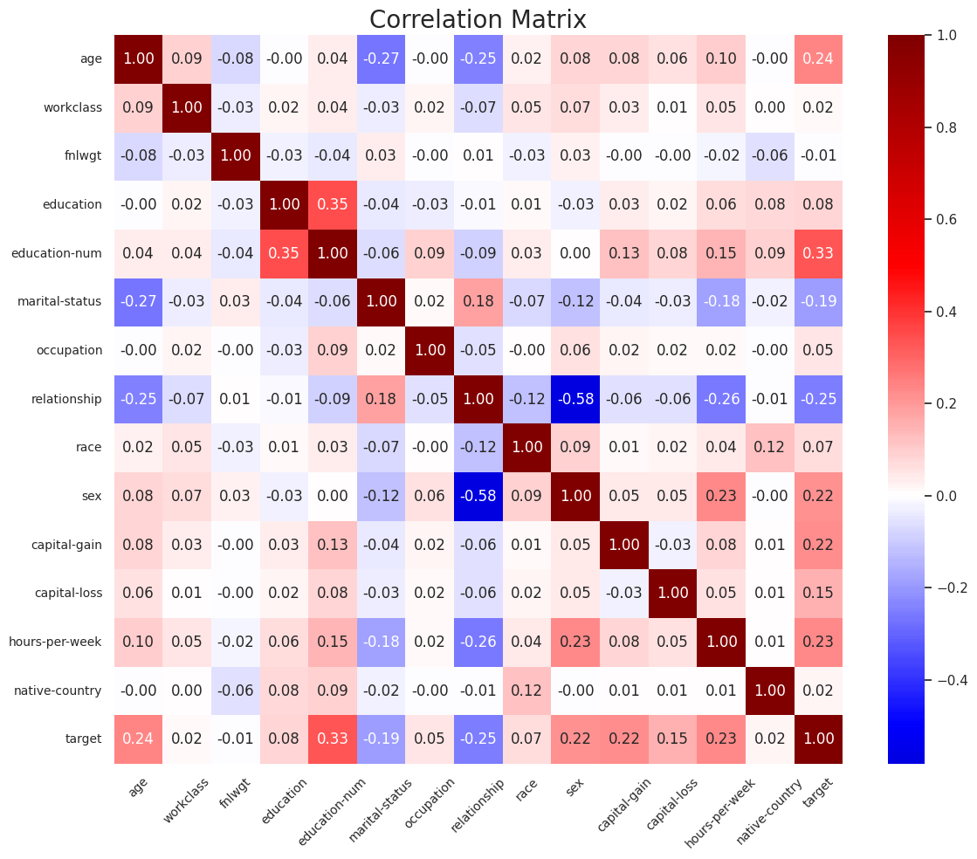
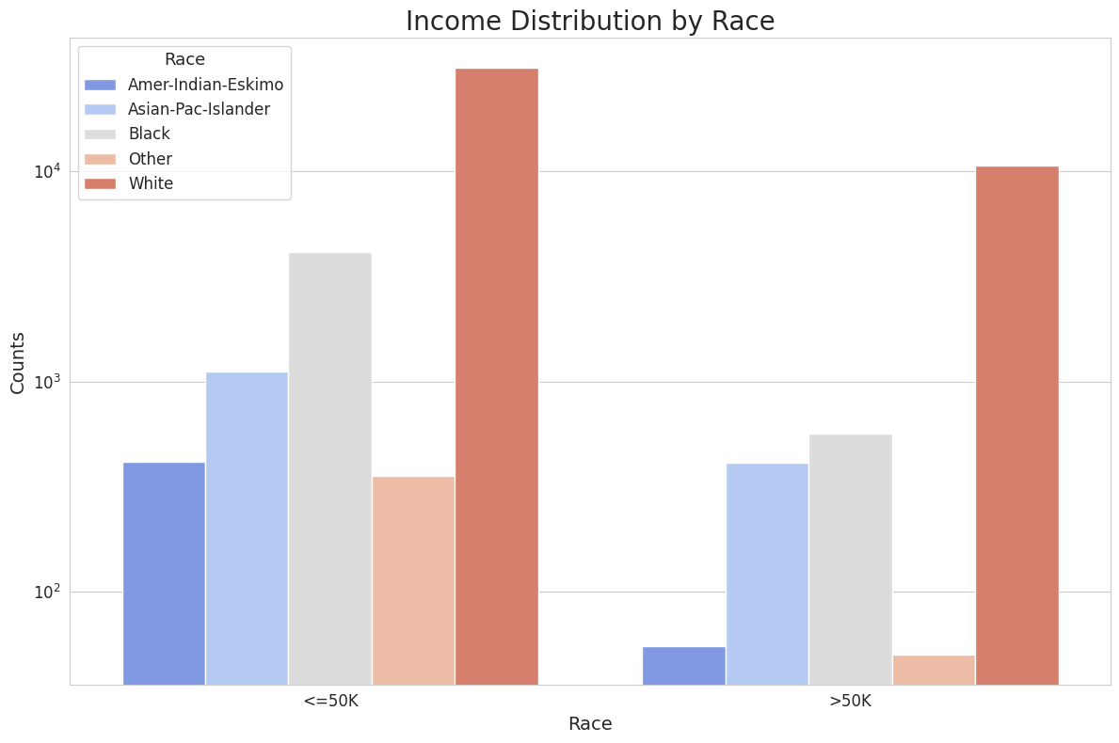
EDA - Adult

Slide 12
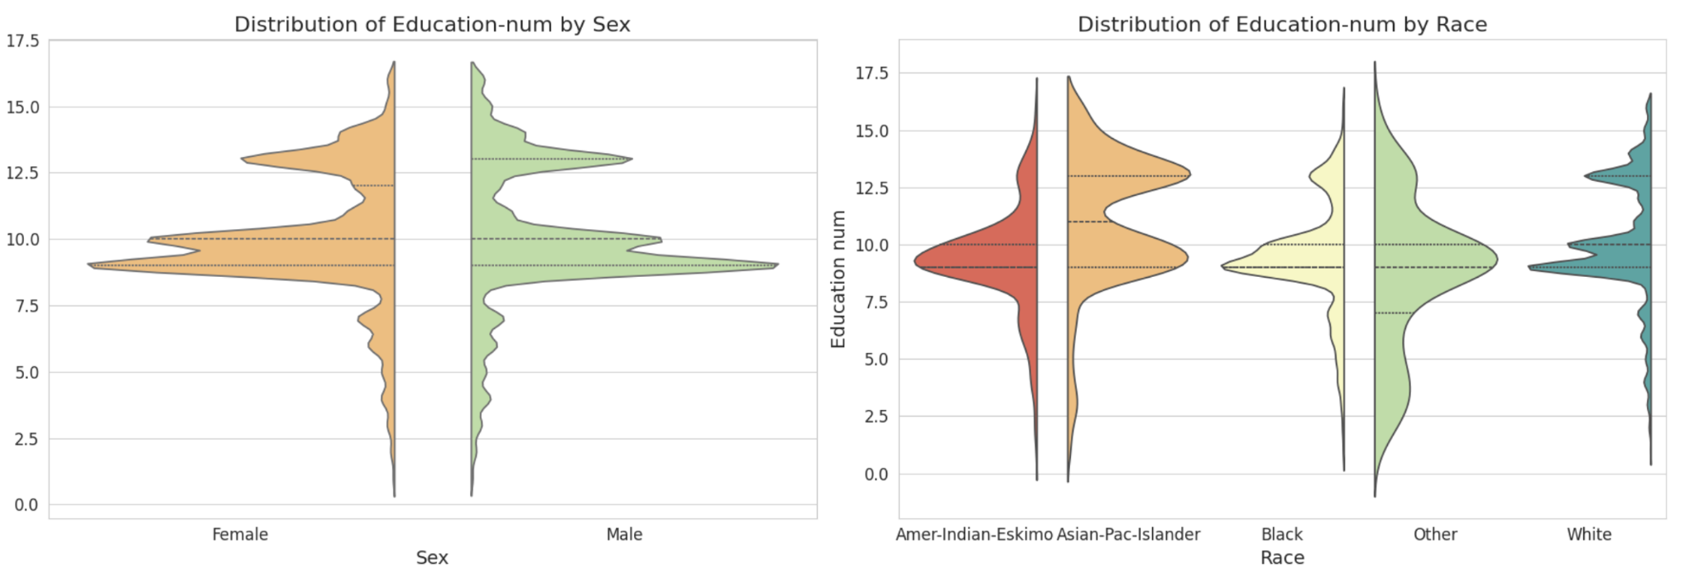
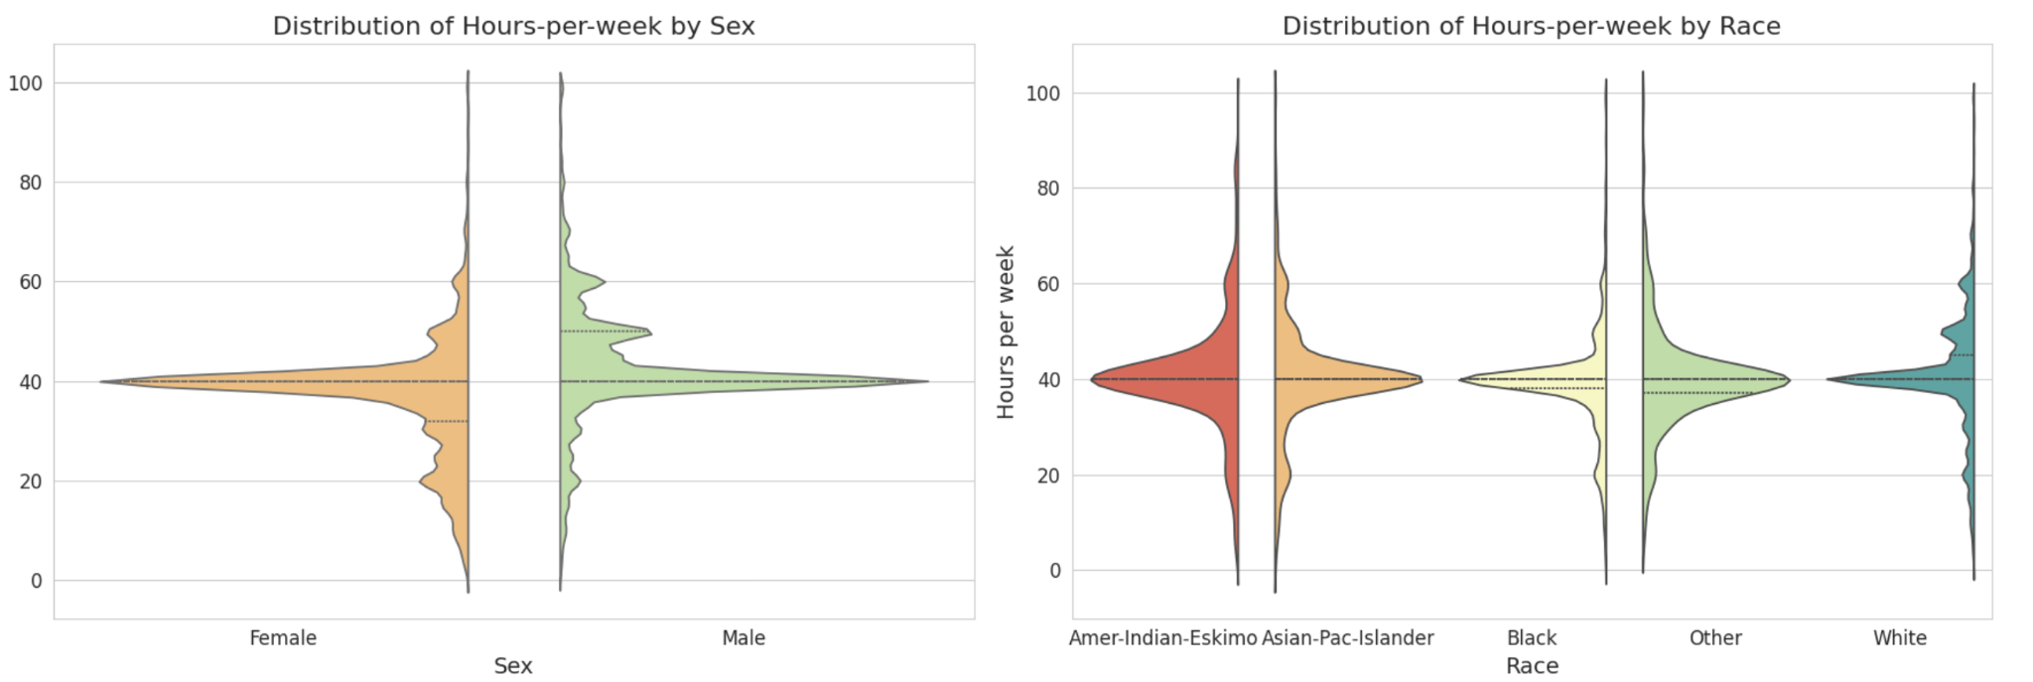

Slide 13
AlphaClean - embedding fairness constraint
Assigns a quality score to each row and based on this score, row-wise substitution or deletion operations are performed.
Tried by having a weight for the quality score
Didn’t work as expected

Slide 14
FairTrain in Action - BoostClean
Implements BoostClean: a data cleaning module within FairTrain.
Iteratively enhances data quality and fairness using boosting techniques.
Includes data preprocessing modules:
Missing Value Imputation, Outlier Detection and Handling as well as Feature Normalization and Scaling
Sensitive attributes considered during the cleaning process.
Post-cleaning, calculates demographic parity difference to monitor fairness.
Logs improvements in fairness after each cleaning round.
Aims to minimize data bias and ensure equitable model predictions.

Slide 15

FairTrain in Action - Auto-SKLearn
AutoSklearn - MetaLearning and Bayesian Optimization package for automl pipelines
Automates entire pipeline from dataset cleaning to hyperparameter search
Allows optimizing with respect to custom functions
Focus on fitting data cleaning and feature extraction pipeline for RandomForest Model
Demographic Parity Constraint
Equalized Odds Constraint
Notes:
A classifier h satisfies demographic parity under a distribution over (X, A, Y) if its prediction h(X) is statistically independent of the sensitive feature A.
A classifier h satisfies equalized odds under a distribution over (X, A, Y) if its prediction h(X) is conditionally independent of the sensitive feature A given the label Y

Slide 16
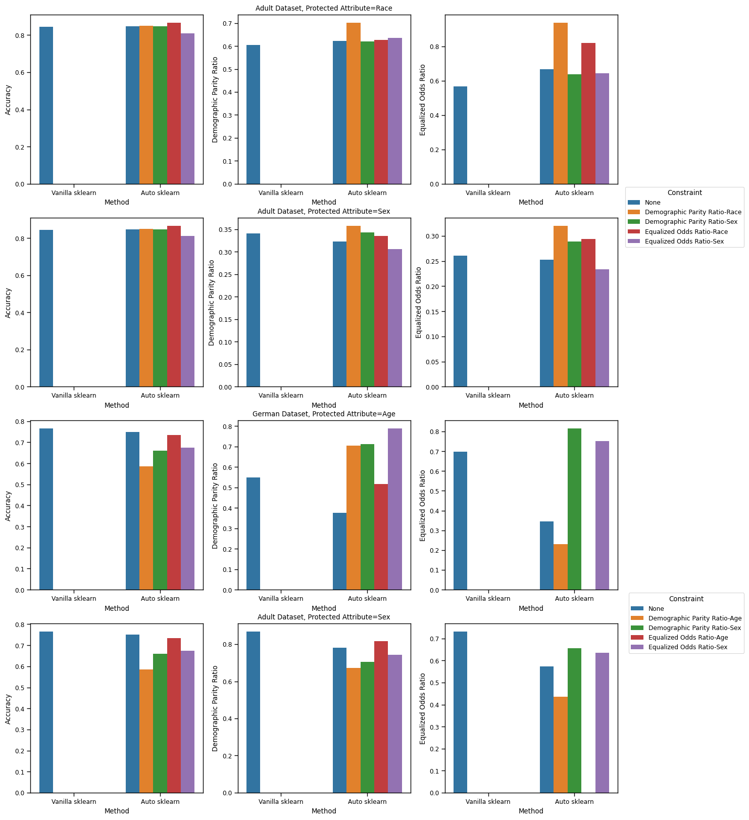
Results - Automl
On the adult Dataset. Optimizing for fairness constraints tend to increase fairness without accuracy tradeoffs
German Credit Dataset is a bit more ambiguous

Slide 17
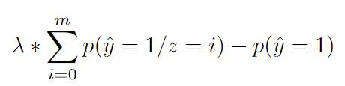


FairTrain in Action - XGBoost
XGBoost - Distributed training for gradient boosted trees
Customize constraint/ objective function
How to enforce fairness while training?
Add “Regularization” term!
Demographic Parity Constraint
Where z represents the sensitive feature(s) and m is the total number of groups in z
Predictive Parity Constraint
Where Precision =

Slide 18
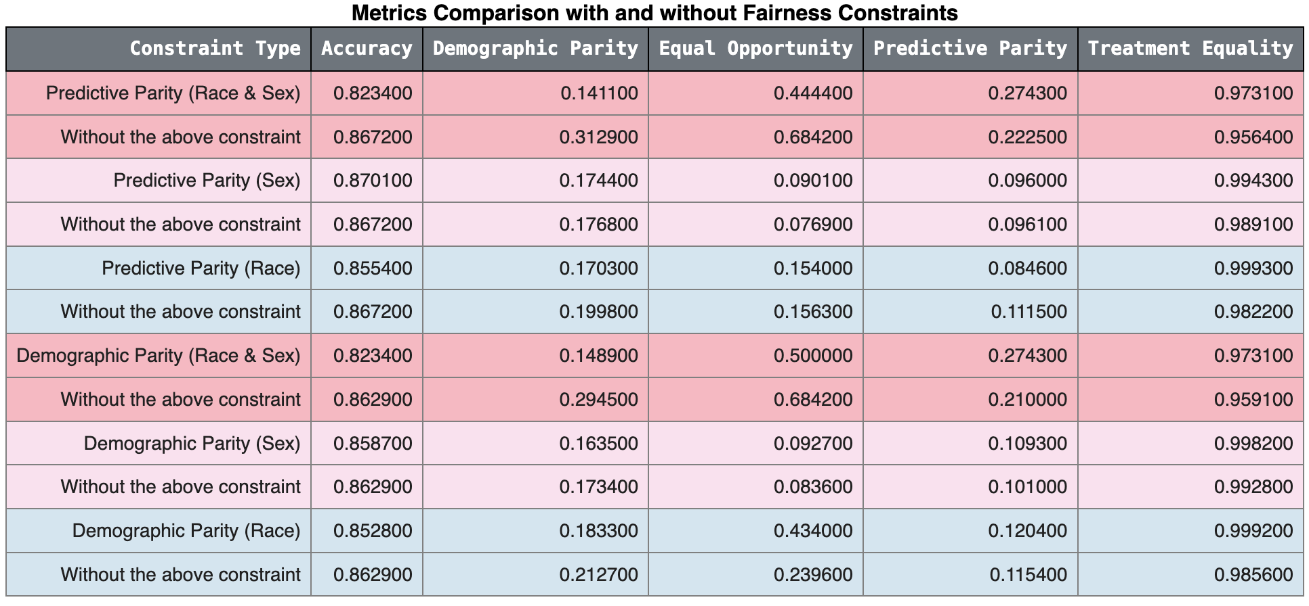
Results - XGBoost on Adult Dataset

Slide 19
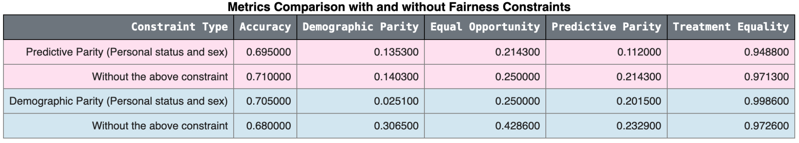
Results - XGBoost on German Credit Dataset

Slide 20
The Road Ahead
Future directions include expanding FairTrain to accommodate more nuanced fairness metrics, multiple fairness objectives and broader data types.
We're also exploring how FairTrain's principles can be integrated into real-time data processing pipelines.

Slide 21
Acknowledgements
We thank our Professor, TAs, and peers for their support and guidance.
Now, we'd love to hear your thoughts, questions, or insights on FairTrain.

Slide 22
THANK YOU

