Slide 1
Blockchain-Based Land Record Management Systems
Major Project Review-III
Submitted By
Team Members
24NG5A5403 – P.Mansoor Ali Khan
23NG1A5451 – Abdul Rafiath Shaik
23NG1A5439 – Dinesh Charan
23NG1A5438 – Shanmukh
Project Guide
K. Jyothi
Associate Professor
Department of Artificial Intelligence
Usha Rama College of Engineering & Technology

Slide 2
Project Abstract
Land record management is essential for secure property ownership and legal
transactions. However, existing systems face challenges such as document tampering,
ownership disputes, fraud, and slow verification. To understand these issues,
a literature survey of recent blockchain-based land record management systems was
conducted. The study analyzes existing problems, proposed solutions, technologies,
and research gaps to identify a suitable implementation approach for developing a
secure, transparent, and reliable land record management system.

Slide 3
Introduction
Land record management is the process of maintaining ownership, registration, and transfer details of land
properties. Traditional land registration systems rely on paper-based records and centralized databases,
making them vulnerable to fraud, document tampering, ownership disputes, and lengthy verification procedures.
Blockchain technology offers a decentralized and tamper-resistant approach that can improve transparency,
security, and trust in managing land records
Need for the Study
Paper-based records are prone to tampering.
Land ownership disputes are increasing.
Verification is time-consuming.
Existing systems lack transparency and traceability.
Blockchain offers secure and immutable record management.

Slide 4
Scope Of Project
Current Scope
The current phase of the project focuses on understanding blockchain applications in land record management through
a comprehensive literature survey. Existing research papers are being analyzed to identify common challenges,
proposed solutions, technologies used, and research gaps. The findings from this study will support the selection of
an appropriate implementation approach for the proposed project.
Scope Includes
Study of blockchain applications in land record management.
Comparative analysis of recent research papers.
Identification of common research gaps and limitations.
Analysis of technologies used in existing systems.
Evaluation of proposed solutions from previous work.
Selection of a suitable base paper for implementation.

Slide 5
Literature Review
Systematic Literature Reviews & Survey Papers
S.No | First Author | Year | Paper Title | Research Gap | Drawbacks | Observation
1 | Zein R. M. | 2023 | Blockchain Technology in Lands Registration: A Systematic Literature Review | Limited practical implementation | Mostly theoretical | Provides a comprehensive overview of blockchain adoption.
2 | Dengjin Wu | 2026 | Benefits and Challenges of Blockchain Technology in Real Estate | Limited implementation validation | Focuses on conceptual analysis | Reviews benefits and challenges of blockchain adoption.
3 | Anniina Saari | 2022 | Blockchain in Real Estate: Recent Developments and Empirical Applications | Few real-world deployments | Survey-based study | Summarizes recent developments in blockchain real estate.
4 | Florbela Galvão da Cunha | 2023 | A Systematic Literature Review on Blockchain for Real Estate Transactions | Limited legal implementation | No deployment methodology | Reviews blockchain applications in property transactions.
5 | Ayesha Riaz | 2025 | Using Blockchain to Overcome the Issues in Land Registry Management | Limited practical case studies | Mostly conceptual | Identifies blockchain solutions for land registry systems.

Slide 6
Literature Review
Case Studies & Country-Based Papers
S.No | First Author | Year | Paper Title | Research Gap | Drawbacks | Observation
6 | Muhammad Masood Tariq | 2025 | Land Registration and Inheritance Automation System (LRIAS) | Limited inheritance scope | Narrow application | Automates land registration and inheritance using blockchain.
7 | Tonoy B. B. | 2026 | Securing Land Transactions using Blockchain and GIS Enabled Biometric Land Information System | Complex implementation | High deployment cost | Integrates GIS and biometric authentication.
8 | Khan R. H. | 2025 | Blockchain-Based Framework for Secure and Reliable Land Registry System | Limited scalability evaluation | Prototype validation | Presents a secure blockchain framework.
9 | Milon Biswas | 2026 | LandChain: A Blockchain-Based Secured Land Registration System | Limited interoperability | Government deployment not validated | Uses Ethereum for decentralized land registration.
10 | Ayesha Riaz | 2025 | Using Blockchain to Overcome the Issues in Land Registry Management | Limited practical validation | Mostly conceptual | Reviews blockchain adoption for land registry.
11 | Insaf Boumezbeur | 2025 | BACP-LRS: Blockchain and IPFS-Based Land Record System | Limited field validation | Depends on IPFS infrastructure | Combines Ethereum with IPFS for document storage.

Slide 7
Literature Review
Technical Implementation Papers
S.No | First Author | Year | Paper Title | Research Gap | Drawbacks | Observation
12 | Suresh S. | 2025 | Cadastral: Blockchain-Based Land Registration System | Government integration challenges | Prototype implementation | Automates registration using blockchain and smart contracts.
13 | R. Sidharthan | 2025 | Secured Land Registration Using Ethereum Blockchain and IPFS | Limited scalability evaluation | Focuses mainly on secure storage | Uses Ethereum, Solidity, IPFS, and MetaMask.
14 | Madhusudhan R. | 2025 | Smart Land Registry System Using Blockchain: Challenges and Solutions | Comparative study only | No implementation prototype | Compares public, private, hybrid, and consortium blockchain models.
15 | Ram Kumar Yadav | 2025 | Smart Contract-Based Land Registration System Using Blockchain | Limited legal framework | Prototype-stage implementation | Automates ownership transfer through smart contracts.
16 | Kuldeep Vayadande | 2022 | Blockchain-Based Land Record System | Government database integration | Prototype implementation | Uses React.js, Node.js, Ethereum, Solidity, MetaMask, and Google Maps.
17 | Krishnapriya S. | 2020 | Securing Land Registration Using Blockchain | Uses older PoW consensus | Limited scalability for large deployments | Uses SHA-256, PoW, Merkle Tree, and ECC for secure land registration.

Slide 8
Key Observations from Literature Review
From Survey & Review Papers
Blockchain enhances transparency, security, and trust in land record management.
Successful implementation depends on legal regulations, government support, and integration with existing land administration systems.
From Case Studies
Different countries face similar challenges such as paper-based records, fraud, and ownership disputes.
Most solutions adopt Ethereum, Smart Contracts, and IPFS to improve security, transparency, and efficient document management while emphasizing government acceptance.
From Technical Implementation Papers
Ethereum and Solidity are the most commonly adopted technologies for blockchain-based land registration systems.
Recent studies integrate IPFS, GIS, biometric authentication, and smart contracts to improve scalability, security, and reliable ownership verification
Overall Understanding
The literature demonstrates that blockchain is a promising solution for secure land record management. However, challenges related to legal compliance, government integration, scalability, and practical deployment remain active research areas, motivating the need for further evaluation before selecting the final implementation approach.

Slide 9
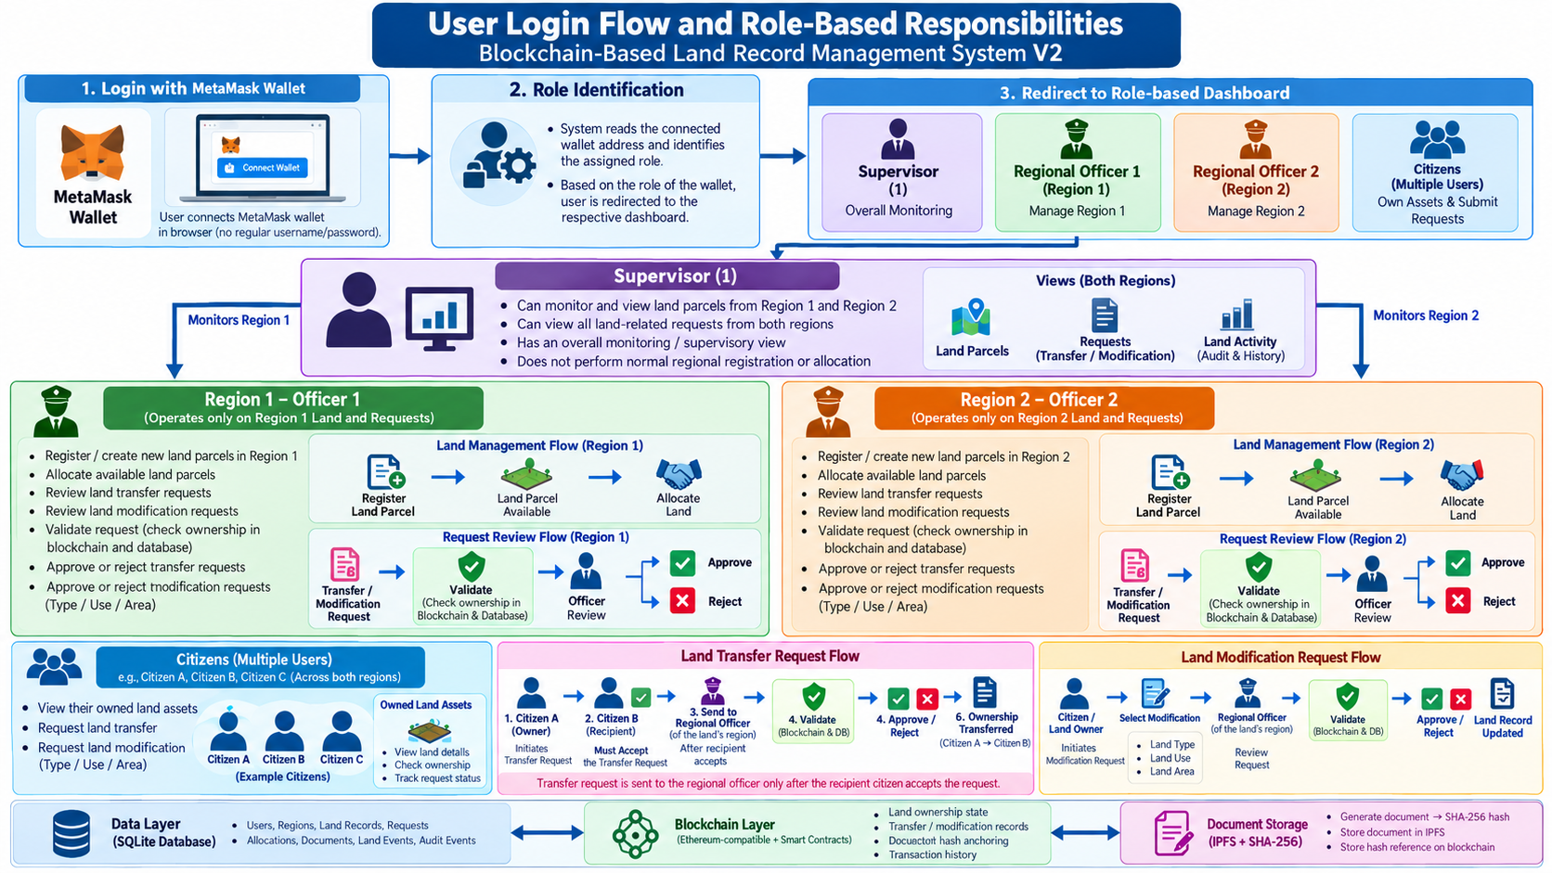
OVERALL SYSTEM WORKFLOW
Flowchart / UML Diagram

Slide 10
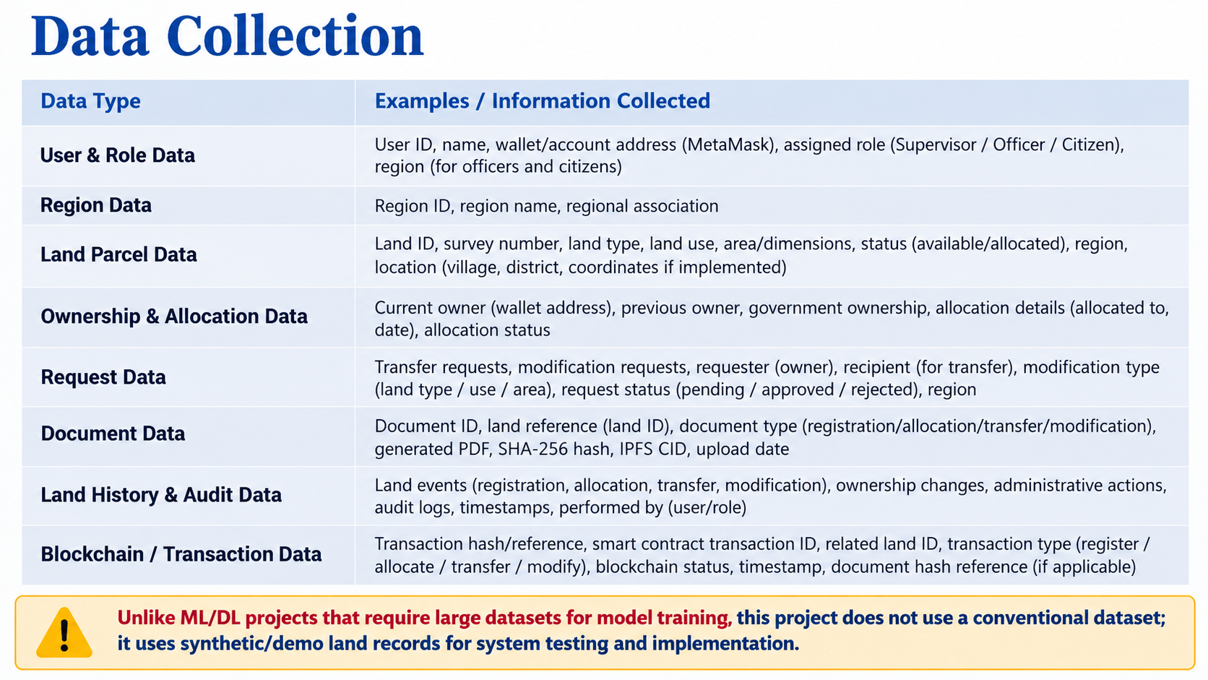

Slide 11
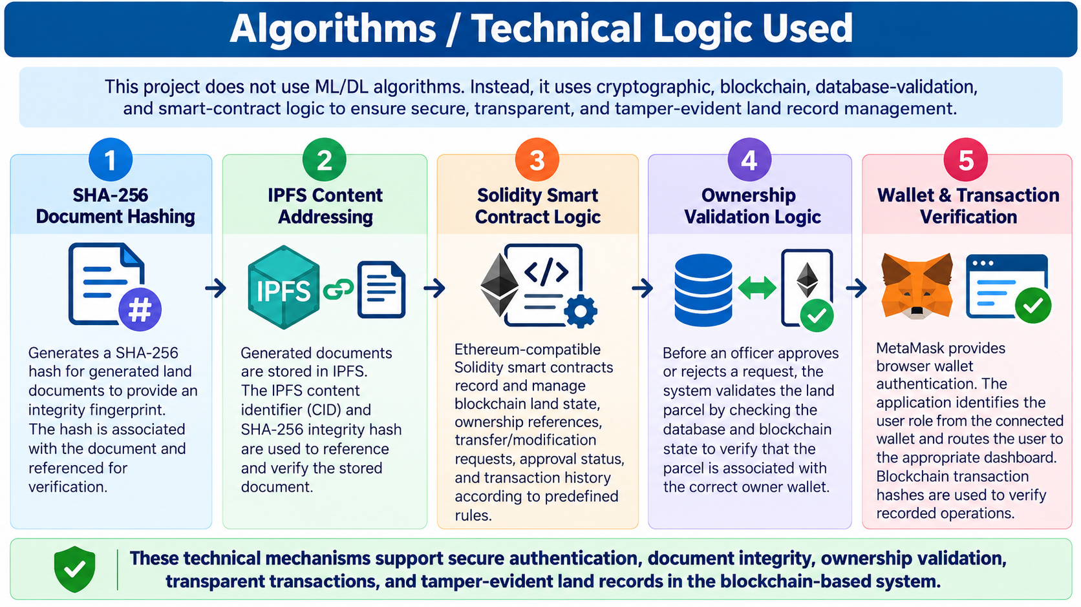

Slide 12
Thank you

