Slide 1

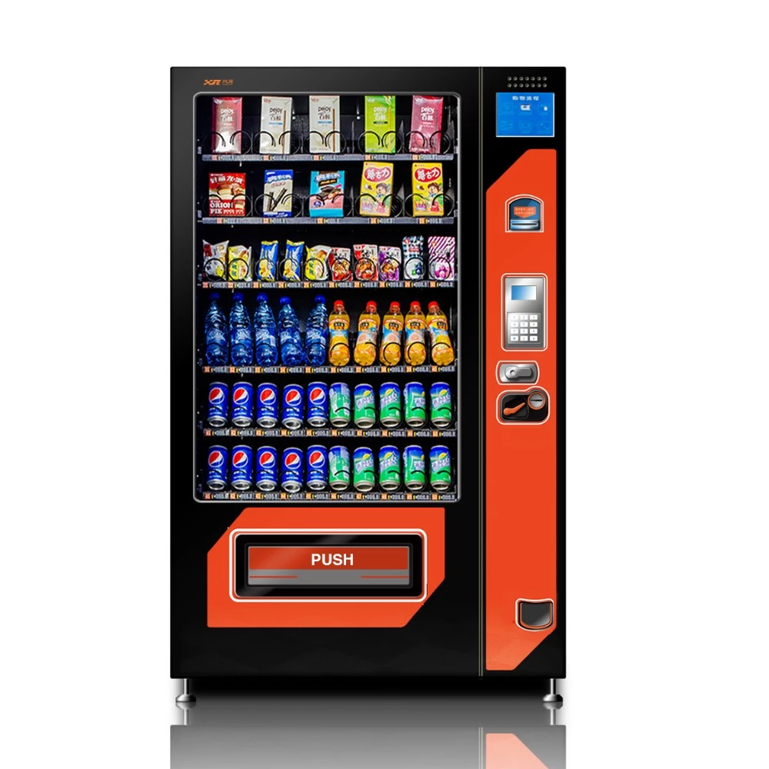
Circuit design with VHDL using Xilinx Vivado ® Design Suite UE19EC208AF
Project Report
Project title : Finite state Machine-Vending Machine
Group 5:
Gayathri Srinivasan:PES2UG19EC037
Ishita Aggarwal:PES2UG19EC047
Madhav Natarajan: PES2UG19EC064
Mansoora S:PES2UG19EC070

Slide 2
Introduction : Implementation a finite state machine(FSM) that describes the functionality of a vending machine:
Consider a vending machine that sells soda cans that costs 2$ each and there are 3 types of coins: 1$, 2$ and 5$.
Objective is to design a state machine that determines when to dispense a can, how to return the change.
In this design it is assumed that there will always be can in the vending machine. Only one action could be made in every “clock cycle” or state.
First the change is given back and then the can is dispensed.

Slide 3
Possibilities:
1) entering no money 2)putting 1$ followed by another 1$ => getting the can 3)putting 1$ followed by 2$ => receiving change => getting a can 4)putting 1$ followed by 5$ => receiving change => getting a can 5)putting 2$ and getting the can 6)putting 5$ => receiving change => getting a can.

Slide 4
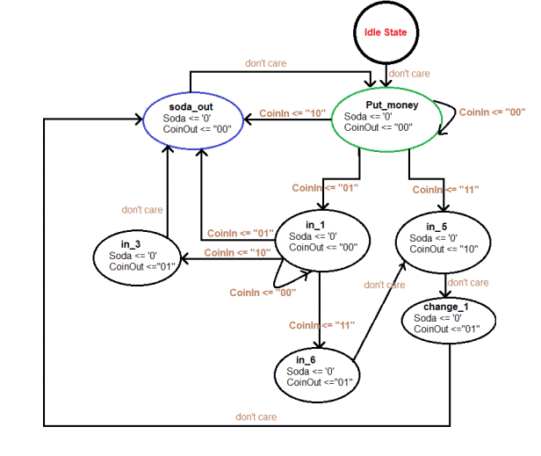
Flow Chart /FSM Diagram
NOTE
0$ = “00”,
1$ = “01”,
2$ = “10”,
5$ = “11”
‘1’
The “idle” state is the first state the machine gets into after its been “turned on”, also this is the state we “Reset” the machine into.
The FSM is a Moore machine, since the output relates to the current state.

Slide 5
States of the vending machine
put_money: This is the first state after ‘idle’, here the customer puts in the coins.
in_5: If the customer puts 5$, the machine moves to this state. The machine gives back a 2$ change without dispensing the can yet.
change_1: After giving a 2$ change for the customer who paid 5$, 1$ is given back as another change. It is to be noted that the can is not dispensed yet.
in_1, in_3, in_6: The machine goes to these states depending on the sum of money that has been inserted by the customer.
soda_out: The soda can is dispensed out.

Slide 6
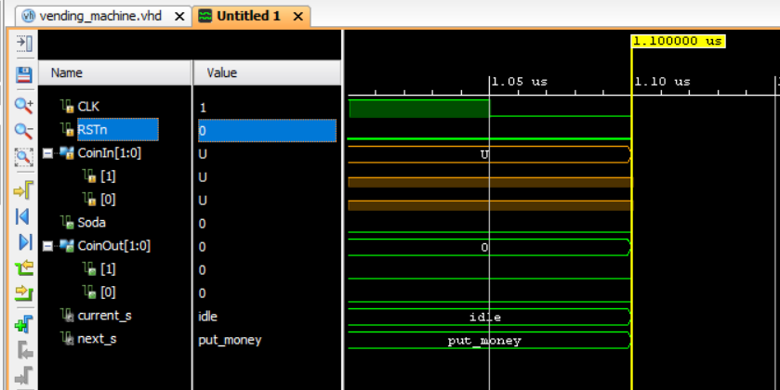
Initially, when
clk is forced with a clock pulse
RSTn =0
The vending machine remains in “idle” state, i.e , current_s = idle
next_s = put_money , because the vending machine requires money to be inserted for a soda can to be dispatched.

Slide 7
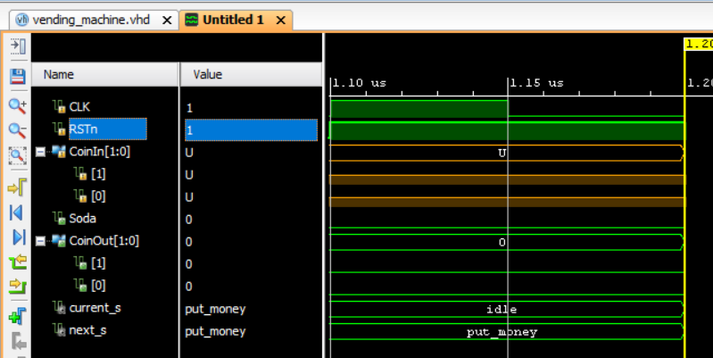
Here, in order to make the machine in the on/ working state,
we are making the RSTn=1

Slide 8
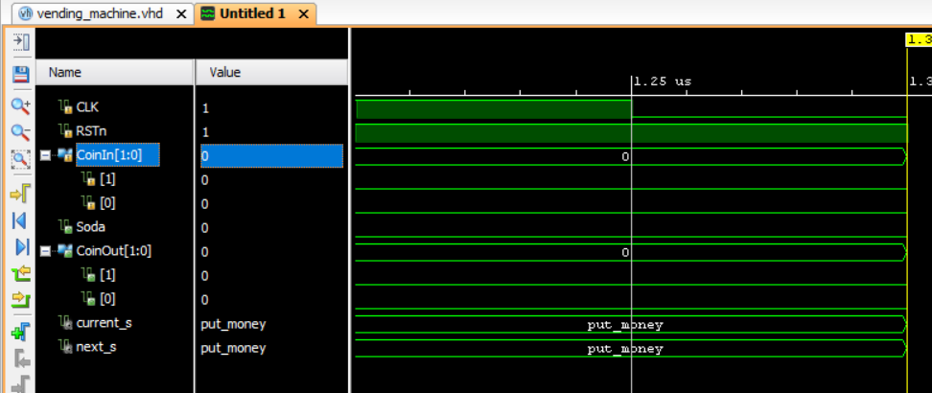
When, value of coin inserted is CoinIn = 00,
the current state of the machine becomes put_money as it requires money to be inserted for machine to vend a soda can.

Slide 9
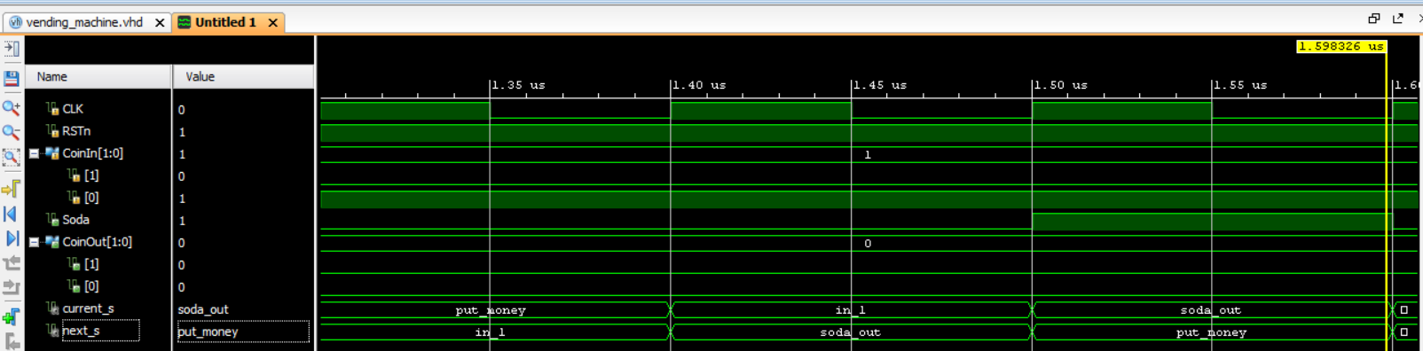
When, the value of CoinIn = 01 (equivalent to 1$),
(the current state) current_s = put_money ,
and (the next state) next_s =in_1, because minimum 2$ are required for a soda can to be dispatched.
When, one more coin of value 1$ is inserted, i.e, CoinIn = 01 again,
(the current state) current_s = in_1, since coin of 1$ is inserted.
(the next state) next_s = soda_out, since in the next state a soda can will be dispatched because the total amount of coins inserted is 2$ now.
Now the current state becomes soda_out and next state becomes put_money, as the vending machine is now ready to except coins for next transaction.

Slide 10
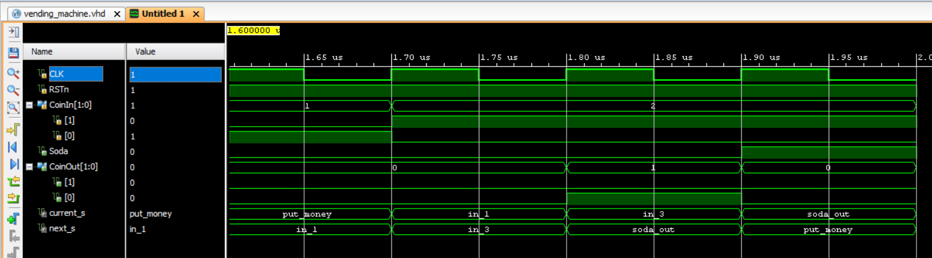
When, the value of CoinIn = 01 (equivalent to 1$),
(the current state) current_s = put_money ,
and (the next state) next_s =in_1, because minimum 2$ are required for a soda can to be dispatched.
When, one more coin of value 2$ is inserted, i.e, CoinIn = 10,
(the current state) current_s = in_1,
(the next state) next_s = in_3, since the machine is in a state where totally 3$ are inserted.
Now, current state become in_3 and a change of 1$ is returned in this case.
Now the current state becomes soda_out and next state becomes put_money, as the vending machine is now ready to except coins for next transaction.

Slide 11
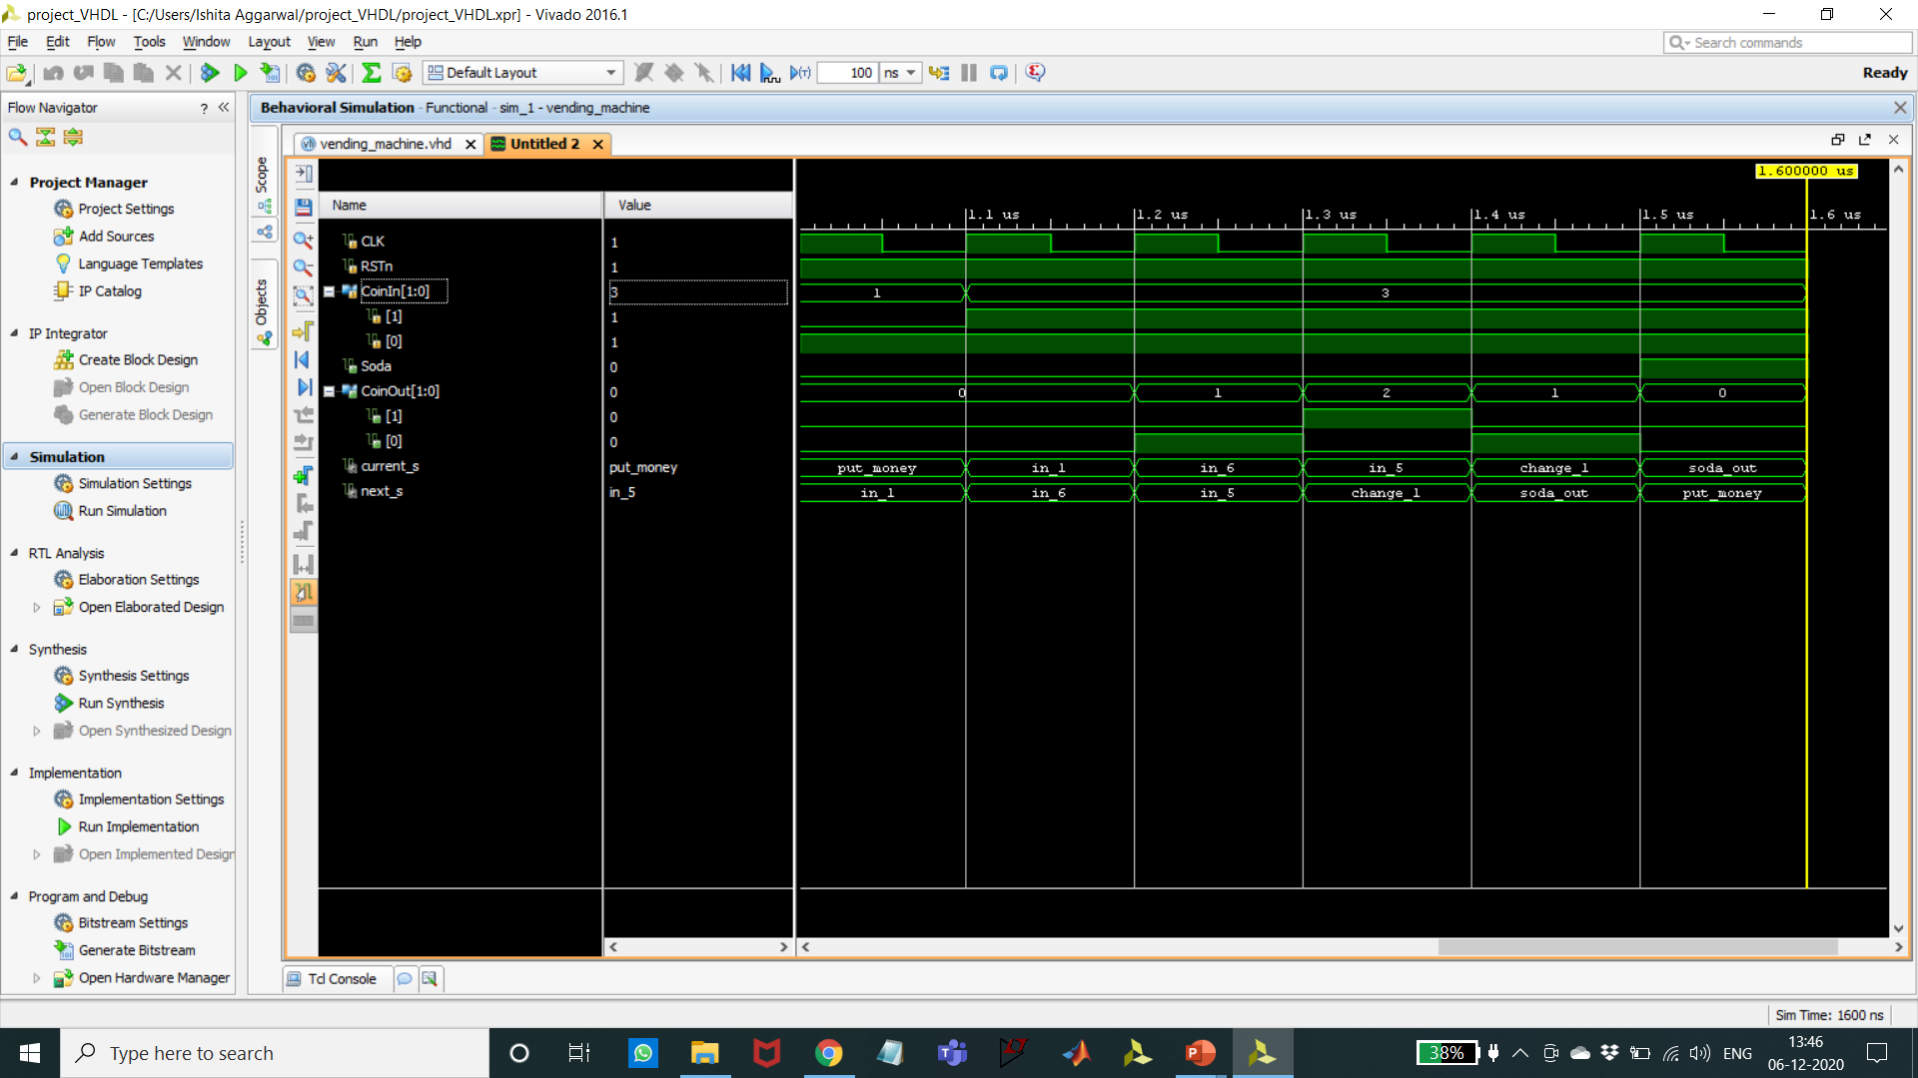
When, the value of CoinIn = 01 (equivalent to 1$),
the (the current state) current_s = put_money ,
and (the next state) next_s =in_1, because minimum 2$ are required for a soda can to be dispatched.
When, one more coin of value 5$ is inserted, i.e, CoinIn = 11,
(the current state) current_s = in_1,
(the next state) next_s = in_6, since the machine is in a state where totally 6$ are inserted.
Now, current state become in_6 and a change of 1$ is returned in this case.
Now, current state become in_5 and a change of 2$ is returned in this case.
Now, current state becomes change_1 and a change of 1$ is returned. (therefore, totally 4$ returned)
Now the current state becomes soda_out and next state becomes put_money, as the vending machine is now ready to except coins for next transaction.

Slide 12
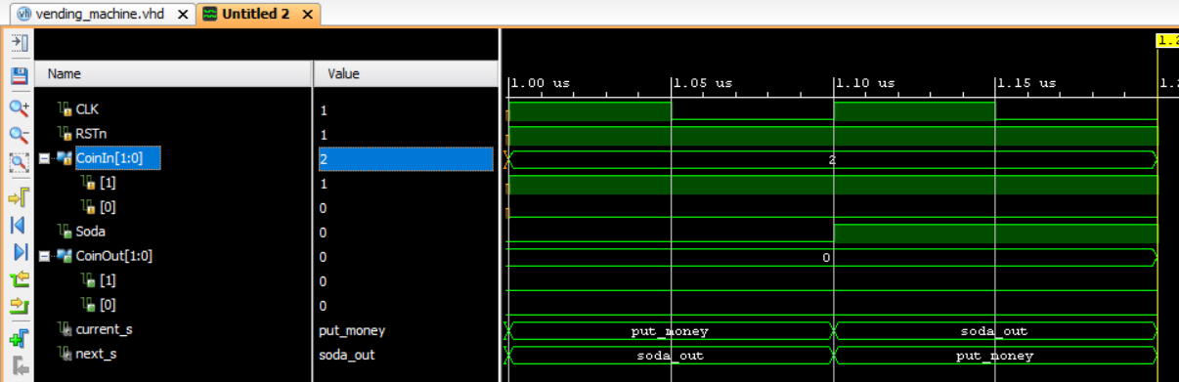
When, the value of CoinIn = 10 (equivalent to 2$),
(the current state) current_s = put_money ,
and (the next state) next_s =soda_out, because 2$ are required for a soda can to be dispatched.
Now the current state becomes soda_out and next state becomes put_money, as the vending machine is now ready to except coins for next transaction.

Slide 13
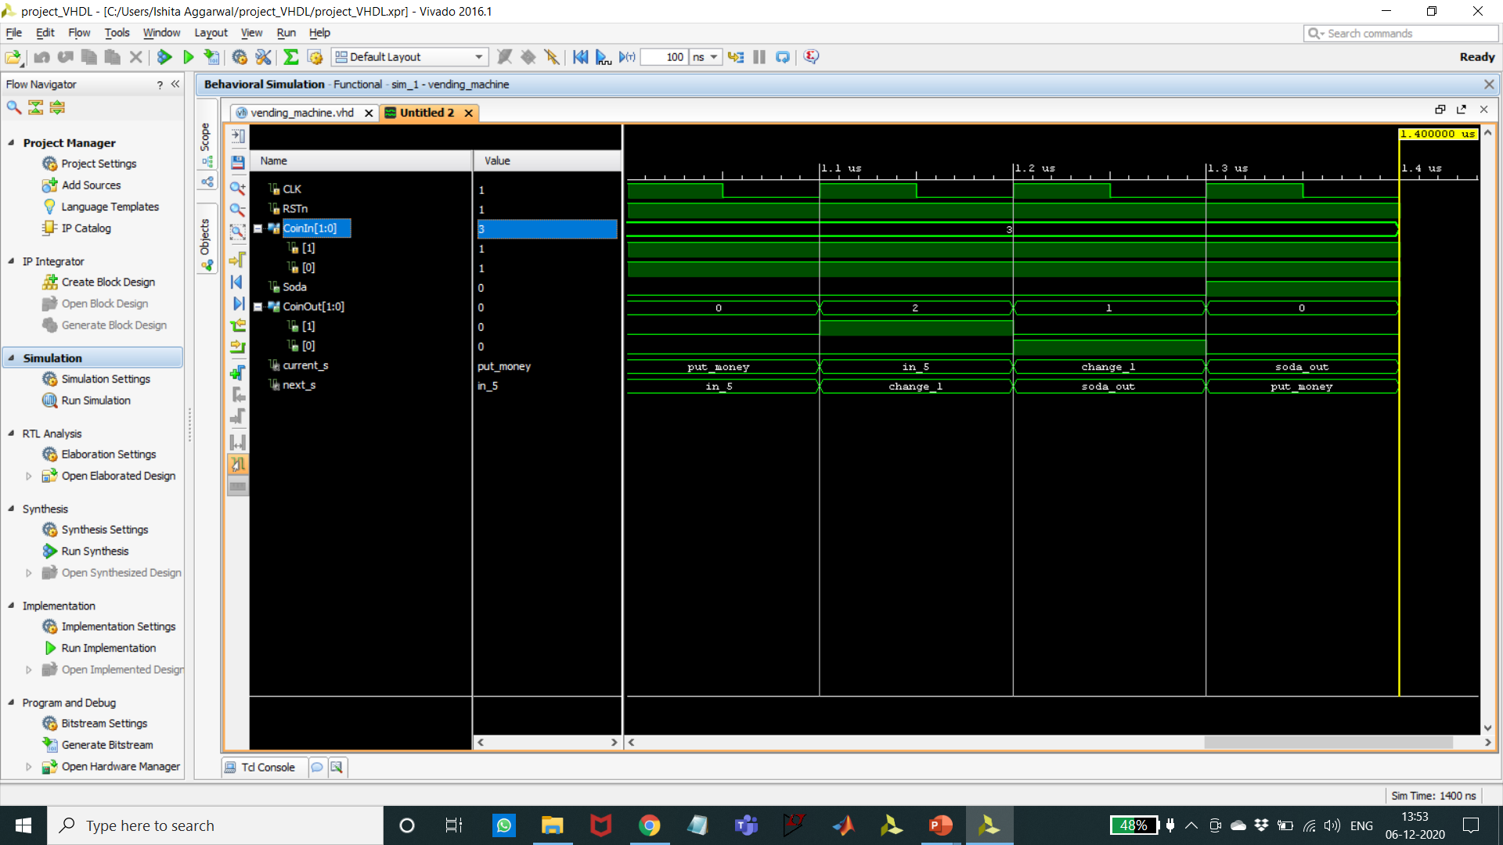
When, the value of CoinIn = 11 (equivalent to 5$),
(the current state) current_s = put_money ,
and (the next state) next_s =in_5
Then,
(the current state) current_s = in_5, and a change of 2$ is returned
Now, current state becomes change_1 and a change of 1$ is returned. (therefore, totally 3$ returned)
Now the current state becomes soda_out and next state becomes put_money, as the vending machine is now ready to except coins for next transaction.

Slide 14

This Photo by Unknown Author is licensed under CC BY-NC-ND

