Slide 1

.

Slide 2
JQUERY TRAVERSING

Slide 3
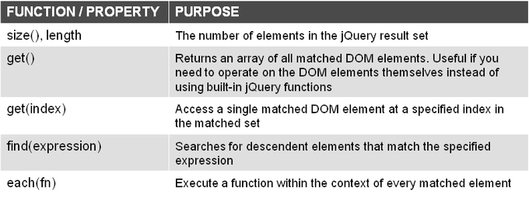
TRAVERSING DOCUMENT INFORMATION
You can traverse the information returned from a document easily.

Slide 4
TRAVERSING DOCUMENT INFORMATION EXAMPLE
<script type="text/javascript">
$("document").ready(function() {
// Inspect the length and size() of a result set
alert("There are " + $("p").length + " <p> elements");
// use the get() and get(index) to retrieve DOM elements
var elems = $("li").get();
alert("There are " + elems.length + " <li> tags");
alert($("li").get(0));
// use the find function
$("ul").find("li.b").css("border", "3px solid red");
// use the each function
var leftmargin = 0;
var border = 3;
$("p").each(function() {
$(this).css("border", border+"px solid red");
$(this).css("margin-left", leftmargin);
border += 2;
leftmargin += 10;
});
});
</script>

Slide 5
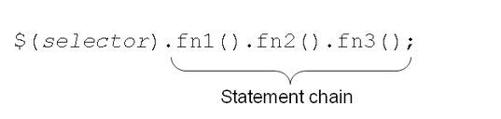
METHOD CHAINING
One of JQuery’s most powerful feature is its ability to chain multiple functions together to perform several operations in one line of code
Example
<script type="text/javascript">
$("#divTest2").text("Hello, world!").removeClass("blue").addClass("bold").css("color", "blue");
</script>

Slide 6
Working With Animation & Effects

Slide 7
OVERVIEW
jQuery library supplies basic animation and effects functions that perform common visual effects.
  Showing and hiding elements
  Fadding elements in and out
  Moving elements around on the screen
You can use the basic animation function to easily build your own animation effects.

Slide 8
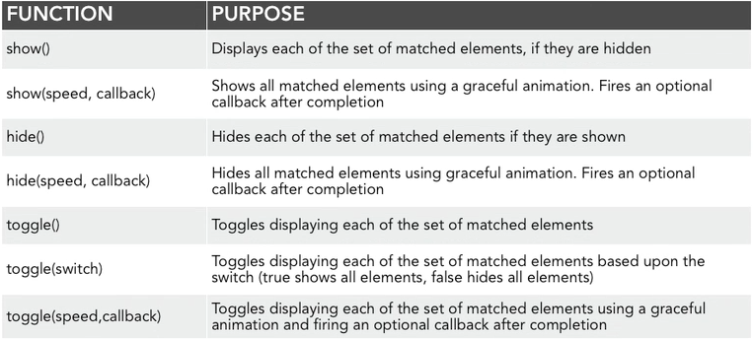
SHOWING AND HIDING PAGE ELEMENTS
Showing/hiding element is simple.
Elements can be shown or hidden immediately or over a specified duration of time

Slide 9
SHOWING AND HIDING EXAMPLE
$("#show").click(function() {
$("#theDiv").show("normal");
});
$("#hide").click(function() {
$("#theDiv").hide("normal");
});
$("#toggle").click(function() {
$("#theDiv").toggle("slow");
});

Slide 10
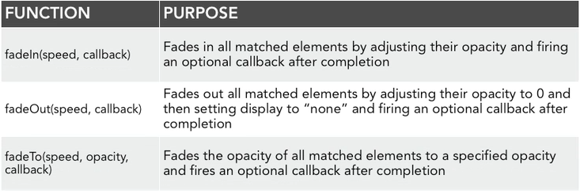
FADING ELEMENTS IN AND OUT
Elements can be faded in or out completely or to a predetermined opacity level.
The speed of the fade can be specified as either a string (“slow”, “noraml”, or “fast”) or a millisecond duration.

Slide 11
FADING ELEMENTS IN AND OUT EXAMPLE
$("#fadein").click(function() {
$("#theDiv").fadeIn("normal");
});
$("#fadeout").click(function() {
$("#theDiv").fadeOut("normal");
});
$("#fadeto3").click(function() {
$("#theDiv").fadeTo("slow", 0.3);
});
$("#fadeup").click(function() {
$("#theDiv").fadeTo("slow", 1.0);
});
$("div").click(function () {
$(this).fadeTo("fast", Math.random());

Slide 12
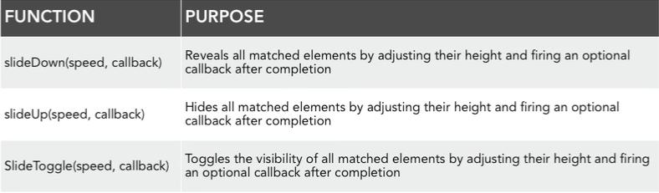
SLIDING PAGE ELEMENTS
The sliding effect is another way to reveal page element in jQuery.
jQuery provides functions for sliding elements up or down, as well as toggling the slide animation.

Slide 13
SLIDING PAGE ELEMENTS EXAMPLE
$("#slideup").click(function() {
$("#theDiv").slideUp("normal");
});
$("#slidedown").click(function() {
$("#theDiv").slideDown("normal");
});
$("#toggle").click(function() {
$("#theDiv").slideToggle("slow");
});

Slide 14
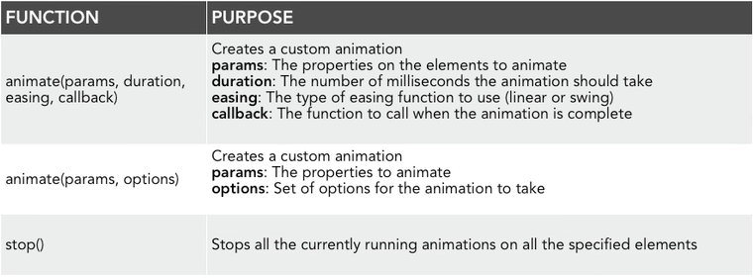
CREATING CUSTOM ANIMATION
To create custom animation for many properties on page elements, call the animate() function.
To stop animation in progress, call the stop() function.

Slide 15
CREATING CUSTOM ANIMATION
The property names must be camel-cased when used with the animate() method: You will need to write paddingLeft instead of padding-left, marginRight instead of margin-right, and so on. Only numeric values can be animated (like "margin:30px"). String values cannot be animated (like "background-color:red")

Slide 16
CREATING CUSTOM ANIMATION
Properties that can be animated:
backgroundPositionX textIndent
backgroundPositionY lineHeight
borderWidth wordSpacing
borderBottomWidth letterSpacing
borderLeftWidth top
borderRightWidth right
borderTopWidth left
borderSpacing bottom
margin fontSize
marginBottom minWidth
marginLeft minHeight
marginRight height
marginTop maxWidth
outlineWidth maxHeight
Padding width
paddingBottom paddingTop
paddingLeft
paddingRight

Slide 17
CUSTOM ANIMATION EXAMPLE
$("#right").click(function() {
$("#theDiv").animate({ width: "500px" }, 1000);
});
$("#text").click(function() {
$("#theDiv").animate({ fontSize: "24pt" }, 1000);
});
$("#toggle").click(function() {
$("#theDiv").animate({ height: "500px" }, 1000, "swing");
});

Slide 18
CUSTOM ANIMATION EXAMPLE (contd.)
<script>
/* Start animation */
$("#go").click(function(){
$(".block").animate({font-size: '100px'}, 2000);
});
/* Stop animation when button is clicked */
$("#stop").click(function(){
$(".block").stop();
});
/* Start animation in the opposite direction */
$("#back").click(function(){
$(".block").animate({font-size: '100px'}, 2000);
});
</script>

Slide 19
CUSTOM ANIMATION EXAMPLE (contd.)
<script src="https://ajax.googleapis.com/ajax/libs/jquery/3.2.1/jquery.min.js"></script>
<script>
$(document).ready(function(){
$("button").click(function(){
var div = $("div");
startAnimation();
function startAnimation(){
div.animate({height: 300}, "slow");
div.animate({width: 300}, "slow");
div.css("background-color", "blue");
div.animate({height: 100}, "slow");
div.animate({width: 100}, "slow", startAnimation);
}
});
});
</script>
</head>
<body>
<button>Start Animation</button>
<div style="width:50px;height:50px;position:absolute;left:10px;top:50px;background-color:red;"></div>
</body>

