Slide 1

Command Line Use of Pipes
Connect standard output of a command to standard input of another
Use the pipe operator, |
Syntax:
cmd1 | cmd2 | … | cmdN

Slide 2
Command Line Use of Pipes
cmd1 | cmd2 | … | cmdN
cmd1
pipe
cmd2
pipe
pipe
cmdN

Slide 3
Command Line Use of Pipes
cat /etc/passwd | grep zaheer
cat
Display Screen
pipe
grep

Slide 4
Without Using a Pipe
cat /etc/passwd | grep zaheer
$ cat /etc/passwd > temp1
$ grep “zaheer” temp1
$ rm temp1

Slide 5
Input, Output, Error Redirection
You can use the Linux redirection features to detach the default files from stdin, stdout, and stderr and attach other files with them.

Slide 6
Input Redirection
Input Redirection:
command < input-file
command 0< input-file
Purpose: Detach keyboard from stdin
and attach ‘input-file’ to it,
i.e., ‘command’ reads input
from ‘input-file’ and not
keyboard

Slide 7
Input Redirection
$ cat < Phones
[ contents of Phones ]
$ grep “Nauman” < Phones
[ output of grep ]
$
Notes:
Take input from the phone file
Grep commond search nauman as string from the contents of the phones file and display all those lines

Slide 8
Output Redirection
Output Redirection:
command > output-file
command 1> output-file
Purpose: Detach the display screen
from stdout and attach
‘output-file’ to it, i.e.,
‘command’ sends output to
‘output-file’ and not the
display screen
Notes:
command 1> output-file = bash, bourn corn shell

Slide 9
Output Redirection
$ cat > Phones
[ your input ]
<Ctrl-D> (end of file characher)
$ grep “Ali” Phones > Ali.phones
[ output of grep ]
$ find ~ -name foo -print > foo.log
[ error messages ]
$
Notes:
lIt take data from the keyboard in term of line and put these lines in phones filea and ctr-D tell that this end of file
Grep commond search ali in phone and put these in ali.phone
~ refer to usr home directory
Find look for file foo in all driectires including home and sub drictries and put these in foo.pog

Slide 10
Error Redirection
Error Redirection:
command 2> error-file
Purpose: Detach the display screen
from stderr and attach ‘error-
file’ to it, i.e., error messages
are sent to ‘error-file’ and not
the display screen

Slide 11
Error Redirection
$ find ~ -name foo -print 2> errors
[ output of the find command ]
$ ls -l foo 2> error.log
[ output of the find command ]
$ cat error.log
ls: foo: No such file or directory
$ find / -name ls -print 2> /dev/null
/bin/ls
$

Slide 12
UNIX/Linux FIFOs
IPC for communication between related or unrelated processes on a computer
P1
P2
FIFO
UNIX/Linux System

Slide 13
UNIX/Linux FIFOs
A file type in UNIX
Created with mknod() or mkfifo() system call or by mkfifo command

Slide 14
UNIX/Linux FIFOs
Unlike a pipe, a FIFO must be opened before using it for communication
A write to a FIFO that no process has opened for reading results in a SIGPIPE signal

Slide 15
UNIX/Linux FIFOs
When the last process to write to a FIFO closes it, an EOF is sent to the reader
Multiple processes can write to a FIFO ➔ atomic writes to prevent interleaving of multiple writes

Slide 16
UNIX/Linux FIFOs
Two common uses of FIFOs
  In client-server applications, FIFOs are used to pass data between a server process and client processes
  Used by shell commands to pass data from one shell pipeline to another, without creating temporary files

Slide 17
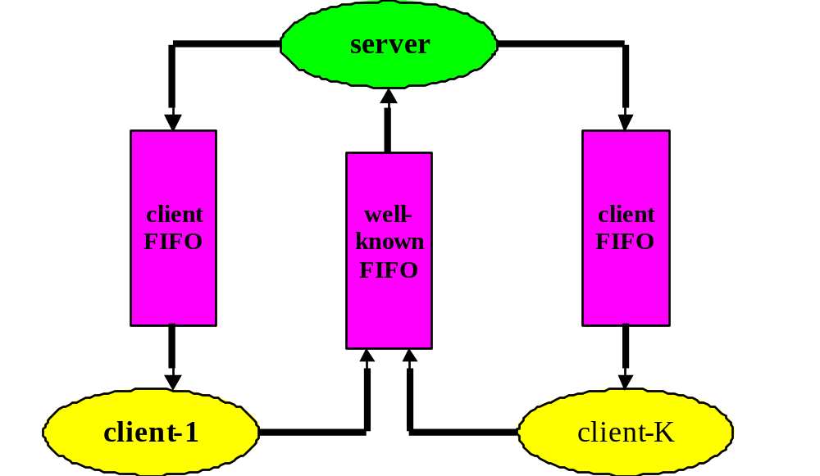
Client-Server Communication with FIFOs

Slide 18
Creating FIFOs
mknod system call
  Designed to create special (device) files
mkfifo Command
mkfifo C library call
  Invokes mknod system call

Slide 19
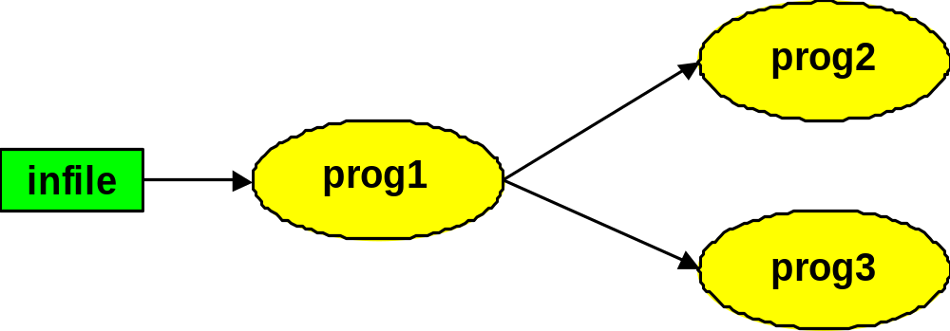
Command Line Use of FIFOs
$ mkfifo fifo1
$ prog3 < fifo1 &
$ prog1 < infile | tee fifo1 | prog2
[ Output ]
$

Slide 20
Command Line Use of FIFOs
$ man ls > ls.dat
$ cat < fifo1 | grep ls | wc -l &
[1] 21108
$ sort < ls.dat | tee fifo1 | wc -l
31
528
$
grep
wc -l
fifo1
Pipe
infile
sort
tee
Pipe
wc -l
Notes:
Wc display size of file, nuber of lines

