Slide 1

Thread Concept
A thread is a “lightweight” process which executes within the address space of a process.
A thread can be scheduled to run on a CPU as an independent unit and terminate.
Multiple threads can run simultaneously.

Slide 2
Thread Concept
Threads have their own
  Thread ID
  CPU context (PC, SP, register set, etc.)
  Stack
  Priority
  errno

Slide 3
Chapter 4: Threads
Overview
Multithreading Models
Threading Issues
Pthreads
Windows XP Threads
Linux Threads
Java Threads

Slide 4
Thread Concept
Threads share
  Code and data
  Open files (through the PPFDT)
  Current working directory
  User and group IDs
  Signal setups and handlers
  PCB

Slide 5

Single and Multithreaded Processes

Slide 6
Threads are Similar to Processes
A thread can be in states similar to a process (new, ready, running, blocked, terminated)
A thread can create another thread

Slide 7
Threads are Different from Processes
Multiple threads can operate within the same address space
No “automatic” protection mechanism is in place for threads—they are meant to help each other

Slide 8
Multiple clients programming
Client
socket
Server
Main
Thread
Serversocket
new
Thread
socket
Client
socket
new
Thread
socket
new
Thread
socket
Client
socket

Slide 9
Advantages of Threads
Responsiveness
  Multi-threaded servers (e.g., browsers) can allow interaction with user while a thread is formulating response to a previous user query (e.g., rendering a web page)

Slide 10
Advantages of Threads
Resource sharing
  Process resources (code, data, etc.)
  OS resources (PCB, PPFDT, etc.)

Slide 11
Advantages of Threads
Economy
  Take less time to create, schedule, and terminate
  Solaris 2: thread creation is 30 times faster than process creation and thread switching is five times faster than process switching

Slide 12
Advantages of Threads
Performance in multi-processor and multi-threaded architectures (e.g., Intel’s P4 HT)
  Multiple threads can run simultaneously

Slide 13
Disadvantages of Threads
Resource sharing— synchronization needed between threads
Difficult to write and debug multi-threaded programs

Slide 14
Single-Threaded Process
main()
{
…
f1(…);
…
f2(…);
…
}
f1(…)
{ … }
f2(…)
{ … }
Thread
f1
f2
Process Terminated

Slide 15
Multi-Threaded Process
main()
{
…
thread(t1,f1);
…
thread(t2,f2);
…
}
f1(…)
{ … }
f2(…)
{ … }
Process Address Space
main
t1
t2
PC
PC
PC

Slide 16
User Threads
Thread management done by user-level threads libraries
  Kernel not aware of threads
  CPU not interrupted during thread switching
  A system call by a thread blocks the whole process
  Fair scheduling: P1 has one thread and P2 has 100 threads

Slide 17
User Threads
Examples
  POSIX Pthreads
  Mach C-threads
  Solaris 2 threads

Slide 18
Kernel Threads
Thread management done by kernel
  Kernel aware of threads
  CPU switched during context switching
  A system call does not block the whole process
  Fair scheduling: P1 has one thread and P2 has 100

Slide 19
Kernel Threads
Examples
  Windows NT/2000
  Solaris 2
  Linux

Slide 20
Multithreading Models
Support for both user and kernel threads
Many-to-One: Many user threads per kernel thread; process blocks when a thread makes a system call
Solaris Green threads
Pthreads

Slide 21
Many-to-One Model
User–level Threads
Kernel–level Thread

Slide 22
Multithreading Models
One-to-One: One user thread per kernel thread; process does not block when a thread makes a system call
Overhead for creating a kernel thread per user thread
True concurrency achieved
Windows NT/2000, OS/2

Slide 23
One-to-One Model
P1
P2
User–level Threads
Kernel–level Threads

Slide 24
Multithreading Models
Many-to-Many: Multiple user threads multiplexed over a smaller or equal number of kernel threads
True concurrency not achieved because kernel can only schedule one thread at a time
Kernel can schedule another thread when a user thread makes a blocking system call
Solaris 2, HP-UX

Slide 25
Many-to-Many Model
P1
P2
P3
User–level Threads
Kernel–level Threads

Slide 26
Solaris 2 Threads Model
Solaris 2: threads, light-weight processes (LWPs), and processes
  At least one LWP per process to allow a user thread to talk to a kernel thread
  User level threads switched and scheduled among LWPs without kernel’s knowledge

Slide 27
Solaris 2 Threads Model
One kernel thread per LWP; some kernel threads have no LWP (e.g., threads for clock interrupt handler and scheduling)

Slide 28

Solaris 2 Threads Model

Slide 29
Pthreads
A POSIX standard (IEEE 1003.1c) API for thread creation, termination, and synchronization.
API specifies the behavior of the thread library, implementation is up to developers of the library.
Common in UNIX operating systems.

Slide 30
Creating a Thread
int pthread_create (pthread_t *threadp,
const pthread_attr_t *attr,
void* (*routine)(void *),
arg *arg);

Slide 31
Creating a Thread
Where:
threadp The thread we are trying to create—thread ID
(TID)
attr Used to modify the thread attributes (stack size,
stack address, detached, joinable,
priority, etc.)
routine The thread function
arg Any argument we want to pass to the thread
function. This does not have to be a simple
native type, it can be a ‘struct’ of whatever we
want to pass in.

Slide 32
Error Handling
pthread_create() fails and returns the corresponding value if any of the following conditions is detected:
  EAGAIN The system-imposed limit on the total number of threads in a process has been exceeded or some system resource has been exceeded (for example, too many LWPs were created).

Slide 33
Error Handling
EINVAL The value specified by attr is invalid.
ENOMEM Not enough memory was available to create the new thread.
Error handling:
  #include <errno.h>
  Error handling code

Slide 34
Joining a Thread
Waiting for a thread
int pthread_join(pthread_t aThread,
void **statusp);
‘statusp’ get return value of pthread_exit

Slide 35
Joining a Thread
Cannot join with a detached thread
Can only join with thread’s in the same process address space
Multiple threads can join with one thread but only one returns successfully; others return with an error that no thread could be found with the given TID

Slide 36
Terminating a Thread
Main thread terminates
Thread returns
void pthread_exit(void *valuep)
Returns value pointed to by ‘valuep’ to a joining thread, provided the exiting thread is not detached

Slide 37
Example 1
#include <stdio.h>
#include <stdlib.h>
#include <pthread.h>
/* Prototype for a function to be passed to our thread */
void* MyThreadFunc(void *arg);
int main()
{
pthread_t aThread;
/* Create a thread and have it run the MyThreadFunction */
pthread_create(&aThread, NULL, MyThreadFunc, NULL);
/* Parent waits for the aThread thread to exit */
pthread_join(aThread, NULL);
printf ("Exiting the main function.\n");
return 0;
}

Slide 38
Example 1
void* MyThreadFunc(void* arg)
{
printf ("Hello, world! ... The threaded version.\n");
return NULL;
}
$ gcc hello.c –o hello –lpthread –D_REENTRANT
$ hello
Hello, world! ... The threaded version.
Exiting the main function.
$

Slide 39
Example 2
#include <pthread.h>
#include <stdio.h>
#define NUM_THREADS 5
void *PrintHello(void *threadid)
{
printf("\n%d: Hello World!\n", threadid); pthread_exit(NULL);
}

Slide 40
Example 2
int main (int argc, char *argv[])
{
pthread_t threads[NUM_THREADS];
int rc, t;
for (t=0; t < NUM_THREADS; t++) {
printf("Creating thread %d\n", t);
rc = pthread_create(&threads[t], NULL, PrintHello, (void *)t);
if (rc) {
printf("ERROR; return code is %d\n", rc);
exit(-1);
}
}
pthread_exit(NULL);
}

Slide 41
Example 2
#include <pthread.h>
#include <stdio.h>
#define NUM_THREADS 5
void *PrintHello(void *threadid)
{
printf("\n%d: Hello World!\n", threadid); pthread_exit(NULL);
}

Slide 42
Example 2
int main (int argc, char *argv[])
{
pthread_t threads[NUM_THREADS];
int rc, t;
for (t=0; t < NUM_THREADS; t++) {
printf("Creating thread %d\n", t);
rc = pthread_create(&threads[t], NULL, PrintHello, (void *)t);
if (rc) {
printf("ERROR; return code is %d\n", rc);
exit(-1);
}
}
pthread_exit(NULL);
}

Slide 43
Threading Issues
Semantics of fork() and exec() system calls
Thread cancellation
Signal handling
Thread pools
Thread specific data
Scheduler activations

Slide 44
Semantics of fork() and exec()
Does fork() duplicate only the calling thread or all threads?
  Two versions of fork
    Duplicate all threads
    Duplicate only the threads that invokes fork
exec() system call?
  If a thread invokes the exec(), will replace the entire process-including all threads
Discus its different variations

Slide 45
Thread Cancellation
Terminating a thread before it has finished
Two general approaches:
  Asynchronous cancellation terminates the target thread immediately
  Deferred cancellation allows the target thread to periodically check if it should be cancelled
Difficulties with cancellation
  De-allocations of resources
  Updating

Slide 46
Signal Handling
Signals are used in UNIX systems to notify a process that a particular event has occurred
A signal handler is used to process signals
  Signal is generated by particular event
  Signal is delivered to a process
  Signal is handled
Options:
  Deliver the signal to the thread to which the signal applies
  Deliver the signal to every thread in the process
  Deliver the signal to certain threads in the process
  Assign a specific thread to receive all signals for the process

Slide 47
Thread Pools
Create a number of threads in a pool where they await work
Advantages:
  Usually slightly faster to service a request with an existing thread than create a new thread
  Allows the number of threads in the application(s) to be bound to the size of the pool

Slide 48
Thread Specific Data
Allows each thread to have its own copy of data
Useful when you do not have control over the thread creation process (i.e., when using a thread pool)

Slide 49
Scheduler Activations
Both M:M and Two-level models require communication to maintain the appropriate number of kernel threads allocated to the application
Scheduler activations provide upcalls - a communication mechanism from the kernel to the thread library
This communication allows an application to maintain the correct number kernel threads

Slide 50
Pthreads
A POSIX standard (IEEE 1003.1c) API for thread creation and synchronization
API specifies behavior of the thread library, implementation is up to development of the library
Common in UNIX operating systems (Solaris, Linux, Mac OS X)

Slide 51
Windows XP Threads
Implements the one-to-one mapping
Each thread contains
  A thread id
  Register set
  Separate user and kernel stacks
  Private data storage area
The register set, stacks, and private storage area are known as the context of the threads
The primary data structures of a thread include:
  ETHREAD (executive thread block)
  KTHREAD (kernel thread block)
  TEB (thread environment block)

Slide 52
Linux Threads
Linux refers to them as tasks rather than threads
Thread creation is done through clone() system call
clone() allows a child task to share the address space of the parent task (process)

Slide 53
Java Threads
Java threads are managed by the JVM
Java threads may be created by:
  Extending Thread class
  Implementing the Runnable interface

Slide 54
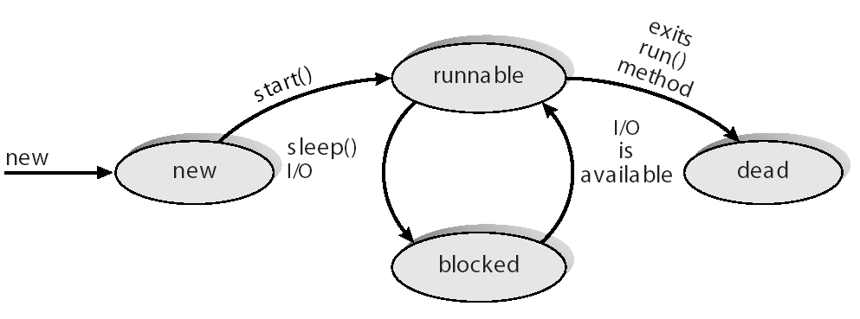
Java Thread States

