Slide 1
Operating Systems
Evolution of Operating Systems
A. Frank - P. Weisberg

Slide 2
Evolution of an Operating Systems?
Must adapt to hardware upgrades and new types of hardware. Examples:
  Character vs. graphic terminals
  Introduction of paging hardware
Must offer new services, e.g., internet support.
The need to change the OS on regular basis place requirements on it’s design:
  modular construction with clean interfaces.
  object oriented methodology.
A. Frank - P. Weisberg

Slide 3
Evolution of Operating Systems
Early Systems (1950)
Simple Batch Systems (1960)
Multiprogrammed Batch Systems (1970)
Time-Sharing and Real-Time Systems (1970)
Personal/Desktop Computers (1980)
Multiprocessor Systems (1980)
Networked/Distributed Systems (1980)
Web-based Systems (1990)
A. Frank - P. Weisberg

Slide 4


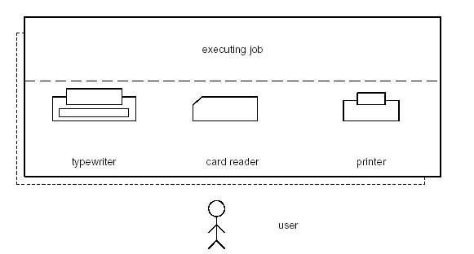
Early Systems
Structure
  Single user system.
  Programmer/User as operator (Open Shop).
  Large machines run from console.
  Paper Tape or Punched cards.
A. Frank - P. Weisberg

Slide 5
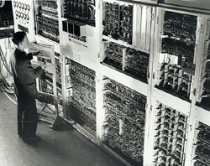
Example of an early computer system
A. Frank - P. Weisberg

Slide 6

Characteristics of Early Systems
Early software: Assemblers, Libraries of common subroutines (I/O, Floating-point), Device Drivers, Compilers, Linkers.
Need significant amount of setup time.
Extremely slow I/O devices.
Very low CPU utilization.
But computer was very secure.
A. Frank - P. Weisberg

Slide 7
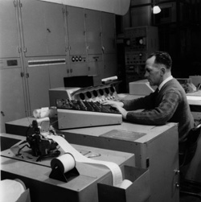
Simple Batch Systems
Use of high-level languages, magnetic tapes.
Jobs are batched together by type of languages.
An operator was hired to perform the repetitive tasks of loading jobs, starting the computer, and collecting the output (Operator-driven Shop).
It was not feasible for users to inspect memory or patch programs directly.
A. Frank - P. Weisberg

Slide 8
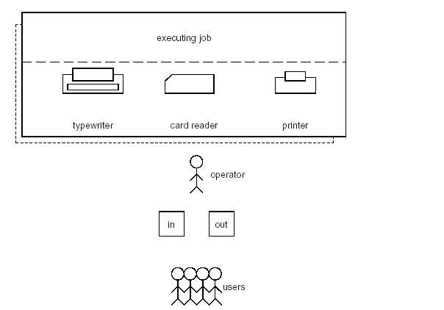
Operator-driven Shop
A. Frank - P. Weisberg

Slide 9
Operation of Simple Batch Systems
The user submits a job (written on cards or tape) to a computer operator.
The computer operator place a batch of several jobs on an input device.
A special program, the monitor, manages the execution of each program in the batch.
Monitor utilities are loaded when needed.
“Resident monitor” is always in main memory and available for execution.
A. Frank - P. Weisberg

Slide 10
Idea of Simple Batch Systems
Reduce setup time by batching similar jobs.
Alternate execution between user program and the monitor program.
Rely on available hardware to effectively alternate execution from various parts of memory.
Use Automatic Job Sequencing – automatically transfer control from one job when it finishes to another one.
A. Frank - P. Weisberg

Slide 11
Control Cards (1)
Problems:
  1. How does the monitor know about the nature of the job (e.g., Fortran versus Assembly) or which program to execute?
  2. How does the monitor distinguish:
  (a) job from job?
  (b) data from program?
Solution: Introduce Job Control Language (JCL) and control cards.
A. Frank - P. Weisberg

Slide 12

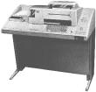
Control Cards (2)
Special cards that tell the monitor which programs to run:
$JOB
$FTN
$RUN
$DATA
$END
Special characters distinguish control cards from data or program cards:
$ in column 1
// in column 1 and 2
709 in column1
A. Frank - P. Weisberg

Slide 13
Job Control Language (JCL)
JCL is the language that provides instructions to the monitor:
  what compiler to use
  what data to use
Example of job format: ------->>
  $FTN loads the compiler and transfers control to it.
  $LOAD loads the object code (in place of compiler).
  $RUN transfers control to user program.
$JOB
$FTN
...
FORTRAN
program
...
$LOAD
$RUN
...
Data
...
$END
A. Frank - P. Weisberg

Slide 14
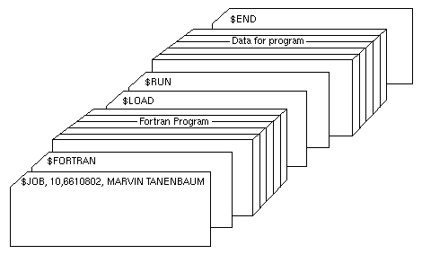
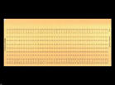

Example card deck of a Job
A. Frank - P. Weisberg

Slide 15
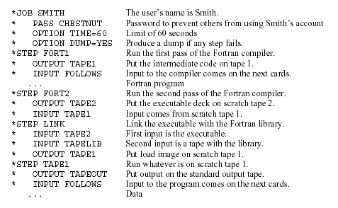
Another Job/Steps example
A. Frank - P. Weisberg

Slide 16
Effects of Job Control Language (JCL)
Each read instruction (in user program) causes one line of input to be read.
Causes (OS) input routine to be invoked:
  checks for not reading a JCL line.
  skip to the next JCL line at completion of user program.
A. Frank - P. Weisberg

Slide 17
Resident Monitor
Resident Monitor is first rudimentary OS.
Resident Monitor (Job Sequencer):
  initial control is in monitor.
  loads next program and transfers control to it.
  when job completes, the control transfers back to monitor.
  Automatically transfers control from one job to another, no idle time between programs.
A. Frank - P. Weisberg

Slide 18
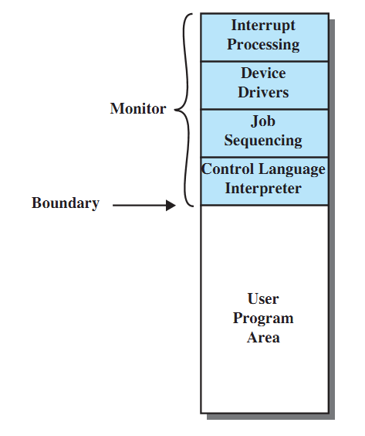
Resident Monitor Layout
A. Frank - P. Weisberg

Slide 19
Resident Monitor Parts
Parts of resident monitor:
  Control Language Interpreter – responsible for reading and carrying out instructions on the cards.
  Loader – loads systems programs and applications programs into memory.
  Device drivers – know special characteristics and properties for each of the system’s I/O devices.
A. Frank - P. Weisberg

Slide 20
Desirable Hardware Features
Memory protection
  do not allow the memory area containing the monitor to be altered by a user program.
Privileged instructions
  can be executed only by the resident monitor.
  A trap occurs if a program tries these instructions.
Interrupts
  provide flexibility for relinquishing control to and regaining control from user programs.
  Timer interrupts prevent a job from monopolizing the system.
A. Frank - P. Weisberg

Slide 21
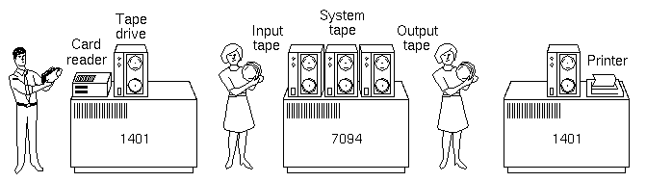
Offline Operation
Problem:
  Card Reader slow, Printer slow (compared to Tape).
  I/O and CPU could not overlap.
Solution: Offline Operation (Satellite Computers) –
speed up computation by loading jobs into memory from tapes while card reading and line printing is
done off-line using smaller machines.
A. Frank - P. Weisberg

Slide 22
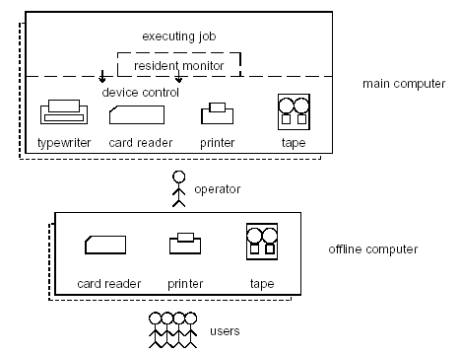
Main/Offline Computers
A. Frank - P. Weisberg

Slide 23
Spooling (1)
Problem:
  Card reader, Line printer and Tape drives slow (compared to Disk).
  I/O and CPU could not overlap.
Solution: Spooling -
  Overlap I/O of one job with the computation of another job (using double buffering, DMA, etc).
  Technique is called SPOOLing: Simultaneous Peripheral Operation On Line.
A. Frank - P. Weisberg

Slide 24
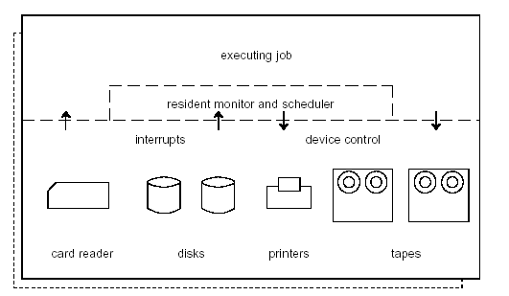
Spooling System Components
A. Frank - P. Weisberg

Slide 25
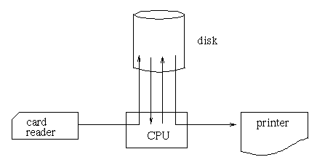
Spooling (2)
While executing one job, the OS:
  Reads next job from card reader into a storage area on the disk (Job pool).
  Outputs printout of previous job from disk to printer.
Job pool – data structure that allows the OS to select which job to run next in order to increase CPU utilization.
A. Frank - P. Weisberg

Slide 26
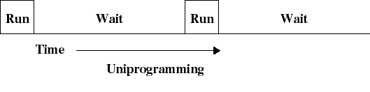
We assumed Uniprogramming until now
I/O operations are exceedingly slow (compared to instruction execution).
A program containing even a very small number of I/O operations, will spend most of its time waiting for them.
Hence: poor CPU usage when only one program is present in memory.
A. Frank - P. Weisberg

Slide 27

Memory Layout for Uniprogramming
A. Frank - P. Weisberg

Slide 28

Memory Layout for Batch Multiprogramming
Several jobs are kept in main memory at the same time, and the CPU is multiplexed among them.
A. Frank - P. Weisberg

Slide 29
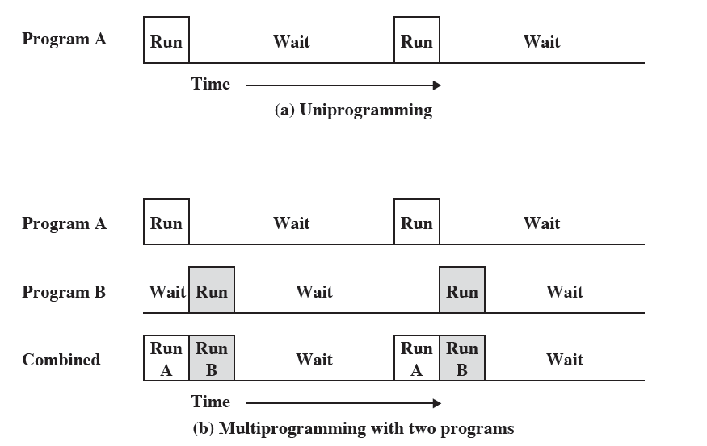
Multiprogramming (1)
A. Frank - P. Weisberg

Slide 30
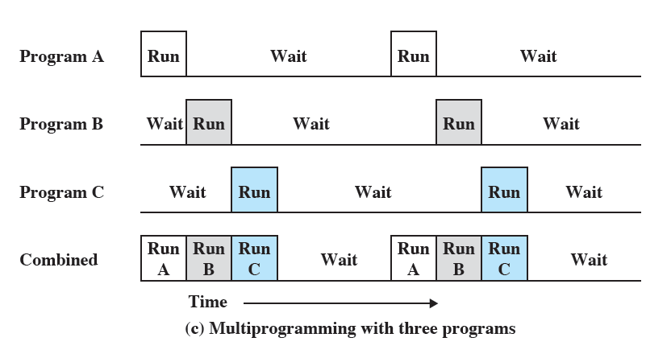
Multiprogramming (2)
A. Frank - P. Weisberg

Slide 31
Why Multiprogramming?
Multiprogramming (also known as Multitasking) needed for efficiency:
  Single user cannot keep CPU and I/O devices busy at all times.
  Multiprogramming organizes jobs (code and data) so CPU always has one to execute.
  A subset of total jobs in system is kept in memory.
  One job selected and run via job scheduling.
  When it has to wait (for I/O for example), OS switches to another job.
A. Frank - P. Weisberg

Slide 32
Example of Multiprogramming
p1
p2
p3
kernel
I/O
}
scheduler
I/O request
{
device driver
}
scheduler
Time slice exceeded
}
scheduler
Interrupt
{
device driver
}
scheduler
A. Frank - P. Weisberg

Slide 33
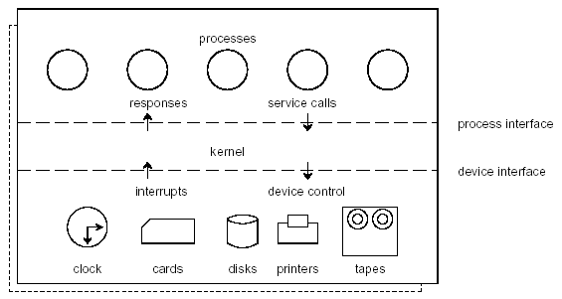
Components of Multiprogramming
A. Frank - P. Weisberg

Slide 34
Requirements for Multiprogramming
Hardware support:
  I/O interrupts and DMA controllers
    in order to execute instructions while I/O device is busy.
  Timer interrupts for CPU to gain control.
  Memory management
    several ready-to-run jobs must be kept in memory.
  Memory protection (data and programs).
Software support from the OS:
  For scheduling (which program is to be run next).
  To manage resource contention.
A. Frank - P. Weisberg

