Slide 1
Operating Systems
File-System Interface
A. Frank - P. Weisberg

Slide 2
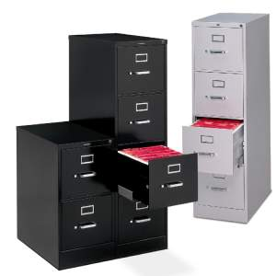
Contents
File Concept
Access Methods
Directory Structures
File System Mounting
File Sharing
Protection
A. Frank - P. Weisberg

Slide 3
File Concept
Contiguous logical address space.
Types:
  Data
    numeric
    character
    binary
  Program
Contents defined by file’s creator:
  Many types:
    Consider text file, source file, executable file

Slide 4
File Structure
None – sequence of words, bytes.
Simple record structure:
  Lines
  Fixed length
  Variable length
Complex Structures:
  Formatted document
  Relocatable load file
Can simulate last two with first method by inserting appropriate control characters.
Who decides:
  Operating system
  Program
A. Frank - P. Weisberg

Slide 5
Basic file attributes
Name – only information kept in human-readable form.
Identifier – unique tag (number) identifies file within system.
Type – needed for systems that support different types.
Location – pointer to file location on device.
Size – current file size.
Protection – controls who can do reading, writing, executing.
Time, date, and user identification – data for protection, security, and usage monitoring.
Information about files are kept in the directory structure,
which is maintained on the disk.
Many variations, including extended file attributes such as file checksum.
Information kept in the directory structure.
A. Frank - P. Weisberg

Slide 6
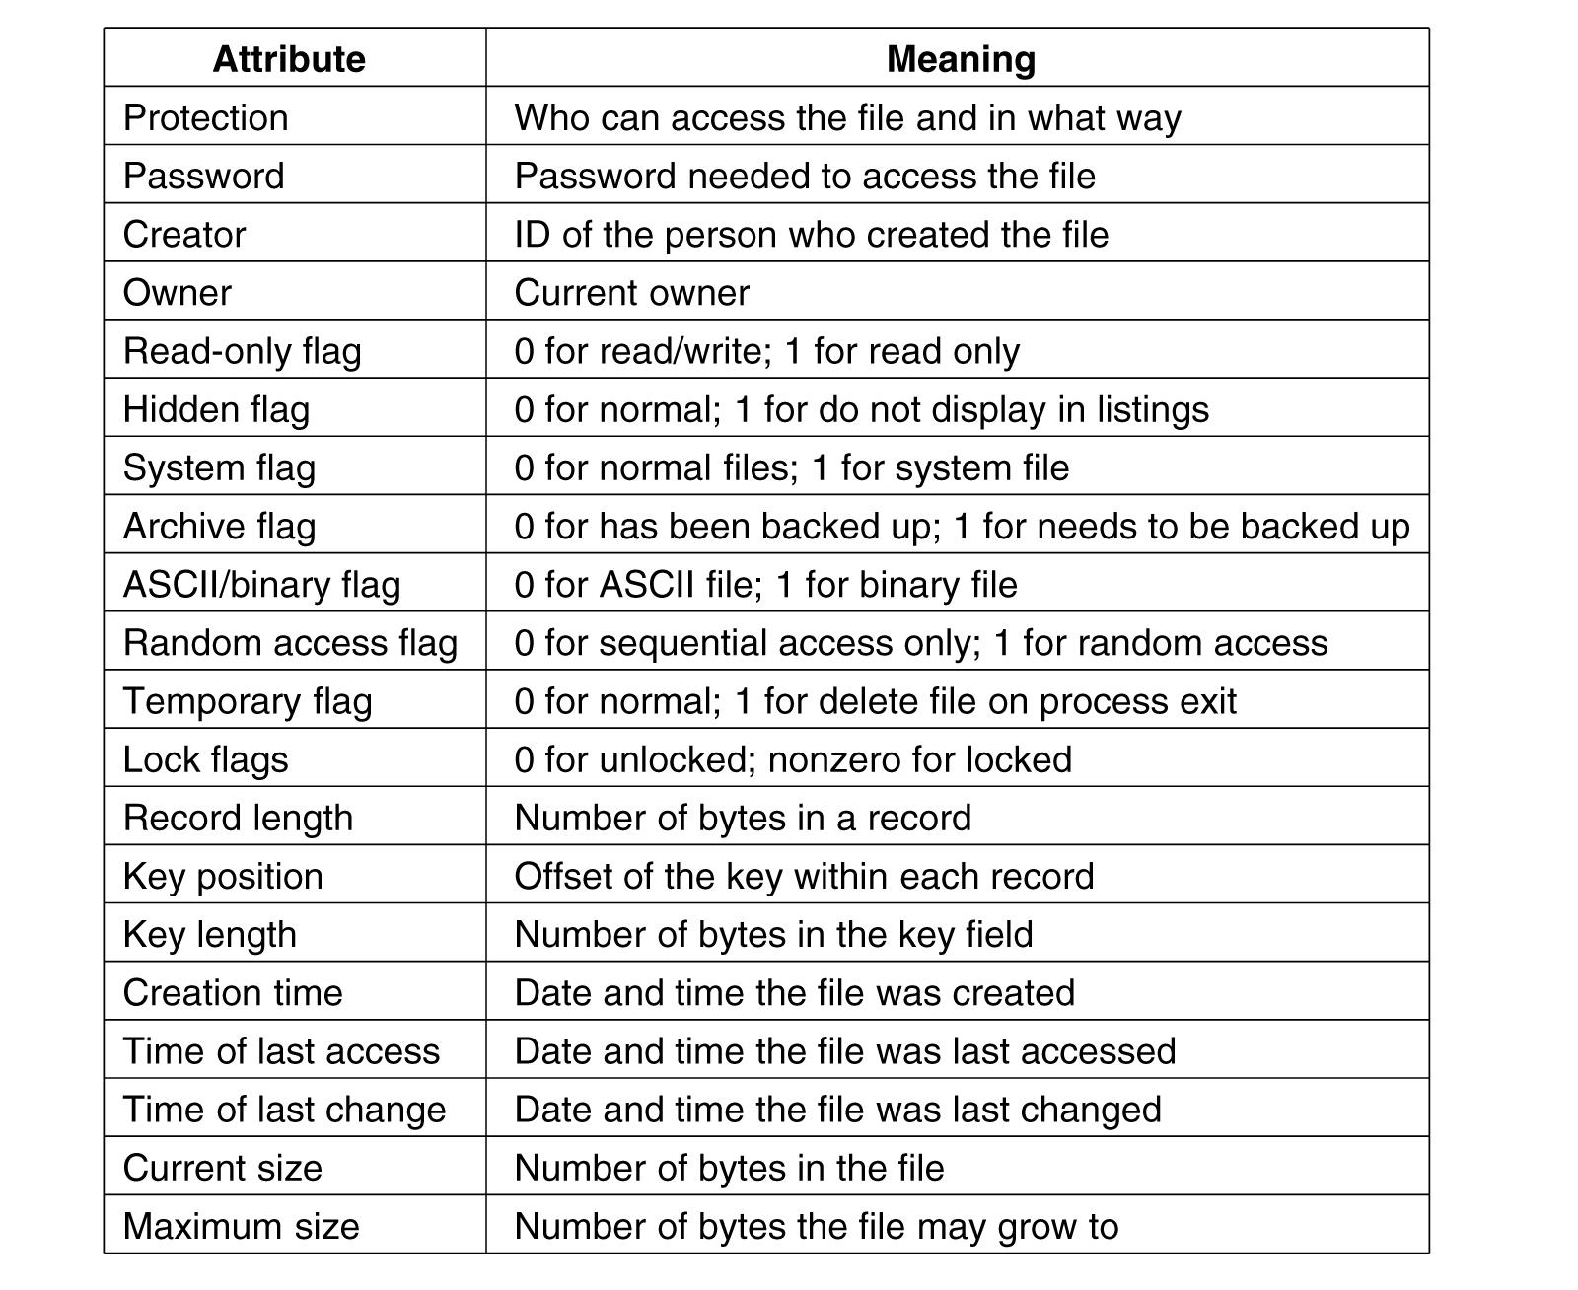
More file attributes
A. Frank - P. Weisberg

Slide 7
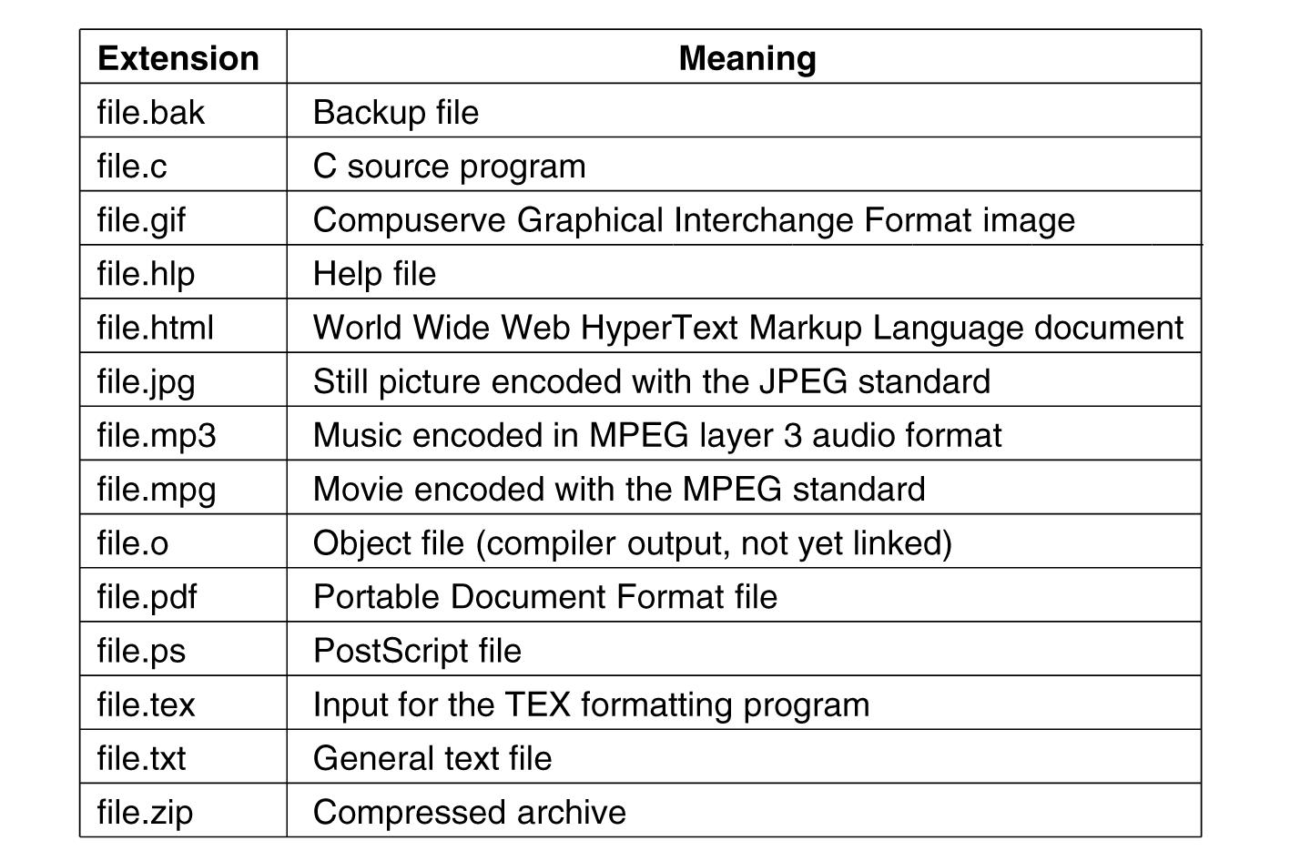
File Type Extensions (1)
A. Frank - P. Weisberg

Slide 8

File Type Extensions (2)
A. Frank - P. Weisberg

Slide 9
Common File Operations
Create
Read/Write – at read/write pointer location.
Seek: Reposition within file.
Delete
Append/Truncate
Set/Get Attributes
Open(F_{i}): search the directory structure on disk for entry F_{i}, and move the content of entry to memory.
Close (F_{i}): move the content of entry F_{i} in memory to directory structure on disk.
A. Frank - P. Weisberg

Slide 10
Open Files
Several pieces of data needed to manage open files:
  Open-file table: tracks open files.
  File pointer: pointer to last read/write location, per process that has the file open.
  File-open count: counter of number of times a file is open – to allow removal of data from open-file table when last processes closes it.
  Disk location of the file: cache of data access information.
  Access rights: per-process access mode information.
A. Frank - P. Weisberg

Slide 11
Access Methods
Sequential Access
read next
write next
reset
no read after last write
(rewrite)
Direct Access – file is fixed length logical records
read n
write n
position to n
read next
write next
rewrite n
n = relative block number
A. Frank - P. Weisberg

Slide 12


Sequential/Direct Access
A. Frank - P. Weisberg

Slide 13
Other Access Methods
Can be built on top of base methods.
General involve creation of an index for the file.
Keep index in memory for fast determination of location of data to be operated on (consider UPC code plus record of data about that item).
If too large, index (in memory) of the index (on disk).
IBM indexed sequential-access method (ISAM):
  Small master index, points to disk blocks of secondary index
  File kept sorted on a defined key
  All done by the OS.
VMS operating system provides index and relative files as another example (see next slide).

Slide 14

Example of Index and Relative Files
A. Frank - P. Weisberg

Slide 15
Disk Structure
Disk can be subdivided into partitions.
Disks or partitions can be RAID protected against failure.
Disk or partition can be used raw – without a file system, or formatted with a file system.
Partitions also known as minidisks, slices.
Entity containing file system known as a volume.
Each volume containing file system also tracks that file system’s info in device directory or volume table of contents.
As well as general-purpose file systems, there are many
special-purpose file systems, frequently all within the same operating system or computer.
A. Frank - P. Weisberg

Slide 16
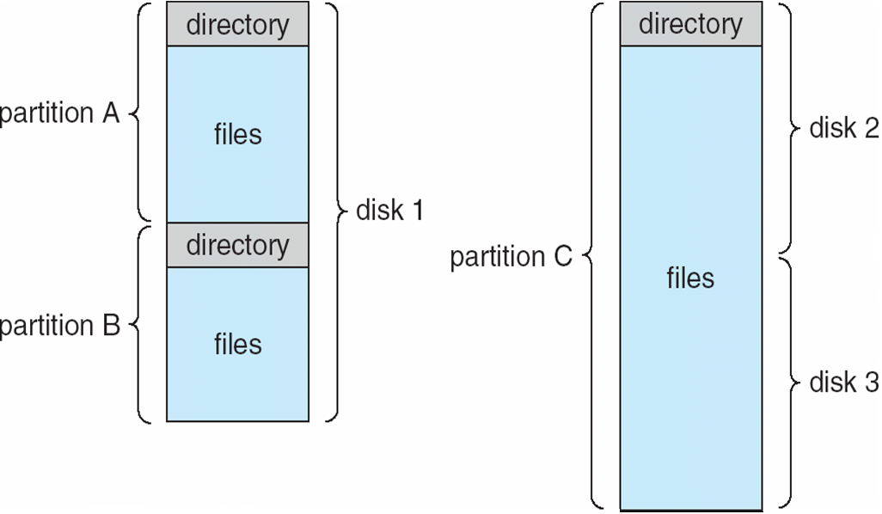
A Typical File-system Organization
A. Frank - P. Weisberg

Slide 17
Types of File Systems
We mostly talk of general-purpose file systems.
But systems frequently have may file systems, some general- and some special- purpose.
Consider Solaris has:
  tmpfs – memory-based volatile FS for fast, temporary I/O
  objfs – interface into kernel memory to get kernel symbols for debugging
  ctfs – contract file system for managing daemons
  lofs – loopback file system allows one FS to be accessed in place of another
  procfs – kernel interface to process structures
  ufs, zfs – general purpose file systems

Slide 18
Directory Structures
Collection of nodes containing information about all files.
Directory
Files
F 1
F 2
F 3
F 4
F n
Both the directory structure and the files reside on disk.
Backups of these two structures are kept on tapes.
A. Frank - P. Weisberg

Slide 19
Information in a Directory Entry
Name
Type
Address
Current length
Maximum length
Date last accessed (for archival)
Date last updated (for dump)
Owner ID (who pays)
Protection information
A. Frank - P. Weisberg

Slide 20
Directory Operations
Operations performed on a directory:
  Search for a file
  Create a file
  Delete a file
  List a directory
  Rename a file
  Traverse the file system
A. Frank - P. Weisberg

Slide 21
Directory Organization Characteristics
Organize the directory (logically) to obtain:
Efficiency – locating a file quickly.
Naming – convenient to users:
  Two users can have same name for different files.
  The same file can have several different names.
Grouping – logical grouping of files by properties, (e.g., all Java programs,
all games, …).
A. Frank - P. Weisberg

Slide 22

Single-Level Directory
A single directory for all users.
Common problems:
  Eventual length of directory.
  Giving unique names to files.
  Remembering names of files.
  Grouping of files (use file extensions).
A. Frank - P. Weisberg

Slide 23

Two-Level Directory
Separate directory for each user.
Use of path name.
Can have the same file name for different users.
Provides efficient searching.
No grouping capability.
Main problem: violates zero-one-infinity principle.
A. Frank - P. Weisberg

Slide 24
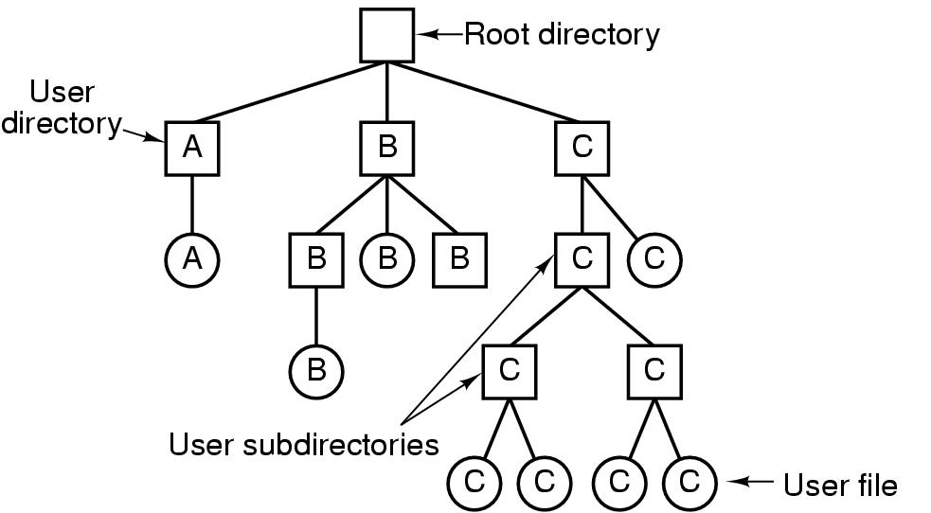
Tree-Structured Directory Components
A. Frank - P. Weisberg

Slide 25
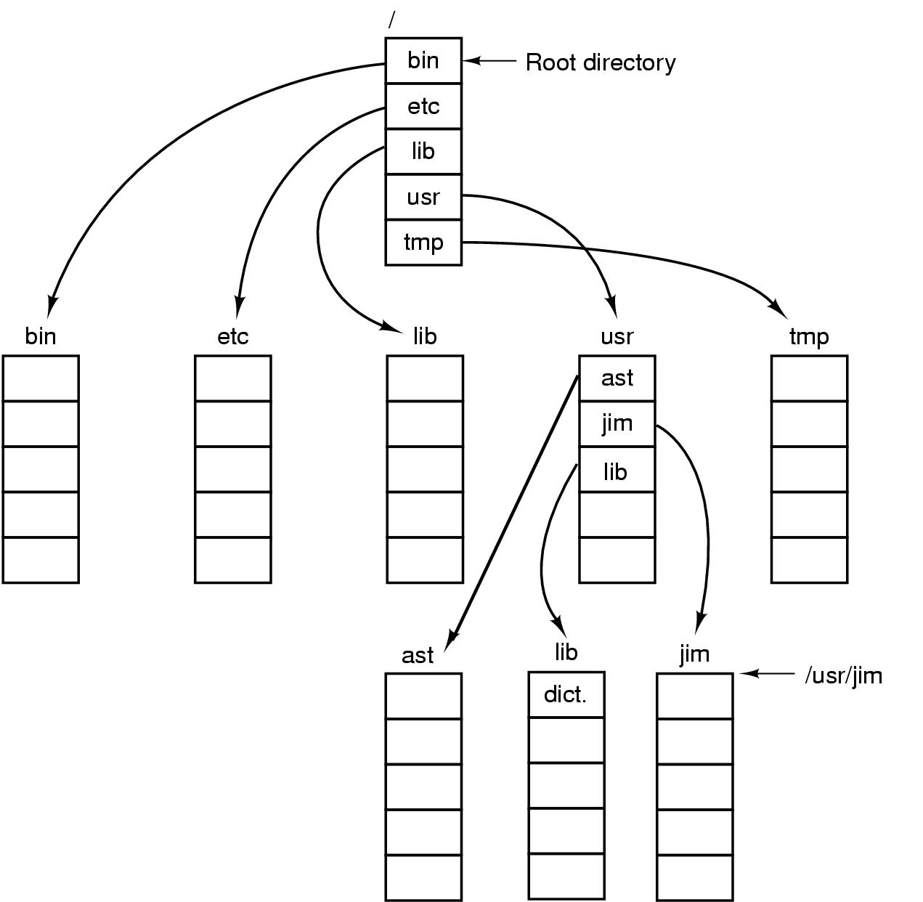
Directory Path Names
A. Frank - P. Weisberg

Slide 26

Tree-Structured Directory
A. Frank - P. Weisberg

Slide 27
Tree-Structured Directories (1)
Provides efficient searching.
Has grouping capability.
Current directory (working directory):
  cd /spell/mail/prog
  type list
Use absolute or relative path name.
A. Frank - P. Weisberg

Slide 28
Tree-Structured Directories (2)
Creating a new file is done in current directory.
Delete a file: rm <file-name>
Creating a new subdirectory is done in current directory: mkdir <dir-name>
Example: if in current directory /mail
mkdir count
Deleting “mail” ⇒ deleting the entire subtree rooted by “mail”.
mail
prog
copy
prt
exp
count
A. Frank - P. Weisberg

Slide 29

Directed Acyclic Graph (DAG) Directories
A. Frank - P. Weisberg

Slide 30
Directed Acyclic Graph Directories
Have shared subdirectories and files.
Entry may have two different names (aliasing).
If dict deletes list ⇒ dangling pointer – solutions:
  Backpointers, so we can delete all pointers.
  Variable size records a problem.
  Backpointers using a daisy chain organization.
  Entry-hold-count solution.
Newer type of directory entry:
  Link – another name (pointer) to an existing file
  Resolve the link – follow pointer to locate the file
A. Frank - P. Weisberg

Slide 31
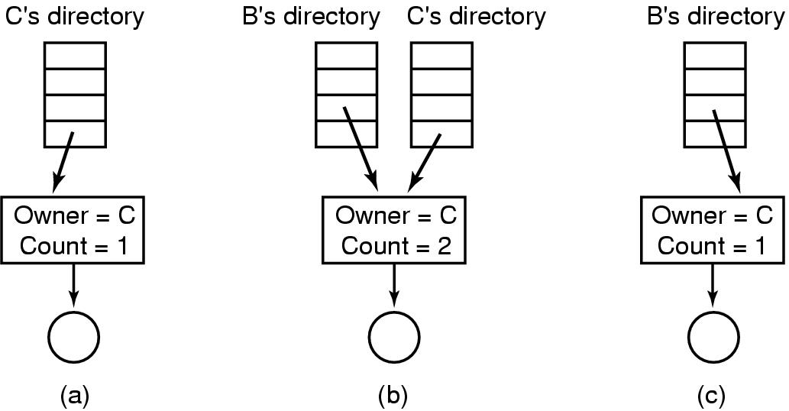
Shared File Example
Situation prior to linking. (b) After the link is created.
(c) After the original owner removes the file.
A. Frank - P. Weisberg

Slide 32
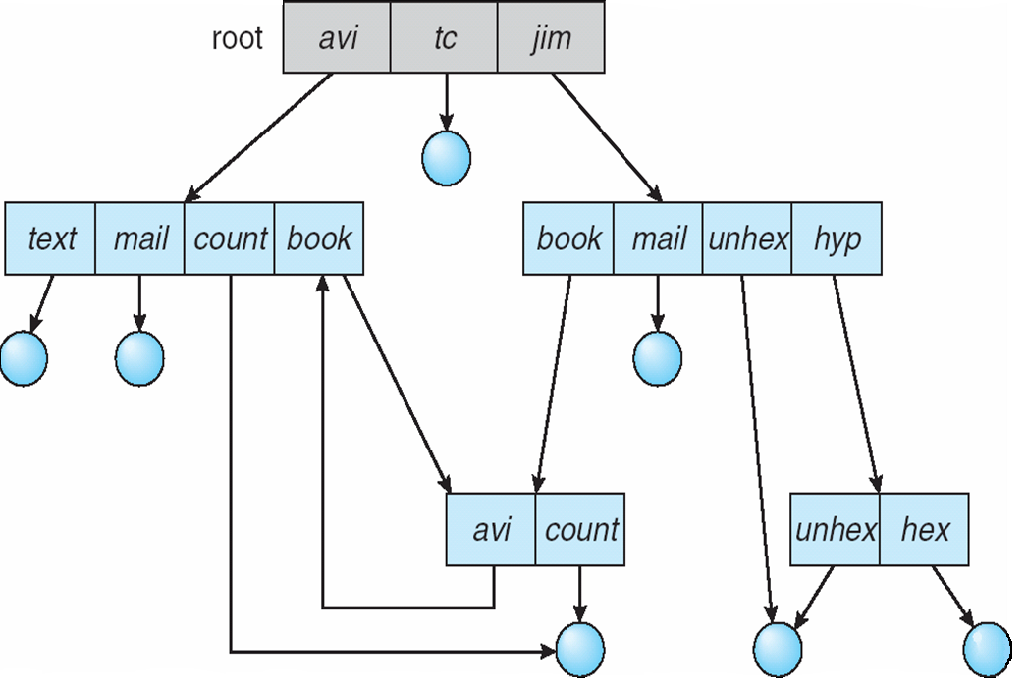
General Graph Directory
A. Frank - P. Weisberg

Slide 33
General Graph Directory
How do we guarantee no cycles?
  Allow only links to files, not subdirectories.
  Every time a new link is added use a cycle detection algorithm to determine whether
  it is OK.
  Use garbage collection.
A. Frank - P. Weisberg

Slide 34
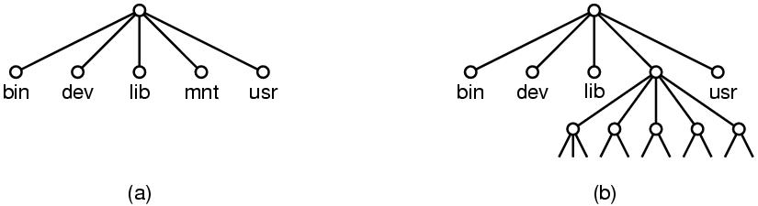
File System Mounting
A file system must be mounted before it can
be accessed.
A unmounted file system is mounted at a mount point.
A. Frank - P. Weisberg

Slide 35
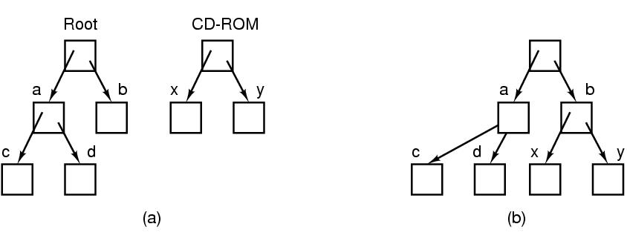
Example – File System Mounting
(a) Before mounting (b) Mounted system
A. Frank - P. Weisberg

Slide 36
File Sharing
Sharing of files on multi-user systems is desirable.
Sharing may be done through a protection scheme.
On distributed systems, files may be shared across a network.
Network File System (NFS) is a common distributed file-sharing method.
If multi-user system:
  User IDs identify users, allowing permissions and protections to be per-user.
  Group IDs allow users to be in groups, permitting group access rights.
  Owner/Group of a file/directory.
A. Frank - P. Weisberg

Slide 37
File Sharing – Remote File Systems
Uses networking to allow file system access between systems:
  Manually via programs like FTP.
  Automatically, seamlessly using distributed file systems.
  Semi automatically via the Web.
Client-server model allows clients to mount remote file systems from servers:
  Server can serve multiple clients.
  Client & user-on-client identification is insecure/complicated.
  NFS is standard UNIX client-server file sharing protocol.
  CIFS is standard Windows protocol.
  Standard operating system file calls are translated into
  remote calls.
  Distributed Information Systems (distributed naming services) such as LDAP, DNS, NIS, Active Directory implement unified access to information needed for remote computing.
A. Frank - P. Weisberg

Slide 38
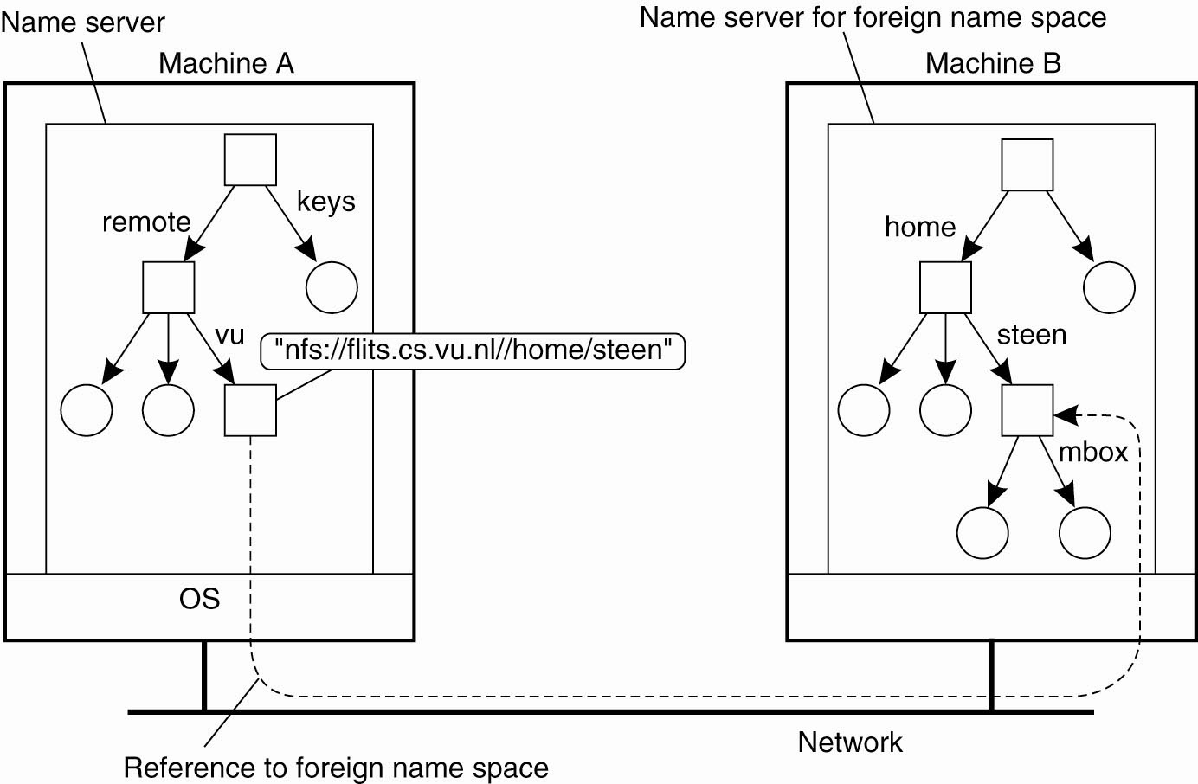
Mounting Remote Name Spaces
A. Frank - P. Weisberg

Slide 39
File Sharing – Failure Modes
All file systems have failure modes:
  For example corruption of directory structures or other non-user data, called metadata.
Remote file systems add new failure modes, due to network failure, server failure.
Recovery from failure can involve state information about status of each remote request.
Stateless protocols such as NFS v3 include all information in each request, allowing easy recovery but less security.
A. Frank - P. Weisberg

Slide 40
Protection
File owner/creator should be able to control:
  what can be done
  and by whom
Types of access:
  Read
  Write
  Execute
  Append
  Delete
  List
A. Frank - P. Weisberg

Slide 41
Access Lists and Groups
Mode of access: read, write, execute
Three classes of users: RWX
a) owner access 7 ⇒ 1 1 1
RWX
b) group access 6 ⇒ 1 1 0
RWX
c) public access 1 ⇒ 0 0 1
Ask manager to create a group (unique name), say G,
and add some users to the group.
For a particular file (say game) or subdirectory, define an appropriate access.
Attach a group to a file
owner
group
public
chmod
761
game
chgrp G game
A. Frank - P. Weisberg

Slide 42
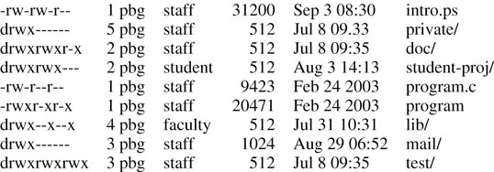
A Sample UNIX Directory Listing
A. Frank - P. Weisberg

Slide 43

Windows XP
Access-control List Management
A. Frank - P. Weisberg

