Slide 1
Operating Systems
File System
Implementation
A. Frank - P. Weisberg

Slide 2
File System Implementation
File-System Structure
File-System Implementation
Allocation Methods
Free-Space Management
Efficiency and Performance
Recovery
A. Frank - P. Weisberg

Slide 3
File-System Structure
File structure:
  Logical storage unit
  Collection of related information
File system resides on secondary storage (disks):
  Provided user interface to storage, mapping logical to physical.
  Provides efficient and convenient access to disk by allowing data to be stored, located retrieved easily.
Disk provides in-place rewrite and random access:
  I/O transfers performed in blocks of sectors (usually 512 bytes).
File control block – storage structure consisting of information about a file.
Device driver controls the physical device.
File system organized into layers.
A. Frank - P. Weisberg

Slide 4
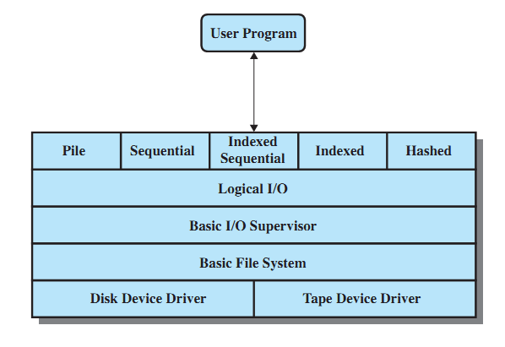
File System Software Architecture
A. Frank - P. Weisberg

Slide 5

A Typical File Control Block (FCB)
A. Frank - P. Weisberg

Slide 6

In-Memory File System Structures
(a) Opening a file
(b) Reading a file
A. Frank - P. Weisberg

Slide 7
Virtual File Systems
Virtual File Systems (VFS) provide an object-oriented way of implementing file systems.
VFS allows the same system call interface
(the API) to be used for different types of file systems.
The API is to the VFS interface, rather than
any specific type of file system.
A. Frank - P. Weisberg

Slide 8

Schematic View of Virtual File System
A. Frank - P. Weisberg

Slide 9
Allocation Methods
An allocation method refers to how disk blocks are allocated for files:
  Contiguous allocation
  Chained/Linked allocation
  Indexed allocation
  Combined schemes
A. Frank - P. Weisberg

Slide 10

Contiguous Allocation Example
(a) Contiguous allocation of disk space for 7 files.
(b) The state of the disk after files D and F have been removed.
A. Frank - P. Weisberg

Slide 11
Contiguous Allocation
Each file occupies a set of contiguous blocks on the disk.
Simple: only starting location (block #) and length (number of blocks) required.
Enables random access.
Wasteful of space (dynamic storage-allocation problem).
Files cannot grow.
A. Frank - P. Weisberg

Slide 12
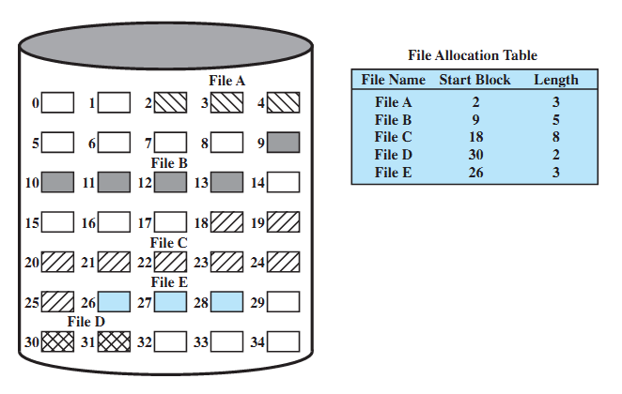
Contiguous File Allocation Example
A. Frank - P. Weisberg

Slide 13
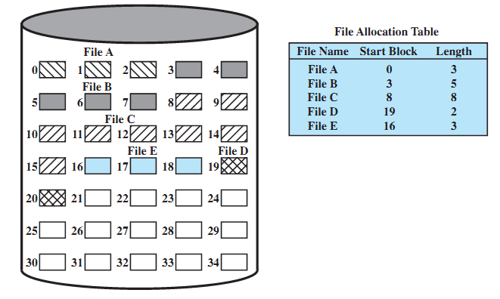
Contiguous file allocation (after compaction)
A. Frank - P. Weisberg

Slide 14
Extent-Based Systems
Many newer file systems (i.e., Veritas File System) use a modified contiguous allocation scheme.
Extent-based file systems allocate disk blocks in extents.
An extent is a contiguous block of disks:
  Extents are allocated for file allocation.
  A file consists of one or more extents.
A. Frank - P. Weisberg

Slide 15

Chained/Linked Allocation Example
A. Frank - P. Weisberg

Slide 16
Chained Allocation
Each file is a linked list of disk blocks: blocks may be scattered anywhere on the disk.
Simple: need only starting address.
Free-space management: no waste of space.
No random access.
block =
pointer
A. Frank - P. Weisberg

Slide 17
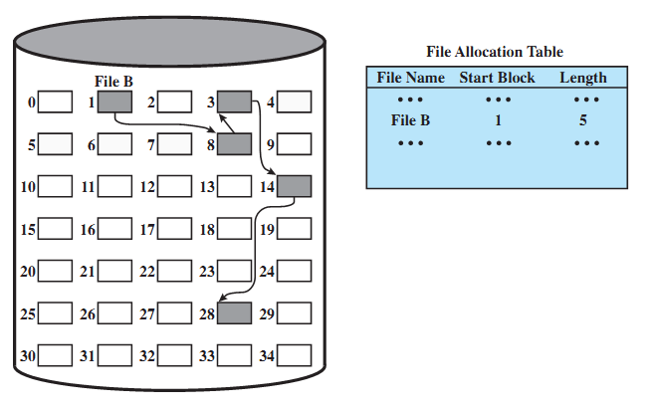
Chained File Allocation Example
A. Frank - P. Weisberg

Slide 18
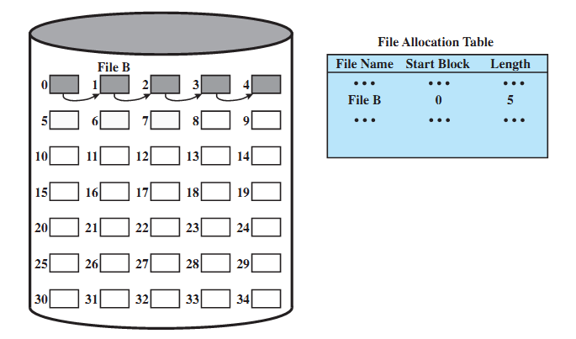
Chained File Allocation (after consolidation)
A. Frank - P. Weisberg

Slide 19

Another Chained Allocation Example
A. Frank - P. Weisberg

Slide 20
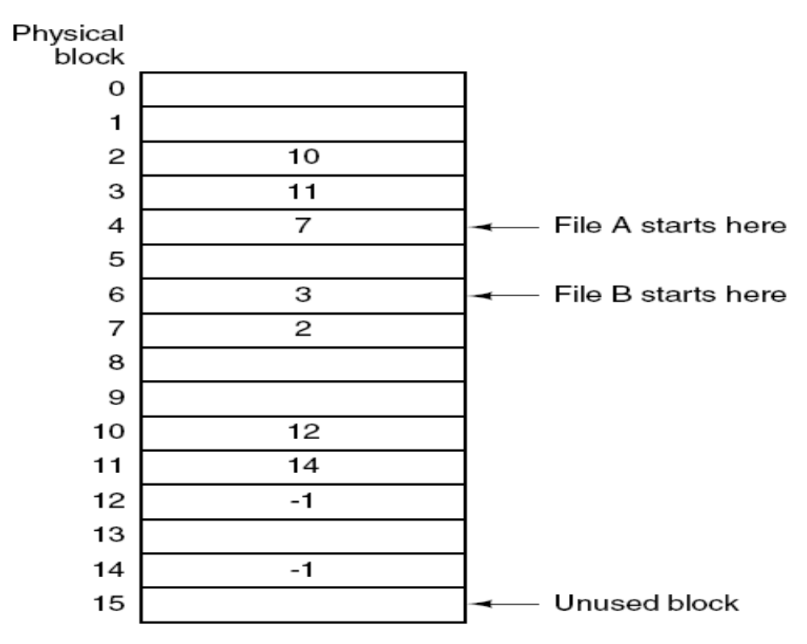
Linked List Allocation Using a Table in Memory
A. Frank - P. Weisberg

Slide 21

File-Allocation Table (FAT) Example
A. Frank - P. Weisberg

Slide 22
Indexed Allocation
Brings all pointers together into
the index block.
It’s a logical view.
Need index table.
Provides random access.
Dynamic access without external fragmentation, but have overhead of
index block.
index table
A. Frank - P. Weisberg

Slide 23
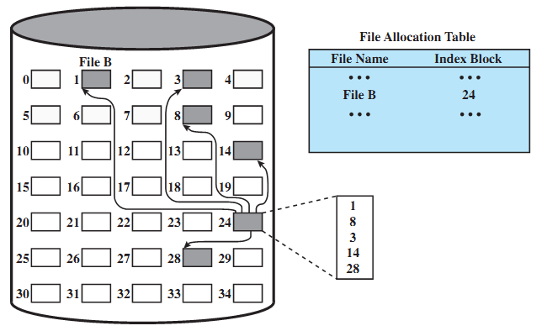
Indexed File Allocation Example
A. Frank - P. Weisberg

Slide 24
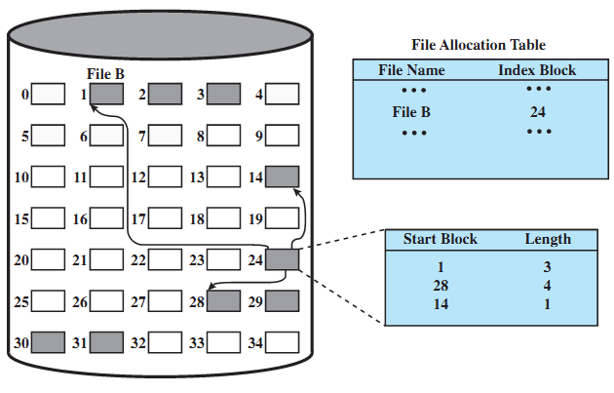
Indexed File Allocation (variable-size)
A. Frank - P. Weisberg

Slide 25
Indexed Allocation Mapping Example

outer-index
index table
file
A. Frank - P. Weisberg

Slide 26
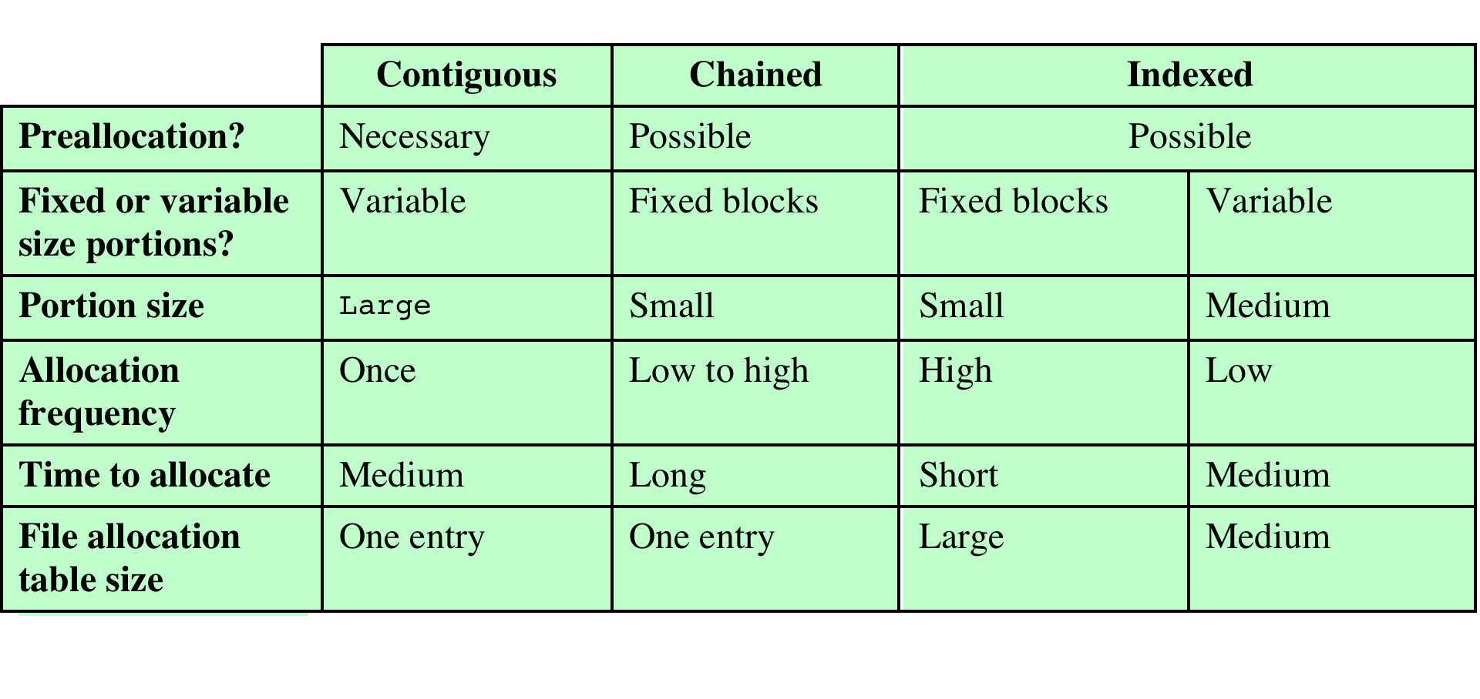
Comparison of file allocation methods
A. Frank - P. Weisberg

Slide 27

Combined Scheme: UNIX UFS (4K bytes per block)
A. Frank - P. Weisberg

Slide 28
Free-Space Management (1)
Bit vector (n blocks)
0
1
2
n-1
…
0 ⇒ block[i] free
1 ⇒ block[i] occupied
bit[i] =

Block number calculation
(number of bits per word) *
(number of 0-value words) +
offset of first 1 bit
A. Frank - P. Weisberg

Slide 29
Free-Space Management (2)
Bit map requires extra space. For example:
block size = 2¹² bytes
disk size = 2³⁰ bytes (1 gigabyte)
n = 2³⁰/2¹² = 2¹⁸ bits (or 32K bytes)
Easy to get contiguous files.
Linked list (free list):
  Cannot get contiguous space easily.
  No waste of space.
Grouping
Counting
A. Frank - P. Weisberg

Slide 30
Free-Space Management (3)
Need to protect:
  Pointer to free list.
  Bit map:
    Must be kept on disk.
    Copy in memory and disk may differ.
    Cannot allow for block[i] to have a situation where
    bit[i] = 1 in memory and bit[i] = 0 on disk.
  Solution:
    Set bit[i] = 1 in disk.
    Allocate block[i].
    Set bit[i] = 1 in memory.
A. Frank - P. Weisberg

Slide 31
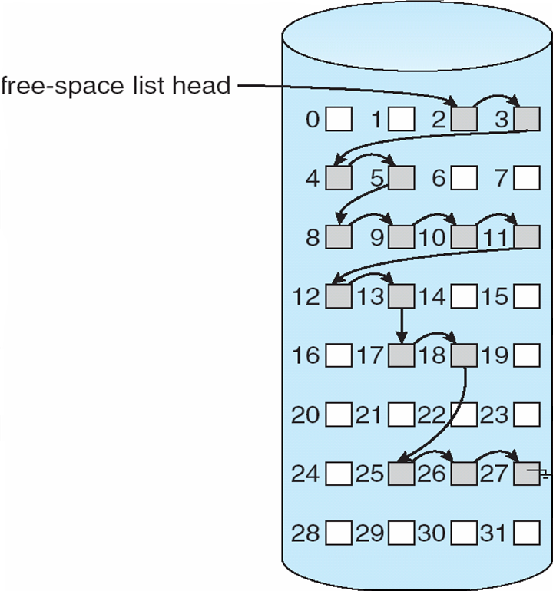
Linked Free Space List on Disk
A. Frank - P. Weisberg

Slide 32
Directory Implementation
Linear list of file names with pointer to the data blocks:
  simple to program
  time-consuming to execute
Hash Table – linear list with hash data structure:
  decreases directory search time
  collisions – situations where two file names hash to the same location
  fixed size
A. Frank - P. Weisberg

Slide 33
Efficiency and Performance
Efficiency dependent on:
  Disk allocation and directory algorithms.
  Types of data kept in file’s directory entry.
Performance:
  Disk cache: separate section of main memory for frequently used blocks.
  Free-behind and read-ahead: techniques to optimize sequential access.
  Improve PC performance by dedicating section of memory as virtual disk or RAM disk.
A. Frank - P. Weisberg

Slide 34
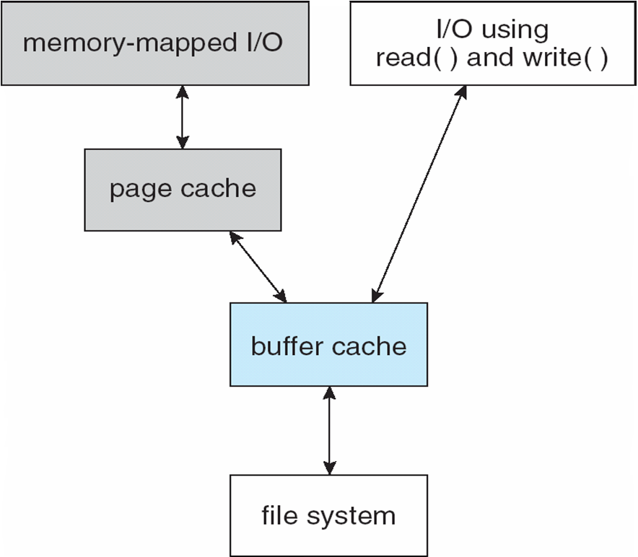
Page Cache
A page cache caches pages rather than disk blocks using virtual memory techniques.
Memory-mapped I/O
uses a page cache.
Routine I/O through
the file system uses the buffer (disk) cache.
A. Frank - P. Weisberg

Slide 35
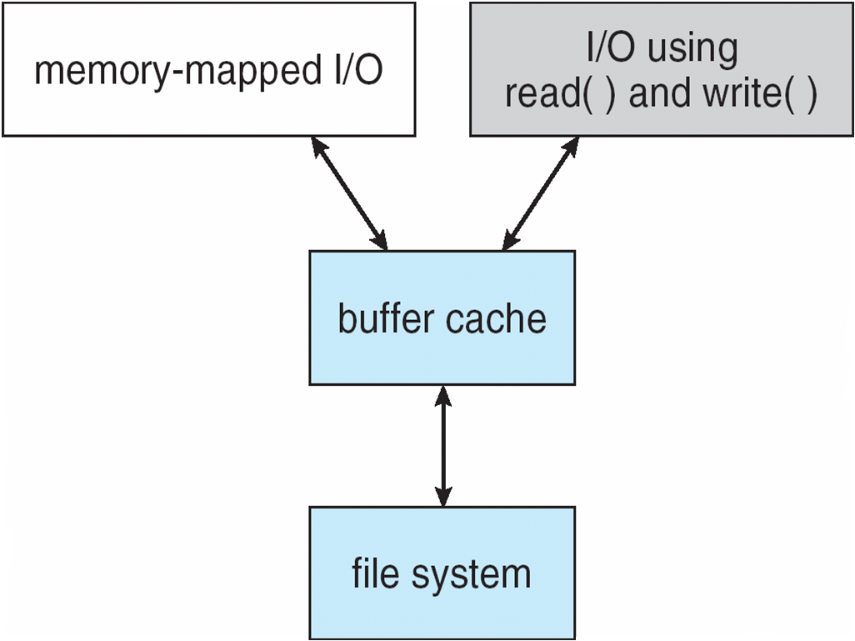
Unified Buffer Cache
A unified buffer cache uses the same page cache to cache both memory-mapped pages and ordinary file system I/O.
A. Frank - P. Weisberg

Slide 36
Recovery
Consistency checking – compares data in directory structure with data blocks on disk,
and tries to fix inconsistencies.
Use system programs to back up data from disk to another storage device (floppy disk, magnetic tape).
Recover lost file or disk by restoring data from backup.
A. Frank - P. Weisberg

Slide 37
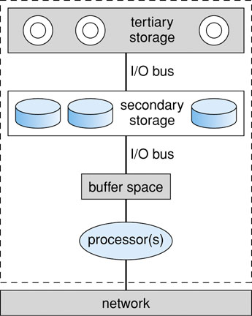
Storage Backup
A. Frank - P. Weisberg

