Slide 1
Operating Systems
Functional View of Operating System
A. Frank - P. Weisberg

Slide 2

Contents
Computer System Organization
Main Memory Management
Memory Protection
I/O Protection
CPU Protection
Types of Interrupts:
  Traps
  External interrupts
  System calls
A. Frank - P. Weisberg

Slide 3

Computer System Organization
  One or more CPUs, device controllers connect through .common bus providing access to shared memory
  Concurrent execution of CPUs and devices competing for .memory cycles
A. Frank - P. Weisberg

Slide 4
Storage Structure
Main memory – only large storage media that the CPU can access directly.
Secondary storage – extension of main memory that provides large nonvolatile storage capacity.
Hard disks – rigid metal or glass platters covered with magnetic recording material:
  Disk surface is logically divided into tracks, which are subdivided into sectors.
  The disk controller determines the logical interaction between the device and the computer.
A. Frank - P. Weisberg

Slide 5


Storage Hierarchy
A. Frank - P. Weisberg

Slide 6
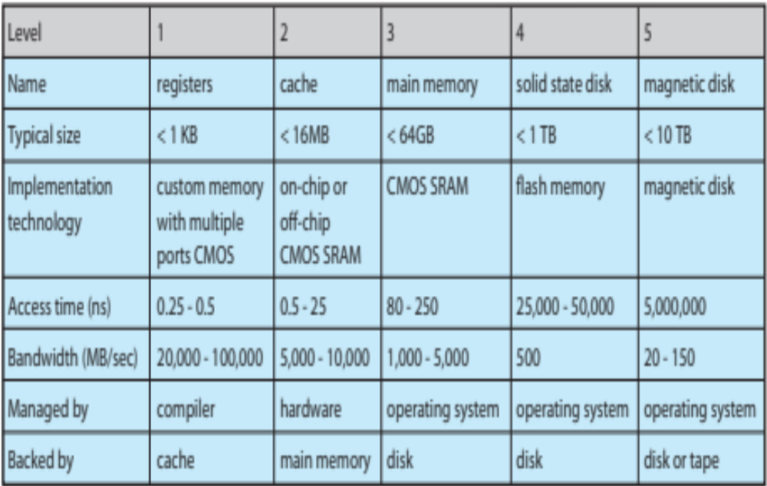
Performance of Various Levels of Storage
A. Frank - P. Weisberg

Slide 7
Caching
Important principle, performed at many levels in a computer (in hardware, operating system, software).
Information in use is copied from slower to faster storage temporarily.
Faster storage (cache) checked first to determine if information is there:
  If it is, information used directly from the cache (fast).
  If not, data copied to cache and used there.
Cache smaller than storage being cached:
  Cache management is an important design problem.
  Cache size and replacement policy matter.
A. Frank - P. Weisberg

Slide 8

Main Memory Management
Initial memory management techniques:
  Minimal management – one program that manages memory for itself. No memory protection problems here.
  Memory split – Resident Monitor and User Job/Program split the memory between them.
  Memory Division – The operating system and
  a few user jobs divide the available
  memory between them.
A. Frank - P. Weisberg

Slide 9

MS-DOS Memory Split
A. Frank - P. Weisberg

Slide 10
Memory Management Dynamics
Sharing system resources requires the operating system to ensure that an incorrect program cannot cause other programs to execute incorrectly.
Resident Monitor is a “Trusted Program” but how to protect it from damage by the user program?
Solution: Fence Register (a dedicated register) and addressing access logic.
A. Frank - P. Weisberg

Slide 11
Memory Split
64K
User
Program
16K
Fence
Register
Resident
Monitor
0K
A. Frank - P. Weisberg

Slide 12
Fence Register
The Fence Register is loaded with the base of the
user program (which is also the limit of the Resident Monitor).
The user program can read any address but addressing access logic assures that it can write only to addresses that are larger than the Fence Register value.
The instruction to load the Fence Register has to be privileged (i.e., can be executed only by the Resident Monitor) – but how to ensure that?
A. Frank - P. Weisberg

Slide 13
Dual-Mode Operation (1)
Provide hardware support to differentiate between at least two modes of operations:
  User mode: execution done on behalf of a user.
  kernel mode: execution done on behalf of OS.
Must ensure that a user program could never gain control of the computer in kernel mode.
Privileged Instructions can be executed only in kernel mode.
Solution: Mode bit (in Status Register).
A. Frank - P. Weisberg

Slide 14
Dual-Mode Operation (2)
Mode bit was added to computer hardware (in Status Register) to indicate the current mode: kernel/system (0) or user (1).
When any type of interrupt occurs, interrupt hardware switches to kernel mode, at the correct service routine in the kernel address space – safe method!
Interrupt hardware
set kernel mode
instruction?
Should be privileged?
No, there should be
no such instruction!
kernel
user
set user mode
instruction
A. Frank - P. Weisberg

Slide 15

UNIX Memory Division
A. Frank - P. Weisberg

Slide 16
Memory Division
In order to have memory division protection, add two registers that determine the range of legal addresses a program may access:
  base register – holds the smallest legal physical memory address of the program.
  limit register – contains the size of the range.
Base/Limit Registers are also called Lower/Upper Fence Registers.
Memory outside the defined range is protected.
A. Frank - P. Weisberg

Slide 17

Example of base and limit Registers
A. Frank - P. Weisberg

Slide 18
Protection Hardware
When executing in kernel mode, the operating system has unrestricted access to both system and user’s memory.
The load instructions for the base and limit registers are privileged instructions (the read instructions for these registers need not be privileged).
Privileged instructions can be issued only in kernel mode.
A. Frank - P. Weisberg

Slide 19

Logic of Protection Hardware
A. Frank - P. Weisberg

Slide 20
Traps
A trap/exception is a software-generated interrupt caused by an error of the program, for example:
  arithmetic overflow/underflow
  division by zero
  execute illegal instruction
  reference outside user’s memory space.
A trap can be initiated also by an explicit trap instruction in the program.
The trap uses the interrupt hardware to switch to kernel mode.
A. Frank - P. Weisberg

Slide 21
Memory Protection Summary
We need to achieve memory protection!?
How to protect jobs in memory space?
  use fence registers and addressing access logic.
But how to protect fence registers?
  use privileged fence load instruction.
But how to ensure privileged execution?
  use mode bit.
But how to protect mode bit?
  change to kernel mode only by
  interrupt hardware!
A. Frank - P. Weisberg

Slide 22

Computer Dynamics
A. Frank - P. Weisberg

Slide 23
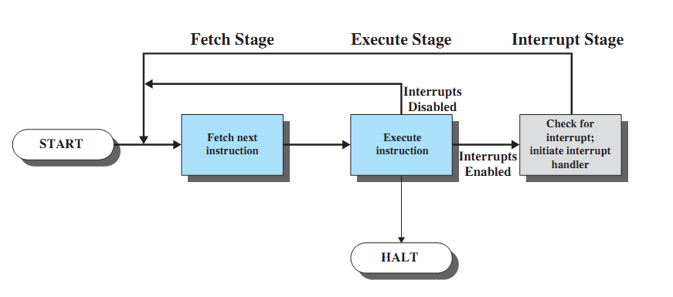
Instruction Cycle with Interrupts
CPU checks for interrupts after each instruction.
If no interrupts, then fetch next instruction of current program.
If an interrupt is pending, then suspend execution of the current program, and execute the interrupt handler.
A. Frank - P. Weisberg

Slide 24
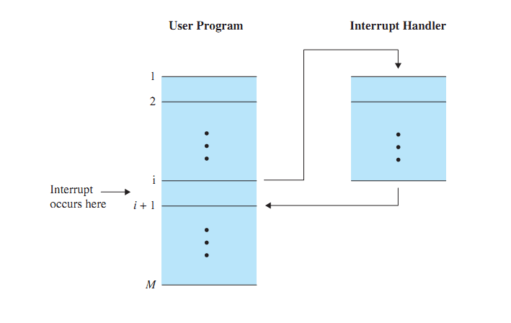
Transfer of control via interrupt
A. Frank - P. Weisberg

Slide 25
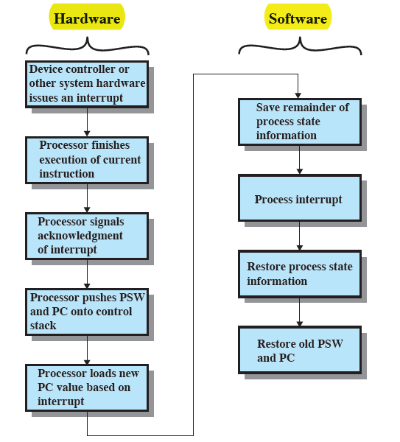
Processing Sample Interrupt
A. Frank - P. Weisberg

Slide 26
Interrupt Handler
A program that determines nature of the interrupt and performs whatever actions are needed.
Interrupt transfers control to the interrupt handler, generally through the interrupt vector, which contains the addresses of all interrupt service routines, which determine how to handle.
Interrupt architecture must save the state of the program (content of PC + registers + ...).
Incoming interrupts are disabled while another interrupt is being processed to prevent a lost interrupt.
Later, control must be transferred back to the interrupted program so that it can be resumed from point of interruption.
A. Frank - P. Weisberg

Slide 27

External Interrupts
An external interrupt is a temporal suspension of a process caused by an event external to that process and performed in such a way that the process can be resumed.
External Interrupts are caused by events external to that process:
  I/O
  Timer
  Hardware failure
A. Frank - P. Weisberg

Slide 28
Common Functions of External Interrupts
Interrupt hardware transfers control to the interrupt service routine IH (Interrupt Handler), generally through the interrupt vector, which contains the addresses of all the service routines.
Interrupt architecture must save the address of the interrupted instruction.
Incoming interrupts are usually disabled while another interrupt is being processed to prevent a lost interrupt.
A. Frank - P. Weisberg

Slide 29
Interrupt Driven I/O (1)
I/O devices and the CPU can execute concurrently.
Each device controller is in charge of a particular device type.
Each device controller has a local buffer.
CPU moves data from/to main memory to/from local buffers.
I/O is from the device to local buffer of controller.
Device controller informs CPU that it has finished its operation by causing an external interrupt.
A. Frank - P. Weisberg

Slide 30
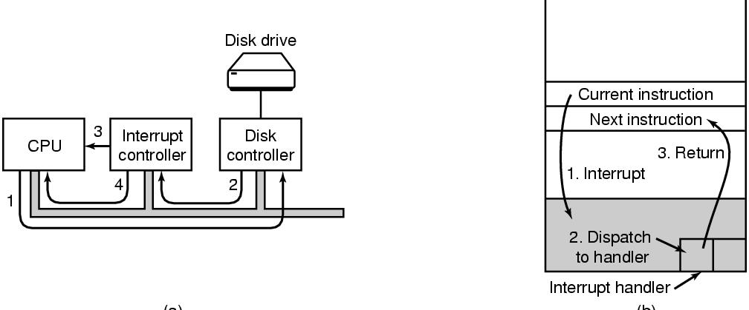
Interrupt Driven I/O (2)
A. Frank - P. Weisberg

Slide 31
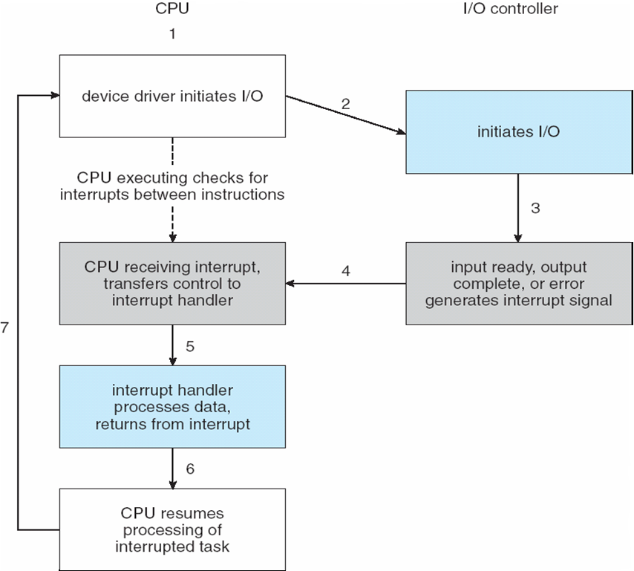
Interrupt-Driven I/O Cycle
A. Frank - P. Weisberg

Slide 32

Interrupt Timeline of CPU and I/O Device
A. Frank - P. Weisberg

Slide 33
Two I/O Methods (1)
Synchronous I/O – After I/O starts, control returns to user program only upon I/O completion.
  Wait instruction idles the CPU until the next interrupt.
  Wait loop (contention for memory access).
  At most one I/O request is outstanding at a time, no simultaneous I/O processing.
Asynchronous I/O – After I/O starts, control returns to user program without waiting for I/O completion.
  System call – request to OS to allow user to wait for I/O completion.
  Device-status table contains entry for each I/O device indicating its type, address, and state.
  Operating system indexes into I/O device table to determine device status and to modify table entry to include interrupt.
A. Frank - P. Weisberg

Slide 34
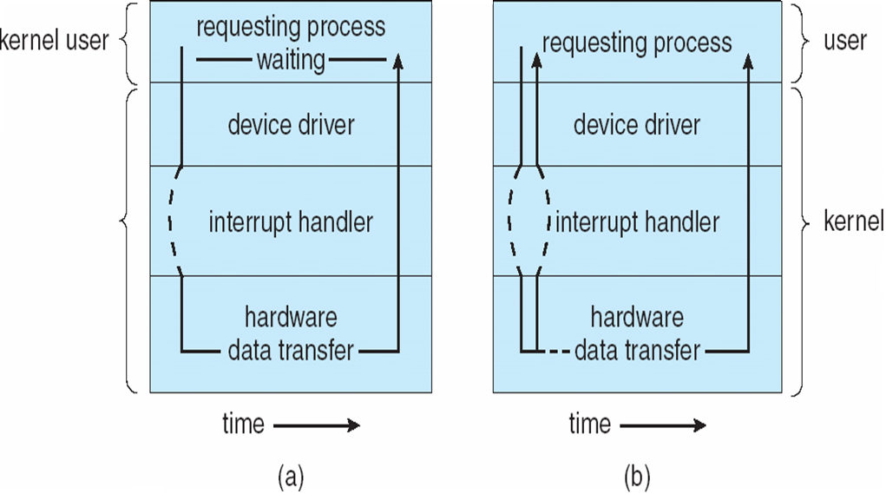
Two I/O Methods (2)
Synchronous
Asynchronous
A. Frank - P. Weisberg

Slide 35
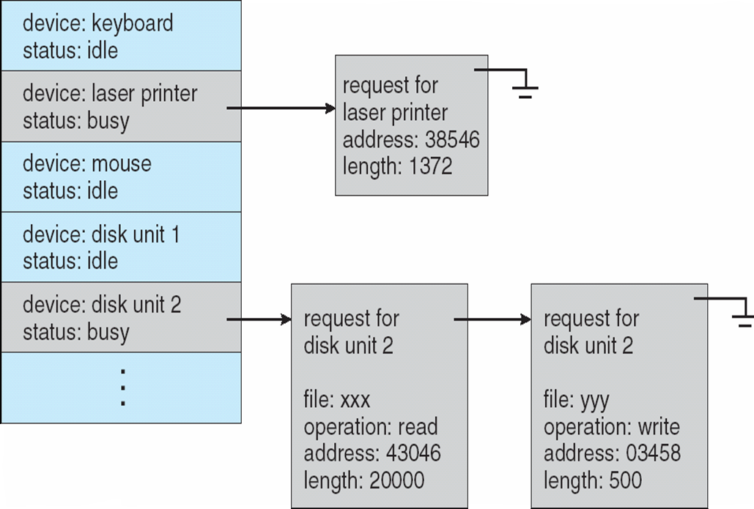
Device-Status Table
A. Frank - P. Weisberg

Slide 36
Direct Memory Access (DMA)
DMA is used by smart high-speed I/O devices able to transmit information at close to memory speeds.
DMA Device controller transfers blocks of data from buffer storage directly to main memory without CPU intervention.
Only one interrupt is generated per block,
rather than one interrupt per byte.
A. Frank - P. Weisberg

Slide 37
I/O Protection
User process may accidentally or purposefully attempt to disrupt normal operation via illegal I/O instructions.
All I/O devices need to be protected from wrongdoing by the users (e.g., prevent current program from reading control cards of next job).
All I/O instructions need to be privileged instructions.
Given that the I/O instructions are privileged, how does the user program perform I/O?
Solution: System Calls (from programs).
A. Frank - P. Weisberg

Slide 38
System Call
The method used by a process to request action by the operating system:
After system call parameter preparations, it uses the trap instruction to transfer control to the requested service routine in the OS.
The system verifies that the parameters are correct and legal, and executes the request.
Returns control to the instruction following the system call.
A. Frank - P. Weisberg

Slide 39

System Call Dynamics
A. Frank - P. Weisberg

Slide 40
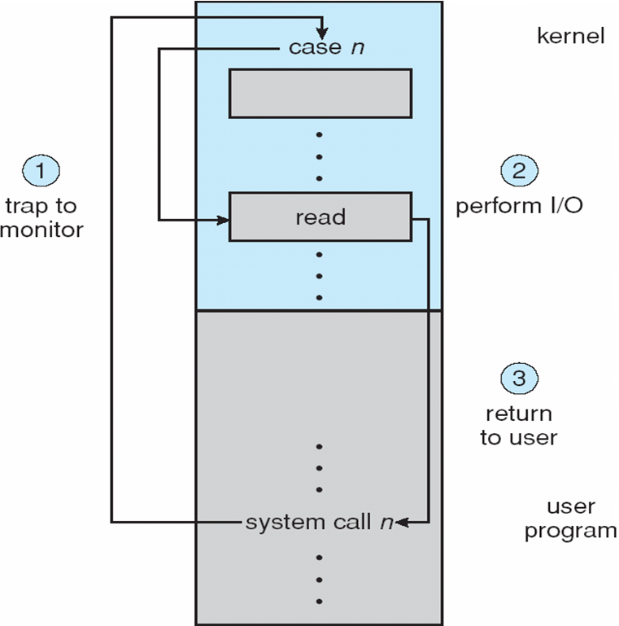
System Call to Perform I/O
A. Frank - P. Weisberg

Slide 41

CPU Protection
Timer – interrupts computer after specified period to ensure operating system maintains control.
Programmable interval timer used for timings,
periodic interrupts.
Set timer is a privileged instruction.
Timer is commonly used to implement Time Sharing Systems.
A. Frank - P. Weisberg

Slide 42
Timer Dynamics
Timer to prevent infinite loop, that is a process hogging resources:
  Timer is set to interrupt the computer after some time period.
  Keep counter that is decremented by physical clock.
  OS sets the counter (privileged instruction).
  When counter is zero generate an interrupt.
  Set up before scheduling process to regain control or terminate program that exceeds allotted time.
A. Frank - P. Weisberg

Slide 43

Interrupt Types and Attributes
An operating system is interrupt driven:
Traps (Exceptions)
External interrupts
System calls
Various interrupt attributes (see next chart):
  Asynchronous vs. Synchronous.
  External/Hardware vs. Internal/Software.
  Implicit vs. Explicit.
A. Frank - P. Weisberg

Slide 44
Attributes of Interrupt Types
Interrupt
types
Asynchronous
External
interrupts
Implicit
Synchronous
Traps
System
calls
Explicit
External/
Hardware
Internal/
Software
A. Frank - P. Weisberg

