Slide 1
Operating Systems
Operating System Structures
A. Frank - P. Weisberg

Slide 2

Operating System Structures
Operating System Services
Common System Components
System Calls and APIs
System Programs
System Design and Implementation
System Pragmatics
A. Frank - P. Weisberg

Slide 3

A View of Operating System Services
A. Frank - P. Weisberg

Slide 4
OS Services (user-oriented)
Program execution – OS capability to load a program into memory, run it, end execution, either normally or abnormally (indicating error).
I/O operations – since user programs cannot execute I/O operations directly, the OS must provide some means to perform I/O, which may involve a file or I/O device.
File systems – program capability to read, write, create, and delete files and directories.
Communication – Processes may exchange information,
on the same computer or between computers over a network – Implemented via shared memory or message passing.
Error detection – ensure correct computing by detecting errors in the CPU and memory hardware, in I/O devices, or in user programs.
A. Frank - P. Weisberg

Slide 5

Communication Models
Communication may take place using either
(a) message passing or (b) shared memory.
A. Frank - P. Weisberg

Slide 6
OS Services (system-oriented)
Resource allocation – When multiple users or multiple jobs running concurrently, resources must be allocated to each of them.
Accounting – To keep track of which users use how much and what kinds of computer resources
Protection and security – The owners of information stored in a multi-user or networked computer system may want to control use of that information, while concurrent processes should not interfere with each other – If a system is to be protected and secure, precautions must be instituted throughout it; a chain
is only as strong as its weakest link.
A. Frank - P. Weisberg

Slide 7

Common System Components
Process Management
Main Memory Management
Storage/File System Management
I/O System Management
Mass-Storage Management
Networking
Command Interpreter
Protection and Security
A. Frank - P. Weisberg

Slide 8
Process Management (1)
A process is a program in execution. It is a unit of work within the system.
Program is a passive entity, process is an active entity.
The operating system is responsible for the following activities in connection with process management:
  Creating and deleting both user and system processes.
  Suspending and resuming processes.
  Providing mechanisms for process synchronization.
  Providing mechanisms for process communication.
  Providing mechanisms for deadlock handling.
A. Frank - P. Weisberg

Slide 9
Process Management (2)
A Process needs resources to accomplish its task:
  CPU, memory, I/O devices, files
  Initialization data
Process termination requires reclaim of any reusable resources.
Single-threaded process has one program counter specifying location of next instruction to execute
  Process executes instructions sequentially, one at a time, until completion.
Multi-threaded process has one program counter per thread.
Typically a system has many processes, some user, some operating system running concurrently on one or more CPUs
  Concurrency by multiplexing the CPUs among the processes/threads.
A. Frank - P. Weisberg

Slide 10
Main Memory Management
To execute a program all (or part) of the instructions must be in memory.
All (or part) of the data that is needed by the program must be in memory.
Memory management determines what is in memory and when
  Optimizing CPU utilization and computer response to users.
Memory management activities:
  Keeping track of which parts of memory are currently being used and by whom.
  Deciding which processes (or parts thereof) and data to move into and out of memory.
  Allocating and de-allocating memory space as needed.
A. Frank - P. Weisberg

Slide 11
Storage/File System Management
A file is a collection of related information.
Commonly, files represent programs (both source and object forms) and data.
Files are usually organized into directories.
  Access control on most file systems to determine who can access what.
OS activities include:
  Creating and deleting files and directories.
  Primitives to manipulate files and directories.
  Mapping files onto secondary storage.
  Backup files onto stable (non-volatile) storage media.
A. Frank - P. Weisberg

Slide 12
I/O System Management
One purpose of OS is to hide peculiarities of hardware devices from the user.
I/O subsystem is responsible for:
  Memory management of I/O including buffering (storing data temporarily while it is being transferred), caching (storing parts of data in faster storage for performance), spooling (the overlapping of output of one job with input of other jobs).
  General device-driver interface.
  Drivers for specific hardware devices.
A. Frank - P. Weisberg

Slide 13

Mass-Storage Management
Usually disks used to store data that does not fit in main memory or data that must be kept for a “long” period of time.
Proper management is of central importance.
Entire speed of computer operation hinges on disk subsystem and its algorithms.
OS activities:
  Free-space management
  Storage allocation
  Disk scheduling
Some storage need not be fast:
  Tertiary storage includes optical storage, magnetic tape
  Varies between WORM (write-once, read-many-times) and RW (read-write)
A. Frank - P. Weisberg

Slide 14
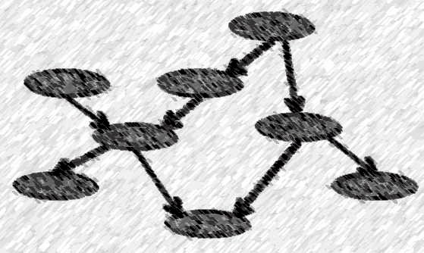
Networking
The processors in the system are connected through a communication network.
Communication takes place using a protocol.
A networked/distributed system provides user access to various system resources.
Access to a shared resource allows:
  Computation speed-up
  Increased data availability
  Enhanced reliability
A. Frank - P. Weisberg

Slide 15
Command Interpreter
Command-Interpreter:
  The program that reads and executes commands given to the operating system.
  Examples of command-line interpreters are command.com (DOS), shell (UNIX).
  In windows systems the interface is mouse and menu based – WIMP (Windows, Icons, Menu, and Pointing device).
A. Frank - P. Weisberg

Slide 16
Graphical User Interface (GUI)
User-friendly desktop metaphor interface:
  Usually mouse, keyboard, and monitor.
  Icons represent files, programs, actions, etc.
  Various mouse buttons over objects in the interface cause various actions (provide information, options, execute function, open folder).
  Invented at Xerox PARC.
Systems now include both CLI and GUI interfaces:
  Microsoft Windows is GUI with CLI “command” shell.
  Apple Mac OS X as “Aqua” GUI with UNIX kernel
  underneath and shells available.
  Solaris is CLI with optional GUIs (Java Desktop, KDE).
A. Frank - P. Weisberg

Slide 17

Protection and Security
Protection – any mechanism for controlling access of processes or users to both system and user resources.
Security – defense of the system against internal and external attacks, with huge range, including:
  Denial-of-service
  Worms
  Viruses
  Identity theft
  Theft of service.
A. Frank - P. Weisberg

Slide 18
Protection Aspects
Systems generally first distinguish among users, to determine who can do what:
  User identities (user IDs, security IDs) include name and associated number, one per user.
  User ID then associated with all files, processes of that user to determine access control.
  Group identifier (group ID) allows set of users to
  be defined and controls managed, then also associated with each process, file.
  Privilege escalation allows user to change to effective ID with more rights.
A. Frank - P. Weisberg

Slide 19

Error Detection/Response
Error Detection
  internal and external hardware errors
    memory error
    device failure
  software errors
    arithmetic overflow
    access forbidden memory locations
Error Response
  simply report error to the application
  Retry the operation
  Abort the application
A. Frank - P. Weisberg

Slide 20
Accounting
Accounting keeps track of and records which users use how much and what kinds of computer resources.
Accounting:
  collect statistics on resource usage
  monitor performance (e.g., response time)
  used for system parameter tuning to improve performance
  useful for anticipating future enhancements
  used for billing users (on multi-user systems)
A. Frank - P. Weisberg

Slide 21
System Calls and APIs
Systems calls provide programming interface to the services provided by the OS.
Typically written in a high-level language (C/C++).
Mostly accessed by programs via a high-level Application Program Interface (API) rather than through direct system calls.
Three most common APIs:
  Win32 API for Windows
  POSIX API for POSIX-based systems (including virtually all versions of UNIX, Linux, and Mac OS X)
  Java API for the Java Virtual Machine (JVM)
A. Frank - P. Weisberg

Slide 22

Example of System Call
A. Frank - P. Weisberg

Slide 23

Example of Standard API
Consider the ReadFile() function in the Win32 API – a function for reading from a file
A description of the parameters passed to ReadFile()
HANDLE file – the file to be read
LPVOID buffer – a buffer where the data will be read into and written from
DWORD bytesToRead – the number of bytes to be read into the buffer
LPDWORD bytesRead – the number of bytes read during the last read
LPOVERLAPPED ovl – indicates if overlapped I/O is being used

Slide 24
System Call Implementation
Typically, a number is associated with each system call
  System-call interface maintains a table indexed according
  to these numbers.
The system call interface invokes intended system call in kernel and returns status of the system call and any return values.
The caller need know nothing about how the system call is implemented:
  Just needs to obey API and understand what OS will do as
  a result call.
  Details of OS interface hidden from programmer by API since managed by run-time support library (set of functions built into libraries included with compiler).
A. Frank - P. Weisberg

Slide 25

API – System Call – OS Relationship
A. Frank - P. Weisberg

Slide 26

Standard C Library Example
C program invoking
printf() library call,
which calls write()
system call.
A. Frank - P. Weisberg

Slide 27
System Call Parameter Passing
Often, more information is required than simply identity of desired system call, but exact type and amount of information vary according to OS and call.
Three general methods used to pass parameters to the OS:
  Simplest: pass the parameters in registers
    In some cases, may be more parameters than registers.
  Parameters stored in a block, or table, in memory, and address of block passed as a parameter in a register
    This approach taken by Linux and Solaris.
  Parameters placed, or pushed, onto the stack by the program and popped off the stack by the operating system.
Block and stack methods do not limit the number or length
of parameters being passed.
A. Frank - P. Weisberg

Slide 28

Parameter Passing via Table
A. Frank - P. Weisberg

Slide 29

Parameter Passing via Stack
The 11 steps in making the system call read(fd, buffer, nbytes)
A. Frank - P. Weisberg

Slide 30
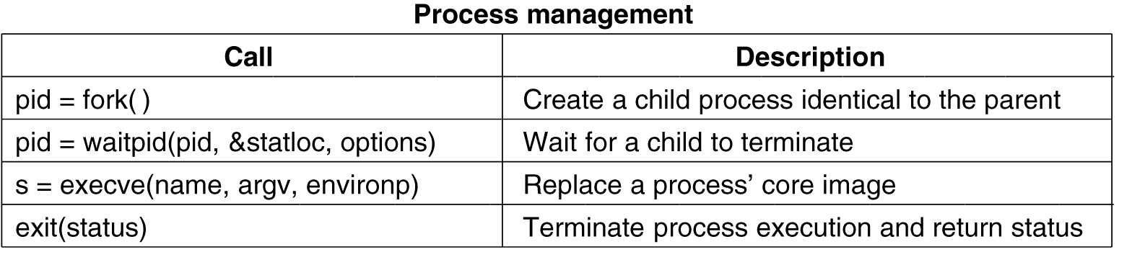
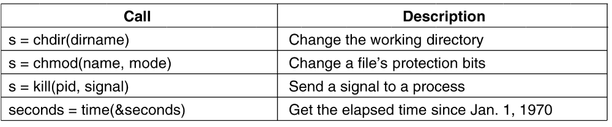
Examples of POSIX System Calls
A. Frank - P. Weisberg

Slide 31
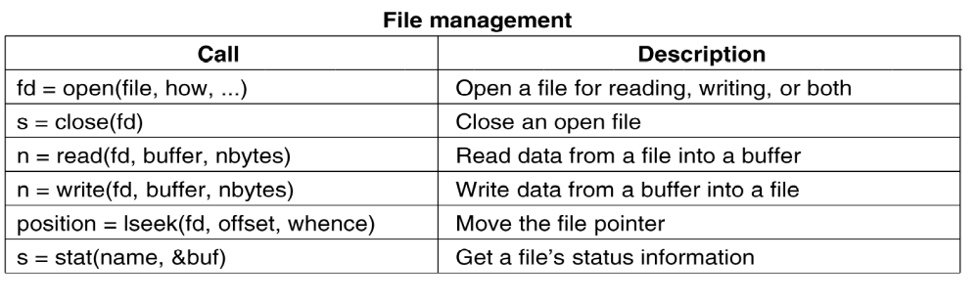
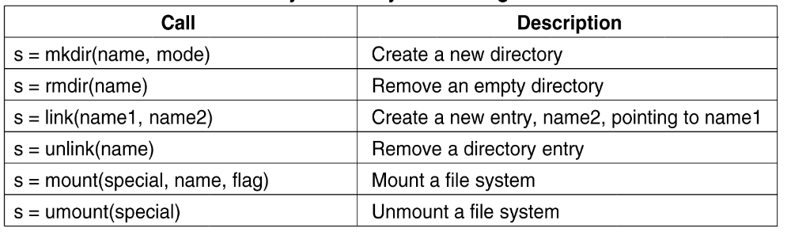
System Calls for File Management (POSIX)
A. Frank - P. Weisberg

Slide 32

Examples of Windows and Unix System Calls

Slide 33
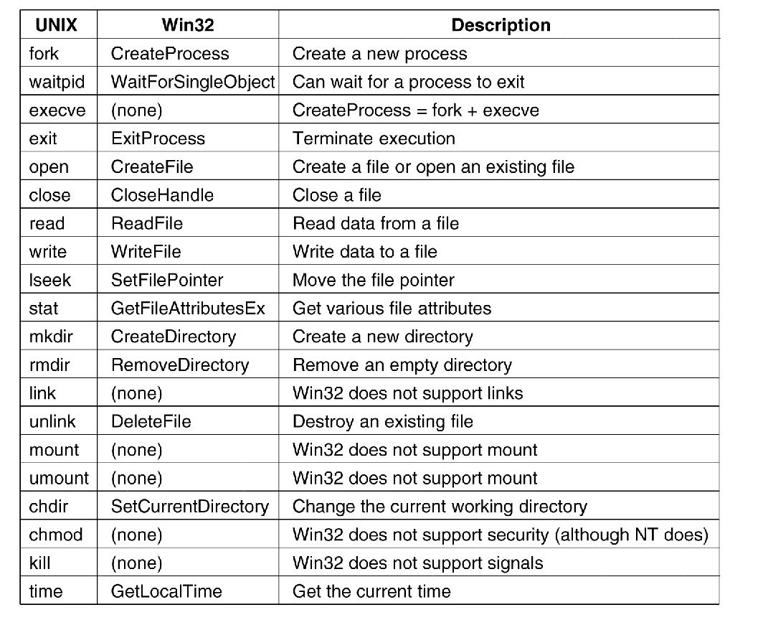
Win32 API calls roughly correspond to UNIX calls
A. Frank - P. Weisberg

Slide 34
System Programs (1)
System programs provide a convenient environment for program development and execution:
  File management/modification, Status information, Programming language support, Program loading and execution, Communications, Application programs
Most users’ view of the operating system is defined
by system programs, not the actual system calls.
Provide a convenient environment for program development and execution:
  Some of them are simply user interfaces to system calls; others are considerably more complex.
A. Frank - P. Weisberg

Slide 35
System Programs (2)
File management – create, delete, copy, rename,
print, dump, list, and others generally manipulate files
and directories.
Status information:
  Some ask the system for information – date, time, amount
  of available memory, disk space, number of users.
  Others provide detailed performance, logging, and debugging information.
  Typically, these programs format and print the output to
  the terminal or other output devices.
  Some systems implement a registry – used to store and retrieve configuration information.
A. Frank - P. Weisberg

Slide 36
System Programs (3)
File modification:
  Text editors to create and modify files
  Special commands to search contents of files or perform
  transformations of the text.
Programming language support – compilers, assemblers, debuggers and interpreters sometimes provided.
Program loading and execution – absolute loaders, relocatable loaders, linkage editors, and overlay loaders,
debugging systems for higher-level and machine language.
Communications – Provide the mechanism for creating virtual connections among processes, users, and computer systems:
  Allow users to send messages to one another’s screens, browse web pages, send electronic-mail messages, log in remotely, transfer files
  from one machine to another.
A. Frank - P. Weisberg

Slide 37
System Design Goals
Design and Implementation of OS not “solvable”, but some approaches have proven successful.
Internal structure of different OSes can vary widely.
Start by defining goals and specifications.
Affected by choice of hardware, type of system.
User goals and System goals:
  User goals – operating system should be convenient to use, easy to learn, reliable, safe, and fast.
  System goals – operating system should be easy to design, implement, and maintain, as well as flexible, reliable,
  error-free, and efficient.
A. Frank - P. Weisberg

Slide 38
Separation of Mechanisms and Policies
Important principle to separate:
Policy: What will be done?
Mechanism: How to do it?
Mechanisms determine how to do something, policies decide what will be done.
The separation of policy from mechanism is a very important principle, it allows maximum flexibility if policy decisions are to be changed later.
A. Frank - P. Weisberg

Slide 39
Example: Managing a Queue
Let’s use an abstract priority queue as example.
We need to support mechanisms for:
  Insert/Delete items at start.
  Insert/Delete items at end.
  Know length of queue.
Body/code of queue can be implemented in different ways.
Policies can be for example FIFO, LIFO (or GIGO ☺) – should be decided by queue user.
A. Frank - P. Weisberg

Slide 40
System Implementation
Traditionally written in assembly language, operating systems can now be written in
higher-level languages.
Code written in a high-level language:
  can be written faster.
  is more compact.
  is easier to understand and debug.
An OS is far easier to port (move to some other hardware) if it is written in a high-level language.
A. Frank - P. Weisberg

Slide 41
Open-Source Operating Systems
Operating systems made available in source-code format rather than just binary closed-source.
Counter to the copy protection and Digital Rights Management (DRM) movement.
Started by Free Software Foundation (FSF), which has “copyleft” GNU Public License (GPL).
Examples include GNU/Linux, BSD UNIX (including core of Mac OS X), and many more.
A. Frank - P. Weisberg

Slide 42
Operating System Debugging (1)
Debugging is finding and fixing errors, or bugs.
OSs generate log files containing error information.
Failure of an application can generate core dump file capturing memory of the process.
Operating system failure can generate crash dump file containing kernel memory.
Beyond crashes, performance tuning can optimize system performance.
A. Frank - P. Weisberg

Slide 43
Operating System Debugging (2)
Kernighan’s Law: “Debugging is twice as hard as writing the code in the first place. Therefore, if you write the code as cleverly as possible, you are, by definition, not smart enough to debug it.”
DTrace tool in Solaris, FreeBSD, Mac OS X allows live instrumentation on production systems
  Probes fire when code is executed, capturing state data
  and sending it to consumers of those probes.
A. Frank - P. Weisberg

Slide 44
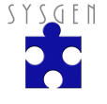
Operating System Generation
Operating systems are designed to run on any of a class of machines; the system must be configured for each specific computer site.
SYSGEN (System Generation) program obtains information concerning the specific
configuration of the hardware system.
Booting – starting a computer by loading the kernel
Bootstrap program – code stored in ROM that is able to locate the kernel, load it into memory, and start its execution
A. Frank - P. Weisberg

Slide 45
System Boot
Operating system must be made available to hardware so the hardware can start it:
  Small piece of code – bootstrap loader/program, locates the OS kernel, loads it into memory, and starts execution.
  Sometimes two-step process where boot block at fixed location loads bootstrap loader.
  Typically stored in ROM or EPROM, generally known as firmware.
  When power-up or reboot, execution of bootstrap program starts at a fixed memory location.
  Initializes all aspects of system.
A. Frank - P. Weisberg

