Slide 1
Operating Systems
Structure of Operating Systems
A. Frank - P. Weisberg

Slide 2

Operating Systems Structures
Structure/Organization/Layout of OSs:
  Monolithic (one unstructured program)
  Layered
  Microkernel
  Virtual Machines
The role of
Virtualization
A. Frank - P. Weisberg

Slide 3
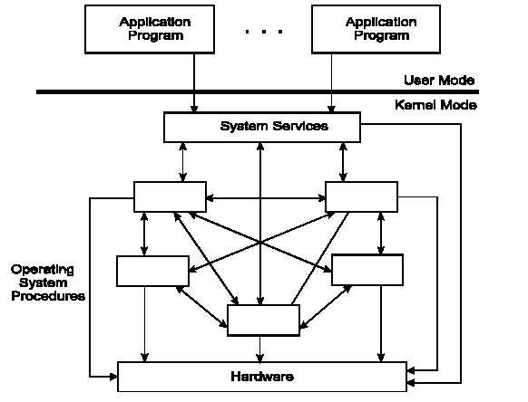
Monolithic Operating System
A. Frank - P. Weisberg

Slide 4
Monolithic OS – basic structure
Application programs that invokes the requested system services.
A set of system services that carry out the operating system procedures/calls.
A set of utility procedures that help the system services.
A. Frank - P. Weisberg

Slide 5
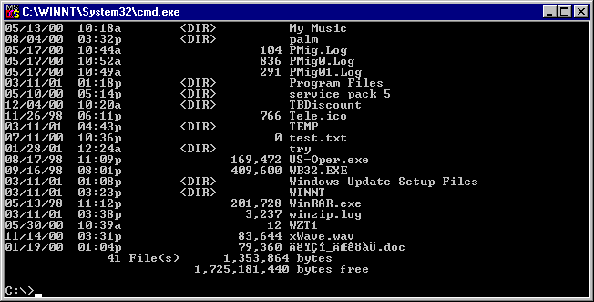
MS-DOS System Structure
MS-DOS – written to provide the most functionality in the least space:
  not divided into modules (monolithic).
  Although MS-DOS has some structure, its interfaces and levels of functionality are not well separated.
A. Frank - P. Weisberg

Slide 6

MS-DOS Layer Structure
A. Frank - P. Weisberg

Slide 7

UNIX System Structure
UNIX – limited by hardware functionality, the original UNIX OS had limited structuring.
The UNIX OS consists of two separable parts:
  Systems Programs:
  The Kernel:
  Consists of everything below the system-call interface and above the physical hardware.
  Provides the file system, CPU scheduling, memory management, and other operating-system functions; a large number of functions for one level.
A. Frank - P. Weisberg

Slide 8

Traditional UNIX System Structure
A. Frank - P. Weisberg

Slide 9
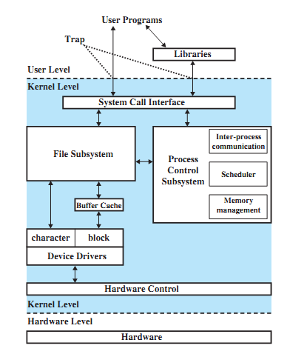
Traditional UNIX Kernel
A. Frank - P. Weisberg

Slide 10
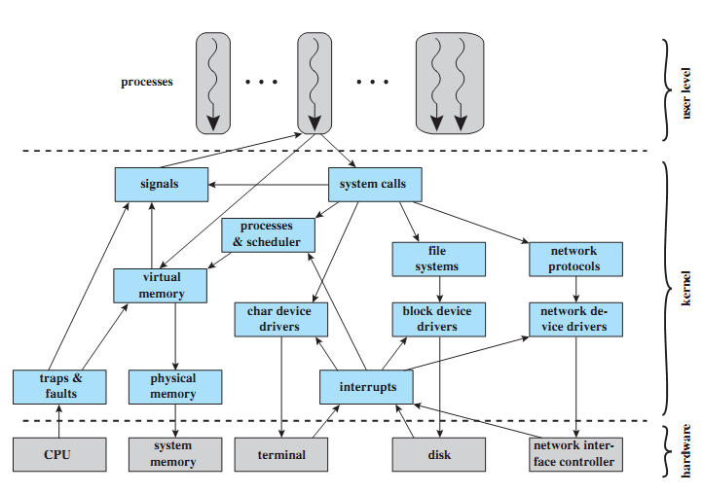
LINUX Kernel Components
A. Frank - P. Weisberg

Slide 11

Layered Approach
The operating system is divided into a number of layers (levels), each built on top of lower layers.
The bottom layer (layer 0) is the hardware; the highest (layer N) is the user interface.
With modularity, layers are selected such that each uses functions (operations) and services of only lower-level layers.
A. Frank - P. Weisberg

Slide 12

Layered Operating System
A. Frank - P. Weisberg

Slide 13

An Operating System Layer
A. Frank - P. Weisberg

Slide 14
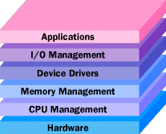
General OS Layers
A. Frank - P. Weisberg

Slide 15
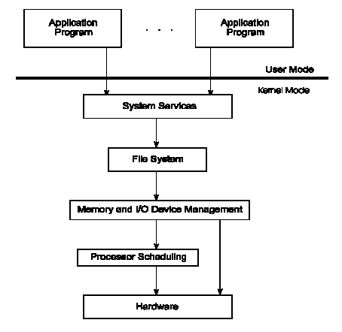
Operating System Layers
A. Frank - P. Weisberg

Slide 16
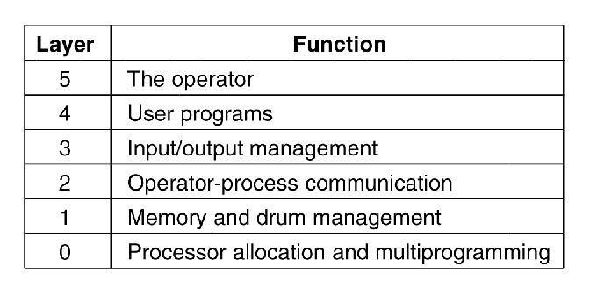
Structure of the THE operating system
A. Frank - P. Weisberg

Slide 17
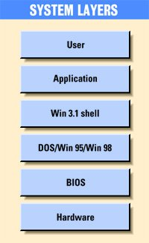
Older Windows System Layers
A. Frank - P. Weisberg

Slide 18
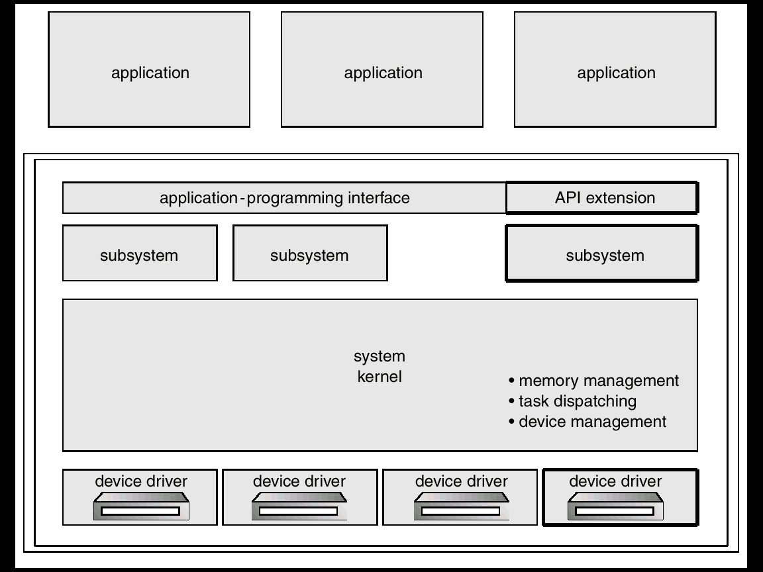
OS/2 Layer Structure
A. Frank - P. Weisberg

Slide 19
Microkernel System Structure (1)
Move as much functionality as possible from the kernel into “user” space.
Only a few essential functions in the kernel:
  primitive memory management (address space)
  I/O and interrupt management
  Inter-Process Communication (IPC)
  basic scheduling
Other OS services are provided by processes running in user mode (vertical servers):
  device drivers, file system, virtual memory…
A. Frank - P. Weisberg

Slide 20
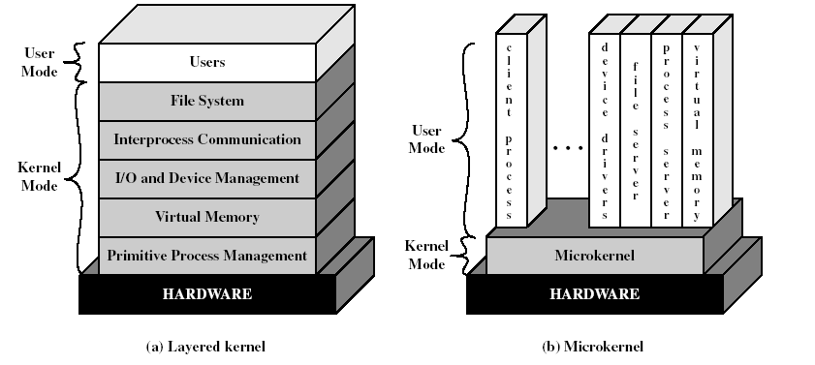
Layered vs. Microkernel Architecture
A. Frank - P. Weisberg

Slide 21


Microkernel System Structure (2)
Communication takes place between user modules using message passing.
More flexibility, extensibility, portability and reliability.
But performance overhead caused by replacing service calls with message exchanges between processes.
A. Frank - P. Weisberg

Slide 22
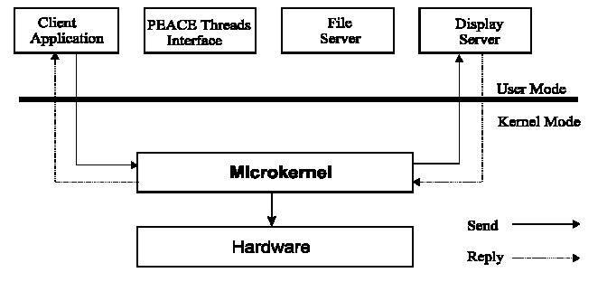
Microkernel Operating System
A. Frank - P. Weisberg

Slide 23
Benefits of a Microkernel Organization (1)
Extensibility/Reliability
  easier to extend a microkernel
  easier to port the operating system to new architectures
  more reliable (less code is running in kernel mode)
  more secure
  small microkernel can be rigorously tested.
Portability
  changes needed to port the system to a new processor is done in the microkernel, not in the other services.
A. Frank - P. Weisberg

Slide 24
Benefits of Microkernel Organization (2)
Distributed system support
  message are sent without knowing what the target machine is.
Object-oriented operating system
  components are objects with clearly defined interfaces that can be interconnected to form software.
A. Frank - P. Weisberg

Slide 25
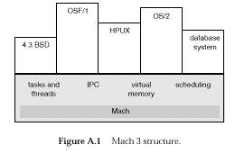
Mach 3 Microkernel Structure
A. Frank - P. Weisberg

Slide 26
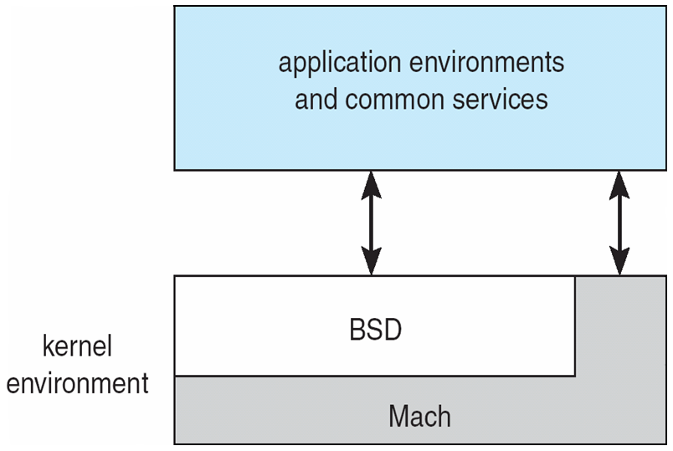
Mac OS X Structure
A. Frank - P. Weisberg

Slide 27
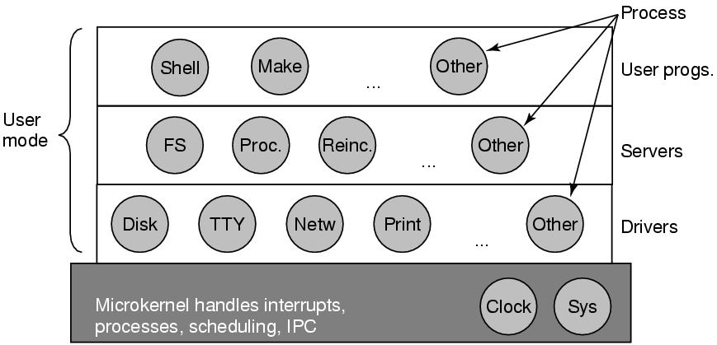
Structure of the MINIX 3 system
A. Frank - P. Weisberg

Slide 28

Windows NT Client-Server Structure
A. Frank - P. Weisberg

Slide 29
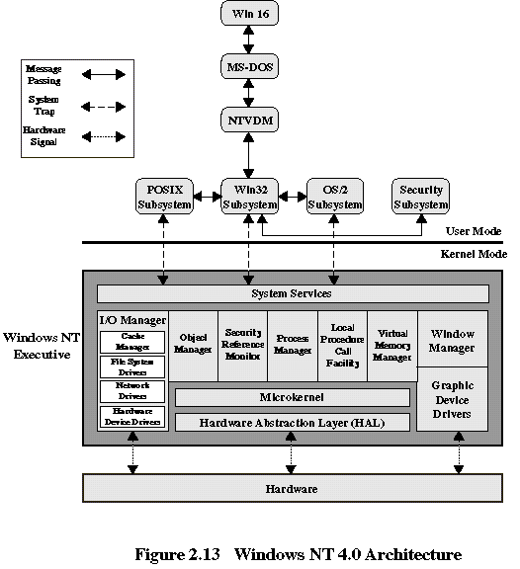
Windows NT 4.0 Architecture
A. Frank - P. Weisberg

Slide 30
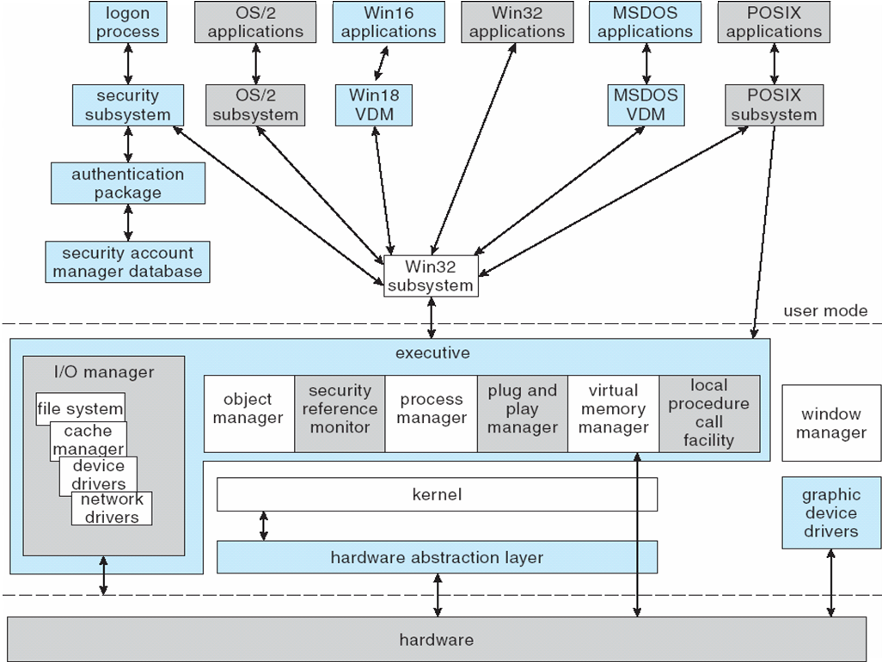
Windows XP Architecture
A. Frank - P. Weisberg

Slide 31
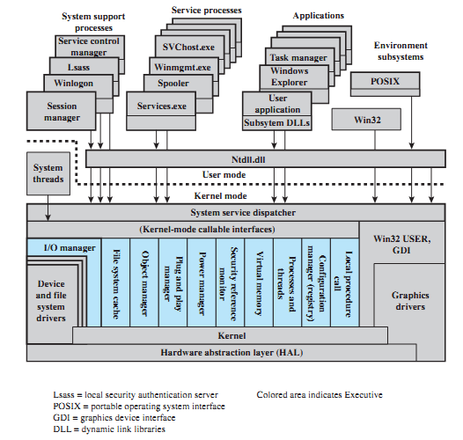
Windows 7.0 Architecture
A. Frank - P. Weisberg

Slide 32
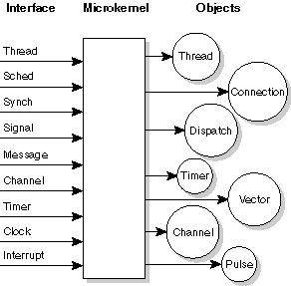
The Neutrino Microkernel
A. Frank - P. Weisberg

Slide 33
Kernel Modules
Most modern operating systems implement kernel modules:
  Uses object-oriented approach.
  Each core component is separate.
  Each talks to the others over known interfaces.
  Each is loadable as needed within the kernel.
Overall, similar to layers but with more flexibility.
A. Frank - P. Weisberg

Slide 34

Solaris Modular Approach
A. Frank - P. Weisberg

Slide 35
Virtual Machines (1)
A Virtual Machine (VM) takes the layered and microkernel approach to its logical conclusion.
It treats hardware and the operating system kernel as though they were all hardware.
A virtual machine provides an interface identical to the underlying bare hardware.
The operating system host creates the illusion that a process has its own processor and (virtual memory).
Each guest provided with a (virtual) copy of underlying computer.
A. Frank - P. Weisberg

Slide 36
Virtual Machines (2)
The resources of the physical computer are shared to create the virtual machines:
  CPU scheduling can create the appearance that users have their own processor.
  Spooling and a file system can provide virtual card readers and virtual line printers.
  A normal user time-sharing terminal serves as the virtual machine operator’s console.
A. Frank - P. Weisberg

Slide 37

on Bare Machine Implementation VM
Non-virtual Machine
Virtual Machine
A. Frank - P. Weisberg

Slide 38
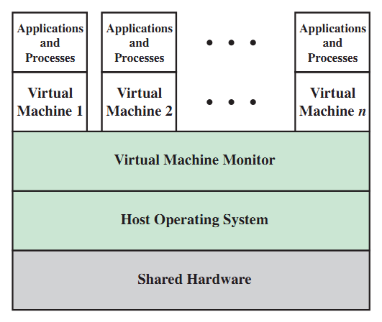
VM Implementation on Host OS
A. Frank - P. Weisberg

Slide 39
Advantages/Disadvantages of VMs
The VM concept provides complete protection of system resources since each virtual machine is isolated from all other virtual machines. This isolation permits no direct sharing of resources.
A VM system is a perfect vehicle for OS research
and development. System development is done on the virtual machine, instead of on a physical machine and so does not disrupt normal system operation.
The VM concept is difficult to implement due to the effort required to provide an exact duplicate to the underlying machine.
A. Frank - P. Weisberg

Slide 40
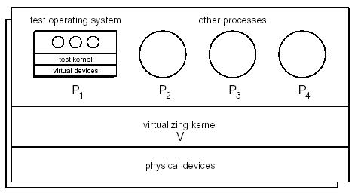
Testing a new Operating System
A. Frank - P. Weisberg

Slide 41
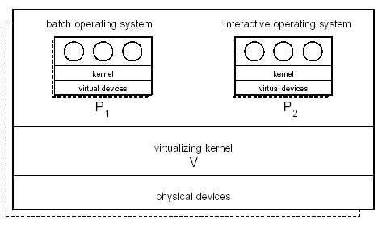
Integrating two Operating Systems
A. Frank - P. Weisberg

Slide 42
Virtual Machines History and Benefits
First appeared commercially in IBM mainframes in 1972.
Fundamentally, multiple protected execution environments (different operating systems) can share the same hardware.
Protect from each other.
Some sharing of file can be permitted, controlled.
Commutate with each other, other physical systems via networking.
Useful for development and testing.
Consolidation of many low-resource use systems onto fewer busier systems.
“Open Virtual Machine Format”, standard format of VMs, allows a VM to run within many different VM (host) platforms.
A. Frank - P. Weisberg

Slide 43
Emulation vs. Virtualization
Emulation – when source CPU type different from target type (i.e., PowerPC to Intel x86):
  Generally slowest method.
  When computer language not compiled to native code – Interpretation.
Virtualization – OS natively compiled for CPU, running guest OSes also natively compiled:
  Consider VMware running WinXP guests, each running applications, all on native WinXP host OS.
  VMM (virtual machine Manager) provides virtualization services.
A. Frank - P. Weisberg

Slide 44
Virtualization Examples
Use cases involve laptops and desktops running multiple OSes for exploration or compatibility:
  Apple laptop running Mac OS X host, Windows as a guest.
  Developing apps for multiple OSes without having multiple systems.
  QA testing applications without having multiple systems.
  Executing and managing compute environments within data centers.
VMM can run natively, so they are also the host:
  There is no general purpose host then (VMware ESX and Citrix XenServer).
A. Frank - P. Weisberg

Slide 45
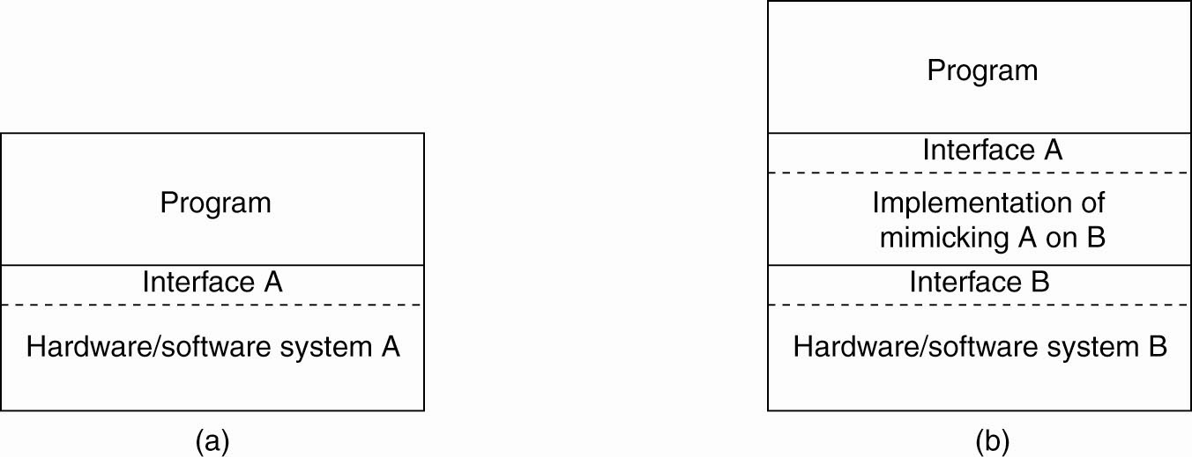
The Role of Virtualization
General organization between a program, interface, and system.
General organization of virtualizing system A on top of system B.
A. Frank - P. Weisberg

Slide 46
Architectures of Virtual Machines (1)
There are interfaces at different levels.
An interface between the hardware and software, consisting of machine instructions
  that can be invoked by any program.
An interface between the hardware and software, consisting of machine instructions
  that can be invoked only by privileged programs, such as an operating system.
A. Frank - P. Weisberg

Slide 47
Architectures of Virtual Machines (2)
An interface consisting of system calls as offered by an operating system.
An interface consisting of library calls:
  generally forming what is known as
  an Application Programming Interface (API).
  In many cases, the aforementioned system calls are hidden by an API.
A. Frank - P. Weisberg

Slide 48
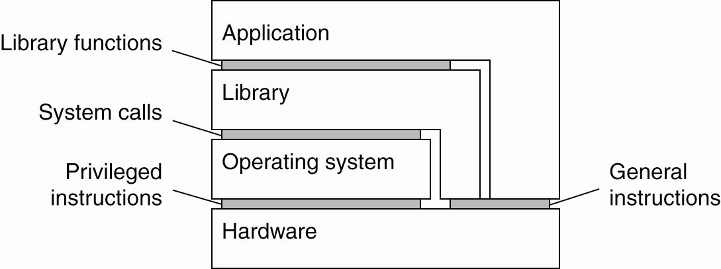
Architectures of Virtual Machines (3)
Various interfaces offered by computer systems
A. Frank - P. Weisberg

Slide 49
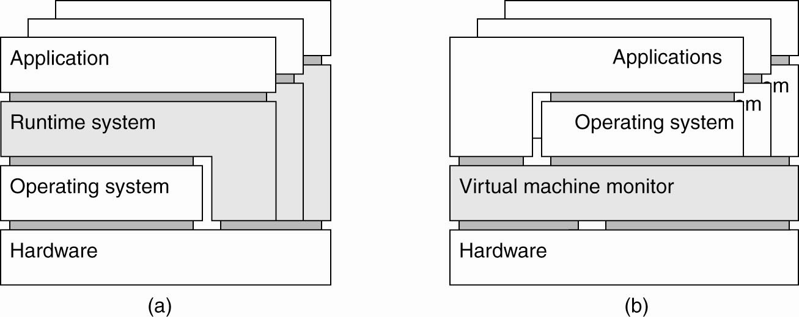
Process Virtual Machine
(a) A process virtual machine, with multiple instances of (application, runtime) combinations.
A. Frank - P. Weisberg

Slide 50

Java Virtual Machine
Compiled Java programs are platform-neutral bytecodes executed by a Java Virtual Machine (JVM).
JVM consists of:
- class loader
- class verifier
- runtime interpreter
Just-In-Time (JIT) compilers increase performance.
A. Frank - P. Weisberg

Slide 51
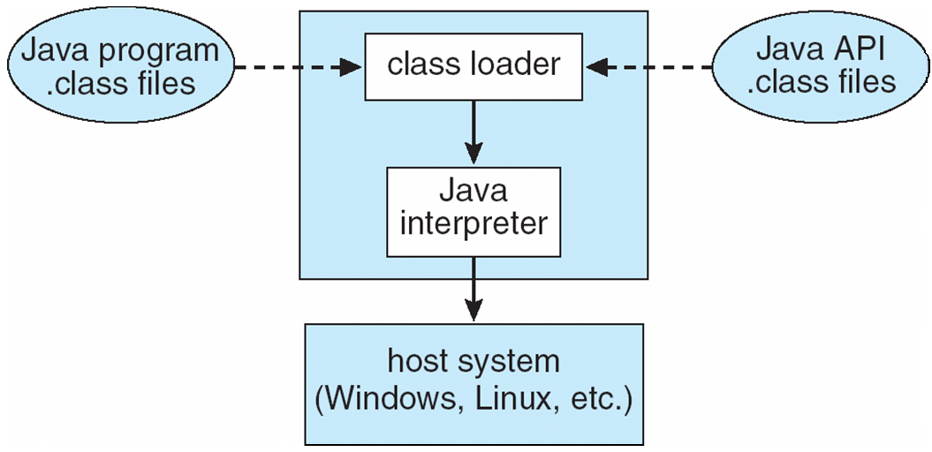
The Java Virtual Machine
A. Frank - P. Weisberg

Slide 52
Hypervisor/VMM (Virtual Machine Monitor)
(b) A virtual machine monitor, with multiple instances of (applications, operating system) combinations.
A. Frank - P. Weisberg

Slide 53
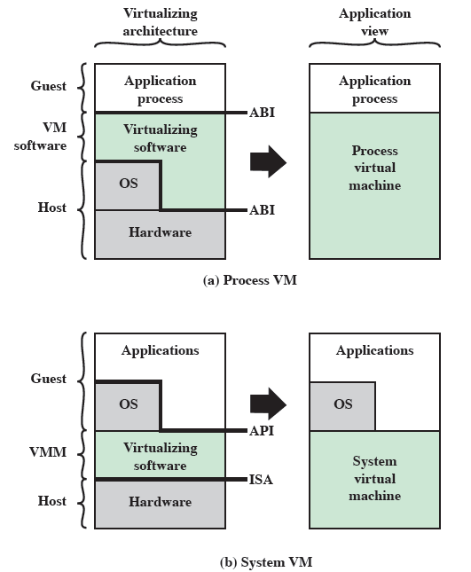
Process and System Virtual Machines
A. Frank - P. Weisberg

Slide 54
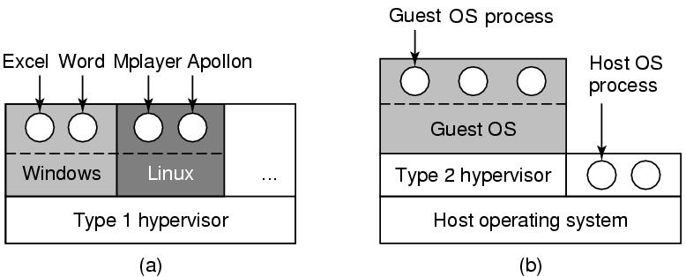
Types of Hypervisors
(a) A type 1 hypervisor. (b) A type 2 hypervisor
A. Frank - P. Weisberg

Slide 55
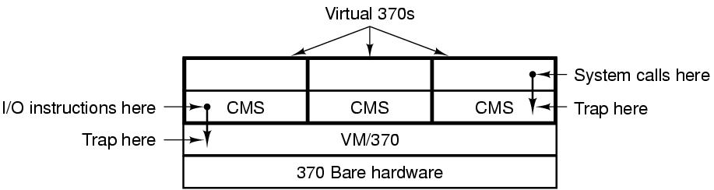
VM/370 with CMSs
A. Frank - P. Weisberg

Slide 56
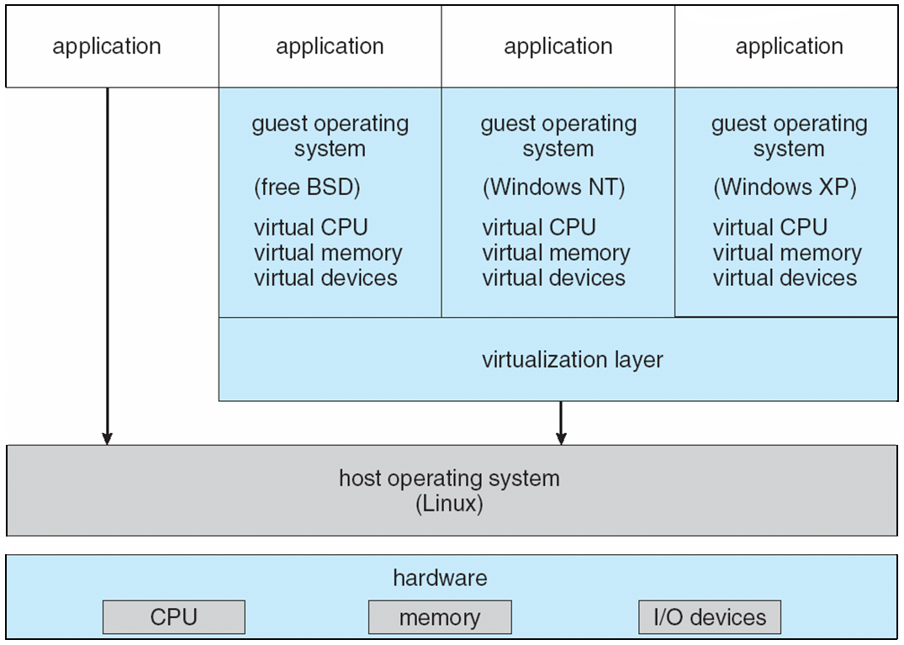
VMware Architecture
A. Frank - P. Weisberg

Slide 57
Para-Virtualization
Presents guest with system similar but not identical to hardware.
Guest must be modified to run on specialized para-virtualized hardware.
Guest can be an OS, or in the case of Solaris 10 applications running in containers.
A. Frank - P. Weisberg

Slide 58
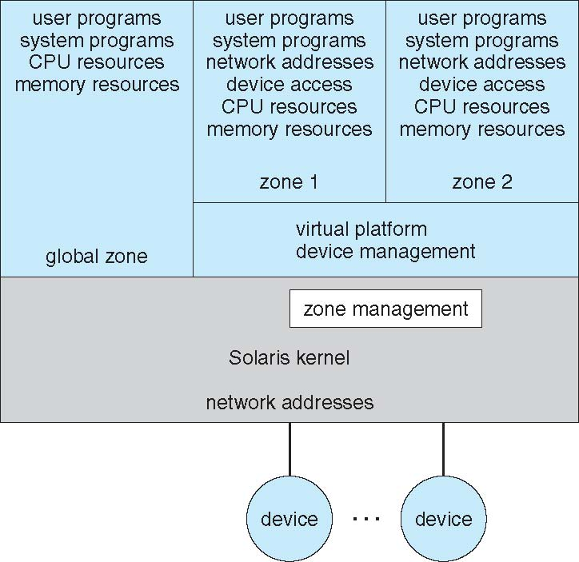
Solaris 10 with Two Containers
A. Frank - P. Weisberg

