Slide 1
Operating Systems
Introduction to Processes
A. Frank - P. Weisberg

Slide 2
Process Concept
Process is a program in execution; forms the basis of all computation; process execution must progress in sequential fashion.
  Program is a passive entity stored on disk (executable file), Process is an active entity; A program becomes a process when executable file is loaded into memory.
Execution of program is started via CLI entry of its name,
GUI mouse clicks, etc.
A process is an instance of a running program; it can be assigned to, and executed on, a processor.
Related terms for Process: Job, Step, Load Module, Task, Thread.
A. Frank - P. Weisberg

Slide 3
Process Parts
A process includes three segments/sections:
  Program: code/text.
  Data: global variables and heap
    Heap contains memory dynamically allocated during run time.
  Stack: temporary data
    Procedure/Function parameters, return addresses,
    local variables.
Current activity of a program includes its Context: program counter, state, processor registers, etc.
One program can be several processes:
  Multiple users executing the same Sequential program.
  Concurrent program running several process.
A. Frank - P. Weisberg

Slide 4
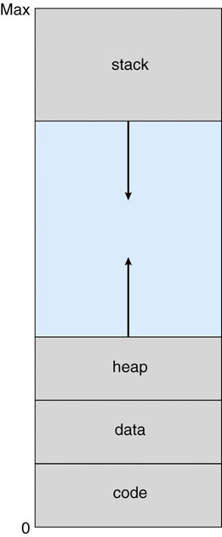
Process in Memory (1)
A. Frank - P. Weisberg

Slide 5

Processes in Memory (2)
A. Frank - P. Weisberg

Slide 6
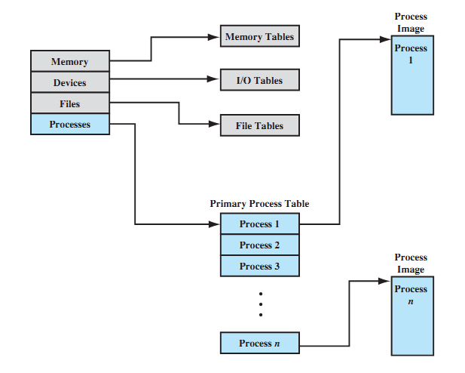
General Structure of OS Control Tables
A. Frank - P. Weisberg

Slide 7
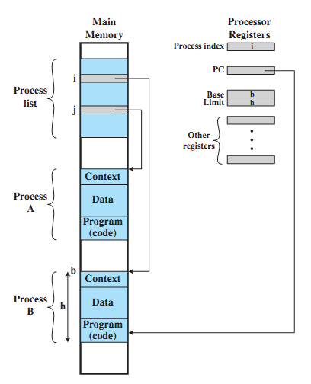
Typical Process Table Implementation
A. Frank - P. Weisberg

Slide 8

Process Attributes
Process ID
Parent process ID
User ID
Process state/priority
Program counter
CPU registers
Memory management information
I/O status information
Access Control
Accounting information
A. Frank - P. Weisberg

Slide 9

Typical process table entry
A. Frank - P. Weisberg

Slide 10
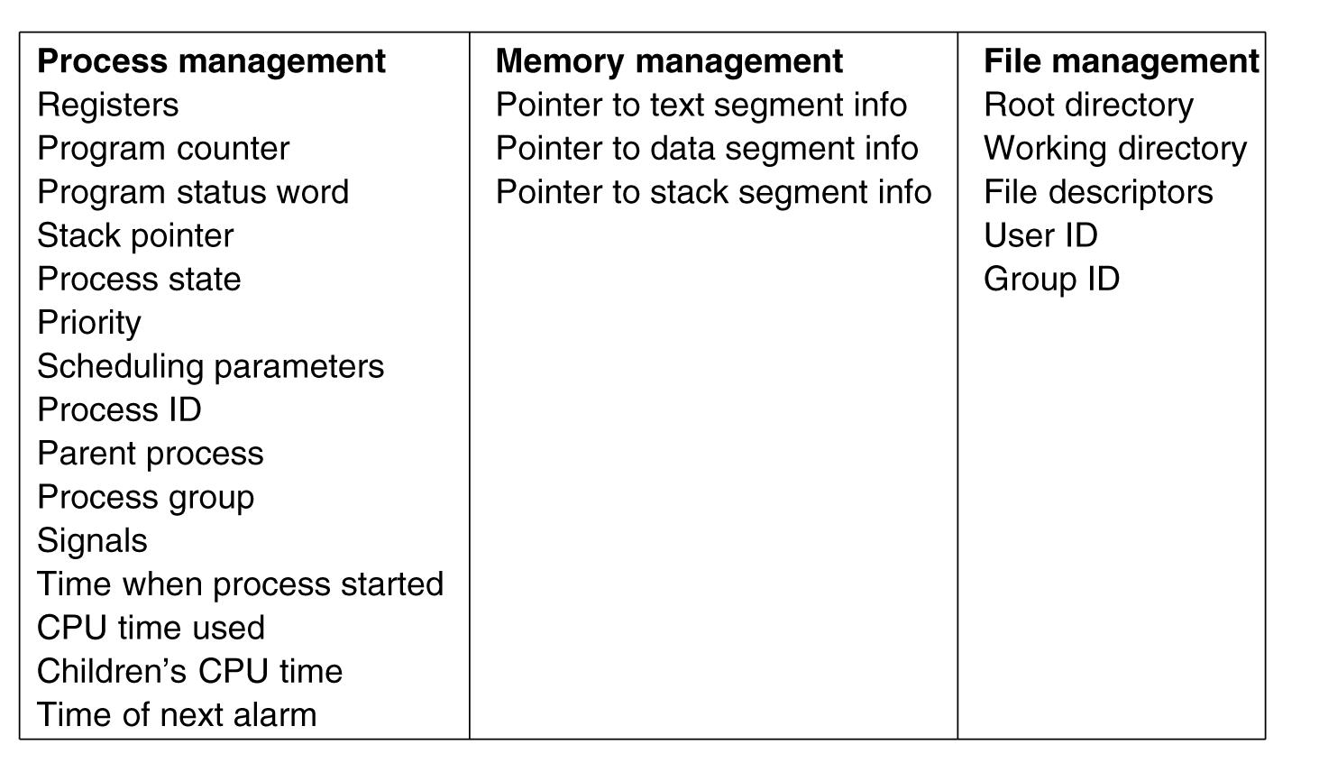
Fields of a typical process table entry
A. Frank - P. Weisberg

Slide 11
Components of Process Control Block (PCB)
Process Control Block (PCB) – IBM name for information associated with each process –
its context!
PCB (execution context) is the data needed (process attributes) by OS to control process:
    Process location information
    Process identification information
    Processor state information
    Process control information
A. Frank - P. Weisberg

Slide 12
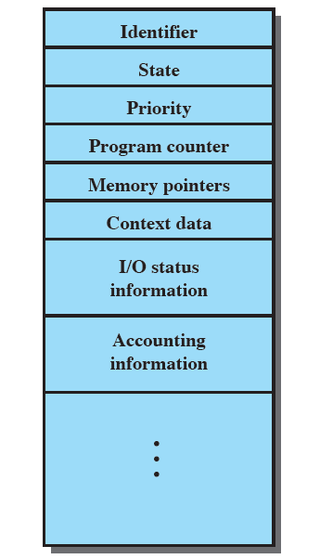
Process Control Block (PCB)
A. Frank - P. Weisberg

Slide 13
Process Location Information
Each process image in memory:
  may not occupy a contiguous range of addresses (depends on memory management scheme used).
  both a private and shared memory address space can be used.
The location if each process image is pointed to by an entry in the process table.
For the OS to manage the process, at least part of its image must be brought into main memory.
A. Frank - P. Weisberg

Slide 14
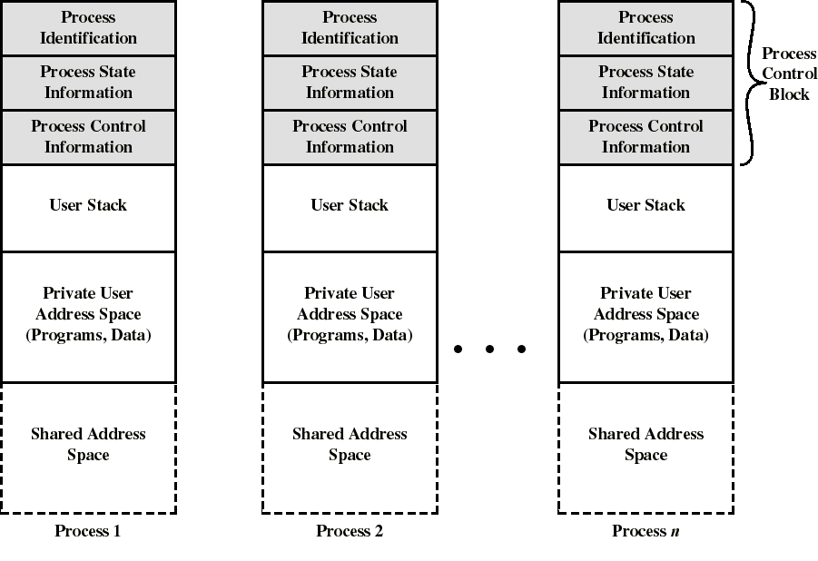
Process Images in Memory

Slide 15
Process Identification Information
A few numeric identifiers may be used:
  Unique process identifier (PID) –
    indexes (directly or indirectly) into the process table.
  User identifier (UID) –
    the user who is responsible for the job.
  Identifier of the process that created this process (PPID).
Maybe symbolic names that are related to numeric identifiers.
A. Frank - P. Weisberg

Slide 16
Processor State Information
Contents of processor registers:
  User-visible registers
  Control and status registers
  Stack pointers
Program Status Word (PSW)
  contains status information
  Example: the EFLAGS register on Pentium machines.
A. Frank - P. Weisberg

Slide 17
Process Control Information
scheduling and state information:
  Process state (i.e., running, ready, blocked...)
  Priority of the process
  Event for which the process is waiting (if blocked).
data structuring information
  may hold pointers to other PCBs for process queues, parent-child relationships and other structures.
A. Frank - P. Weisberg

Slide 18
Process Control Information
Inter-process communication –
  may hold flags and signals for IPC.
Resource ownership and utilization –
  resource in use: open files, I/O devices...
  history of usage (of CPU time, I/O...).
Process privileges (Access control) –
  access to certain memory locations, to resources, etc…
Memory management –
  pointers to segment/page tables assigned to this process.
A. Frank - P. Weisberg

Slide 19
Process States
Let us start with three states:
  Running state –
    the process that gets executed (single CPU);
    its instructions are being executed.
  Ready state –
    any process that is ready to be executed; the process
    is waiting to be assigned to a processor.
  Waiting/Blocked state –
    when a process cannot execute until its I/O
    completes or some other event occurs.
A. Frank - P. Weisberg

Slide 20
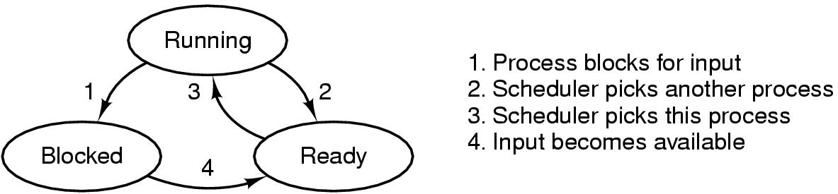
A Three-state Process Model
Dispatch
Ready
Running
Time-out
Event
Occurs
Event
Wait
Waiting

Slide 21

Process Transitions (1)
Ready –> Running
  When it is time, the dispatcher selects a new process to run.
Running –> Ready
  the running process has expired his time slot.
  the running process gets interrupted because a higher priority process is in the ready state.
A. Frank - P. Weisberg

Slide 22
Process Transitions (2)
Running –> Waiting
  When a process requests something for which it must wait:
    a service that the OS is not ready to perform.
    an access to a resource not yet available.
    initiates I/O and must wait for the result.
    waiting for a process to provide input.
Waiting –> Ready
  When the event for which it was waiting occurs.
A. Frank - P. Weisberg

Slide 23
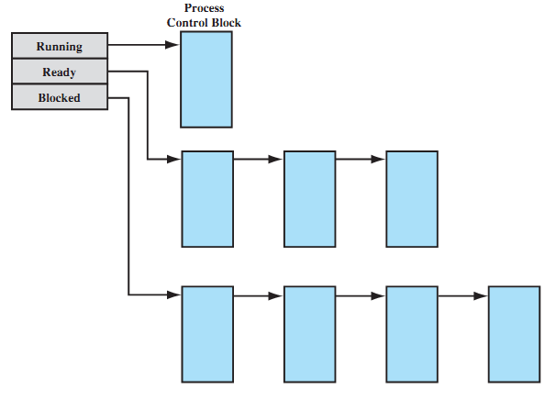
Process List Structures
A. Frank - P. Weisberg

Slide 24

Five-state Process Model
A. Frank - P. Weisberg

Slide 25

Other Useful States (1)
New state –
  OS has performed the necessary actions to create the process:
    has created a process identifier.
    has created tables needed to manage the process.
  but has not yet committed to execute the process (not yet admitted):
    because resources are limited.
A. Frank - P. Weisberg

Slide 26
Other Useful States (2)
Terminated state –
  Program termination moves the process to this state.
  It is no longer eligible for execution.
  Tables and other info are temporarily preserved for auxiliary program –
    Example: accounting program that cumulates resource usage for billing the users.
The process (and its tables) gets deleted when the data is no more needed.
A. Frank - P. Weisberg

Slide 27
Reasons for Process Creation
System initialization.
Submission of a batch job.
User logs on.
Created by OS to provide a service to a user (e.g., printing a file).
A user request to create a new process.
Spawned by an existing process
  a program can dictate the creation of a number of processes.
A. Frank - P. Weisberg

Slide 28

Process Creation (1)
Parent process create children processes, which, in turn create other processes, forming a tree of processes.
Possible resource sharing:
  Parent and children share all resources.
  Children share subset of parent’s resources.
  Parent and child share no resources.
Possible execution:
  Parent and children execute concurrently.
  Parent waits until children terminate.
A. Frank - P. Weisberg

Slide 29

A tree of processes on UNIX
A. Frank - P. Weisberg

Slide 30
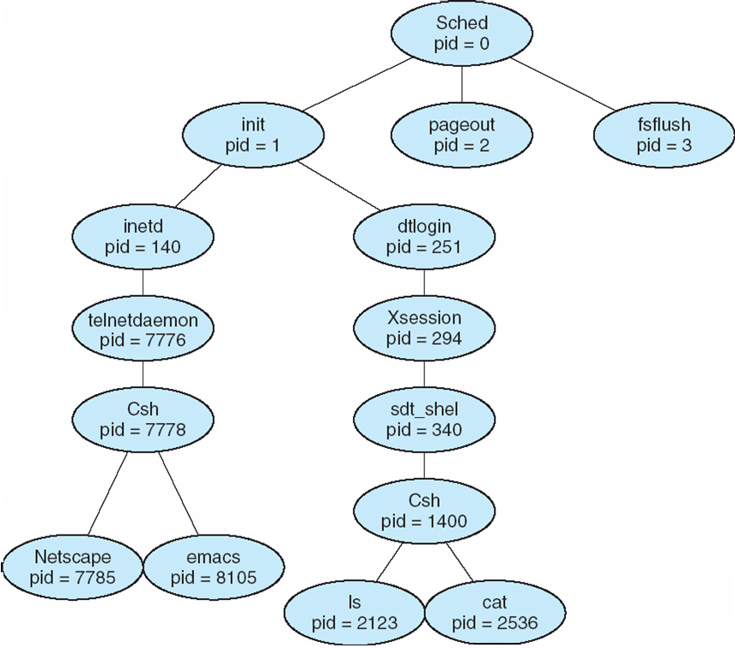
A tree of processes on typical Solaris
A. Frank - P. Weisberg

Slide 31

Process Creation (2)
Assign a unique process identifier (PID).
Allocate space for the process image.
Initialize process control block
  many default values (e.g., state is New, no I/O devices or files...).
Set up appropriate linkages
  Ex: add new process to linked list used for the scheduling queue.
A. Frank - P. Weisberg

Slide 32

Process Creation (3)
Address space
  Child duplicate of parent.
  Child has a program loaded into it.
UNIX examples
  fork system call creates new process.
  exec system call used after a fork to replace the process’ memory space with a new program.
A. Frank - P. Weisberg

Slide 33
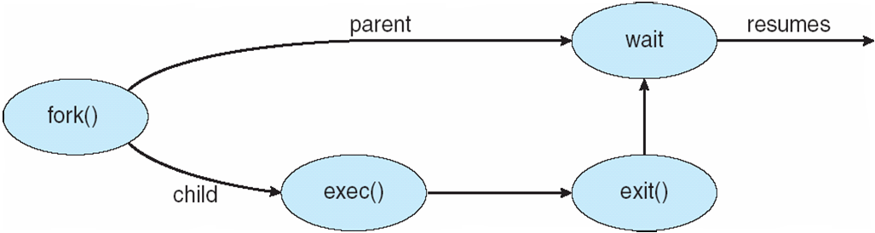
Process Creation (3)
A. Frank - P. Weisberg

Slide 34
C Program Forking Separate Process
int main()
{
pid_t pid;
/* fork another process */
pid = fork();
if (pid < 0) { /* error occurred */
fprintf(stderr, "Fork Failed");
exit(-1);
}
else if (pid == 0) { /* child process */
execlp("/bin/ls", "ls", NULL);
}
else { /* parent process */
/* parent will wait for the child to complete */
wait (NULL);
printf ("Child Complete");
exit(0);
}
}

Slide 35

When does a process get terminated?
Batch job issues Halt instruction.
User logs off.
Process executes a service request to terminate.
Parent kills child process.
Error and fault conditions.
A. Frank - P. Weisberg

Slide 36

Reasons for Process Termination (1)
Normal/Error/Fatal exit.
Time limit exceeded
Memory unavailable
Memory bounds violation
Protection error
  example: write to read-only file
Arithmetic error
Time overrun
  process waited longer than a specified maximum for an event.
A. Frank - P. Weisberg

Slide 37

Reasons for Process Termination (2)
I/O failure
Invalid instruction
  happens when trying to execute data.
Privileged instruction
Operating system intervention
  such as when deadlock occurs.
Parent request to terminate one child.
Parent terminates so child processes terminate.
A. Frank - P. Weisberg

Slide 38
Process Termination
Process executes last statement and asks the operating system to terminate it (exit):
  Output data from child to parent (via wait).
  Process’ resources are deallocated by operating system.
Parent may terminate execution of child processes (abort):
  Child has exceeded allocated resources.
  Mission assigned to child is no longer required.
  If Parent is exiting:
    Some OSs do not allow child to continue if its parent terminates.
    Cascading termination – all children terminated.
A. Frank - P. Weisberg

Slide 39
UNIX SVR4 Process States
User Running Executing in user mode.
Kernel Running Executing in kernel mode.
Ready to Run, in Memory Ready to run as soon as the kernel schedules it.
Asleep in Memory Unable to execute until an event occurs; process is in main memory (a blocked state).
Ready to Run, Swapped Process is ready to run, but the swapper must swap the process into main memory before the kernel can schedule it to execute.
Sleeping, Swapped The process is awaiting an event and has been swapped to secondary storage (a blocked state).
Preempted Process is returning from kernel to user mode, but the kernel preempts it and does a process switch to schedule another process.
Created Process is newly created and not yet ready to run.
Zombie Process no longer exists, but it leaves a record for its parent process to collect.
A. Frank - P. Weisberg

Slide 40
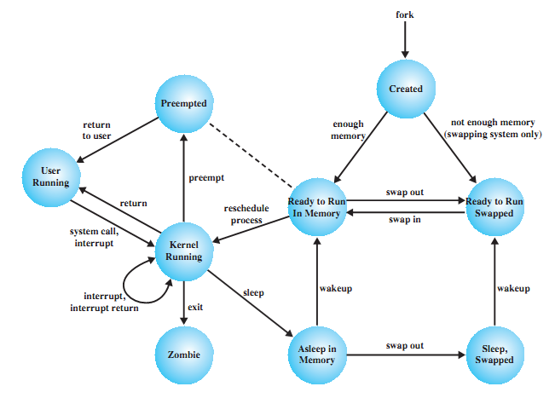
UNIX SVR4 States Process Model
A. Frank - P. Weisberg

