Slide 1
Operating Systems
Process Scheduling and Switching
A. Frank - P. Weisberg

Slide 2
Processor Scheduling
Maximize CPU use, quickly switch processes onto CPU for time sharing.
Process scheduler selects among available processes for next execution on CPU.
Maintains scheduling queues of processes:
  Job queue – set of all processes in the system.
  Ready queue – set of all processes residing in main memory, ready and waiting to execute.
  Device queues – set of processes waiting for an I/O device.
Processes migrate among the various queues.
A. Frank - P. Weisberg

Slide 3
Types of Schedulers
Long-term scheduler (jobs scheduler) – selects which programs/processes should be brought into the ready queue.
Medium-term scheduler (emergency scheduler) – selects which job/process should be swapped out if system is loaded.
Short-term scheduler (CPU scheduler) – selects which process should be executed next and allocates CPU.
A. Frank - P. Weisberg

Slide 4
Long-Term Scheduling
Determines which programs are admitted to the system for processing.
Controls the degree of multiprogramming.
If more processes are admitted:
  less likely that all processes will be blocked –
  better CPU usage.
  each process has less fraction of the CPU.
Long-term scheduler strives for good process mix.
A. Frank - P. Weisberg

Slide 5
Short-Term Scheduling
Determines which process is going to execute next (also called CPU scheduling).
The short term scheduler is also known as the dispatcher (which is part of it).
Is invoked on a event that may lead to choose another process for execution:
  clock interrupts
  I/O interrupts
  operating system calls and traps
  signals
A. Frank - P. Weisberg

Slide 6
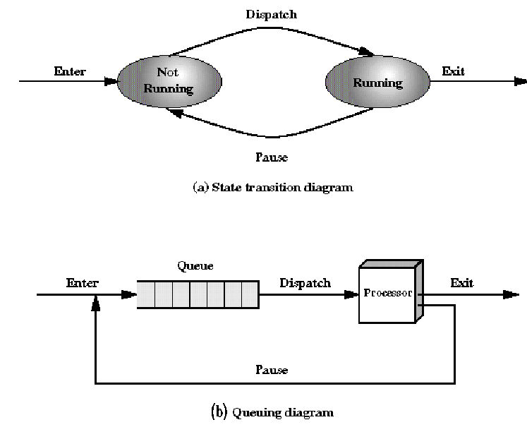
Long/Short-Term Scheduling
Short-
term
Long-
term
A. Frank - P. Weisberg

Slide 7
Aspects of Schedulers
Long-term scheduler is invoked very infrequently (seconds, minutes) ⇒ (may be slow).
The long-term scheduler controls the degree of multiprogramming.
Short-term scheduler is invoked very frequently (milliseconds) ⇒ (must be fast).
Processes can be described as either:
  I/O-bound process – spends more time doing I/O than computations, many short CPU bursts.
  CPU-bound process – spends more time doing computations; few very long CPU bursts.
A. Frank - P. Weisberg

Slide 8
Medium-Term Scheduling
So far, all processes have to be (at least partly) in main memory.
Even with virtual memory, keeping too many processes in main memory will deteriorate the system’s performance.
The OS may need to swap out some processes to disk, and then later swap them back in.
Swapping decisions based on the need to manage multiprogramming.
A. Frank - P. Weisberg

Slide 9
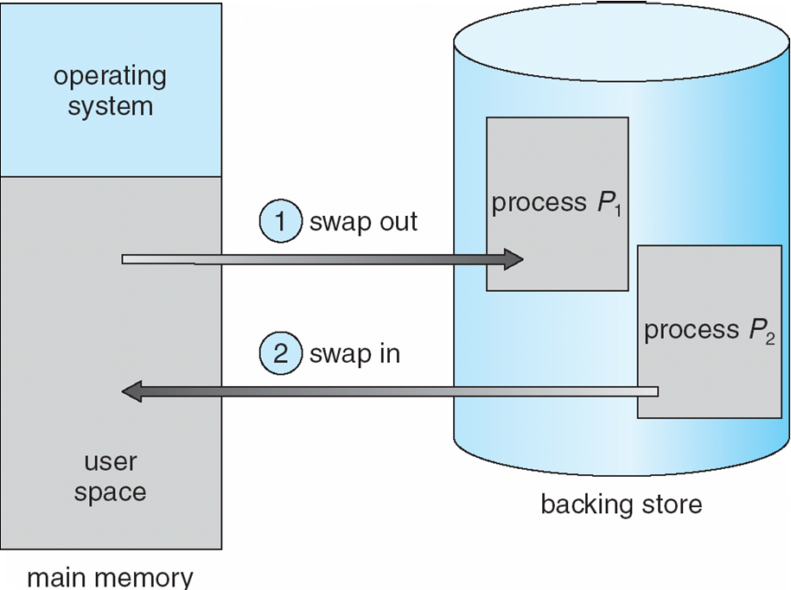
Schematic View of Swapping
A. Frank - P. Weisberg

Slide 10
Dynamics of Swapping
A process can be swapped temporarily out of memory to a backing store, and then brought back into memory for
continued execution
Backing store – fast disk large enough to accommodate copies of all memory images for all users; must provide direct access to these memory images.
Roll out, roll in – swapping variant used for priority-based scheduling algorithms; lower-priority process is swapped out so higher-priority process can be loaded and executed.
Major part of swap time is transfer time; total transfer time is directly proportional to the amount of memory swapped.
Modified versions of swapping are found on many systems (i.e., UNIX, Linux, and Windows).
System maintains a ready queue of ready-to-run processes which have memory images on disk
A. Frank - P. Weisberg

Slide 11

Swapping Example
A. Frank - P. Weisberg

Slide 12

Addition of Medium Term Scheduling
Medium-
term
Short-
term
Long-
term
A. Frank - P. Weisberg

Slide 13
Support for Swapping
The OS may need to suspend some processes, i.e., to swap them out to disk and then swap them back in.
We add 2 new states:
  Blocked Suspend: blocked processes which have been swapped out to disk.
  Ready Suspend: ready processes which have been swapped out to disk.
A. Frank - P. Weisberg

Slide 14
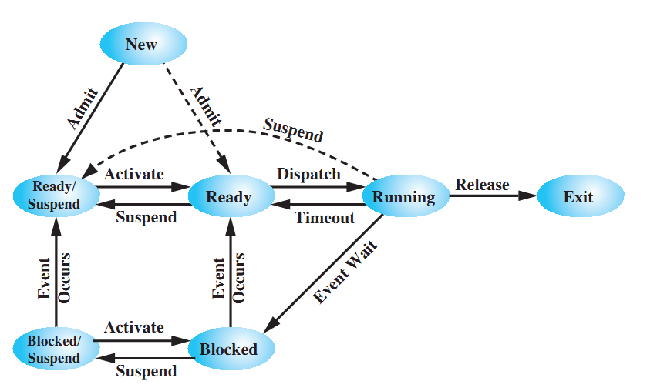
A Seven-state Process Model
A. Frank - P. Weisberg

Slide 15
New state transitions
Blocked –> Blocked Suspend
  When all processes are blocked, the OS will make room to bring a ready process in memory.
Blocked Suspend –> Ready Suspend
  When the event for which it has been waiting occurs
  (state info is available to OS).
Ready Suspend –> Ready
  when no more ready processes in main memory.
Ready –> Ready Suspend (unlikely)
  When there are no blocked processes and must free
  memory for adequate performance.
A. Frank - P. Weisberg

Slide 16
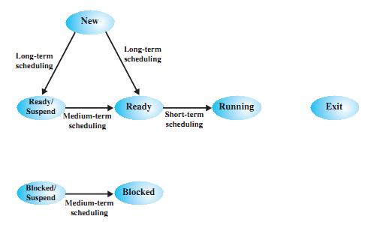
Classification of Scheduling Activity
A. Frank - P. Weisberg

Slide 17
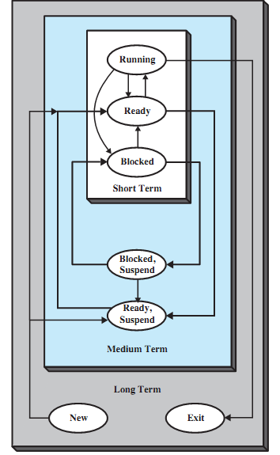
Another view of the 3 levels of scheduling
A. Frank - P. Weisberg

Slide 18
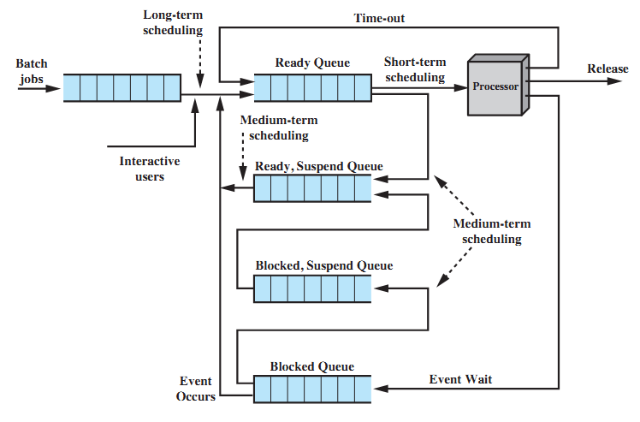
Queuing Diagram for Scheduling

Slide 19
Dispatcher (short-term scheduler)
Is an OS program that moves the processor from one process to another.
It prevents a single process from monopolizing processor time.
It decides who goes next according to a scheduling algorithm.
The CPU will always execute instructions from the dispatcher while switching from process A to process B.
A. Frank - P. Weisberg

Slide 20
Process Scheduling Queues
Process queue – set of all processes in the system.
Ready queue – set of processes residing in main memory, ready and waiting to execute.
Device queues – set of processes waiting for
an I/O device.
Processes migrate among the various queues.
A. Frank - P. Weisberg

Slide 21
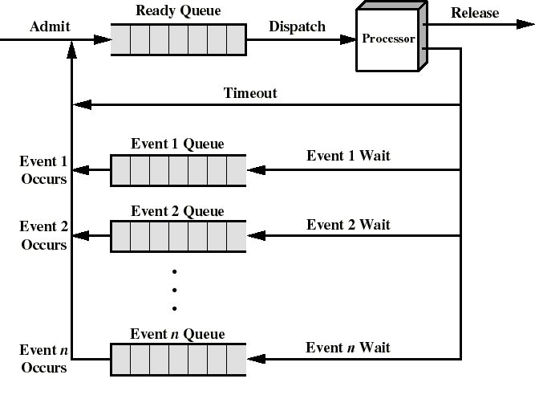
A Queuing Discipline
When event n occurs, the corresponding process is moved into the ready queue
A. Frank - P. Weisberg

Slide 22

Ready Queue and various I/O Device Queues
A. Frank - P. Weisberg

Slide 23

Process Switch
A. Frank - P. Weisberg

Slide 24
When to Switch a Process?
A process switch may occur whenever the OS has gained control of CPU. i.e., when:
  Supervisor Call
    explicit request by the program (example: file open) –
    the process will probably be blocked.
  Trap
    an error resulted from the last instruction –
    it may cause the process to be moved to terminated state.
  Interrupt
    the cause is external to the execution of the current instruction – control is transferred to Interrupt Handler.
A. Frank - P. Weisberg

Slide 25
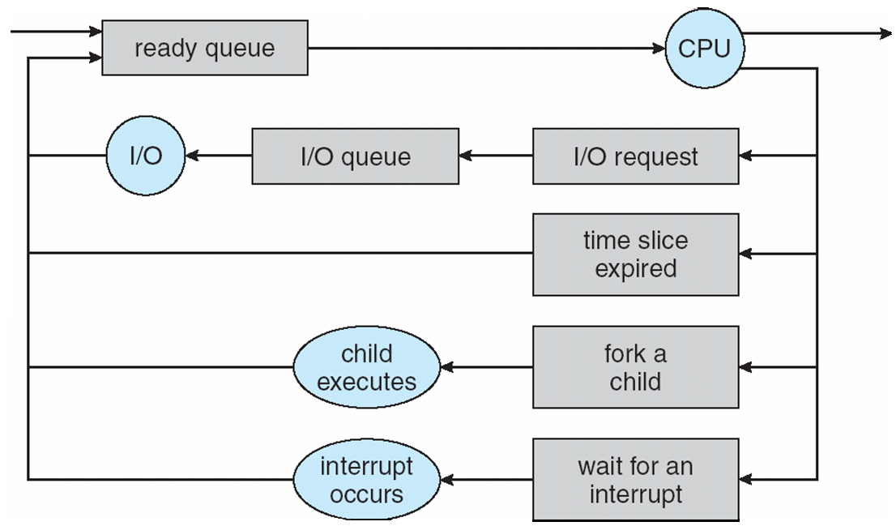
Reasons for Process Switch
A. Frank - P. Weisberg

Slide 26
Context Switch
When CPU switches to another process, the system must save the state of the old process and load the saved state for the new process.
This is called context switch.
Context of a process represented in the PCB.
The time it takes is dependent on hardware support.
Context-switch time is overhead; the system does no useful work while switching.
A. Frank - P. Weisberg

Slide 27
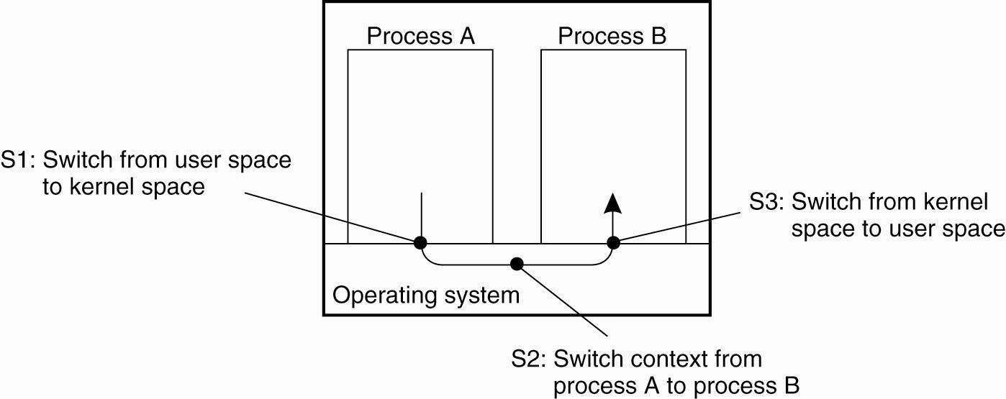
Context switch between processes (1)
A. Frank - P. Weisberg

Slide 28

Context switch between processes (2)
A. Frank - P. Weisberg

Slide 29
Steps in Context Switch
Save context of processor including program counter and other registers.
Update the PCB of the running process with its new state and other associate information.
Move PCB to appropriate queue – ready, blocked,
Select another process for execution.
Update PCB of the selected process.
Restore CPU context from that of the selected process.
A. Frank - P. Weisberg

Slide 30
Example of Context Switch
p1
p2
p3
kernel
I/O
}
scheduler
I/O request
{
device driver
}
scheduler
Time slice exceeded
}
scheduler
Interrupt
{
device driver
}
scheduler
A. Frank - P. Weisberg

Slide 31
Mode Switch
It may happen that an interrupt does not produce a context switch.
The control can just return to the interrupted program.
Then only the processor state information needs to be saved on stack.
This is called mode switch (user to kernel mode when going into Interrupt Handler).
Less overhead: no need to update the PCB like for context switch.
A. Frank - P. Weisberg

