Slide 1
Operating Systems
Introduction to Tasks/Threads
A. Frank - P. Weisberg

Slide 2
Process Characteristics (1)
Unit of resource ownership – process is allocated:
  an address space to hold the process image.
  control of some resources (files, I/O devices...).
Unit of dispatching – process is an execution path through one or more programs:
  execution may be interleaved with other process.
  the process has an execution state and a dispatching priority.
A. Frank - P. Weisberg

Slide 3
Process Characteristics (2)
These two characteristics are treated independently by some recent OSs:
  The unit of resource ownership is usually referred to as a Task or (for historical reasons) also as a Process.
  The unit of dispatching is usually referred to a Thread or a Light-Weight Process (LWP).
A traditional Heavy-Weight Process (HWP) is equal to a task with a single thread.
Several threads can exist in the same task.
  Multithreading - The ability of an OS to support multiple, concurrent paths of execution within a single process.
A. Frank - P. Weisberg

Slide 4

The Process vs. Thread Model
(a) Three processes each with one thread.
(b) One process with three threads.
A. Frank - P. Weisberg

Slide 5
Threads Motivation
Most modern applications are multithreaded.
Threads run within application.
Multiple tasks with the application can be implemented by separate threads:
  Update display
  Fetch data
  Spell checking
  Answer a network request
Process creation is heavy-weight while thread creation is light-weight.
Can simplify code, increase efficiency.
Kernels are generally multithreaded.
A. Frank - P. Weisberg

Slide 6
Tasks/Processes and Threads (1)
Task Items (shared by all threads of task):
  address space which holds the process image
  global variables
  protected access to files, I/O and other resources
Thread Items:
  an execution state (Running, Ready, etc.)
  program counter, register set
  execution stack
  some per-thread static storage for local variables
  saved thread context when not running
A. Frank - P. Weisberg

Slide 7
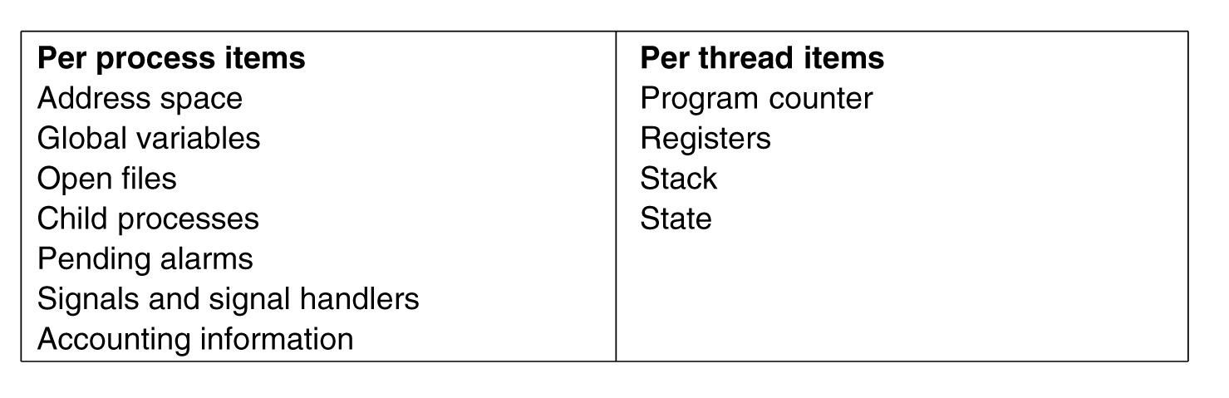
Tasks/Processes and Threads (2)
A. Frank - P. Weisberg

Slide 8

Each thread has its own stack
A. Frank - P. Weisberg

Slide 9
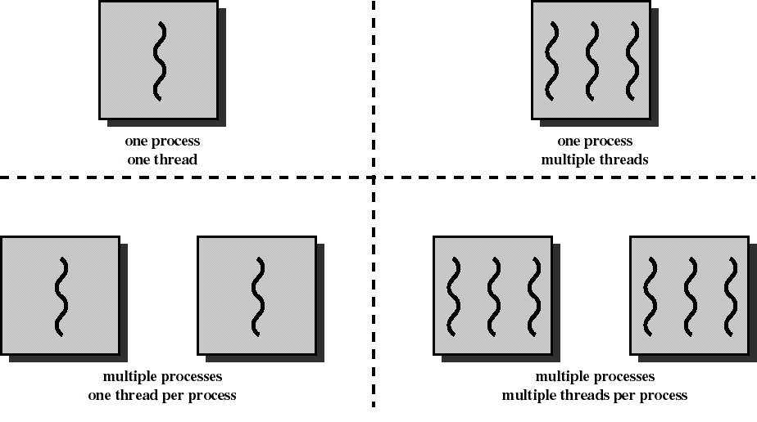
Combinations of Threads and Processes
A. Frank - P. Weisberg

Slide 10

Single and Multithreaded Processes
A. Frank - P. Weisberg

Slide 11
Processes vs. Threads
Creating and managing processes is generally
regarded as an expensive task (fork system call).
Making sure all the processes peacefully co-exist on the system is not easy (as concurrency transparency comes at a price).
Threads can be thought of as an “execution of a part of a program (in user-space)”.
Rather than make the OS responsible for concurrency transparency, it is left to the individual application to manage the creation and scheduling of each thread.
A. Frank - P. Weisberg

Slide 12
Benefits of Threads (1)
Responsiveness – may allow continued execution if part of process is blocked, especially important for user interfaces.
Resource Sharing – threads share process resources, easier than shared memory or message passing.
Economy – cheaper than process creation, thread switching lower overhead than context switching.
Scalability – process can take advantage of multiprocessor architectures and networked/distributed systems.
A. Frank - P. Weisberg

Slide 13
Benefits of Threads (2)
Threads allows parallel activity inside a single address space:
  While one server thread is blocked and waiting,
  a second thread in the same task can run.
  Less time to create and terminate a thread than a process (because we do not need another address space).
  Less time to switch between two threads than between processes.
  Inter-thread communication and synchronization
  is very fast.
A. Frank - P. Weisberg

Slide 14
Examples of benefits of threads
Example 1: Word Processor:
  one thread displays menu and reads user input while another thread executes user commands and a third one writes to disk – the application is more responsive.
Example 2: a File/Web server on a LAN:
  It needs to handle several files/pages requests over a short period.
  Hence more efficient to create (and destroy) a single thread for each request.
  On a SMP machine: multiple threads can possibly be executing simultaneously on different processors.
A. Frank - P. Weisberg

Slide 15

Thread usage example: Word Processor
A. Frank - P. Weisberg

Slide 16

Thread usage example: Web Server
A. Frank - P. Weisberg

Slide 17
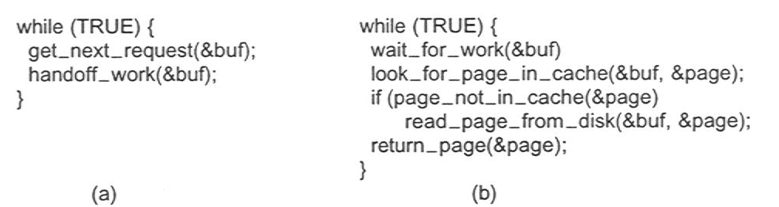
Web Server Threads
Dispatcher thread
Worker thread
A. Frank - P. Weisberg

Slide 18

Multithreaded Server Architecture
A. Frank - P. Weisberg

Slide 19
Important Implications
Two Important Implications:
  Threaded applications often run faster than non-threaded applications (as context-switches between kernel and user-space are avoided).
  Threaded applications are harder to develop (although simple, clean designs can help here).
Additionally, the assumption is that the development environment provides a Threads Library for developers to use (most modern environments do).
A. Frank - P. Weisberg

Slide 20
Application benefits of threads (1)
Consider an application that consists of several independent parts that do not need to run in sequence.
Each part can be implemented as a thread.
Whenever one thread is blocked waiting for an I/O, execution could possibly switch to another thread of the same application (instead of blocking it and switching to another application).
A. Frank - P. Weisberg

Slide 21

Application benefits of threads (2)
Since threads within the same process share memory and files, they can communicate with each other without invoking the kernel.
Therefore necessary to synchronize the activities of various threads so that they do not obtain inconsistent views of the current data.
A. Frank - P. Weisberg

Slide 22
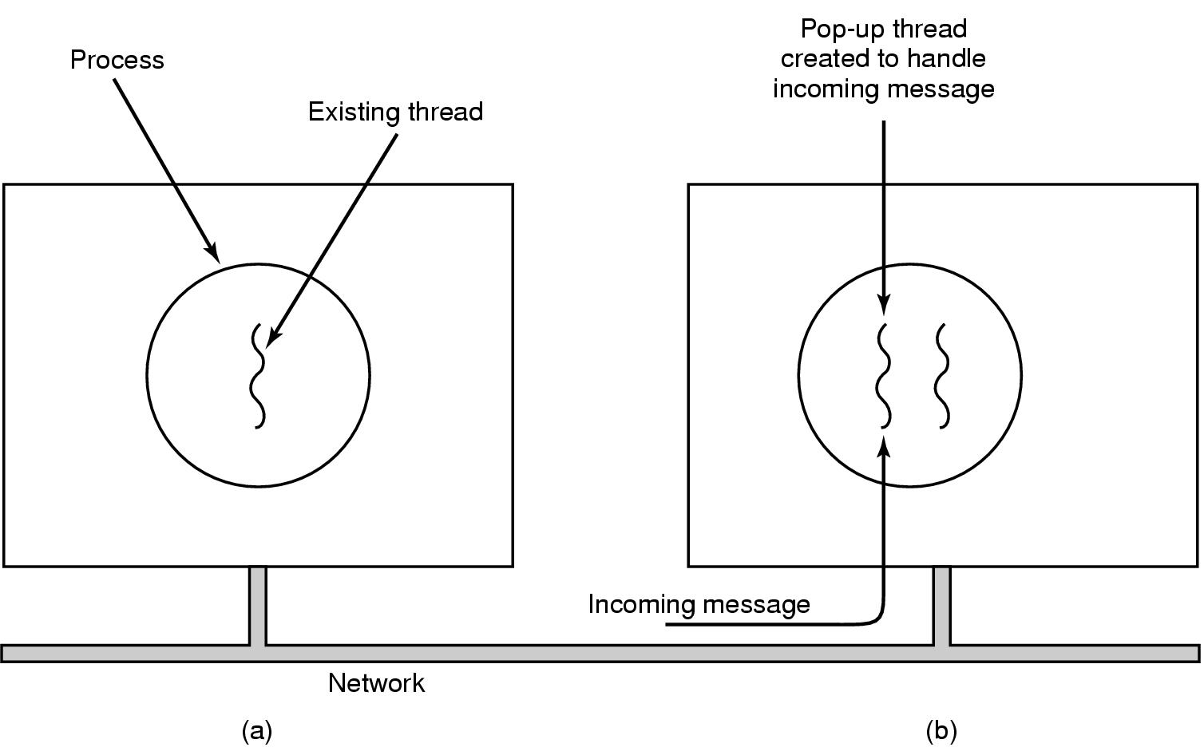
Pop-Up Threads
A. Frank - P. Weisberg

Slide 23
Thread Characteristics
Has an execution context/state.
Thread context is saved when not running.
Has an execution stack and some per-thread static storage for local variables.
Has access to the memory address space and resources of its task:
  all threads of a task share this.
  when one thread alters a (non-private) memory item, all other threads (of the task) see that.
  a file open with one thread, is available to others.
A. Frank - P. Weisberg

Slide 24
Threads States
Three key states: running, ready, blocked
They have no suspend state because all threads within same task share the same address space
  Indeed: suspending (i.e., swapping) a single thread involves suspending all threads of the same task.
Termination of a task, terminates all threads within the task.
A. Frank - P. Weisberg

Slide 25
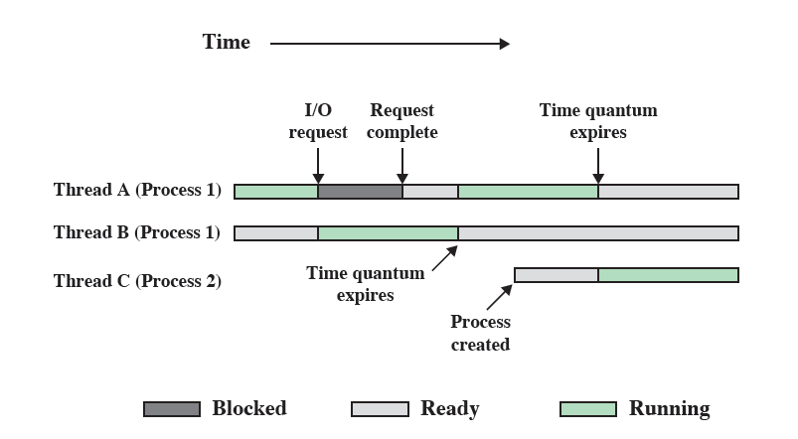
Multithreading Example
A. Frank - P. Weisberg

