Slide 1
Operating Systems
Threads Implementation
A. Frank - P. Weisberg

Slide 2


Contents
Multithreading Levels
Multithreading Models
Threading Issues
A. Frank - P. Weisberg

Slide 3
Multithreading vs. Single threading
Single threading: when the OS does not recognize the concept of thread.
Multithreading: when the OS supports multiple threads of execution within a single process.
MS-DOS supports a single user process and a single thread.
Older UNIXs supports multiple user processes but only support one thread per process.
Solaris and Windows NT support multiple threads.
A. Frank - P. Weisberg

Slide 4

Multithreading Levels
Thread library provides programmer with API for creating and managing threads.
Three multithreading levels:
  User-Level Threads (ULT)
    Library entirely in user space.
  Kernel-Level Threads (KLT)
    Kernel-level library supported by the OS.
  Hybrid ULT/KLT Approach
A. Frank - P. Weisberg

Slide 5
User(-level) and Kernel(-level) Threads
User(-level) threads – management by user-level threads library.
Three primary thread libraries:
  POSIX Pthreads
  Windows threads
  Java threads
Kernel(-level) threads – supported by the Kernel.
Examples – virtually all general purpose operating systems, including:
  Windows
  Solaris
  Linux
  Tru64 UNIX
  Mac OS X
A. Frank - P. Weisberg

Slide 6
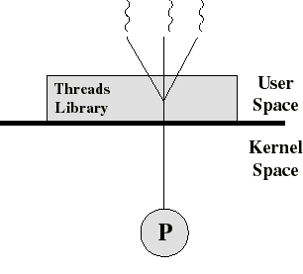
1) User-Level Threads (ULT)
Thread management done by user-level threads library
The kernel is not aware of
the existence of threads.
All thread management is
done by the application by
using a thread library.
Thread switching does not require kernel mode privileges.
Scheduling is application specific.
A. Frank - P. Weisberg

Slide 7
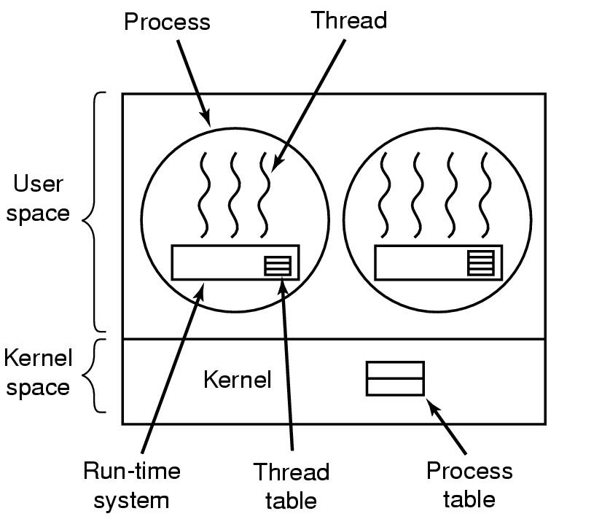
Implementing Threads in User Space
A. Frank - P. Weisberg

Slide 8

ULT Idea
Thread management done by user-level threads library.
Threads library contains code for:
  creating and destroying threads.
  passing messages and data between threads.
  scheduling thread execution.
  saving and restoring thread contexts.
Three primary thread libraries:
  POSIX Pthreads
  Win32 threads
  Java threads
A. Frank - P. Weisberg

Slide 9
POSIX Pthreads
A POSIX standard (IEEE 1003.1c) API for thread creation and synchronization.
May be provided either as ULT or KLT.
API specifies behavior of the thread library, implementation is up to development of the library.
Common in UNIX operating systems (Solaris, Linux, Mac OS X).
A. Frank - P. Weisberg

Slide 10
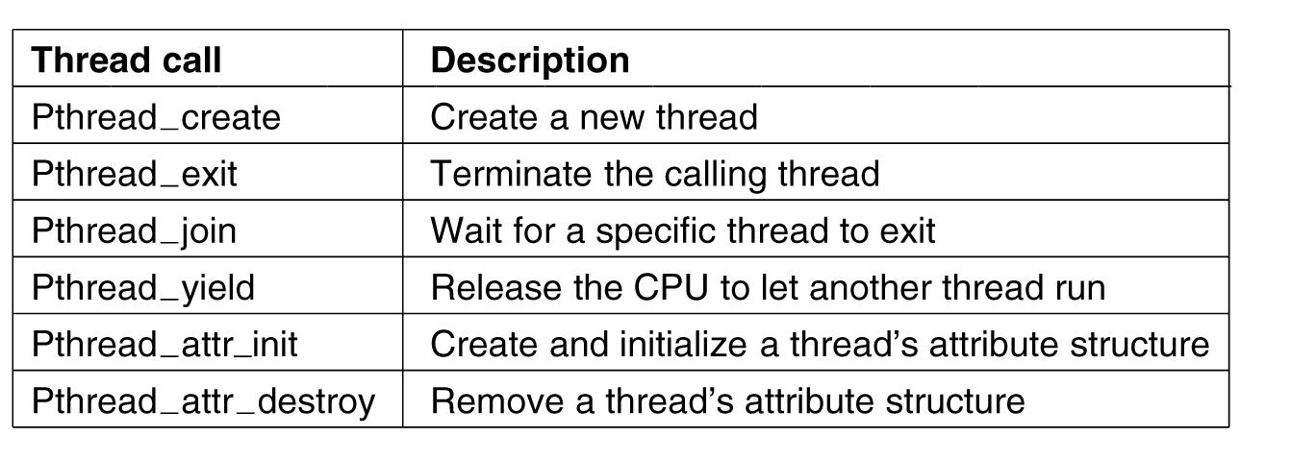
Some of the Pthreads function calls
A. Frank - P. Weisberg

Slide 11
Kernel activity for ULTs
The kernel is not aware of thread activity but it is still managing process activity.
When a thread makes a system call, the whole task will be blocked.
But for the thread library that thread is still in the running state.
So thread states are independent of process states.
A. Frank - P. Weisberg

Slide 12
Advantages and inconveniences of ULT
Advantages
  Thread switching does not involve the kernel: no mode switching.
  Scheduling can be application specific: choose the best algorithm.
  ULTs can run on any OS. Only needs a thread library.
Inconveniences
  Most system calls are blocking and the kernel blocks processes. So all threads within the process will be blocked.
  The kernel can only assign processes to processors. Two threads within the same process cannot run simultaneously on two processors.
A. Frank - P. Weisberg

Slide 13
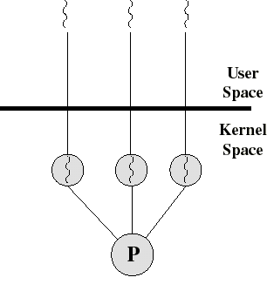
2) Kernel-Level Threads (KLT)
All thread management is done by kernel.
No thread library but an API to the kernel thread facility.
Kernel maintains context information for the process and the threads.
Switching between threads requires the kernel.
Scheduling on a thread basis.
A. Frank - P. Weisberg

Slide 14
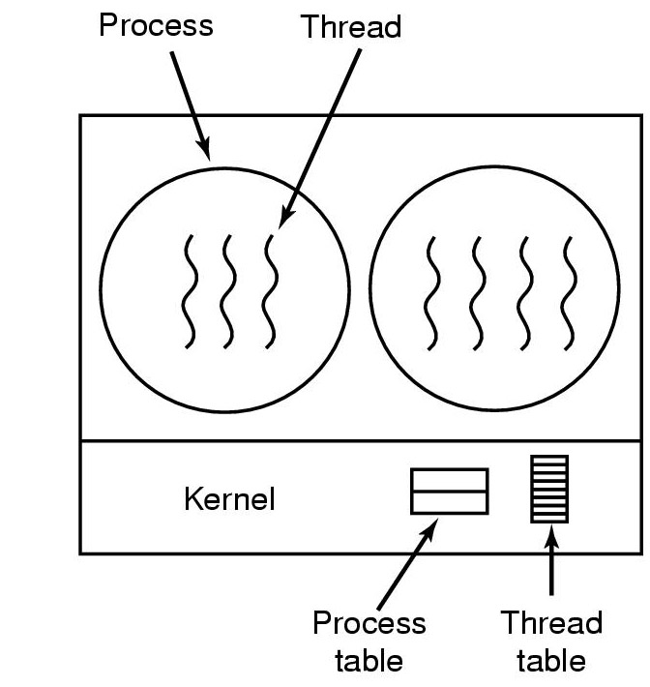
Implementing Threads in the Kernel
A. Frank - P. Weisberg

Slide 15

KLT Idea
Threads supported by the Kernel.
Examples:
  Windows 2000/XP
  OS/2
  Linux
  Solaris
  Tru64 UNIX
  Mac OS X
A. Frank - P. Weisberg

Slide 16
Linux Threads
Linux refers to them as tasks rather than threads.
Thread creation is done through clone()
system call.
clone() allows a child task to share the address space of the parent task (process).
This sharing of the address space allows the cloned child task to behave much like a separate thread.
A. Frank - P. Weisberg

Slide 17
Advantages and inconveniences of KLT
Advantages
  the kernel can simultaneously schedule many threads of the same process on many processors.
  blocking is done on a thread level.
  kernel routines can be multithreaded.
Inconveniences
  thread switching within the same process involves the kernel. We have 2 mode switches per thread switch.
  this results in a significant slow down.
A. Frank - P. Weisberg

Slide 18

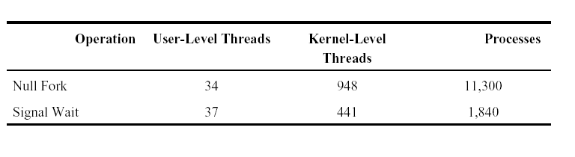
Thread operation latencies ( )
Source: Anderson, T. et al, “Scheduler Activations: Effective Kernel Support for the User-Level Management of Parallelism”, ACM TOCS, February 1992.
A. Frank - P. Weisberg

Slide 19
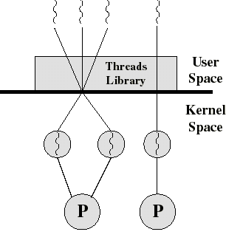
3) Hybrid ULT/KLT Approaches
Thread creation done in the user space.
Bulk of scheduling and synchronization of threads done in the user space.
The programmer may adjust the number of KLTs.
May combine the best of both approaches.
Example is Solaris prior to version 9.
A. Frank - P. Weisberg

Slide 20
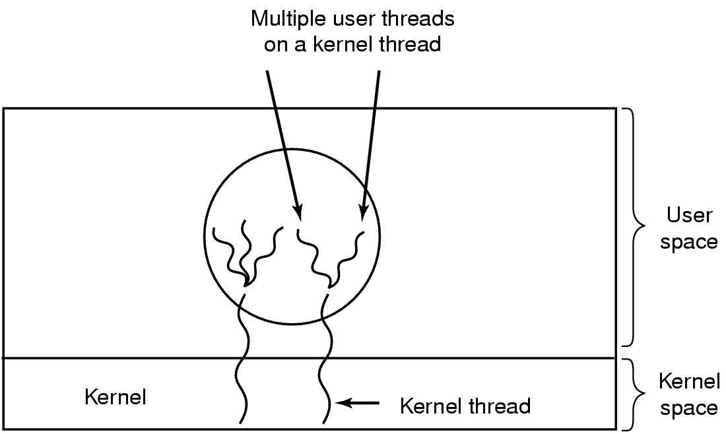
Hybrid Implementation (1)
Multiplexing user-level threads onto kernel-level threads.
A. Frank - P. Weisberg

Slide 21
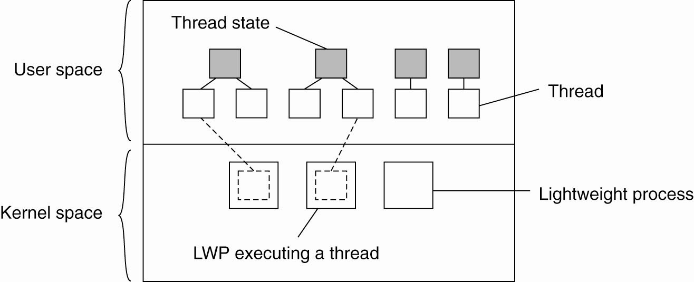
Hybrid Implementation (2)
A. Frank - P. Weisberg

Slide 22
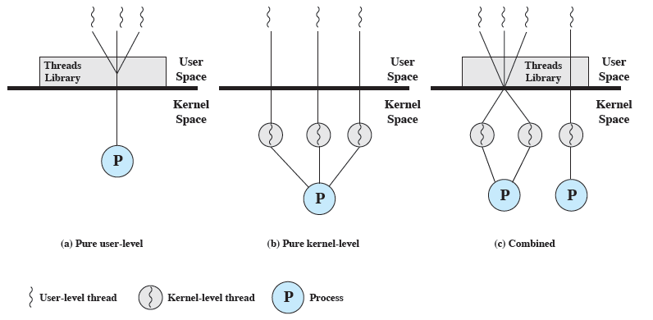
ULT, KLT and Combined Approaches
A. Frank - P. Weisberg

Slide 23

Multithreading Models
Many-to-One
One-to-One
Many-to-Many
Two-level Model
A. Frank - P. Weisberg

Slide 24
Relationship between Threads and Processes
Threads:Processes | Description | Example Systems
1:1 | Each thread of execution is a unique process with its own address space and resources. | Traditional UNIX implementations
M:1 | A process defines an address space and dynamic resource ownership. Multiple threads may be created and executed within that process. | Windows NT, Solaris, Linux, OS/2, OS/390, MACH
1:M | A thread may migrate from one process environment to another. This allows a thread to be easily moved among distinct systems. | Ra (Clouds), Emerald
M:N | Combines attributes of M:1 and 1:M cases. | TRIX
A. Frank - P. Weisberg

Slide 25
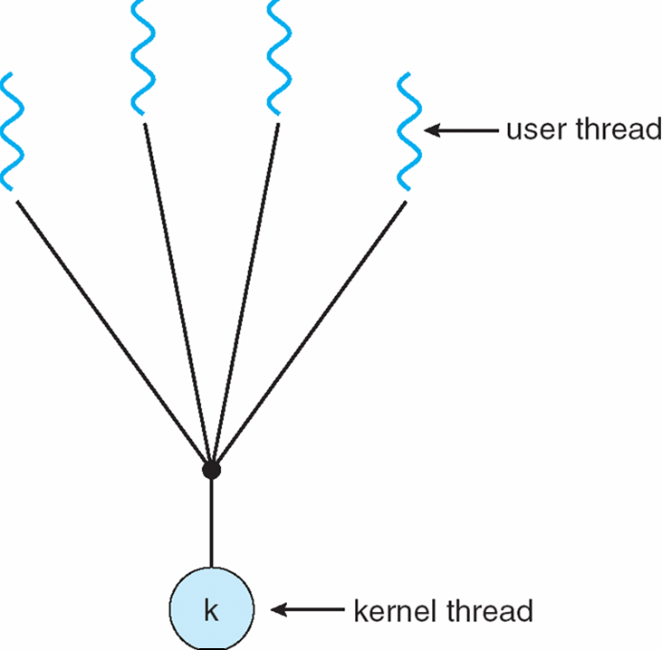
Many-to-One Model (1)
Many user-level threads mapped to single
kernel-level thread.
A. Frank - P. Weisberg

Slide 26
Many-to-One Model (2)
One thread blocking causes all to block.
Multiple threads may not run in parallel on multi-core system because only one may be in kernel at a time.
Few systems currently use this model.
Examples:
  Solaris Green Threads
  GNU Portable Threads
A. Frank - P. Weisberg

Slide 27
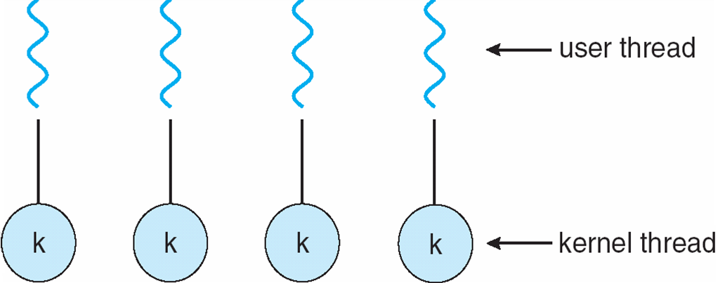
One-to-One Model (1)
Each user-level thread maps to kernel-level thread.
A. Frank - P. Weisberg

Slide 28
One-to-One Model (2)
Creating a user-level thread creates a kernel thread.
More concurrency than many-to-one.
Number of threads per process sometimes restricted due to overhead.
Examples
  Windows
  Linux
  Solaris 9 and later
A. Frank - P. Weisberg

Slide 29

Many-to-Many Model (1)
Allows many user level threads to be mapped to many kernel threads.
A. Frank - P. Weisberg

Slide 30
Many-to-Many Model (2)
Allows the operating system to create a sufficient number of kernel threads.
Solaris prior to version 9.
Windows with the ThreadFiber package.
A. Frank - P. Weisberg

Slide 31
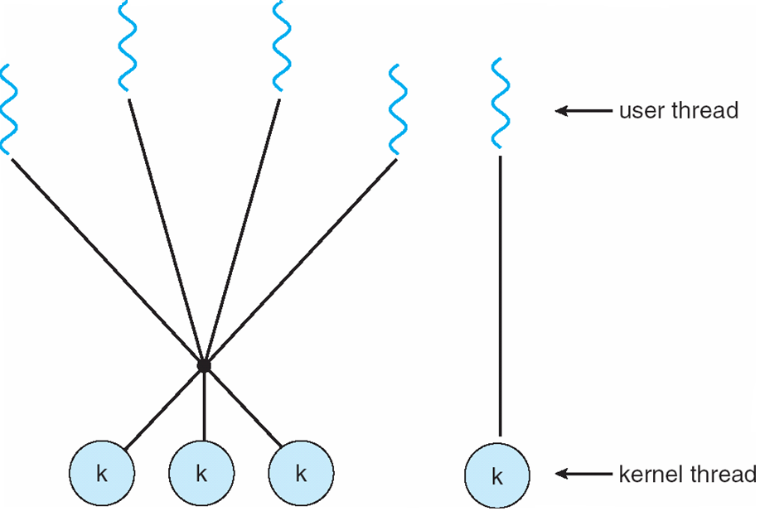
Two-level Model (1)
Similar to Many-to-Many model, except that it allows a user thread to be bound to kernel thread.
A. Frank - P. Weisberg

Slide 32
Two-level Model (2)
Examples:
  IRIX
  HP-UX
  Tru64 UNIX
  Solaris 8 and earlier
A. Frank - P. Weisberg

Slide 33
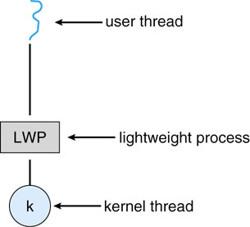
Lightweight Process (LWP)
A. Frank - P. Weisberg

Slide 34

Solaris 2 Threads
A. Frank - P. Weisberg

Slide 35

Java Threads
Java threads are managed by the JVM.
Typically implemented using the threads model provided by underlying OS.
Java threads may be created by:
  Extending Thread class (at language-level)
  Implementing the Runnable interface
A. Frank - P. Weisberg

Slide 36

Threading Issues
Semantics of fork() and exec() system calls
  Does fork() duplicate only the calling thread or all threads?
Thread cancellation of target thread
  Asynchronous or deferred
Signal handling
Thread pools
Thread-local storage
Scheduler activations
A. Frank - P. Weisberg

Slide 37
Thread Cancellation
Terminating a thread before it has finished.
Two general approaches:
  Asynchronous cancellation terminates the target thread immediately.
  Deferred cancellation allows the target thread to periodically check if it should be cancelled.
A. Frank - P. Weisberg

Slide 38
Signal Handling (1)
Signals are used in UNIX systems to notify a process that a particular event has occurred.
A signal handler is used to process signals:
  Signal is generated by particular event.
  Signal is delivered to a process.
  Signal is handled by one of two signal handlers:
    default
    user-defined
Every signal has default handler that kernel runs when
handling signal:
  User-defined signal handler can override default.
  For single-threaded, signal delivered to process.

Slide 39
Signal Handling (2)
Where should a signal be delivered for multi-threaded?
  Deliver the signal to the thread to which the signal applies.
  Deliver the signal to every thread in the process.
  Deliver the signal to certain threads in the process.
  Assign a specific thread to receive all signals for the process.

Slide 40
Thread Pools
Create a number of threads in a pool where
they await work.
Advantages:
  Usually slightly faster to service a request with an existing thread than create a new thread.
  Allows the number of threads in the application(s) to be bound to the size of the pool.
A. Frank - P. Weisberg

Slide 41
Thread-Local Storage
Thread-local storage (TLS) allows each thread to have its own copy of data.
Useful when you do not have control over the thread creation process (i.e., when using a thread pool).
Different from local variables:
  Local variables visible only during single function invocation.
  TLS visible across function invocations.
Similar to static data:
  TLS is unique to each thread.

Slide 42

Scheduler Activations
Both M:M and Two-level models require communication to maintain the appropriate number of kernel threads allocated to the application/
Typically use an intermediate data structure between user and kernel threads – lightweight process (LWP):
  Appears to be a virtual processor on which process can schedule user thread to run.
  Each LWP attached to kernel thread.
  How many LWPs to create?
Scheduler activations provide upcalls –
a communication mechanism from the kernel to
the upcall handler in the thread library.
This communication allows an application to maintain the correct number kernel threads.

Slide 43
Operating System Examples
Windows Threads
Linux Threads

Slide 44
(1) Windows Threads
Windows implements the Windows API – primary API for
Win 98, Win NT, Win 2000, Win XP, and Win 7.
Implements the one-to-one mapping, kernel-level.
Each thread contains:
  A thread id.
  Register set representing state of processor.
  Separate user and kernel stacks for when thread runs in user mode or kernel mode.
  Private data storage area used by run-time libraries and dynamic link libraries (DLLs).
The register set, stacks, and private storage area are known as the context of the thread.

Slide 45
Windows Threads (2)
The primary data structures of a thread include:
  ETHREAD (executive thread block) – includes pointer to process to which thread belongs and to KTHREAD, in kernel space.
  KTHREAD (kernel thread block) – scheduling and synchronization info, kernel-mode stack, pointer to TEB, in kernel space.
  TEB (thread environment block) – thread id, user-mode stack, thread-local storage, in user space.

Slide 46
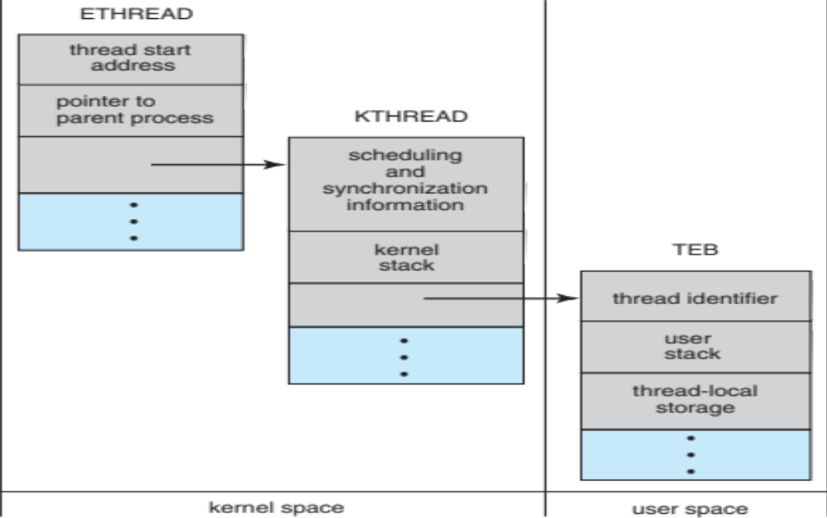
Windows Threads Data Structures

Slide 47
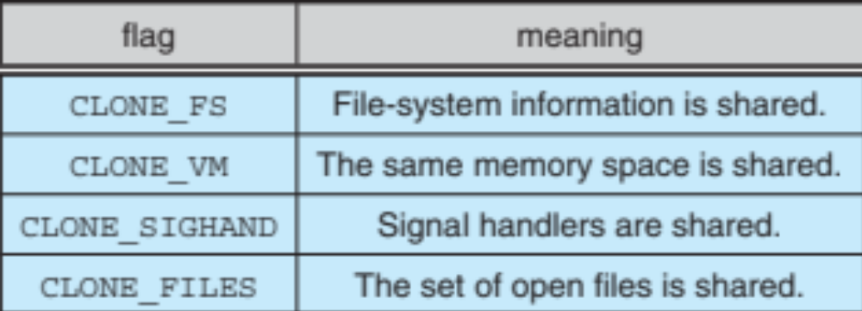
Linux Threads
Linux refers to them as tasks rather than threads.
Thread creation is done through clone()system call.
clone() allows a child task to share the address space of the parent task (process).
  Flags control behavior.
struct task_struct points to process data structures (shared or unique).

