Slide 1
Operating Systems
Introduction to
Cooperating Processes
A. Frank - P. Weisberg

Slide 2
Cooperating Processes
Introduction to Cooperating Processes
Producer/Consumer Problem
The Critical-Section Problem
Synchronization Hardware
Semaphores
A. Frank - P. Weisberg

Slide 3

Introduction to Cooperating Processes
Processes within a system may be independent or cooperating.
Independent process cannot affect or be affected by the execution of another process.
Cooperating process can affect or be affected by other processes, including sharing data.
Reasons for cooperating processes:
  Information sharing
  Computation speed-up
  Modularity
  Convenience
A. Frank - P. Weisberg

Slide 4

Cooperation Models

Slide 5
Cooperation among Processes by Sharing
Processes use and update shared data such as shared variables, memory, files, and databases.
Writing must be mutually exclusive to prevent a race condition leading to inconsistent data views.
Critical sections are used to provide this data integrity.
A process requiring the critical section must not be delayed indefinitely; no deadlock or starvation.
A. Frank - P. Weisberg

Slide 6
Cooperation among Processes by Communication
Communication by messages provides a way to synchronize, or coordinate, the various activities.
Possible to have deadlock –
  each process waiting for a message from the other process.
Possible to have starvation –
  two processes sending a message to each other while another process waits for a message.
A. Frank - P. Weisberg

Slide 7
Producer/Consumer (P/C) Problem (1)
Paradigm for cooperating processes – Producer process produces information that is consumed by a Consumer process.
  Example 1: a print program produces characters that are consumed by a printer.
  Example 2: an assembler produces object modules that are consumed by a loader.
A. Frank - P. Weisberg

Slide 8
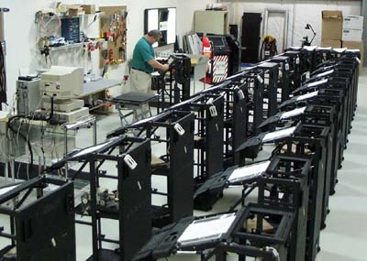
Producer/Consumer (P/C) Problem (2)
We need a buffer to hold items that are produced and later consumed:
  unbounded-buffer places no practical limit on the size of the buffer.
  bounded-buffer assumes that there is a fixed buffer size.
A. Frank - P. Weisberg

Slide 9
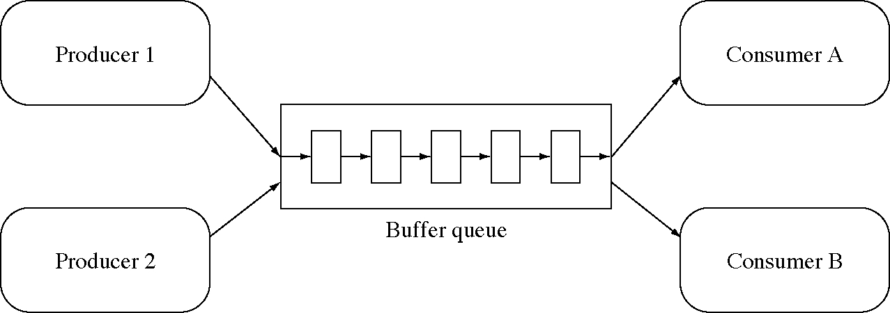
Multiple Producers and Consumers
A. Frank - P. Weisberg

Slide 10
Producer/Consumer (P/C) Dynamics
A producer process produces information that is consumed by a consumer process.
At any time, a producer activity may create some data.
At any time, a consumer activity may want to accept some data.
The data should be saved in a buffer until they are needed.
If the buffer is finite, we want a producer to block if its new data would overflow the buffer.
We also want a consumer to block if there are no data available when it wants them.
A. Frank - P. Weisberg

Slide 11
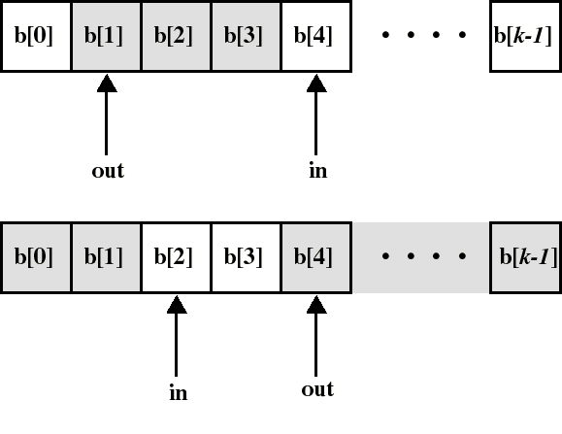
Idea for Producer/Consumer Solution
The bounded buffer is implemented as a circular array with 2 logical pointers: in and out.
The variable in points to the next free position in the buffer.
The variable out points to the first full position in the buffer.
A. Frank - P. Weisberg

Slide 12
Bounded-Buffer – Shared-memory Solution
Shared data
      #define BUFFER_SIZE 10
      typedef struct {
      . . .
      } item;
      item buffer[BUFFER_SIZE];
      int in = 0;
      int out = 0;
Suggested solution is correct, but can only use BUFFER_SIZE-1 elements.
A. Frank - P. Weisberg

Slide 13
Bounded-Buffer – Producer Process
item nextProduced;
while (TRUE) {
while (((in + 1) % BUFFER_SIZE) == out);
/* do nothing –- no free slots */
buffer[in] = nextProduced;
in = (in + 1) % BUFFER_SIZE;
}
A. Frank - P. Weisberg

Slide 14
Bounded-Buffer – Consumer Process
item nextConsumed;
while (TRUE) {
while (in == out);
/* do nothing – nothing to consume */
nextConsumed = buffer[out];
out = (out + 1) % BUFFER_SIZE;
}
A. Frank - P. Weisberg

Slide 15
Problems with concurrent execution
Concurrent processes (or threads) often need to share data (maintained either in shared memory or files) and resources.
If there is no controlled access to shared data, some processes will obtain an inconsistent view of this data.
The action performed by concurrent processes will then depend on the order in which their execution is interleaved.
A. Frank - P. Weisberg

Slide 16
Example of inconsistent view
3 variables: A, B, C which are shared by thread T1 and thread T2.
T1 computes C = A+B.
T2 transfers amount X from A to B
  T2 must do: A = A-X and B = B+X (so that A+B is unchanged).
But if T1 computes A+B after T2 has done A = A-X but before B = B+X.
Then T1 will not obtain the correct result for C = A+B.
A. Frank - P. Weisberg

Slide 17
Inconsistent View Example
Process P1 and P2 are running this same procedure and have access to the same variable “a”.
Processes can be interrupted anywhere.
If P1 is first interrupted after user input and P2 executes entirely.
Then the character echoed by P1 will be the one read by P2 !!
static char a;
void echo()
{
cin >> a;
cout << a;
}
A. Frank - P. Weisberg

Slide 18
Data Consistency
Concurrent access to shared data may result in data inconsistency.
Maintaining data consistency requires mechanisms to ensure the orderly execution of cooperating processes.
Suppose that we wanted to provide a solution to the consumer-producer problem that fills all the buffer. We can do so by having an integer count that keeps track of the number of items in the buffer.
Initially, the count is set to 0. It is incremented by the producer after it produces a new item and is decremented by the consumer after it consumes a item.
A. Frank - P. Weisberg

Slide 19
Bounded-Buffer – Shared Counter (1)
Shared data
    #define BUFFER_SIZE 10
    typedef struct {
    . . .
    } item;
    item buffer[BUFFER_SIZE];
    int in = 0;
    int out = 0;
    int count = 0;
A. Frank - P. Weisberg

Slide 20
Bounded-Buffer – Producer Process
item nextProduced;
while (TRUE) {
/* produce an item and put in nextProduced */
while (count == BUFFER_SIZE);
/* do nothing – no free slots */
buffer[in] = nextProduced;
in = (in + 1) % BUFFER_SIZE;
count++;
}
A. Frank - P. Weisberg

Slide 21
Bounded-Buffer – Consumer Process
item nextConsumed;
while (TRUE) {
while (count == 0);
/* do nothing – nothing to consume */ nextConsumed = buffer[out];
out = (out + 1) % BUFFER_SIZE;
count--;
/* consume the item in nextConsumed */
}
A. Frank - P. Weisberg

Slide 22
Bounded-Buffer – Shared Counter (2)
The statements
count++;
count--;
must be performed atomically.
Atomic/Indivisible operation means an operation that completes in its entirety without interruption.
A. Frank - P. Weisberg

Slide 23
Bounded-Buffer – Shared Counter (3)
The statement “count++” could be implemented in machine language as:
register1 = count
register1 = register1 + 1
count = register1
The statement “count--” could be implemented as:
register2 = count
register2 = register2 – 1
count = register2
A. Frank - P. Weisberg

Slide 24
Bounded-Buffer – Shared Counter (4)
If both the producer and consumer attempt to update the buffer concurrently, the assembly language statements may get interleaved.
The interleaving depends upon how the producer and consumer processes are scheduled.
A. Frank - P. Weisberg

Slide 25
Bounded-Buffer – Shared Counter (5)
Consider this execution interleaving with “count = 5” initially:
producer: register1 = count (register1 = 5)
producer: register1 = register1 + 1 (register1 = 6)
consumer: register2 = count (register2 = 5)
consumer: register2 = register2 – 1 (register2 = 4)
producer: count = register1 (count = 6)
consumer: count = register2 (count = 4)
The value of count may be either 4 or 6, whereas the correct result should be 5.
A. Frank - P. Weisberg

Slide 26

This is the Race Condition
Race condition: The situation where several processes access and manipulate shared data concurrently. The final value of the shared data depends upon which process finishes last.
To prevent race conditions, concurrent processes must coordinate or be synchronized.
A. Frank - P. Weisberg

Slide 27
Race condition updating a variable (1)
shared double balance;
Code for p1:
. . .
balance += amount;
. . .
Code for p1:
. . .
Load R1, balance
Load R2, amount
Add R1, R2
Store R1, balance
. . .
Code for p2:
. . .
balance += amount;
. . .
Code for p2:
. . .
Load R1, balance
Load R2, amount
Add R1, R2
Store R1, balance
. . .
A. Frank - P. Weisberg

Slide 28
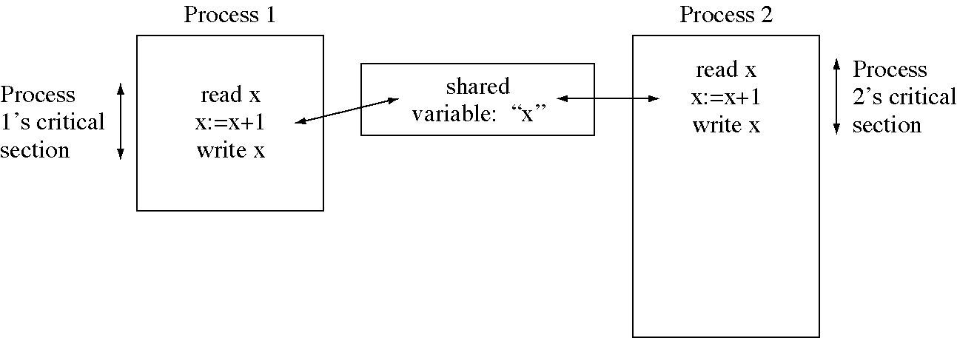
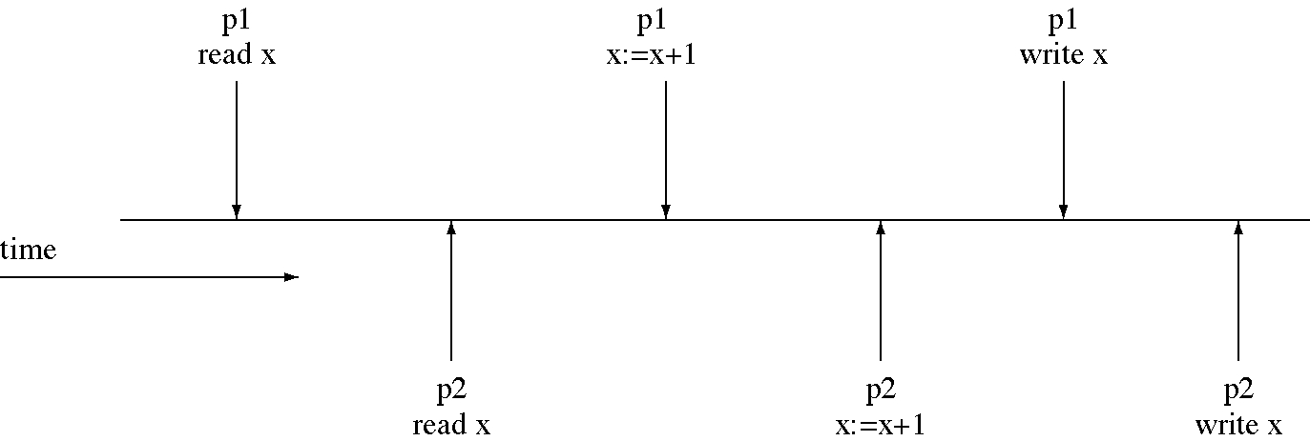
Race condition updating a variable (2)
A. Frank - P. Weisberg

Slide 29
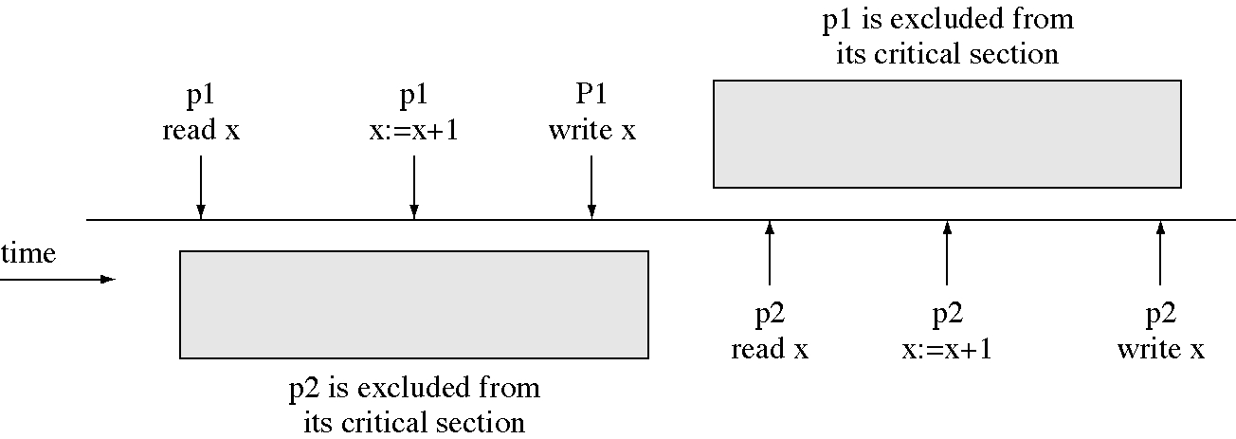
Critical section to prevent a race condition
Multiprogramming allows logical parallelism, uses devices efficiently
but we lose correctness when there is a race condition.
So we forbid logical parallelism inside critical section so we lose some parallelism but we regain correctness.
A. Frank - P. Weisberg

