Slide 1
Operating Systems
Synchronization Solutions
A. Frank - P. Weisberg

Slide 2
Cooperating Processes
Introduction to Cooperating Processes
Producer/Consumer Problem
The Critical-Section Problem
Synchronization Hardware
Semaphores
A. Frank - P. Weisberg

Slide 3
Synchronization Hardware
Many systems provide hardware support for implementing the critical section code.
All solutions below based on idea of locking:
  Protecting critical regions via locks.
Uniprocessors – could disable interrupts:
  Currently running code would execute without preemption.
  Generally too inefficient on multiprocessor systems:
    Operating systems using this are not broadly scalable.
Modern machines provide special atomic (non-interruptible) hardware instructions:
  Either test memory word and set value at once.
  Or swap contents of two memory words.
A. Frank - P. Weisberg

Slide 4
Interrupt Disabling
On a Uniprocessor: mutual exclusion is preserved but efficiency of execution is degraded: while in CS, we cannot interleave execution with other processes that are in RS.
On a Multiprocessor: mutual exclusion is not preserved:
  CS is now atomic but not mutually exclusive (interrupts are not disabled on other processors).
Process Pi:
repeat
disable interrupts
critical section
enable interrupts
remainder section
forever

Slide 5
Special Machine Instructions
Normally, access to a memory location excludes other access to that same location.
Extension: designers have proposed machines instructions that perform 2 actions atomically (indivisible) on the same memory location (e.g., reading and writing).
The execution of such an instruction is also mutually exclusive (even on Multiprocessors).
A. Frank - P. Weisberg

Slide 6
Solution to Critical Section Problem using Locks
The general layout is of lock solution is:
do {
acquire lock
critical section
release lock
remainder section
} while (TRUE);
A. Frank - P. Weisberg

Slide 7
TestAndSet Synchronization Hardware
Test and set (modify) the content of a word atomically (a Boolean version):
boolean TestAndSet(boolean *target) {
boolean rv = *target;
*target = TRUE;
return rv;
}
  Executed atomically.
  Returns the original value of passed parameter.
  Set the new value of passed parameter to “TRUE”.
The Boolean function represents the essence of the corresponding machine instruction.
A. Frank - P. Weisberg

Slide 8
Mutual Exclusion with TestAndSet
Shared data:
boolean lock = FALSE;
Process P_{i}
do {
while (TestAndSet(&lock));
critical section
lock = FALSE;
remainder section
} while (TRUE);
A. Frank - P. Weisberg

Slide 9
Another Test-and-Set Example
An algorithm that uses testset for Mutual Exclusion:
  Shared variable b is initialized to 0
  Only first Pi who sets b enters CS
A C++ description of machine instruction of test-and-set:
bool testset(int& i)
{
if (i==0) {
i=1;
return TRUE;
} else {
return FALSE;
}
}
Process Pi:
repeat
repeat{}
until testset(b);
CS
b:=0;
RS
forever
A. Frank - P. Weisberg

Slide 10
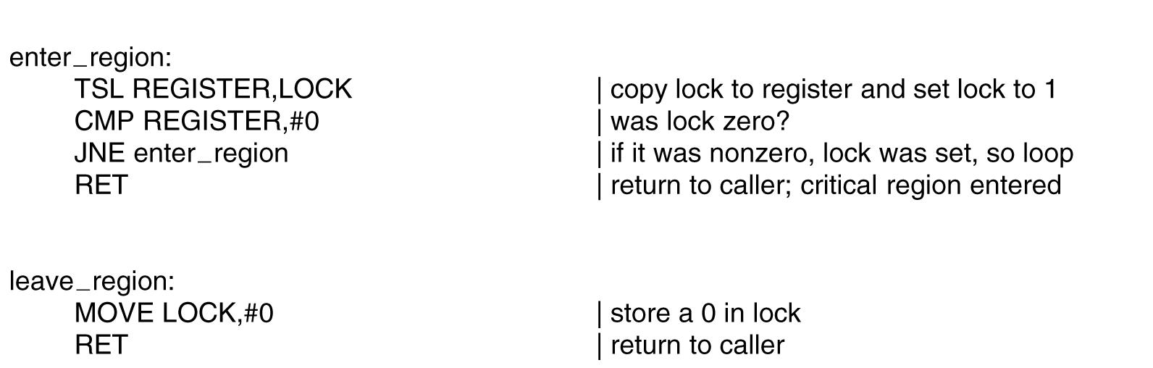
Test-and-Set Instruction at Assembly Level
A. Frank - P. Weisberg

Slide 11
Swap Synchronization Hardware
Atomically swap (exchange) two variables:
void Swap(boolean *a, boolean *b) {
boolean temp = *a;
*a = *b;
*b = temp;
}
The procedure represents the essence of the corresponding machine instruction.
A. Frank - P. Weisberg

Slide 12
Mutual Exclusion with Swap
Shared data:
boolean lock = FALSE;
Process P_{i}
do {
/* Each process has a local Boolean variable key */
key = TRUE;
while (key == TRUE)
Swap(&lock, &key);
critical section
lock = FALSE;
remainder section
} while (TRUE);
A. Frank - P. Weisberg

Slide 13
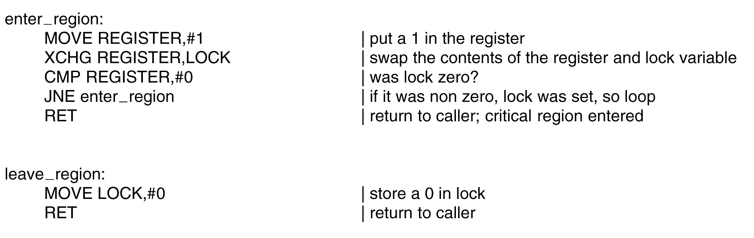
Swap instruction at Assembly Level
A. Frank - P. Weisberg

Slide 14
Compare and Swap Synchronization Hardware
int compare_and_swap(int *value, int expected, int new_value) {
int temp = *value;
if (*value == expected)
*value = new_value;
return temp;
}
Executed atomically.
Returns the original value of passed parameter “value”.
Set the variable “value” the value of the passed parameter “new_value” but only if “value” ==“expected”. That is, the swap takes place only under this condition.
A. Frank - P. Weisberg

Slide 15
Mutual Exclusion with Compare and Swap
Shared integer “lock” initialized to 0;
Solution:
do {
while (compare_and_swap(&lock, 0, 1) != 0)
; /* do nothing */
/* critical section */
lock = 0;
/* remainder section */
} while (true);
A. Frank - P. Weisberg

Slide 16
Disadvantages of Special Machine Instructions
Busy-waiting is employed, thus while a process is waiting for access to a critical section it continues
to consume processor time.
No Progress (Starvation) is possible when a process leaves CS and more than one process is waiting.
They can be used to provide mutual exclusion but
need to be complemented by other mechanisms to satisfy the bounded waiting requirement of the CS problem.
See next slide for an example.
A. Frank - P. Weisberg

Slide 17
Critical Section Solution with TestAndSet()
Process P_{i}
do {
waiting[i] = TRUE;
key = TRUE;
while (waiting[i] && key)
key = TestAndSet(&lock);
waiting[i] = FALSE;
critical section
j = (i + 1) % n;
while ((j != i) && !waiting[j])
j = (j + 1) % n;
if (j == i) lock = FALSE;
else waiting[j] = FALSE;
remainder section
} while (TRUE);
A. Frank - P. Weisberg

Slide 18
Mutex Locks
Previous solutions are complicated and generally inaccessible to application programmers.
OS designers build software tools to solve critical section problem.
Simplest is mutex lock.
Protect a critical section by first acquire() a lock then release() the lock:
  Boolean variable indicating if lock is available or not.
Calls to acquire() and release() must be atomic:
  Usually implemented via hardware atomic instructions.
But this solution requires busy waiting:
  This lock therefore called a spinlock.

Slide 19
acquire() and release()
acquire() {
while (!available)
; /* busy wait */
available = false;;
}
release() {
available = true;
}
do {
acquire lock
critical section
release lock
remainder section
} while (true);

Slide 20

Semaphores (1)
Synchronization tool that provides more sophisticated ways (than Mutex locks)
for process to synchronize their activities.
Logically, a semaphore S is an integer variable that, apart from initialization, can only be changed through 2 atomic and mutually exclusive operations:
  wait(S) (also down(S), P(S))
  signal(S) (also up(S), V(S)
Less complicated.
A. Frank - P. Weisberg

Slide 21

Critical Section of n Processes
Shared data:
semaphore mutex; // initiallized to 1
Process Pi:
do {
wait(mutex);
critical section
signal(mutex);
remainder section
} while (TRUE);
A. Frank - P. Weisberg

Slide 22
Semaphores (2)
Access is via two atomic operations:
wait (S):
while (S <= 0);
S--;
signal (S):
S++;
A. Frank - P. Weisberg

Slide 23
Semaphores (3)
Must guarantee that no 2 processes can execute wait() and signal() on the same semaphore at the same time.
Thus, implementation becomes the critical section problem where the wait and signal code are placed in the critical section.
  Could now have busy waiting in CS implementation:
    But implementation code is short
    Little busy waiting if critical section rarely occupied.
Note that applications may spend lots of time in critical sections and therefore this is not a good solution.
A. Frank - P. Weisberg

Slide 24
Semaphores (4)
To avoid busy waiting, when a process has to wait, it will be
put in a blocked queue of processes waiting for the same event.
Hence, in fact, a semaphore is a record (structure):
type semaphore = record
count: integer;
queue: list of process
end;
var S: semaphore;
With each semaphore there is an associated waiting queue.
Each entry in a waiting queue has 2 data items:
  value (of type integer)
  pointer to next record in the list
A. Frank - P. Weisberg

Slide 25
Semaphore’s operations
When a process must wait for a semaphore S, it is blocked and put on the semaphore’s queue.
Signal operation removes (assume a fair policy like FIFO) first process from the queue and puts it on list of ready processes.
wait(S):
S.count--;
if (S.count<0) {
block this process
place this process in S.queue
}
signal(S):
S.count++;
if (S.count<=0) {
remove a process P from S.queue
place this process P on ready list
}

Slide 26
Semaphore Implementation (1)
Define semaphore as a C struct:
typedef struct {
int value;
struct process *list;
} semaphore;
Assume two operations:
  Block: place the process invoking the operation
  on the appropriate waiting queue.
  Wakeup: remove one of processes in the waiting queue and place it in the ready queue.
A. Frank - P. Weisberg

Slide 27
Semaphore Implementation (2)
Semaphore operations now defined as
wait (semaphore *S) {
S->value--;
if (S->value < 0) {
add this process to S->list;
block();
}
}
signal (semaphore *S) {
S->value++;
if (S->value <= 0) {
remove a process P from S->list;
wakeup(P);
}
}
A. Frank - P. Weisberg

Slide 28
Two Types of Semaphores
Counting semaphore – integer value can range over an unrestricted domain.
Binary semaphore – integer value can range only between 0 and 1 (really a Boolean); can be simpler to implement (use waitB and signalB operations); same as Mutex lock.
We can implement a counting semaphore S using 2 binary semaphores (that protect its counter).
A. Frank - P. Weisberg

Slide 29
Binary semaphores
waitB(S):
if (S.count = 1) {
S.count := 0;
} else {
block this process
place this process in S.queue
}
signalB(S):
if (S.queue is empty) {
S.count := 1;
} else {
remove a process P from S.queue
place this process P on ready list
}
A. Frank - P. Weisberg

Slide 30
Implementing S as a Binary Semaphore (1)
Data structures:
binary-semaphore S1, S2;
int C;
Initialization:
S1 = 1
S2 = 0
C = initial value of counting semaphore S
A. Frank - P. Weisberg

Slide 31
Implementing S as a Binary Semaphore (2)
wait operation:
waitb(S1);
C--;
if (C < 0) {
signalb(S1);
waitb(S2); }
signalb(S1);
signal operation:
  waitb(S1);
  C++;
  if (C <= 0)
  signalb(S2);
  else signalb(S1);
A. Frank - P. Weisberg

Slide 32

Semaphore as a General Synchronization Tool
Execute B in P_{j} only after A executed in P_{i}
Use semaphore flag initialized to 0.
Code:
P_{i} P_{j}
 
A wait(flag)
signal(flag) B
A. Frank - P. Weisberg

Slide 33
Deadlock and Starvation
Deadlock – two or more processes are waiting indefinitely for an event that can be caused by only one of waiting processes.
Let S and Q be two semaphores initialized to 1
P₀ P₁
wait(S); wait(Q);
wait(Q); wait(S);
 
signal(S); signal(Q);
signal(Q) signal(S);
Starvation – indefinite blocking. A process may never be removed from the semaphore queue (say, if LIFO) in which it is suspended.
Priority Inversion – scheduling problem when lower-priority process holds a lock needed by higher-priority process
A. Frank - P. Weisberg

Slide 34
Problems with Semaphores
Semaphores provide a powerful tool for enforcing mutual exclusion and coordinate processes.
But wait(S) and signal(S) are scattered among several processes. Hence, difficult to understand their effects.
Usage must be correct in all the processes (correct order, correct variables, no omissions).
Incorrect use of semaphore operations:
  signal (mutex) …. wait (mutex)
  wait (mutex) … wait (mutex)
  Omitting of wait (mutex) or signal (mutex) (or both)
One bad (or malicious) process can fail the entire collection of processes.
A. Frank - P. Weisberg

