Slide 1
Operating Systems
Classical Problems of Concurrency
A. Frank - P. Weisberg

Slide 2
Introduction to Concurrency
Classical Problems of Concurrency
Critical Regions
Monitors
Inter-Process Communication (IPC)
Communications in Client-Server Systems
A. Frank - P. Weisberg

Slide 3

Classical Problems of Concurrency
There are many of them – let’s briefly see three famous problems:
  P/C Bounded-Buffer
  Readers and Writers
  Dining-Philosophers
A. Frank - P. Weisberg

Slide 4
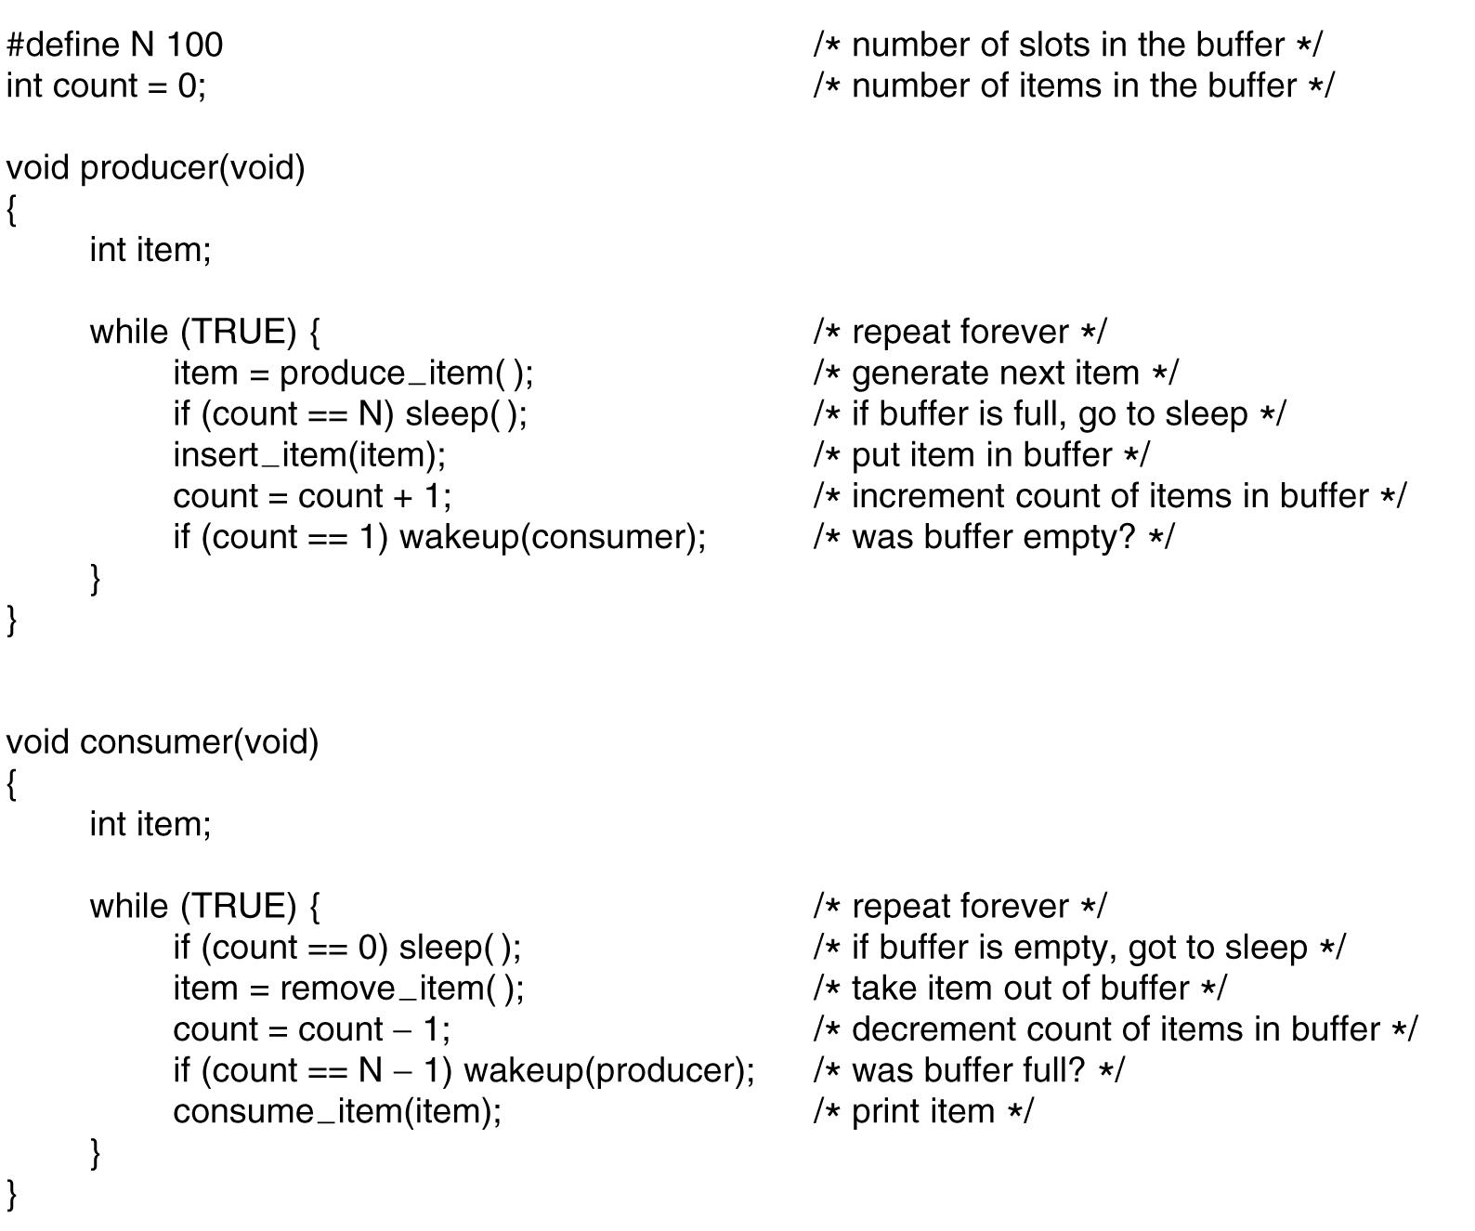
Reminder: P/C problem with race condition
A. Frank - P. Weisberg

Slide 5
P/C Bounded-Buffer Problem
We need 3 semaphores:
A semaphore mutex (initialized to 1) to have mutual exclusion on buffer access.
A semaphore full (initialized to 0) to synchronize producer and consumer on the number of consumable items.
A semaphore empty (initialized to n) to synchronize producer and consumer on the number of empty spaces.
A. Frank - P. Weisberg

Slide 6
Bounded-Buffer – Semaphores
Shared data
semaphore full, empty, mutex;
Initially:
full = 0, empty = n, mutex = 1
A. Frank - P. Weisberg

Slide 7
Bounded-Buffer – Producer Process
do {
…
produce an item in nextp
…
wait(empty);
wait(mutex);
…
add nextp to buffer
…
signal(mutex);
signal(full);
} while (TRUE);
A. Frank - P. Weisberg

Slide 8
Bounded-Buffer – Consumer Process
  do {
  wait(full)
  wait(mutex);
  …
  remove an item from buffer to nextc
  …
  signal(mutex);
  signal(empty);
  …
  consume the item in nextc
  …
  } while (TRUE);
A. Frank - P. Weisberg

Slide 9
Notes on P/C Bounded-Buffer Solution
Remarks (from consumer point of view):
  Putting signal(empty) inside the CS of the consumer (instead of outside) has no effect since
  the producer must always wait for both semaphores before proceeding.
  The consumer must perform wait(full) before wait(mutex), otherwise deadlock occurs if consumer enters CS while the buffer is empty.
Conclusion: using semaphores is a
difficult art ... ☺
A. Frank - P. Weisberg

Slide 10
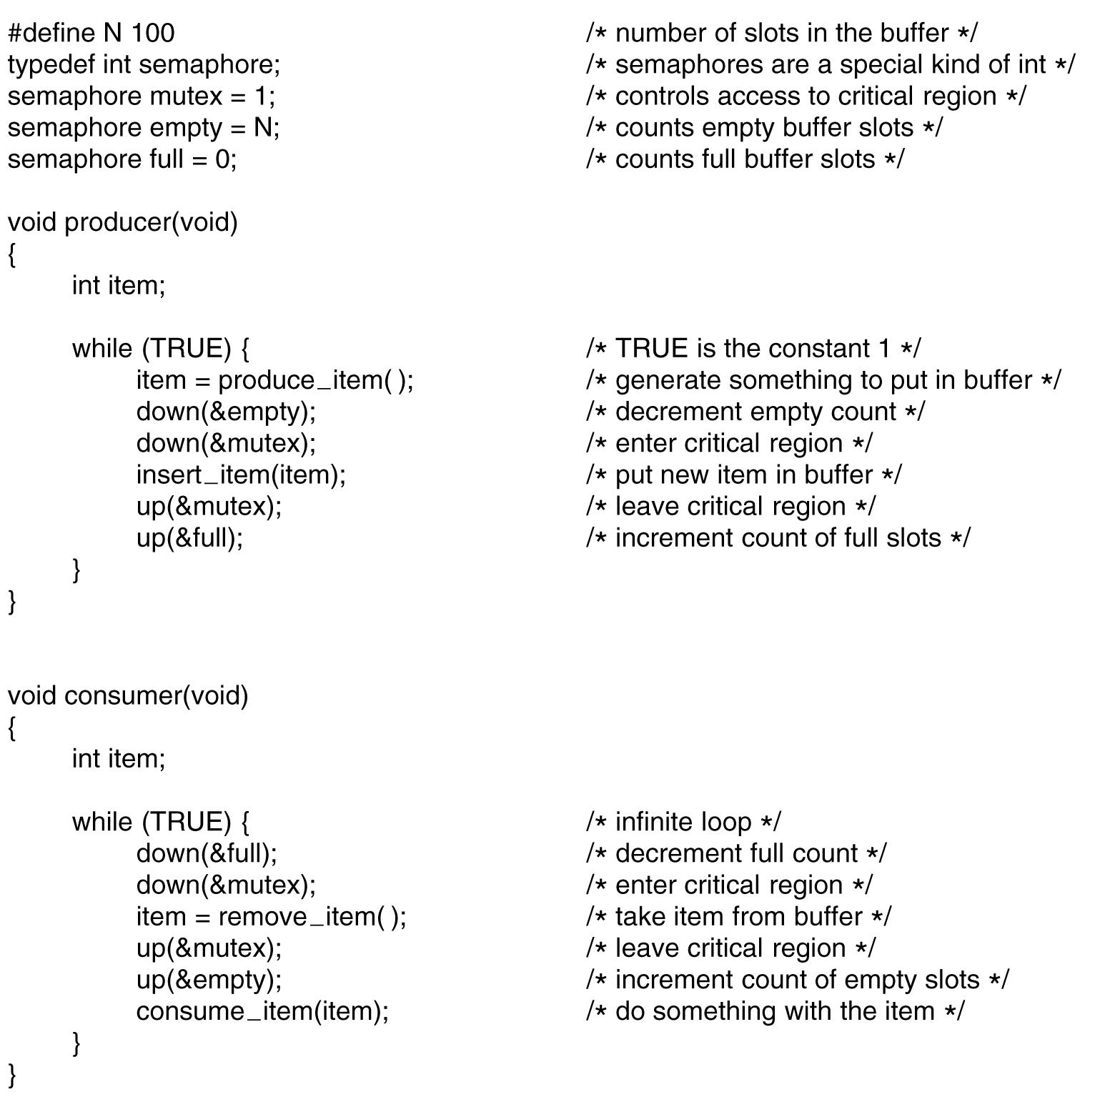
Full P/C Bounded-Buffer Solution
A. Frank - P. Weisberg

Slide 11

Readers-Writers Problem
A data set/repository is shared among a number of concurrent processes:
  Readers – only read the data set; they do not perform any updates.
  Writers – can both read and write.
Problem – allow multiple readers to read at the same time. Only one single writer can access the shared data at the same time.
A. Frank - P. Weisberg

Slide 12
Readers-Writers Dynamics
Any number of reader activities and writer activities are running.
At any time, a reader activity may wish to read data.
At any time, a writer activity may want to modify the data.
Any number of readers may access the data simultaneously.
During the time a writer is writing, no other reader or writer may access the shared data.
A. Frank - P. Weisberg

Slide 13
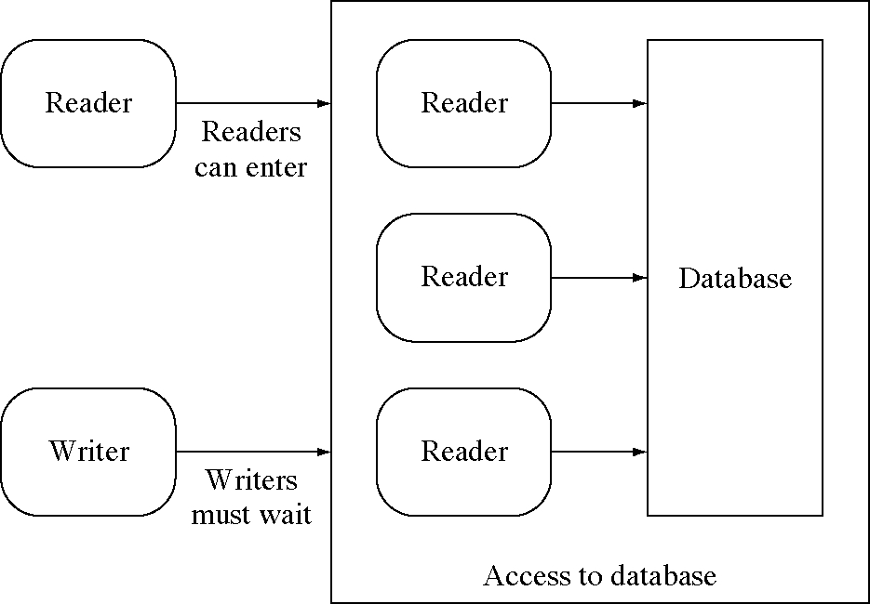
Readers-Writers with active readers
A. Frank - P. Weisberg

Slide 14
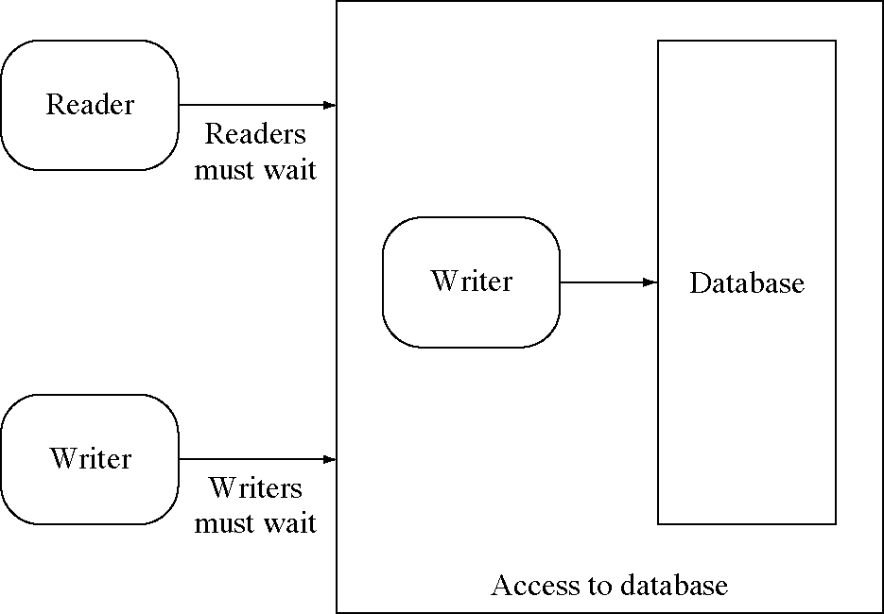
Readers-Writers with an active writer
A. Frank - P. Weisberg

Slide 15
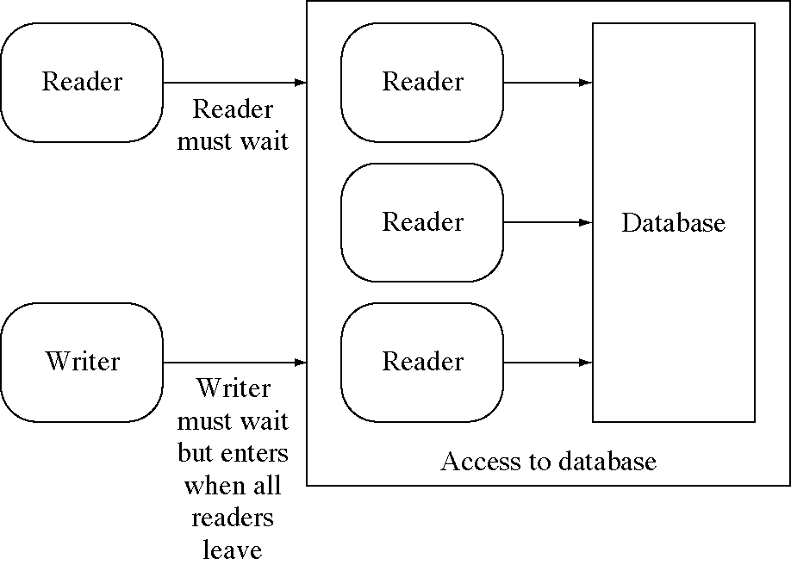
Should readers wait for waiting writer?
A. Frank - P. Weisberg

Slide 16
Readers-Writers problem
There are various versions with different readers and writers preferences:
The first readers-writers problem, requires that no reader will be kept waiting unless a writer has obtained access to the shared data.
The second readers-writers problem, requires that once a writer is ready, no new readers may start reading.
In a solution to the first case writers may starve; In a solution to the second case readers may starve.
A. Frank - P. Weisberg

Slide 17
First Readers-Writers Solution (1)
readcount (initialized to 0) counter keeps track of how many processes are currently reading.
mutex semaphore (initialized to 1) provides mutual exclusion for updating readcount.
wrt semaphore (initialized to 1) provides mutual exclusion for the writers; it is also used by the first or last reader that enters or exits the CS.
A. Frank - P. Weisberg

Slide 18
First Readers-Writers Solution (2)
Shared data
semaphore mutex, wrt;
int readcount;
Initially
mutex = 1, wrt = 1, readcount = 0
A. Frank - P. Weisberg

Slide 19

First Readers-Writers – Writer Process
do {
wait(wrt);
…
writing is performed
…
signal(wrt);
} while(TRUE);
A. Frank - P. Weisberg

Slide 20
First Readers-Writers – Reader Process
do {
wait(mutex);
readcount++;
if (readcount == 1)
wait(wrt);
signal(mutex);
…
reading is performed
…
wait(mutex);
readcount--;
if (readcount == 0)
signal(wrt);
signal(mutex);
} while(TRUE);
A. Frank - P. Weisberg

Slide 21
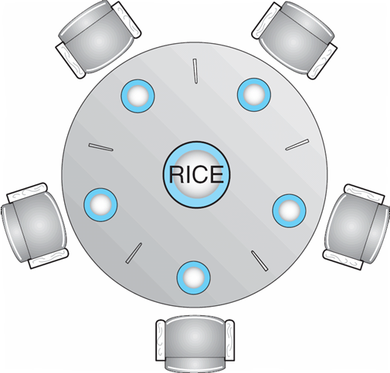
Dining Philosophers Problem (1)
Philosophers spend their lives alternating between thinking and eating.
Five philosophers can be seated around a circular table.
There is a shared bowl of rice.
In front of each one is a plate.
Between each pair of philosophers there is a chopstick, so there are five chopsticks.
It takes two chopsticks to take/eat rice, so while n is eating neither n+1 nor n-1 can be eating.
A. Frank - P. Weisberg

Slide 22


Dining Philosophers Problem (2)
Each one thinks for a while, gets the chopsticks/forks needed, eats, and puts the chopsticks/forks down again, in an endless cycle.
Illustrates the difficulty of allocating resources among process without deadlock and starvation.
A. Frank - P. Weisberg

Slide 23


Dining Philosophers Problem (3)
The challenge is to grant requests for chopsticks while avoiding deadlock and starvation.
Deadlock can occur if everyone tries to get their chopsticks at once. Each gets a left chopstick, and is stuck, because each right chopstick is someone else’s left chopstick.
A. Frank - P. Weisberg

Slide 24
Dining Philosophers Solution (1)
Each philosopher is a process.
One semaphore per fork:
  fork: array[0..4] of semaphores
  Initialization: fork[i].count := 1 for i := 0..4
Process Pi:
repeat
think;
wait(fork[i]);
wait(fork[i+1 mod 5]);
eat;
signal(fork[i+1 mod 5]);
signal(fork[i]);
forever
Note: deadlock if each philosopher starts by picking up his left fork!
A. Frank - P. Weisberg

Slide 25
Dining Philosophers Solution (2)
Possible solutions to avoid deadlock:
Allow at most four philosophers to be sitting simultaneously at the table.
Allow a philosopher to pick up the forks only if both are available (picking must be done in
a critical section).
  Use an asymmetric solution - an odd-numbered philosopher picks up first the left chopstick and then the right chopstick. Even-numbered philosopher picks up first the right chopstick and then the left chopstick.
A. Frank - P. Weisberg

Slide 26
Dining Philosophers Solution (4)
A solution: admit only 4 philosophers at a time that try to eat.
Then 1 philosopher can always eat when the other 3 are holding 1 fork.
Hence, we can use another semaphore T that would limit at 4 the number of philosophers “sitting at the table”.
Initialize: T.count := 4
Process Pi:
repeat
think;
wait(T);
wait(fork[i]);
wait(fork[i+1 mod 5]);
eat;
signal(fork[i+1 mod 5]);
signal(fork[i]);
signal(T);
forever
A. Frank - P. Weisberg

Slide 27
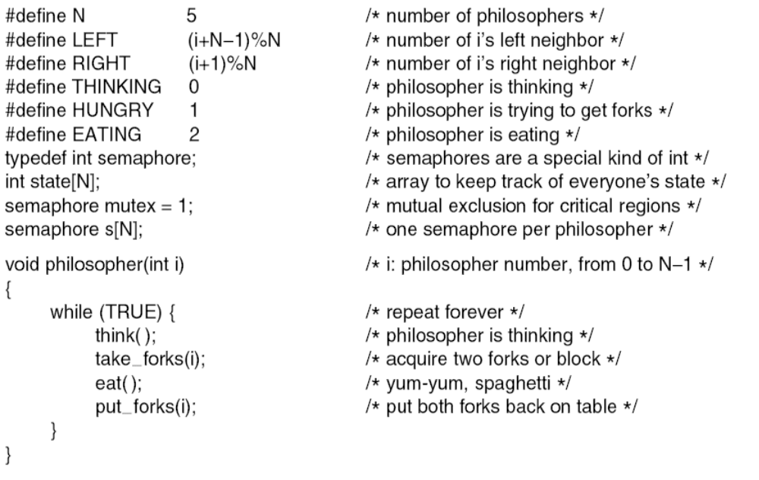
Dining Philosophers Solution (5)
. . .
A. Frank - P. Weisberg

Slide 28
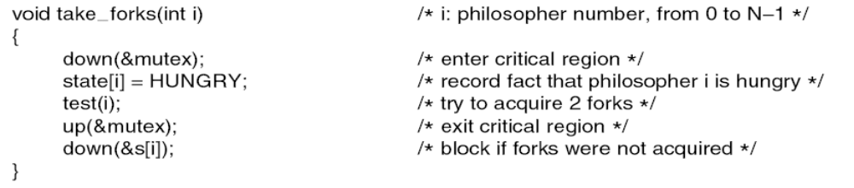
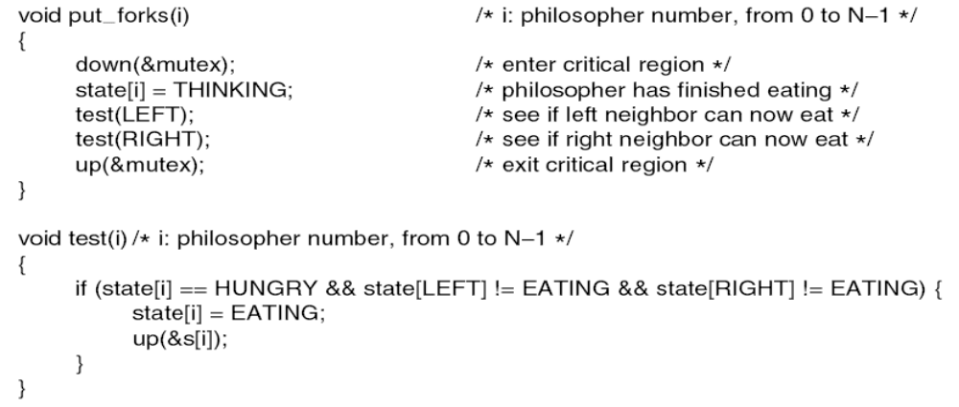
Dining Philosophers Problem (6)
A. Frank - P. Weisberg

