Slide 1
Operating Systems
Concurrency Linguistic Constructs
A. Frank - P. Weisberg

Slide 2
Introduction to Concurrency
Classical Problems of Concurrency
Critical Regions
Monitors
Inter-Process Communication (IPC)
Communications in Client-Server Systems
A. Frank - P. Weisberg

Slide 3
Critical Regions (1)
High-level linguistic synchronization construct.
A shared variable v of type T, is declared as:
v: shared T
Variable v accessed only inside statement
region v when B do S
where B is a Boolean expression.
While statement S is being executed, no other process can access variable v.
Can be implemented by semaphores.
A. Frank - P. Weisberg

Slide 4
Critical Regions (2)
Regions referring to the same shared variable exclude each other in time.
When a process tries to execute the region statement:
The Boolean expression B is evaluated.
If B is true, statement S is executed.
If it is false, the process is delayed until B becomes true and no other process is in the region associated with v.
A. Frank - P. Weisberg

Slide 5

Bounded Buffer – Critical Region
Shared data:
struct buffer {
int pool[n];
int counter, in, out;
}
A. Frank - P. Weisberg

Slide 6
Bounded Buffer – Producer Process
Producer process inserts nextp into the shared buffer.
region buffer when(counter < n) {
pool[in] = nextp;
in = (in+1) % n;
counter++;
}
A. Frank - P. Weisberg

Slide 7
Bounded Buffer – Consumer Process
Consumer process removes an item from the shared buffer and puts it in nextc
region buffer when (counter > 0) { nextc = pool[out];
out = (out+1) % n;
counter--;
}
A. Frank - P. Weisberg

Slide 8

Critical Regions Limitation
A. Frank - P. Weisberg

Slide 9
Monitors (1)
A high-level abstraction that provides a convenient and effective mechanism for process synchronization.
Abstract data type, internal variables only accessible by code within the procedure.
Only one process active within monitor at a time.
There are many kinds.
But not powerful enough to model some synchronization schemes.
Found in many concurrent programming languages:
    Concurrent Pascal, Modula-3, uC++, Java, ...
Can be implemented by semaphores.
A. Frank - P. Weisberg

Slide 10
Monitors (2)
Monitor is a software module containing:
  one or more procedures (operations)
  an initialization sequence
  local data variables.
Characteristics:
  local variables accessible only by monitor’s procedures.
  a process enters the monitor by invoking one of it’s procedures.
  only one process can be in the monitor at any one time.
A. Frank - P. Weisberg

Slide 11
Monitor Layout
    monitor monitor-name
    {
    // shared variable declarations
    procedure P1 (…) { …. }
    procedure Pn (…) {……}
    Initialization code (…) { … }
    }
    }
A. Frank - P. Weisberg

Slide 12
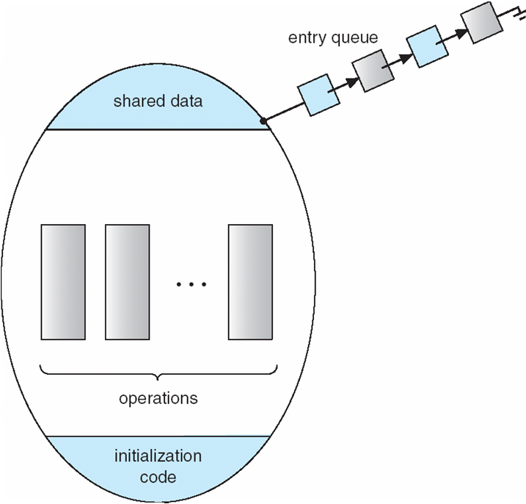
Schematic View of a Monitor
A. Frank - P. Weisberg

Slide 13
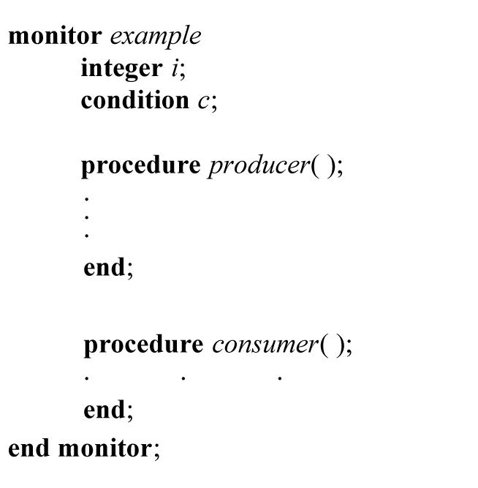
Monitor Example
A. Frank - P. Weisberg

Slide 14
Monitor Characteristics
The monitor ensures mutual exclusion: no need to program this constraint explicitly.
Hence, shared data are protected by placing them in the monitor.
  The monitor locks shared data on process entry.
Process synchronization is done by the programmer by using condition variables that represent conditions a process may need to wait for before executing in the monitor.
A. Frank - P. Weisberg

Slide 15
Monitor Conditions (1)
To allow a process to wait within the monitor, a condition variable must be declared, for example:
condition x, y;
Condition variables are local to the monitor (accessible only within the monitor).
Condition variables can only be used with the operations cwait and csignal executed on an associated queue.
A. Frank - P. Weisberg

Slide 16
Monitors Conditions (2)
The operations cwait and csignal:
  The operation
  x.cwait(); or cwait(x);
  means that the process invoking the operation is suspended until another process signals it.
  x.csignal(); or csignal(x);
  The csignal operation resumes exactly one suspended process that invoked cwait. If no
  process is suspended, then the csignal operation
  has no effect.
A. Frank - P. Weisberg

Slide 17

Monitor With Condition Variables
A. Frank - P. Weisberg

Slide 18
Condition Variables Choices
If process P invokes x.signal(), and process Q is suspended in x.wait(), what should happen next?
  Both Q and P cannot execute in paralel. If Q is resumed, then P must wait.
Options include:
  Signal and wait – P waits until Q either leaves the monitor or it waits
  for another condition.
  Signal and continue – Q waits until P either leaves the monitor or it waits for another condition.
  Both have pros and cons – language implementer can decide.
  Monitors implemented in Concurrent Pascal compromise:
    P executing signal immediately leaves the monitor, Q is resumed.
  Implemented in other languages including Mesa, C#, Java.

Slide 19
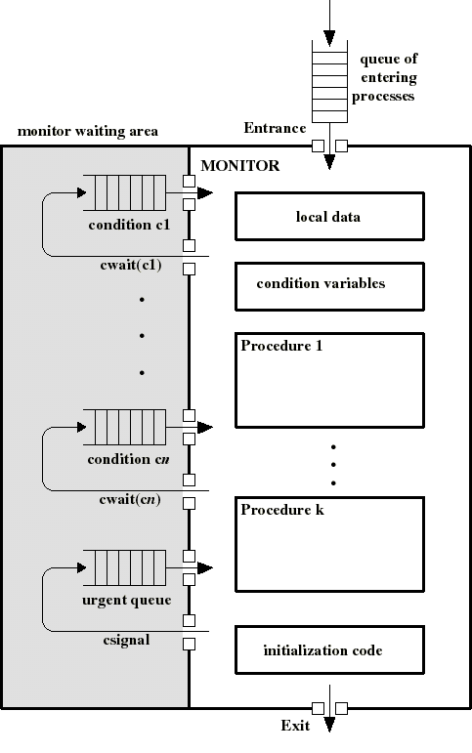
Possible Monitor Dynamics
Awaiting processes are either in the entrance queue or in a condition queue.
A process puts itself into condition queue cn by issuing cwait(cn).
csignal(cn) brings into the monitor one process in condition cn queue.
Hence csignal(cn) blocks the calling process and puts it in the urgent queue (unless csignal is the last operation of the monitor procedure).

Slide 20
A Monitor to Allocate Single Resource
monitor ResourceAllocator
{
boolean busy;
condition x;
void acquire(int time) {
if (busy)
x.wait(time);
busy = TRUE;
}
void release() {
busy = FALSE;
x.signal();
}
initialization code() {
busy = FALSE;
}
}

Slide 21
Producer/Consumer Problem
Two types of processes:
  producers
  consumers
Synchronization is now confined within the monitor.
append() and take() are procedures within the monitor: the only means by which P/C can access the buffer.
If these procedures are correct, synchronization will be correct for all participating processes.
ProducerI:
repeat
produce v;
append(v);
forever
ConsumerI:
repeat
take(v);
consume v;
forever
A. Frank - P. Weisberg

Slide 22
Bounded Buffer – Monitor (1)
Monitor needs to hold the buffer:
  buffer: array[0..k-1] of items;
needs two condition variables:
  notfull: csignal(notfull) indicates that the buffer is not full.
  notempty: csignal(notempty) indicates that the buffer is not empty.
needs buffer pointers and counts:
  nextin: points to next item to be appended.
  nextout: points to next item to be taken.
  count: holds the number of items in buffer.
A. Frank - P. Weisberg

Slide 23
Bounded Buffer – Monitor (2)
Monitor boundedbuffer:
buffer: array[0..k-1] of items;
nextin:=0, nextout:=0, count:=0: integer;
notfull, notempty: condition;
append(v):
if (count=k) cwait(notfull);
buffer[nextin]:= v;
nextin:= nextin+1 mod k;
count++;
csignal(notempty);
take(v):
if (count=0) cwait(notempty);
v:= buffer[nextout];
nextout:= nextout+1 mod k;
count--;
csignal(notfull);
A. Frank - P. Weisberg

Slide 24
Dining Philosophers Example (1)
monitor DiningPhilosophers
{
enum { THINKING; HUNGRY, EATING) state [5] ;
condition self [5];
void pickup (int i) {
state[i] = HUNGRY;
test(i);
if (state[i] != EATING) self[i].wait;
}
void putdown (int i) {
state[i] = THINKING;
// test left and right neighbors
test((i + 4) % 5);
test((i + 1) % 5);
}
A. Frank - P. Weisberg

Slide 25
Dining Philosophers Example (2)
void test (int i) {
if ((state[(i + 4) % 5] != EATING) &&
(state[i] == HUNGRY) &&
(state[(i + 1) % 5] != EATING) ) {
state[i] = EATING ;
self[i].signal () ;
}
}
initialization_code() {
for (int i = 0; i < 5; i++)
state[i] = THINKING;
}
}
A. Frank - P. Weisberg

Slide 26
Dining Philosophers Example (3)
Each philosopher i invokes the operations pickup()and putdown()as follows:
DiningPhilosophers.pickup(i);
EAT
DiningPhilosophers.putdown(i);
Solution assures that no two neighbors are simultaneously eating.
This is a deadlock-free solution, but starvation is possible.
A. Frank - P. Weisberg

Slide 27
Monitor implementation using Semaphores
Variables
semaphore mutex; // (initially = 1)
semaphore next; // (initially = 0)
int next_count = 0;
Each procedure F will be replaced by
wait(mutex);
…
body of F;
…
if (next_count > 0)
signal(next)
else
signal(mutex);
Mutual exclusion within a monitor is ensured.
A. Frank - P. Weisberg

Slide 28
Monitor implementation using Semaphores
For each condition variable x, we have:
semaphore x_sem; // (initially = 0)
int x_count = 0;
The operation x.wait can be implemented as:
x_count++;
if (next_count > 0)
signal(next);
else
signal(mutex);
wait(x_sem);
x_count--;
The operation x.signal can be implemented as:
if (x_count > 0) {
next_count++;
signal(x_sem);
wait(next);
next_count--;
}
A. Frank - P. Weisberg

Slide 29
Resuming Processes within a Monitor
If several processes queued on condition x, and x.signal() executed, which should be resumed?
FCFS frequently not adequate.
conditional-wait construct of the form x.wait(c):
  Where c is priority number.
  Process with lowest number (highest priority) is scheduled next.

Slide 30
Single Resource allocation
Allocate a single resource among competing processes using priority numbers that specify the maximum time a process plans to use the resource
R.acquire(t);
...
access the resource;
...
R.release;
Where R is an instance of type ResourceAllocator

Slide 31
A Monitor to Allocate Single Resource
monitor ResourceAllocator
{
boolean busy;
condition x;
void acquire(int time) {
if (busy)
x.wait(time);
busy = TRUE;
}
void release() {
busy = FALSE;
x.signal();
}
initialization code() {
busy = FALSE;
}
}

Slide 32
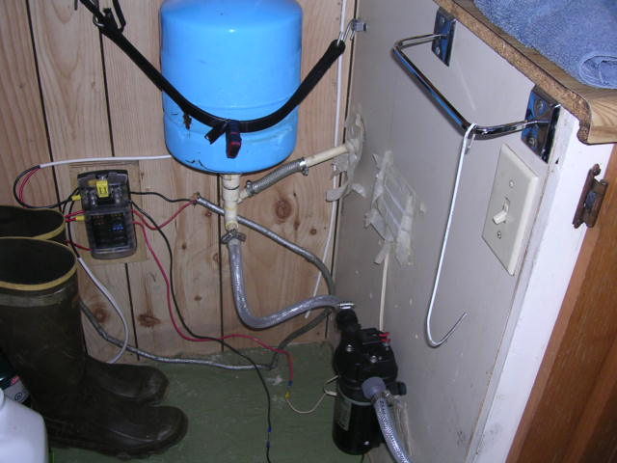
Synchronization Examples
Solaris
Windows XP
Linux
Pthreads
A. Frank - P. Weisberg

Slide 33
Solaris Synchronization
Implements a variety of locks to support multitasking, multithreading (including real-time threads), and multiprocessing.
Uses adaptive mutexes for efficiency when protecting data from short code segments:
  Starts as a standard semaphore spin-lock.
  If lock held, and by a thread running on another CPU, spins.
  If lock held by non-run-state thread, block and sleep waiting for signal of lock being released.
Uses condition variables.
Uses readers-writers locks when longer sections of code need access to data.
Uses turnstiles to order the list of threads waiting to acquire either an adaptive mutex or reader-writer lock:
  Turnstiles are per-lock-holding-thread, not per-object.
Priority-inheritance per-turnstile gives the running thread the highest of the priorities of the threads in its turnstile.
A. Frank - P. Weisberg

Slide 34
Windows XP Synchronization
Uses interrupt masks to protect access to global resources on uniprocessor systems.
Uses spinlocks on multiprocessor systems:
  Spinlocking-thread will never be preempted.
Also provides dispatcher objects user-land which may act mutexes, semaphores, events, and timers:
  Events
    An event acts much like a condition variable.
  Timers notify one or more thread when time expired.
  Dispatcher objects either signaled-state (object available) or non-signaled state (thread will block).
A. Frank - P. Weisberg

Slide 35
Linux Synchronization
Linux:
  Prior to kernel Version 2.6, disables interrupts to implement short critical sections.
  Version 2.6 and later, fully preemptive.
Linux provides:
  Semaphores
  Atomic integers
  spinlocks
  reader-writer versions of both.
On single-CPU system, spinlocks replaced by enabling and disabling kernel preemption.
A. Frank - P. Weisberg

Slide 36
Pthreads Synchronization
Pthreads API is OS-independent.
It provides:
  mutex locks
  condition variables
Non-portable extensions include:
  read-write locks
  spinlocks
A. Frank - P. Weisberg

