Slide 1
Operating Systems
Inter-Process Communication (IPC)
A. Frank - P. Weisberg

Slide 2
Introduction to Concurrency
Classical Problems of Concurrency
Critical Regions
Monitors
Inter-Process Communication (IPC)
Communications in Client-Server Systems
A. Frank - P. Weisberg

Slide 3

Inter-Process Communication (IPC)
Mechanism for processes to communicate and to synchronize their actions.
Message system – processes communicate with each other without resorting to shared variables.
We have at least two primitives:
  send(destination, message) or send(message)
  receive(source, message) or receive(message)
Message size is fixed or variable.
A. Frank - P. Weisberg

Slide 4
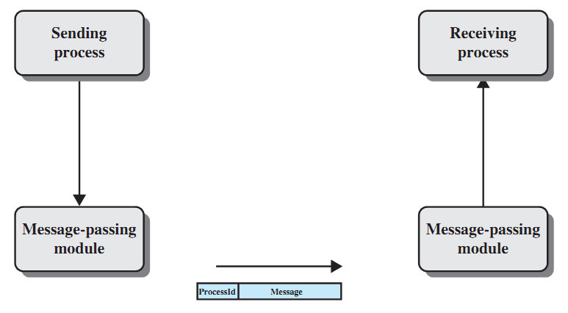
Basic Message-passing Primitives
A. Frank - P. Weisberg

Slide 5
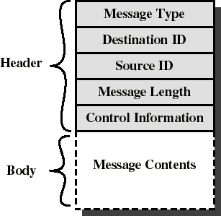
Message format
Consists of header and body of message.
In Unix: no ID, only message type.
Control info:
  what to do if run out of buffer space.
  sequence numbers.
  priority.
Queuing discipline: usually FIFO but can also include priorities.
A. Frank - P. Weisberg

Slide 6
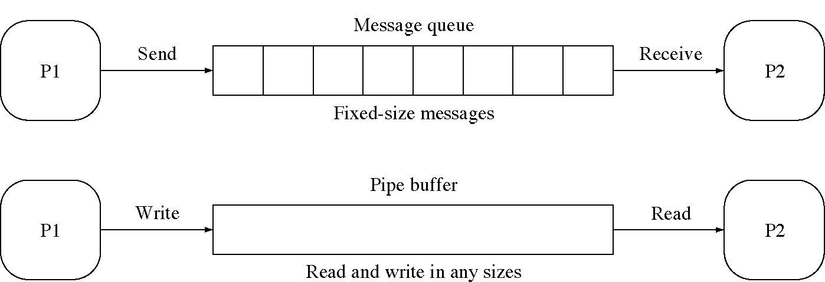
Messages and Pipes Compared
A. Frank - P. Weisberg

Slide 7

Message Passing
Message passing is a general method used for IPC:
  for processes inside the same computer.
  for processes in a networked/distributed system.
In both cases, the process may or may not be blocked while sending a message or attempting to receive a message.
A. Frank - P. Weisberg

Slide 8
Synchronization in message passing (1)
Message passing may be blocking or non-blocking.
Blocking is considered synchronous
  Blocking send has the sender block until the message is received
  Blocking receive has the receiver block until a message is available
Non-blocking is considered asynchronous
  Non-blocking send has the sender send the message and continue
  Non-blocking receive has the receiver receive a valid message or null
A. Frank - P. Weisberg

Slide 9
Synchronization in message passing (2)
For the sender: it is more natural not to be blocked after issuing send:
  can send several messages to multiple destinations.
  but sender usually expect acknowledgment of message receipt (in case receiver fails).
For the receiver: it is more natural to be blocked after issuing receive:
  the receiver usually needs the information before proceeding.
  but could be blocked indefinitely if sender process fails before send.
A. Frank - P. Weisberg

Slide 10
Synchronization in message passing (3)
Hence other possibilities are sometimes offered.
Example: blocking send, blocking receive:
  both are blocked until the message is received.
  occurs when the communication link is unbuffered (no message queue).
  provides tight synchronization (rendezvous).
A. Frank - P. Weisberg

Slide 11
Synchronization in message passing (4)
There are really 3 combinations here that make sense:
Blocking send, Blocking receive
Nonblocking send, Nonblocking receive
Nonblocking send, Blocking receive – most popular – example:
    Server process that provides services/resources to other processes. It will need the expected information before proceeding.

Slide 12
IPC Requirements
If P and Q wish to communicate, they need to:
  establish communication link between them.
  exchange messages via send/receive.
Implementation of communication link:
  physical (e.g., shared memory, hardware bus)
  logical (e.g., logical properties)
A. Frank - P. Weisberg

Slide 13
Implementation Questions
How are links established?
Can a link be associated with more than two processes?
How many links can there be between every pair of communicating processes?
What is the capacity of a link?
Is the size of a message that the link can accommodate fixed or variable?
Is a link unidirectional or bi-directional?
A. Frank - P. Weisberg

Slide 14

Link Capacity – Buffering
Queue of messages attached to the link; implemented in one of three ways:
1. Zero capacity – 0 messages
Sender must wait for receiver (rendezvous).
2. Bounded capacity – finite length of n messages
Sender must wait if link full.
3. Unbounded capacity – infinite length
Sender never waits.
A. Frank - P. Weisberg

Slide 15
Direct/Indirect Communication
Direct communication:
  when a specific process identifier is used for source/destination.
  but it might be impossible to specify the source ahead of time (e.g., a print server).
Indirect communication (more convenient):
  messages are sent to a shared mailbox which consists of a queue of messages.
  senders place messages in the mailbox, receivers pick them up.
A. Frank - P. Weisberg

Slide 16
Direct Communication
Processes must name each other explicitly:
  send(P, message) – send a message to process P
  receive(Q, message) – receive a message from Q
Properties of communication link:
  Links are established automatically.
  A link is associated with exactly one pair of communicating processes.
  Between each pair there exists exactly one link.
  The link may be unidirectional, but is usually bi-directional.
A. Frank - P. Weisberg

Slide 17
Indirect Communication (1)
Messages are directed and received from mailboxes (also referred to as ports).
  Each mailbox has a unique id.
  Processes can communicate only if they share a mailbox.
Properties of communication link:
  Link established only if processes share a common mailbox.
  A link may be associated with many processes.
  Each pair of processes may share several communication links.
  Link may be unidirectional or bi-directional.
A. Frank - P. Weisberg

Slide 18

Indirect Communication (2)
Operations
  create a new mailbox
  send and receive messages through mailbox
  destroy a mailbox
Primitives are defined as:
send(A, message) – send a message to mailbox A.
receive(A, message) – receive a message from mailbox A.
A. Frank - P. Weisberg

Slide 19

Indirect Communication (3)
Mailbox sharing
  P₁, P₂, and P₃ share mailbox A.
  P₁, sends; P₂ and P₃ receive.
  Who gets the message?
Possible solutions:
  Allow a link to be associated with at most two processes.
  Allow only one process at a time to execute a receive operation.
  Allow the system to select arbitrarily the receiver. Sender is notified who the receiver was.
A. Frank - P. Weisberg

Slide 20
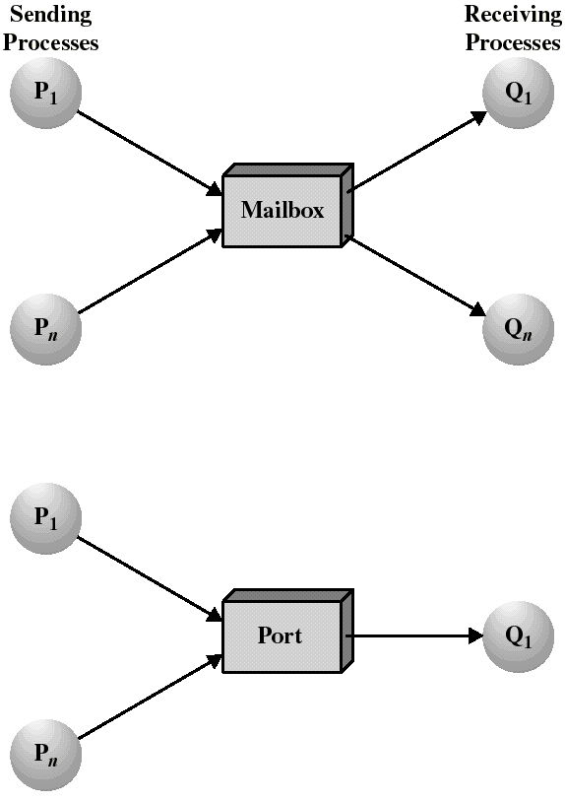
Mailboxes and Ports
A mailbox can be private to one sender/receiver pair.
The same mailbox can be shared among several senders and receivers:
  the OS may then allow the use of message types (for selection).
Port: is a mailbox associated with one receiver and multiple senders
  used for client/server applications: the receiver is the server.

Slide 21

Ownership of ports and mailboxes
A port is usually own and created by the receiving process.
The port is destroyed when the receiver terminates.
The OS creates a mailbox on behalf of a process (which becomes the owner).
The mailbox is destroyed at the owner’s request or when the owner terminates.
A. Frank - P. Weisberg

Slide 22
Mutual Exclusion – Message Passing
create a mailbox mutex shared by n processes.
send() is non-blocking.
receive() blocks when mutex is empty.
Initialization: send(mutex, “go”);
The first Pi who executes receive() will enter CS. Others will be blocked until Pi resends msg.
Process Pi:
var msg: message;
repeat
receive(mutex,msg);
CS
send(mutex,msg);
RS
forever
A. Frank - P. Weisberg

Slide 23
Bounded-Buffer – Message Passing
The producer place items (inside messages) in the mailbox mayconsume.
mayconsume acts as our buffer: consumer can consume item when at least one message present.
Mailbox mayproduce is filled initially with k null messages (k= buffer size).
The size of mayproduce shrinks with each production and grows with each consumption.
Solution can support multiple producers/consumers.
A. Frank - P. Weisberg

Slide 24
Bounded-Buffer – Message Passing
  Producer:
  var pmsg: message;
  repeat
  receive(mayproduce, pmsg);
  pmsg := produce();
  send(mayconsume, pmsg);
  forever
  Consumer:
  var cmsg: message;
  repeat
  receive(mayconsume, cmsg);
  consume(cmsg);
  send(mayproduce, null);
  forever
A. Frank - P. Weisberg

Slide 25
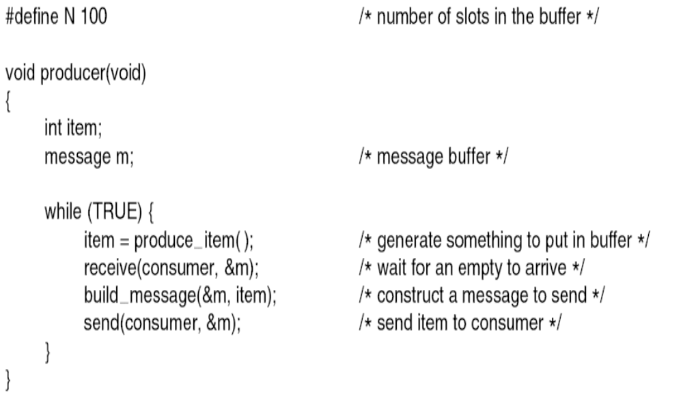
P/C Problem with Message Passing (1)
A. Frank - P. Weisberg

Slide 26
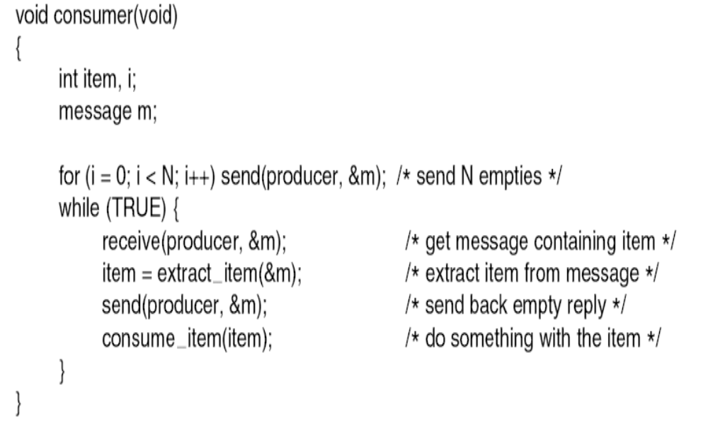
P/C Problem with Message Passing (2)
A. Frank - P. Weisberg

Slide 27
Examples of IPC Systems – POSIX
POSIX Shared Memory example
Process first creates shared memory segment
segment_id = shmget(IPC_PRIVATE, size, S_IRUSR | S_IWUSR);
Process wanting access to that shared memory must attach to it
shared_memory = (char *) shmat(segment_id, NULL, 0);
Now the process could write to the shared memory
sprintf(shared_memory, "Writing to shared memory");
When done a process can detach the shared memory from its address space
shmdt(shared_memory);
Now process can remove the shared memory segment
shmdt(shared_id, IPC_RMID, NULL);
A. Frank - P. Weisberg

Slide 28
Examples of IPC Systems – Mach
Mach communication is message based:
  Even system calls are messages.
  Each task gets two mailboxes at creation:
  Kernel and Notify.
  Only three system calls needed for message transfer:
  msg_send(), msg_receive(), msg_rpc()
  Mailboxes needed for communication, created via
  port_allocate()
A. Frank - P. Weisberg

Slide 29
Examples of IPC Systems – Windows XP
Message-passing centric via LPC facility:
  Only works between processes on the same system.
  Uses ports (like mailboxes) to establish and maintain communication channels.
  Communication works as follows:
    The client opens a handle to the subsystem’s connection port object.
    The client sends a connection request.
    The server creates two private communication ports and returns the handle to one of them to the client.
    The client and server use the corresponding port handle
    to send messages or callbacks and to listen for replies.
A. Frank - P. Weisberg

Slide 30

Local Procedure Calls in Windows XP
A. Frank - P. Weisberg

Slide 31

Communications in Client-Server Systems
There are various mechanisms:
Pipes
Sockets (Internet)
Remote Procedure Calls (RPCs)
Remote Method Invocation (RMI, Java)
A. Frank - P. Weisberg

Slide 32
Pipes
Acts as a conduit allowing two processes to communicate.
Some issues:
    Is communication unidirectional or bidirectional?
    In the case of two-way communication, is it half
    or full-duplex?
    Must there exist a relationship (i.e., parent-child) between the communicating processes?
    Can the pipes be used over a network?

Slide 33
Ordinary Pipes
Ordinary Pipes allow communication in standard producer-consumer style.
Producer writes to one end (the write-end of
the pipe).
Consumer reads from the other end (the read-end of the pipe).
Ordinary pipes are therefore unidirectional.
Require parent-child relationship between communicating processes.

Slide 34

Ordinary Pipes

Slide 35
Named Pipes
Named Pipes are more powerful than ordinary pipes.
Communication is bidirectional.
No parent-child relationship is necessary between the communicating processes.
Several processes can use the named pipe for communication.
Provided on both UNIX and Windows systems.

Slide 36
Sockets
A socket is defined as an endpoint for communication.
Concatenation of IP address and port.
The socket 161.25.19.8:1625 refers to port 1625 on host 161.25.19.8.
Communication consists between a pair of sockets.
A. Frank - P. Weisberg

Slide 37

Socket Communication
A. Frank - P. Weisberg

Slide 38
Remote Procedure Calls (RPCs)
RPC abstracts a Local Procedure Call (LPC) between processes on a networked system.
Stubs – client-side proxy for the actual procedure existing on the server.
The client-side stub locates the server and marshals the parameters.
The server-side stub/skeleton receives this message, unpacks the marshaled parameters, and performs the procedure on the server.
Vice versa happens on the opposite direction.
A. Frank - P. Weisberg

Slide 39
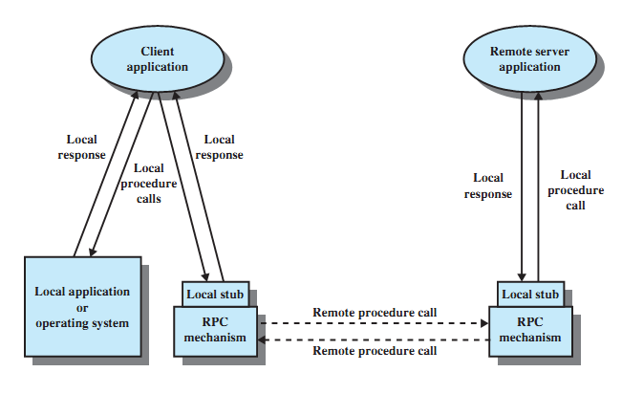
Remote Procedure Call Mechanism
A. Frank - P. Weisberg

Slide 40
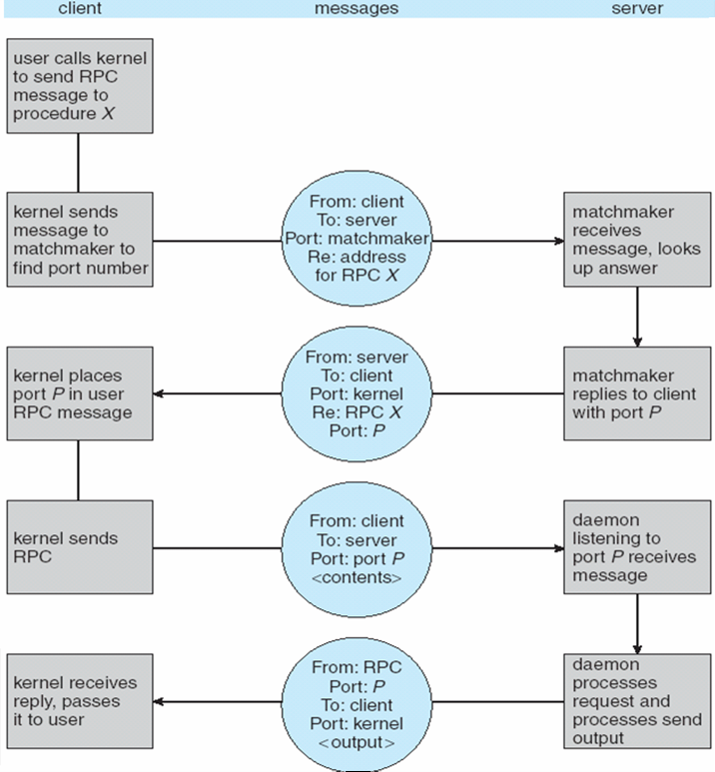
Execution of RPC
A. Frank - P. Weisberg

Slide 41
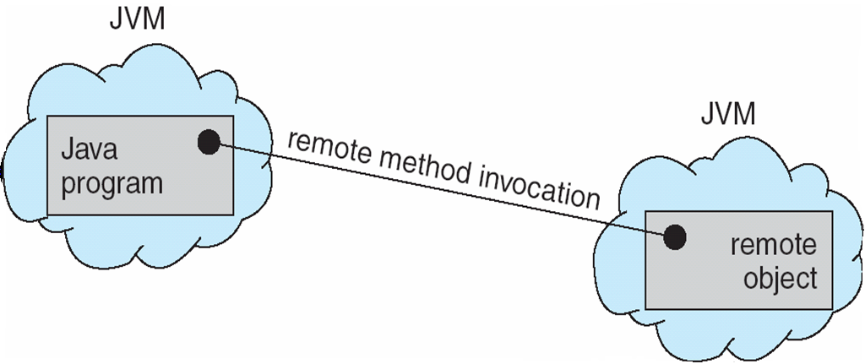
Remote Method Invocation
Remote Method Invocation (RMI) is a Java mechanism similar to RPCs.
RMI allows a Java program on one machine to invoke a method on a remote object.
A. Frank - P. Weisberg

Slide 42
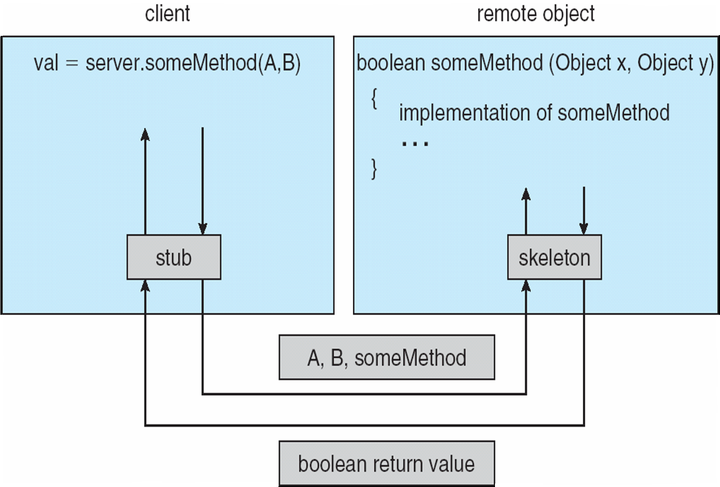
(Un)Marshalling Parameters
A. Frank - P. Weisberg

