Slide 1
Operating Systems
Real Memory Management
A. Frank - P. Weisberg

Slide 2
Real Memory Management
Background
Memory Management Requirements
Fixed/Static Partitioning
Variable/Dynamic Partitioning
Simple/Basic Paging
Simple/Basic Segmentation
Segmentation with Paging
A. Frank - P. Weisberg

Slide 3
Background (1)
Program must be brought (from disk) into memory and placed within a process for it to be run.
Main memory and registers are only storage CPU can access directly.
Memory unit only sees a stream of addresses + read requests, or address + data and write requests.
Register access in one CPU clock (or less).
Main memory can take many cycles, causing a stall.
Cache sits between main memory and CPU registers.
Protection of memory required to ensure correct operation.
A. Frank - P. Weisberg

Slide 4
Background (2)
Memory management is the task carried out by the OS and hardware to accommodate multiple processes in main memory.
User programs go through several steps before being able to run.
This multi-step processing of the program invokes the appropriate utility and generates
the required module at each step (see next slides).
A. Frank - P. Weisberg

Slide 5
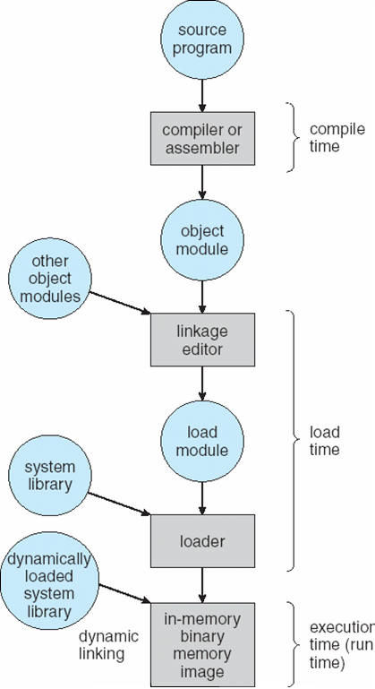
Multi-step processing of user program (1)
A. Frank - P. Weisberg

Slide 6
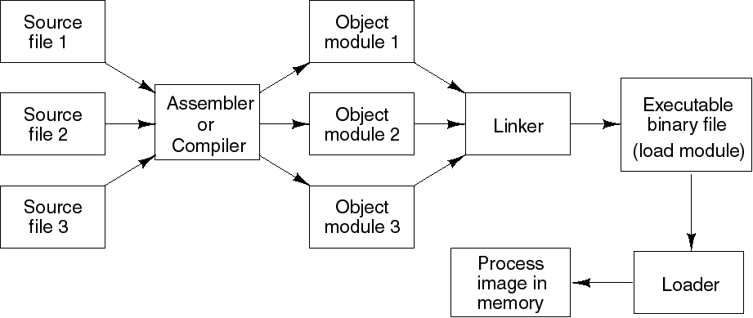
Multi-step processing of user program (2)
A. Frank - P. Weisberg

Slide 7
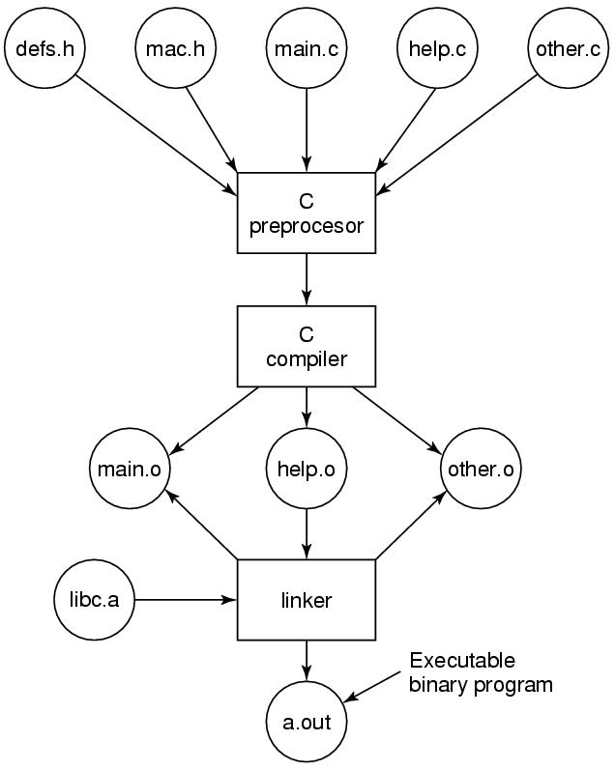
A C Compilation Example
A. Frank - P. Weisberg

Slide 8
Object Module
Public names are usable by other object modules.
External names are defined in other object modules:
  Includes the list of instructions having these names as operands.
Relocation dictionary:
  Has the list of instructions who’s operands are addresses (since they are relocatable).
Only code and data will be loaded in physical memory:
  The rest is used by the linker and then removed.
The stack is allocated only at load time.
End of module
Relocation dictionary
Data
Machine code
External names table
Public names table
Module identification
A. Frank - P. Weisberg

Slide 9
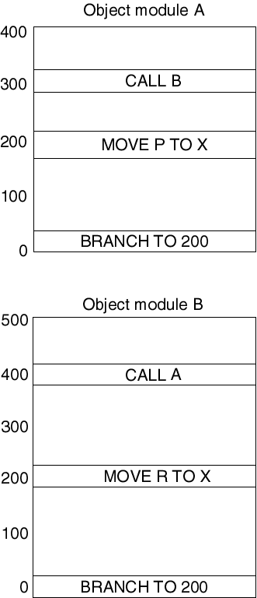
Object Modules
Initially, each object module has its own address space.
All addresses are relative to the beginning of the module.
A. Frank - P. Weisberg

Slide 10
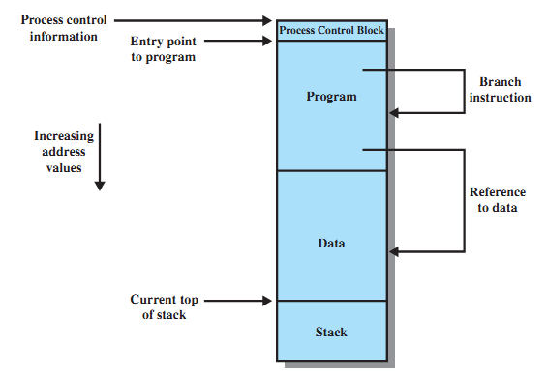
Addressing Requirements for Process
A. Frank - P. Weisberg

Slide 11
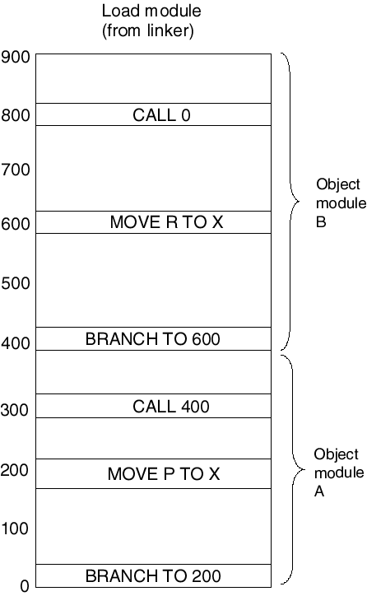
Linking Static
The linker uses tables in object modules to link modules into a single linear addressable space.
The new addresses are addresses relative to the beginning of the load module.
A. Frank - P. Weisberg

Slide 12
Dynamic Linking
The linking of some external modules is done after the creation of the load module (executable file).
Load-time dynamic linking:
  The load module contains references to external modules which are resolved at load time.
Run-time dynamic linking:
  references to external modules are resolved when a call is made to a procedure defined in the external module.
  unused procedure is never loaded.
  Process starts faster.
A. Frank - P. Weisberg

Slide 13
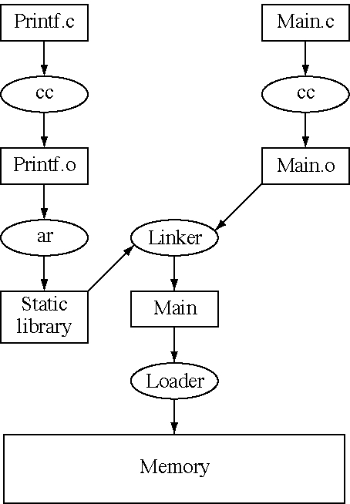
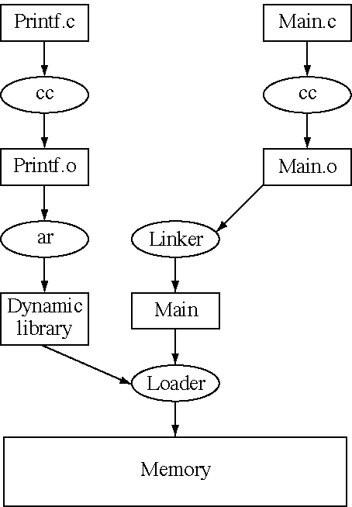
Static vs. Load-time Dynamic Linking
A. Frank - P. Weisberg

Slide 14
Program vs. Memory sizes
What to do when program size is larger than the amount of memory/partition (that exists or can be) allocated to it?
There are two basic solutions within real memory management:
  Overlays
  Dynamic Linking (Libraries – DLLs)
A. Frank - P. Weisberg

Slide 15
1. Overlays
Keep in memory only the overlay (those instructions and data that are) needed at any given phase/time.
Overlays can be used only for programs that fit this model, i.e., multi-pass programs like compilers.
Overlays are designed/implemented by programmer. Needs an overlay driver.
No special support needed from operating system, but program design of overlays structure is complex.
A. Frank - P. Weisberg

Slide 16

Overlays for a Two-Pass Assembler
A. Frank - P. Weisberg

Slide 17
2. Dynamic Linking
Dynamic linking is useful when large amounts of code are needed to handle infrequently occurring cases.
Routine is not loaded unless/until it is called.
Better memory-space utilization; unused routine is never loaded.
Useful when large amounts of code are needed to handle infrequently occurring cases.
Not much support from OS is required – implemented through program design.
A. Frank - P. Weisberg

Slide 18
Dynamics of Dynamic Linking
Linking postponed until execution time.
Small piece of code, stub, used to locate the appropriate memory-resident library routine.
Stub replaces itself with the address of the routine, and executes the routine.
OS needed to check if routine is in processes’ memory address.
Dynamic linking is particularly useful for shared/common libraries – here full OS support is needed.
A. Frank - P. Weisberg

Slide 19
Advantages of Dynamic Linking
Executable files can use another version of the external module without the need of being modified.
Each process is linked to the same external module.
  Saves disk space.
The same external module needs to be loaded in main memory only once.
  Processes can share code and save memory.
Examples:
  Windows: external modules are .DLL files.
  Unix: external modules are .SO files (shared library).
A. Frank - P. Weisberg

Slide 20
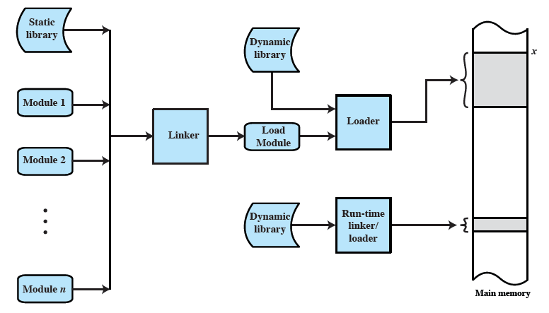
Dynamic Linking/Loading Scenario
A. Frank - P. Weisberg

Slide 21
Memory Management Requirements
If only a few processes can be kept in main memory, then much of the time all processes will be waiting for I/O and the CPU will be idle.
Hence, memory needs to be allocated efficiently in order to pack as many processes into memory as possible. Need additional support for:
  Relocation
  Protection
  Sharing
  Logical Organization
  Physical Organization
A. Frank - P. Weisberg

Slide 22
Memory Management Requirements (1)
Relocation:
  Programmer cannot know where the program will be placed in memory when it is executed.
  A process may be (often) relocated in main memory due to swapping/compaction:
    Swapping enables the OS to have a larger pool of ready-to-execute processes.
    Compaction enables the OS to have a larger contiguous memory to place programs in.
A. Frank - P. Weisberg

Slide 23
Memory Management Requirements (2)
Protection:
  Processes should not be able to reference memory locations in another process without permission.
  Impossible to check addresses in programs at compile/load-time since the program could be relocated.
  Address references must be checked at execution-time by hardware.
A. Frank - P. Weisberg

Slide 24
Memory Management Requirements (3)
Sharing:
  must allow several processes to access a common portion of main memory without compromising protection:
    Better to allow each process to access the same copy of the program rather than have their own separate copy.
    Cooperating processes may need to share access to the same data structure.
A. Frank - P. Weisberg

Slide 25
Memory Management Requirements (4)
Logical Organization:
  Users write programs in modules with different characteristics:
    instruction modules are execute-only.
    data modules are either read-only or read/write.
    some modules are private and others are public.
  To effectively deal with user programs, the OS and hardware should support a basic form of a module to provide the required protection and sharing.
A. Frank - P. Weisberg

Slide 26
Memory Management Requirements (5)
Physical Organization:
  External memory is the long term store for programs and data while main memory holds programs and data currently in use.
  Moving information between these two levels of the memory hierarchy is a major concern of memory management –
    it is highly inefficient to leave this responsibility to the application programmer.
A. Frank - P. Weisberg

Slide 27
The need for Relocation
Because of need for process swapping and memory compaction, a process may occupy different main memory locations during its lifetime.
Consequently, physical memory references (addresses) by a process cannot always be fixed.
This problem is solved by distinguishing between logical address and physical address.
A. Frank - P. Weisberg

Slide 28
Address Types
A physical (absolute) address is a physical location in main memory.
A logical (virtual) address is a reference to a memory location that is independent of the physical organization of memory.
Compilers produce code in which all memory references are logical addresses.
A relative address is an example of logical address in which the address is expressed as a location relative to some known point in the program (ex: the beginning).
A. Frank - P. Weisberg

Slide 29
Relocation Scheme
Relative address is the most frequent type of logical address used in program modules (i.e., executable files).
Relocatable modules are loaded in main memory with all memory references left in relative form.
Physical addresses are calculated “on the fly” as the instructions are executed.
For adequate performance, the translation from relative to physical address must by done by
hardware.
A. Frank - P. Weisberg

Slide 30
Memory-Management Unit (MMU)
Hardware device that maps logical/virtual address to real/physical address.
In MMU scheme, the value in the base (relocation) register is added to every logical (virtual) address generated by a user process
at the time it is sent to memory.
The user program deals with logical/virtual addresses; it never sees the real/physical addresses.
A. Frank - P. Weisberg

Slide 31

CPU, MMU and Memory
A. Frank - P. Weisberg

Slide 32

Dynamic relocation using a relocation register
A. Frank - P. Weisberg

Slide 33

Hardware Support for Relocation and Limit Registers
A. Frank - P. Weisberg

Slide 34
When binding of Instructions/Data to Memory?
Address-binding of instructions and data to memory addresses can happen at three different stages:
  Compile-time: If memory location is known a priori, absolute code can be generated; must recompile code if the starting location changes.
  Load-time: Must generate relative code if memory location is not known at compile-time; loading maps relative code to absolute code by adding start location.
  Execution-time: Binding delayed until run-time if the process can be relocated (i.e., relocatable code) during its execution from one place to another. Need hardware support for address maps (e.g., base and limit registers).
A. Frank - P. Weisberg

Slide 35
Logical vs. Physical Address Space
The concept of a logical address space of a program that is bound to a separate physical address space is central to proper memory management.
  Logical address – generated by the CPU; also referred to later as Virtual address.
  Physical address – address seen by the memory unit.
Logical and physical addresses are the same at the end in compile-time and load-time address-binding schemes.
Logical (virtual) and physical addresses differ in execution-time address-binding scheme.
A. Frank - P. Weisberg

Slide 36
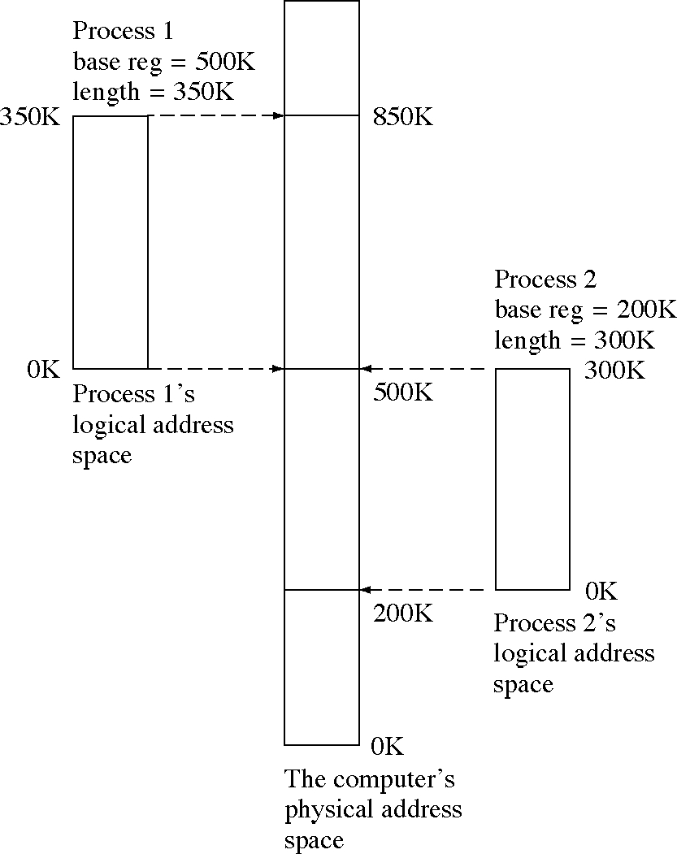
Logical and Physical Address Spaces
A. Frank - P. Weisberg

Slide 37
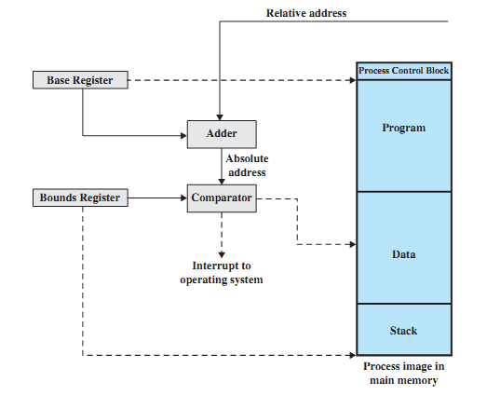
Example Hardware for Address Translation

Slide 38
Dynamics of hardware translation of addresses
When a process is assigned to the running state, a relocation/base register gets loaded with the starting physical address of the process.
A limit/bounds register gets loaded with the process’s ending physical address.
When a relative addresses is encountered, it is added with the content of the base register to obtain the physical address which is compared with the content of the limit/bounds register.
This provides hardware protection: each process can only access memory within its process image.
A. Frank - P. Weisberg

