Slide 1
Operating Systems
Fixed/Variable Partitioning
A. Frank - P. Weisberg

Slide 2
Real Memory Management
Background
Memory Management Requirements
Fixed/Static Partitioning
Variable/Dynamic Partitioning
Simple/Basic Paging
Simple/Basic Segmentation
Segmentation with Paging
A. Frank - P. Weisberg

Slide 3
Contiguous Allocation
An executing process must be loaded entirely in main memory (if overlays are not used).
Main memory is usually split into two (Memory split) or more (Memory division) partitions:
  Resident operating system, usually held in low memory partition with interrupt vector.
  User processes then held in high memory partitions.
Relocation registers used to protect user processes from each other, and from changing OS code and data:
  Base register contains value of smallest physical address.
  Limit register contains range of logical addresses –
  each logical address must be less than the limit register.
  MMU maps logical address dynamically.
A. Frank - P. Weisberg

Slide 4
Real Memory Management Techniques
Although the following simple/basic memory management techniques are not used in modern OSs, they lay the ground for a later proper discussion of virtual memory:
  Fixed/Static Partitioning
  Variable/Dynamic Partitioning
  Simple/Basic Paging
  Simple/Basic Segmentation
A. Frank - P. Weisberg

Slide 5
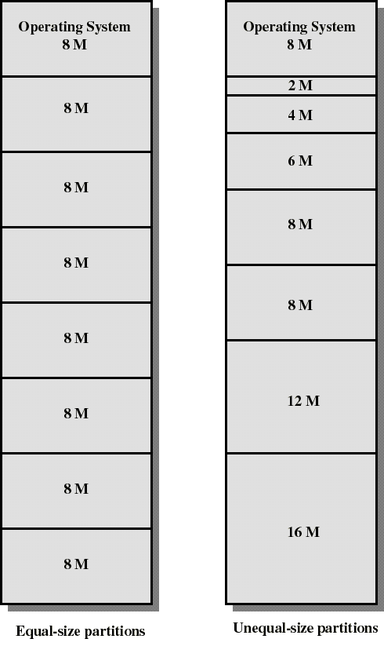
Fixed Partitioning
Partition main memory into a set of non-overlapping memory regions called partitions.
Fixed partitions can be of equal or unequal sizes.
Leftover space in partition, after program assignment, is called internal fragmentation.

Slide 6
Placement Algorithm with Partitions
Equal-size partitions:
  If there is an available partition, a process can be loaded into that partition –
    because all partitions are of equal size, it does not matter which partition is used.
  If all partitions are occupied by blocked processes, choose one process to swap out to make room for the new process.
A. Frank - P. Weisberg

Slide 7
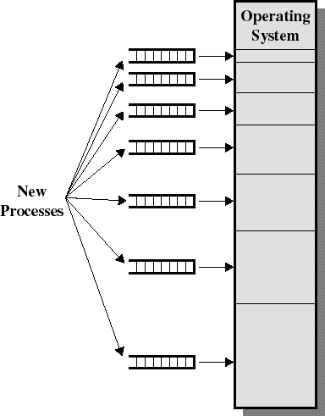
Placement Algorithm with Partitions
Unequal-size partitions, use of multiple queues:
  assign each process to the smallest partition within which it will fit.
  a queue exists for each partition size.
  tries to minimize internal fragmentation.
  problem: some queues might be empty while some might be loaded.

Slide 8
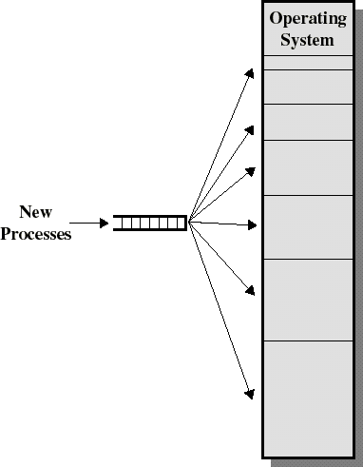
Placement Algorithm with Partitions
Unequal-size partitions, use of a single queue:
  when its time to load a process into memory, the smallest available partition that will hold the process is selected.
  increases the level of multiprogramming at the expense of internal fragmentation.

Slide 9
Dynamics of Fixed Partitioning
Any process whose size is less than or equal to a partition size can be loaded into the partition.
If all partitions are occupied, the OS can swap a process out of a partition.
A program may be too large to fit in a partition. The programmer must design the program with overlays.
A. Frank - P. Weisberg

Slide 10
Comments on Fixed Partitioning
Main memory use is inefficient. Any program, no matter how small, occupies an entire partition. This can cause internal fragmentation.
Unequal-size partitions lessens these problems but they still remain ...
Equal-size partitions was used in early IBM’s OS/MFT (Multiprogramming with a Fixed number of Tasks).
A. Frank - P. Weisberg

Slide 11

Variable Partitioning
  Degree of multiprogramming limited by number of partitions.
  Variable-partition sizes for efficiency (sized to a given process’ needs).
  Hole – block of available memory; holes of various size are scattered
  throughout memory.
  When a process arrives, it is allocated memory from a hole large enough to accommodate it.
  Process exiting frees its partition, adjacent free partitions combined.
  Operating system maintains information about:
  a) allocated partitions b) free partitions (hole)

Slide 12

Managing allocated and free partitions
Example: memory with 5 processes and 3 holes:
  tick marks show memory allocation units.
  shaded regions (0 in the bitmap) are free.
A. Frank - P. Weisberg

Slide 13
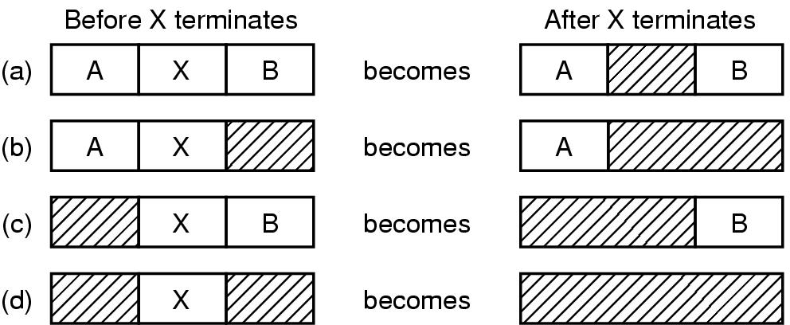
Memory Management with Linked Lists
A. Frank - P. Weisberg

Slide 14
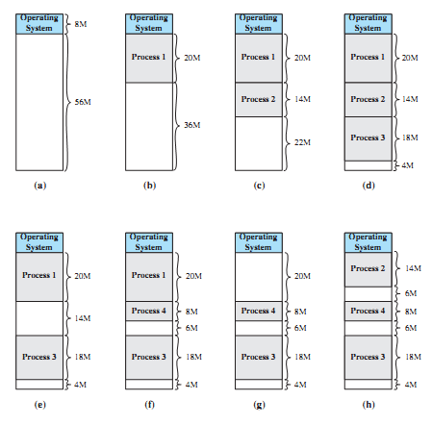
Variable Partitioning: example
A. Frank - P. Weisberg

Slide 15
Internal/External Fragmentation
There are really two types of fragmentation:
Internal Fragmentation –
allocated memory may be slightly larger than requested memory; this size difference is memory internal to a partition, but not being used.
External Fragmentation –
total memory space exists to satisfy a size n request, but that memory is not contiguous.
A. Frank - P. Weisberg

Slide 16
Reducing External Fragmentation
Reduce external fragmentation by doing compaction:
  Shuffle memory contents to place all free memory together in one large block (or possibly a few large ones).
  Compaction is possible only if relocation is dynamic, and is done at execution time.
  I/O problem:
    Lock job in memory while it is involved in I/O.
    Do I/O only into OS buffers.
A. Frank - P. Weisberg

Slide 17
Comments on Variable Partitioning
Partitions are of variable length and number.
Each process is allocated exactly as much memory as it requires.
Eventually holes are formed in main memory. This can cause external fragmentation.
Must use compaction to shift processes so they are contiguous; all free memory is in one block.
Used in IBM’s OS/MVT (Multiprogramming with a Variable number of Tasks).
A. Frank - P. Weisberg

Slide 18
Dynamic Storage-Allocation Problem
Satisfy request of size n from list of free holes – four basic methods:
  First-fit: Allocate the first hole that is big enough.
  Next-fit: Same logic as first-fit but starts search always from the last allocated hole (need to keep a pointer to this) in a wraparound fashion.
  Best-fit: Allocate the smallest hole that is big enough; must search entire list, unless ordered by size. Produces the smallest leftover hole.
  Worst-fit: Allocate the largest hole; must also search entire list. Produces the largest leftover hole.
A. Frank - P. Weisberg

Slide 19
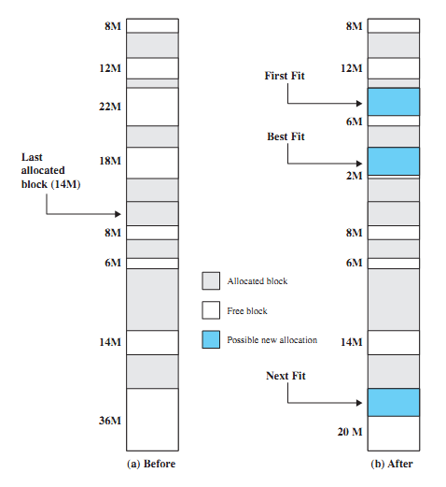
Placement Algorithms
Used to decide which free block to allocate to a process of 16MB.
Goal: reduce usage of compaction procedure (its time consuming).
Example algorithms:
  First-fit
  Next-fit
  Best-fit
  Worst-fit (to imagine)

Slide 20
Comments on Placement Algorithms
First-fit favors allocation near the beginning: tends to create less fragmentation then Next-fit.
Next-fit often leads to allocation of the largest block at the end of memory.
Best-fit searches for smallest block: the fragment left behind is small as possible –
  main memory quickly forms holes too small to hold any process: compaction generally needs to be done more often.
First/Next-fit and Best-fit better than Worst-fit (name is fitting) in terms of speed and storage utilization.
A. Frank - P. Weisberg

Slide 21
Replacement Algorithm
When all processes in main memory are blocked, the OS must choose which process to replace:
  A process must be swapped out (to a Blocked-Suspend state) and be replaced by a process from the Ready-Suspend queue or a new process.
A. Frank - P. Weisberg

Slide 22
Knuth’s Buddy System
A reasonable compromise to overcome disadvantages of both fixed and variable partitioning schemes.
  Memory allocated using power-of-2 allocation; Satisfies requests in units sized as power of 2.
Memory blocks are available in size of 2^{K} where L <= K <= U and where:
  2^{L} = smallest size of block allocatable.
  2^{U} = largest size of block allocatable
  (generally, the entire memory available).
A modified form is used in Unix SVR4 for kernel memory allocation.
A. Frank - P. Weisberg

Slide 23
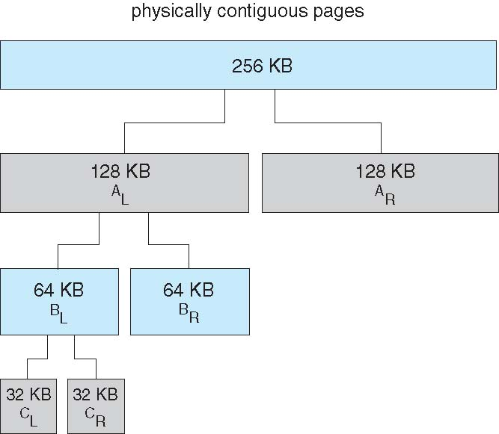
Buddy System Allocation

Slide 24
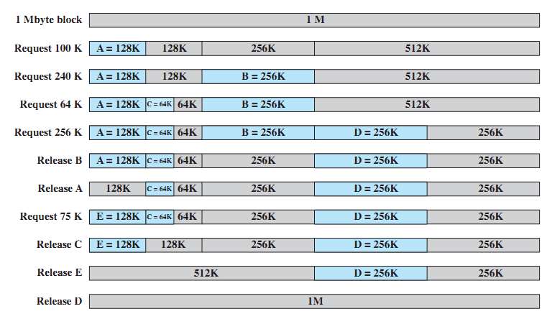
Example of Buddy System
A. Frank - P. Weisberg

Slide 25
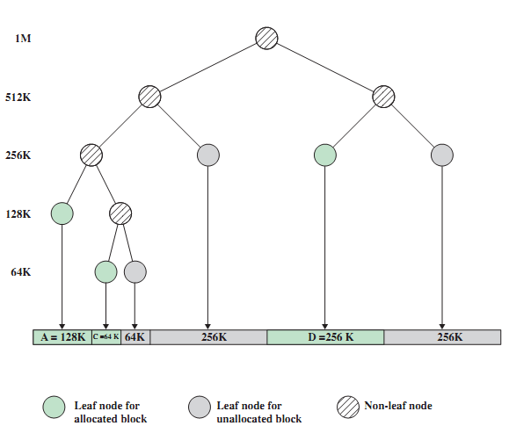
Tree Representation of Buddy System
A. Frank - P. Weisberg

Slide 26
Dynamics of Buddy System (1)
We start with the entire block of size 2^{U}.
When a request of size S is made:
  If 2^{U-1} < S <= 2^{U} then allocate the entire block of size 2^{U}.
  Else, split this block into two buddies, each of size 2^{U-1}.
  If 2^{U-2} < S <= 2^{U-1} then allocate one of the 2 buddies.
  Otherwise one of the 2 buddies is split again.
This process is repeated until the smallest block greater or equal to S is generated.
Two buddies are coalesced whenever both of them become unallocated.
A. Frank - P. Weisberg

Slide 27
Dynamics of Buddy System (2)
The OS maintains several lists of holes:
  the i-list is the list of holes of size 2^{i}.
  whenever a pair of buddies in the i-list occur, they are removed from that list and coalesced into a single hole in the (i+1)-list.
Presented with a request for an allocation of size k such that 2^{i-1} < k <= 2^{i}:
  the i-list is first examined.
  if the i-list is empty, the (i+1)-list is then examined ...
A. Frank - P. Weisberg

Slide 28
Comments on Buddy System
Mostly efficient when the size M of memory used by the Buddy System is a power of 2:
  M = 2^{U} “bytes” where U is an integer.
  then the size of each block is a power of 2.
  the smallest block is of size 1.
On average, internal fragmentation is 25%
  each memory block is at least 50% occupied.
Programs are not moved in memory:
  simplifies memory management.
A. Frank - P. Weisberg

