Slide 1
Operating Systems
Simple/Basic Paging
A. Frank - P. Weisberg

Slide 2
Real Memory Management
Background
Memory Management Requirements
Fixed/Static Partitioning
Variable/Dynamic Partitioning
Simple/Basic Paging
Simple/Basic Segmentation
Segmentation with Paging
A. Frank - P. Weisberg

Slide 3
Simple/Basic Paging (1)
Idea: Physical address space of a process can be noncontiguous; process is allocated physical memory whenever the latter is available:
  Avoids external fragmentation.
  Avoids problem of varying sized memory chunks.
Divide physical memory into fixed-sized chunks/blocks called frames (size is power of 2, usually between 512 bytes and 16 MB).
Divide logical memory into blocks of same size pages.
A. Frank - P. Weisberg

Slide 4
Simple/Basic Paging (2)
The process pages can thus be assigned to any free frames in main memory; a process does not need to occupy a contiguous portion of physical memory.
Need to keep track of all free frames.
To run a program of size n pages, need to find
n free frames and load program.
Need to set up a page table to translate logical to physical pages/addresses.
Internal fragmentation possible only for page at
end of program.
A. Frank - P. Weisberg

Slide 5

Paging Example
A. Frank - P. Weisberg

Slide 6
Simple/Basic Paging (3)
To run a program of size n pages, need to find any n free frames and load all the program (pages).
So need to keep track of all free frames in physical memory – use free-frame list.
Free-frame list example in next slide.
A. Frank - P. Weisberg

Slide 7

Free-Frame list example
A. Frank - P. Weisberg
After allocation
Before allocation

Slide 8
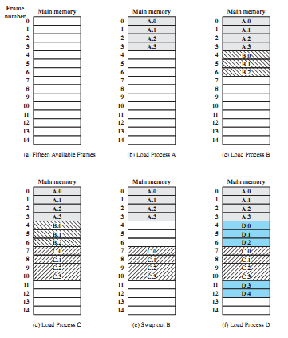
Example of processes loading
A. Frank - P. Weisberg

Slide 9
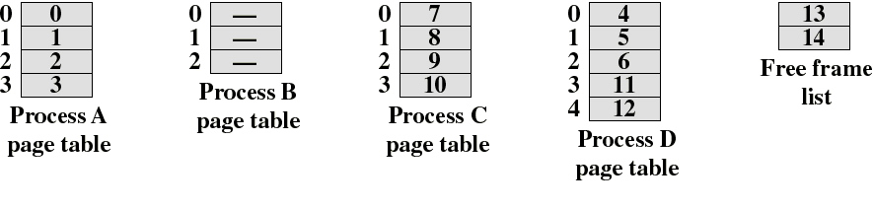
Example of processes loading (3)
The OS now needs to maintain (in main memory) a page table for each process.
Each entry of a page table consists of the frame number where the corresponding page is physically located.
The corresponding page table is indexed by the page number to obtain the frame number.
A free frame table/list, of available pages, is maintained.
A. Frank - P. Weisberg

Slide 10
Calculating Internal Fragmentation
Page size = 2,048 bytes
Process size = 72,766 bytes
35 pages + 1,086 bytes
Internal fragmentation of 2,048 - 1,086 = 962 bytes
Worst case fragmentation = 1 frame – 1 byte
On average fragmentation = 1 / 2 frame size
So small frame sizes desirable?
But each page table entry takes memory to track.
Page sizes growing over time:
  Solaris supports two page sizes – 8 KB and 4 MB.

Slide 11
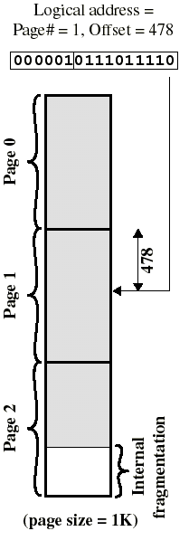
Logical address in paging
The logical address becomes a relative address when the page size is a power of 2.
Example: if 16 bits addresses are used and page size = 1K, we need 10 bits for offset and have 6 bits available for page number.
Then the 16 bit address, obtained with the 10 least significant bits as offset and 6 most significant bits as page number, is a location relative to the beginning of the process.
A. Frank - P. Weisberg

Slide 12
Logical address used in paging
Within each program, each logical address must consist of a page number and an offset within the page.
A dedicated register always holds the starting physical address of the page table of the currently running process.
Presented with the logical address (page number, offset) the processor accesses the page table to obtain the physical address (frame number, offset).
A. Frank - P. Weisberg

Slide 13
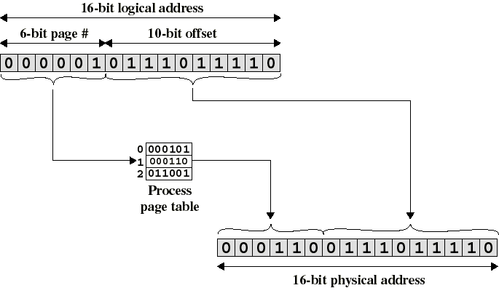
Logical-to-Physical Address Translation in Paging
A. Frank - P. Weisberg

Slide 14
Address Translation Scheme (1)
Logical address generated by CPU is divided into two parts:
  Page number (p) – used as an index into a page table which contains the base address of each page in physical memory.
  Page offset/displacement (d) – combined with base address to define the physical memory address that is sent to the memory unit.
For given logical address space 2^{m} and page size 2^{n}.
page number
page offset
p
d
m – n
n
A. Frank - P. Weisberg

Slide 15
Address Translation Scheme (2)
By using a page size of a power of 2, the pages are invisible to the programmer, compiler/assembler, and the linker.
Address translation at run-time is then easy to implement in hardware:
  logical address (p, d) gets translated to physical address (f, d) by indexing the page table with p and appending the same displacement/offset d to the frame number f.
A. Frank - P. Weisberg

Slide 16
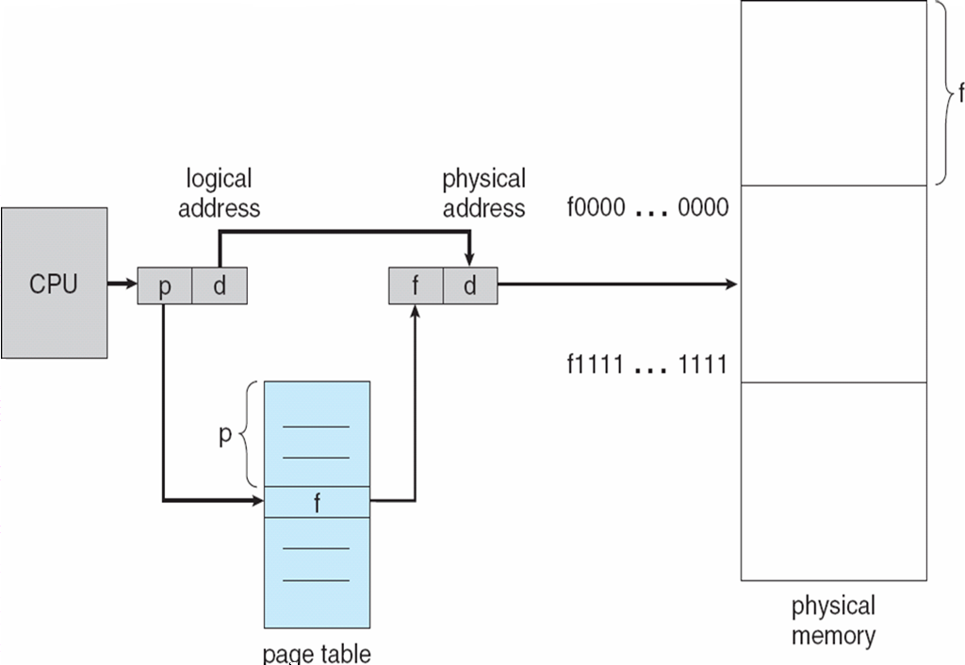
Address Translation Architecture
A. Frank - P. Weisberg

Slide 17

Paging Example
A. Frank - P. Weisberg

Slide 18
How to implement Page Table? (1)
Keep Page Table in main memory:
  Page-table base register (PTBR) points to the page table.
  Page-table length register (PTLR) indicates size of the page table.
  However, in this scheme, every data/instruction access requires two memory accesses – one for the page table and one for the data/instruction.
Keep Page Table in hardware (in MMU) –
  However, page table can be large – too expensive.
A. Frank - P. Weisberg

Slide 19
How to implement Page Table? (2)
The two memory accesses problem can be solved by combining mechanisms 1 & 2:
  Use a special fast-lookup hardware cache called
  Associative Memory (Registers) or Translation Look-aside Buffer (TLB) – enables fast parallel search:
Address translation (p, d)
  If p is in associative register, get frame # out.
  Otherwise get frame # from page table in memory.
Page #
Frame #
A. Frank - P. Weisberg

Slide 20

Paging Hardware With TLB
A. Frank - P. Weisberg

Slide 21
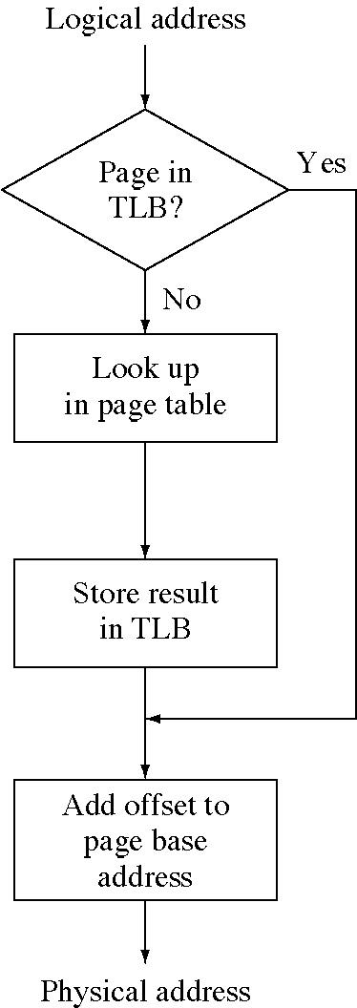
TLB Flow Chart
A. Frank - P. Weisberg

Slide 22
Why TLB works
TLB takes advantage of the Locality Principle.
TLB uses associative mapping hardware to simultaneously interrogate all TLB entries to find a match/hit on page number.
TLB hit rates are 90+%.
The TLB must be flushed each time a new process enters the running state.
Maybe keep/load TLB information in/from process context.
A. Frank - P. Weisberg

Slide 23
Effective Access Time (EAT)
Effective Access Time (EAT) is between 1 and 2 access times – should be closer to 1.
Assume memory cycle time is 1 microsecond.
Associative (Memory) Lookup = ε time unit.
Hit ratio = α – percentage of times that a page number is found in the associative memory; ratio related to number of associative registers.
EAT = α(ε + 1) + (1 – α)(ε + 2) = 2 + ε – α
A. Frank - P. Weisberg

Slide 24
EAT Examples
Assume memory cycle time is 100 nanosecond.
Associative memory lookup = 20 nanosecond.
Hit ratio = 80%
  EAT = 0.80 x 120 + 0.20 x 220 = 140 ns
  So 40% slowdown in memory access time.
Hit ratio = 98%
  EAT = 0.98 x 120 + 0.02 x 220 = 122 ns
  So only 22% slowdown in memory access time.
A. Frank - P. Weisberg

Slide 25
Advanced TLB Aspects
Some TLBs store address-space identifiers (ASIDs) in each TLB entry – uniquely identifies each process to provide address-space protection for that process:
  Otherwise need to flush at every context switch.
TLBs typically small (64 to 1,024 entries).
On a TLB miss, value is loaded into the TLB for faster access next time:
  Replacement policies must be considered.
  Some entries can be wired down for permanent fast access.

Slide 26
Memory Protection
Memory protection implemented by associating protection bit with each frame to indicate if read-only or read-write access is allowed:
  Can also add more bits to indicate page execute-only, and
  so on.
Valid-invalid bit attached to each entry in the page table:
  “valid” indicates that the associated page is in the process’ logical address space, and is thus a legal page.
  “invalid” indicates that the page is not in the process’ logical address space.
A. Frank - P. Weisberg

Slide 27

Valid (v) or Invalid (i) Bit in a Page Table
A. Frank - P. Weisberg

Slide 28
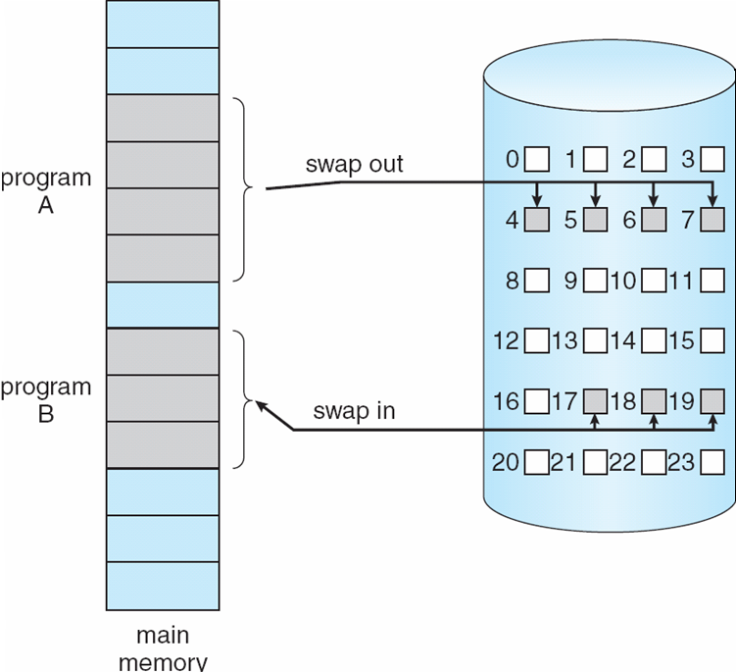
Transfer of a Paged Memory to Contiguous Disk Space
A. Frank - P. Weisberg

Slide 29
Shared Pages
Shared code:
  One copy of read-only (reentrant) code shared among processes (i.e., text editors, compilers, window systems).
  Shared code must appear in same location in the logical address space of all processes.
Private code and data:
  Each process keeps separate copy of code and data.
  The pages for the private code and data can appear anywhere in the logical address space.
A. Frank - P. Weisberg

Slide 30
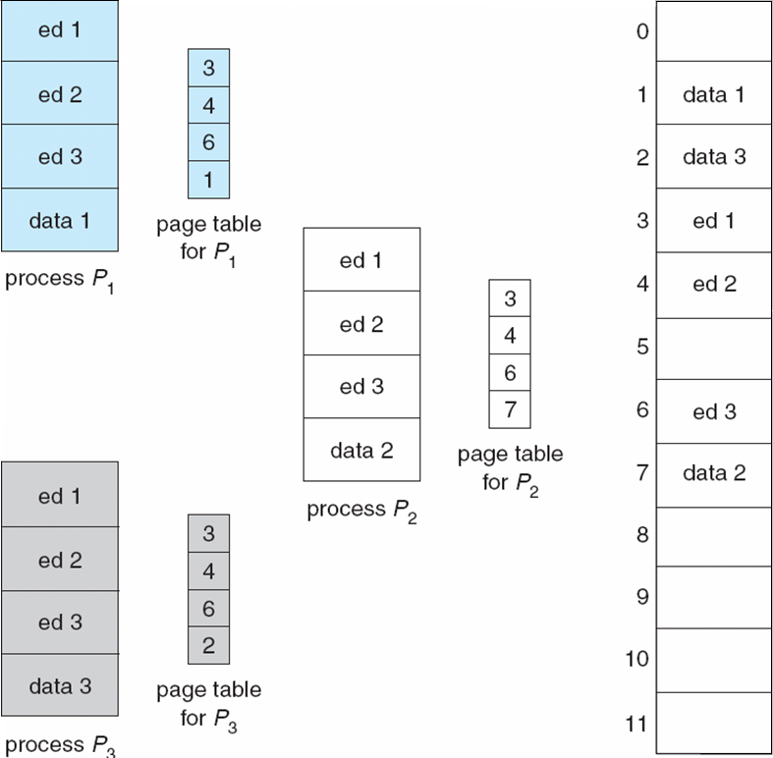
Shared Pages Example
A. Frank - P. Weisberg

