Slide 1
Operating Systems
Simple/Basic Segmentation
A. Frank - P. Weisberg

Slide 2
Real Memory Management
Background
Memory Management Requirements
Fixed/Static Partitioning
Variable/Dynamic Partitioning
Simple/Basic Paging
Simple/Basic Segmentation
Segmentation with Paging
A. Frank - P. Weisberg

Slide 3
Simple/Basic Segmentation
Paging division is arbitrary; no natural/logical boundaries for protection/sharing.
Segmentation supports user’s view of a program.
A program is a collection of segments –
logical units – such as:
  main program, subprogram, class
  procedure, function,
  object, method,
  local variables, global variables,
  common block,
  stack, symbol table, arrays
A. Frank - P. Weisberg

Slide 4

User’s View of a Program
A. Frank - P. Weisberg

Slide 5
Example of Segmentation Need
A compiler has many tables that are built up as compilation proceeds, possibly including:
The source text being saved for the printed listing (on batch systems).
The symbol table – the names and attributes of variables.
The table containing integer, floating-point
constants used.
The parse tree, the syntactic analysis of the program.
The stack used for procedure calls within the compiler.
A. Frank - P. Weisberg

Slide 6

One-dimensional address space
In a one-dimensional address space with growing tables, one table may bump into another.
A. Frank - P. Weisberg

Slide 7
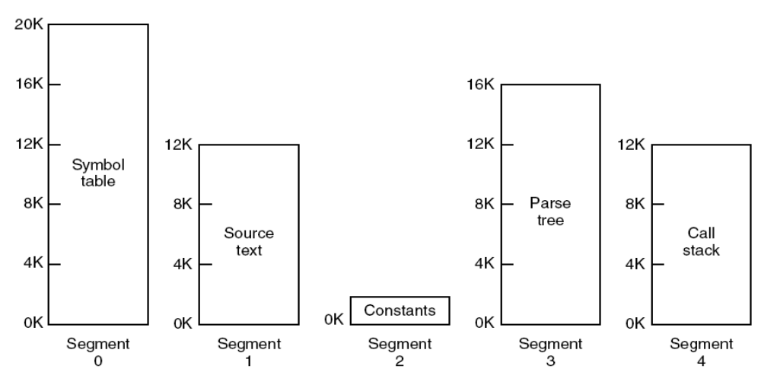
Segmentation Solution
Segmentation allows each table to grow or shrink independently of the other tables.
A. Frank - P. Weisberg

Slide 8
Dynamics of Simple Segmentation (1)
Each program is subdivided into blocks of non-equal size called segments.
When a process gets loaded into main memory, its different segments can be located anywhere.
Each segment is fully packed with instructions/data; no internal fragmentation.
There is external fragmentation; it is reduced when using small segments.
A. Frank - P. Weisberg

Slide 9
Logical view of simple segmentation
1
1
4
2
3
4
2
3
user space
physical memory space
A. Frank - P. Weisberg

Slide 10
Dynamics of Simple Segmentation (2)
In contrast with paging, segmentation is visible to the programmer:
  provided as a convenience to organize logically programs (example: data in one segment, code in another segment).
  must be aware of segment size limit.
The OS maintains a segment table for each process. Each entry contains:
  the starting physical addresses of that segment.
  the length of that segment (for protection).
A. Frank - P. Weisberg

Slide 11
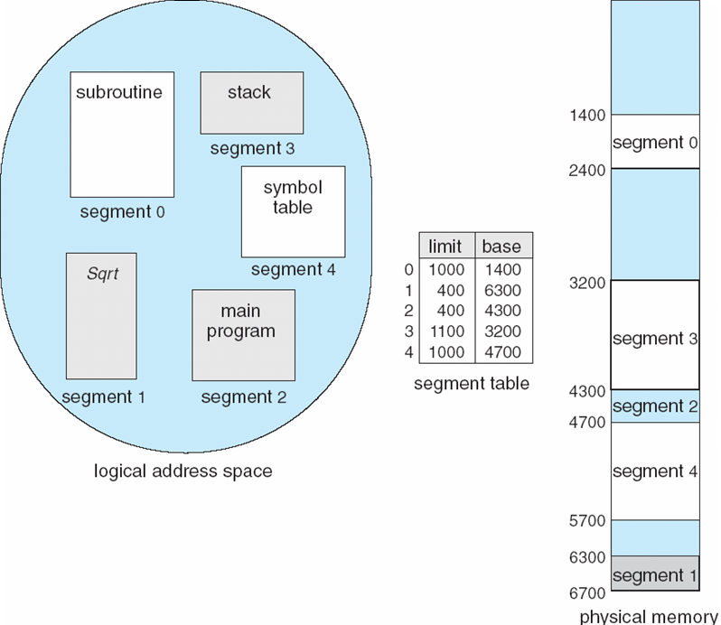
Example of Segmentation
A. Frank - P. Weisberg

Slide 12
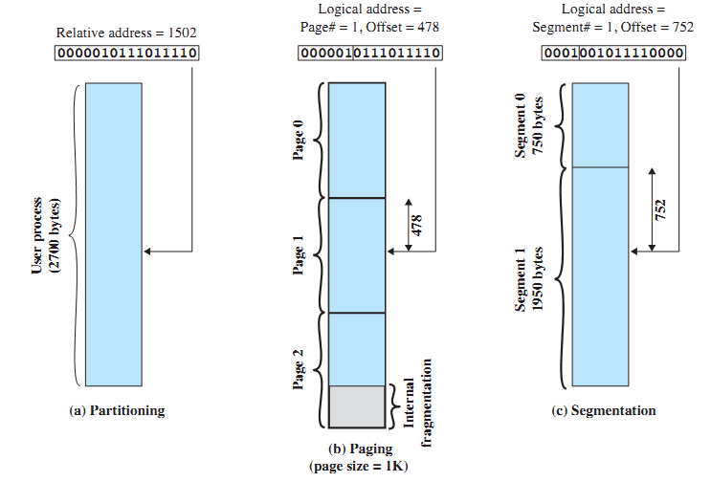
Logical address in segmentation
A. Frank - P. Weisberg

Slide 13
Logical address used in segmentation
When a process enters the Running state, a dedicated register gets loaded with the starting address of the process’s segment table.
Presented with a logical address (segment number, offset) = (s, d), the CPU indexes (with s) the segment table to obtain the starting physical address b and the length l of that segment.
The physical address is obtained by adding d to b (in contrast with paging):
  the hardware also compares the offset d with the length l of that segment to determine if the address is valid.
A. Frank - P. Weisberg

Slide 14
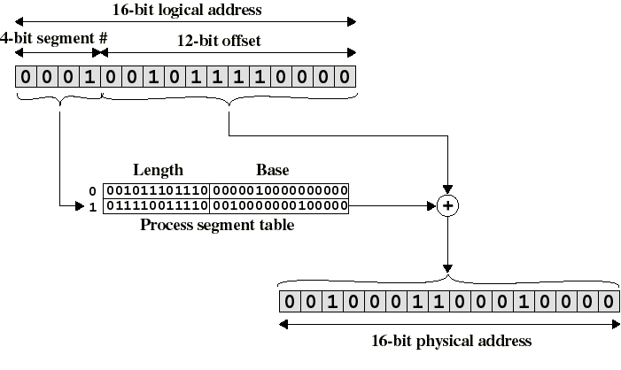
Logical-to-Physical Address Translation in segmentation
A. Frank - P. Weisberg

Slide 15
Segmentation Architecture
Logical address consists of a two tuple:
<segment-number, offset>,
Segment table – maps two-dimensional physical addresses; each table entry has:
  base – contains the starting physical address where the segments reside in memory.
  limit – specifies the length of the segment.
Segment-table base register (STBR) points to the segment table’s location in memory.
Segment-table length register (STLR) indicates number of segments used by a program; segment-number s is legal
if s < STLR.
A. Frank - P. Weisberg

Slide 16
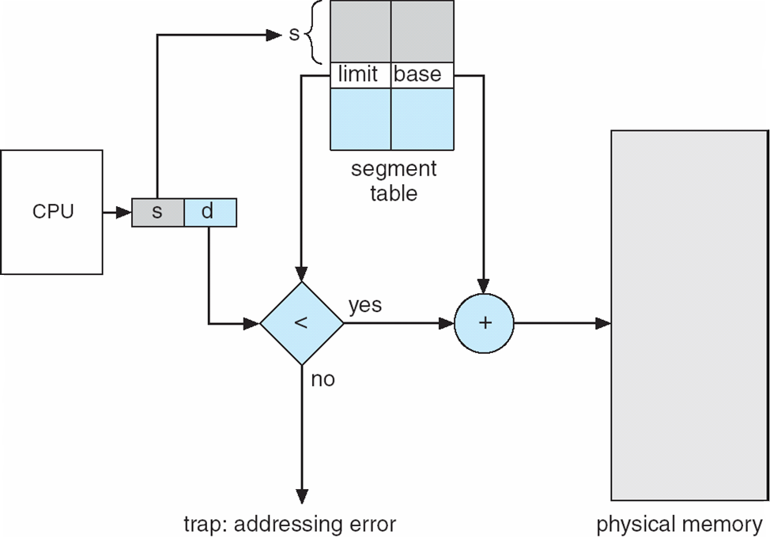
Address Translation Architecture
A. Frank - P. Weisberg

Slide 17
Protection in Segmentation
Protection – with each entry in segment table associate:
  validation bit = 0 ⇒ illegal segment
  read/write/execute privileges
Protection bits associated with segments; code sharing occurs at segment level.
Since segments vary in length, memory allocation is a dynamic storage-allocation problem.
A. Frank - P. Weisberg

Slide 18
Sharing in Segmentation Systems
Segments are shared when entries in the segment tables of 2 different processes point to the same physical locations.
Example: the same code of a text editor can be shared by many users:
  Only one copy is kept in main memory.
But each user would still need to have its own private data segment.
A. Frank - P. Weisberg

Slide 19
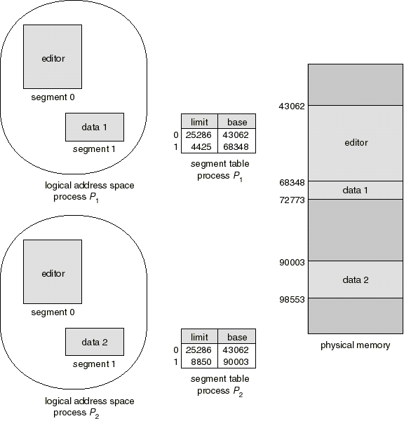
Shared Segments Example

Slide 20
Simple segmentation/paging comparison (1)
Segmentation is visible to the programmer whereas paging is transparent.
Naturally supports protection/sharing.
Segmentation can be viewed as commodity offered to the programmer to logically organize a program into segments while using different kinds of protection (example: execute-only for code but read-write for data).
A. Frank - P. Weisberg

Slide 21
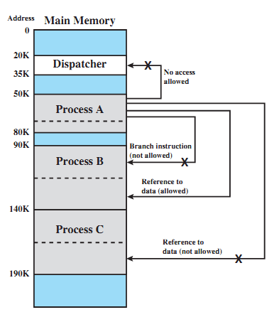
A. Frank - P. Weisberg

Slide 22
Simple segmentation/paging comparison (2)
Segments are variable-size; Pages are fixed-size.
Segmentation requires more complicated hardware for address translation than paging.
Segmentation suffers from external fragmentation. Paging only yields a small internal fragmentation.
Maybe combine Segmentation and Paging?
A. Frank - P. Weisberg

Slide 23
Example: MULTICS
The MULTICS system solved problems of external fragmentation and lengthy search
times by paging the segments.
Solution differs from pure segmentation in that the segment-table entry contains not the base address of the segment, but rather the base address of a page table for this segment.
Example in the next slide.
A. Frank - P. Weisberg

Slide 24

MULTICS Address Translation Scheme
A. Frank - P. Weisberg

Slide 25
Example: The Intel Pentium
Supports both segmentation and segmentation with paging.
CPU generates logical address
  Given to segmentation unit which produces linear addresses.
  Linear address given to paging unit:
    Which generates physical address in main memory.
    Paging units form equivalent of MMU.
A. Frank - P. Weisberg

Slide 26


Logical to Physical Address Translation
A. Frank - P. Weisberg

Slide 27

Intel Pentium Segmentation
A. Frank - P. Weisberg

Slide 28

Pentium Paging Architecture
A. Frank - P. Weisberg

Slide 29

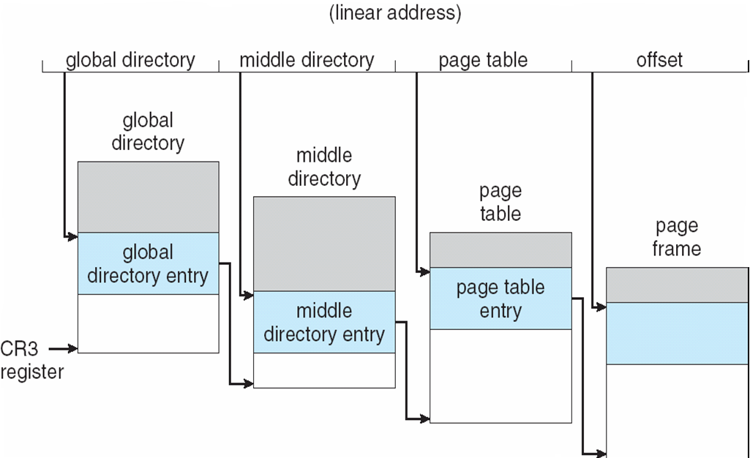
Three-level Paging in Linux
A. Frank - P. Weisberg

