Slide 1
Operating Systems
Virtual Memory Management
A. Frank - P. Weisberg

Slide 2
Virtual Memory Management
Background
Demand Paging
Demand Segmentation
Paging Considerations
Page Replacement Algorithms
Virtual Memory Policies
A. Frank - P. Weisberg

Slide 3
Background (1)
Code needs to be in memory to execute, but entire program rarely used:
  Error code, unusual routines, large data structures.
Entire program code not needed at same time.
Consider ability to execute partially-loaded program:
  Program no longer constrained by limits of physical memory.
  Each program takes less memory while running ->
  more programs run at the same time:
    Increased CPU utilization and throughput with no increase in response time or turnaround time.
  Less I/O needed to load or swap programs into memory -> each user program runs faster.

Slide 4
Background (2)
Virtual memory – separation of user logical memory from physical memory:
  Only part of the program needs to be in memory for execution.
  Logical address space can therefore be much larger than physical address space.
  Allows address spaces to be shared by several processes.
  Allows for more efficient process creation.
  More programs running concurrently.
  Less I/O needed to load or swap processes.

Slide 5
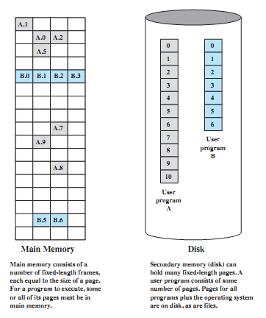
Virtual Memory Components
A. Frank - P. Weisberg

Slide 6
Background (3)
Virtual address space – logical view of how process is stored in memory:
  Usually start at address 0, contiguous addresses until end
  of space.
  Meanwhile, physical memory organized in page frames.
  MMU must map logical to physical.
Virtual memory can be implemented via:
  Demand paging
  Demand segmentation

Slide 7
(4) Background
Based on Paging/Segmentation, a process may be broken up into pieces (pages or segments) that do not need to be located contiguously in main memory.
Based on the Locality Principle, all pieces of a process do not need to be loaded in main memory during execution; all addresses are virtual.
The memory referenced by a virtual address is called virtual memory:
  It is mainly maintained on secondary memory (disk).
  pieces are brought into main memory only when needed.
A. Frank - P. Weisberg

Slide 8
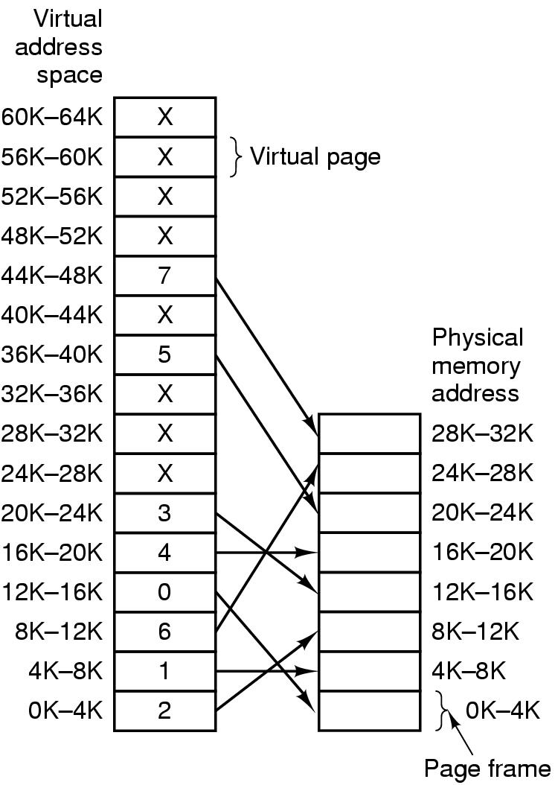
Virtual Memory Example
A. Frank - P. Weisberg

Slide 9
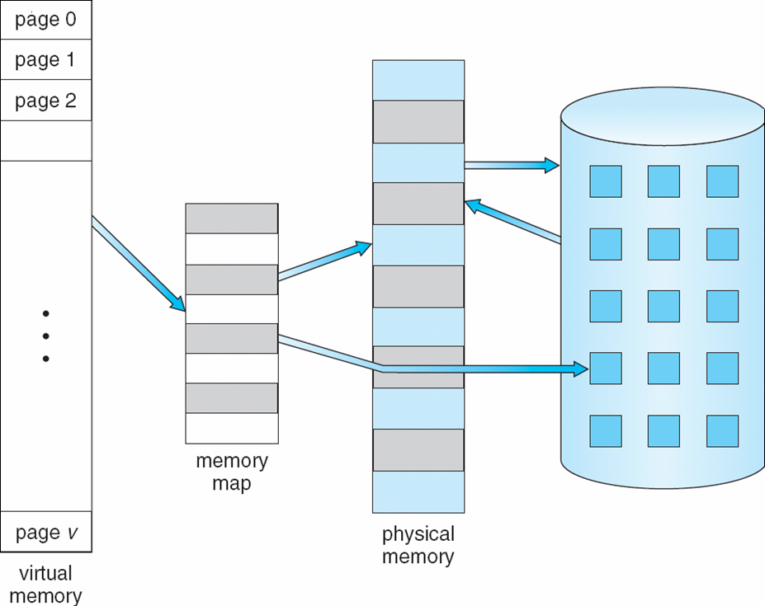
Virtual Memory that is larger than Physical Memory
A. Frank - P. Weisberg

Slide 10
Advantages of Partial Loading
More processes can be maintained in main memory:
  only load in some of the pieces of each process.
  with more processes in main memory, it is more likely that a process will be in the Ready state at any given time.
A process can now execute even if it is larger than the main memory size:
  it is even possible to use more bits for logical addresses than the bits needed for addressing the physical memory.
A. Frank - P. Weisberg

Slide 11
Virtual Memory: Large as you wish!
Example:
  Just 16 bits are needed to address a physical memory of 64KB.
  Lets use a page size of 1KB so that 10 bits are needed for offsets within a page.
  For the page number part of a logical address we may use a number of bits larger than 6, say 22 (a modest value!!), assuming a 32-bit address.
A. Frank - P. Weisberg

Slide 12
Support needed for Virtual Memory
Memory management hardware must support paging and/or segmentation.
OS must be able to manage the movement of pages and/or segments between external memory and main memory, including placement and replacement of pages/segments.
A. Frank - P. Weisberg

Slide 13

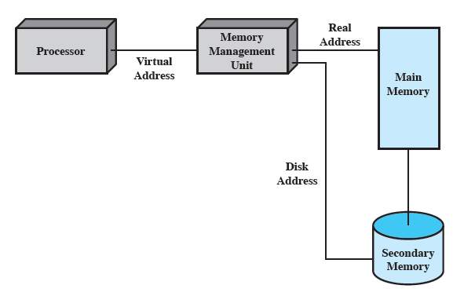
Virtual Memory Addressing
A. Frank - P. Weisberg

Slide 14

Virtual-address Space
Usually design logical address space for stack to start at Max logical address and grow “down” while heap grows “up”:
  Maximizes address space use.
  Unused address space between the two is hole.
  No physical memory needed until heap or stack grows to a given new page.
Enables sparse address spaces with holes left for growth, dynamically linked libraries, etc.
System libraries shared via mapping into virtual address space.
Shared memory by mapping pages read-write into virtual address space.
Pages can be shared during fork(), speeding process creation.

Slide 15

Shared Library using Virtual Memory

Slide 16
Process Execution (1)
The OS brings into main memory only a few pieces of the program (including its starting point).
Each page/segment table entry has a valid-invalid bit that is set only if the corresponding piece is in main memory.
The resident set is the portion of the process that is in main memory at some stage.
A. Frank - P. Weisberg

Slide 17
Process Execution (2)
An interrupt (memory fault) is generated when the memory reference is on a piece that is not present in main memory.
OS places the process in a Blocking state.
OS issues a disk I/O Read request to bring into main memory the piece referenced to.
Another process is dispatched to run while the disk I/O takes place.
An interrupt is issued when disk I/O completes; this causes the OS to place the affected process back in the Ready state.
A. Frank - P. Weisberg

Slide 18
Demand Paging
Bring a page into memory only when it is needed:
  Less I/O needed, no unnecessary I/O
  Less memory needed
  Faster response
  More users
Page is needed ⇒ reference to it:
  invalid reference ⇒ abort
  not-in-memory ⇒ bring to memory
Similar to paging system with swapping.
Lazy swapper – never swaps a page into memory unless page will be needed; Swapper that deals with pages is a pager.
A. Frank - P. Weisberg

Slide 19
Basic Concepts
With swapping, pager guesses which pages will be used before swapping out again.
Instead, pager brings in only those pages into memory.
How to determine that set of pages?
  Need new MMU functionality to implement demand paging.
If pages needed are already memory resident:
  No difference from non demand-paging.
If page needed and not memory resident:
  Need to detect and load the page into memory from storage:
    Without changing program behavior.
    Without programmer needing to change code.

Slide 20
Valid-Invalid Bit
With each page table entry, a valid–invalid (present-absent) bit is associated
(v ⇒ in-memory, i ⇒ not-in-memory).
Initially valid–invalid bit is set to i on all entries.
Example of a page table snapshot:
During address translation, if valid–invalid bit in page table entry
is i ⇒ page fault.
Frame #
valid-invalid bit
v
v
v
v
i
….
i
i
A. Frank - P. Weisberg

Slide 21

Virtual Memory Mapping Example
A. Frank - P. Weisberg

Slide 22
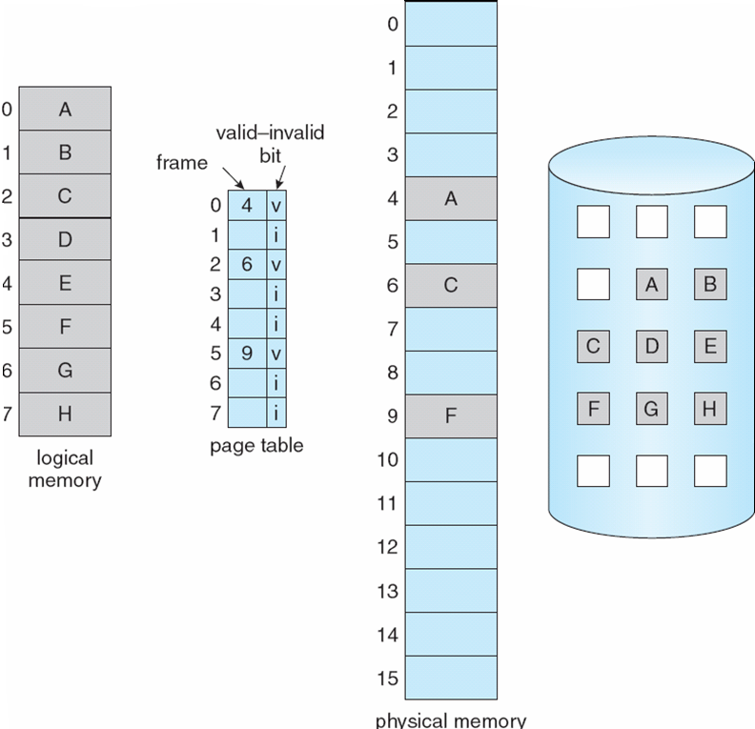
Page Table when some
Pages are not in Main Memory
A. Frank - P. Weisberg

Slide 23
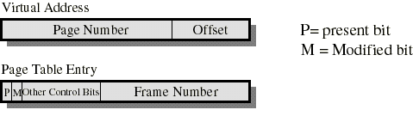
Dynamics of Demand Paging (1)
Typically, each process has its own page table.
Each page table entry contains a present (valid-invalid) bit to indicate whether the page is in main memory or not.
  If it is in main memory, the entry contains the frame number of the corresponding page in main memory.
  If it is not in main memory, the entry may contain the address of that page on disk or the page number may be used to index another table (often in the PCB) to obtain the address of that page on disk.
A. Frank - P. Weisberg

Slide 24
Dynamics of Demand Paging (2)
A modified bit indicates if the page has been altered since it was last loaded into main memory:
  If no change has been made, page does not have to be written to the disk when it needs to be swapped out.
Other control bits may be present if protection is managed at the page level:
  a read-only/read-write bit.
  protection level bit: kernel page or user page (more bits are used when the processor supports more than 2 protection levels).
A. Frank - P. Weisberg

Slide 25
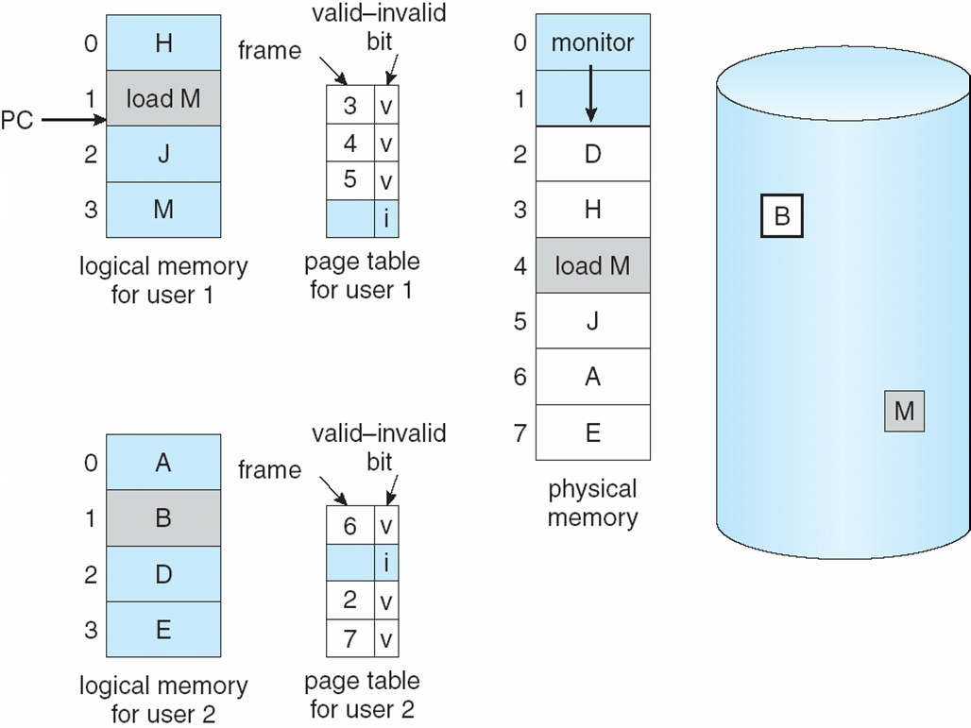
Need For Page Fault/Replacement
A. Frank - P. Weisberg

Slide 26

Steps in handling a Page Fault (1)
A. Frank - P. Weisberg

Slide 27
Steps in handling a Page Fault (2)
If there is ever a reference to a page not in memory, first reference will cause page fault.
Page fault is handled by the appropriate OS service routines.
Locate needed page on disk (in file or in backing store).
Swap page into free frame (assume available).
Reset page tables – valid-invalid bit = v.
Restart the instruction that caused the page fault.
A. Frank - P. Weisberg

Slide 28
What happens if there is no free frame?
Page replacement – find some page in memory, but not really in use, swap it out.
Need page replacement algorithm.
Performance – want an algorithm which will result in minimum number of page faults.
Same page may be brought into memory several times.
A. Frank - P. Weisberg

Slide 29
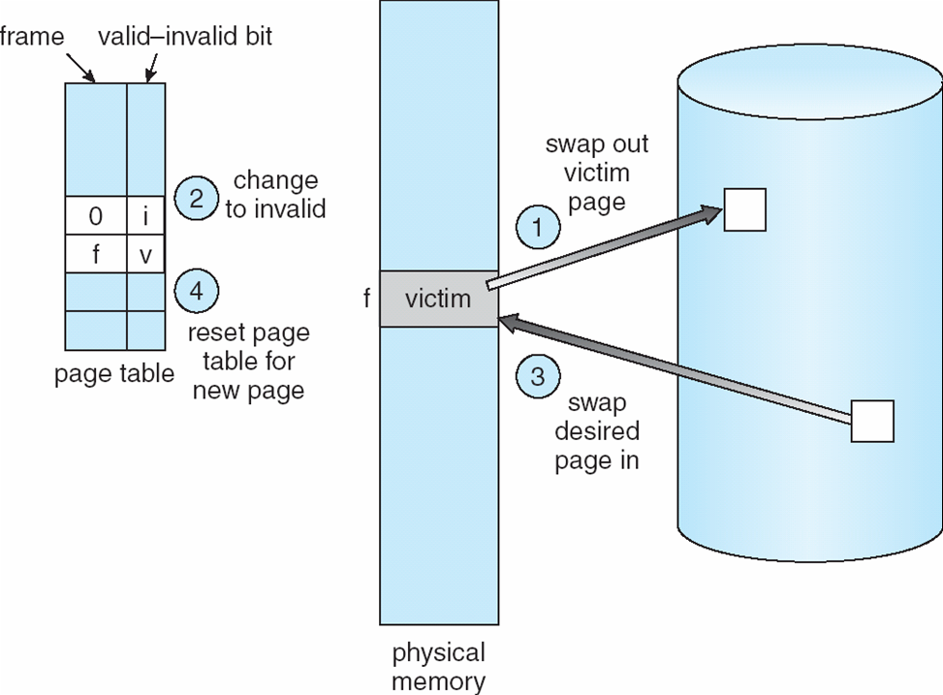
Steps in handling a Page Replacement (1)
A. Frank - P. Weisberg

Slide 30
Steps in handling a Page Replacement (2)
Find the location of the desired page on disk.
Find a free frame:
  If there is a free frame, use it.
  If there is no free frame, use a page replacement algorithm to select a victim page.
Bring the desired page into the (newly) free frame; update the page and frame tables.
Restart the process.
A. Frank - P. Weisberg

Slide 31
Comments on Page Replacement
Prevent over-allocation of memory by modifying page-fault service routine to include page replacement.
Use modify (dirty) bit to reduce overhead of page transfers – only modified pages are written to disk.
Page replacement completes separation between logical memory and physical memory – large virtual memory can be provided on a smaller physical memory.
A. Frank - P. Weisberg

Slide 32
Aspects of Demand Paging
Extreme case – start process with no pages in memory:
  OS sets instruction pointer to first instruction of process,
  non-memory-resident -> page fault.
  And for every other process pages on first access.
  This is Pure demand paging.
Actually, a given instruction could access multiple pages -> multiple page faults:
  Consider fetch and decode of instruction which adds 2 numbers from memory and stores result back to memory.
  Pain decreased because of locality of reference.
Hardware support needed for demand paging:
  Page table with valid/invalid bit.
  Secondary memory (swap device with swap space).
  Instruction restart.

Slide 33

Instruction Restart
Consider an instruction that could access several different locations:
  block move
  auto increment/decrement location
  Restart the whole operation?
    What if source and destination overlap?

Slide 34
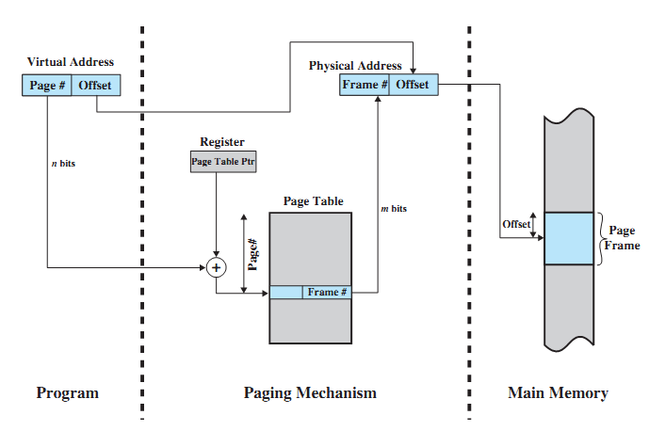
Address Translation in a Paging System

Slide 35
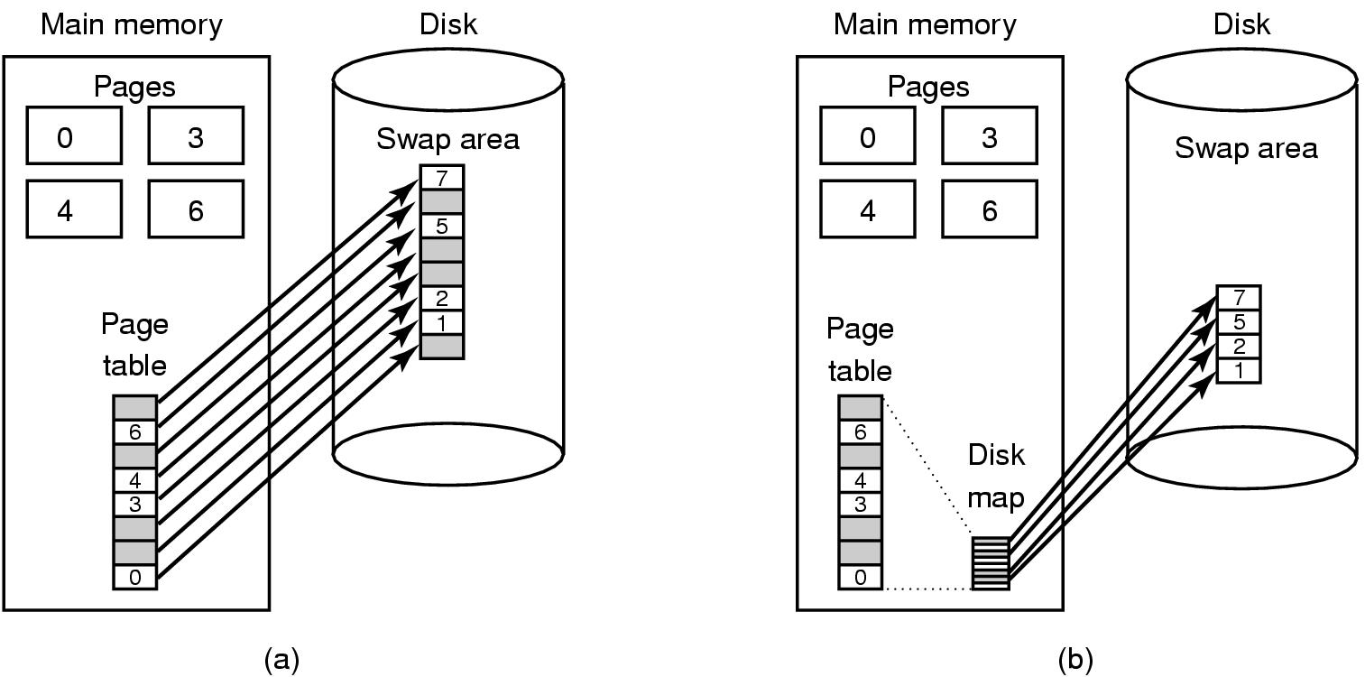
Backing/Swap Store
(a) Paging to static swap area. (b) Backing up pages dynamically.
A. Frank - P. Weisberg

Slide 36
Need for TLB
Because the page table is in main memory, each virtual memory reference causes at least two physical memory accesses:
  one to fetch the page table entry.
  one to fetch the data.
To overcome this problem a special cache is set up for page table entries, called the TLB (Translation Look-aside Buffer):
  Contains page table entries that have been most recently used.
  Works similar to main memory cache.
A. Frank - P. Weisberg

Slide 37
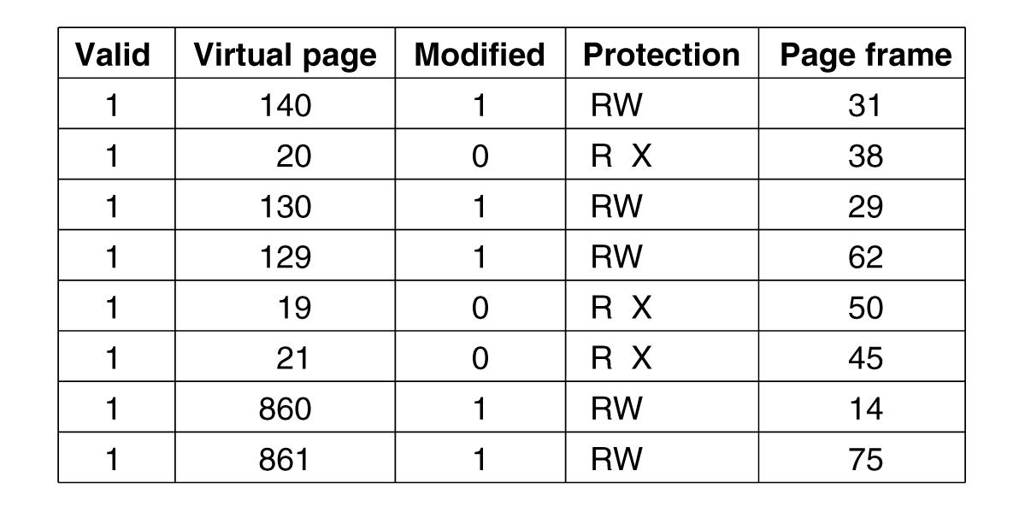
Example TLB
A. Frank - P. Weisberg

Slide 38
TLB Dynamics
Given a logical address, the processor examines the TLB.
If page table entry is present (a hit), the frame number is retrieved and the real (physical) address is formed.
If page table entry is not found in the TLB (a miss), the page number is used to index the process page table:
  if valid bit is set, then the corresponding frame is accessed.
  if not, a page fault is issued to bring in the referenced page in main memory.
The TLB is updated to include the new page entry.
A. Frank - P. Weisberg

Slide 39
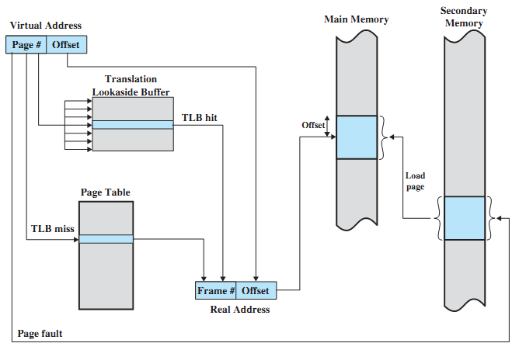
Use of a Translation Look-aside Buffer

Slide 40
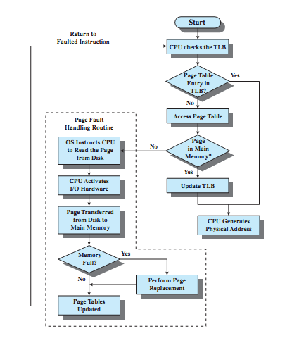
Operation of Paging and TLB
A. Frank - P. Weisberg

Slide 41
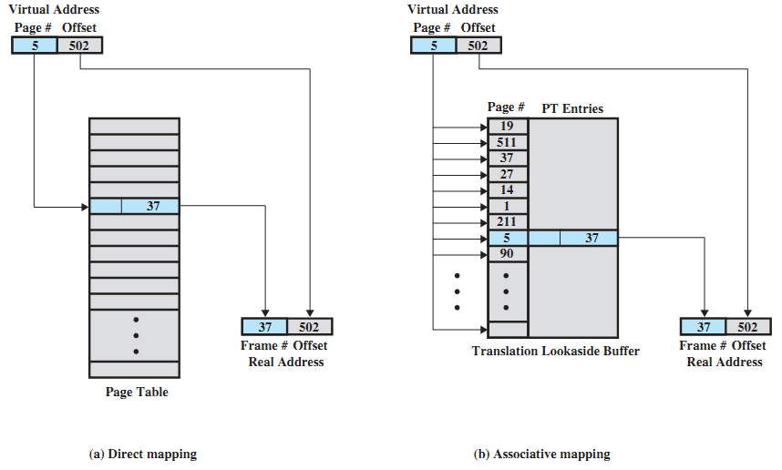
Direct vs. Associative Lookup for Page Table Entries
A. Frank - P. Weisberg

Slide 42
TLB: further comments
TLB use associative mapping hardware to simultaneously interrogates all TLB entries to find a match on page number.
The TLB must be flushed each time a new process enters the Running state.
The CPU uses two levels of cache on each virtual memory reference:
  first the TLB: to convert the logical address to the physical address.
  once the physical address is formed, the CPU then looks in the regular cache for the referenced word.
A. Frank - P. Weisberg

Slide 43
Stages in Demand Paging (worse case)
Trap to the operating system.
Save the user registers and process state.
Determine that the interrupt was a page fault.
Check that the page reference was legal and determine location of page on the disk.
Issue a read from the disk to a free frame:
  Wait in a queue for this device until the read request is serviced.
  Wait for the device seek and/or latency time.
  Begin the transfer of the page to a free frame.
While waiting, allocate the CPU to some other user.
Receive an interrupt from the disk I/O subsystem (I/O completed).
Save the registers and process state for the other user.
Determine that the interrupt was from the disk.
Correct the page table and other tables to show page is now in memory.
Wait for the CPU to be allocated to this process again.
Restore the user registers, process state, and new page table, and then resume the interrupted instruction.

Slide 44
Performance of Demand Paging
Three major activities:
  Service the interrupt – careful coding means just several hundred
  instructions needed.
  Read the page – lots of time..
  Restart the process – again just a small amount of time
Page Fault Rate 0 ≤ p ≤ 1
  if p = 0, no page faults.
  if p = 1, every reference is a fault.
Effective Access Time (EAT) –
EAT = (1 – p) x memory access
+ p x (page fault overhead
+ [swap page out]
+ swap page in
+ restart overhead)
A. Frank - P. Weisberg

Slide 45
Demand Paging Example
Memory access time = 200 nanoseconds.
Average page-fault service time = 8 milliseconds.
EAT = (1 – p) x 200 + p (8 milliseconds)
= (1 – p) x 200 + p x 8,000,000
= 200 + p x 7,999,800
If one access out of 1,000 causes a page fault, then
EAT = 8.2 microseconds.
This is a slowdown by a factor of 40!!
If want performance degradation < 10 percent
  220 > 200 + 7,999,800 x p
  20 > 7,999,800 x p
  p < .0000025
  < one page fault in every 400,000 memory accesses.
A. Frank - P. Weisberg

