Slide 1
Operating Systems
Segmentation and Paging Considerations
A. Frank - P. Weisberg

Slide 2
Virtual Memory Management
Background
Demand Paging
Demand Segmentation
Paging Considerations
Page Replacement Algorithms
Virtual Memory Policies
A. Frank - P. Weisberg

Slide 3
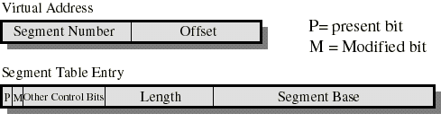
Dynamics of Segmentation
Typically, each process has its own segment table.
Similarly to paging, each segment table entry contains a present (valid-invalid) bit and a modified bit.
If the segment is in main memory, the entry contains the starting address and the length of that segment.
Other control bits may be present if protection and sharing is managed at the segment level.
Logical to physical address translation is similar to paging except that the offset is added to the starting address (instead of appended).

Slide 4
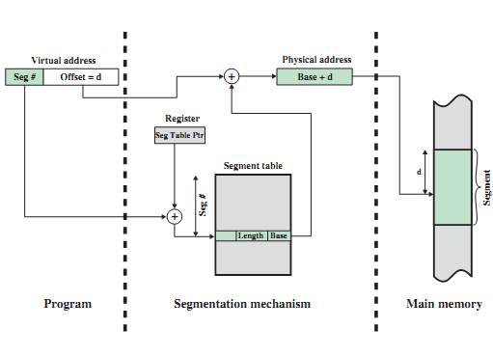
Address Translation in a Segmentation System
A. Frank - P. Weisberg

Slide 5
Segmentation on Comments
In each segment table entry, we have both the starting address and length of the segment; The segment can thus dynamically grow or shrink as needed.
But variable length segments introduce external fragmentation and are more difficult to swap in and out.
It is natural to provide protection and sharing at
the segment level since segments are visible to
the programmer (pages are not).
Useful protection bits in segment table entry:
  read-only/read-write bit
  Kernel/User bit
A. Frank - P. Weisberg

Slide 6

Comparison of Paging and Segmentation
A. Frank - P. Weisberg

Slide 7
Combined Segmentation and Paging
To combine their advantages, some OSs page the segments.
Several combinations exist – assume each process has:
  one segment table.
  several page tables: one page table per segment.
The virtual address consists of:
  a segment number: used to index the segment table who’s entry gives the starting address of the page table for that segment.
  a page number: used to index that page table to obtain the corresponding frame number.
  an offset: used to locate the word within the frame.
A. Frank - P. Weisberg

Slide 8
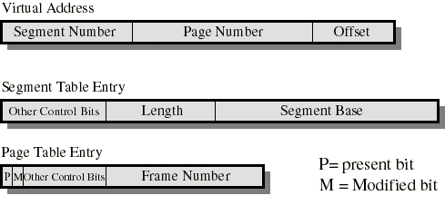
Simple Combined Segmentation and Paging
The Segment Base is the physical address of the page table of that segment.
Present/modified bits are present only in page table entry.
Protection and sharing info most naturally resides in segment table entry.
  Ex: a read-only/read-write bit, a kernel/user bit...
A. Frank - P. Weisberg

Slide 9
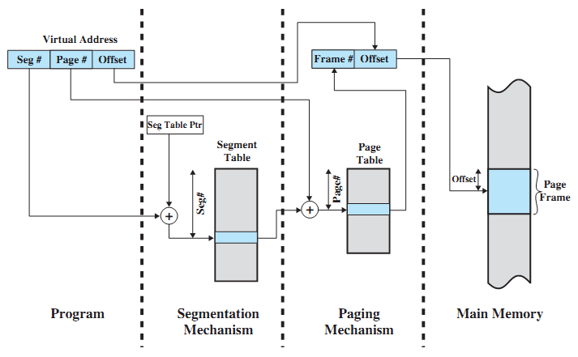
Address Translation in combined Segmentation/Paging
A. Frank - P. Weisberg

Slide 10
Paging Considerations
Locality, VM and Thrashing
Prepaging (Anticipatory Paging)
Page size issue
TLB reach
Program structure
I/O interlock
Copy-on-Write
Memory-Mapped Files
A. Frank - P. Weisberg

Slide 11
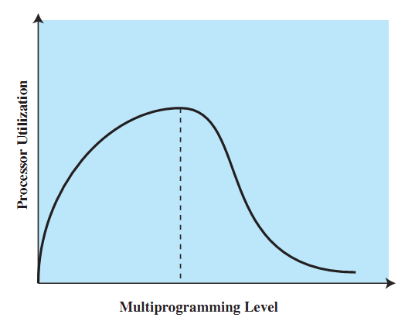
Degree of multiprogramming to be reached
A. Frank - P. Weisberg

Slide 12
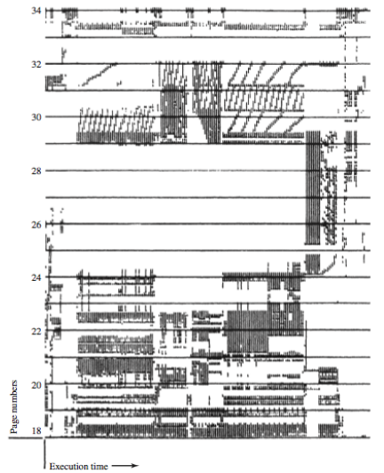
Locality in a Memory-Reference Pattern
A. Frank - P. Weisberg

Slide 13
Locality and Virtual Memory
Principle of locality of references: memory references within a process tend to cluster.
Hence: only a few pieces of a process will be needed over a short period of time.
Possible to make intelligent guesses about which pieces will be needed in the future.
This suggests that virtual memory may work efficiently (i.e., thrashing should not occur too often).
A. Frank - P. Weisberg

Slide 14
Possibility of Thrashing (1)
If a process does not have “enough” pages, the
page-fault rate is very high:
  Page fault to get page
  Replace existing frame
  But quickly need replaced frame back
  This leads to:
    Low CPU utilization
    Operating system thinking that it needs to increase the degree of multiprogramming
    Another process added to the system.
Thrashing ≡ a process is busy swapping pages in and out.
A. Frank - P. Weisberg

Slide 15
Possibility of Thrashing (2)
To accommodate as many processes as possible,
only a few pieces of each process are maintained in main memory.
But main memory may be full: when the OS brings one piece in, it must swap one piece out.
The OS must not swap out a piece of a process just before that piece is needed.
If it does this too often this leads to thrashing:
  The processor spends most of its time swapping pieces rather than executing user instructions.
A. Frank - P. Weisberg

Slide 16
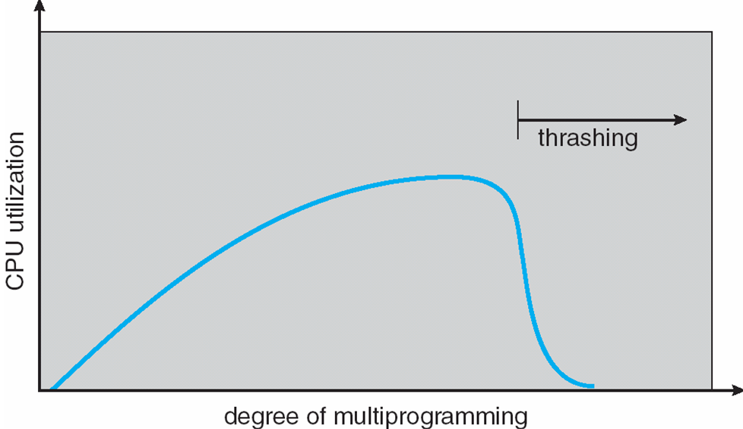
Locality and Thrashing
Why does demand paging work?
Locality model:
  Process migrates from one locality to another.
  Localities may overlap.
Why does thrashing occur?
Σ size of locality > total memory size
A. Frank - P. Weisberg

Slide 17
Prepaging
Can help to reduce the large number of page faults that occurs at process startup or resumption.
Prepage all or some of the pages a process will need, before they are referenced.
But if prepaged pages are unused, I/O and memory was wasted.
Assume s pages are prepaged and a fraction α of the pages are used:
  Is cost of s * α saved pages faults greater or less than the cost of prepaging s * (1- α) unnecessary pages?
  α near zero ⇒ prepaging loses.

Slide 18
Page Size Issues
Sometimes OS designers have a choice:
  Especially if running on custom-built CPU.
Page size selection must take into consideration:
  Fragmentation
  Page table size
  I/O overhead
  Number of page faults
  Locality
  TLB size and effectiveness
Always power of 2, usually in the range 2¹² (4,096 bytes) to 2²² (4,194,304 bytes).
On average, growing over time.

Slide 19
The Page Size Issue (1)
Page size is defined by hardware; exact size to use is a difficult question:
  Large page size is good since for a small page size, more pages are required per process; More pages per process
  means larger page tables. Hence, a larger portion of page tables in virtual memory.
  Large page size is good since disks are designed to efficiently transfer large blocks of data.
  Larger page sizes means less pages in main memory; this increases the TLB hit ratio.
  Small page size is good to minimize internal fragmentation.
A. Frank - P. Weisberg

Slide 20
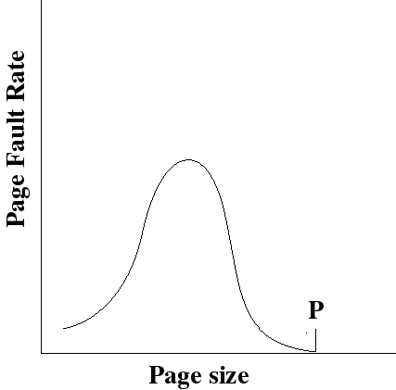
The Page Size Issue (2)
With a very small page size, each page matches the code that is actually used: faults are low.
Increased page size causes each page to contain more code that is not used. Page faults rise.
Page faults decrease if we approach point P were the size of a page is equal to the size of the entire process.
A. Frank - P. Weisberg

Slide 21
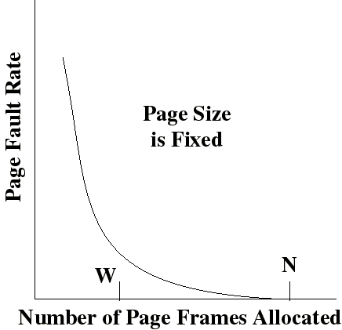
The Page Size Issue (3)
Page fault rate is also determined by the number of frames allocated per process.
Page faults drops to a reasonable value when W frames are allocated.
Drops to 0 when the number (N) of frames is such that a process is entirely in memory.
A. Frank - P. Weisberg

Slide 22
The Page Size Issue (4)
Page sizes from 1KB to 4KB are most commonly used. Increase in page sizes is related to trend of increasing block sizes.
But the issue is non trivial. Hence some processors supported multiple page sizes, for example:
  Pentium supports 2 sizes: 4KB or 4MB
  R4000 supports 7 sizes: 4KB to 16MB
A. Frank - P. Weisberg

Slide 23
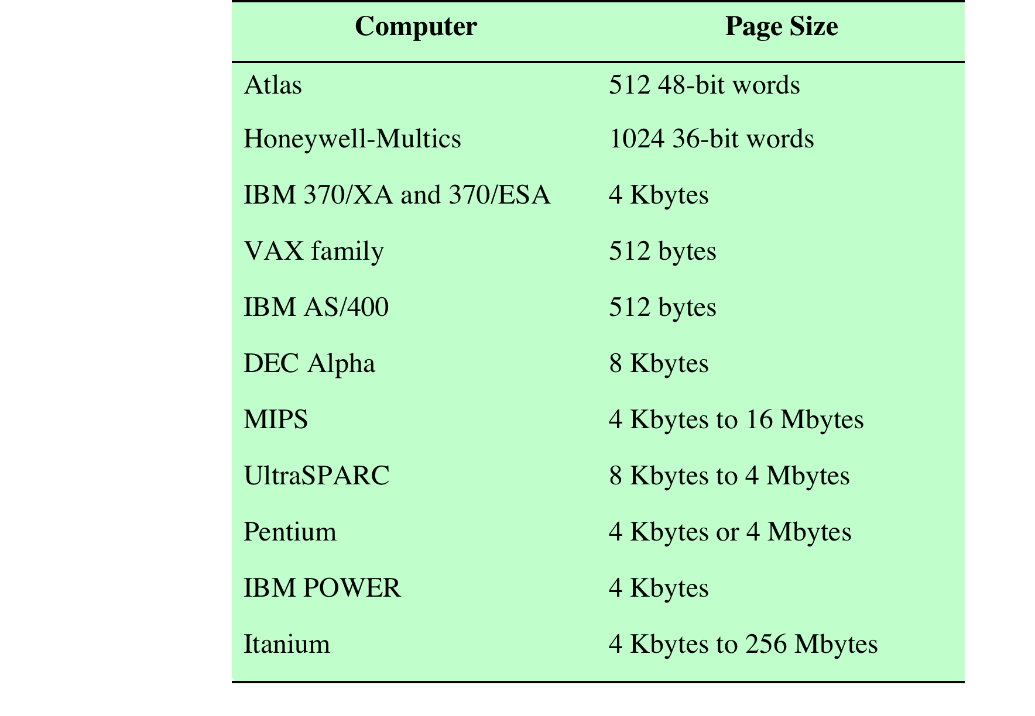
Example Page Sizes
A. Frank - P. Weisberg

Slide 24
TLB Reach
The amount of memory accessible from the TLB.
Ideally, working set of each process is stored in TLB:
  Otherwise there is a high degree of page faults.
TLB Reach = (TLB Size) x (Page Size)
Increase the size of the TLB:
  might be expensive.
Increase the Page Size:
  This may lead to an increase in internal fragmentation as
  not all applications require a large page size.
Provide Multiple Page Sizes:
  This allows applications that require larger page sizes the opportunity to use them without an increase in fragmentation.
A. Frank - P. Weisberg

Slide 25
Program Structure
Program structure
  int A[][] = new int[1024][1024];
  Each row is stored in one page.
  Program 1: for (j = 0; j < A.length; j++)
  for (i = 0; i < A.length; i++)
  A[i,j] = 0;
  we have 1024 x 1024 page faults
  Program 2: for (i = 0; i < A.length; i++)
  for (j = 0; j < A.length; j++)
  A[i,j] = 0;
  we have 1024 page faults
A. Frank - P. Weisberg

Slide 26

I/O Interlock
I/O Interlock – Pages must sometimes be locked into memory.
Consider I/O – Pages that are used for copying a file from a device must be locked from being selected for eviction by a page replacement algorithm.
A. Frank - P. Weisberg

Slide 27
Copy-on-Write
Copy-on-Write (COW) allows both parent and child processes to initially share the same pages in memory.
If either process modifies a shared page, only then is the page copied.
COW allows more efficient process creation as only modified pages are copied.
In general, free pages are allocated from a pool of zero-fill-on-demand pages.
A. Frank - P. Weisberg

Slide 28
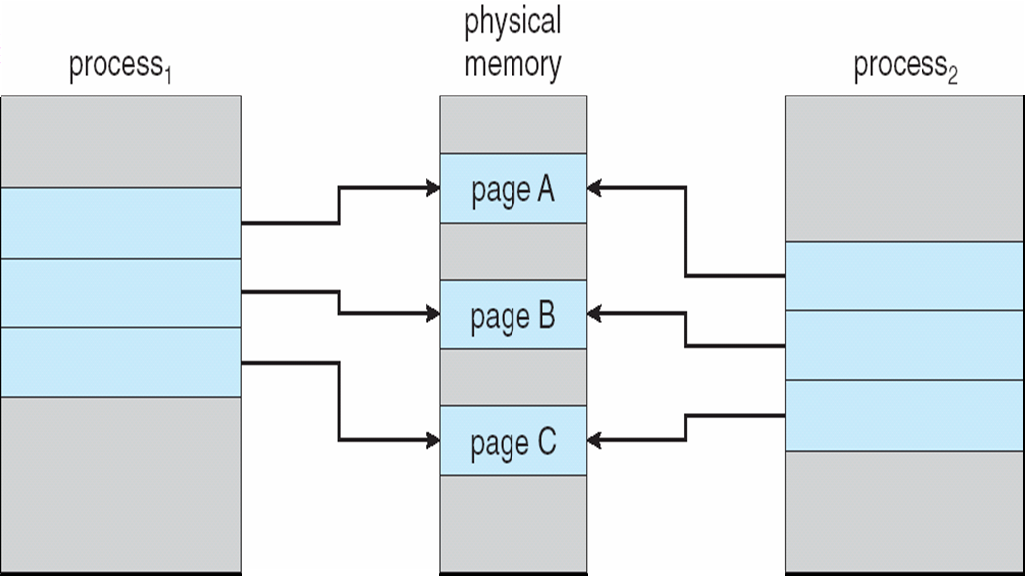
Before Process 1 Modifies Page C
A. Frank - P. Weisberg

Slide 29

After Process 1 Modifies Page C
A. Frank - P. Weisberg

Slide 30
What Happens if there is no Free Frame?
Used up by process pages.
Also in demand from the kernel, I/O buffers, etc.
How much to allocate to each?
Page replacement – find some page in memory,
but not really in use, page it out:
  Algorithm – terminate? swap out? replace the page?
  Performance – want an algorithm which will result in minimum number of page faults.
Same page may be brought into memory several times.

