Slide 1
Operating Systems
CPU Scheduling
A. Frank - P. Weisberg

Slide 2
CPU Scheduling
Basic Concepts
Scheduling Criteria
Simple Scheduling Algorithms
Advanced Scheduling Algorithms
Algorithms Evaluation
A. Frank - P. Weisberg

Slide 3
The CPU-I/O Burst Cycle
Maximum CPU utilization obtained with multiprogramming.
CPU-I/O Burst Cycle – Process execution consists of a cycle of CPU execution and I/O wait.
Each cycle consists of a CPU burst followed by a (usually longer) I/O burst.
A process usually terminates on a CPU burst.
CPU burst distribution is of main concern.
A. Frank - P. Weisberg

Slide 4

Alternating sequence of CPU and I/O Bursts
A. Frank - P. Weisberg

Slide 5
Basic Concepts
Burst/Service time = total processor time needed in one CPU-I/O burst cycle.
Jobs with long CPU burst time are CPU-bound jobs and are also referred to as “long jobs”.
Jobs with short CPU burst time are IO-bound jobs and are also referred to as “short jobs”.
CPU-bound processes have longer CPU bursts than I/O-bound processes.
A. Frank - P. Weisberg

Slide 6

Long vs. Short CPU Burst time
A. Frank - P. Weisberg

Slide 7

Histogram of CPU burst Times
A. Frank - P. Weisberg

Slide 8
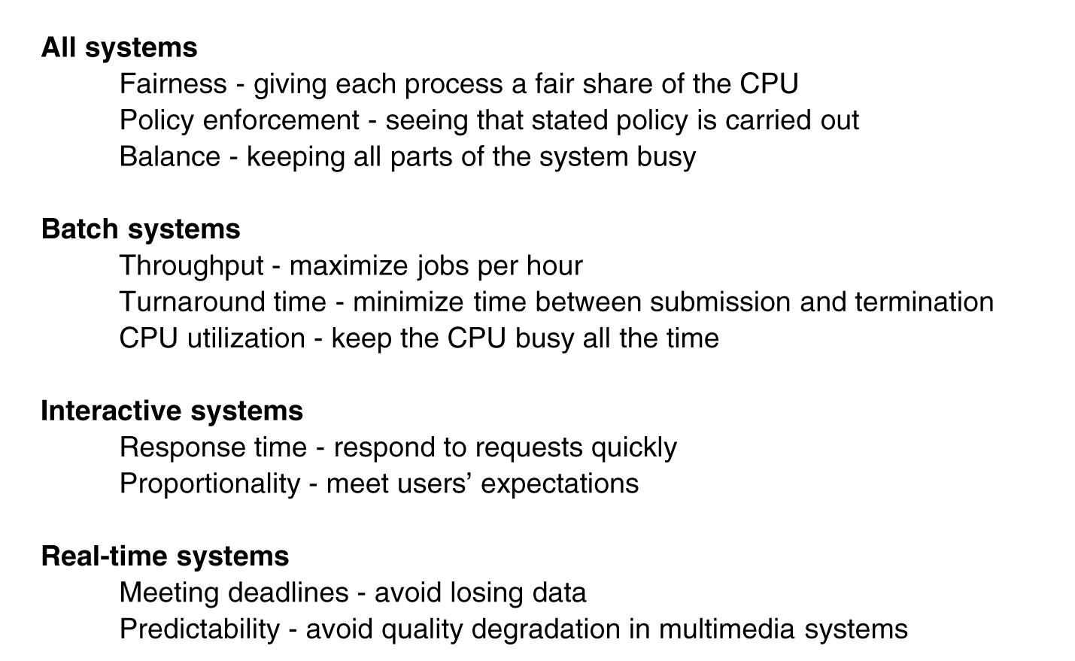
Scheduling Goals of Different Systems
A. Frank - P. Weisberg

Slide 9
Uniprocessor Scheduling
We concentrate on the problem of scheduling the usage of a single processor among all the existing ready processes in the system (short-term scheduling).
The goal is to achieve:
  High processor utilization.
  High throughput
    number of processes completed per unit time.
  Low turnaround/response time.
A. Frank - P. Weisberg

Slide 10
Scheduling Criteria
CPU utilization – keeping CPU as busy as possible.
Throughput – # of processes that complete their execution per time unit.
Turnaround time – amount of time to execute a particular process from start to end.
Waiting time – amount of time a process has been waiting in the ready queue.
Response time – amount of time it takes from when a request was submitted until the first response is produced (for time-sharing environment).
A. Frank - P. Weisberg

Slide 11
Classification of Scheduling Criteria
User-oriented:
  Response Time: Elapsed time from the submission of a request to the beginning of response.
  Turnaround Time: Elapsed time from the submission of a process to its completion.
System-oriented:
  CPU utilization
  Throughput: number of process completed per unit time.
  Fairness
A. Frank - P. Weisberg

Slide 12
Optimization Criteria
Max CPU utilization
Max throughput
Min turnaround time
Min waiting time
Min response time
A. Frank - P. Weisberg

Slide 13
CPU (short-term) Scheduler
Selects from among the processes that are ready to execute, and allocates the CPU to one of them.
CPU scheduling decisions may take place when a process:
  1. Switches from running to waiting state.
  2. Switches from running to ready state.
  3. Switches from waiting to ready.
  4. Terminates.
Scheduling under 1 and 4 is nonpreemptive.
All other scheduling is preemptive.
A. Frank - P. Weisberg

Slide 14
Characterization of Scheduling Policies
The selection function: determines which process in the ready queue is selected next for execution.
The decision mode: specifies the instants in time at which the selection function is exercised.
  Nonpreemptive:
    Once a process is in the running state, it will continue until it terminates or blocks itself for I/O.
  Preemptive:
    Currently running process may be interrupted and moved to the Ready state by the OS.
    Allows for better service since any one process cannot monopolize the processor for very long.
A. Frank - P. Weisberg

Slide 15
Dispatcher
Dispatcher module gives control of the CPU to the process selected by the short-term scheduler; this involves:
  switching context.
  switching to user mode.
  jumping to the proper location in the user program to restart that program.
Dispatch latency – time it takes for the dispatcher to stop one process and start another running.
A. Frank - P. Weisberg

Slide 16

Dispatch Latency
A. Frank - P. Weisberg

Slide 17
First Come First Served (FCFS)
Selection function: the process that has been waiting the longest in the ready queue – hence called First-Come First-Served (FCFS).
Decision mode: Nonpreemptive.
A. Frank - P. Weisberg

Slide 18
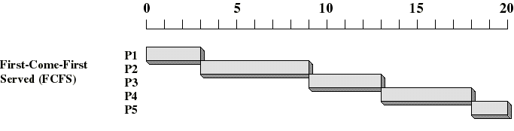
FCFS Example
Arrival
Time
Service
Time
Process
1
0
3
2
2
6
3
4
4
4
6
5
5
8
2
A. Frank - P. Weisberg

Slide 19
A Simpler FCFS Example
Process Burst Time
P₁ 24
P₂ 3
P₃ 3
Suppose that the processes arrive in the order: P₁ , P₂ , P₃
The Gantt Chart for the schedule is:
Waiting time for P₁ = 0; P₂ = 24; P₃ = 27
Average waiting time: (0 + 24 + 27)/3 = 17
Convoy effect: short process behind long process:
    Consider one CPU-bound and many I/O-bound processes.
P₁
P₂
P₃
0
24
27
30
A. Frank - P. Weisberg

Slide 20
A Twist on the FCFS Example
Suppose that processes arrive in the order: P₂ , P₃ , P₁
The Gantt chart for the schedule is:
Waiting time for P₁ = 6; P₂ = 0; P₃ = 3
Average waiting time: (6 + 0 + 3)/3 = 3
Much better than previous case.
P₂
P₃
P₁
0
3
6
30
A. Frank - P. Weisberg

Slide 21
FCFS Drawbacks
A process that does not perform any I/O will monopolize the processor (Convoy Effect).
Favors CPU-bound processes:
  I/O-bound processes have to wait until CPU-bound process completes.
  They may have to wait even when their I/O are completed (poor device utilization).
  We could have kept the I/O devices busy by giving a bit more priority to I/O bound processes.
A. Frank - P. Weisberg

Slide 22
Shortest Job First (SJF)
Selection function: the process with the shortest expected CPU burst time; Need to associate with each process the length of its next CPU burst.
Decision mode: Nonpreemptive.
Called also Shortest Time First (STF) and Shortest Process Next (SPN).
I/O bound processes will be picked first.
SJF is optimal – gives minimum average waiting
time for a given set of processes.
A. Frank - P. Weisberg

Slide 23
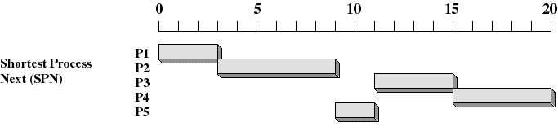
Shortest Job First (SJF) Example
Arrival
Time
Service
Time
Process
1
0
3
2
2
6
3
4
4
4
6
5
5
8
2
A. Frank - P. Weisberg

Slide 24

Simple Example of SJF
Process l Time Burst Time
P₁ 0.0 6
P₂ 2.0 8
P₃ 4.0 7
P₄ 5.0 3
SJF scheduling chart
Average waiting time = (3 + 16 + 9 + 0) / 4 = 7

Slide 25
Another Example of SJF
Process Arrival Time Burst Time
P₁ 0.0 7
P₂ 2.0 4
P₃ 4.0 1
P₄ 5.0 4
SJF (non-preemptive)
Average waiting time = (0 + 6 + 3 + 7)/4 = 4
P₁
P₃
P₂
P₄
0
3
7
8
12
16
A. Frank - P. Weisberg

Slide 26
Dynamics of Shortest-Job-First (SJF)
Associate with each process the length of its next CPU burst. Use these lengths to schedule the process with the shortest time.
Nonpreemptive – once CPU given to the process it cannot be preempted until completes its CPU burst.
We need to somehow estimate the required processing time (CPU burst time) for each process.
A. Frank - P. Weisberg

Slide 27
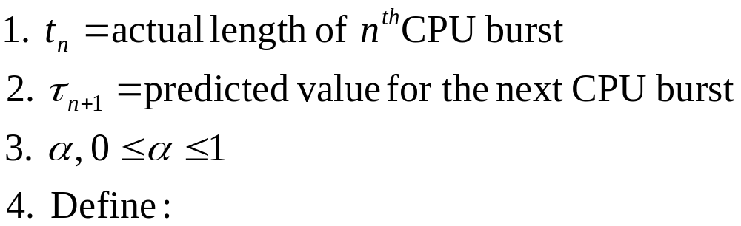
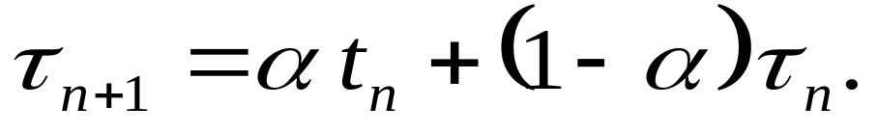
Determining length of next CPU Burst
Can only estimate the length – should be similar to the previous one.
Can be done by using the length of previous CPU bursts, using exponential averaging:
A. Frank - P. Weisberg

Slide 28
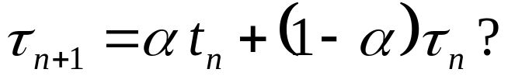
Examples of Exponential Averaging
How to set α in
α = 0
  τ_{n+1} = τ_{n,}
  Recent history does not count.
α = 1
  τ_{n+1} = t_{n,}
  Only the actual last CPU burst counts.
Let’s be balanced: α = 0.5 – See example in next slide.
A. Frank - P. Weisberg

Slide 29

Prediction of the length of the next CPU Burst
A. Frank - P. Weisberg

Slide 30
Idea of Exponential Averaging
If we expand the formula, we get:
    τ_{n+1} = α t_{n}+(1 – α) α t_{n-1} + …
    +(1 – α )^{j} α t_{n-j} + …
    +(1 – α )^{n+1} τ₀
Since both α and (1 – α) are less than or equal to 1, each successive term has less weight than its predecessor; term weights are decreasing exponentially.
Exponential averaging here is better than simple averaging.
A. Frank - P. Weisberg

Slide 31
Shortest Job First Drawbacks
Possibility of starvation for longer processes as long as there is a steady supply of shorter processes.
Lack of preemption is not suited in a time sharing environment:
  CPU bound process gets lower priority (as it should) but a process doing no I/O could still monopolize the CPU if he is the first one to enter the system.
SJF implicitly incorporates priorities: shortest jobs are given preferences.
A. Frank - P. Weisberg

Slide 32
Priority Scheduling
A priority number is associated with each process.
The CPU is allocated to the process with the highest priority (smallest integer = highest priority).
SJF is a priority scheduling where priority is the predicted next CPU burst time.
Problem: Starvation – low priority processes may never execute.
Solution: Aging – as time progresses, increase the priority of the process.
A. Frank - P. Weisberg

Slide 33

Example of Priority Scheduling
Process Burst Time Priority
P₁ 10 3
P₂ 1 1
P₃ 2 4
P₄ 1 5
P₅ 5 2
Priority scheduling Gantt Chart
Average waiting time = 8.2

