Slide 1
Operating Systems
Advanced CPU Scheduling
A. Frank - P. Weisberg

Slide 2
CPU Scheduling
Basic Concepts
Scheduling Criteria
Simple Scheduling Algorithms
Advanced Scheduling Algorithms
Algorithms Evaluation
A. Frank - P. Weisberg

Slide 3
Idea of Time Quantum
Decision mode: preemptive –
  a process is allowed to run until the set time slice period, called time quantum, is reached.
  then a clock interrupt occurs and the running process is put on the ready queue.
How to set the quantum q?
A. Frank - P. Weisberg

Slide 4
Shortest-Remaining-Job-First (SRJF)
Associate with each process the length of its next/remaining CPU burst. Use these lengths to schedule the process with the shortest time.
Preemptive – if a new process arrives with CPU burst length less than remaining time of current executing process, preempt.
Called Shortest-Remaining-Job-First (SRJF).
A. Frank - P. Weisberg

Slide 5

Example of Shortest-remaining-time-first
ProcessA arri Arrival TimeT Burst Time
P₁ 0 8
P₂ 1 4
P₃ 2 9
P₄ 3 5
Preemptive SJF Gantt Chart
Average waiting time = [(10-1)+(1-1)+(17-2)+5-3)]/4 =
26/4 = 6.5

Slide 6
Another Example of SRJF
Process Arrival Time Burst Time
P₁ 0.0 7
P₂ 2.0 4
P₃ 4.0 1
P₄ 5.0 4
SRJF (preemptive) with q = 2
Average waiting time = (9 + 1 + 0 +2)/4 = 3
P₁
P₂
P₃
P₂
P₄
P₁
0
2
4
5
7
11
16
A. Frank - P. Weisberg

Slide 7
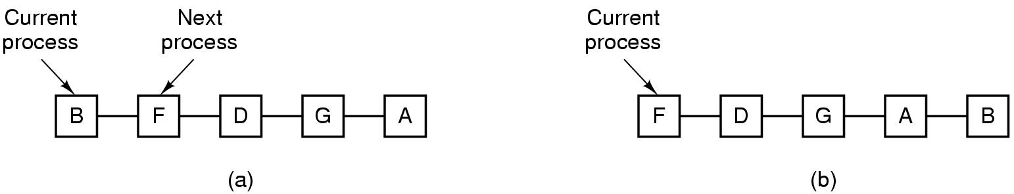
Round-Robin (RR)
Selection function: (initially) same as FCFS.
Decision mode: preemptive –
  a process is allowed to run until the time slice period, called time quantum, is reached.
  then a clock interrupt occurs and the running process is put at the end of the ready queue.
A. Frank - P. Weisberg

Slide 8
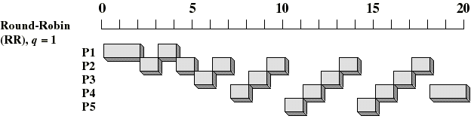
Round-Robin (RR) Example
Arrival
Time
Service
Time
Process
1
0
3
2
2
6
3
4
4
4
6
5
5
8
2
A. Frank - P. Weisberg

Slide 9
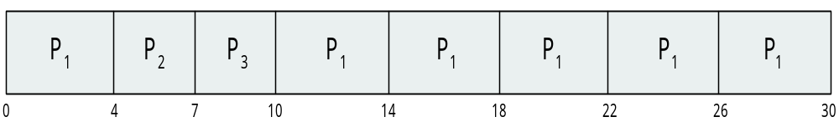
Example of RR with Time Quantum = 4
Process Burst Time
P₁ 24
P₂ 3
P₃ 3
The Gantt chart is:
Typically, higher average turnaround than SJF,
but better response.

Slide 10
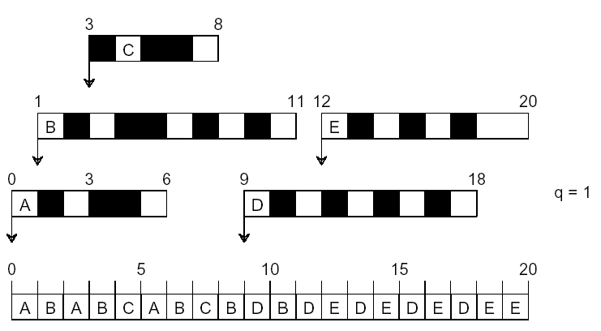
Another RR Example (q = 1)
A. Frank - P. Weisberg

Slide 11
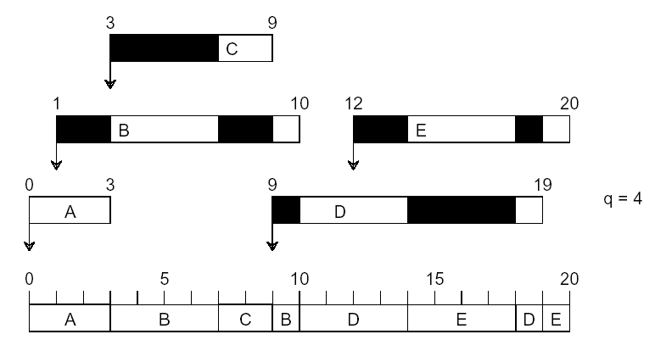
Another RR Example (q = 4)
A. Frank - P. Weisberg

Slide 12
Example of RR with Time Quantum = 20
Process Burst Time
P₁ 53
P₂ 17
P₃ 68
P₄ 24
The Gantt chart is:
q should be large compared to context switch time.
q usually 10ms to 100ms, context switch < 10 usec.
P₁
P₂
P₃
P₄
P₁
P₃
P₄
P₁
P₃
P₃
0
20
37
57
77
97
117
121
134
154
162
A. Frank - P. Weisberg

Slide 13
Dynamics of Round Robin (RR)
Each process gets a time quantum, usually 10-100 milliseconds. After this time has elapsed, the process is preempted and added to the end of the ready queue.
If there are n processes in the ready queue and the
time quantum is q, then each process gets 1/n of the CPU time in chunks of at most q time units at once. No process waits more than (n-1)q time units.
Performance
  q large ⇒ FIFO.
  q small ⇒ q must be large with respect to context switch, otherwise overhead is too high.
A. Frank - P. Weisberg

Slide 14

Time Quantum and Context Switch Time
A. Frank - P. Weisberg

Slide 15

Turnaround Time varies with the Time Quantum
A. Frank - P. Weisberg

Slide 16
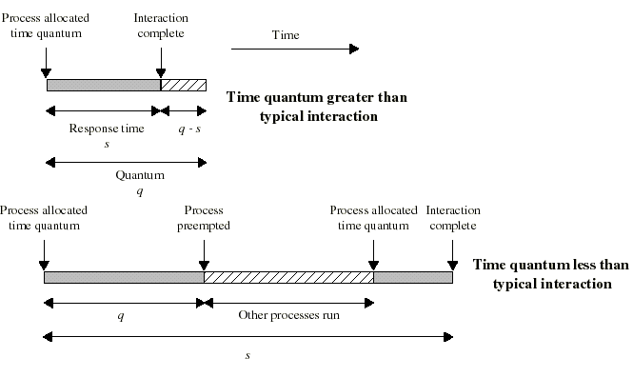
Time Quantum for Round Robin
Must be substantially larger than the time required to handle the clock interrupt and dispatching.
Should be larger then the typical interaction (but not much more to avoid penalizing I/O bound processes).

Slide 17
Round Robin Drawbacks
Still favors CPU-bound processes:
  A I/O bound process uses the CPU for a time that is less than the time quantum and then blocked waiting for I/O.
  A CPU-bound process runs for all its time slice and is put back into the ready queue (thus getting in front of blocked processes).
A solution: virtual round robin:
  When a I/O has completed, the blocked process is moved to an auxiliary queue which gets preference over the main ready queue.
  A process dispatched from the auxiliary queue runs no longer than the basic time quantum minus the time spent running since it was selected from the ready queue.
A. Frank - P. Weisberg

Slide 18
Multiple Priorities
Implemented by having multiple ready queues to represent each level of priority.
Scheduler will always choose a process of higher priority over one of lower priority.
Lower-priority may suffer starvation.
Then allow a process to change its priority based on
its age or execution history.
Our first scheduling algorithms did not make use of multiple priorities.
We will now present other algorithms that use
dynamic multiple priority mechanisms.
A. Frank - P. Weisberg

Slide 19
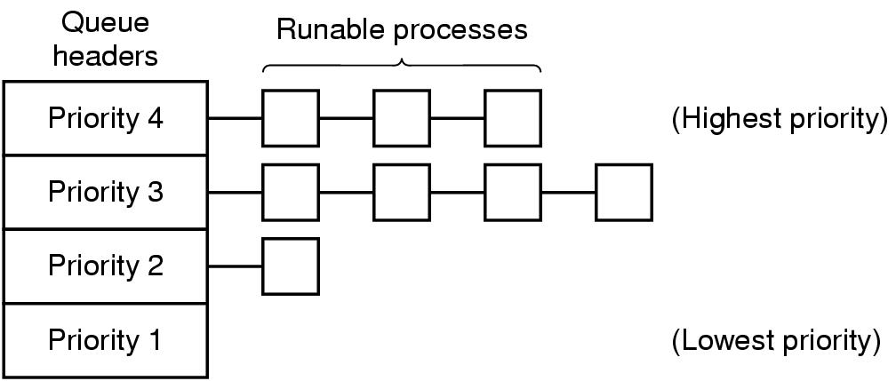
Priority Scheduling with Queues
A. Frank - P. Weisberg

Slide 20
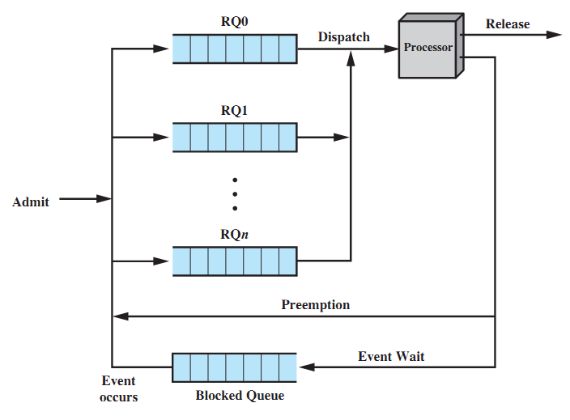
Priority Queuing
A. Frank - P. Weisberg

Slide 21
Multilevel Queue Scheduling (1)
Ready queue is partitioned into separate queues:
- foreground (interactive)
- background (batch)
Process permanently in a given queue.
Each queue has its own scheduling algorithm:
- foreground – RR
- background – FCFS
Scheduling must be done between the queues:
  Fixed priority scheduling (i.e., serve all from foreground then from background) – possibility of starvation.
  Time slice – each queue gets a certain amount of CPU time which it can schedule amongst its processes; i.e., 80% to foreground in RR; 20% to background in FCFS.
A. Frank - P. Weisberg

Slide 22
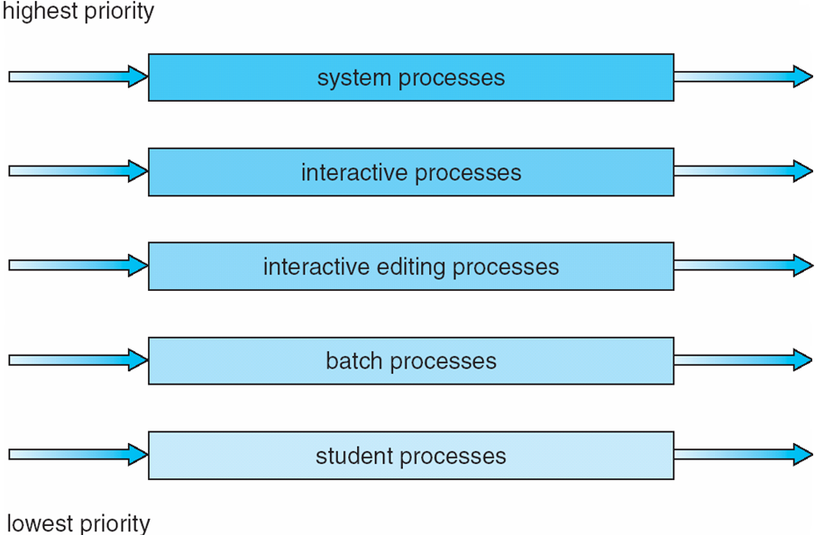
Multilevel Queue Scheduling (2)
A. Frank - P. Weisberg

Slide 23
Multilevel Feedback Queue
Preemptive scheduling with dynamic priorities.
A process can move between the various queues; aging can be implemented this way.
Multilevel-feedback-queue scheduler defined by the following parameters:
  number of queues.
  scheduling algorithms for each queue.
  method used to determine which queue a process will enter when that process needs service.
  method used to determine when to upgrade process.
  method used to determine when to demote process.
A. Frank - P. Weisberg

Slide 24
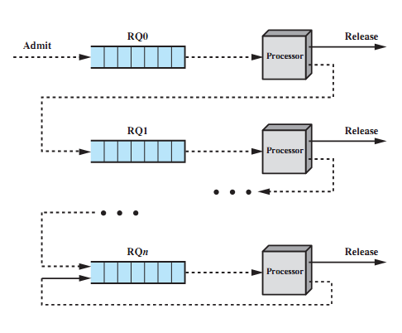
Multiple Feedback Queues
A. Frank - P. Weisberg

Slide 25
Dynamics of Multilevel Feedback
Several ready to execute queues with decreasing priorities:
  P(RQ0) > P(RQ1) > ... > P(RQn).
New process are placed in RQ0.
When they reach the time quantum, they are placed in RQ1. If they reach it again, they are place in RQ2... until they reach RQn.
I/O-bound processes will tend to stay in higher priority queues. CPU-bound jobs will drift downward.
Dispatcher chooses a process for execution in RQi only if RQi-1 to RQ0 are empty.
Hence long jobs may starve.
A. Frank - P. Weisberg

Slide 26
Example of Multilevel Feedback Queue
Three queues:
  Q₀ – RR with time quantum 8 milliseconds
  Q₁ – RR with time quantum 16 milliseconds
  Q₂ – FCFS
Scheduling:
  A new job enters queue Q₀ which is served FCFS. When it gets CPU, job receives 8 milliseconds. If it does not finish in 8 milliseconds, job is moved to queue Q₁.
  At Q₁ job is again served FCFS and receives 16 additional milliseconds. If it still does not complete, it is preempted and moved to queue Q₂.
  Could be also vice versa.
A. Frank - P. Weisberg

Slide 27
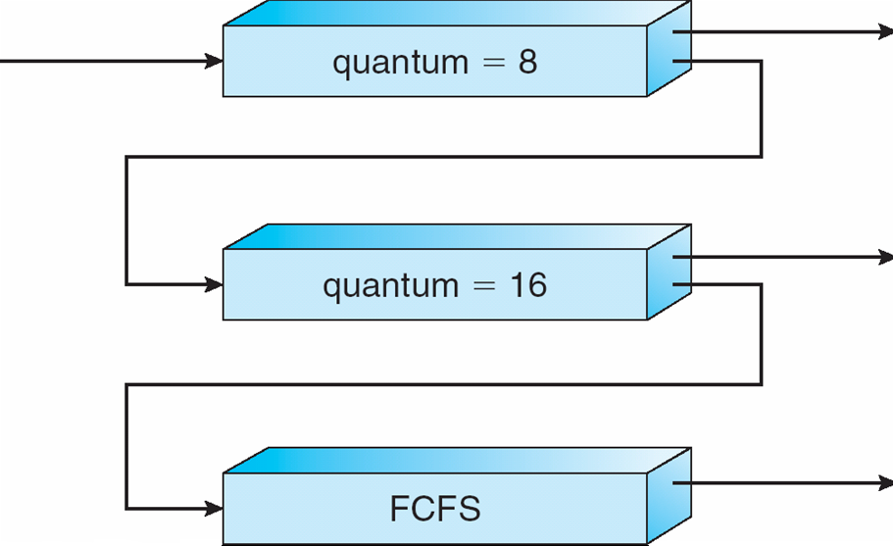
Multilevel Feedback Queues
A. Frank - P. Weisberg

Slide 28
Time Quantum for Feedback Scheduling
With a fixed quantum time, the turnaround time of longer processes can stretch out alarmingly.
To compensate we can increase the time quantum according to the depth of the queue:
  Example: time quantum of RQi = 2^{i-1}
See next slide for an example.
Longer processes may still suffer starvation. Possible fix: promote a process to higher priority after some time.
A. Frank - P. Weisberg

Slide 29
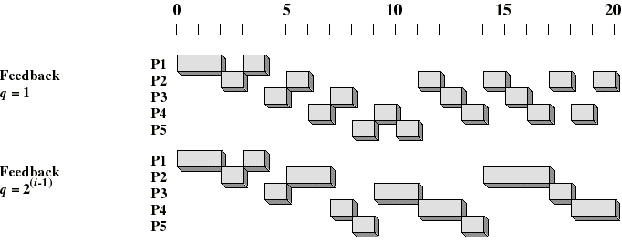
Time Quantum for Feedback Scheduling
A. Frank - P. Weisberg

Slide 30
Algorithms Comparison
Which one is best?
The answer depends on:
  on the system workload (extremely variable).
  hardware support for the dispatcher.
  relative weighting of performance criteria (response time, CPU utilization, throughput...).
  The evaluation method used (each has its limitations...).
Hence the answer depends on too many factors to give any...
A. Frank - P. Weisberg

Slide 31
Scheduling Algorithm Evaluation
Deterministic modeling – takes a particular predetermined workload and defines the performance of each algorithm for that workload.
Queuing models
Simulations
Implementation
A. Frank - P. Weisberg

Slide 32
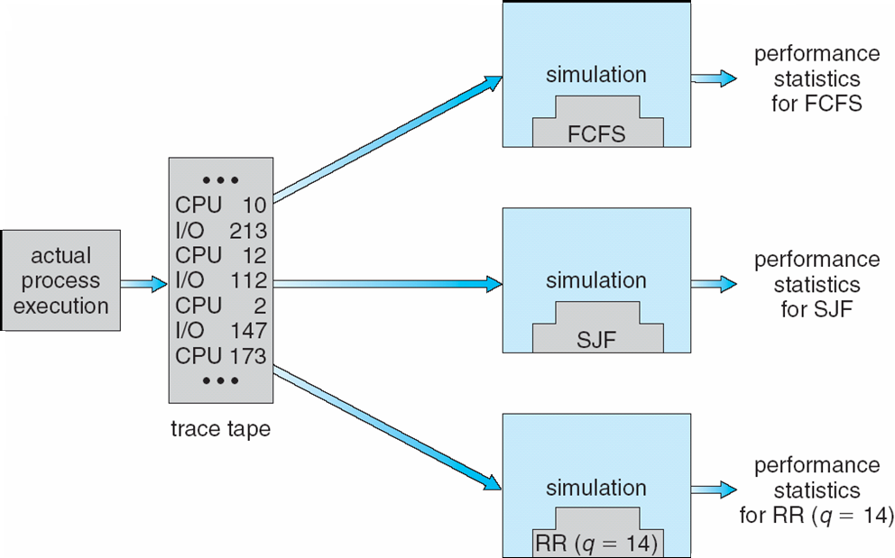
Evaluation of CPU Schedulers by Simulation
A. Frank - P. Weisberg

Slide 33
Thread Scheduling
Depends if ULT or KLT or mixed.
Local Scheduling – How the threads library decides which ready thread to run.
ULT can employ an application-specific thread scheduler.
Global Scheduling – How the kernel decides which kernel thread to run next.
KLT can employ priorities within thread scheduler.
A. Frank - P. Weisberg

Slide 34
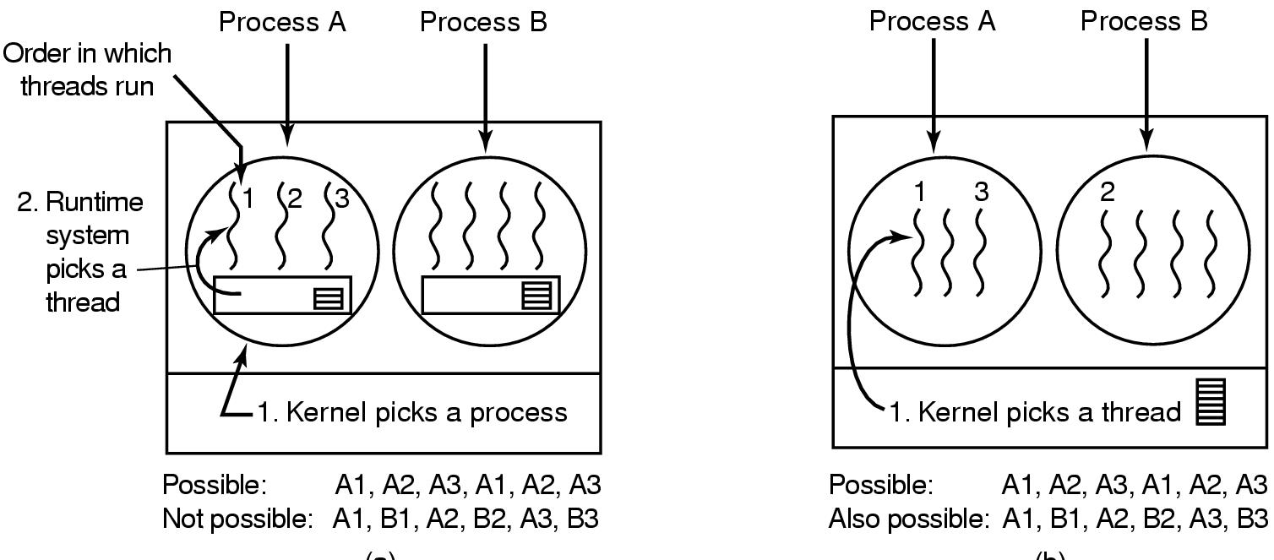
Thread Scheduling Example
A. Frank - P. Weisberg

