Slide 1
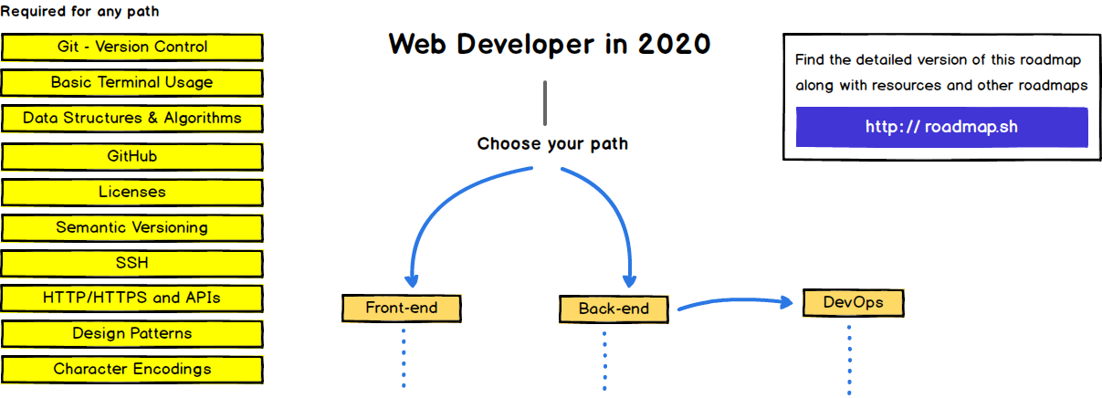

Slide 2
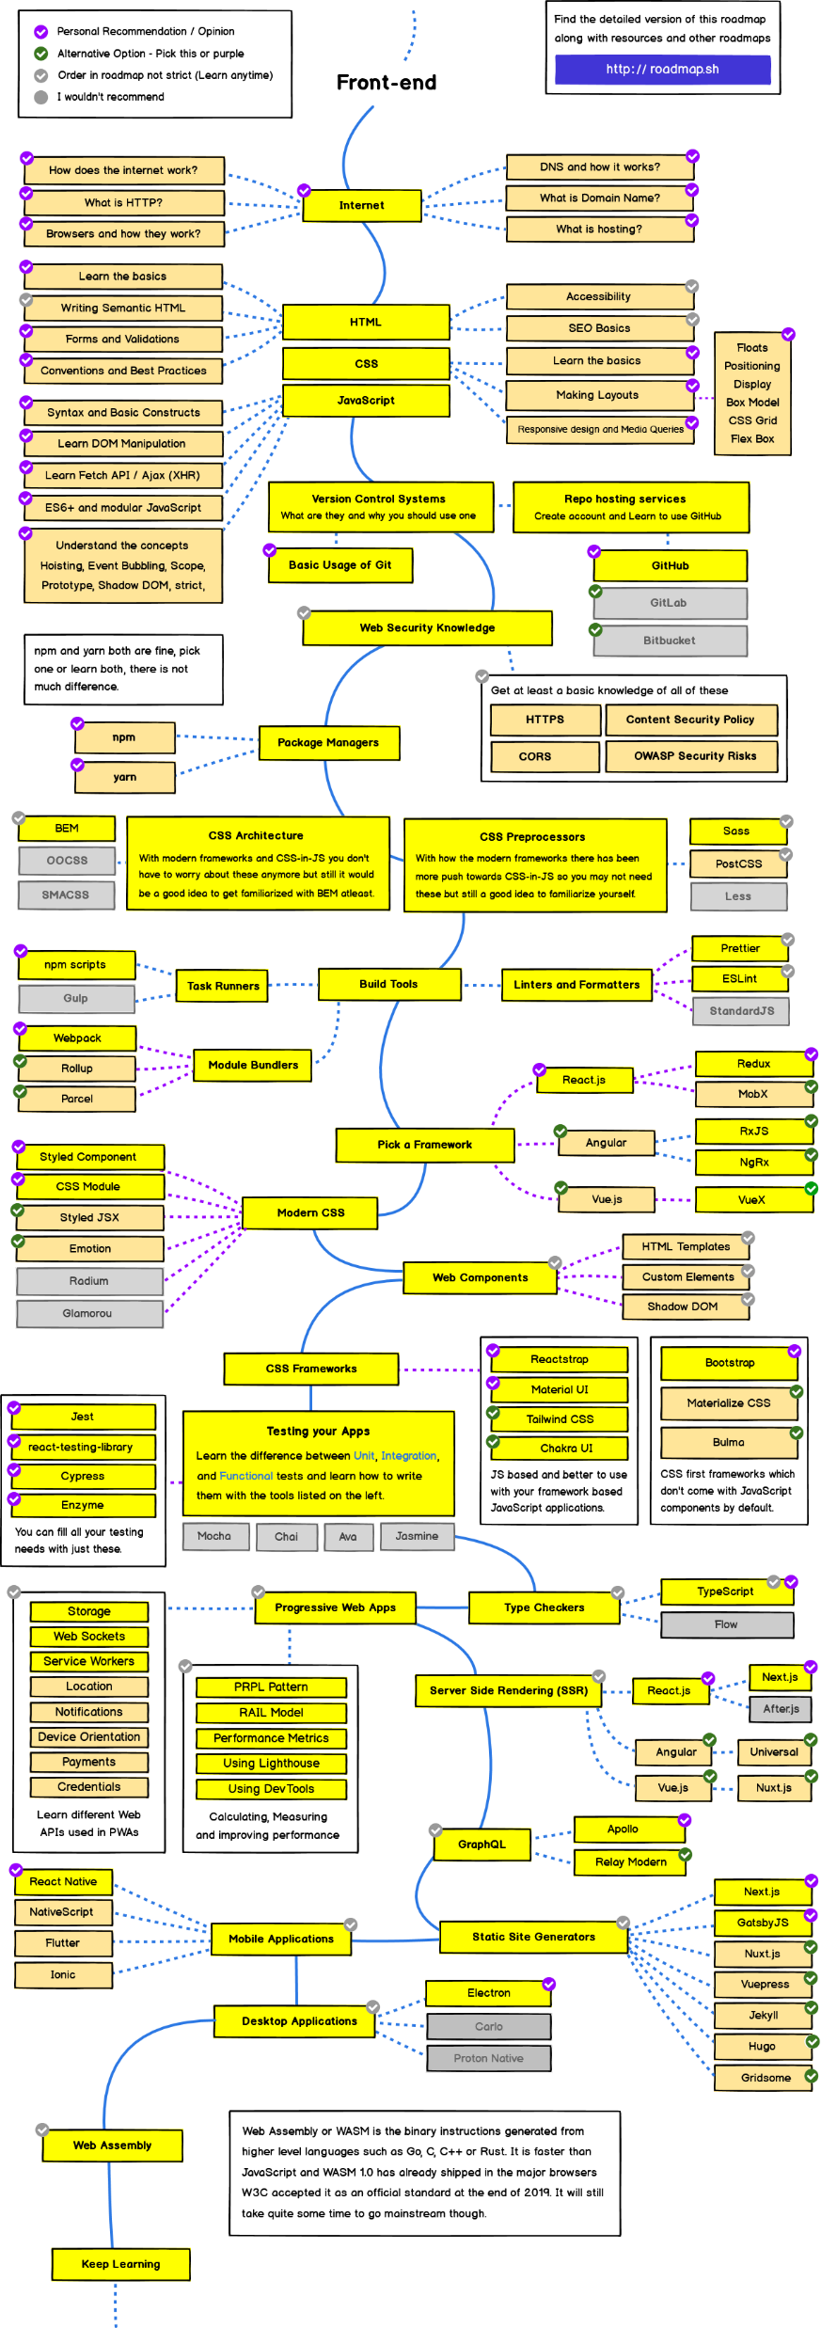

Slide 3
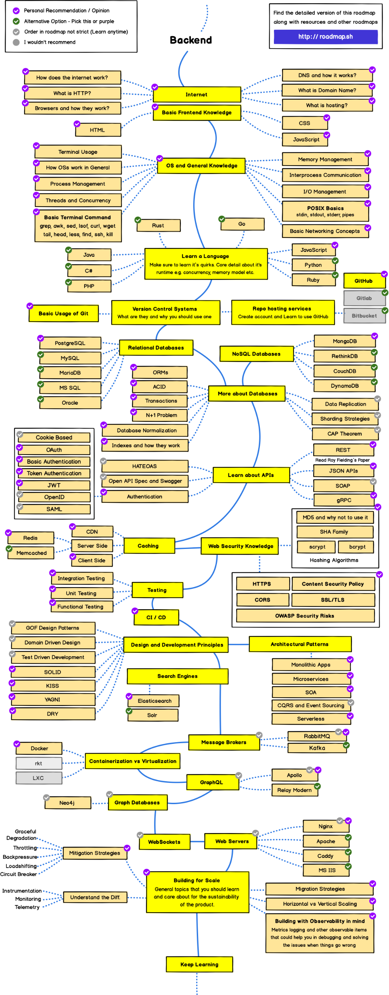

Slide 4
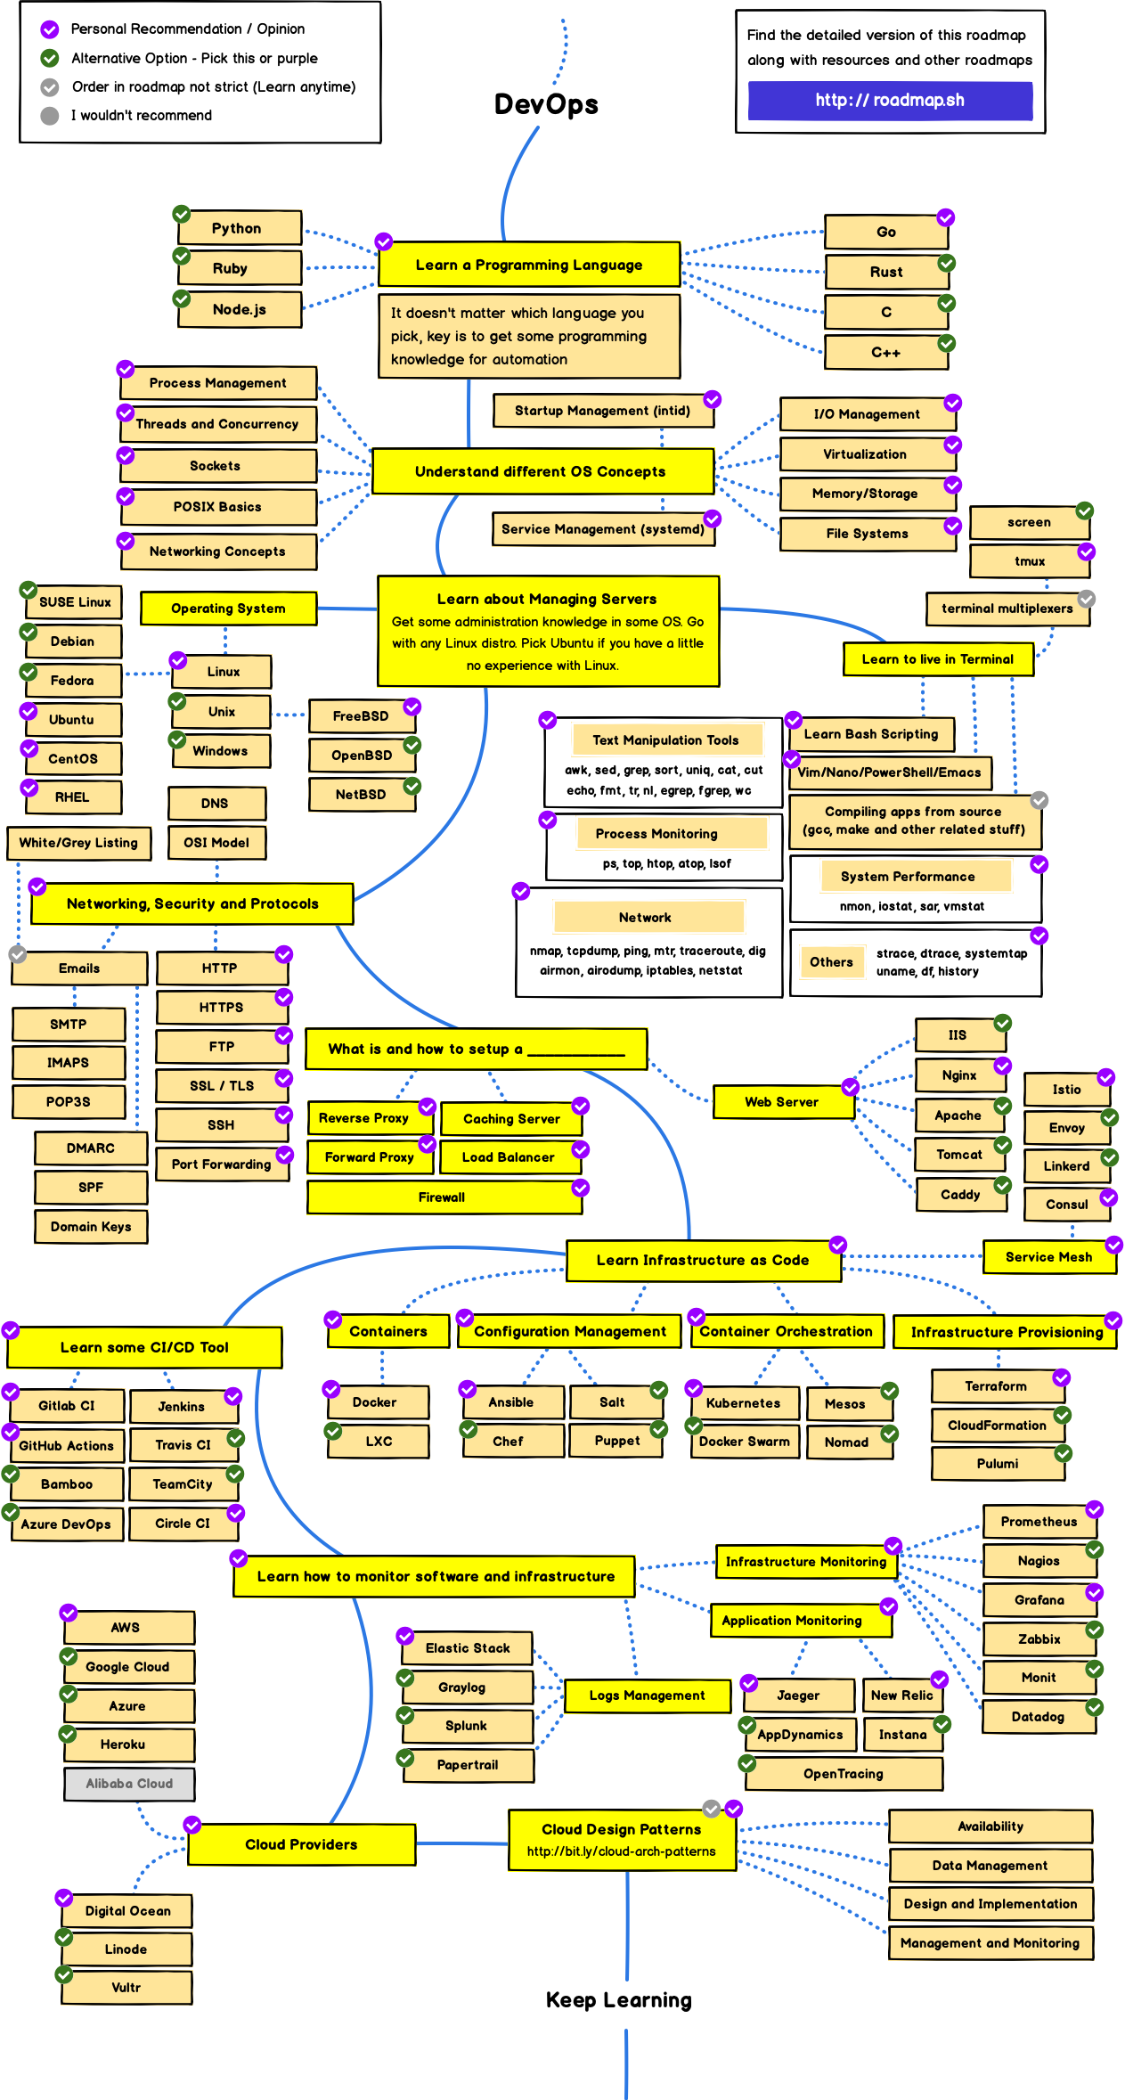

Slide 5
Flexbox
Flexbox is a CSS3 layout model that provides an easy and clean way to arrange items within a container.
No Floats
Responsive and mobile friendly
Positioning child elements is MUCH easier
Flex containers' margins do not collapse with the margins of its contents
Order of elements can easily be changed without editing the source HTML

Slide 6
Flexible Box Model Concepts
The ability to alter item width and height to best fit in its containers available free space
Flexbox is direction-agnostic
Built for small-scale layouts while the Grid specifications is for more large scale

Slide 7
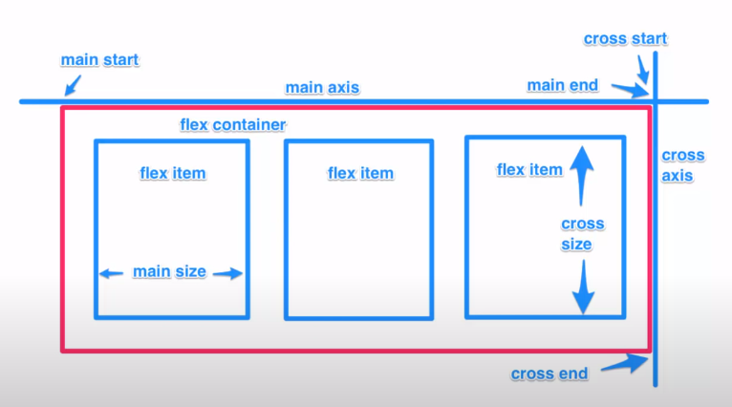

Slide 8
Flex Properties
display: flex | inline-flex
flex-direction: row | column
flex-wrap: wrap | nowrap | wrapreverse
flex-basis: <length>
justify-content: flex-start | flex-end | center
align-self: flex-start | flex-end | center
align-items: flex-start | flex-end | center
align-content: flex-start | flex-end | center
flex-grow: <number>
flex-shrink: <number>
flex: <integer>
order: <integer>

Slide 9
HTML 5

Slide 10
Basic HTML Tags
<html> </html>
<head> </head>
<body> </body>
<title> </title>

Slide 11
Text Tags
<pre> </pre>
<h1> </h1> --> <h6> </h6>
<b> </b>
<i> </i> <em>
<tt> </tt>
<code> </code>
<cite> </cite>
<address> </address>
<strong> </strong>
<font size=?> </font>
<font color=?> </font>
<font face=?> </font>

Slide 12
Formatting
<p> </p>
<br>
<q></q>
<blockquote> </blockquote>
<div> </div>
<span> </span>

Slide 13
Lists
<ul> </ul>
<ol start=?> </ol>
<li> </li>
<dl> </dl>
<dt>
<dd>

Slide 14
Graphical elements
<hr>
<hr size=?>
<hr width=?>
<hr noshade>
<img src="URL" />
<img src="URL" align=?>
<img src="URL" border=?>
<img src="URL" height=?>
<img src="URL" width=?>
<img src="URL" alt=?>

Slide 15
Forms
<form> </form>
<select multiple name=? size=?> </select>
<select name=?> </select>
<option>
<textarea name=? cols="x" rows="y"></textarea>
<input type="checkbox" name=? value=?>
<input type="checkbox" name=? value=? checked>
<input type="radio" name=? value=?>
<input type="radio" name=? value=? checked>
<input type="text" name=? size=?>
<input type="submit" value=?>
<input type="image" name=? src=? border=? alt=?>
<input type="reset">

Slide 16
Tables
<table></table>
<tr> </tr>
<td> </td>
<th> </th>

Slide 17
Table attributes
<table border=?>
<table cellspacing=?>
<table cellpadding=?>
<table width=?>
<tr align=?>
<td align=?>
<tr valign=?>
<td valign=?>
<td rowspan=?>
<td colspan=?>
<td nowrap>

Slide 18
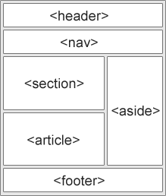
HTML5
<article>
<aside>
<details><summary><summary></details>
<figure> <figcaption>
<footer>
<header>
<main>
<mark>
<nav>
<section>
<time>

Slide 19
More HTML5 Tags
<audio>
<audio controls> <source src="horse.ogg" type="audio/ogg"> <source src="horse.mp3" type="audio/mpeg"> Your browser does not support the audio element. </audio>
<video>
<video width="320" height="240" controls> <source src="movie.mp4" type="video/mp4"> <source src="movie.ogg" type="video/ogg"> Your browser does not support the video tag. </video>
<canvas> <svg>
The HTML <canvas> element is used to draw graphics, on the fly, via JavaScript.
<datalist>
<datalist id="browsers">
<option value="Internet Explorer">
<option value="Firefox">
<option value="Chrome">
<option value="Opera">
<option value="Safari">
</datalist>
<meter>
<meter value="2" min="0" max="10">2 out of 10</meter><br>
<meter value="0.6">60%</meter>

Slide 20
HTML5 API
Geolocation API
The HTML Geolocation API is used to get the geographical position of a user.
Drag & Drop API
Drag and drop is a very common feature. It is when you "grab" an object and drag it to a different location.
Web Storage
With web storage, web applications can store data locally within the user's browser.
Web Worker
A web worker is a JavaScript running in the background, without affecting the performance of the page.
Server-Sent Events
A server-sent event is when a web page automatically gets updates from a server.

Slide 21
Javascript
<script></script>
Document.write
Alert/window.alert
Console.log
Var (implicit and explicit)
Var with + operation of string
Camel case
Comments
Operators
var person = {firstName:"John", lastName:"Doe", age:50, eyeColor:"blue"};
Typeof
Primitive Datatype(Stirng, number, Boolean, undefined)

Slide 22
Javascript
Functions
Objects
var person = { firstName:"John", lastName:"Doe", age:50, eyeColor:"blue" };

Slide 23
Events
Onchange
Onclick
Onmouseover
Onmouseout
Onkeydown
Onload
Dblclick
LIST: https://www.w3schools.com/jsref/dom_obj_event.asp

Slide 24
Strings
txt.length;
str.indexOf("locate");
str.lastIndexOf("locate");
str.indexOf("locate",15); // 15 is starting position
str.search("locate");
slice(start, end) ::: If a parameter is negative, the position is counted from the end of the string. One parameter will be from the postion to the rest of the string.
substring(start, end)::: The difference is that substring() cannot accept negative indexes.
substr(start, length)::: The difference is that the second parameter specifies the length of the extracted part.
str.replace("Microsoft", “Macrosoft");
str.replace(/MICROSOFT/i, “microsoft"); /Microsoft/g
text1.toUpperCase();
text1.toLowerCase();
text1.concat(" ", text2);
str.trim()
String to array with split(“,”)
var x = 123; x.toString();
var x = 9.656; x.toPrecision();

Slide 25
Numbers
Number()
parseInt()
parseFloat()
Array
Pop
Push
Shift
Unshift
Length
var fruits = ["Banana", "Orange", "Apple", "Mango"]; fruits.splice(2, 2, "Lemon", "Kiwi");
Sort
Reverse
Math.floor(Math.random() * 101); // returns a random integer from 0 to 100
function getRndInteger(min, max) { return Math.floor(Math.random() * (max - min) ) + min; }

Slide 26
JSON (Short intro)
var text = '{ "employees" : [' + '{ "firstName":"John" , "lastName":"Doe" },' + '{ "firstName":"Anna" , "lastName":"Smith" },' + '{ "firstName":"Peter" , "lastName":"Jones" } ]}’;
var obj = JSON.parse(text);
<p id="demo"></p> <script> document.getElementById("demo").innerHTML = obj.employees[1].firstName + " " + obj.employees[1].lastName; </script>

Slide 27

DOM

Slide 28
DOM
<p id="demo"></p> <script> document.getElementById("demo").innerHTML = "Hello World!"; </script>
document.getElementById(id)
document.getElementsByTagName(name)
document.getElementsByClassName(name)
<img id="myImage" src="smiley.gif"> <script> document.getElementById("myImage").src = "landscape.jpg"; </script>
<p id="p2">Hello World!</p> <script> document.getElementById("p2").style.color = "blue"; </script>

Slide 29
XML
XML stands for eXtensible Markup Language
XML is a markup language much like HTML
XML was designed to store and transport data
Maybe it is a little hard to understand, but XML does not DO anything.
<note> <to>Tove</to> <from>Jani</from> <heading>Reminder</heading> <body>Don't forget me this weekend!</body> </note>

Slide 30
XML
XML Does Not Use Predefined Tags
XML Simplifies Things
It simplifies data sharing
It simplifies data transport
It simplifies platform changes
It simplifies data availability

Slide 31
XML Elements
XML Naming Rules
Element names are case-sensitive
Element names must start with a letter or underscore
Element names cannot start with the letters xml (or XML, or Xml, etc)
Element names can contain letters, digits, hyphens, underscores, and periods
Element names cannot contain spaces
Best Naming Practices
Create descriptive names, like this: <person>, <firstname>, <lastname>.
Create short and simple names, like this: <book_title> not like this: <the_title_of_the_book>.
Avoid "-". If you name something "first-name", some software may think you want to subtract "name" from "first".
Avoid ".". If you name something "first.name", some software may think that "name" is a property of the object "first".
Avoid ":". Colons are reserved for namespaces (more later).
Non-English letters like éòá are perfectly legal in XML, but watch out for problems if your software doesn't support them.
Naming Styles
XML Elements are Extensible

Slide 32
XML Attributes
XML Attributes Must be Quoted
Attribute values must always be quoted. Either single or double quotes can be used.
Date can be attribute as well as an element
Avoid XML Attributes
attributes cannot contain multiple values (elements can)
attributes cannot contain tree structures (elements can)
attributes are not easily expandable (for future changes)
<note day="10" month="01" year="2008" to="Tove" from="Jani" heading="Reminder" body="Don't forget me this weekend!"> </note>

Slide 33
XML
<?xml version="1.0" encoding="UTF-8"?> <bookstore> <book category="cooking"> <title lang="en">Everyday Italian</title> <author>Giada De Laurentiis</author> <year>2005</year> <price>30.00</price> </book> <book category="children"> <title lang="en">Harry Potter</title> <author>J K. Rowling</author> <year>2005</year> <price>29.99</price> </book> <book category="web"> <title lang="en">Learning XML</title> <author>Erik T. Ray</author> <year>2003</year> <price>39.95</price> </book> </bookstore>

Slide 34
XML News
<?xml version="1.0" encoding="UTF-8"?> <nitf> <head> <title>Colombia Earthquake</title> </head> <body> <headline> <hl1>143 Dead in Colombia Earthquake</hl1> </headline> <byline> <bytag>By Jared Kotler, Associated Press Writer</bytag> </byline> <dateline> <location>Bogota, Colombia</location> <date>Monday January 25 1999 7:28 ET</date> </dateline> </body> </nitf>

Slide 35
XML Weather
<?xml version="1.0" encoding="UTF-8"?> <current_observation> <credit>NOAA's National Weather Service</credit> <credit_URL>http://weather.gov/</credit_URL> <image> <url>http://weather.gov/images/xml_logo.gif</url> <title>NOAA's National Weather Service</title> <link>http://weather.gov</link> </image> <location>New York/John F. Kennedy Intl Airport, NY</location> <station_id>KJFK</station_id> <latitude>40.66</latitude> <longitude>-73.78</longitude> <observation_time_rfc822>Mon, 11 Feb 2008 06:51:00 -0500 EST </observation_time_rfc822> <weather>A Few Clouds</weather> <temp_f>11</temp_f> <temp_c>-12</temp_c> <relative_humidity>36</relative_humidity> <wind_dir>West</wind_dir> <wind_degrees>280</wind_degrees> <wind_mph>18.4</wind_mph> <wind_gust_mph>29</wind_gust_mph> <pressure_mb>1023.6</pressure_mb> <pressure_in>30.23</pressure_in> <dewpoint_f>-11</dewpoint_f> <dewpoint_c>-24</dewpoint_c> <windchill_f>-7</windchill_f> <windchill_c>-22</windchill_c> <visibility_mi>10.00</visibility_mi> <icon_url_base>http://weather.gov/weather/images/fcicons/</icon_url_base> <icon_url_name>nfew.jpg</icon_url_name> <disclaimer_url>http://weather.gov/disclaimer.html</disclaimer_url> <copyright_url>http://weather.gov/disclaimer.html</copyright_url> </current_observation>

Slide 36
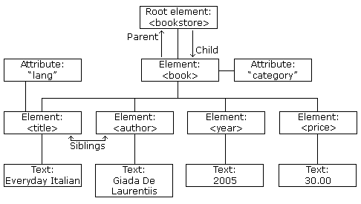
XML Tree

Slide 37
XML Parsing
Using DOM
parser = new DOMParser(); xmlDoc = parser.parseFromString(text,"text/xml"); document.getElementById("demo").innerHTML = xmlDoc.getElementsByTagName("title")[0].childNodes[0].nodeValue; </script>
Using XPath
Using XLST
Using XQuery
Using XLink

Slide 38
XPath
bookstore
Selects all nodes with the name "bookstore“.
/bookstore
Selects the root element bookstore
bookstore/book
Selects all book elements that are children of bookstore
//book
Selects all book elements no matter where they are in the document
bookstore//book
Selects all book elements that are descendant of the bookstore element, no matter where they are under the bookstore element
//@lang
Selects all attributes that are named lang

Slide 39
XPath
/bookstore/book[1]
Selects the first book element that is the child of the bookstore element.
/bookstore/book[last()]
Selects the last book element that is the child of the bookstore element
/bookstore/book[price>35.00]
Selects all the book elements of the bookstore element that have a price element with a value greater than 35.00
/bookstore/book[price>35.00]/title
Selects all the title elements of the book elements of the bookstore element that have a price element with a value greater than 35.00

Slide 40
XML Validation
XML documents must have a root element
XML elements must have a closing tag
XML tags are case sensitive
XML elements must be properly nested
XML attribute values must be quoted

Slide 41
XML DTD
<?xml version="1.0" encoding="UTF-8"?> <!DOCTYPE note SYSTEM "Note.dtd"> <note> <to>Tove</to> <from>Jani</from> <heading>Reminder</heading> <body>Don't forget me this weekend!</body> </note>
<!DOCTYPE note [ <!ELEMENT note (to,from,heading,body)> <!ELEMENT to (#PCDATA)> <!ELEMENT from (#PCDATA)> <!ELEMENT heading (#PCDATA)> <!ELEMENT body (#PCDATA)> ]>

Slide 42
XML Schema
<xs:element name="note"> <xs:complexType> <xs:sequence> <xs:element name="to" type="xs:string"/> <xs:element name="from" type="xs:string"/> <xs:element name="heading" type="xs:string"/> <xs:element name="body" type="xs:string"/> </xs:sequence> </xs:complexType> </xs:element>

Slide 43
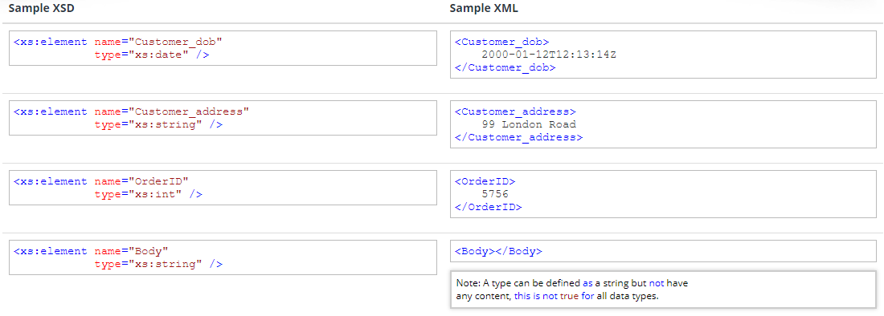
XML Schema example

Slide 44
JSON
{"employees":[ { "firstName":"John", "lastName":"Doe" }, { "firstName":"Anna", "lastName":"Smith" }, { "firstName":"Peter", "lastName":"Jones" } ]}
<employees> <employee> <firstName>John</firstName> <lastName>Doe</lastName> </employee> <employee> <firstName>Anna</firstName> <lastName>Smith</lastName> </employee> <employee> <firstName>Peter</firstName> <lastName>Jones</lastName> </employee> </employees>

Slide 45
JSON vs XML
JSON is Like XML Because
Both JSON and XML are "self describing" (human readable)
Both JSON and XML are hierarchical (values within values)
Both JSON and XML can be parsed and used by lots of programming languages
Both JSON and XML can be fetched with an XMLHttpRequest
JSON is Unlike XML Because
JSON doesn't use end tag
JSON is shorter
JSON is quicker to read and write
JSON can use arrays
The biggest difference is:
XML has to be parsed with an XML parser. JSON can be parsed by a standard JavaScript function.
Why JSON is Better Than XML
XML is much more difficult to parse than JSON.
JSON is parsed into a ready-to-use JavaScript object.
For AJAX applications, JSON is faster and easier than XML:
Fetch an XML document
Use the XML DOM to loop through the document
Extract values and store in variables
Using JSON
Fetch a JSON string
JSON.Parse the JSON string

Slide 46
YAML

Slide 47
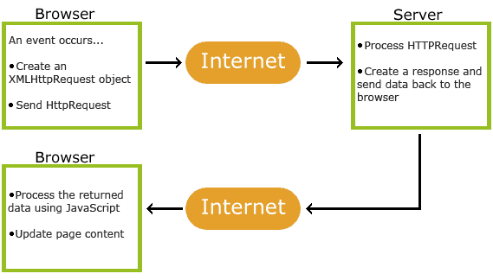
AJAX
Asynchronous Javascript and XML

Slide 48
Ajax wokring
An event occurs in a web page (the page is loaded, a button is clicked)
An XMLHttpRequest object is created by JavaScript
The XMLHttpRequest object sends a request to a web server
The server processes the request
The server sends a response back to the web page
The response is read by JavaScript
Proper action (like page update) is performed by JavaScript

Slide 49
XMLHttpRequest
var xhr= new XMLHttpRequest();
var xhr = new ActiveXObject("Microsoft.XMLHTTP");
if (window.XMLHttpRequest) xhr= new XMLHttpRequest(); else xhr= new ActiveXObject("Microsoft.XMLHTTP");

Slide 50
XMLHttpRequest (Methods)
new XMLHttpRequest() | Creates a new XMLHttpRequest object
open(method,url,async,user,psw) | Specifies the request method: the request type GET or POST url: the file location async: true (asynchronous) or false (synchronous) user: optional user name psw: optional password
send() | Sends the request to the server Used for GET requests
send(string) | Sends the request to the server. Used for POST requests

Slide 51
XMLHttpRequest (Properties)
onreadystatechange | Defines a function to be called when the readyState property changes
readyState | Holds the status of the XMLHttpRequest. 0: request not initialized 1: server connection established 2: request received 3: processing request 4: request finished and response is ready
responseText | Returns the response data as a string
responseXML | Returns the response data as XML data
status | Returns the status-number of a request 200: "OK" 403: "Forbidden" 404: "Not Found" For a complete list go to the Http Messages Reference
statusText | Returns the status-text (e.g. "OK" or "Not Found")

Slide 52
<p id="number"></p>
<script>
xhr = new XMLHttpRequest();
var p = document.getElementById("number");
xhr.onreadystatechange = function()
{
if (xhr.readyState == 4 && xhr.status == 200)
{
//var txt = xhr.responseText;
p.innerHTML = xhr.responseText;
}
};
xhr.open("GET","s.php",true);
xhr.send();
</script>

Slide 53
OOP
Class
Methods & Properties
Public, Private, Protected
Constructors
Get & Set Methods
Deleting an object
Initializing properties using constructor

Slide 54

MVC

