Slide 1
SenseHat and SensorTag Data Processing
A presentation of Mahmoud Mansur, Frank Lühring and Björn Ziegler

Slide 2
Summary
Project Overview
MQTT
Node-red
Java
Matlab
Demo
Q & A
Notes:
Matlab Björn Ziegler
java part Mahmoud
At least we will give a demo

Slide 3
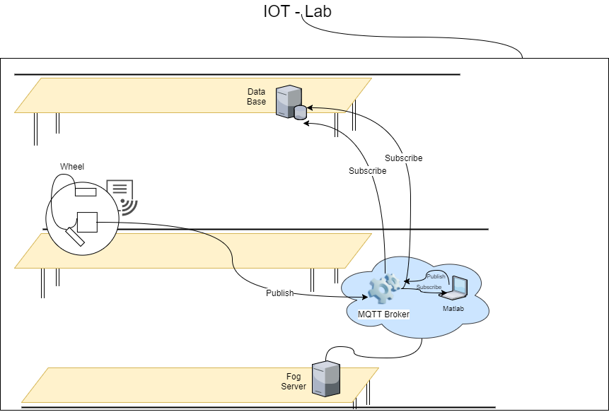
Project Overview
What was the task?
Publish data from sensors via MQTT to a Broker
Subscribe with Matlab and the MQTT-Protocol to this Broker
Refurbish the data
Vizualise it in Matlab
Notes:
What was the task?
Publish data from sensors via MQTT to a Broker
Subscribe with Matlab and the MQTT-Protocol to this Broker
Refurbish the data
Vizualise it in Matlab

Slide 4
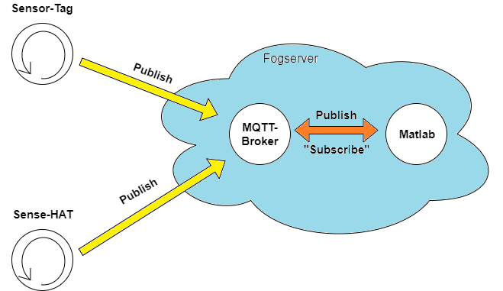
MQTT
Why MQTT?
MQTT keeps bandwidth at an absolute minimum
deals with unreliable networks without complex error handling
It is capable of delivering messages in near real time and guarantees their delivery
Notes:
Why MQTT?
MQTT keeps bandwidth at an absolute minimum
deals with unreliable networks without complex error handling
It is capable of delivering messages in near real time and guarantees their delivery

Slide 5
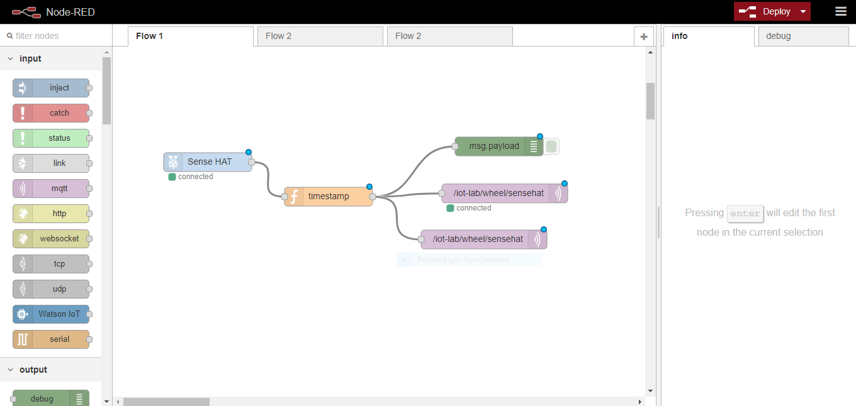
Node-red

Slide 6
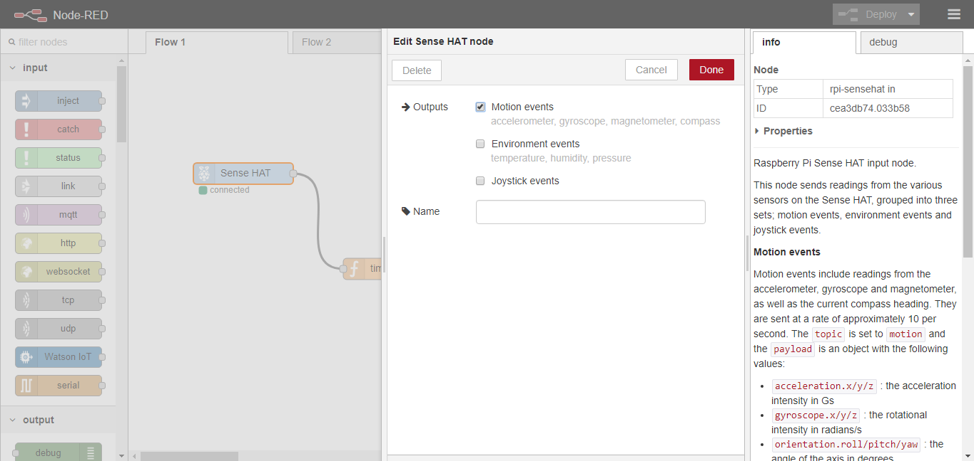
Node-red
Notes:
premade node wich supports the Sense-HAT
Environment and joystick events aren't necessary for our purpose, so we uncheck these two points, to decrease the data traffic.

Slide 7
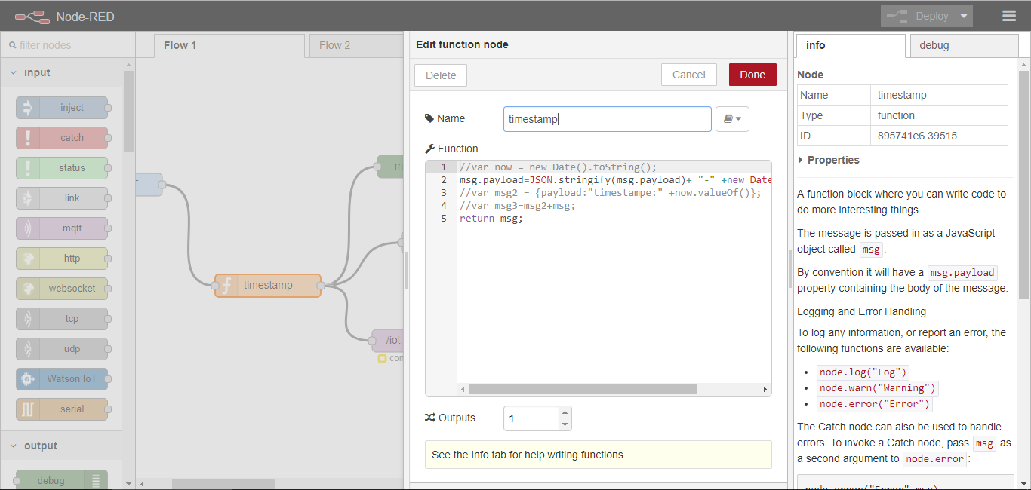
Node-red
Notes:
For our purpose in Matlab we need an timestamp, to display and process the data correctly which we get from the sensors

Slide 8
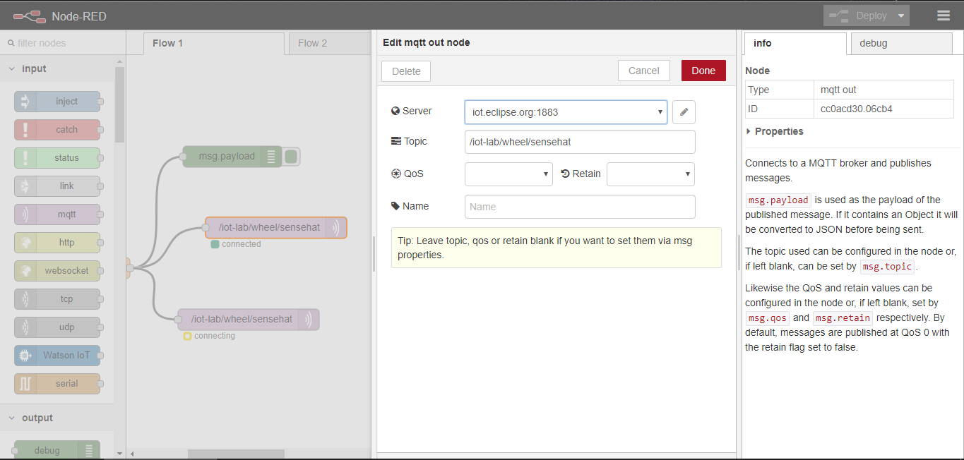
Node-red
Notes:
Server nearly always port 1883
Topic /iot-lab/wheel/sensehat
Quality of Service
0 – at most once (fire and forget) no acknowledge so fast and unsafe
1 – at least once. Guarantees deliver at least once, but can be more often. Thing between
2 – once. Guarantees just one deliver. Slow and safe
Retain – Save the last known value and send it to new subscribers

Slide 9
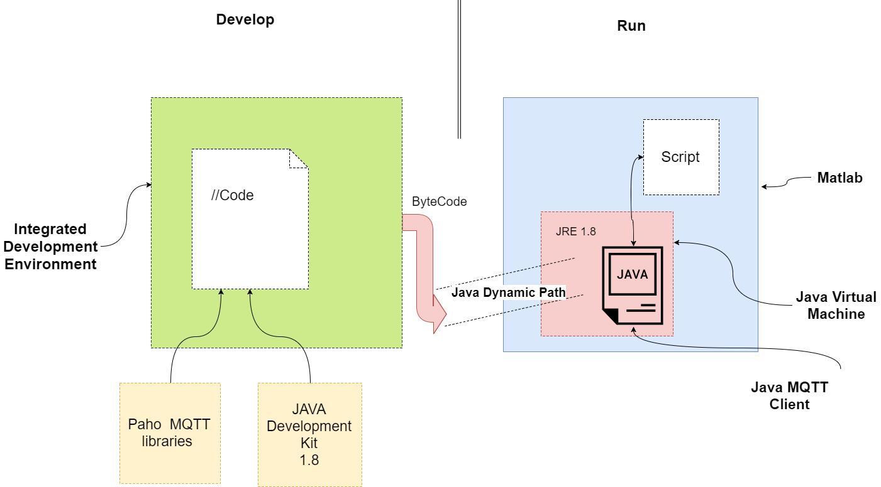
Java – Work Logic

Slide 10
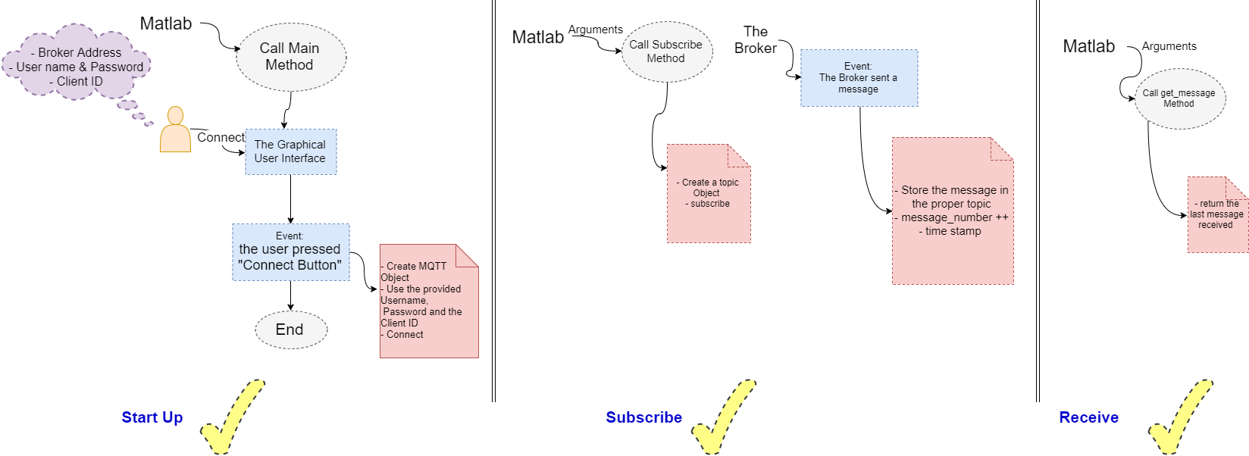
Java – Code Logic

Slide 11
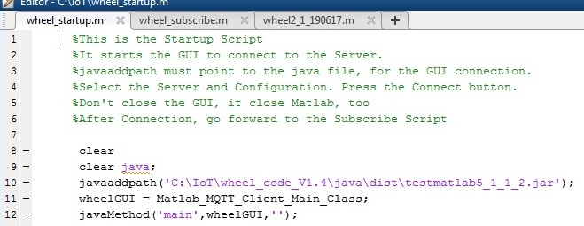
Matlab

Slide 12
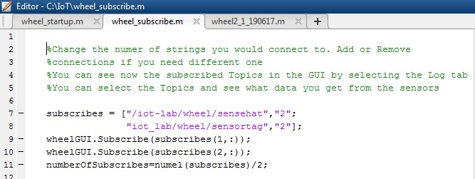
Matlab

Slide 13
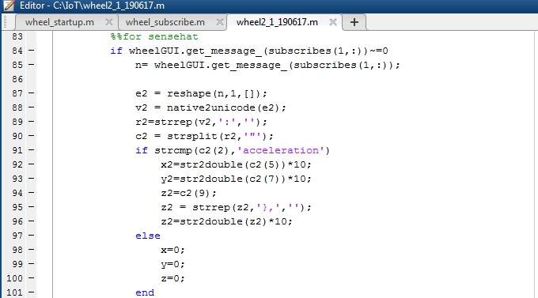
Matlab

Slide 14
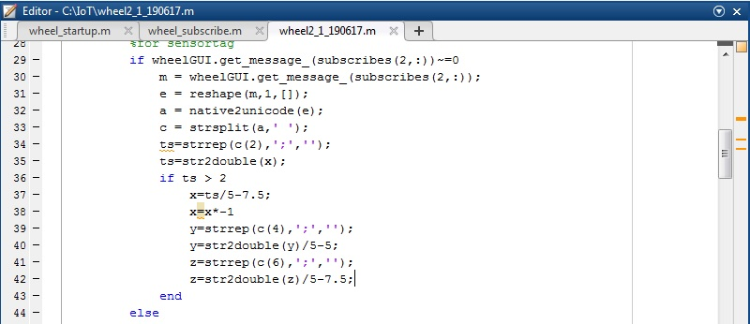
Matlab

Slide 15
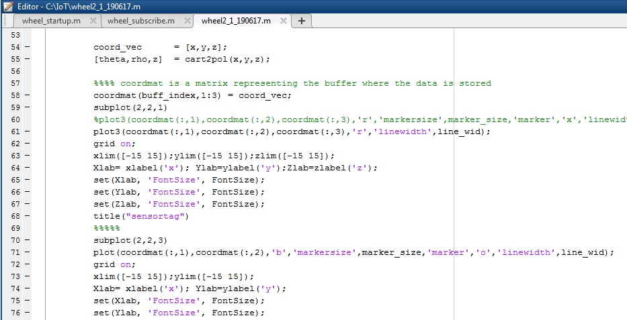
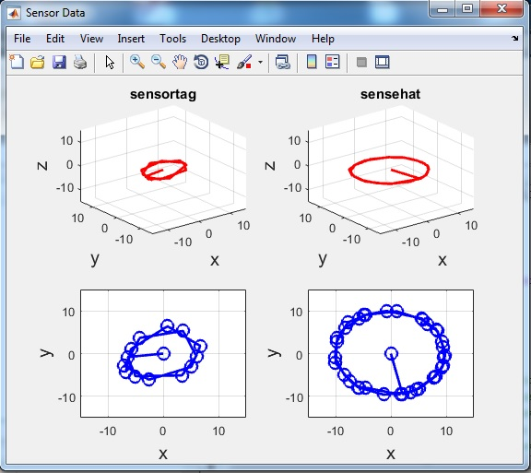
Matlab

Slide 16
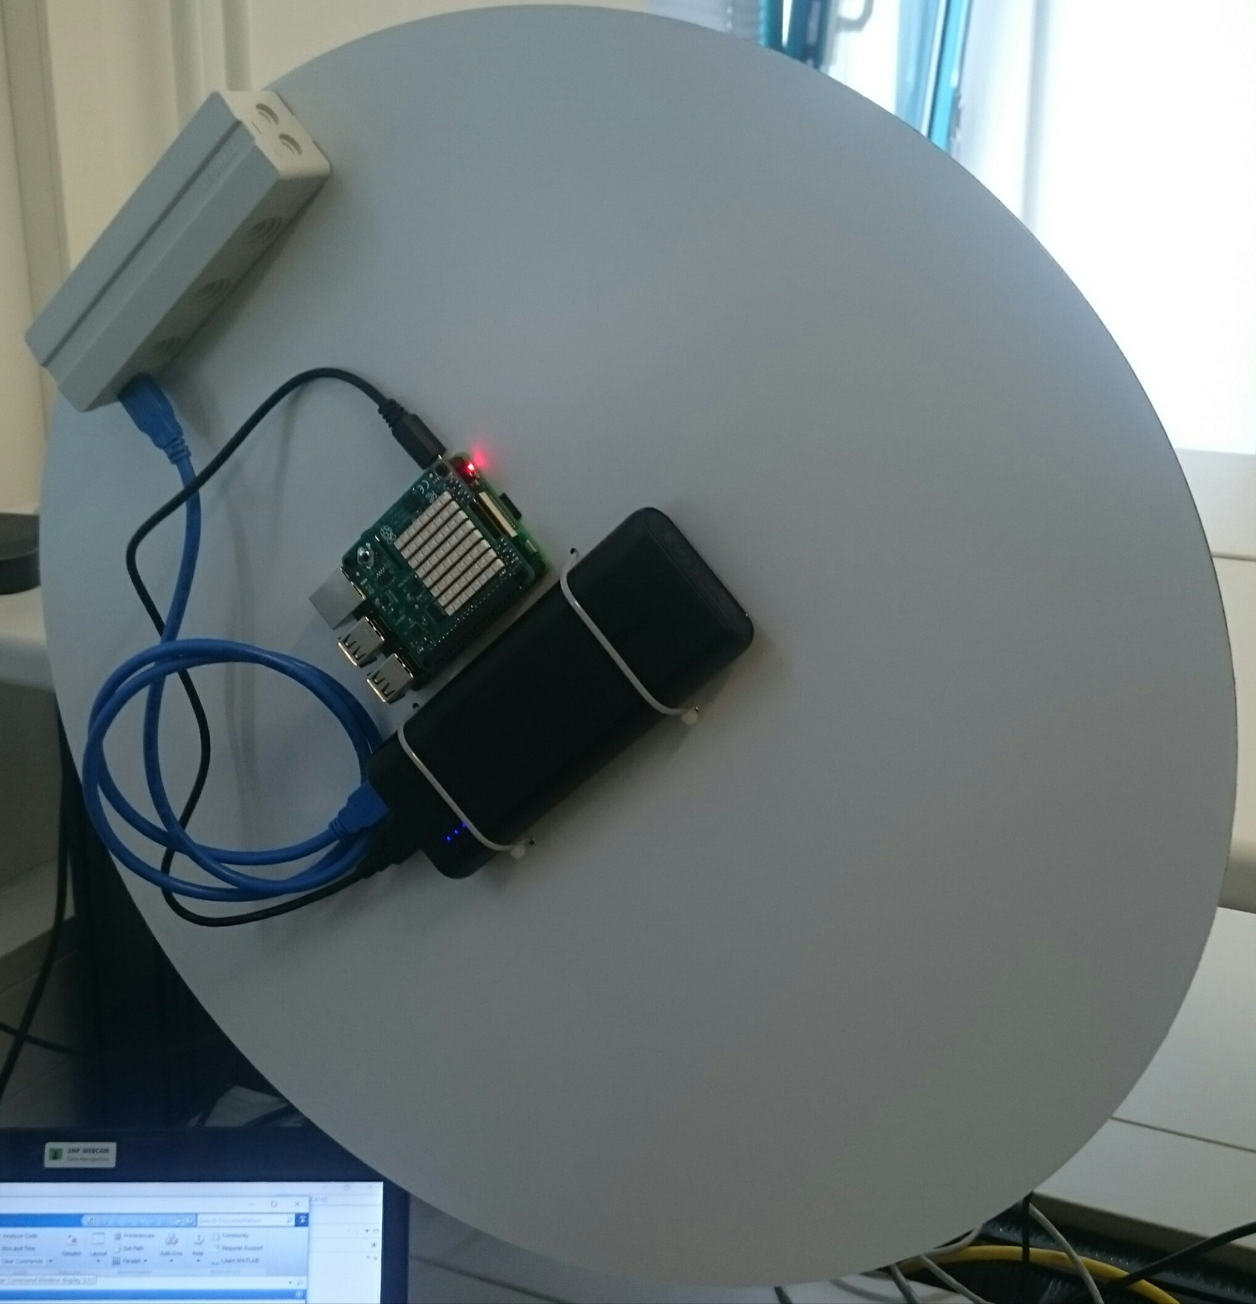
Demo

Slide 17

Q&A

