Slide 1

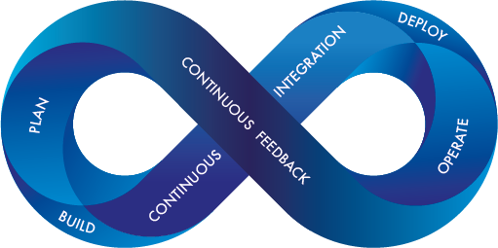






DevOps Engineering
Agile practices within
(Microservices, Mobile, Web, IOT, Data Science, BlockChain)
Version 0.0.1
Ahmed Khalil

