Slide 1

MACHINE LEARNING PROJECT
Credit Score
Prediction System
An end-to-end machine learning system that classifies customers into Good, Standard, or Poor credit score tiers using their financial behaviour, credit history, and payment patterns.
AI Credit Intelligence
Accurate · Explainable · Data-Driven
Presented by Mahmoud Mansour

Slide 2




THE PROBLEM
Why Credit Scoring Matters
Lenders need to judge repayment risk for every applicant, fast and consistently. Manual, rule-of-thumb credit assessment doesn't scale — and small inconsistencies cost real money.
Data-driven, not guesswork
A model learns real repayment patterns from 100,000 historical customer records instead of fixed rules.
Consistent at scale
Every applicant is scored the same way, instantly — no reviewer fatigue or bias drift.
A wrong call is costly either way
Balances risk & inclusion
Good classification catches risky applicants without unfairly rejecting reliable ones.
Credit Score Prediction System
2

Slide 3

THE DATA
Dataset Overview
Monthly financial snapshots per customer — income, loans, credit cards, payment history, and behaviour — labelled with their credit score tier.
TOTAL RECORDS
RAW COLUMNS
TIME SPAN
TARGET CLASSES
100,000
28
8 Months
3
customer-month rows
→ 23 features after cleaning
January – August
Good · Standard · Poor
Feature groups: 17 numerical features (income, balances, counts, ratios) and 6 categorical features (occupation, loan type, payment behaviour, credit mix, month, minimum-payment flag).
Target distribution is imbalanced: Standard 53.2% · Poor 29.0% · Good 17.8%
Credit Score Prediction System
3

Slide 4
DATA CLEANING
Taming Messy Real-World Data
Raw fields were riddled with corrupted strings, placeholder junk, and mixed types. Every column below needed a custom cleaning rule before it was model-ready.
Column
Raw Value
Cleaned Result
Age
"-500" / "23_"
23 (outlier removed)
Occupation
"_______"
→ treated as missing
Credit_Mix
"_"
→ treated as missing
Credit_History_Age
"22 Years and 1 Months"
265 (months)
Outstanding_Debt
"1234_56"
1234.56
Payment_Behaviour
"!@9#%8"
→ treated as missing
Credit Score Prediction System
4

Slide 5

EXPLORATORY DATA ANALYSIS
Data Insights
Understanding class balance is the first step — it shapes every modelling decision that follows.
Standard dominates
Over half of all customers (53%) fall into the Standard tier — a naive model could exploit this.
Real imbalance
Good customers are the minority class (18%) — the hardest to recall correctly.
SMOTE was necessary
Training folds are rebalanced with SMOTE so the model doesn't ignore the minority classes.
Credit Score Prediction System
5

Slide 6


PREPROCESSING
From Raw Data to Model-Ready
A single pipeline handles cleaning, encoding, scaling, and class balancing — fit once, applied consistently to every prediction.
→
→
→
→
Raw Data
Cleaning
Encode & Scale
SMOTE
Model
100k rows
28 columns
Fix types,
handle outliers
Numeric +
categorical pipes
Balance the
3 classes
Random Forest
classifier
Why SMOTE, not just class weights? Oversampling the minority classes inside the training folds gave every algorithm a fair, comparable shot at learning Good and Poor customers, not just the dominant Standard tier.
Credit Score Prediction System
6

Slide 7
EXPERIMENT TRACKING
Model Comparison
Four algorithms benchmarked with 5-fold cross-validation on SMOTE-balanced data. All scores are macro-averaged on the held-out test set.
★ Random Forest was selected for production — see next slides.
Credit Score Prediction System
7

Slide 8
MODEL DIAGNOSTICS
Train vs. Test — Overfitting Check
A model that memorizes training data but fails on new data is useless in production. F1 score, compared across train and test sets, exposes that gap.
Decision Tree and Random Forest hit 100% on training data — expected for fully-grown trees. What matters is the test score, where Random Forest and XGBoost clearly generalize best.
Credit Score Prediction System
8

Slide 9
TUNING EXPERIMENT
When Tuning Backfires
A RandomizedSearchCV over max_depth [5,6,7] and n_estimators [50,100,200] found "better" cross-validation params — but they underperformed on the real test set.
TUNED RANDOM FOREST
DEFAULT RANDOM FOREST ✓
65.76%
73.45%
Constrained depth → underfit
Kept for production
Test F1 (macro) · max_depth=7, n_estimators=100
Test F1 (macro) · fully-grown trees, no depth limit
Takeaway: the search space was too conservative — shallow trees underfit this dataset. The untuned, fully-grown Random Forest scored higher on unseen data, so it shipped instead.
Credit Score Prediction System
9

Slide 10

FINAL RESULTS
Production Model
Random Forest Classifier + SMOTE
Selected after comparing 4 algorithms and a tuning experiment
TEST ACCURACY
PRECISION (MACRO)
RECALL (MACRO)
F1 SCORE (MACRO)
74.87%
72.36%
75.19%
73.45%
Model card
Algorithm: Random Forest Classifier (scikit-learn, default hyperparameters)
Imbalance handling: SMOTE oversampling on training folds
Validation: 5-fold cross-validation
Classes: Good · Standard · Poor
Credit Score Prediction System
10

Slide 11
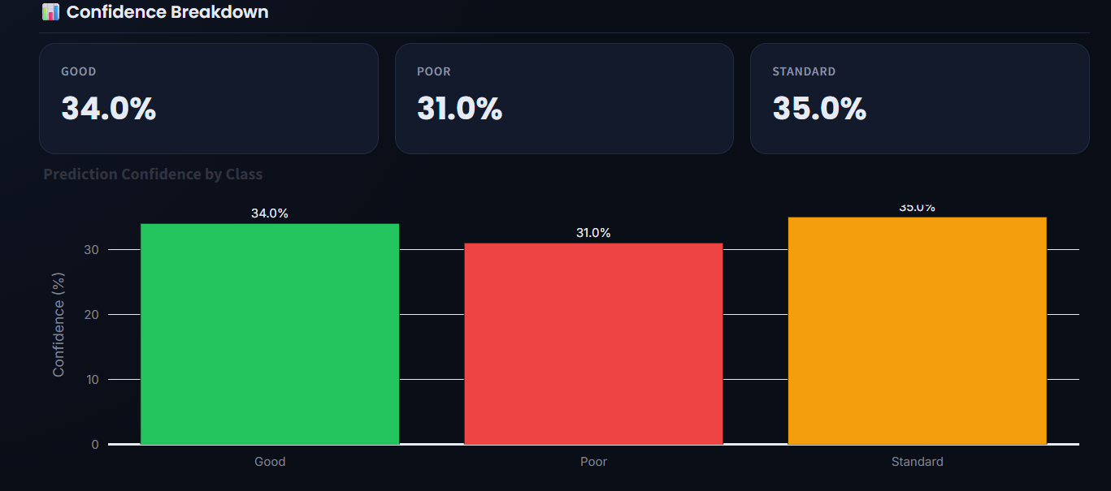

LIVE APPLICATION
The Streamlit App
A 4-page dashboard puts the whole project in one place — for analysts and end users alike.
About
Project overview, snapshot stats, and tech stack.
Data Insight
Live EDA — distributions, correlations, breakdowns — computed straight from the dataset.
Model Performance
Interactive comparison of all 4 algorithms plus the tuning story.
Real output — Prediction page confidence breakdown
Batch CSV scoring, per-class confidence, and downloadable results round out the Prediction page.
Prediction
Score one customer via a form, or a full CSV batch, with confidence per class.
Credit Score Prediction System
11

Slide 12

WRAP UP
Tech Stack & Next Steps
Built with
Future work
Python
Pandas / NumPy
Add SHAP-based explainability to the Prediction page
scikit-learn
Track model drift once real customer data arrives
imbalanced-learn (SMOTE)
XGBoost
Expand the tuning search space with a wider depth range
Plotly
Streamlit
Add authentication for batch scoring in production
In short: cleaned a genuinely messy 100k-row dataset, benchmarked 4 algorithms fairly with cross-validation, shipped a SMOTE-balanced Random Forest at 74.9% test accuracy, and wrapped it all in a live Streamlit app.
Credit Score Prediction System
12

Slide 13

Thank You
Questions & Discussion
Credit Score Prediction System · Your Name

