Slide 1
Recommendation using Nodejs, R, Twitter API and Angular

Slide 2
Agenda
Application Overview
1
Summary
3
Integration of Node Js with Big Data Technologies
2
Problem
Challenge
Solutions
Idea

Slide 3

LETS START A STORY

Slide 4



The Personas
Jill
New employee
John
10 - year employee
Kate
Social club manager
Notes:
We choose three different persona in order to describe our scenario for this application. Let’s see what our persona feel and what can be developed in order to solve their problems.

Slide 5
Activities
View/Attend latest club activities / events
Get to know more work colleagues and make new friends
Jill
New Employee
Problems
“ I only want to see activities/events I may be interested.
I don’t know who works using same technology skills as me, who has same interests as me /suitable for being friends.
I would like to see any events/activities near me or with suitable time.
Notes:
The first personal is Jill who is a software engineer and just joined the organization recently. She is eager to get know more people and culture. So she joined social sports club of her organization. Since then, she starts to receive emails about club activities and newsletters.
The problem is:
Some of those activities she likes some other she does not.
Sometimes she lost track of event emails or received too many notification emails. She wishes she could have a better tool to check more personalized recommendation events.
In addition, she very likes Zumba dance. She would like to know any other work colleagues who have same interest as her. She could hang out with.

Slide 6
Activities
View/Attend latest club activities / events
Post/Organize some activities such as node.js workshop, code dojo volunteer, weekend drinks and so on.
John
10-year employee
Problems
“How could I get notifications of new events which I am interested
How could I notify other members about my activities
Notes:
Second personal is John who has already worked in the organization for 20 years. Of course, he also often receives emails about club recent activities. Sometimes he also sends emails to organize some Nodejs workshops or code dojo volunteer activities.
The problem for him is:
He also wants to find a better channel to get recent activities notifications and help new employees.

Slide 7
Activities
Publish latest social club information such as cinema tickets, restaurant voucher and social activities
Hand over tickets to members
Register or cancel membership
Problems
“How could I notify members about every activity/discount .
How could I manage new/old/cancelled memberships
I don’t want to spend too much time handing over tickets to each member”
Kate
Social club manager
Notes:
Kate works as social sports club manager. Her daily activities are to publish social club news/activities such as cinema tickets and restaurant discounts, hand over tickets/vouchers to each member every Wednesday and manage member information.
She also has similar problems as Jill and John. She spent too much time sending spam emails to all members about activities.

Slide 8
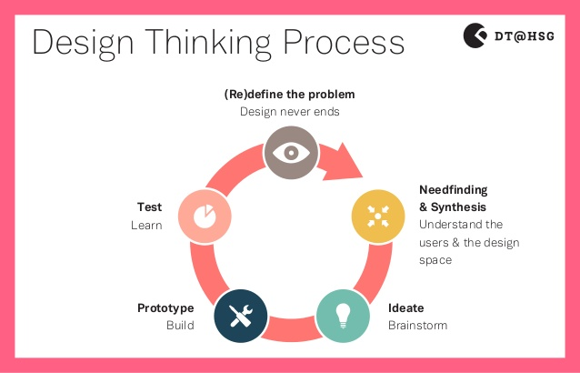
Requirement Analysis with Ibm Design Thinking
Design thinking
To understand what others say,
do, think and feel
Notes:
Design Thinking . It has five very clear phases: Empathize, Define, Ideate, Prototype and Test . With a ton of ideas to choose from, the team gets to select which they will work on. A good technique is voting with stickers: each team member gets a set of stickers and individually each team member marks the ideas they would like to work on.

Slide 9
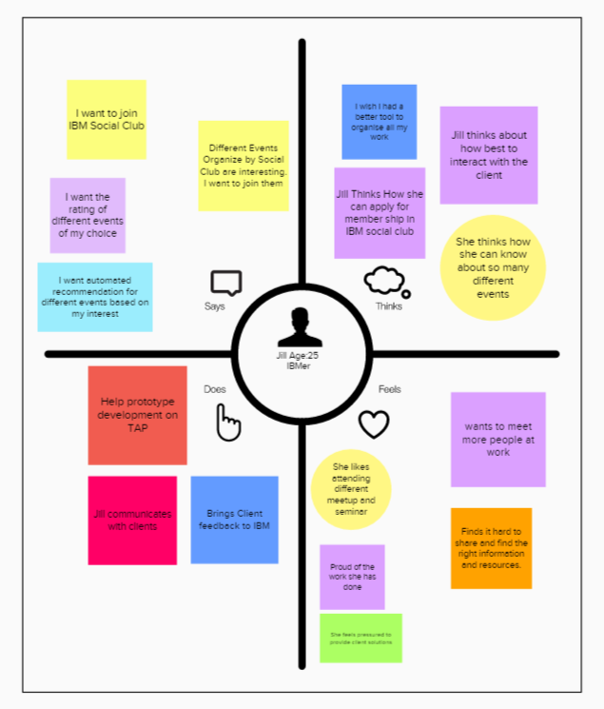
Empathy Map
Notes:
Let us focus on personal Jill, age 25, a new employee (software engineer) . To see what she says, thinks , does and feels.
She says she wants to join interesting events, she thinks how she needs a better tool to know so many events, she needs to work with client during her job and she feels hard to share her interests with work colleagues or make new friends inside the organization.

Slide 10
Solution ?

Slide 11
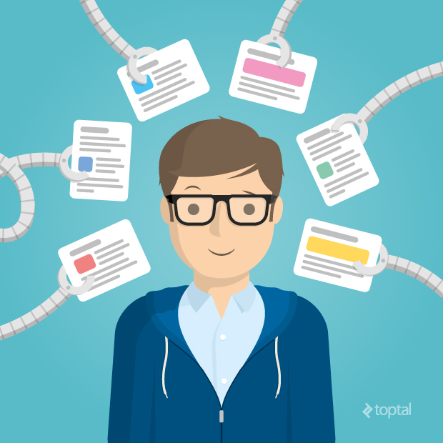
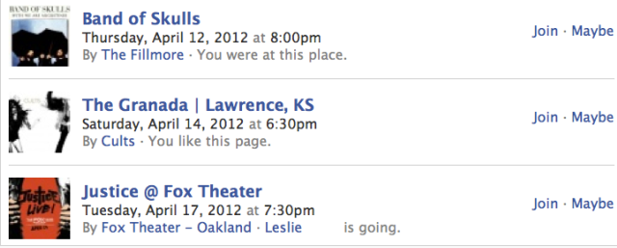
The solution - Ecosystem with Personalized Recommendation Engine
Get recommended event list
Based on personal interests
Update event list
based on user activities
Notes:
It sounds like we need a meetup to view/publish/attend events, or an internal forum for posting/voting new activities or internal Facebook for making friends . Answer is No. We could do better.
Generally speaking , on one hand, we could display a list of suggested events for end users by analyzing his personal interests through social media .
On the other hand, we could keep updating our list of suggested events based on user recent activities/feedback through machine learning.

Slide 12
IBM Design Thinking Cont…
WHO
WOW
WHAT
Notes:
Once our goal is finalized, we need to move forward about our action to achieve the Goal. To determine our action, we again come back to IBM design thinking and after some brain storming session we finalized our Hills and technical foundation
At this state, according to IBM design thinking we need to identify the Hill. So conceptually we define 3 core Hill and one technical foundation. We refer to these elements as the Who, the What, and the Wow.
So who is the end user from whom this solution is going to be implemented
Then What is the ultimate outcome of this solution and
Wow is the differentiator that will make this solution worth their while
So we followed the IBM designing thinking and identify our 3 Hills and 1 technical foundation

Slide 13
Hills + Technical Foundation
Use will get recommendations for upcoming event based on his/ her as well as his/her connection’s preference and interest also based on user’s location, date of availability, priority
User can give feedback by ranking the given recommendation for better machine learning and improving the recommendation algorithm
User can also save data regarding geo-spatial, interest and personal insight for better recommendation to match his/her own profile
Tech Foundation : Develop Hybrid recommendation Engine to use machine learning

Slide 14
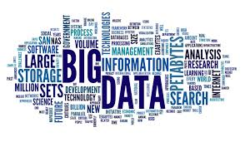
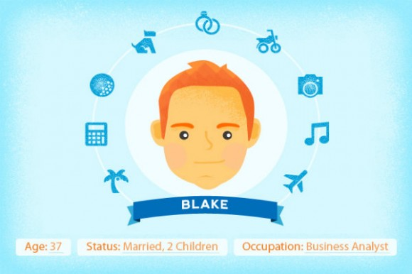

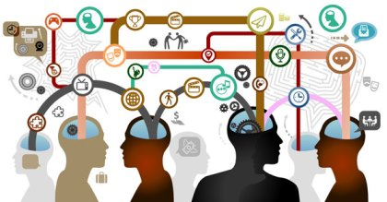

The basic Idea behind ‘Social Events’
Notes:
Gather data from different sources and analyze them using data mining to prepare User profile with interest, personal insight.
Use the new generated ‘Interest profile’ as an input for the recommendation engine
Recommendation engine will generate recommendations for event or list
Send recommendations to other system as API

Slide 15










Social Analytics and Recommendation
Notes:
The next important step is to finalized the technologies that we are going to use.
By the time, we already understood that data is the vital part of our information, if there is no relevant data about user , how fine the algorithm is it wont give a proper recommendation and would end up in another disappointment. Therefore, we really have tried to gather information about user profile as much as possible
We have tried using all relevant social media such as facebook, twitter, google profile, meetup, ficker, instragram, pintrest and so on. For employee, we gathered information about a person from company profile. We have collected information from twitter and meetup API in order to get an idea about place, interest, social community and other relevant information. We have also used IBM Watson personality Insight API to get an idea about the emotional graph for a person.

Slide 16
Proposed Recommendation Engine (Hybrid)
Collaborative filtering
Follow friends and connections and find suitable recommendations
Content based
Follow user’s own preference , ratings for similar event or learning Courses and filter the recommendations
Purposed based
Target the actual purpose of user to join any event or course or for a new house byer/ renter and prioritize the recommendation based on the purpose
Knowledge based
Follow historical data about user and his connections on social media and use historical data for further recommendation

Slide 17
How Recommenation Engine work
Collaborative
Social Filtering
Reco
Combiner
Input
Purpose Filtering
Content Filtering
Knowledge

Slide 18





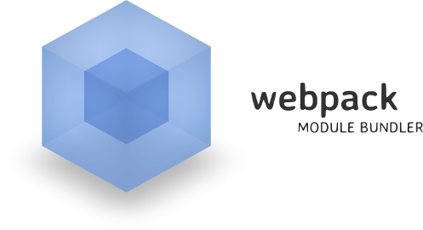




Technologies

Slide 19



RAW Data
RAW Data
Data Analysed
Data
Third party API
Notes:
Data Flow

Slide 20
Example with Event Recommendation
Generate profile (P) – From company B profile Page + Twitter TimeLine +Google Search
Extract Profile (P) to different meta tag
Prepare Target Profile (TP) for original profile (P) using meta tag
Rank different interest in TP based on their frequency and weight
Match events store in database with TP
Show matched events

Slide 21

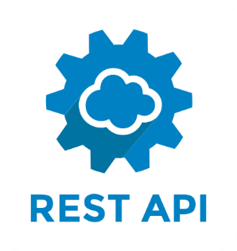
Storing Data in IBM CLOUDANT

Slide 22
Map- Reduce for Graph data
Meetup
Music
Development
Language
Life style
Jazz
Nodejs
Angularjs
Spanish
English
Yoga
P1
P2
P1
P3
For each category
for each event
emit (event.id, person.id)

Slide 23
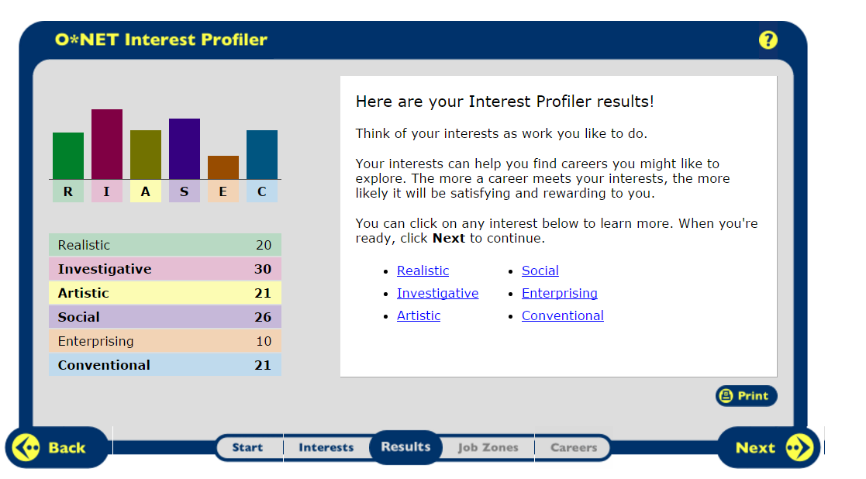
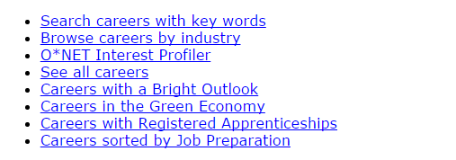
OnET Service
https://www.onetcenter.org/IP.html
https://services.onetcenter.org/ip

Slide 24
Protect personal identifiable information
Gather
Identify
Refine
Store
Copy
Destroy
Communication

Slide 25
Refine PII
Process | Example
Aggregation | e.g age, lon, lat, personality insight response
Hashing | e.g. Name, location, personality insight response , some api response result
Substitution | gender

Slide 26
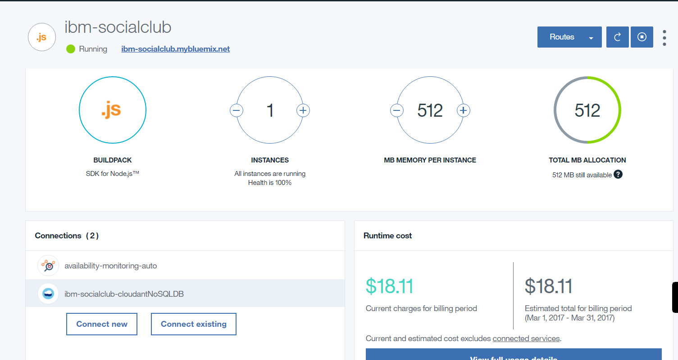
How IBM cloud can be used for Nodejs and IBM cloudant based application?
Bluemix is a growing ecosystem of available services and runtime frameworks to enable engineers to rapidly build, deploy and manage their cloud applications

Slide 27
How it can be integrated with other Big Data technologies ?
Big Data technologies
A) IBM Watson services – provide cognitive computing features using IBM Watson’s Language, Vision, Speech and Data APIs
B ) R is an open source language and environment for data manipulation, calculation and visual display (R studio).
How node.js can be integrated with R ?
1) r-script, r-broker, npm
2) Microsoft Deploy R https://msdn.microsoft.com/en-us/microsoft-r/deployr-about

Slide 28
How node.js can be integrated with IBM Watson?
Personality Insights service
(API) that enables applications to derive insights from social media, enterprise data, or other digital communications
https://watson-api-explorer.mybluemix.net/apis/personality-insights-v3#!/personality45insights/profile
https://personality-insights-livedemo.mybluemix.net/
https://github.com/watson-developer-cloud/personality-insights-nodejs
Notes:
Watson can understand all forms of data, interact naturally with people, and learn and reason, at scale” It is available as a set of open APIs and SaaS products. One of very useful service API is personality Insights service.
Personality Insights service
(API) that enables applications to derive insights from social media, enterprise data, or other digital communications
Let us take a quick look at this example API. It gains insight into how and why people think, act, and feel the way they do.

Slide 29
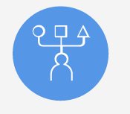
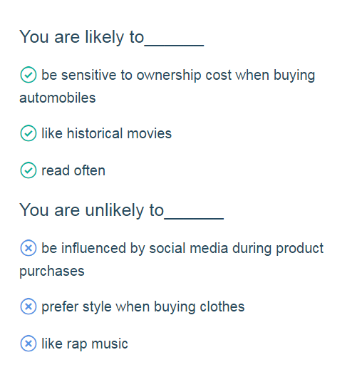
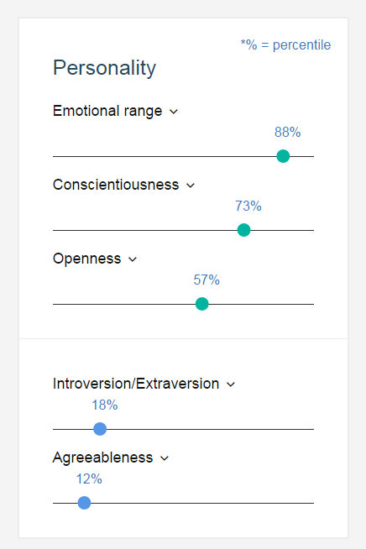
IBM Watson Personality Insights API
https://personality-insights-livedemo.mybluemix.net/

Slide 30
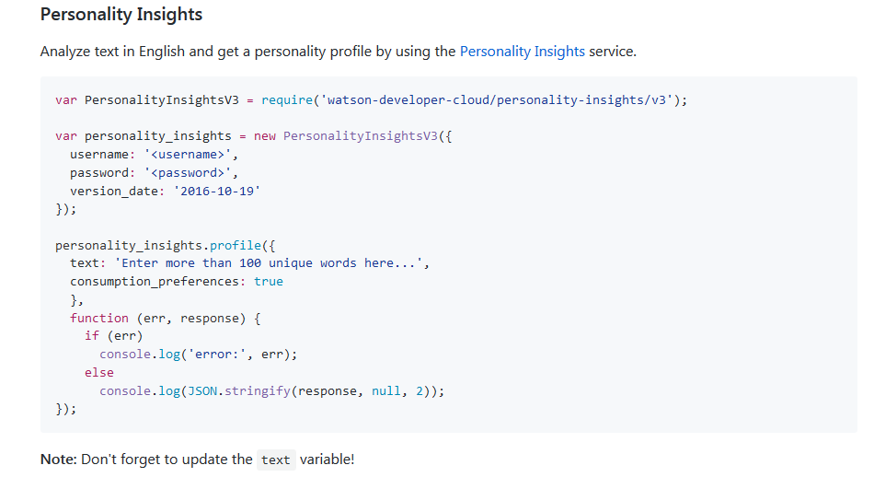
IBM Watson Personality Insights Sample code
https://github.com/watson-developer-cloud/node-sdk#personality-insights

Slide 31
SOME other WATSON Recommendation API
Celebrity matching - https://your-celebrity-match.mybluemix.net/
IBM Chef Watson - https://www.ibmchefwatson.com/tupler

Slide 32
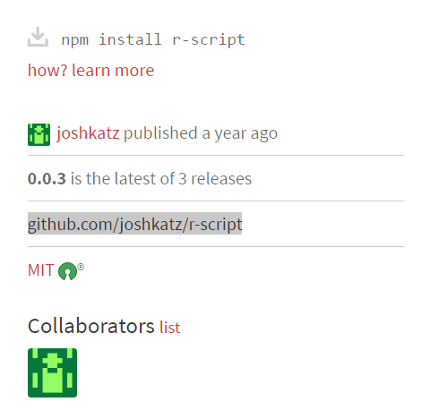
R-script
R server needs to run in same machine as the Nodejs server
Therefore, it was a blocking for us as we could not use IBM bluemix and need to deploy our application in Docker
R code need to be formatted after coding , for example change each ‘->’ sign to ‘%>%’

Slide 33
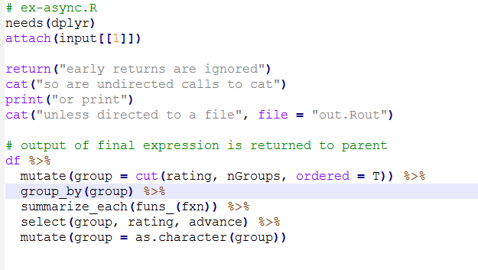
Example
// Load the R library.
var R = require("r-script");
// run R script from Nodejs
R("example/ex-async.R")
.data({df: rattings, nGroups: 3, fxn: "mean" })
.call(function(err, hello) {
if (err) throw err;
console.log(hello);
});
Node Js script
R script

Slide 34
Microsoft R
The JavaScript RBroker Framework
Workflow of Integration
Define an RTask for any particular analysis
Submit the task to an instance of RBroker
Return RTaskResult, a collection of result data return by an instance of RTask

Slide 35
rBroker implementation

Slide 36
Lessons learned
Machine learning for recommendation engine
Recommendation Engine Algorithm
Text mining
Personalization
Protect personality Identifiable Information
Nodejs Integration with IBM Watson API
Nodejs Integration with R analytics
Debugging Nodejs
Asynchronous programming with Nodejs
Nodejs application deployment with IBM Bluemix
Nodejs application deployment with Docker
IBM Design Thinking
Microsoft R with Nodejs

Slide 37
Additional Link
IBM Design Thinking
Mural
Interested about learning R? Take a look at the overview of our experience here.
Sample code of R code for Recommendation Engine.
Microsoft R

Slide 38
Thanks!!
Special Thanks to Simon Finney, Anthony Whalley

