Slide 1
Live Data Streaming Project
Python Group
03/11/2022

Slide 2
Who we are
We are a team of 4 Big Data Engineers working on this project we worked as a team and individually to finish the project and solve the problem. And we divided the tasks to finish the project.
Abhinita: creating architecture;
Mehdi: preparing documentation;
Lawrence: hive connection, kafka;
Mansur: data transformations, web-scraping, flask;

Slide 3
Problem Statement
Connect Python to websites and scrape data from them and save them in Python Dataframe, and send the Dataframes from Pyspark to HIVE and Superset in a secure channel with Kafka.

Slide 4
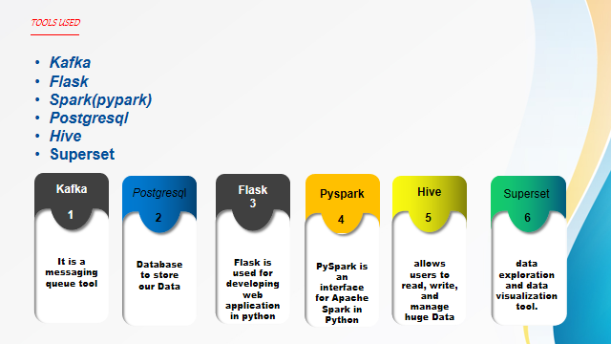

Slide 5










Logical flow Diagram
hr_data_transformed

Slide 6
FLOW CHART
START
we are using already transformed
data as input from postgresql.
N
We are using transformed data to create API
with the Help of Web Scraper in Python.
Successfully
Obtained
Data
web scraping process
Y
Load data
in Hive
Json and HTML Script to display the pattern
END
Retrieve data from source using pyspark
Kafka

Slide 7
Stream the data in a table
<!DOCTYPE html>
<html lang="en">
<head>
<title> Table </title>
</head>
<body>
<div align="center">
<table>
<h1>
<!--Displaying the converted table-->
{% for table in tables %}
<h2>{{titles[loop.index]}}</h2>
{{ table|safe }}
{% endfor %}
</h1>
</table>
</div>
</body>
</html>

Slide 8



