Slide 1
Scala
Team
Data Scrapping from
Web API to Hive
Gabriele Qazolli
Biswajit Deb
Junayd Mohammed
Dharani Jayakumar
03/11/2022

Slide 2
CONTENTS
01
PROBLEM STATEMENT & PROCESS
02
LOGICAL REPRESENTATION
03
FLOW CHART
04
SUPERSET-INSIGHTS

Slide 3

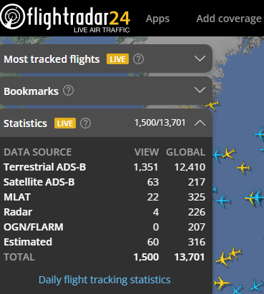
Problem Statement
Take live data, store them on Hive and visualize them in real time.
Process
Get the live data from flightradar24.
Scrap the data.
Sent total number of flights, estimated, Terrestrial and Satellite ADS data to Kafka using spark.
Using Spark – Read data from Kafka – Sent into hive.
From Hive – create insights using Superset.

Slide 4





Logical Representation
Technology Stack
Languages
SCALA- Spark
Data Warehouse
Hive
Data stream
kAFKA
Insights
superset
Spark & Kafka
Sending and receiving data to Kafka using Spark.
Visualize data to Consumer Kafka.
Web API
Scrapping of JSON file using Spark from flightradar24.
Hive & Superset
Sending data to Hive and visualize the result on Superset.

Slide 5
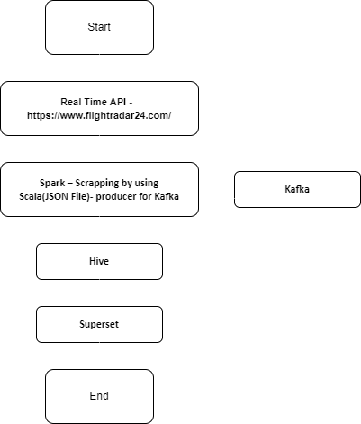
Flow Chart
STREAM
STORE
TIME
SQL
KAFKA
HIVE
SPARK
SEND
FILE
SUPERSET
CHART
GRAPH
DASHBOARD

Slide 6
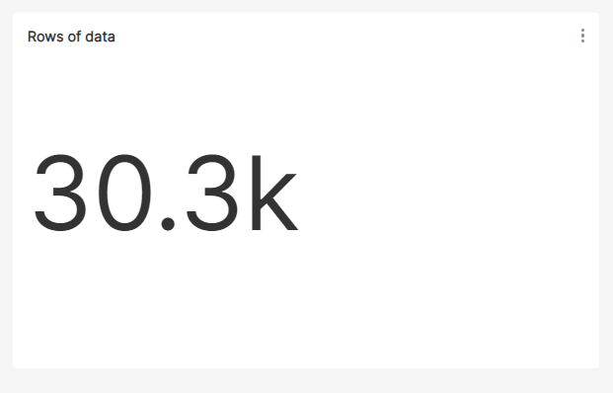
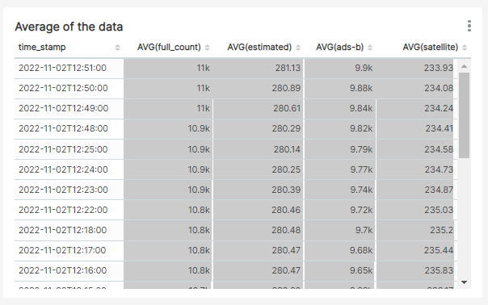
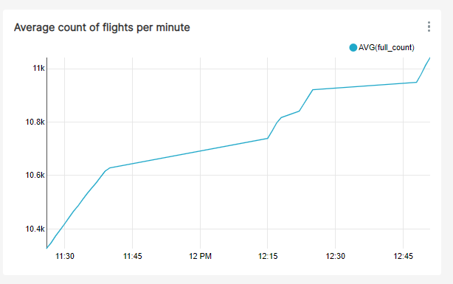
Superset-Insights
NUMBER OF ROW IN TABLE
TABLE AVERAGE USING AGGREGATION
NUMBER OF FLIGHTS PER MINUTE

Slide 7
THANKS
2017/5/14

