Slide 1
elev.th file conflict in SCHISM and UFS-Coastal
Mansur Ali Jisan

Slide 2
The Problem
During the simulation of SCHISM with ESMF as coupler within UFS-Coastal, a conflict arose where ESMF unintentionally overwrote the boundary condition file (elev.th; type 1), leading to model failures.
SCHISM needed consistent, read-only access to elev.th file to maintain model accuracy and boundary conditions.

Slide 3
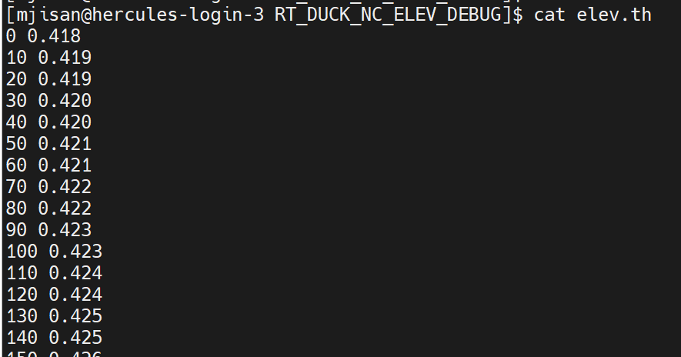
elev.th file
Time varying surface water elevation
elevation (m)
Time in second

Slide 4
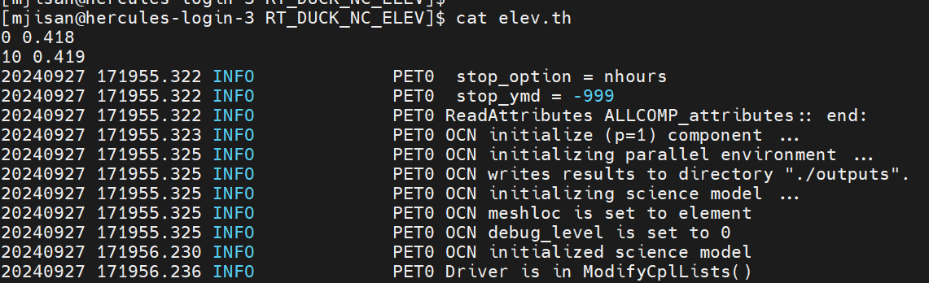
elev.th file
During simulation, it gets modified by ESMF_LogWrite
Except the first two lines, the entire elev.th file gets modified by ESMF with logs related to PET00.ESMF_LogFile

Slide 5
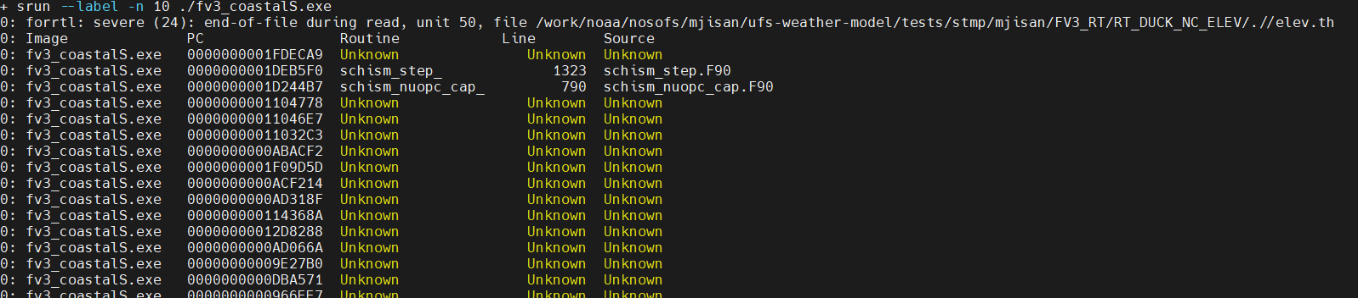
Error Messages
err file
Errors related to schism_stepand schism_nuopc_cap subroutines

Slide 6
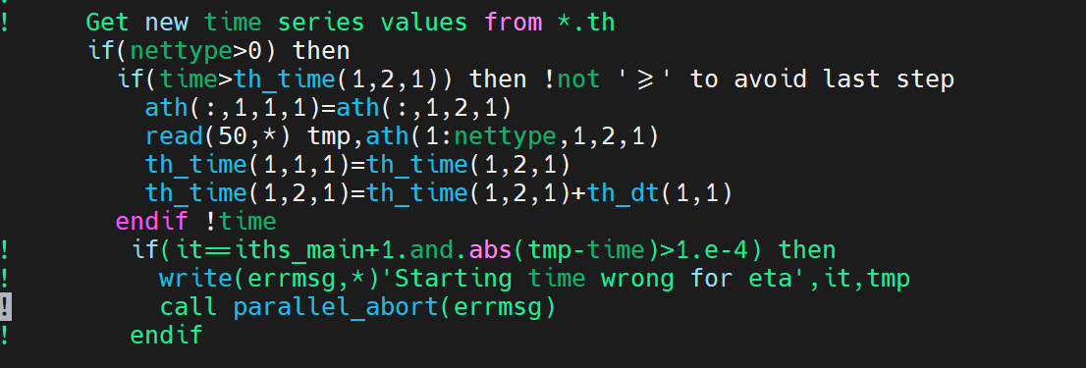
Error Messages
schism_step.F90 code snippet
Line 1323
Unit number
Time-stamp
Data-point

Slide 7
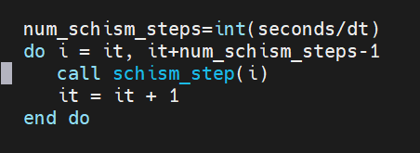
Error Messages
schism_nuopc_cap.F90 code snippet
Error occurring in the line associated with schism_step call within the schism_nuopc_cap
Line 790

Slide 8
Solution Attempt: 1
Make the elev.th file read-only (chmod 444 elev.th)
Model failed because ESMF is unable to modify the elev.th file
0: forrtl: severe (47): write to READONLY file, unit 50, file /work/noaa/nosofs/mjisan/ufs-weather-model/tests/stmp/mjisan/FV3_RT/RT_DUCK_NC_ELEV/.//elev.th
0: Image PC Routine Line Source 0: fv3_coastalS.exe 0000000001FF7398 Unknown Unknown Unknown
0: fv3_coastalS.exe 0000000000D9ADAD Unknown Unknown Unknown
0: fv3_coastalS.exe 0000000000D9797C Unknown Unknown Unknown
0: fv3_coastalS.exe 0000000001D2DB8E schism_nuopccap 347 schism_nuopc_cap.F90
0: fv3_coastalS.exe 0000000000ACF214 Unknown Unknown Unknown
0: fv3_coastalS.exe 0000000000AD318F Unknown Unknown Unknown

Slide 9
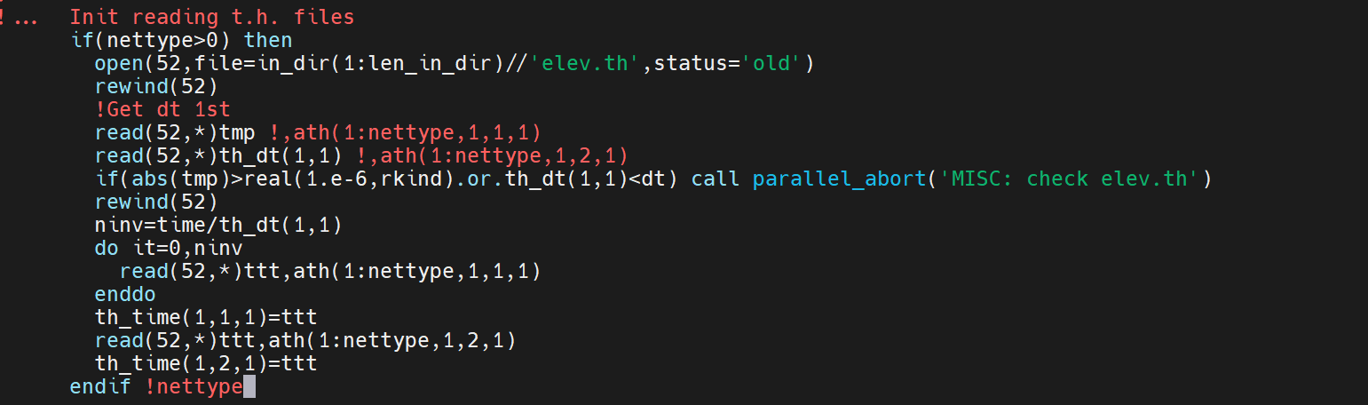
Solution Attempt: 2
Change unit number of elev.th in schism_step.F90 and misc_subs.F90
I suspect there’s a conflict with unit number 50 which might also be used in ESMF side
Modified unit number associate with elev.th which is part of misc_modules and schism_step subroutine.
Replace unit number 50 with 52
Misc_subs.F90

Slide 10
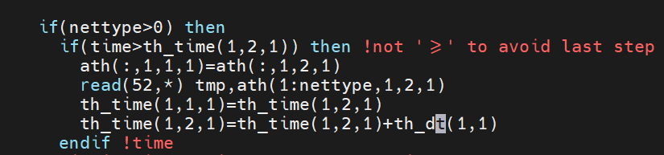
Solution Attempt: 2
Change unit number of elev.th in schism_step.F90 and misc_subs.F90
I suspect there’s a conflict with unit number 50 which might also be used in ESMF side
Modified unit number associate with elev.th which is part of misc_modules and schism_step subroutine.
Replace unit number 50 with 52
Schism_step.F90

Slide 11
Solution Attempt: 2
Solution attempt 2 worked and model run completed successfully
The elev.th file didn’t get modified by the ESMF and the model was able to read it correctly.
Next steps would be to check if the model results are affected by these changes.
Solution attempt 2 indicates that there might be conflict regarding unit number between SCHISM and ESMF subroutines.

Slide 12
Some Workarounds
I tried running the model using type 3 boundary condition (tidal amp/phase).
Using BC type 3 doesn’t require elev.th file since the model reads data directly from the bctides.in file.
The simulation worked fine when type 3 boundary condition (tidal amp/phases) was used

Slide 13
Test Case Directory in Hercules:
/work/noaa/nosofs/mjisan/ufs-weather-model/tests/stmp/mjisan/FV3_RT/RT_DUCK_NC_ELEV
Water elevation comparisons:
https://drive.google.com/file/d/1OLqQNRfvI6Q1yXnooRbKqYXUCt3-EmbF/view

