Slide 1
If-Else

Slide 2
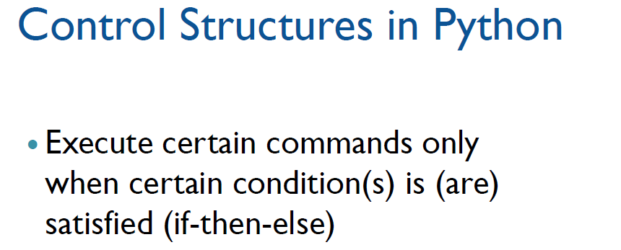
if condition:
statements
[elif condition:
statements] ...
else:
statements

Slide 3
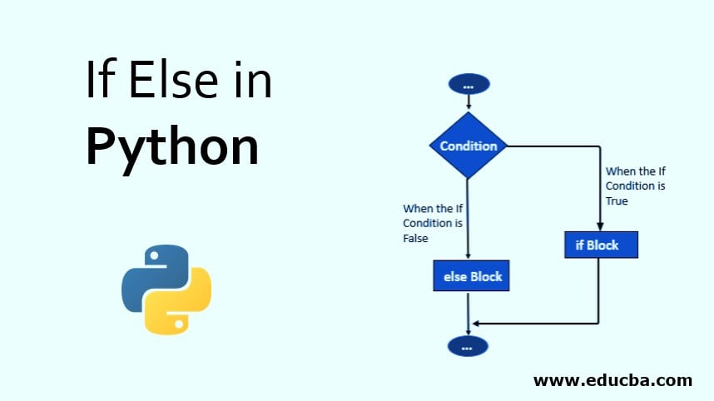

Slide 4
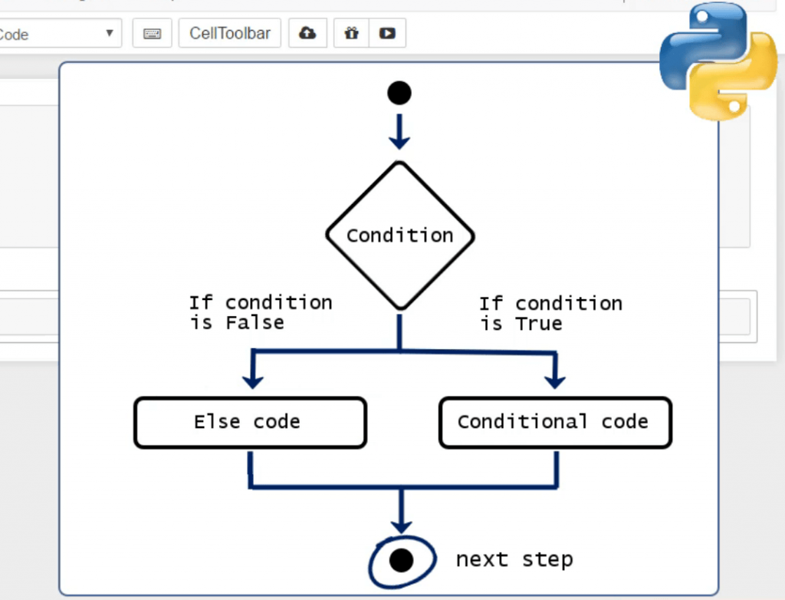

Slide 5
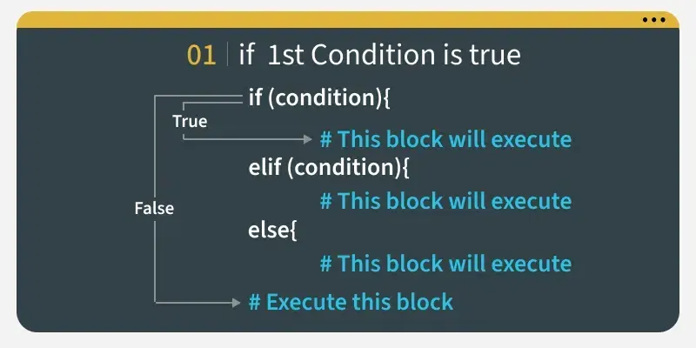

Slide 6
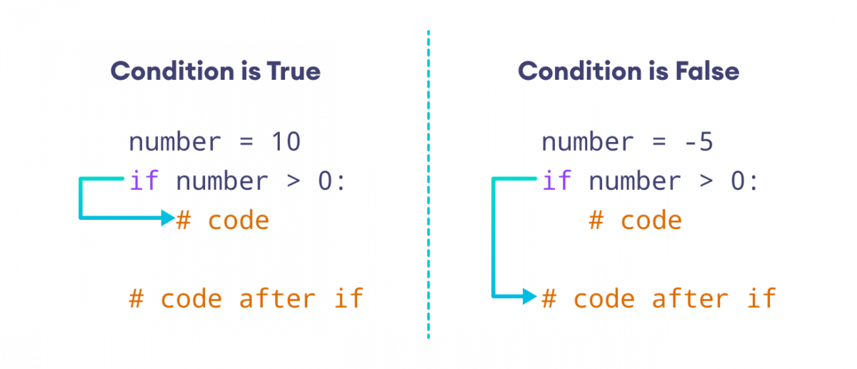
Working of If Statement

Slide 7
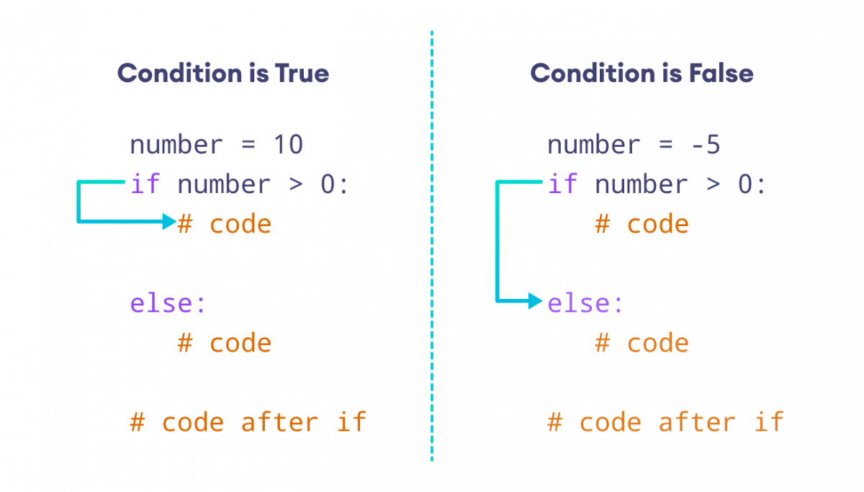
Working of If-Else Statement

Slide 8
Whitespace
Whitespace is meaningful in Python: especially indentation and placement of newlines
No braces {} to mark blocks of code, use consistent indentation instead
    First line with less indentation is outside of the block
    First line with more indentation starts a nested block
Colons start of a new block in many constructs, e.g. function definitions, then clauses

