Slide 1
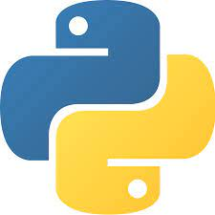

Loops

Slide 2
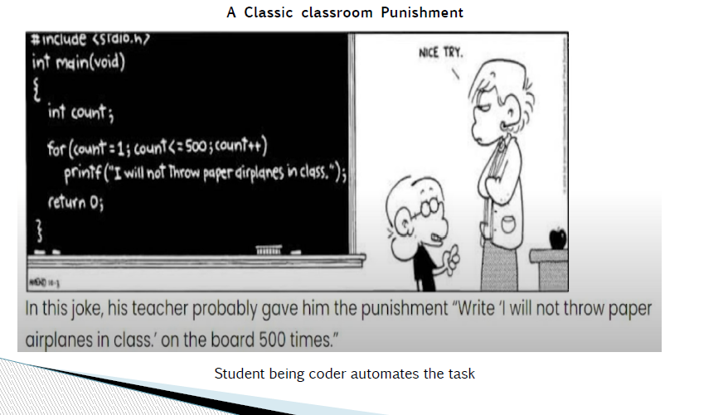

Slide 3
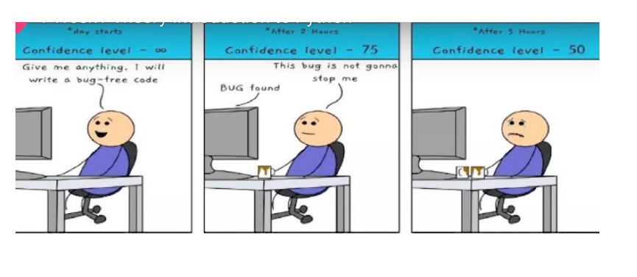

Slide 4
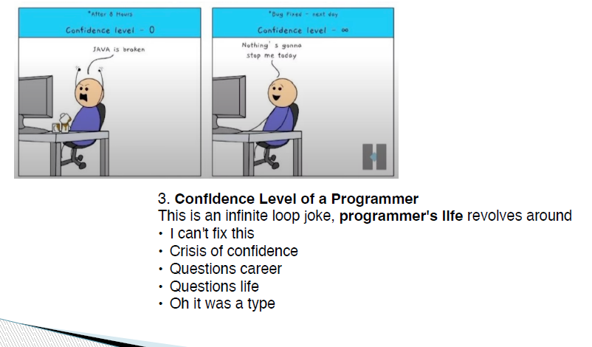

Slide 5
What is key takeaway for Python Learners???
Bugs are part of journey. Your confidence might fluctuate, but every challenge strengthens your problem solving skills.

Slide 6
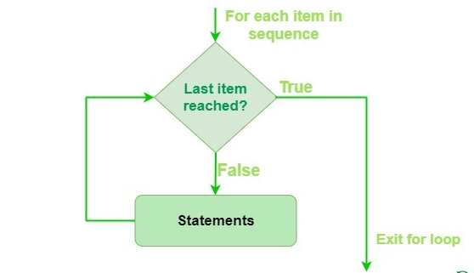
Loops
Loops in Python are used to repeat actions efficiently

Slide 7
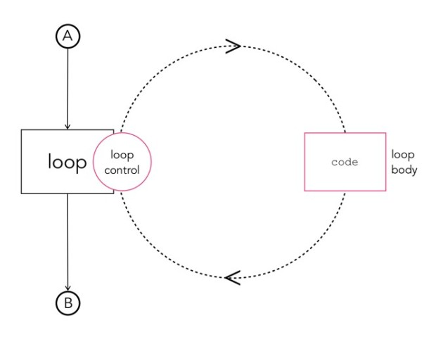
loops

Slide 8
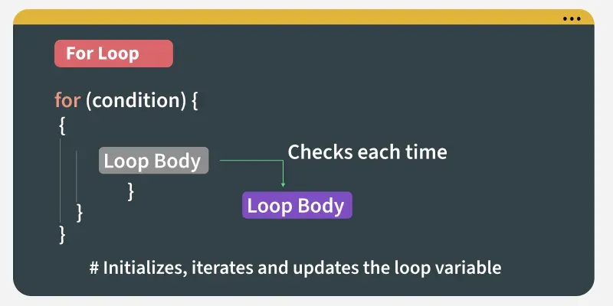
For Loop
For loops is used to iterate over a sequence. It allow to execute a block of code repeatedly, once for each item in the sequence.
for iterator_var in sequence:
statements(s)

Slide 9
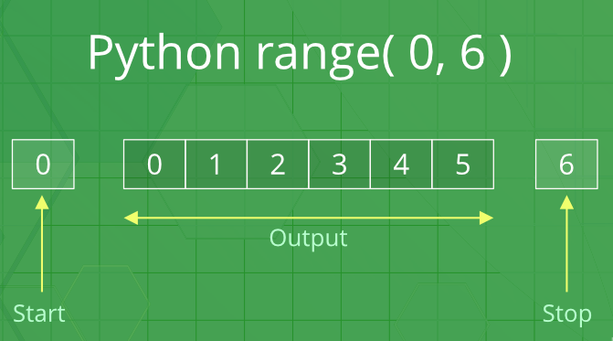

Slide 10
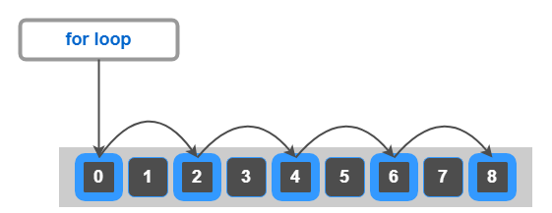
Example: Display a message “hello python” 8 times
for i in range (0, 8):
print(“hello python”)

Slide 11
Example: Display a message “hello python” 8 times
n = 8
for i in range (0, n):
print(“hello python”)

Slide 12
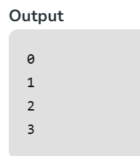

Example:
Explanation: This code prints the numbers from 0 to 3 (inclusive) using a for loop that iterates over a range from 0 to n-1 (where n = 4).

Slide 13
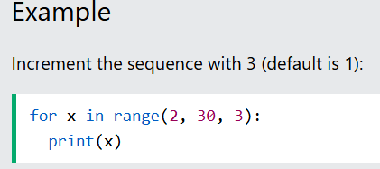
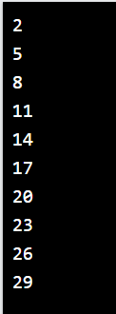
The range() function defaults to increment the sequence by 1, however it is possible to specify the increment value by adding a third parameter:
Eg: range(2, 30, 3):
Output:

