Slide 1

WIPRO NGA Program – 25SUB4509_NMS Testing
Capstone Project Presentation –14th Feb 2026
Project Title -Multi-Area OSPFv2/v3, EIGRP and GRE , NETCONF-Based Automation
Presented by –
Mantasha Ahmad
Superset ID: 5882049
www.rpsconsulting.in

Slide 2

Problem Statement
Enterprise networks require dual-stack support (IPv4 & IPv6), scalable routing, secure tunneling, and automation. Manual configuration of EIGRP, OSPFv2, OSPFv3, and GRE tunnels is complex, time-consuming, and prone to errors. Understanding routing concepts such as areas, LSAs, neighbor relationships, and protocol operations is critical for efficient network management.
Key Technologies Implemented:
Multi-Area OSPFv2 (IPv4) Link-state routing with backbone and non-backbone areas
OSPFv3 (IPv6) IPv6 routing and neighbor establishment
EIGRP Configuration Hybrid routing protocol with fast convergence
GRE Tunnel over OSPF Virtual point-to-point tunnel for secure reachability
NETCONF Automation using Python Automated OSPFv2 configuration push using ncclient
Simulation Tool
GNS3 for network design, configuration, and testing
2024 - RPS Consulting all rights reserved

Slide 3
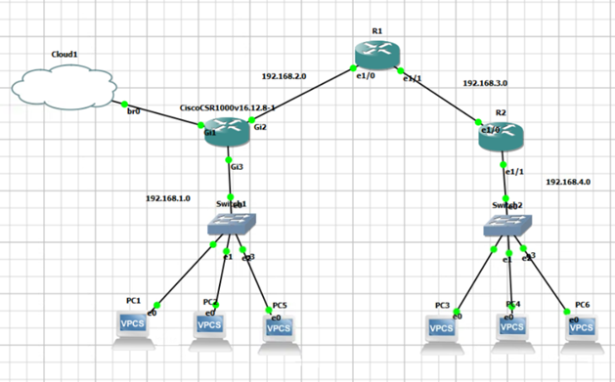
Network Topology Diagram
2024 - RPS Consulting all rights reserved

Slide 4
IPv4 Addressing Plan
Device Interface IP Address Subnet Mask
R3 Gi3 (LAN) 192.168.1.1 255.255.255.0
R3 Gi2 (to R1) 192.168.2.1 255.255.255.252
R1 e1/0 (to R3) 192.168.2.2 255.255.255.252
R1 e1/1 (to R2) 192.168.3.1 255.255.255.252
R2 e1/0 (to R1) 192.168.3.2 255.255.255.252
R2 e1/1 (LAN) 192.168.4.1 255.255.255.0
IPv4 Addressing Plan for PCs:
● Left LAN (PC1–PC2–PC5 Network): 192.168.1.0/24
● Right LAN (PC3–PC4–PC6 Network): 192.168.4.0/24
2024 - RPS Consulting all rights reserved

Slide 5
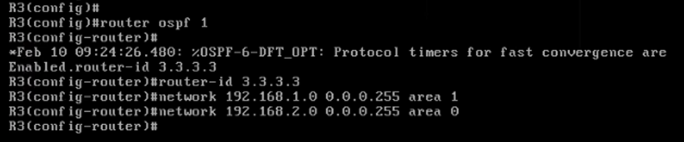
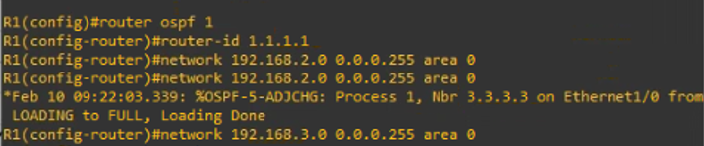
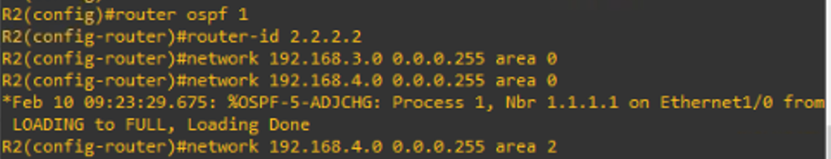
Multi-Area OSPFv2 Config
Area Assignment
Left LAN → Area 1
Backbone → Area 0
Right LAN → Area 2
Multi-Area OSPF is an OSPF design where the network is divided into multiple smaller areas instead of using a single large area . It improves scalability and performance by reducing routing overhead..
Area 0 = Backbone
Other areas connect through ABRs
Reduces LSDB size.
2024 - RPS Consulting all rights reserved

Slide 6
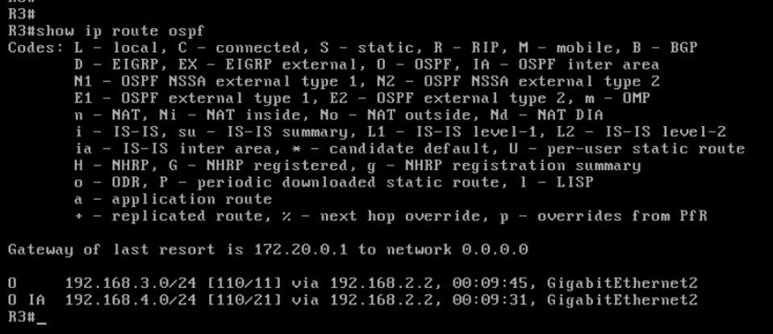
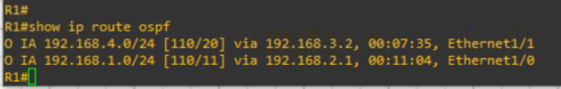

Verification of OSPF
2024 - RPS Consulting all rights reserved

Slide 7
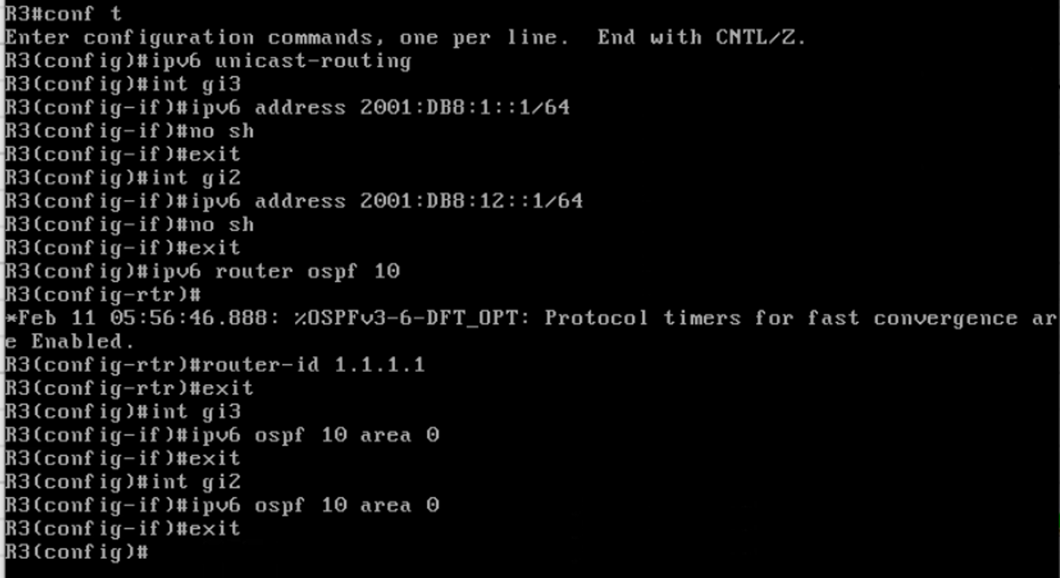
OSPFv3 Implementation (IPv6 Routing)
IPv6 Addressing Plan Used
Link | IPv6 Network
Left LAN | 2001:DB8:1::/64
R3 ↔ R1 | 2001:DB8:12::/64
R1 ↔ R2 | 2001:DB8:23::/64
Right LAN | 2001:DB8:4::/64
OSPFv3 (IPv6) Routing Configuration :
2024 - RPS Consulting all rights reserved

Slide 8
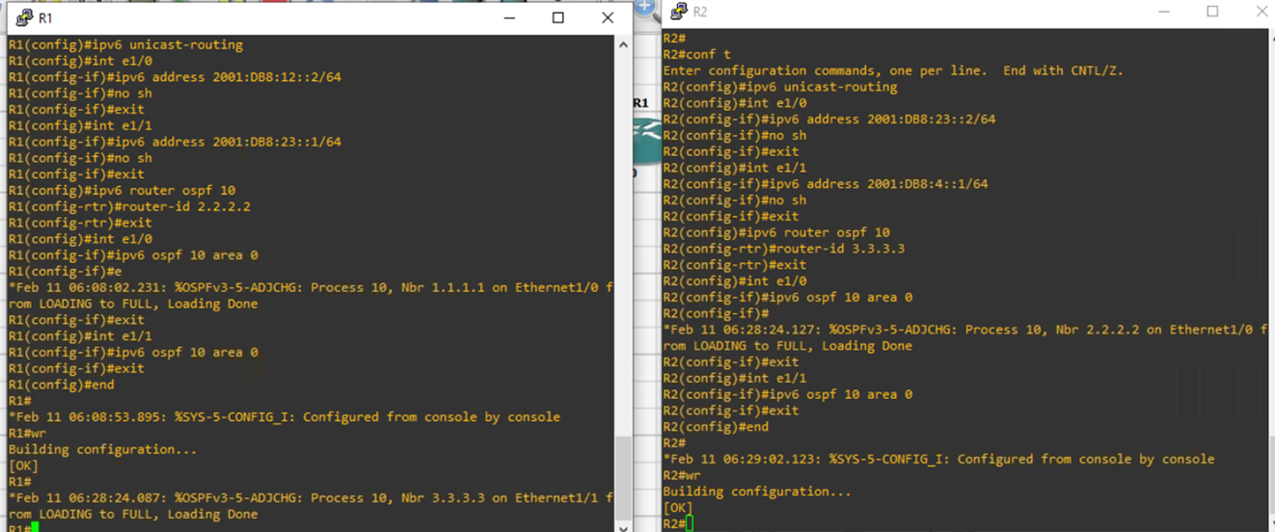
OSPFv3 (IPv6) Routing Configuration
2024 - RPS Consulting all rights reserved

Slide 9
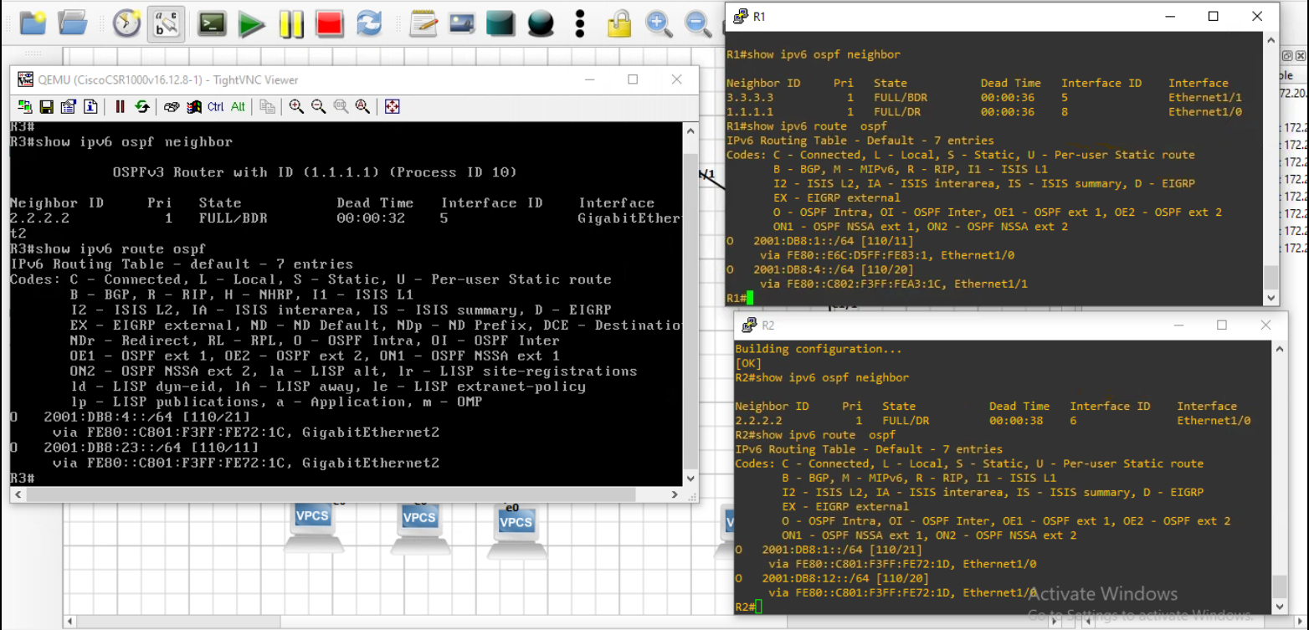
Verification of OSPFv3
2024 - RPS Consulting all rights reserved

Slide 10
EIGRP
EIGRP (Enhanced Interior Gateway Routing Protocol) is a Cisco-developed dynamic routing protocol used to share routing information between routers within the same autonomous system (AS).
Key Characteristics
Uses DUAL (Diffusing Update Algorithm)
finds best path
find backup path
prevent routing loops
Provides fast convergence
Uses Bandwidth and Delay to calculate best path
Maintains Neighbor Table, Topology Table, and Routing Table
2024 - RPS Consulting all rights reserved

Slide 11
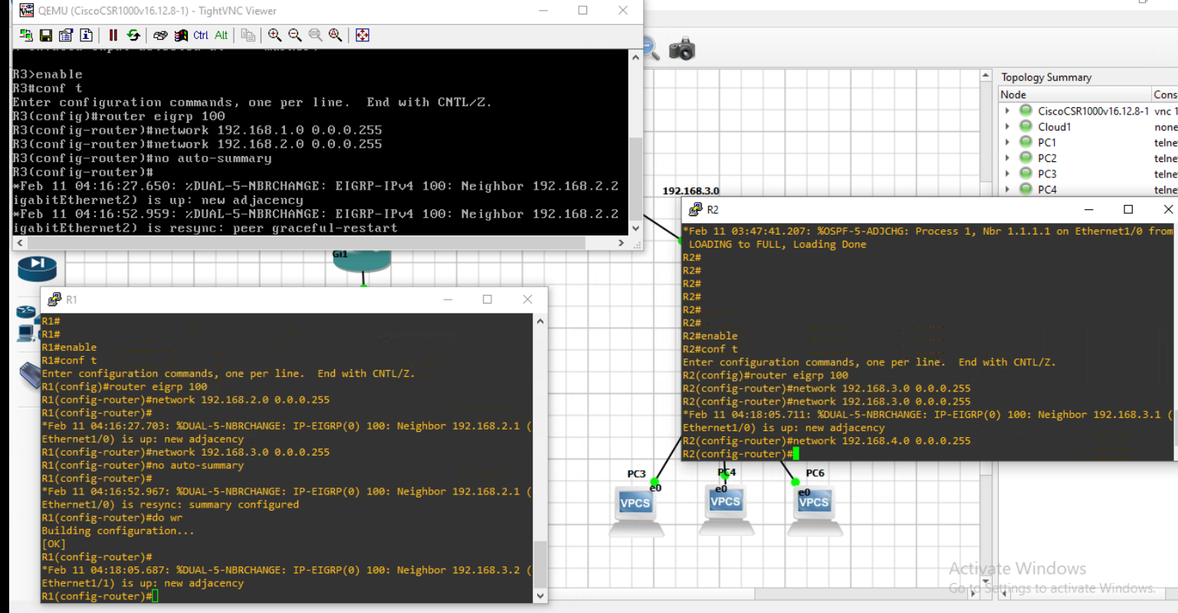
EIGRP AS 100 Configuration
Enable EIGRP AS 100 on Routers
2024 - RPS Consulting all rights reserved

Slide 12
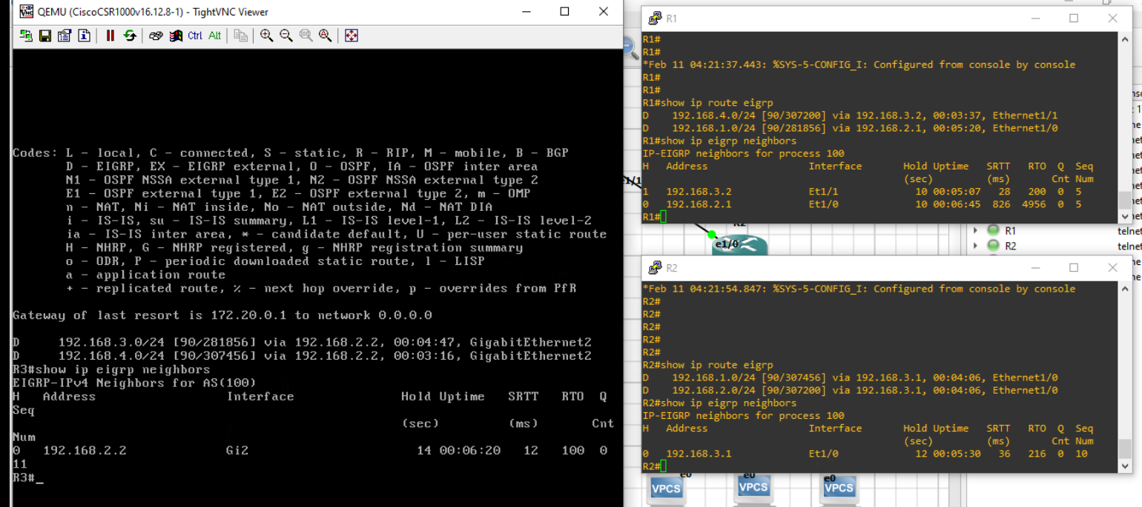
Verification of EIGRP
2024 - RPS Consulting all rights reserved

Slide 13
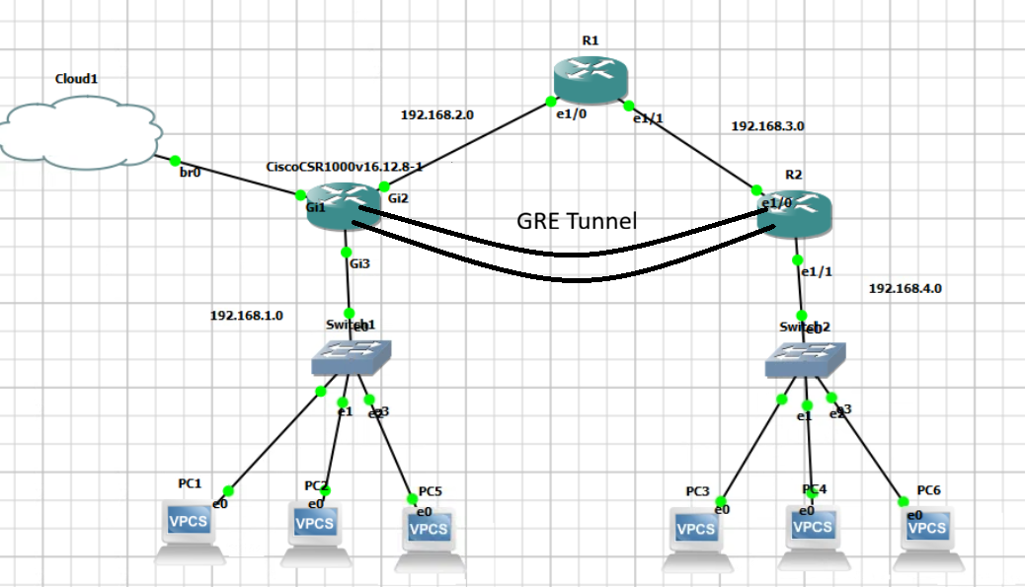
GRE Tunnel Over OSPF (R2 ↔ R3)
Tunnel Network: 10.10.10.0/30
GRE (Generic Routing Encapsulation) creates a virtual tunnel between R2 and R3
Runs over the existing OSPF
networkEncapsulates packets to allow communication between remote networks
2024 - RPS Consulting all rights reserved

Slide 14
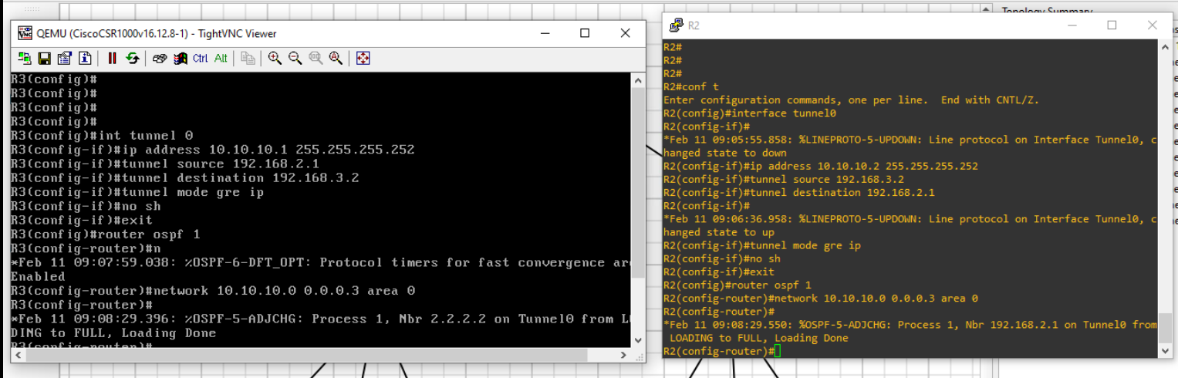
GRE Tunnel Over OSPF (R2 ↔ R3)
Tunnel Network: 10.10.10.0/30
2024 - RPS Consulting all rights reserved

Slide 15
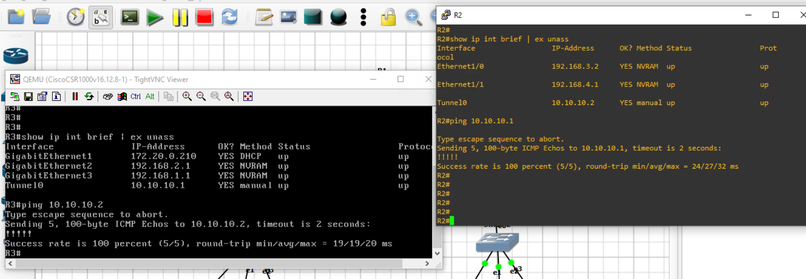
Verification of GRE Tunnel
2024 - RPS Consulting all rights reserved

Slide 16
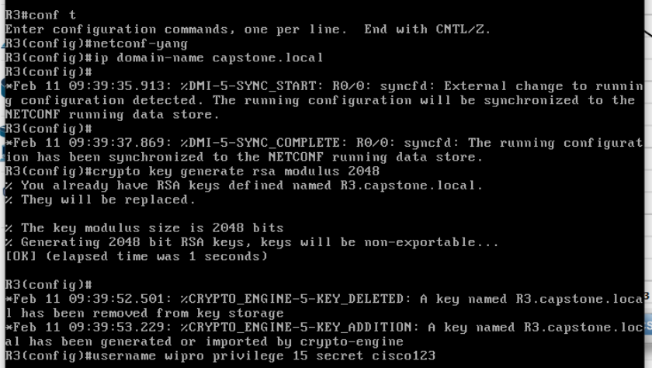




NETCONF Automation Script
Enable NETCONF on Routers
2024 - RPS Consulting all rights reserved

Slide 17
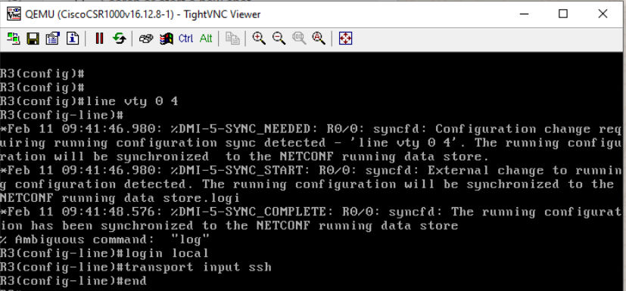



NETCONF Automation Script
Enable NETCONF on Routers
2024 - RPS Consulting all rights reserved

Slide 18
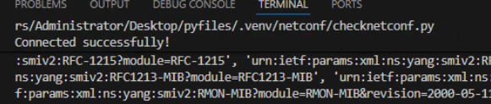
TEST NETCONF CONNECTION using Python Script
PYTHON Library used : ncclient
NETCONF Connection Script:
- Connect to router using ncclient manager
- Verify server capabilities
- Close session after testing
OUTPUT :
Python Script
from ncclient import manager
router = manager.connect(
host="172.20.0.210",
port=830,
username="wipro",
password="cisco123",
hostkey_verify=False,
allow_agent = False,
look_for_keys = False
)
print("Connected successfully!")
print(router.server_capabilities)
router.close_session()
2024 - RPS Consulting all rights reserved

Slide 19
Python Script — Push OSPFv2 Using NETCONF
Connect to router using ncclient manager
Verify server capabilities
Use edit-config operation to apply OSPFv2 configuration to the running datastore
Close session after testing
Python Script
from ncclient import manager
ROUTER_IP = "172.20.0.210"
USERNAME = "wipro"
PASSWORD = "cisco123"
ospfv2_config = """
<config>
<native xmlns="http://cisco.com/ns/yang/Cisco-IOS-XE-native">
<router>
<ospf xmlns="http://cisco.com/ns/yang/Cisco-IOS-XE-ospf">
2024 - RPS Consulting all rights reserved

Slide 20
Python Script
<id>1</id>
<router-id>1.1.1.1</router-id>
<network>
<ip>192.168.1.0</ip>
<mask>0.0.0.255</mask>
<area>0</area>
</network>
<network>
<ip>192.168.2.0</ip>
<mask>0.0.0.255</mask>
<area>0</area>
</network>
</ospf>
</router>
</native>
</config>
"""
with manager.connect(
host=ROUTER_IP,
port=830,
username=USERNAME,
password=PASSWORD,
hostkey_verify=False
) as m:
print("✅ Connected to Router3 NETCONF")
response = m.edit_config(target="running", config=ospfv2_config)
print("✅ OSPFv2 Configuration Pushed Successfully!")
print(response)
2024 - RPS Consulting all rights reserved

Slide 21
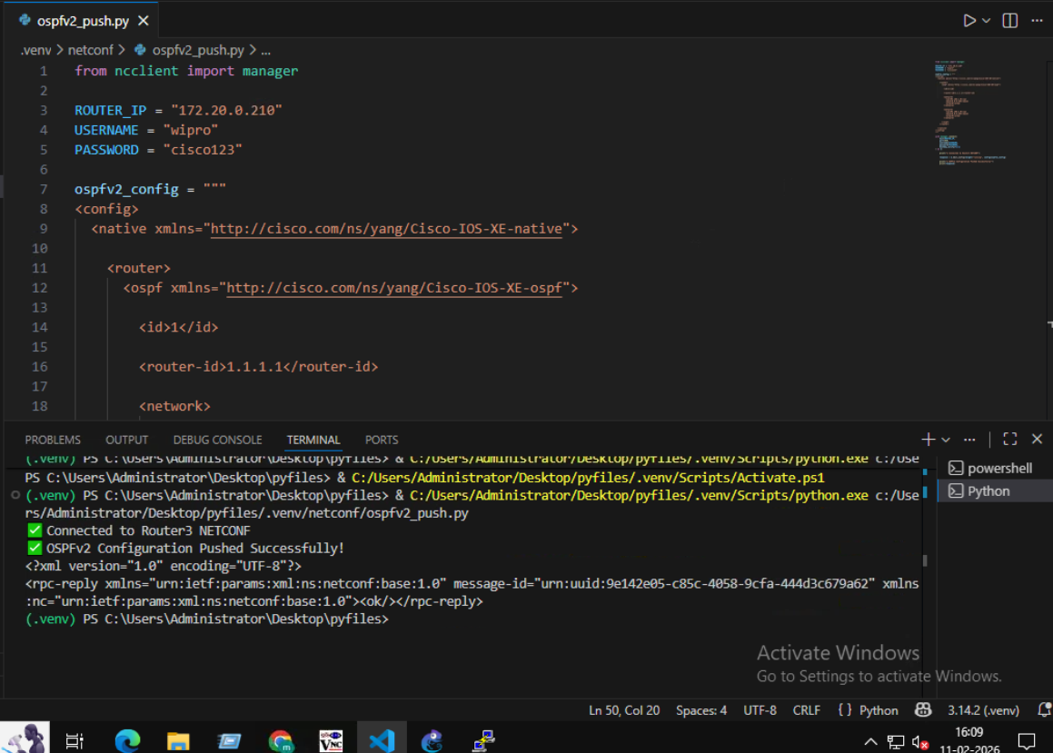

OUTPUT
2024 - RPS Consulting all rights reserved

Slide 22
Python Script — Push OSPFv3 Using NETCONF
Connects to Router using NETCONF
Sends XML configuration
Enables IPv6 routing
Creates OSPFv3 process 10
Prints confirmation
Python Script
from ncclient import manager
ROUTER_IP = "172.20.0.210"
USERNAME = "wipro"
PASSWORD = "cisco123"
ospfv3_config = """
<config>
<native xmlns="http://cisco.com/ns/yang/Cisco-IOS-XE-native">
<ipv6>
<unicast-routing/>
2024 - RPS Consulting all rights reserved

Slide 23
Python Script
<router>
<ospf>
<id>10</id>
</ospf>
</router>
</ipv6>
</native>
</config>
"""
with manager.connect(
host=ROUTER_IP,
port=830,
username=USERNAME,
password=PASSWORD,
hostkey_verify=False
) as m:
print("✅ Connected to Router3 NETCONF")
response = m.edit_config(target="running", config=ospfv3_config)
print("✅ OSPFv3 Process Created Successfully!")
print(response)
2024 - RPS Consulting all rights reserved

Slide 24
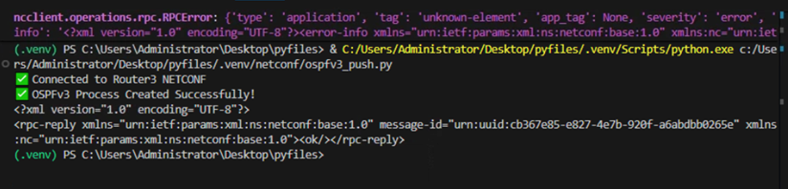


OUTPUT
2024 - RPS Consulting all rights reserved

Slide 25
Manual Configuration vs Automated Configuration
Aspect | Manual Configuration (CLI Based) | Automated Configuration (NETCONF + Python)
Configuration Method | Router CLI commands entered manually | Python script using NETCONF (ncclient)
Protocols Configured | OSPFv2, OSPFv3, EIGRP, GRE configured one-by-one on each router | OSPFv2 and OSPFv3 pushed automatically via XML
Time Required | High – configure each router separately | Low – script pushes config instantly
Human Errors | High chance (wrong area, wrong mask, typo errors) | Minimal errors (standardized XML template)
Scalability | Difficult for large networks | Easily scalable to many routers
2024 - RPS Consulting all rights reserved

Slide 26
Conclusion
This project successfully demonstrated the implementation of enterprise routing and tunneling technologies along with network automation.
Key Achievements
Implemented Multi-Area OSPFv2 for IPv4 routing across backbone and non-backbone areas
Configured OSPFv3 to enable dynamic IPv6 connectivity between all routers
Established EIGRP AS 100 for efficient hybrid routing and fast convergence
Built a GRE Tunnel over OSPF to provide virtual secure communication between remote routers
Verified end-to-end reachability using ping, traceroute, and routing protocol commands
Automated OSPFv2 configuration deployment using Python + NETCONF (ncclient)
Final Outcome
A fully connected multi-protocol network was achieved with both manual configuration and automated routing deployment, reflecting real-world enterprise networking practices.
2024 - RPS Consulting all rights reserved

