Slide 1

Covid-19
DJANGO BASED WEBAPP FOR COVID-19 VISUALIZATION
-Mushraf Perween
-Mantasha Fatma
- MANTASHAFATMA

Slide 2
Introduction
Welcome to a captivating voyage through the COVID-19 pandemic, as we present our innovative "COVID-19 Visualization WebApp." In this presentation, we invite you to join us on an immersive journey into the depths of data-driven insights that shed light on the global impact of this unprecedented crisis.
Captivating Visuals: Brace yourself for an array of captivating data visualizations that breathe life into the pandemic's narrative.
Charting the Trajectory: Explore the rise and fall of COVID-19 cases, the impact on continents, and the measures taken across nations.
An Interactive Experience: Prepare for an interactive journey where you'll have the power to delve into country-specific insights and compare data across continents.
Unraveling Trends: Uncover the pandemic's trends and milestones, empowering you with valuable knowledge for the future.
Inspiring Resilience: Witness the stories of nations that led the battle and celebrate the triumphs of human determination.

Slide 3
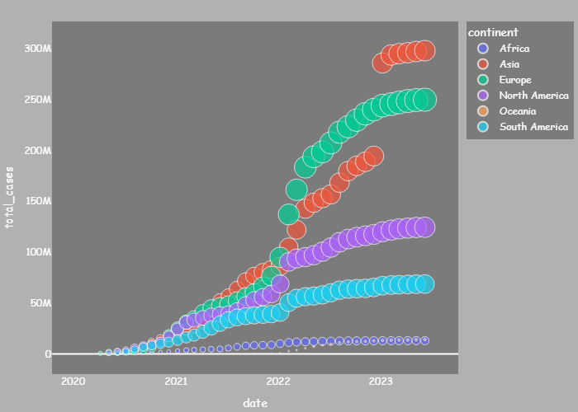
Global Symphony of COVID-19: The Corona Arise Scatter Plot
A captivating scatter plot that breathes life into the global COVID-19 pandemic.
Each dot marks the rise of cases in all continents, revealing the relentless spread of the virus.
Engage with this visual narrative as it unravels the virus's impact across the world.
Unveil patterns and trends, empowering us to understand the pandemic's evolution.
Explore continents as interconnected data points, highlighting our shared experiences.

Slide 4
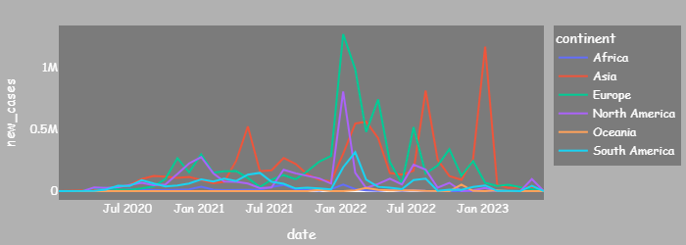
Unfolding Trends: New COVID-19 Cases Across Continents
Embark on a revealing expedition through continents with the "New Cases Line Chart."
Traverse through time as this captivating line chart illustrates new COVID-19 cases year by year.
Follow the upward and downward trends, uncovering pivotal moments in the pandemic's trajectory.
The x-axis marks the passage of time, while the y-axis reflects the emergence of new cases.
Gain insights into how the virus evolved and challenged different regions worldwide.
Illuminate the effectiveness of various measures and strategies in curbing the spread.

Slide 5
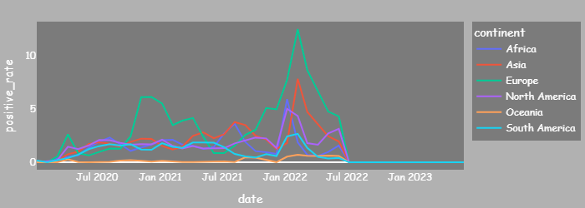
Unveiling the Positivity Puzzle: Continents at a Glance
Travel through continents with the captivating "Positivity Rate Line Chart."
Unlock the pandemic's secrets as we journey year by year through this engaging line chart.
Watch the positivity rate, a critical indicator, come to life on the y-axis, while time unfolds on the x-axis.
Discover intriguing patterns that shed light on the virus's impact across continents.
Compare responses and resilience of different regions, revealed by varying trends in positivity over time.

Slide 6
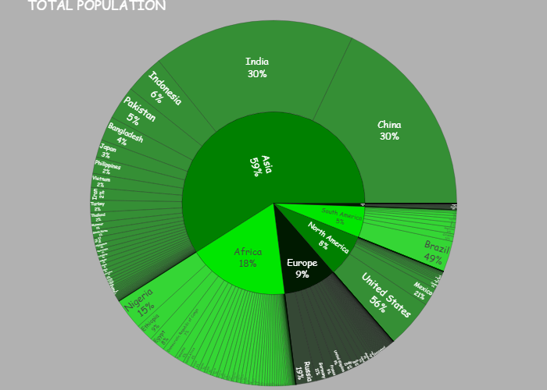
Sunburst Splendor: Total Population by Continent
Embark on a mesmerizing journey of demographics with the "Sunburst Chart."
Unveil the population tapestry of each continent with this captivating visualization.
Radiating from the center, each layer represents population levels, revealing a rich story of diversity.
Engage with a kaleidoscope of colors, each hue reflecting a unique continent's inhabitants.
Gain a holistic perspective on global demographics, accentuating each continent's significance.
Illuminate the vital role of population dynamics in shaping the pandemic's impact.
Let the "Sunburst Chart" captivate you with its brilliance, as it paints a portrait of humanity's diversity.

Slide 7
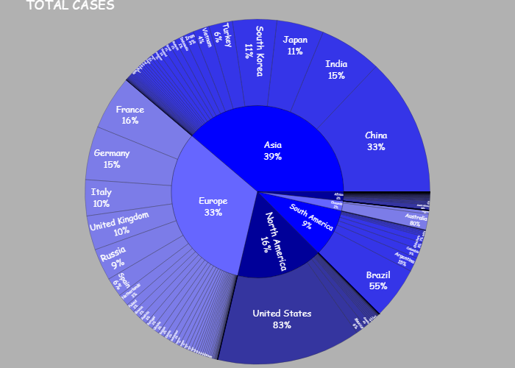
Pandemic's Global Pulse: Total Cases by Continent
Embark on an illuminating exploration of the pandemic's pulse with the "Sunburst Chart."
Discover the pandemic's footprint across continents through this captivating visualization.
Each layer, like ripples on water, unveils the total COVID-19 cases in each continent.
Engage with an array of vibrant hues, each representing the magnitude of cases in a specific region.
Gain a comprehensive understanding of the virus's global impact, continent by continent.
Unveil the stark contrasts in case numbers, reflecting diverse responses and challenges.

Slide 8
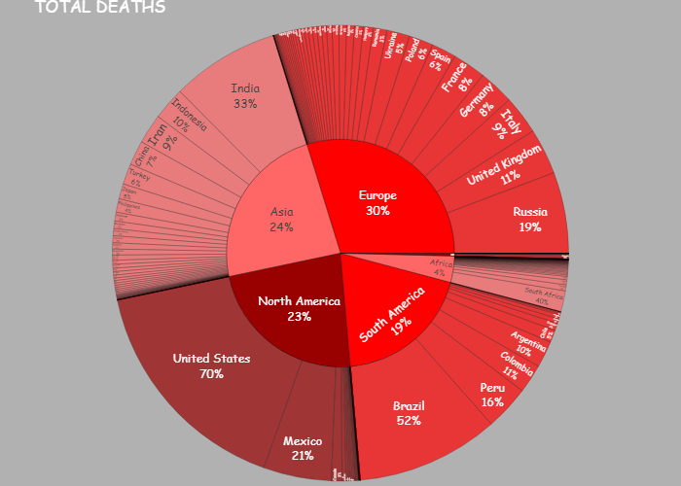
Glimpse of Loss: Total Deaths by Continent
Embark on an emotional journey as we uncover the toll of the pandemic with the "Sunburst Chart."
Witness the heart-rending impact of COVID-19 on each continent through this evocative visualization.
Each layer reveals the solemn count of lives lost, echoing the gravity of the pandemic's toll.
Engage with a poignant spectrum of shades, symbolizing the profound human losses endured.
Gain a poignant perspective on the global impact of the pandemic, continent by continent.
Unveil the diversity of experiences, highlighting the importance of unity and compassion.
Let the "Sunburst Chart" remind us of the lives lost, inspiring our commitment to a safer future.

Slide 9
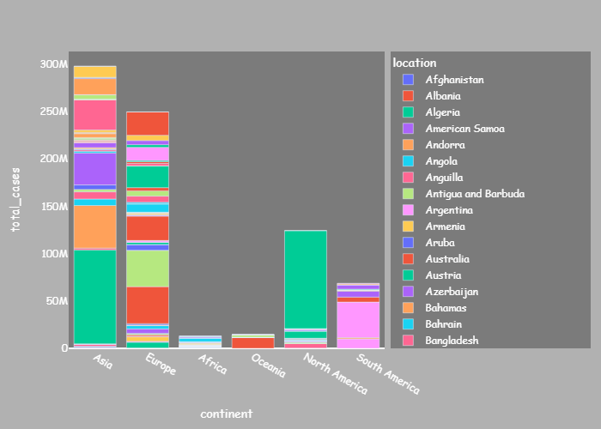
Continents Unmasked: Stacked Bar Chart
Unmask the pandemic's reach across continents with the revealing "Stacked Bar Chart."
Witness the collective impact of COVID-19 in each continent, layer by layer.
Each bar symbolizes a continent, and within it, layers reveal the total cases in each country.
Engage with a multi-dimensional representation, reflecting the diverse scale of the pandemic.
Gain a comprehensive view of how nations within continents experienced the outbreak.
Uncover the continent-specific challenges and successes in curbing the virus's spread.

Slide 10
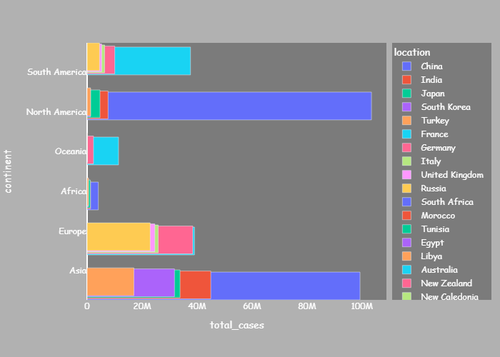
Leading the Battle: Top 5 Countries by Continent
Witness the front-runners in the global fight against COVID-19 with the "Horizontal Stacked Bar Chart."
Meet the top 5 countries that have shouldered the highest case counts on each continent.
Each bar represents a continent, and within it, layers showcase the most affected countries.
Engage with a powerful visual representation, highlighting the leading nations' roles in combatting the pandemic.
Gain valuable insights into the pandemic's impact and response strategies across continents.
Uncover the diversity of experiences and challenges faced by these eminent nations.
Let the "Horizontal Stacked Bar Chart" inspire us with stories of perseverance and determination.

Slide 11

Country Insights: Interactive Visualizations
Step into the realm of country-specific data with the "Country Page Charts."
Experience a personalized journey, exploring COVID-19 insights of your chosen country.
Navigate through a collection of interactive line charts, each illuminating different aspects.
"Total Cases," "New Cases," "Vaccination," and "Total Deaths" charts provide a holistic view.
Witness the pandemic's impact year by year, tracking key statistics with each chart's time axis.
Uncover patterns, milestones, and responses unique to your selected country.

Slide 12
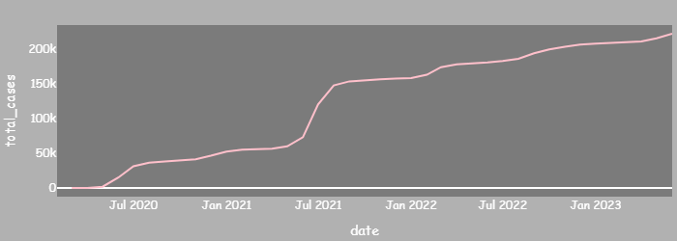
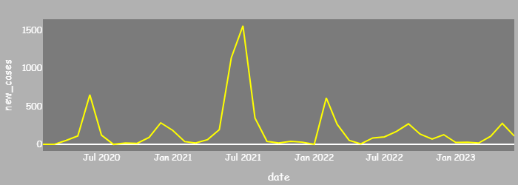
Engage in a detailed analysis of Afghanistan's battle against COVID-19 with the illuminating "Line Charts."
Uncover the trajectory of the pandemic within Afghanistan, showcased through two insightful line charts: "Total Cases" and "New Cases."
The "Total Cases" chart presents Afghanistan's overall case count, providing a panoramic view of the pandemic's scale and progression within the nation.
Observe how the case count evolved over time, revealing critical milestones and challenges faced during the pandemic's course.
Delve into the intricacies of the pandemic's spread with the "New Cases" chart, depicting the daily or weekly influx of new infections.
Identify periods of surges, dips, or stability, providing valuable insights into the effectiveness of containment measures and vaccination campaigns.
Compare and contrast the trends between the two charts to uncover connections between the accumulation of cases and the fluctuations in new infections.
COVID-19 Cases Analysis in Afghanistan: Total Cases vs. New Cases

Slide 13
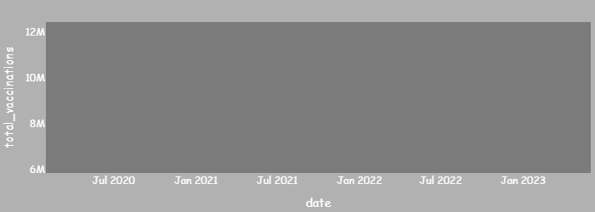
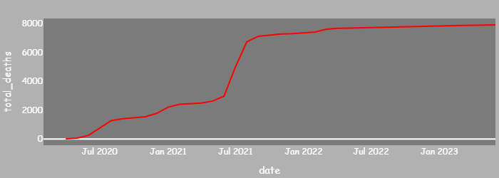
Unveil the pivotal aspects of Afghanistan's COVID-19 journey with two crucial line charts: "Vaccination" and "Total Deaths."
Gain profound insights into Afghanistan's vaccination progress and its impact on the nation's resilience in the face of the pandemic.
The "Vaccination" chart showcases the cumulative doses administered, reflecting Afghanistan's strides towards herd immunity and protection.
Observe the acceleration in vaccinations, indicating a concerted effort in safeguarding the population.
Delve into the effectiveness of vaccination campaigns, potentially curbing infection rates and reducing severe outcomes.
The "Total Deaths" chart portrays the solemn toll of the pandemic on Afghanistan, capturing the lives lost to COVID-19.
Pay tribute to those who lost their lives, understanding the human cost of the pandemic's impact.
Analyze the intersection of vaccination efforts and the impact on reducing fatalities.
COVID-19 Impact: Vaccination and Total Deaths in Afghanistan

Slide 14
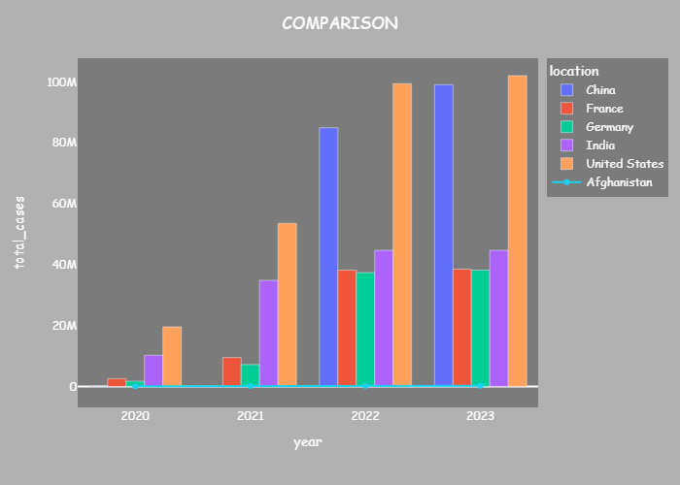
Pandemic Perspectives: Top 5 Countries vs. Afghanistan
Embark on a riveting journey of pandemic perspectives with the captivating "Comparison Chart," where data reveals the intertwined stories of Afghanistan and the top 5 countries with the highest total COVID-19 cases.
The chart comes alive as the bars elegantly display the annual total cases for each of the leading nations, bringing to light the diverse and ever-evolving nature of their pandemic experiences.
Afghanistan's unique trajectory is thoughtfully represented by the distinguished line, providing a personalized lens into the nation's ongoing response.
Witness how Afghanistan's battle against the pandemic aligns or diverges from the top performers, unearthing critical learnings and potential strategies.
Explore pivotal turning points that shaped each country's course, identifying correlations between actions and outcomes, and uncovering the factors influencing their pandemic narratives.
Gain deeper insights into Afghanistan's journey as the line chart weaves through triumphs and challenges, unveiling the nation's resilience in the face of adversity.

Slide 15
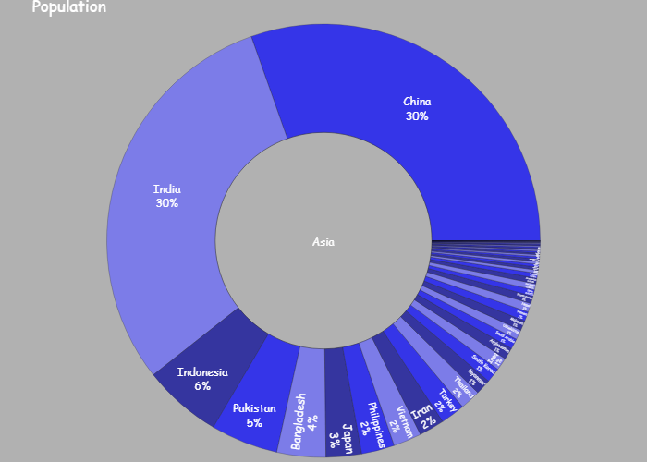
Continental Insights: Sunburst Chart of Population in Asia
Embark on an enlightening journey into the heart of Asia with the mesmerizing "Sunburst Chart."
Unveil the total population of Asia, the continent to which Afghanistan belongs, offering a holistic understanding of the region's significance in the global fight against COVID-19.
The "Sunburst Chart" artfully visualizes the population distribution across different tiers, providing a comprehensive view of the continent's demographics.
Explore the hierarchy of population segments, from countries to regions, cities, and beyond, to comprehend Asia's immense diversity.
Understand how Afghanistan, as a prominent country within Asia, fits into this broader tapestry, recognizing its role within the continental context.
Gain valuable insights into Asia's capacity to mobilize resources, expertise, and collective responses in combatting the pandemic.
Empower policymakers and the audience with nuanced knowledge, guiding informed strategies for regional cooperation and support.

Slide 16
Conclusion
As our journey through the "COVID-19 Visualization WebApp" comes to a close, we find ourselves enlightened by the power of data-driven insights. The dynamic visualizations presented have been windows into the impact of the pandemic across continents and countries, revealing invaluable patterns and trends.
Informed by these visual revelations, we are now better equipped to make well-informed decisions and navigate the challenges that lie ahead. The interconnectedness of nations has become strikingly apparent, emphasizing the need for global unity and collective action in confronting global crises.
Throughout our exploration, we witnessed the resilience and determination of nations in the face of adversity. Their stories inspire hope and remind us of the human spirit's capacity to overcome challenges. Armed with this knowledge, we are called upon to embrace continued vigilance in safeguarding public health and well-being.
As we bid farewell, let us carry forward the lessons learned and transform data into meaningful action. Each of us plays a crucial role in building a healthier, more resilient world. Together, we have the power to champion a future where knowledge guides us through uncertainty, bringing us closer to a brighter tomorrow.
Thank You!

