Slide 1

Note: The data and information in this document is reflective of a hypothetical situation and client. This document is to be used for KPMG Virtual Internship purposes only.
Sprocket Central Pty Ltd
Data analytics approach
[Division Name] - [Engagement Manager], [Senior Consultant], [Junior Consultant]
Mantas Birskus KPMG Virtual Internship 2020-12-23

Slide 2
Note: The data and information in this document is reflective of a hypothetical situation and client. This document is to be used for KPMG Virtual Internship purposes only.
Agenda
Introduction
Data Exploration
Model Development
Interpretation

Slide 3





Note: The data and information in this document is reflective of a hypothetical situation and client. This document is to be used for KPMG Virtual Internship purposes only.
Introduction
Sections
To build our model for most promising customers we firstly need a combined training set. We will approach it during data exploration.
We will then build a preliminary model depending on the most valuable data and introduce to the structure of the model which would process the data in the most useful way.
Finally, we will interpret the results and decide whether they are logical. We will draw any conclusions and make any recommendations.

Slide 4

Note: The data and information in this document is reflective of a hypothetical situation and client. This document is to be used for KPMG Virtual Internship purposes only.
Data Exploration
Data distributions
Goal: understand how data is distributed and distinguish what information will be used.
We will specify what will be taken from each of the datasets before we combine them into one.

Slide 5
Note: The data and information in this document is reflective of a hypothetical situation and client. This document is to be used for KPMG Virtual Internship purposes only.
Data Exploration
Data distributions: Customer Demographic
Remove entries with empty values in “DOB” – this also gets rid of “U” gender and blank cells in “tenure”, making the dataset smoother.
Ignore “first_name” and “last_name” columns – we are using customer IDs for identification.
Ignore “job_title” – there is a more abstract category “job_industry” which makes the analysis results more generalized.
Ignore “deceased_indicator” – over 99% of the records are indicated by “N” in this column so we can assume it has no impact.
customer_id
gender
past_3_years_bike_related_ purchases
DOB
job_industry_category
wealth_segment
owns_car
tenure

Slide 6
Note: The data and information in this document is reflective of a hypothetical situation and client. This document is to be used for KPMG Virtual Internship purposes only.
Data Exploration
Data distributions: Customer Address
Ignore “address” – as addresses are all different, each of them almost identifies each customer independently. We have IDs for that and for location analysis we are using more abstract values.
Ignore “postcode” – this would be useful for classifying locations into some sets, for example, states. As we already have “states”, we can remove “postcode”.
Ignore “country” – all the entries have “Australia” as their country, so this has no impact to our analysis.
customer_id
state
property_valuation

Slide 7
Note: The data and information in this document is reflective of a hypothetical situation and client. This document is to be used for KPMG Virtual Internship purposes only.
Data Exploration
Data distributions: Transactions
Remove entries with “Cancelled” order status – we care about the entries which brought profit to the company.
Only keep columns “customer_id”, “list_price” and “standard_cost” – other columns specify details that do not contribute to our analysis, for example, “product_class” might be useful to determine what products the new customers should be targeted with, but, to fulfill our main goal, we only need to know whether the customer made any purchases in general.
customer_id
list_price
standard_cost

Slide 8
Note: The data and information in this document is reflective of a hypothetical situation and client. This document is to be used for KPMG Virtual Internship purposes only.
Data Exploration
Data distributions: New Customer List
full_name
gender
past_3_years_bike_related_ purchases
DOB
job_industry_category
wealth_segment
owns_car
tenure
state
property_valuation
We simply keep only those columns which a joint set of the 3 earlier described databases would have.
We do keep, however, “first_name” and “last_name” in case we want to specify any customers. They both are merged into one column “full_name”.

Slide 9
Note: The data and information in this document is reflective of a hypothetical situation and client. This document is to be used for KPMG Virtual Internship purposes only.
Data Exploration
Feature engineering
Over 10% of records have a listed price 10-40 times bigger than the standard cost. We assume this is not an outlier and we can safely calculate the profit based on all the taken records from Transactions.
However, <1% records (totaling in 2 distinct products) have listed price almost 100 times bigger that the standard cost. These records are considered as outliers and will be removed.
We assume the company raises profit whenever a customer buys an item for a listed price. The gained profit is the difference between the listed price and the standard cost.
We aggregate all the rows based on the IDs and calculate total profit gained from each customer.

Slide 10
Note: The data and information in this document is reflective of a hypothetical situation and client. This document is to be used for KPMG Virtual Internship purposes only.
Data Exploration
Feature engineering
We then join the 3 datasets into 1. We note that there are around 500 records which had no transaction history in the provided period. We keep them for a more comprehensive feedback.
We also add one more column called “entries” which will help us keep track of how many records there are in a certain category.
customer_id | gender | past_3_years_bike_ related_purchases | DOB | job_industry_category | wealth_segment
owns_car | tenure | state | property_valuation | profit | entries

Slide 11
Note: The data and information in this document is reflective of a hypothetical situation and client. This document is to be used for KPMG Virtual Internship purposes only.
Data Exploration
Data transformation
Certain columns need to have their values grouped which will make it easier for us to generalize the data. We apply the following:
Convert values in “DOB” to 5 age groups.
Convert values in “past_3_years_bike_related_purchases” to 10 groups.
Convert values in “tenure” to 6 groups
Rename columns to simpler names.
The same logic is applied to New Customer List dataset for consistency.

Slide 12
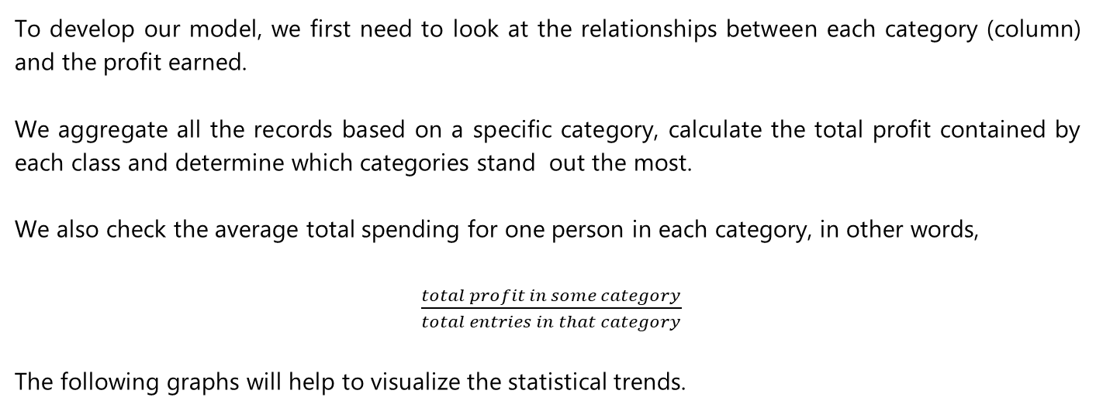
Note: The data and information in this document is reflective of a hypothetical situation and client. This document is to be used for KPMG Virtual Internship purposes only.
Model Development
Modelling
To develop our model, we first need to look at the relationships between each category (column) and the profit earned.
We aggregate all the records based on a specific category, calculate the total profit contained by each class and determine which categories stand out the most.
We also check the average total spending for one person in each category, in other words,
$\frac{total profit in some category}{total entries in that category}$
The following graphs will help to visualize the statistical trends.

Slide 13
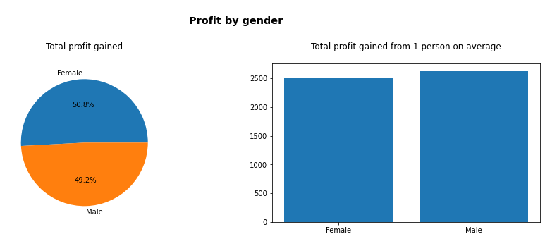
Note: The data and information in this document is reflective of a hypothetical situation and client. This document is to be used for KPMG Virtual Internship purposes only.
Model Development
Modelling: gender

Slide 14
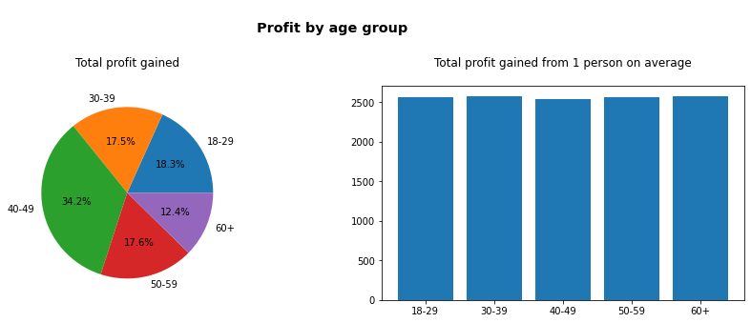
Note: The data and information in this document is reflective of a hypothetical situation and client. This document is to be used for KPMG Virtual Internship purposes only.
Model Development
Modelling: age group

Slide 15
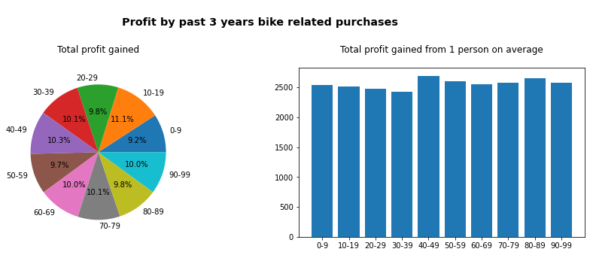
Note: The data and information in this document is reflective of a hypothetical situation and client. This document is to be used for KPMG Virtual Internship purposes only.
Model Development
Modelling: past 3 years bike related purchases

Slide 16
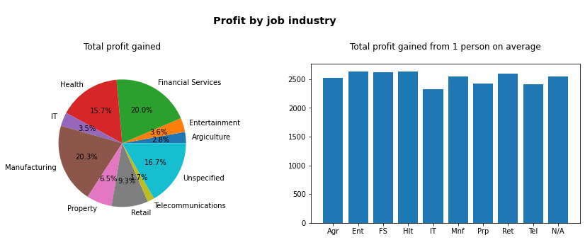
Note: The data and information in this document is reflective of a hypothetical situation and client. This document is to be used for KPMG Virtual Internship purposes only.
Model Development
Modelling: job industry

Slide 17
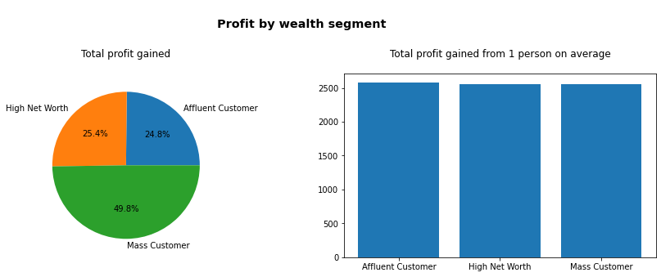
Note: The data and information in this document is reflective of a hypothetical situation and client. This document is to be used for KPMG Virtual Internship purposes only.
Model Development
Modelling: wealth segment

Slide 18
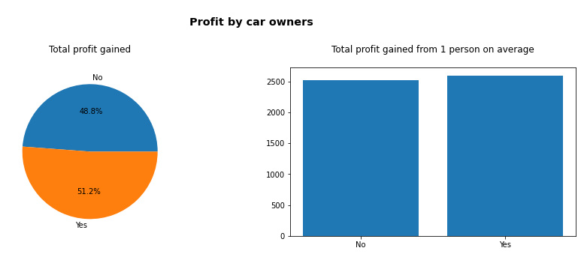
Note: The data and information in this document is reflective of a hypothetical situation and client. This document is to be used for KPMG Virtual Internship purposes only.
Model Development
Modelling: owns car

Slide 19
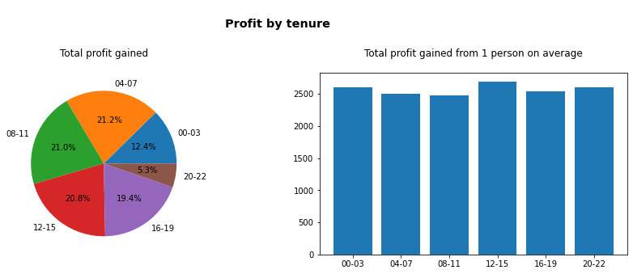
Note: The data and information in this document is reflective of a hypothetical situation and client. This document is to be used for KPMG Virtual Internship purposes only.
Model Development
Modelling: tenure

Slide 20
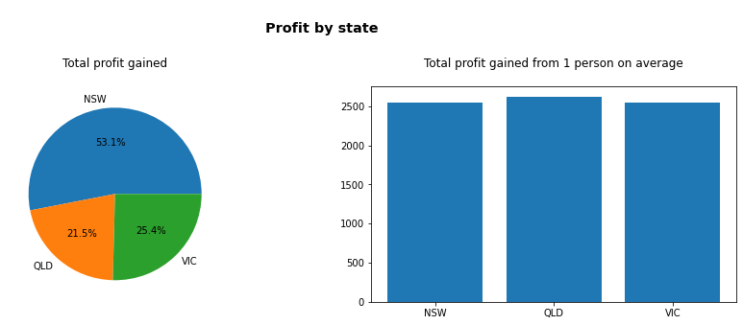
Note: The data and information in this document is reflective of a hypothetical situation and client. This document is to be used for KPMG Virtual Internship purposes only.
Model Development
Modelling: state

Slide 21
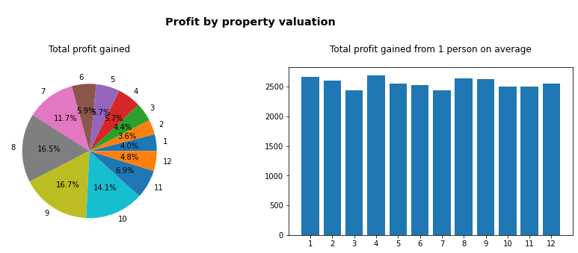
Note: The data and information in this document is reflective of a hypothetical situation and client. This document is to be used for KPMG Virtual Internship purposes only.
[-]
Model Development
Modelling: property valuation

Slide 22
Note: The data and information in this document is reflective of a hypothetical situation and client. This document is to be used for KPMG Virtual Internship purposes only.
Model Development
Modelling
From the trends it can be seen that, in every category, from one person on average, the company acquired $2,500 by selling them bicycles and accessories during the provided period.
Additional tests were done, and it was determined that this average remains constant when we explore some certain category because normal distributions for other categories remain constant as well.
For example, if we took a subset of only females or people who own car, the profit distribution across states would remain the same, i.e., most sales will still be done for people from NSW.
For this reason, we will not focus on the average but, mainly, on the overall profit a certain category brings to the company.

Slide 23
Note: The data and information in this document is reflective of a hypothetical situation and client. This document is to be used for KPMG Virtual Internship purposes only.
Interpretation
Results interpretation
As stated previously, we need to pick specific categories which bring the most profit. This brings us several choices of interest:
Age group: 40-49
Job industry: Financial Services, Health and Manufacturing
Wealth sector: Mass Customer
State: NSW
Property valuation: 8 to 9

Slide 24
Note: The data and information in this document is reflective of a hypothetical situation and client. This document is to be used for KPMG Virtual Internship purposes only.
Interpretation
Results interpretation
From those, we choose 2 general categories, “Mass Customer” and “NSW”, as there were the most entries in them. The named classes will be further analyzed for potential differences on proportion of distributions of other classes within them. Even if they are minor, it is better to judge a particular category rather than to combine the overall trends of the whole set.
One point to note is that it may seem that the reason why there are so many records from NSW is because the state has the largest population out of the three. However, we still choose this state because the difference in populations is roughly similar, but the profit distribution is not.

Slide 25
Note: The data and information in this document is reflective of a hypothetical situation and client. This document is to be used for KPMG Virtual Internship purposes only.
Interpretation
Reporting
The results our model will bring will be presented graphically. A visual dashboard will be presented using Tableau.
Obtained information will be interpreted, explained and used to identify the customers who would bring the most value to the company.
We will also build any recommendations on what additional data should be collected for better target marketing and we will formulate the strategy the company should put forward.

Slide 26
Note: The data and information in this document is reflective of a hypothetical situation and client. This document is to be used for KPMG Virtual Internship purposes only.
Appendix

Slide 27
Note: The data and information in this document is reflective of a hypothetical situation and client. This document is to be used for KPMG Virtual Internship purposes only.
Appendix
Please check these resources to confirm the reasoning in this presentation
https://itt.abs.gov.au/itt/r.jsp?databyregion
dataExploration.ipynb file attached along with these slides

