Slide 1
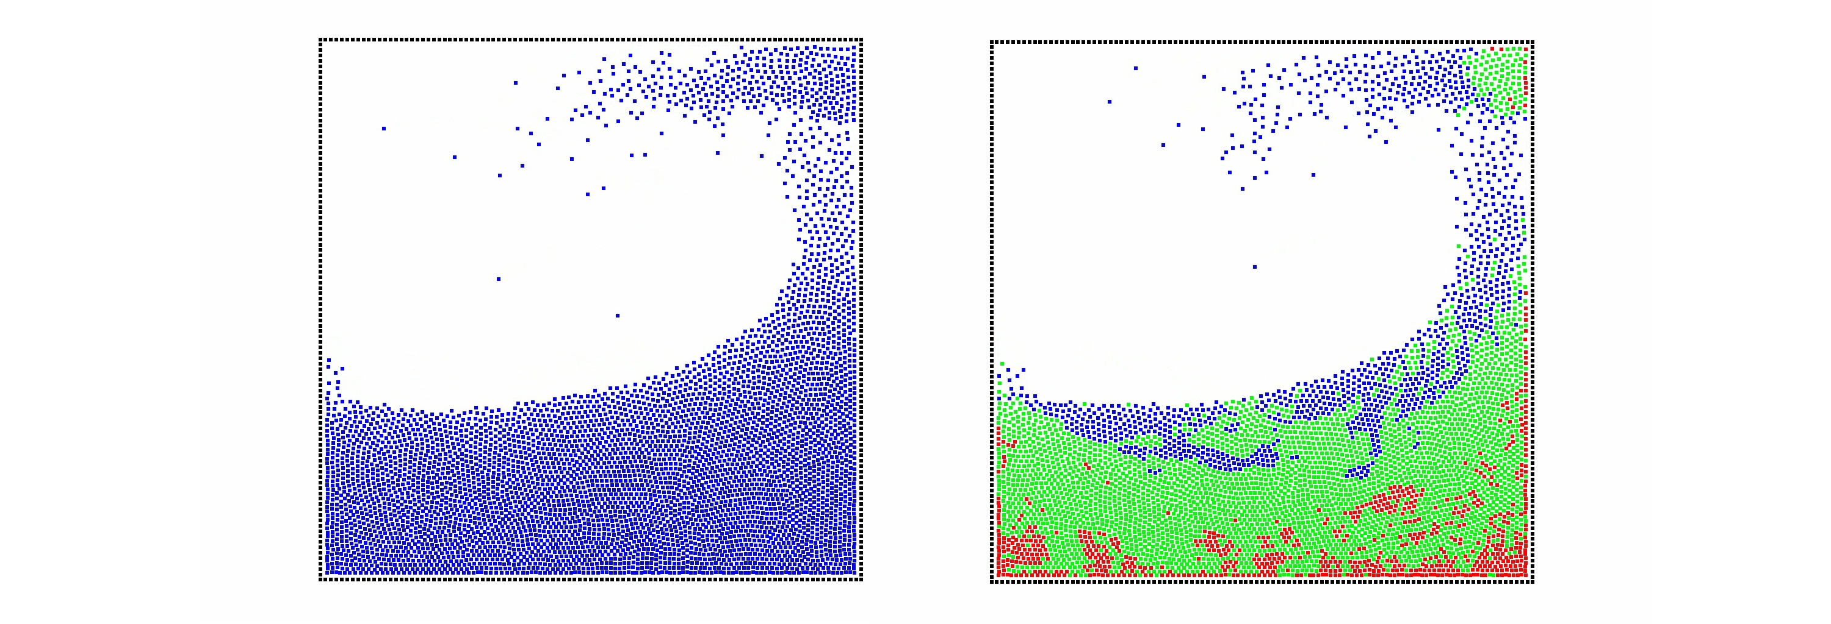
Exploring the use of adaptively restrained particles in graphics simulation
Pierre-Luc Manteaux, François Faure, Stéphane Redon & Marie-Paule Cani
LJK-CNRS Grenoble University, Inria
Notes:
Hello everyone, today I will present a new adaptive method to speed-up particle simulation in computer graphics.

Slide 2
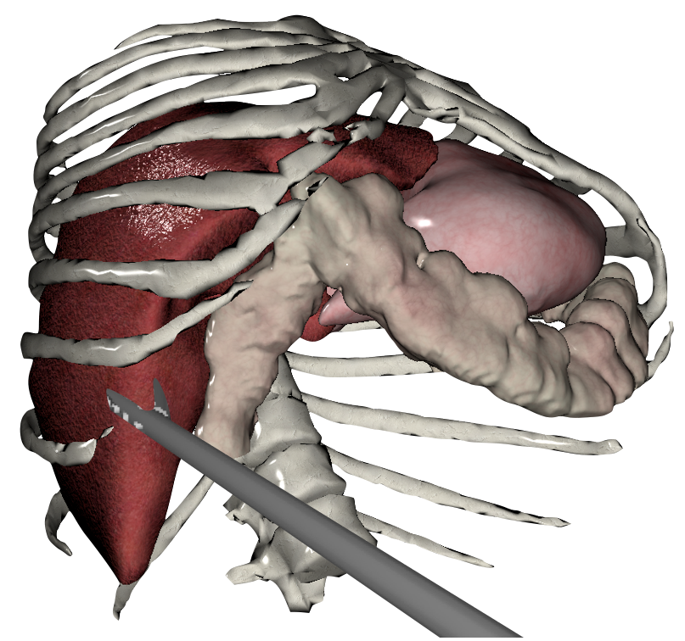

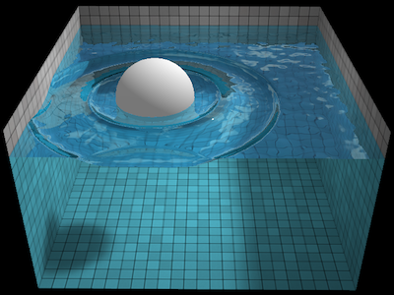
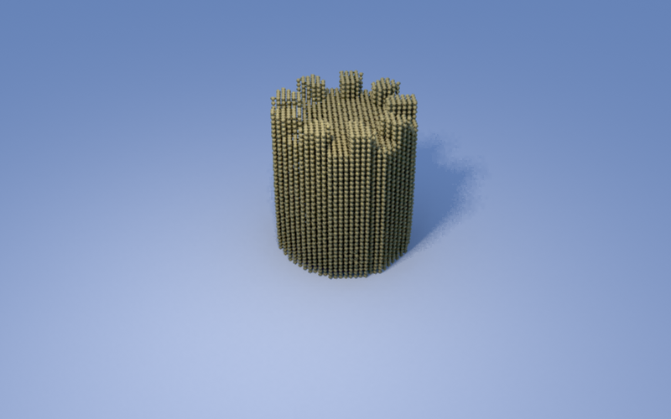
Motivations
Time is lost in quasi-static situations.
Wrinkles
Surgical Simulation
Water at rest
Granular Material with High Friction
Notes:
There are a lot of simulation where only local interaction occur,
So, a lot of computational time is lost in these quasi-static situation.
For instance this sofa where wrinkles appear on only one cushion.
A surgical simulation where interaction may happen everywhere but only locally.
Water simulation when it come at rest.
Or finally, granular material which quickly stop moving due to friction.
What we want is to spare ressources in these cases to focus computational ressources on the most interesting part of a simulation.

Slide 3
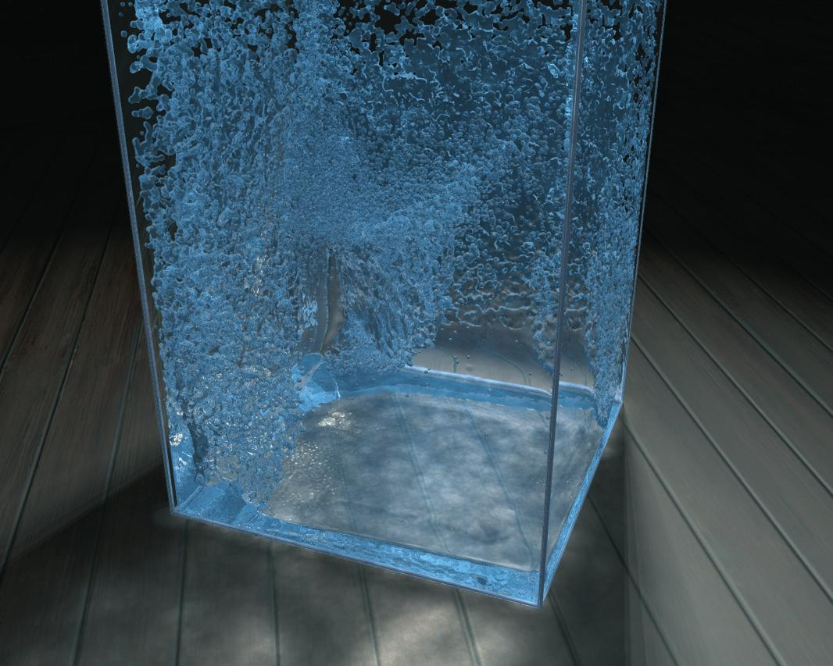
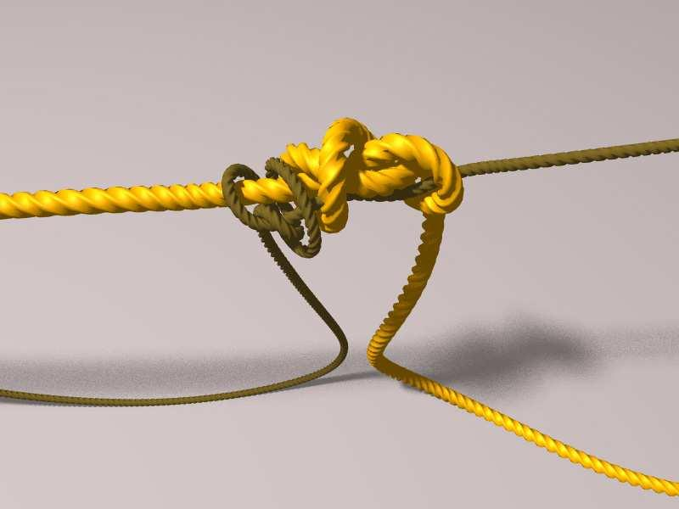
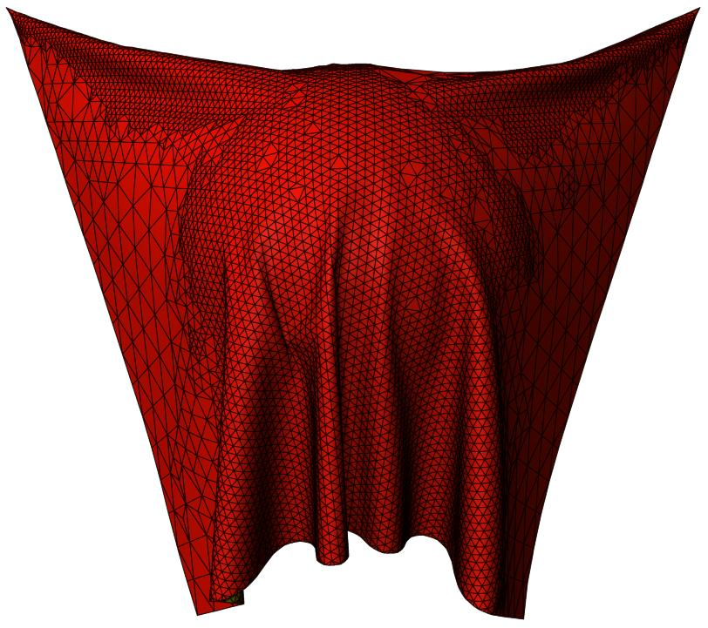
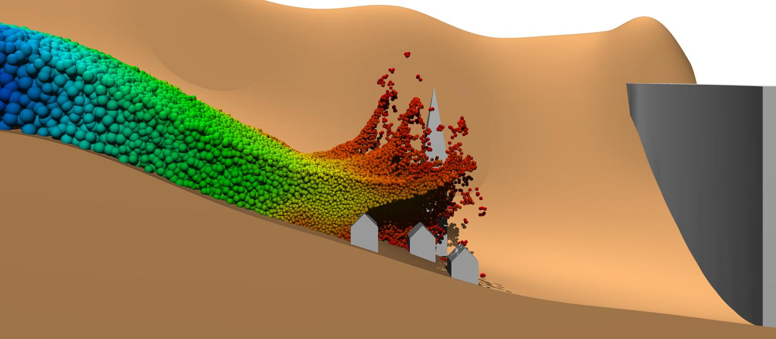
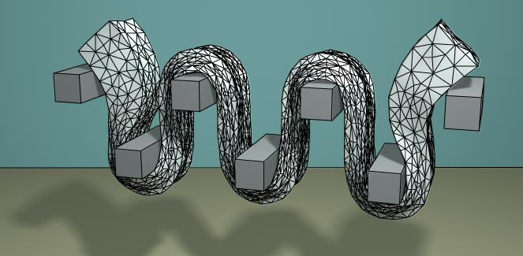
Related Work
Time
Rods
Cloth
[Desbrun&al 1996]
[Spillmann&al 2008]
[Bender&al 2012]
[Ihmsen&al 2010]
[Servin&al 2011]
[Narain&al 2012]
Small scale details
Large deformation
[Adams&al 2006]
[Solenthaler&al 2011]
[Debunne&al 2001]
[Grinspun&al 2002]
[Goswami&al 2011]
[Ando&al 2013]
[Wojtan&al 2008]
[Wicke&al 2010]
How/When inactive particles may move again in a coherent way ?
Notes:
Adaptive simulation is not a new topic in CG.
Basically we can distinguish two kind of adaptivity.
Time adaptivity : to get large time steps without compromising stability.
Spatial adaptivity : to get the best sampling to capture small scale details, wrinkles, large deformation.
But how to save time in quasi static simulation stay mainly unadressed..
[Goswami&al 2011] proposed to approximate slow particles by immobile ones but violating Newton's Action/Reaction principle.
Freezing technics exist in video game but are mainly restricted to rigid bodies simulation.
The question of how/when the inactive particles may restart in a coherent fashion stay unanswered in computer graphics.

Slide 4
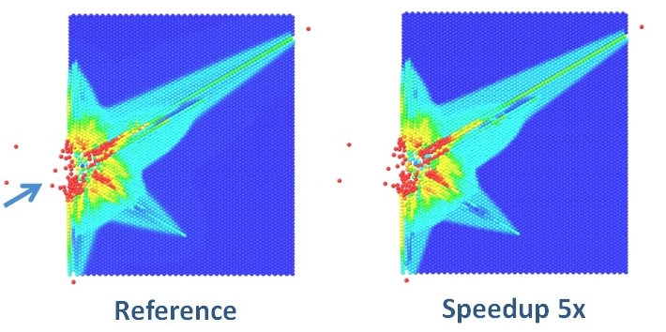
Adaptively Restrained Particle Simulations
Proposed by [Artemova & Redon 2012] in the context of Molecular Dynamics
Slow particles
~
Immobile
Constant Forces
Accumulation
Restart
* Important speed-up achieved
* Features well preserved
* Trade-off Precision/Speed possible
Notes:
Recently this question was addressed in molecular dynamics by Artemova & Redon.
Their approach is called Adaptively Restrained Particle Simulations, ARPS.
As Goswami , slow particles are considered immobile, so interparticle forces are constant and do not need to be computed.
But the momenta associated to these constant forces still accumulates and particle may start moving again by themselves in physically coherent way.
The method has been validated on several examples.
One of the most impressive is a collision cascade simulation.
One particle is launched against one block of particles and a shock wave propagates.
In this simulation, a 5x speed-up was achieved while extremely well preserving the features of the shock.
In their paper they explain that a trade-off between precision and speed can be achieved by tuning two user-defined threshold.

Slide 5
Summary
Goal : Explore/Extend ARPS to speed-up graphics simulations.
I – Principle of ARPS
II – Extension to particle-based fluids
A – SPH algorithm
B – How to handle viscosity
III – Extension to cloth simulation
A – Implicit integrator
IV – Limitations & Future work
Notes:
I have the following plan.
Firt I will explain you what ARPS is .
It will allow me to introduce motivations and related work.
And then I will present our two contributions.
An extension to particle based fluids.
An extension to implicit integration.
Finally I will conclude with limitations & future works.

Slide 6
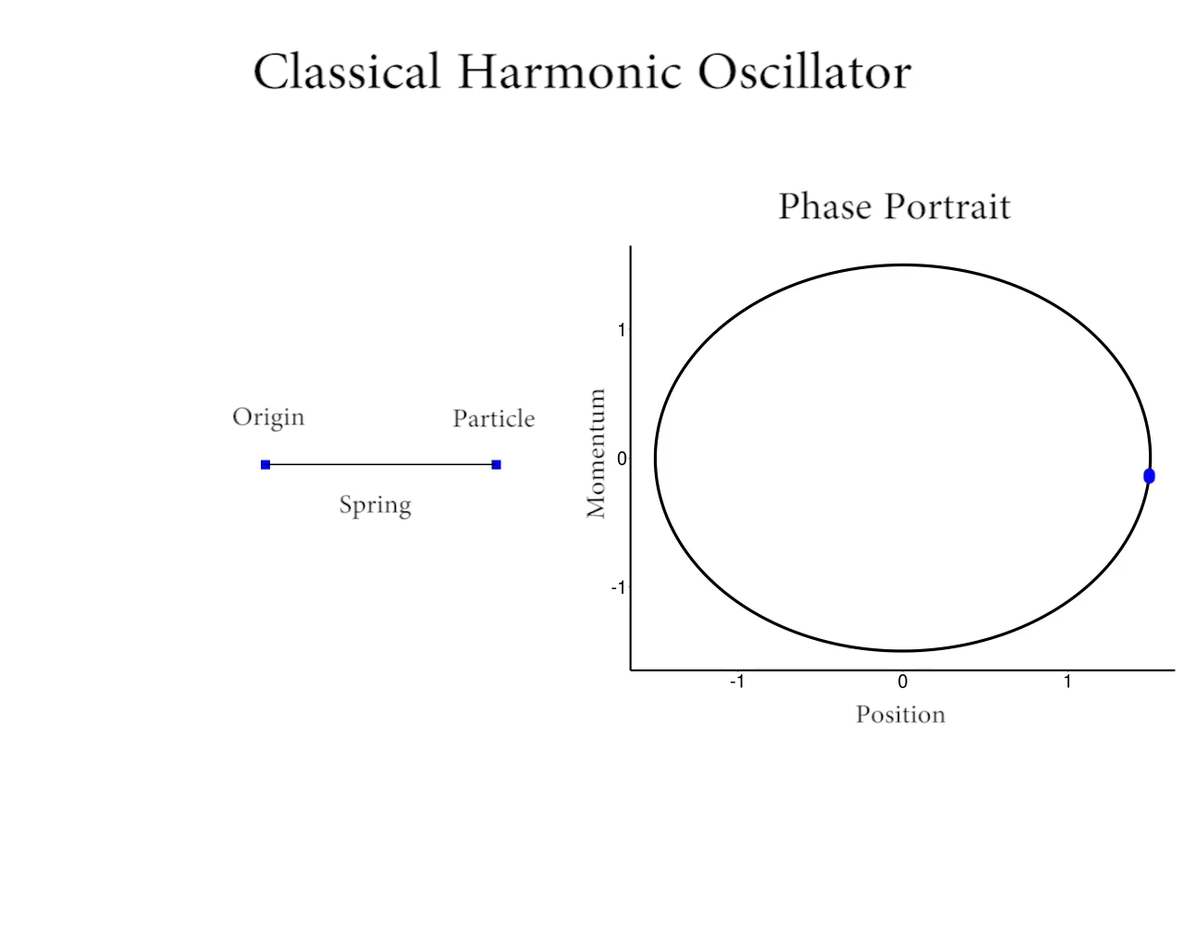
Principle of ARPS
Video
Notes:
I will show you a short video to better illustrate the principle of ARPS.
On the left. The simplest example of a particle system.
A p. is linked by a perfect spring to a fix point in space.
On the right. The phase portrait of the simulation.
It represents momentum (mass time velocity) with respect to position.
During a classic simulation. The interparticle force is computed at each time step.
Even if there is some instant where nothig visually important happen.
Here is the same HO but this time AR. The phase portrait is a bit different.
An ARP can have trhee state. It can be inactive when the velocity is too low.
It corresponds to a R dynamics. It can be trans. and it corresponds to a Tdynamics.
It can active, it corresponds to the classic F dynamics.
During the R. Dynamics, The particle accumulates momenta until a user-define threshold.
Then the particle become transitive. The purpose of this phase is to spent the energy which has been accumulated during the restrained dynamics.
Once it is done, the particle can become active and join back a classic full dynamic.
Time is saved on restrained dynamics, no interparticle force is computed.
Using appropriate thresholds you can obtain a simulation which stay close to the reference simulation.

Slide 7
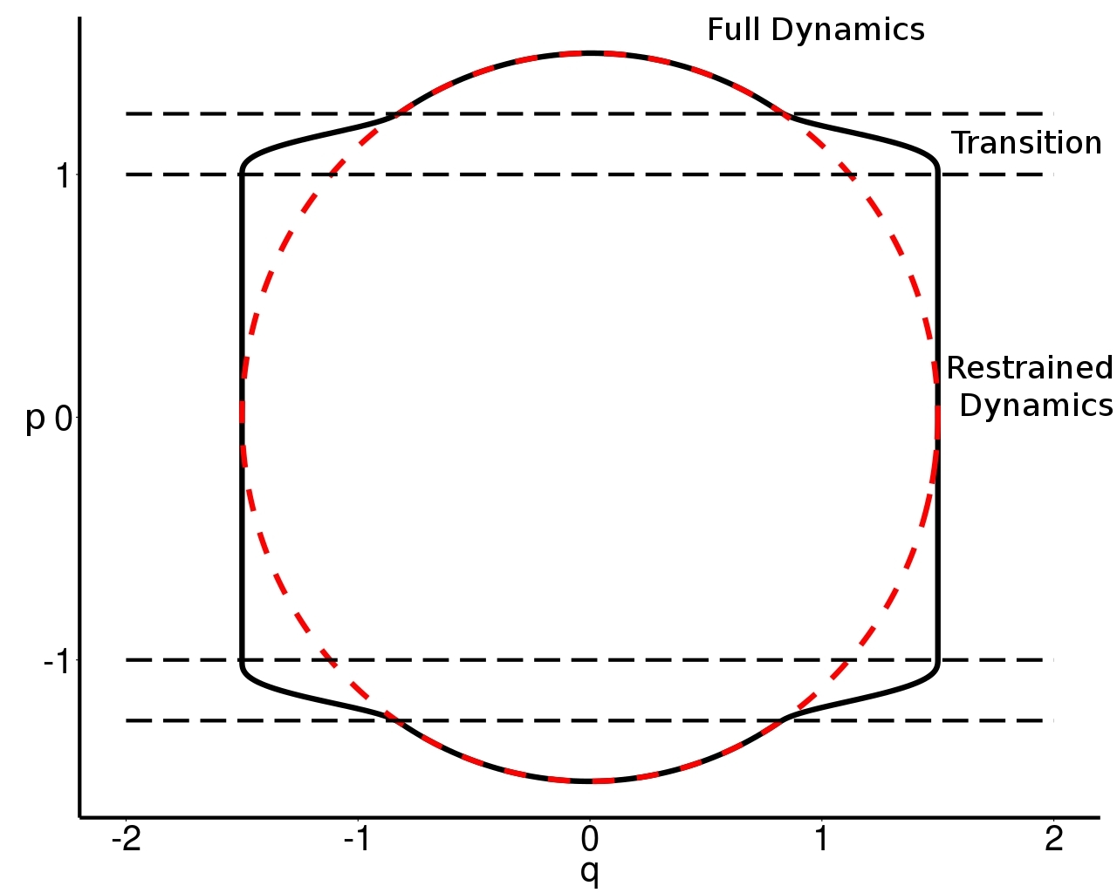
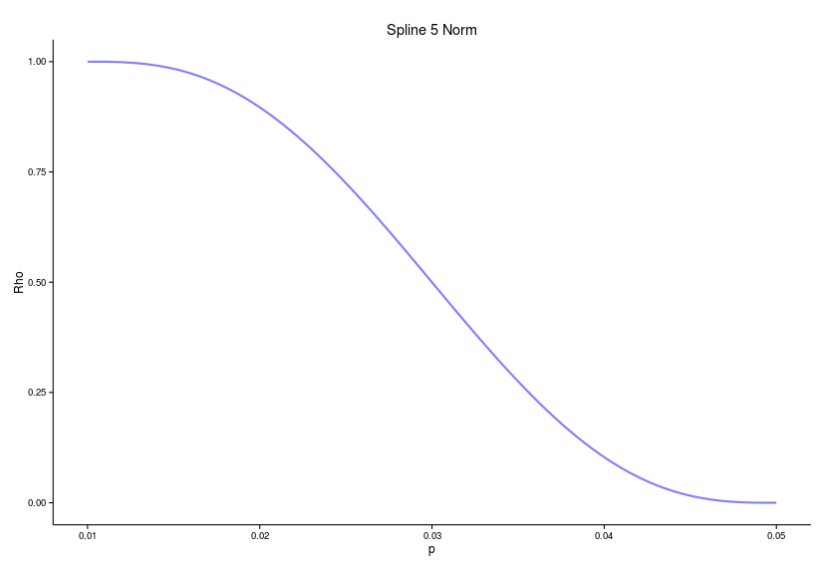



Principle of ARPS
Restraining function
Inactive
Active
Transition
Transition ensures a smooth start/stop of the particle.
Transition size is defined by thresholds.
Thresholds and Restraining function are extremly involved in realism and stability.
Notes:
I will show you a short video to better illustrate the principle of ARPS.
On the left. The simplest example of a particle system.
A p. is linked by a perfect spring to a fix point in space.
On the right. The phase portrait of the simulation.
It represents momentum (mass time velocity) with respect to position.
During a classic simulation. The interparticle force is computed at each time step.
Even if there is some instant where nothig visually important happen.
Here is the same HO but this time AR. The phase portrait is a bit different.
An ARP can have trhee state. It can be inactive when the velocity is too low.
It corresponds to a R dynamics. It can be trans. and it corresponds to a Tdynamics.
It can active, it corresponds to the classic F dynamics.
During the R. Dynamics, The particle accumulates momenta until a user-define threshold.
Then the particle become transitive. The purpose of this phase is to spent the energy which has been accumulated during the restrained dynamics.
Once it is done, the particle can become active and join back a classic full dynamic.
Time is saved on restrained dynamics, no interparticle force is computed.
Using appropriate thresholds you can obtain a simulation which stay close to the reference simulation.

Slide 8
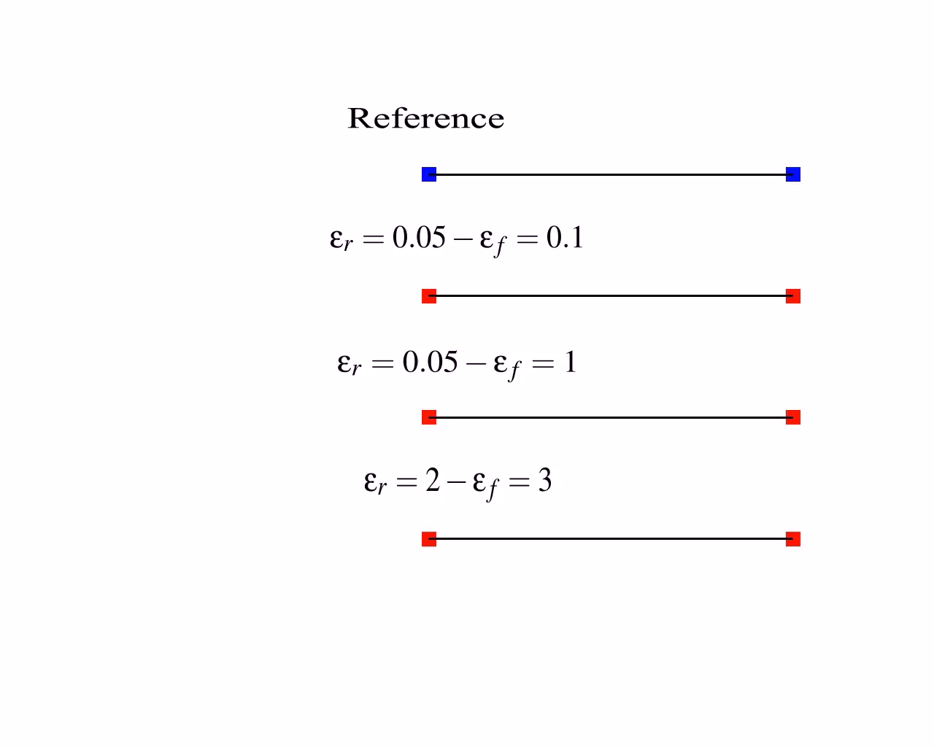
Principle of ARPS
Video
Notes:
I will show you a short video to better illustrate the principle of ARPS.
On the left. The simplest example of a particle system.
A p. is linked by a perfect spring to a fix point in space.
On the right. The phase portrait of the simulation.
It represents momentum (mass time velocity) with respect to position.
During a classic simulation. The interparticle force is computed at each time step.
Even if there is some instant where nothig visually important happen.
Here is the same HO but this time AR. The phase portrait is a bit different.
An ARP can have trhee state. It can be inactive when the velocity is too low.
It corresponds to a R dynamics. It can be trans. and it corresponds to a Tdynamics.
It can active, it corresponds to the classic F dynamics.
During the R. Dynamics, The particle accumulates momenta until a user-define threshold.
Then the particle become transitive. The purpose of this phase is to spent the energy which has been accumulated during the restrained dynamics.
Once it is done, the particle can become active and join back a classic full dynamic.
Time is saved on restrained dynamics, no interparticle force is computed.
Using appropriate thresholds you can obtain a simulation which stay close to the reference simulation.

Slide 9
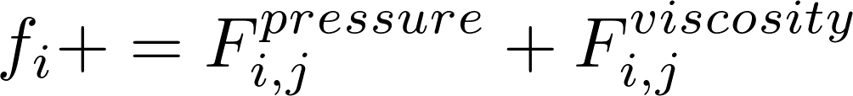
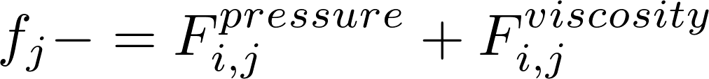
Extension To Particle-Based Fluids
Smoothed Particles Hydrodynamics [Becker&al 2007]
For each particle
Compute neighbors
For each particle i
Scalar fields
For each neighbor j
Compute Density & Pressure
For each particle i
h
For each neighbor j < i
Force fields
For each particle
Integration
Integrate motion equation
Neighbors search is the main bottleneck !
Notes:
Our first contribution is an extension to particle-based fluids.
We chose SPH, smoothed particles hydrodynamics to illustrate it.
SPH interpolates fluid quantities trhough particles.
The classic algorithm is the following.
First compute neighbors for each particle.
Then you have two double loop.
The first one computes scalar fields : density, pressure.
The second one accumulates interparticle forces : pressure, viscosity.
Density and forces are a sum of symetric terms depending on positions.
You only need to compute once the contribution between two particles
And add it to both.
Finally particles are integrated in time and accumulation vector are cleared.
In this algorithm the main bottleneck is the neighbor search.

Slide 10

Extension To Particle-Based Fluids
Inactive
Active & Transitive
For each active particle & neighbor
Subtract old scalar & force contribution
Compute neighbors only for active particles
For each active particle & neighbor
Add new scalar contribution
For each active particle & neighbor
Add new force contribution
For each particle
Integrate ARPS motion equation
Update particle state
New : Scalar fields benefit from ARPS !
All particles still respect Newton's Action/Reaction principle.
Notes:
By adapting ARPS idea to SPH, you can reduce the NS to AP only.
Imagine an active particle with all its neighbors which are inactive.
The new SPH algorithm is the following.
The active particle moved in the previous step.
So interparticle forces with its inactive neighbors changed.
The first step is to retrieve the old contributions (scalar fields & force fields)
from inactive neighbors of the active particle.
Then you perform a neighbor search, but only for active particle.
You have the same double loop as before but restrained to active particles and their neighbors.
These two loops are used to upade active particle quantities and correct inactive neighbors quantities.
Inactive particles still have correct forces.
Finally particles are integrated with adaptively restrained equation of motion.
Their state is updated.

Slide 11
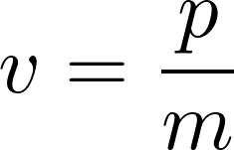
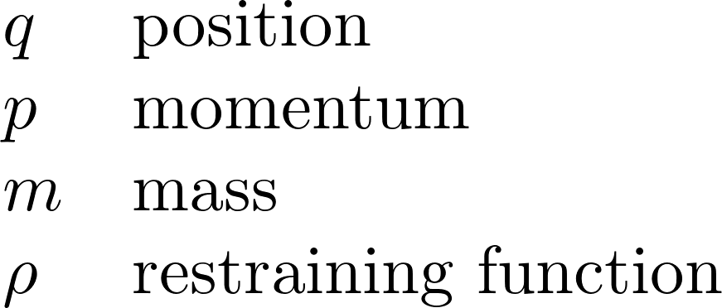
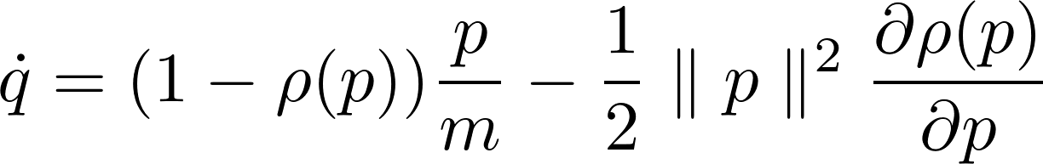
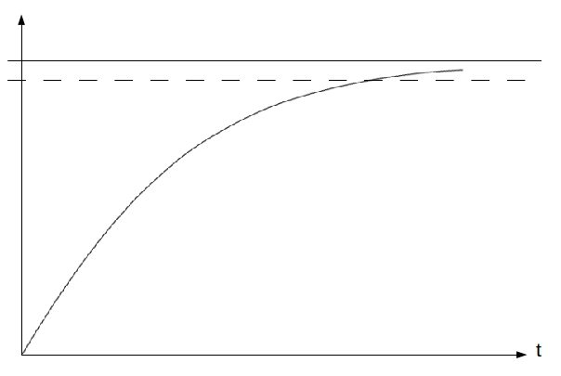
Extension To Particle-Based Fluids
Viscosity forces involve velocity.
Accumulated velocity
Effective
Damped particles asymptotically tends to inactivity.
Inactivity threshold
Additive threshold
Notes:
An important point to outlined.
Viscosity forces not only involve positions but also velocities.
In ARPS there exist two velocities.
The accumulated velocity.
The effective velocity deduced by ARPS equations of motion.
It is the effective velocity which has to be used in viscosity forces, because it is in adequation with the state of the particle whereas accumulated velocity is not.
Unfortunately particles with low velocity will never become inactive if you do not use an additive threshold to make them inactive.
Because viscosity make particle asymptotically tends to inactivity without never reaching it due to numerical precision.

Slide 12
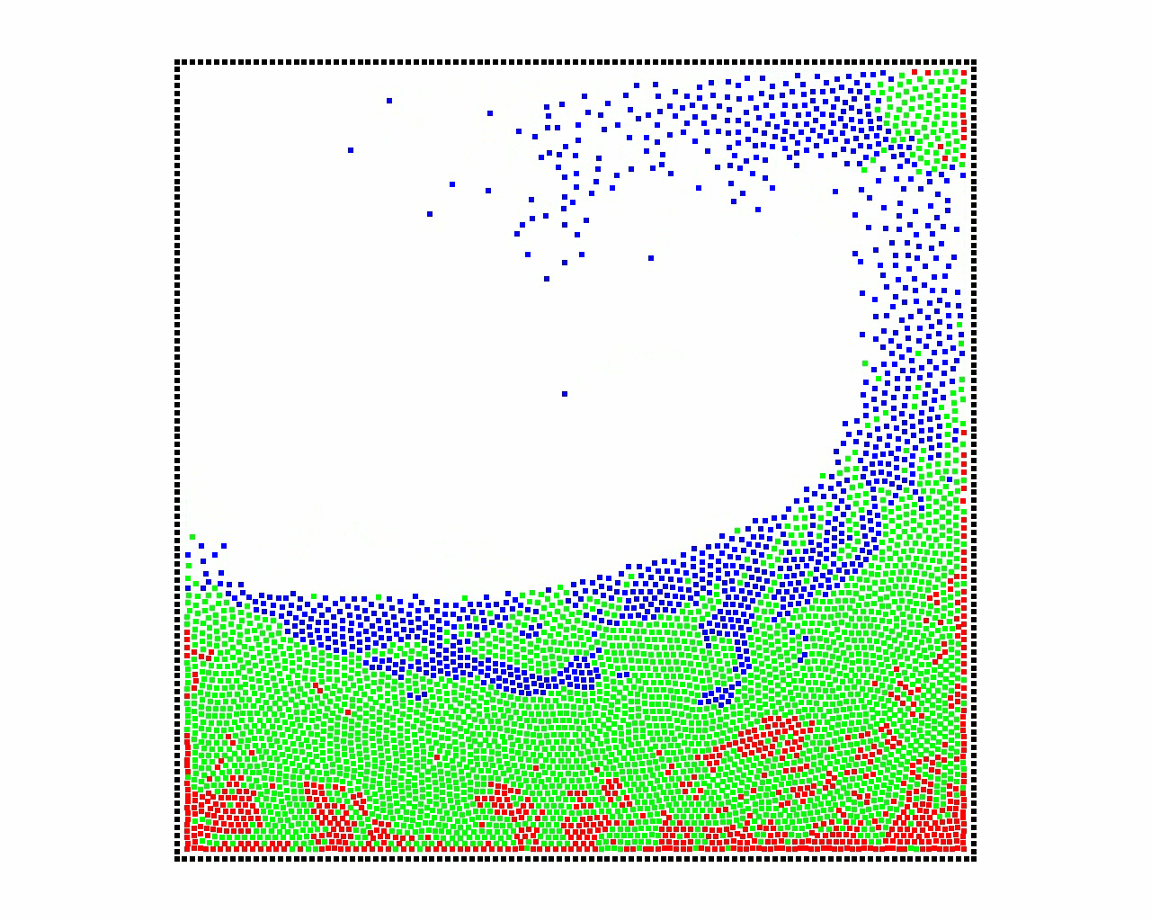
Extension To Particle-Based Fluids
Video
Notes:
Two results.
Left image corresponds to classic SPH simulation at a specific time step.
Middle image is ARPS at the same time step with visualized particle state.
The right image corresponds to the last step.
The first experience is a dam break simulation.
At the beginning of the simulation a little overhead is noticed.
But quickly P. are more and more inactive. Speed up becomes interesting.
Finally when nothing happen the speed up is great.
In the second one a permanent flow is created.
Basically we observe the same phenomena. Overhead, speed-up.

Slide 13
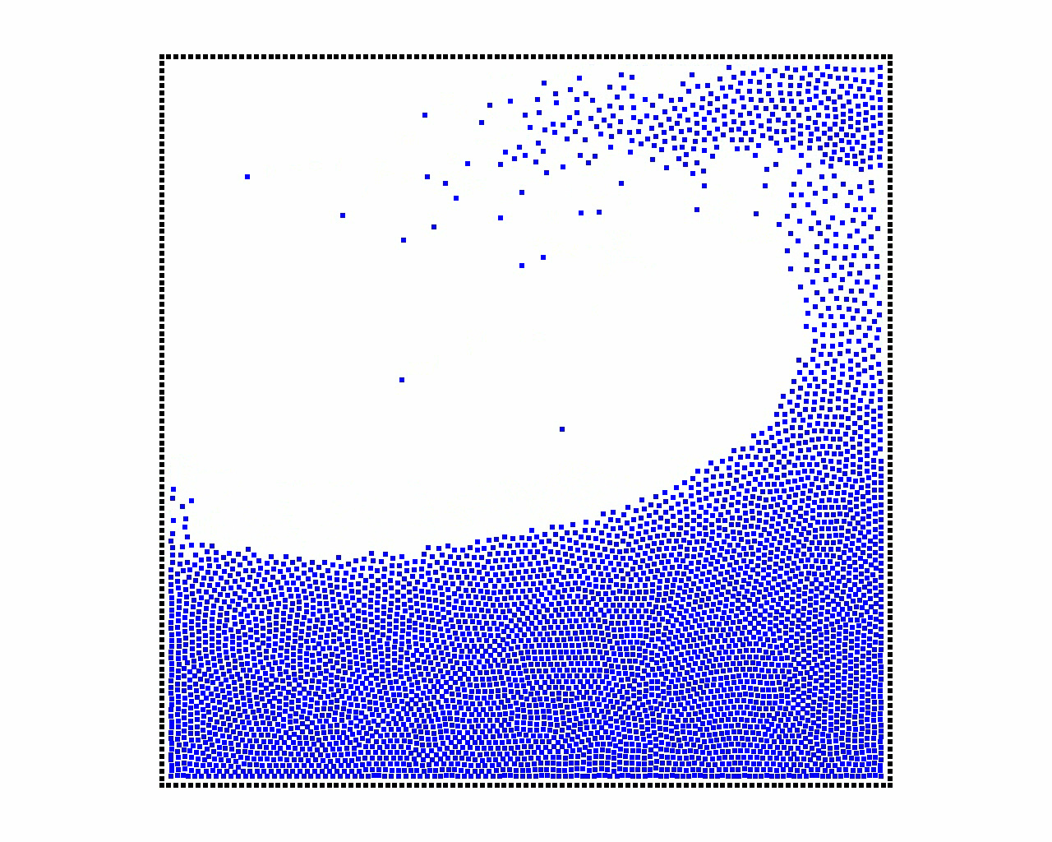
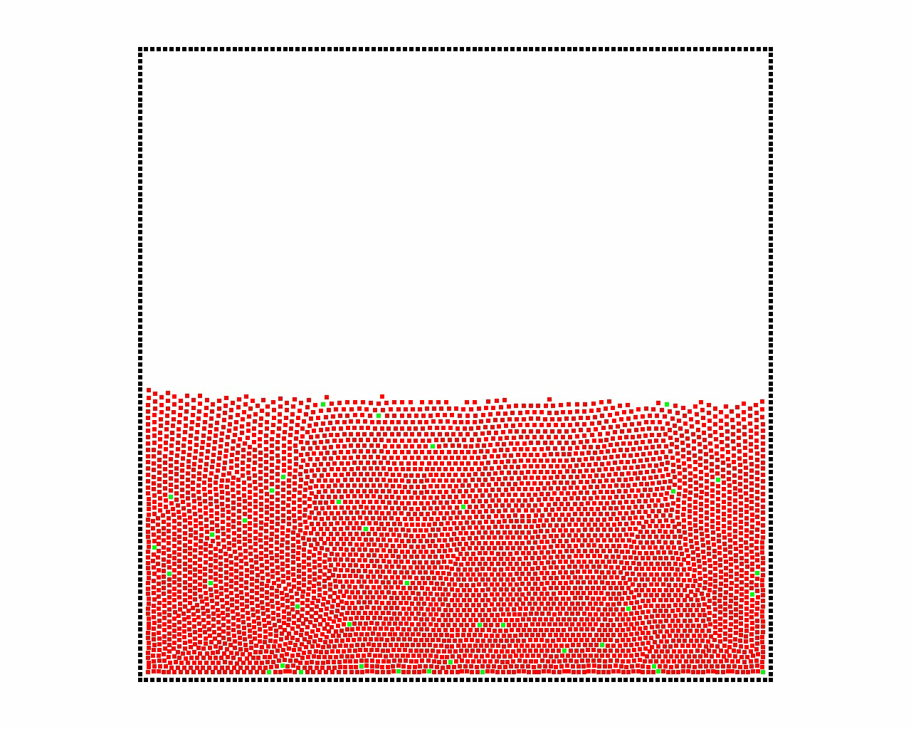
Extension To Particle-Based Fluids
Dam Break
SPH
ARPS
3.85x faster
Features are really well preserved
Notes:
Two results.
Left image corresponds to classic SPH simulation at a specific time step.
Middle image is ARPS at the same time step with visualized particle state.
The right image corresponds to the last step.
The first experience is a dam break simulation.
At the beginning of the simulation a little overhead is noticed.
But quickly P. are more and more inactive. Speed up becomes interesting.
Finally when nothing happen the speed up is great.
In the second one a permanent flow is created.
Basically we observe the same phenomena. Overhead, speed-up.

Slide 14
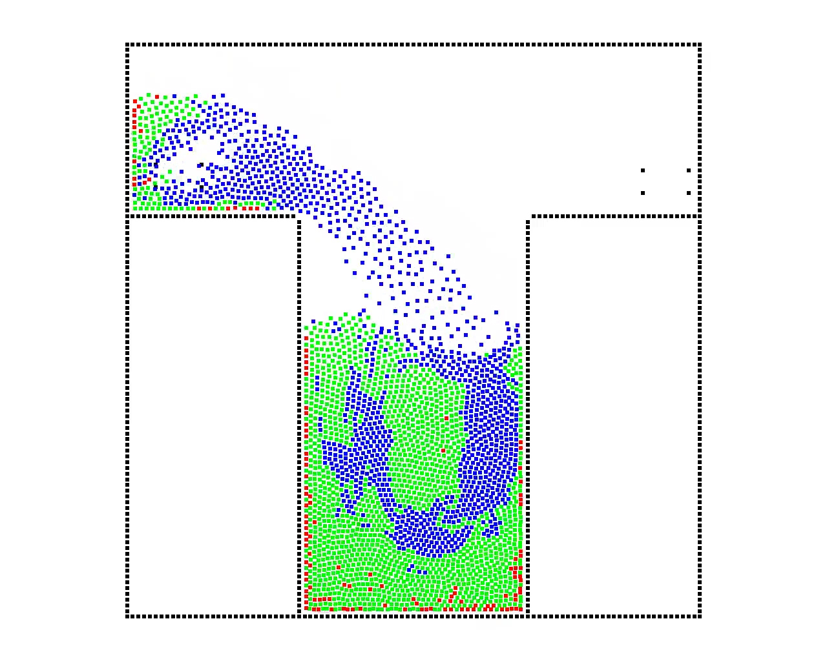
Extension To Particle-Based Fluids
Video
Notes:
Two results.
Left image corresponds to classic SPH simulation at a specific time step.
Middle image is ARPS at the same time step with visualized particle state.
The right image corresponds to the last step.
The first experience is a dam break simulation.
At the beginning of the simulation a little overhead is noticed.
But quickly P. are more and more inactive. Speed up becomes interesting.
Finally when nothing happen the speed up is great.
In the second one a permanent flow is created.
Basically we observe the same phenomena. Overhead, speed-up.

Slide 15
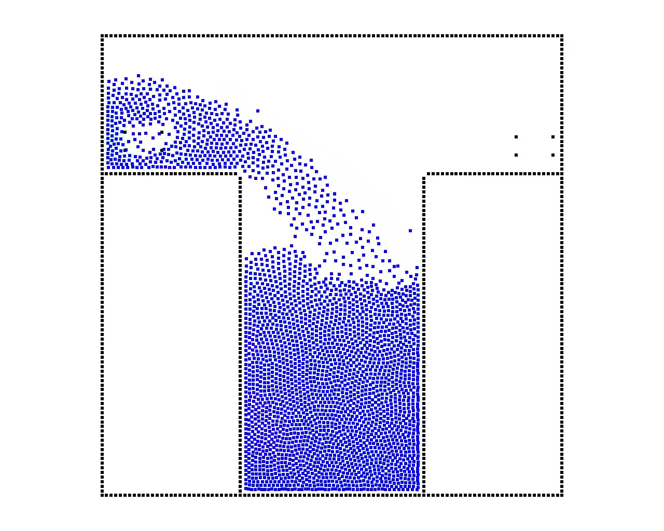
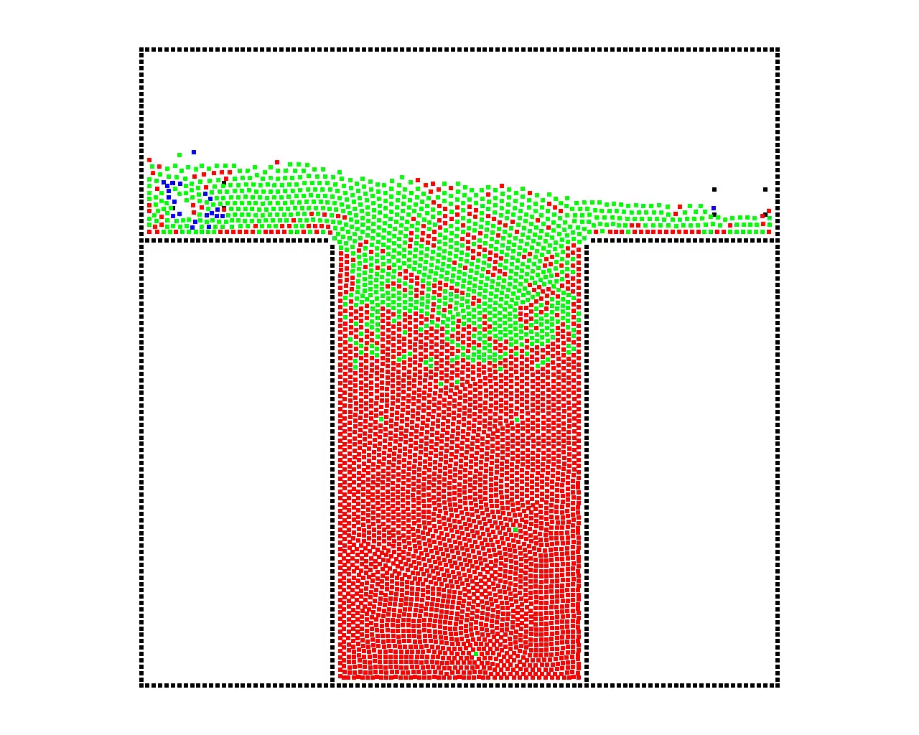
Extension To Particle-Based Fluids
Permanent Flow
SPH
ARPS
2.7x faster
Stop/Start are well handled.
Notes:
Two results.
Left image corresponds to classic SPH simulation at a specific time step.
Middle image is ARPS at the same time step with visualized particle state.
The right image corresponds to the last step.
The first experience is a dam break simulation.
At the beginning of the simulation a little overhead is noticed.
But quickly P. are more and more inactive. Speed up becomes interesting.
Finally when nothing happen the speed up is great.
In the second one a permanent flow is created.
Basically we observe the same phenomena. Overhead, speed-up.

Slide 16
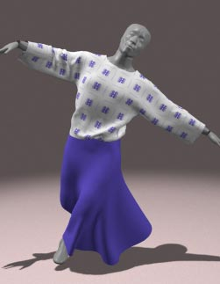
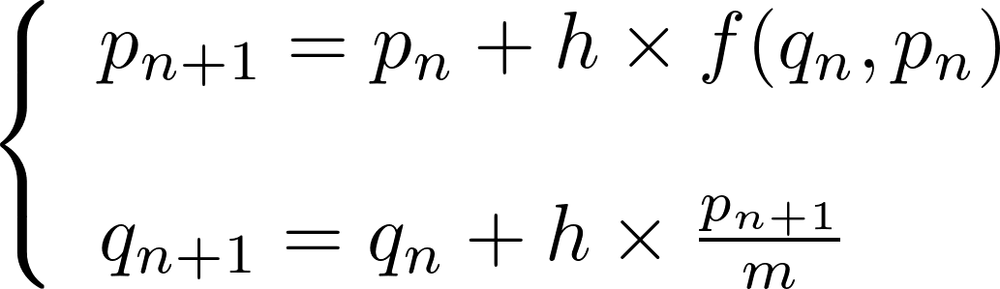
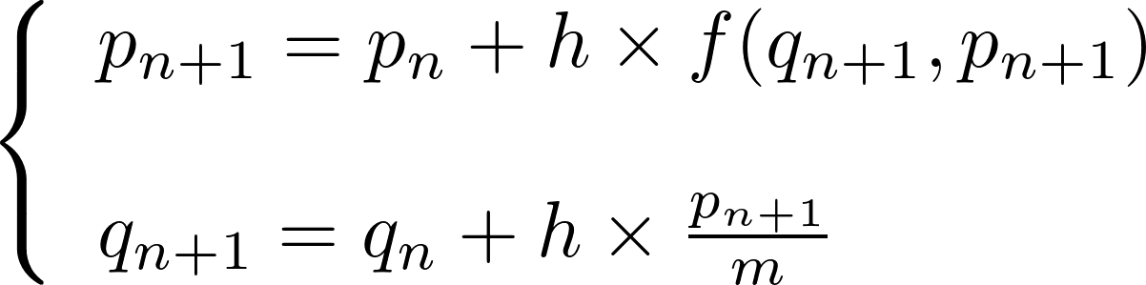
Extension to cloth simulation
Implicit Integration
Explicit integration can be a bottleneck due to stiff equations.
Explicit integration
Implicit integration
Very small time steps
Large time steps
Taylor -Young
Linear System
[Baraff&Witkin 1998]
Idea : Reduce the size of the linear system with ARPS.
Notes:
Our second contribution. An extension to implicit integration.
For structured objects, the bottleneck can be explicit integration.
Because due to stiff equations very small time steps are necessary.
A classic solution, proposed by Baraff&witkin is to use implicit integration.
Instead of using current F. in the discretization of EoM.
Next step forces are used.
Using a TY Development you end up with an expensive LS to solve
but it allow you to use large time steps, this is much better.
Our idea is to use ARPS to reduce the size of the linear system.

Slide 17






Extension to cloth simulation
Implicit Integration
Encapsulate transition and particle state
All Inactive
Explicit
All Active
Implicit
Notes:
To do that, we start with ARPS equations of motion.
We use an implicit discretization, apply a TY dev.
And end up with a different linear system to solve.
There are two new terms : matrix R and vector s which handle the particle state.
When all particle are inactive : R and s are zero and we are back to explicit integration.
When all particles are active : R is identity and s is momenta and we are back to classic implicit integration.

Slide 18
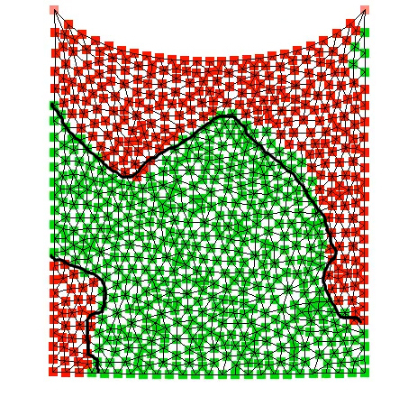
Extension to cloth simulation
Implicit Integration
Video
Notes:
School case !!!! During a simulation, some parts of the object will be inactive and explicitly integrated whereas active parts will be implicitly integrated.
Thanks to that, the size of the linear system can be reduced to the number of active particles and their neighbors, and speed up can be obtained.
For now the only example we have is a hanging cloth.

Slide 19
Extension to cloth simulation
Implicit Integration
Explicitly Integration
2.7x faster
The linear system can be greatly reduced.
Implicit Integration
Notes:
School case !!!! During a simulation, some parts of the object will be inactive and explicitly integrated whereas active parts will be implicitly integrated.
Thanks to that, the size of the linear system can be reduced to the number of active particles and their neighbors, and speed up can be obtained.
For now the only example we have is a hanging cloth.

Slide 20
Conclusion
Contribution : Coherent approximation of particle simulation in Computer Graphics.
Extension to Particle-based fluids
SPH algorithm
Viscosity handling
Extension to Cloth Simulation
Implicit integrator
Hybrid solver
Both results in interesting speed-ups
Limitation Instabilities due to restraining function second derivatives.
Future Work
Visual transition criteria can be used (e.g distance to camera).
Notes:
This talk is over.
I just remind our two contribution and possible future work.
The first thing to do would be to carefuly study the restraining function to solve stability issues.
More exciting future works, would be to employ non physically based transition ( distance to camera, visibility)
And finally find a way to couple ARPS with rigid motion. Where inactive particles sets would be restrained to rigid body motions.

Slide 21
Thank you !
SPH
SPH + ARPS
Notes:
I thank you for your attention and I am ready for questions.
===== SLIDE ====
ARPS has originally been proposed by A&R
in the context of Molecular Dynamics.
The key idea of their work is that :
Slow particles are considered fixed.
Almost no computation is needed for them.
But these restrained particles still accumulate
momenta.
So they can start moving again by themselves.
I will show you a short video to illustrate this idea.
And then I will give motivations for extending it to CG.
==== VIDEO ====
On the left.
The simplest example of a particle system.
A p. is linked by a perfect spring to a fix point in space.
On the right.
The phase portrait of the simulation.
It represents momentum (mass time velocity)
with respect to position.
During a classic simulation.
The interparticle force is computed at each time step.
Even if there is some instant where nothig
visually important happen.
Here is the same HO but this time AR.
The phase portrait is a bit different.
An ARP can have trhee state.
It can be inactive when the velocity is too low.
It corresponds to a R dynamics.
It can be trans. and it corresponds to a Tdynamics.
It can active, it corresponds to the classic F dynamics.
During the R. Dynamics,
The particle accumulates momenta until a user-define threshold.
Then the particle become transitive. The purpose of this phase is to spent the energy which has been accumulated during the restrained dynamics.
Once it is done, the particle can become active and join back a classic full dynamic.
Time is saved on restrained dynamics, no interparticle force is computed.
Using appropriate thresholds you can obtain a simulation which stay close to the reference simulation.

Slide 22
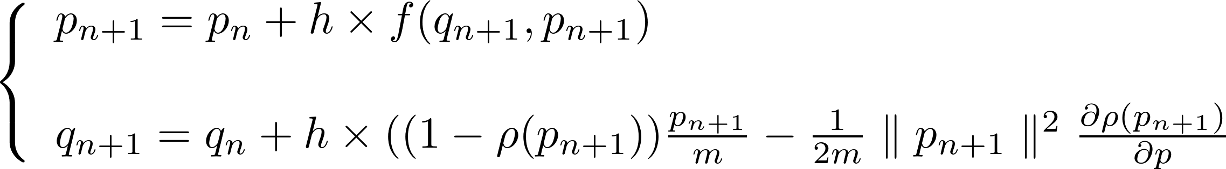
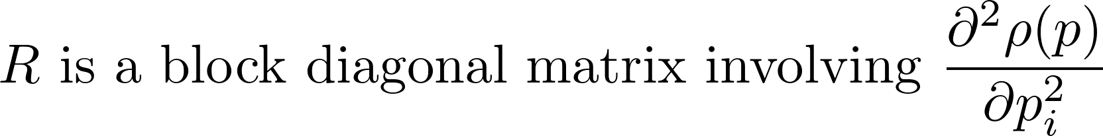
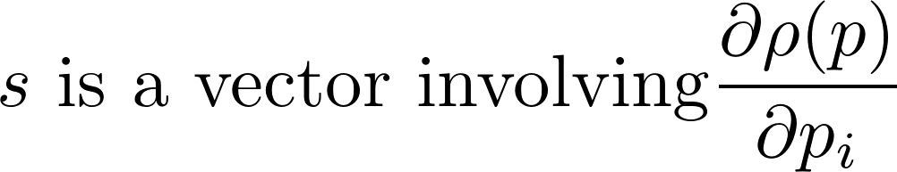
Extension to implicit integration
All Inactive
Explicit
All Active
Implicit
Notes:
To do that, we start with ARPS equations of motion.
We use an implicit discretization, apply a TY dev.
And end up with a different linear system to solve.
There are two new terms : matrix R and vector s which handle the particle state.
When all particle are inactive : R and s are zero and we are back to explicit integration.
When all particles are active : R is identity and s is momenta and we are back to classic implicit integration.

Slide 23
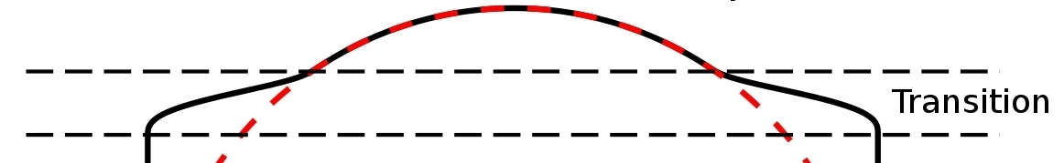

Limitation
Severe stability issues during transition due to restraining function second derivatives.
Momenta
Notes:
This is not great and it brings me to the main limitation of our work.
Particle state is dictated by velocity and a restraining function which ensure transition between the state.
In the linear system we built, the transition is encapsulated in the matrix R and the vector s and it involves second derivatives of the restraining function.
These second derivatives are very important and if the transition is not well taken by particle, instability occurs very easily.

Slide 24
Extension To Particle-Based Fluids
Inactive
Active & Transitive
Boring but efficient
Same complexity
Gain
Overhead

