Slide 1




Interactive detailed cutting of thin sheets
Pierre-Luc Manteaux¹ Wei-Lun Sun²
François Faure¹ Marie-Paule Cani¹ James F. O'Brien²
¹University Grenoble-Alpes, CNRS (LJK) and Inria
²University of California, Berkeley
Notes:
Hi everyone, my name is Pierre-Luc Manteaux, I am a PhD student from LJK in Grenoble in the team IMAGINE. I am going to talk about a work I did with Wei-Lun Sun, François Faure, Marie-Paule Cani and James F. O’Brien, which is about the detailed and interactive cutting of thin sheets. Thin sheets are deformable objects such as paper or cloth. Before talking about these objects, I will say a few words about interaction and details.

Slide 2
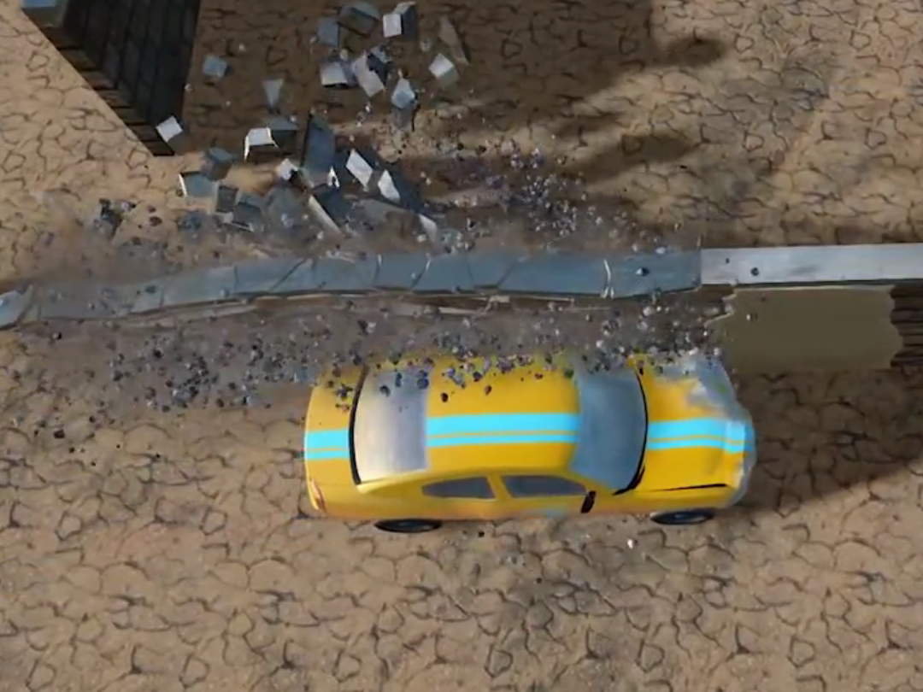
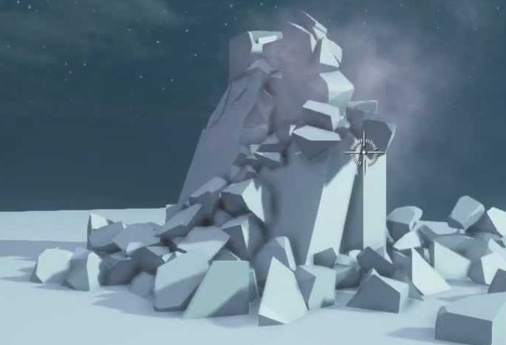
Motivations
Realistic interaction = immersion
@copyright, havok
@copyright, unreal engine 4
Notes:
Here are two examples where virtual objects behave realistically and undergo strong changes of shapes. These changes greatly enhance the user immersion into the virtual environment by pushing forward the possibilities of interactions.
Unfortunately, in practice, these changes are limited: geometry are quite simple, destroyed elements look similar to each other. More important, the user cannot precisely interact with the shape of these objects.

Slide 3
Challenges
Details are expensive
@copyright, havok
@copyright, unreal engine 4
Details = f(degrees of freedom)
Notes:
This restriction comes from the computational cost of the physical system used to simulate the behavior of these objects.
The problem is that, in existing systems, there is a strong relationship between the desired level of geometric details and the required number of degrees of freedom used to depict the objects in the physical system. Basically, the more you want details, the more you need degrees of freedom.
In this context, detailed and interactive topological changes remain a challenge, especially in video games where the amount of resources is limited and cannot undergo large variation.
Today, there are mainly two ways to reduce the dependence between level of details and number of DoF.

Slide 4
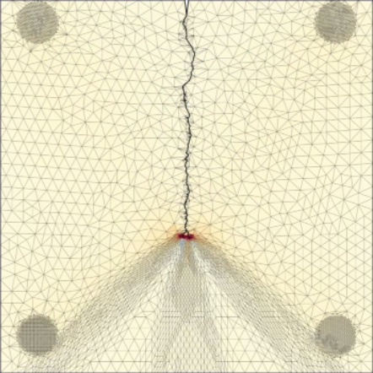
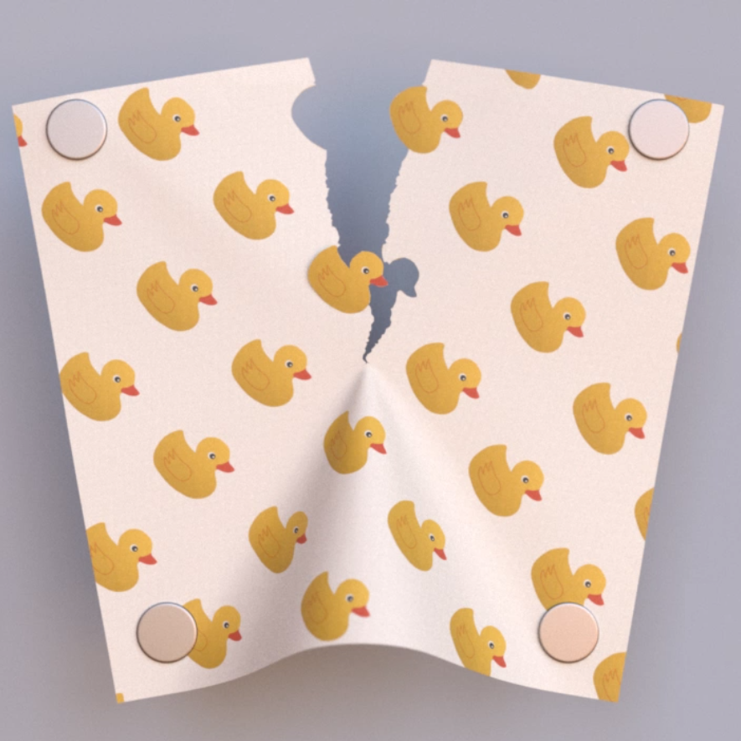
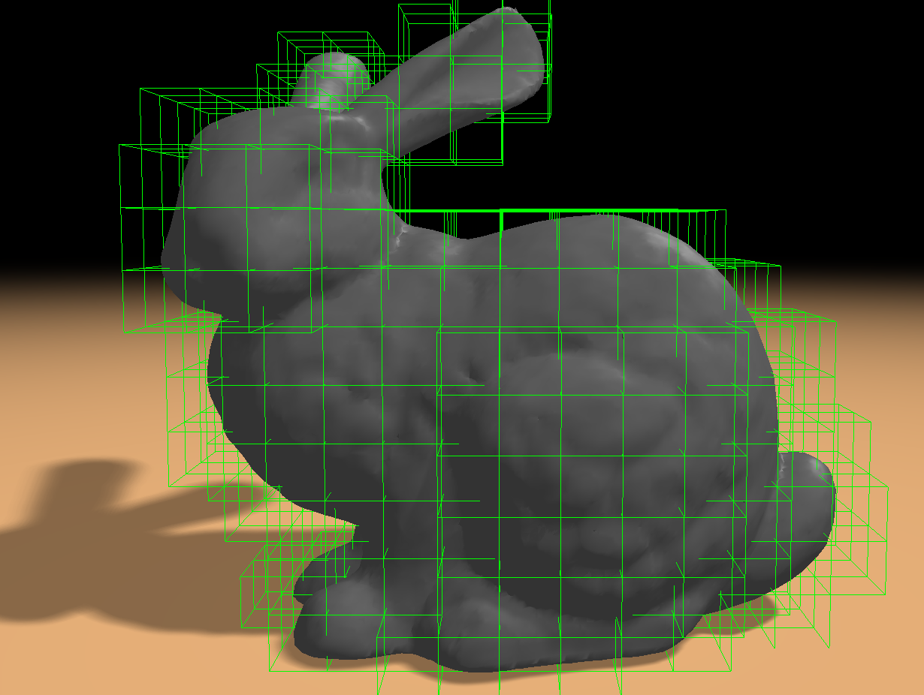
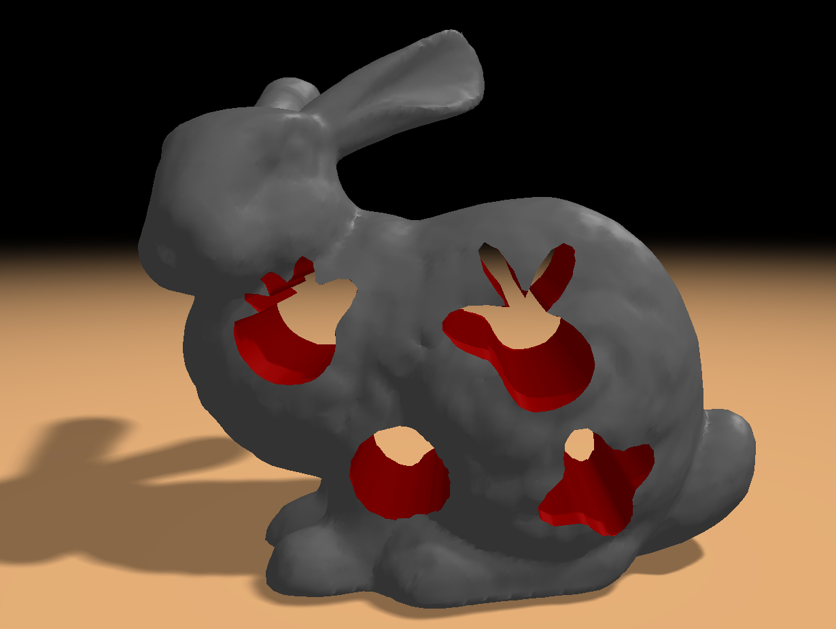
Related work : Topological changes
Visual = Physical
Embedding
[Pfaff et al. 2014], 3010 DoF
[Wu et al. 2011], 4485 DoF
Geometric details
Physical accuracy
High number of DoF
Notes:
The first method is to use the same model for both visualization and simulation. And to use, remeshing operations in order to control the number of DoF and concentrate them where details will appear. For instance, on the left image, you can observe a sheet of paper being torn and many geometric details appear along the fracture where degrees of freedom have been resampled.
The second method is to use two distinct models: One for visualization, one for simulation and to embed the visual model into the physical one. Thus the two models can have different natures and resolutions. For instance, on the right image, the visual model is a very detailed triangular mesh of a bunny. The physical model is a much coarser hexahedral finite element grid in green. This combination allows to reduce the number of DoF while performing detailed cutting.
These two approaches produce stunning results. But, in both cases, the number of degrees of freedom still vary too much with respect to the number of cuts and their details. Once again because the relationship between geometric details, simulation quality and number of DoF is very strong.

Slide 5
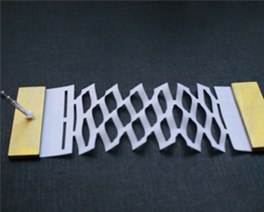
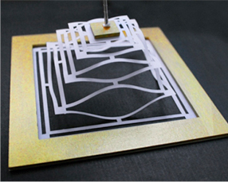
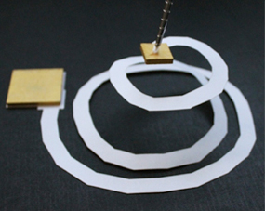
Objectives
@copyright, nature
@copyright, nature
@copyright, nature
Details = f(degrees of freedom)
Notes:
Our objective is to reduce as much as possible this dependence.
In this work, we focused on the detailed cutting of thin deformable objects while using a vey low number of DoF. These three images are Kirigami, paper with detailed cuts from where complex behavior can emerge. We used them to illustrate our method.

Slide 6
Notes:
Before going further, here is a video of what we want to do. We progressively cut a spiral in a thin sheet which is simulated with only 5 deformable frames, so 60 DoF. The mesh used for visualization is made of 2000 vertices, 6000 DoF for a FEM simulation.

Slide 7
Contents
I. Frame-based model
II. Cut pipeline
III. Contributions
IV. Results
Notes:
In the following, I will first introduce the frame-based deformable model on which our work is based. Then I will speak about the cut pipeline and our contributions in this pipeline. Finally, I will present some results.

Slide 8
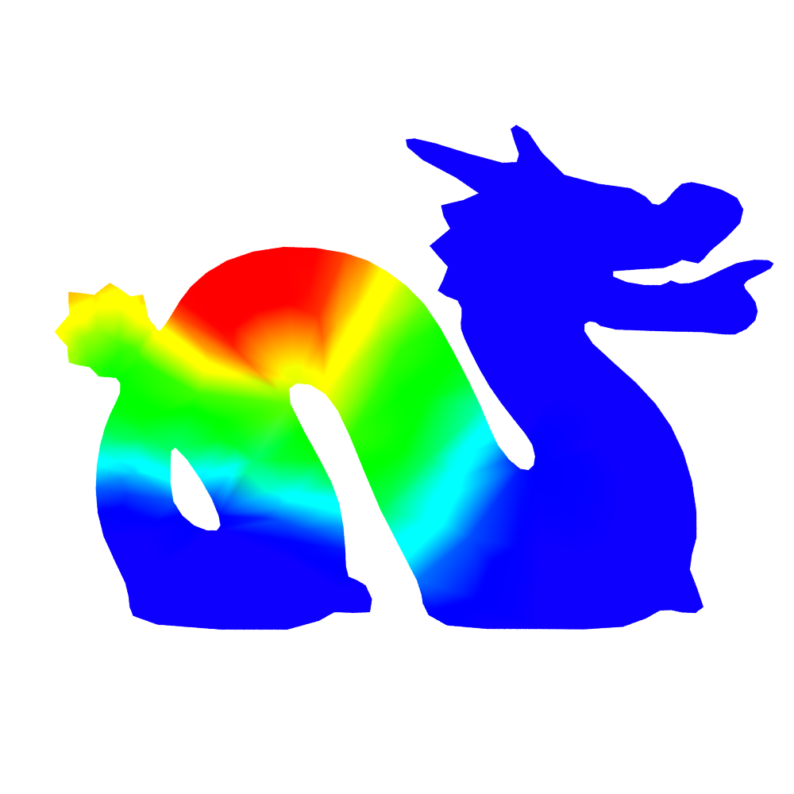

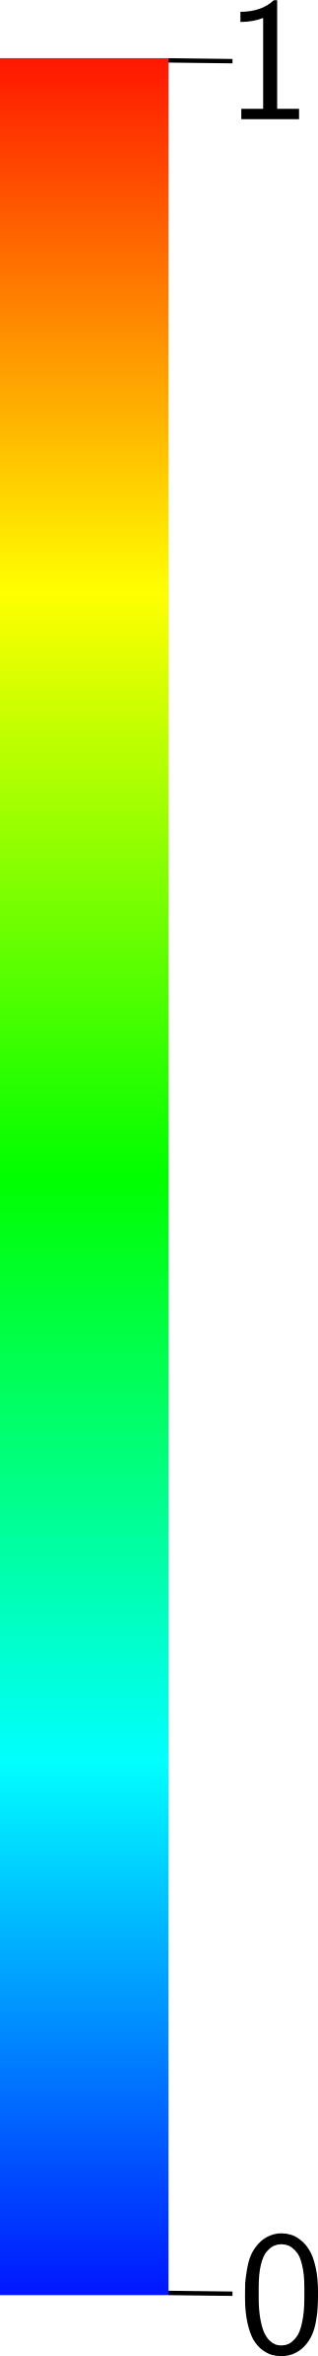
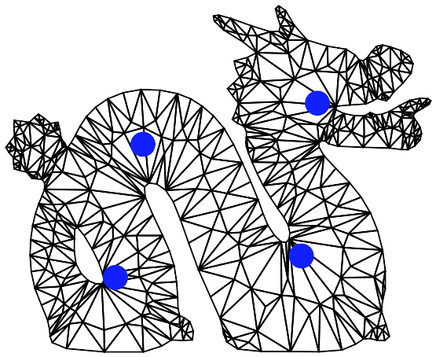

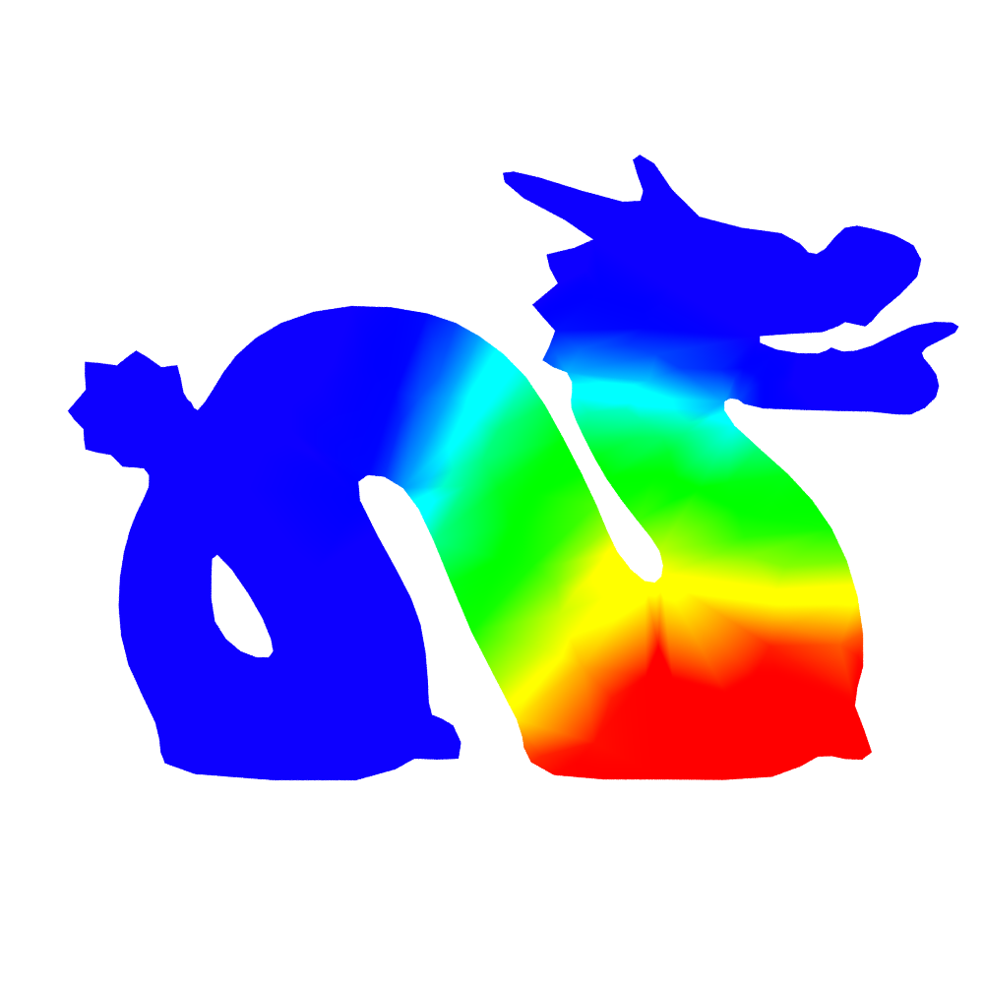
I. Frame-based model
[Gilles et al. 2011, Faure et al. 2012]
Global shape functions
Very few DoF
Notes:
The frame-based deformable model was proposed by Gilles in 2011.
It allows to simulate complex deformable objects with only a very few number of DoF.
The key idea is that each deformable frame has a large region of influence, also called shape function.
On the left, a model sampled with deformable frames (in blue), and on the right the corresponding regions of influence.
They decrease with respect to geodesic distance.

Slide 9
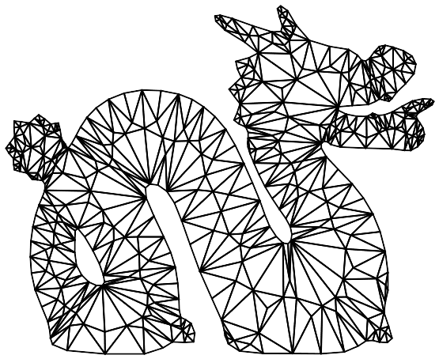
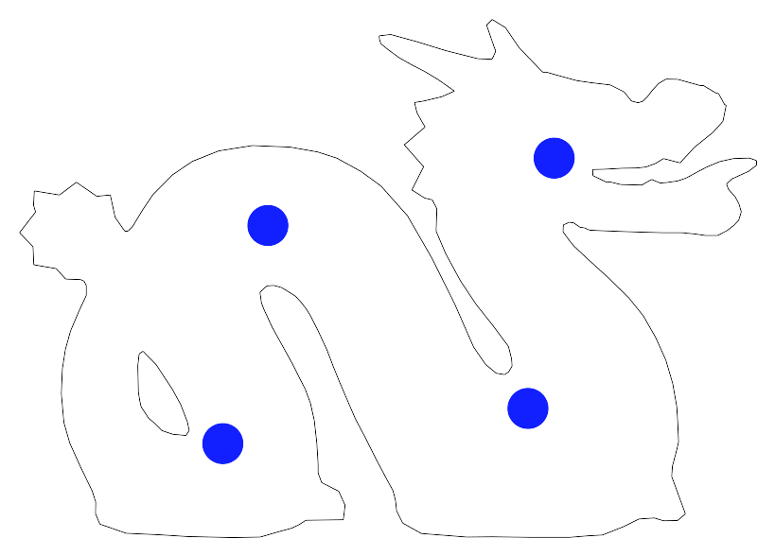
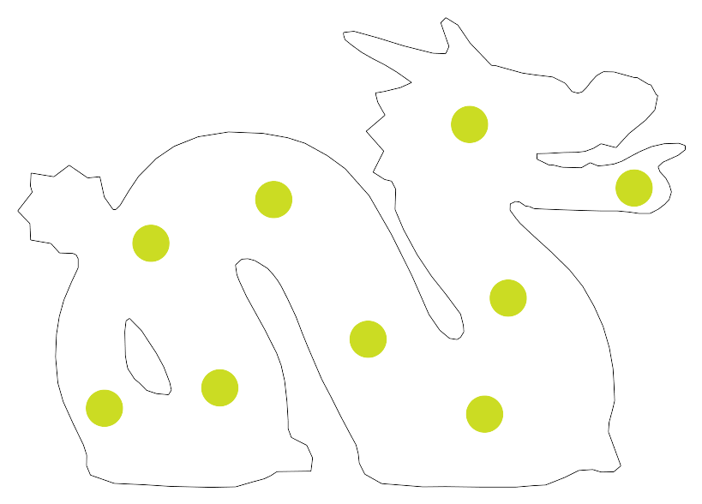
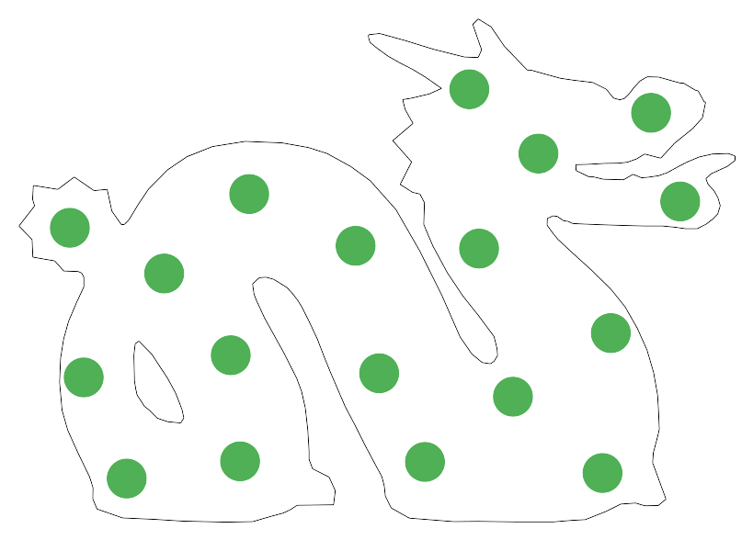
I. Frame-based model
[Gilles et al. 2011, Faure et al. 2012]
Visualization
Linear Blend Skinning
Deformation
Dynamics
Collision
Notes:
Once the model has been sampled and shape functions have been computed.
All the dynamics, from classical mechanics, is computed on the frames.
And an interpolation method, here the linear blend skinning, with the shape functions as skinning weights is used to embed several layers.
A first layer, the visual (a mesh) will follow the motion of the frames.
A second layer, compute the deformation of the physical model and transfer back internal forces to the frames in order to solve the dynamics.
This layer is made of a uniform sampling of integration points.
A final layer, which handles collision and transfer back external forces to the frame.
The main idea is that each of these layer can have different nature and resolutions.
The visual layer is a fine mesh. The deformation and collision layer are made of a uniform sampling of points.
A great deal of trade offs is made possible.
The only missing ingredient is the handling of topological changes such as we conserve the advantages of the model.

Slide 10
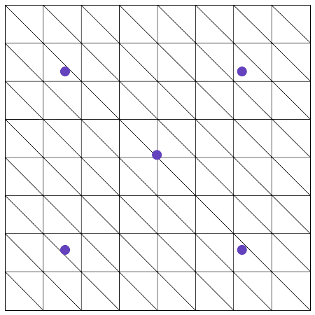
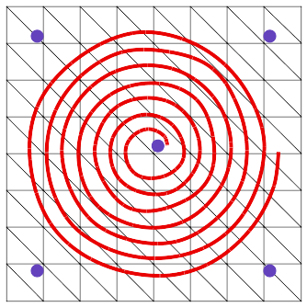
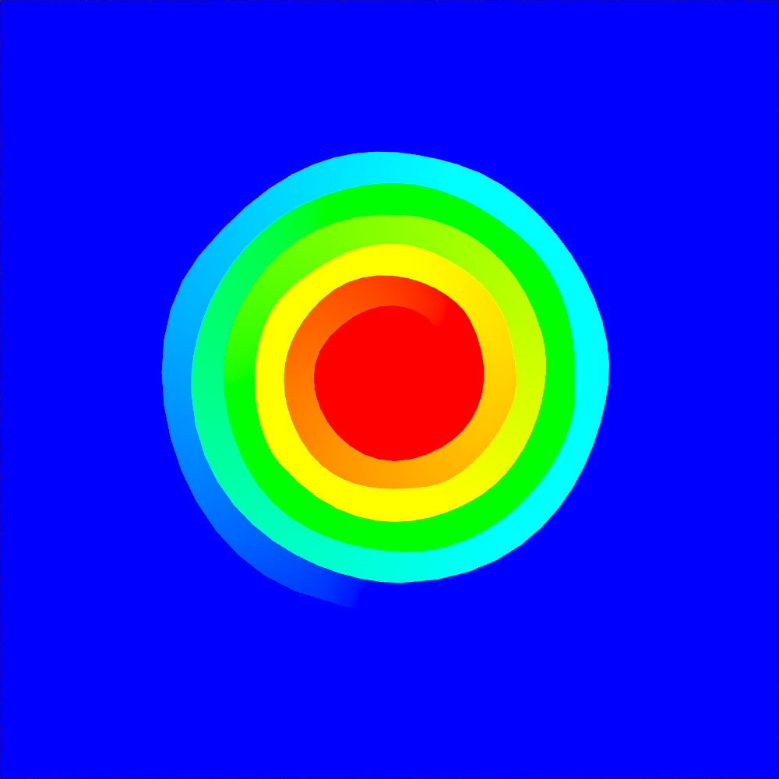
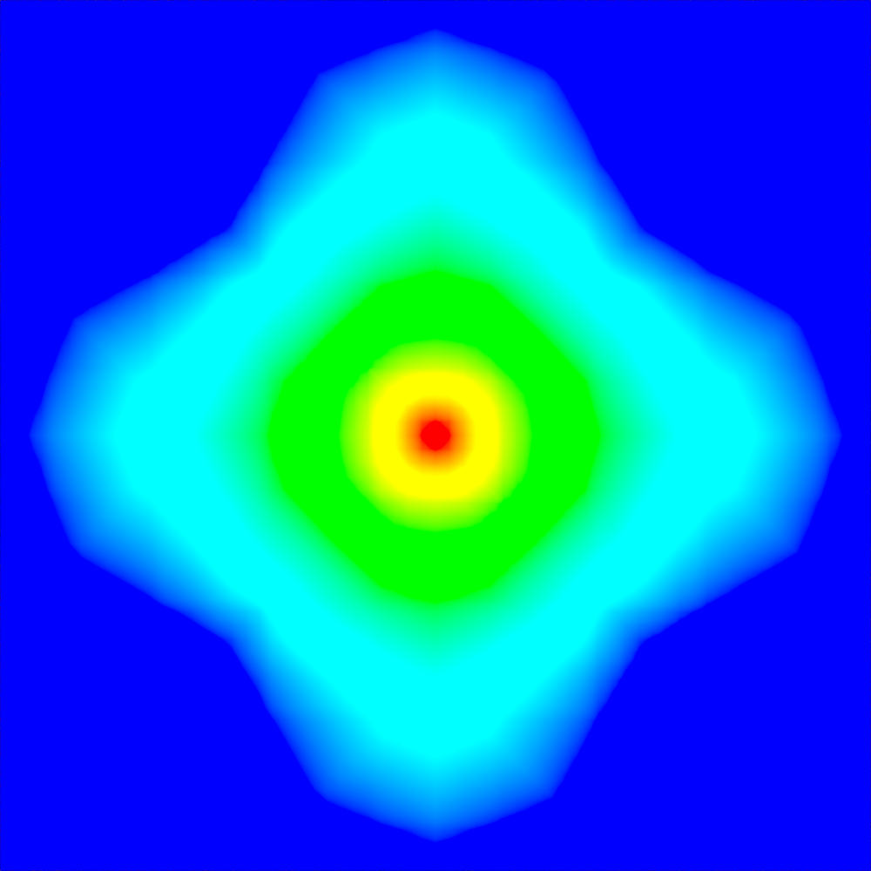
II. Cut pipeline
Shape functions
update
Re-meshing
Notes:
Here comes the cut pipeline we propose.
We start from a mesh embedded into a frame-based simulation.
The user can apply cuts on the visual layer which is updated by remeshing.
Then shape functions are updated so that they take into account the topological changes into the dynamics.

Slide 11
II. Cut pipeline
Notes:
Here is a video that illustrates our pipeline.
On the left, a mesh sampled with 5 frames (blue circles).
On the right, the shape functions for each of the frame.
We progressively cut a spiral and dynamically update the shape functions to take into account the new topology.
Thus, a visual model with detailed cuts can be simulated with a very few number of DOF.

Slide 12
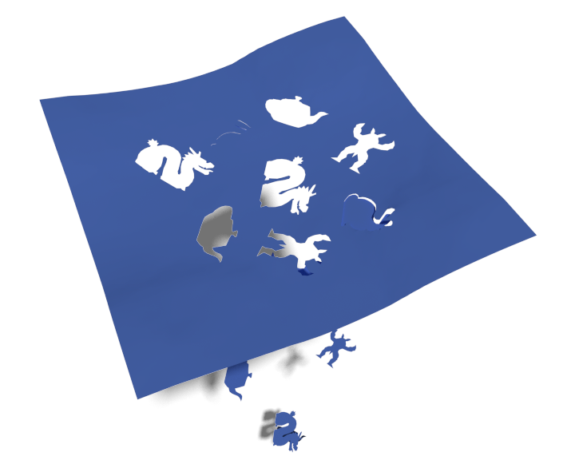
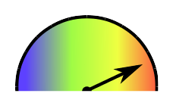
III. Contributions
Detailed cuts, very few DoF
A. Shape functions update
B. Frames re-sampling
C. Incremental update
Notes:
I am done with the general overview of this work. Now some details.
The objective is to simulate detailed geometric cutting with very few frames.
For that, we need to update the shape functions to represent the mesh topology into the dynamics.
We also need a re-sampling strategy to handle cases where parts are being completely cut.
Finally, we propose an incremental update of the simulation data in order to save computational time.

Slide 13
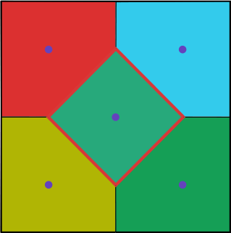

A. Shape functions update
Discrete Voronoi
(Dijkstra)
0
0
Interpolation
0.5
1
0.5
0.5
0.5
0
0
Grid connectivity update
Correct geodesic distances
Notes:
Let's start with the shape functions.
They are computed on grid which embeds the visual model.
A discrete voronoi is computed from the positions of the frames.
Then for each frame, we build a function whose value is 1 at the position of the frame, 0 at its voronoi neighbors and 0.5 on the voronoi border.
This gives us a function that linearly decrease with respect to geodesic distance.
Once the visual model has been cut, we transfer the topological changes onto the grid by changing its connectivity so that geodesic distances are correctly computed when updating shape functions.
To store the grid connectivity, we used a non-manifold grid.

Slide 14
A. Shape functions update
Non-manifold grid: Cells with independent connectivity are duplicated.
Classical connectivity
8 neighbors
Notes:
Simply put, a non-manifold grid is just a grid where cells can store independant connectivities.
You can see these cells as if they were duplicated as many times as they have connectivities.
I will try to illustrate this idea.
Let's say we start from a grid with a 8 neighbor connectivity.

Slide 15

A. Shape functions update
Non-manifold grid: Cells with independent connectivity are duplicated.
Classical connectivity
8 neighbors
Two duplicates
5 neighbors each
Notes:
If a cut goes through a cell. We want to store the connectivity of both sides. In this case, the cell will be duplicated. Each duplicates will have its own connectivity, here 5 neighbors.

Slide 16

A. Shape functions update
Non-manifold grid: Cells with independent connectivity are duplicated.
Classical connectivity
8 neighbors
Two duplicates
5 neighbors each
Four duplicates
8 and 0 neighbors
Notes:
If, inside the same cell, several parts have been cut.
In this example, there are 4 duplicates, 3 with no neighbors and 1 with 8 neighbors.

Slide 17
A. Shape functions update
Non-manifold grid: Cells with independent connectivity are duplicated.
Classical connectivity
8 neighbors
Two duplicates
5 neighbors each
Four duplicates
8 and 0 neighbors
Cuts complexity and grid resolution are independent.
Disconnected components are easy to handle.
Notes:
Why do we use this structure to represent the topology ?
The main advantage is that it allows to decouple as much as possible the grid resolution from the geometrical complexity of the cuts.
On this slide, the best example is the one where several debris are in the same cell. No matter how small they are or how detailed their contour are, they can be taken into account into a low resolution grid.

Slide 18




A. Shape functions update
Step 1: Embed the mesh into a uniform grid
Step 2: For each cell
Detect elements that
overlap with the cell
Detect disconnected components
Create duplicates
Build the connectivity of
the duplicates
Notes:
To build this grid.
We start from a mesh embedded into a uniform grid.
Then for each cell of the grid, we start by detecting elements that overlap the cell. Then, among these elements, we detect disconnected components.For each of them, we duplicate the cell.
Finally, for each duplicate, we determine its connectivity from the neighborhood of the elements which composed the duplicate.

Slide 19
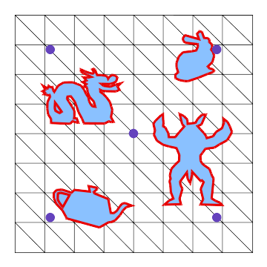
B. Frames re-sampling
Detect empty regions – Flood fill algorithm
Uniform sampling – Lloyd relaxation
Popping reduction – Frame’s orientation/velocity interpolation
Notes:
Now we have a cut pipeline which allows to transfer the mesh topology on the frame-based dynamics while decoupling details/simulation.
Even if we want to keep the number of DoF as low as possible, this is still relative to the number of part which have been cut. Of course, each of them should be sampled by frames in order to be simulated.
The re-sampling strategy is the following. We detect regions that do not contain frames by using a floodfill algorithm.
We use a Lloyd relaxation to uniformly sample these regions. And finally we interpolate the orientation/velocity of the new frames, from the frames that were influencing the cut regions, in order to reduce discontinuities in positions and velocities.
Should we talk about the number of frames ?

Slide 20
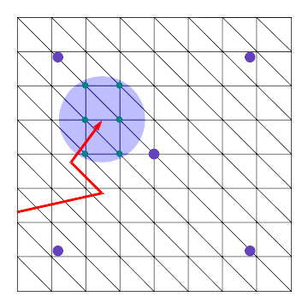
C. Incremental update
Exploit the locality of cuts = Savings
Detect regions that need to be updated
Regions where shape functions have changed
Update simulation data
Progressive re-sampling
Notes:
At the beginning of the talk, I briefly presented the different layers which communicate with the frames: the visual layer, the deformation and collision layer.
Each of them store values and derivatives of the shape functions. So, at each cut, it is crucial to update them from the newly computed shape functions.
They represent an important amount of data, expensive to update at each cut.
We exploit the fact that cuts are often a progressive and localized phenomena in order to incrementally update the simulation data.
First, simply by detecting regions which were affected by the cut and updating the simulation data only in these regions.
Also, integration points that compute internal forces and collision points need to be re-sampled in cut regions, just as the frames.
However, these two set of samples are generally more important than the frames. So, instead of adding more and more of them, we can simply apply Lloyd relaxation step to progressively re-sample the model without adding more of them.

Slide 21
IV. Results
Intersection of cuts
Notes:
Here are some results.
Firstly, an example that shows the capacity of our system to handle intersecting cuts.
In this video, the simulation is using only 5 frames.

Slide 22
IV. Results
Multiple detailed pieces
Notes:
In this example, we cut multiple detailed shapes.
Each time a shape is cut, we re-sample the model with frames.
In this example, we start with 5 frames and end up with 12.

Slide 23
IV. Results
Multiple cuts resulting in bending
Notes:
Finally, here is an example with 47 frames and about fifty cuts.
This allows to have a bending behavior emerging.
47 frames is a lot of frames compared to the other examples.
However, it is still very low compared to a finite element simulation. For instance, the visual mesh is made of 4000 vertices at the end of the cutting scenario.

Slide 24
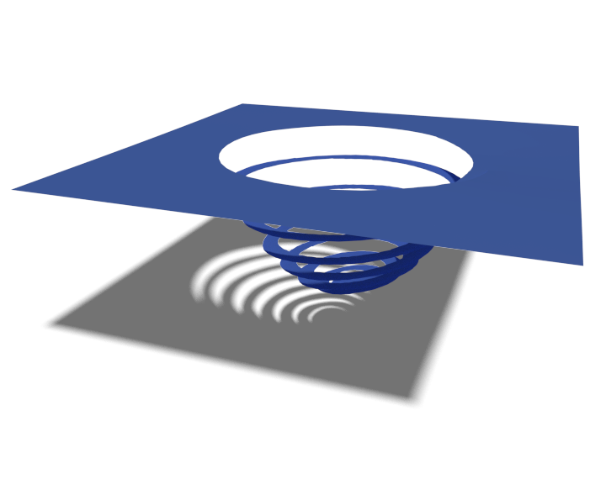
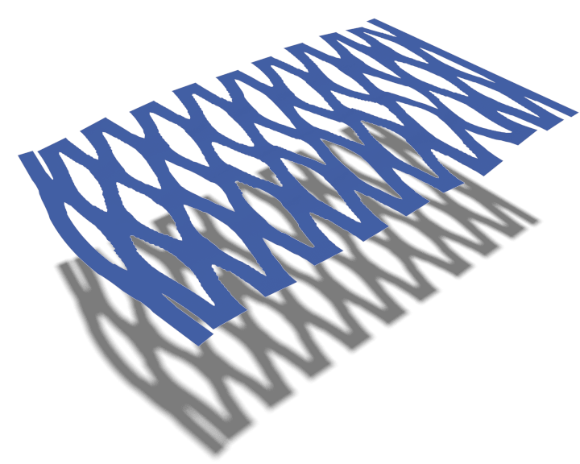
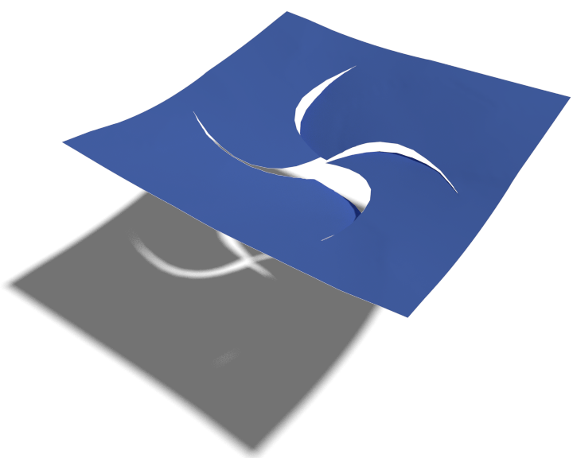
IV. Results
Performances
#Frames | 5 | 47 | 5→12 | 5
FPS Before|During|After | 60 | 15 | 60 | 11 | 3 | 11 | 60 | 7 | 45 | 45 | 7 | 35
% update | 43 | 17 | 5 | 15
Notes:
A few words about the performance.
On the first line, you can see the number of frames.
On the second, the framerate before,during,after the cuts.
On the last, the percentage of computational time that was needed when updating the system.
We can see, that during the cutting, the FPS is much lower.
This comes from our remeshing algorithm which uses different structure.
However, it is important to note that the framerate does not change that much before/after the cuts, even if the number of geometric details is much more important.
Finally, in the last line, three of the examples have under 20% of computational time used to update the system.
This tends to confirm that the incremental update works well.
The first example has a very expensive update. It shows the limit of our system. The spiral cut occupies almost the totality of the model with only 5 frames.
Therefore, even a local change has global consequences on the shape functions.

Slide 25
Conclusion & future works
Contributions: Detailed cutting of thin sheets with very few frames.
Shape function update
Frame re-sampling
Incremental update
Future works
Volumetric objects : Surface-only non-manifold grid
Fracture + procedural details
Robust frame re-sampling
Notes:
In this work we proposed a method to simulate detailed cutting of thin objects with very few degrees of freedom.
To do that, we proposed a way to update the regions of influence based on a non-manifold grid, a re-sampling strategy and an incremental update of the simulation data which exploit the locality of cuts.
There are several possibilities of future work.
First, we'd like to extend our method to volumetric object. The main thing to do is to be able to build the grid from a surfacic contour.
For now, it uses the interior of the object. In 3D, this would require a tetrahedral discretization that we want to avoid.
Second, we think this method can produce nice fracture scenarios. Our idea is to evaluate the stress tensor from low resolution simulation only to have a rough idea of the fracture direction.
Then we would combine this direction with a procedural method to generate details along the crack.
Finally there is still work to do on the re-sampling of frames.
For now, we re-sample a user-defined number of frames in cut regions.
This number should at least vary with respect to the simulated material.
We know that for rigid material, the number of frames can be very low, one per disconnected regions.
Whereas for soft bodies, as the number of deformation modes is much more important, we need more frames.
Thank you very much for your attention.

